Slide 1
Addressing cryptic relatedness in candidate samples for 1KG
James Nemesh
Steve McCarroll
02/13/2012

Slide 2
Analytical approach
For each pair of diploid genomes, evaluate what fraction of the genome is likely to reflect recent shared ancestry (identity by descent)
Identity by descent (IBD) analysis, using combination of PLINK and custom R scripts
Approach: measure patterns of relatedness across all pairs of diploid genomes in each population
Unrelated individuals are generally >99% IBD0
Parent – child relationships are generally 100% IBD1
Sibling relationships are generally 25% IBD2, 50% IBD1, 25% IBD0
Avuncular relations are generally 50% IBD1, 0% IBD2

Slide 3
Data, QC and analysis
Data used: 2.5M Illumina genotypes of 2122 individuals
ftp://share.sph.umich.edu/1000genomes/fullProject/phase2.OMNI.1856/
ftp://ftp.1000genomes.ebi.ac.uk/vol1/ftp/technical/working/20110505_sample_pedigree/
SNPs filtered for
missingness
Hardy-Weinberg equilibrium
Mendel errors
minor allele frequency > 0
IBD calculated for each pair of genomes from each population sample using an HMM method by Plink
Expected parent-offspring relationships
(100% IBD1)
Z1
(% of genome IBD1)
Expected lack of relatedness (~100% IBD0)
among individuals from different trios (black)
and parents in same trios (green)
Z0
(% of genome IBD0)

Slide 4
Cryptic relatedness in CHS
(using all available data: 150 individuals; 1.4M QC+ polymorphic SNPs)
Cryptic siblings from different trios
Second-order (e.g. uncle/nephew) relationships
involving annotated relatives of these cryptic siblings
More-distant (e.g. cousin) relationships among
relatives of these cryptic siblings
All samples

Slide 5
Cryptic siblings: one example (of four)
Three trios not previously annotated as related to one another
HG00500
HG00501
HG00512
HG00513
HG00524
HG00525
HG00502
HG00514
HG00526

Slide 6
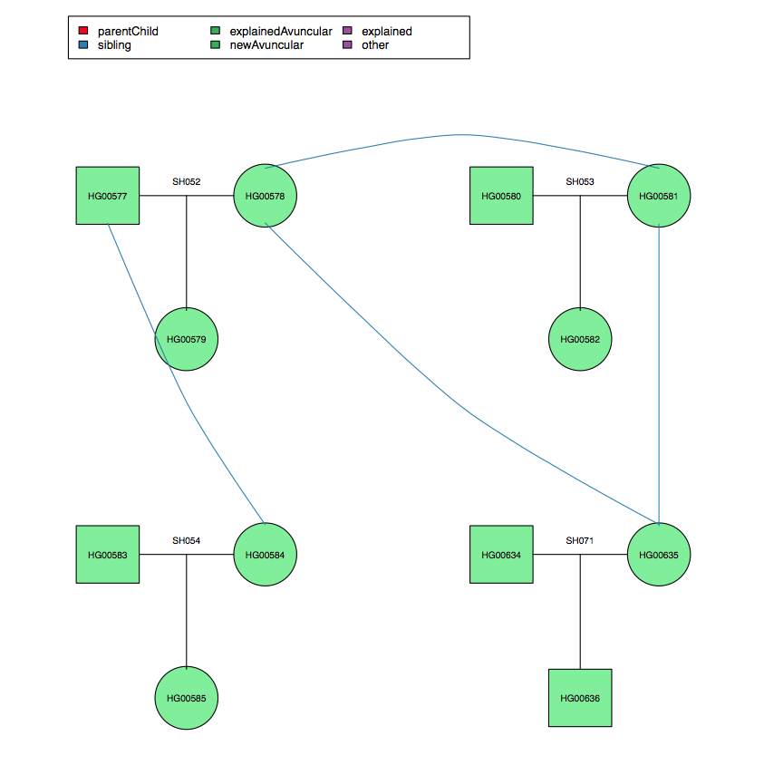
Finding Samples to Remove
Find maximally connected network of individuals
Find the individual with the largest number of cryptic relations and remove
Iterate until remaining samples are unrelated
Notes:
We want to remove cryptic relationships from these populations, but we want to remove as few samples as possible
From the CHS population

Slide 7
Minimal sample replacements that would result in all-unrelated cohorts
Population | Samples to replace | Families to replace
ASW | 12 | 10
MXL | 8 | 6
CDX | 8 | 8
CHS | 11 | 6
TSI | 1 | 1
GIH | 3 | 3
LWK | 11 | 10
PEL | 3 | 2
Populations not listed have no identified cryptic relationships

Slide 8
Five potentially problematic samples
Pop Label | Population | Potentially contaminated samples
ASW | African Ancestry in Southwest US | NA20278 (39)
PEL | Peruvian in Lima, Peru | HG01948 (31)
GBR | British from England and Scotland | HG00098 (21)
IBS | Iberian populations in Spain | HG01667 (17)
TSI | Toscani in Italia | NA20760 (96)
Five samples have low-level reported "IBD" to dozens of other samples
This can arise when a DNA sample or cell line has some contamination from another genome
Three of these individuals also have excess heterozygosity
All other things equal, might be better to sequence different samples from these populations

Slide 9
Relationships not supported by genotyping
Pop Label | Ancestry | New Parent / Offspring not supported by genotyping
CLM | Americas | Parent:HG01440 child:HG01442
One parent/child relationship in the pedigree file is not supported by genotyping.
The relationship appears to be an avuncular one – the “father” is actually the child’s uncle.

