Slide 1


From here to perpetuity: challenges (and a few confessions) in preserving web-based AV content
ASRA Conference 2011
Paul Koerbin
Manager Web Archiving
National Library of Australia
Notes:
Reluctant to accept invitation – forces me to profess sins rather than solutions – as much frustration as there is celebration
Such an invitation it seems should be the opportunity to describe success and solution – but it seems its more about shortcomings and sins

Slide 2
PANDORA web archive
Began (collecting) in 1996
Developed from proof-of-concept project
Complex born digital online material
No control over native formats
Best effort QA (hand crafting)
Permissions based (no legal deposit)
Accessible to the public
Small scale (6Tb, 130m files)
Notes:
Coming to this from a Collections manager perspective and this embodies a bias towards the collecting – library’s core business and the legacy of traditional print materials
though collection manages in the digital world must have more oversight of the preservation of their collections, at the very least in respect to intent – to help the preservation specialists

Slide 3
Web archiving
Web sites (and all they contain)
documents, images, media, style elements, client side scripts
Includes sites with embedded (multi)media
lots of formats (mpeg, flv, QT, wmv, rm, Shockwave)
audio/video ~2% archive data?
Content is harvested with crawl robots
deposit is harder to deal with
Dynamic content becomes static HTML
Media files just harvested (hopefully)

Slide 4
Web archiving
A browser view – a snapshot
Creating the heritage artefacts of the web
AV collected in the context of the website
our intent is to retain that context
others suggest decoupling collecting and generic access
Collecting is not the full story of archiving
Preservation intent and actions
Long term access

Slide 5
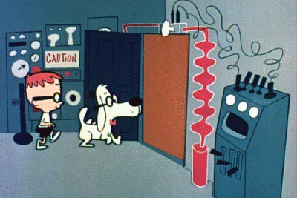
WABAC (‘PANDORA’) Machine
Notes:
Sherman and Mr Peabody enter the WABAC machine

Slide 6
Web archive AV – examples
Yothu Yindi (1999) link
Web of poets (2000) link
Queensland Election (2001) link
Federal Election (2007) link
YouTube
Independent videos
Linsey Pollak (2008) link

Slide 7
Observations
Trying to capture and retain the AV media in the context of the website/page – but not always possible
Balancing the need for timely collecting and legacy systems with implementing and working with standards
Faced with the challenge of managing the objectives (and tensions) of collecting, preserving and access
Keeping up skills and experience – understanding formats and web publishing technologies
Awareness and management of the problems we are filling our archive with

Slide 8

“ Web archivists have a difficult time gathering web video that are, more often than not served with non-standard tools and protocols ... it is difficult to design a general solution for dealing with all the Web sites hosting video content ... [so] ... the harvesting technique should be adapted to each particular case. The crawl engineering effort needed to adapt the tools is generally dependent on the complexity of the Web site.”
Pop, Vasile, Masanes (2010)
http://www.flickr.com/photos/ricksmit/15671245/

