Slide 1
Slowmations
Assessment Task 2

Slide 2

The process of slowmation is a simplified version of clay animation.
Claymation has been made popular recently through movies such as Wallace & Grommit, Chicken Run & Harvie Krumpet.’
Claymation is very engaging and interesting but extremely complex, time consuming and expensive to produce.
Notes:
The film Harvey Crumpet, for example, took four years to make, cost $400,000, runs for 23 minutes and is made up of approximately 33,000 pictures of different movements of clay models. On any one day only 2 secs of movie was made.

Slide 3
Slowmation
Slowmation (SlOW Motion AnimaTION) does not show fluid movement between frames.
We are interested in the content message more than the artistry.
Slowmations can be used in primary and secondary schools to explore ideas/concepts, including scientific ones
Water cycle

Slide 4
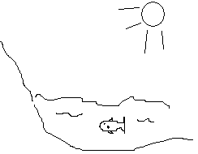
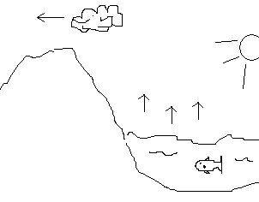
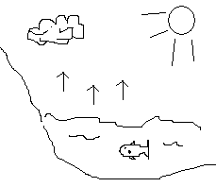
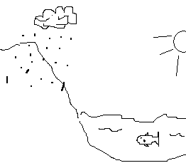
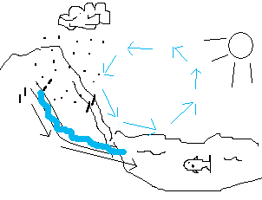
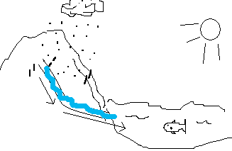
Deconstructing the Water Cycle
Evaporation | Condensation – Cloud gets bigger | Cloud movement over land
Warmth from the sun causes water to evaporate from seas, lakes, rivers and the leaves of plants (6-8 photos) | As the water vapour rises it cools and condenses, forming clouds (6-8 photos) | Wind blows the cloud over land. (6-8 photos)
Precipitation | Water run off and return to sea | Represent cyclic nature of process
Where the tiny droplets join up and fall as rain, hail or snow. (6-8 photos) | The rain runs into rivers and lakes which flow into the seas. (6-8 photos) | Completing the water cycle. (6-8 photos)

Slide 5
The Slowmation Assignment
You have to use a slowmation to show how a technological innovation associated with sustainability works.
Topics to be covered:
Solar Power Panels 9. Wind Power
Wave/Tidal Power 10. Hybrid Cars
Biomass Power 11. Desalination
HydroPower 12. CO₂ Capturing in Coal fired
Solar Power Farms (Mirrors) Power Stations
Hydrogen Power 13. catalytic converters
Geothermal Power 14. Nuclear Power
Solar Hot Water
Your slowmation needs to depict and explain (narration or words in the clip) the science/technology behind how the process occurs.

Slide 6
The learning processes involved
Representation: recognising a whole process
Deconstruction: analysing the component elements (completed using a storyboard)
Reconstruction: synthesising together again as a whole process (depicted in the movie file created)
Notes:
From a teaching & learning perspective slowmation is a ‘translation’ task that enables users to represent their ideas in different ways, in this case by using using models. the essence of slowmation like claymation — analysing a process into its smallest parts to photograph and then synthesising it all together again as a whole product — may enhance students’ understanding of the particular concept, in this context, thinking about science concept. This is like studying the whole of a process, then the parts, and then the whole again.

Slide 7
Timetable for working…
Week | Lecture | Tute
7 (This Week!) | What is slowmation How to Storyboard | 1. Generate electricity 2. Create Story boards WITH Scripts!
8 | Guest lecture – John McKean from BREAZE | Greenhouse calculator Energy Experiments
Vacation Week
9 | Nuclear Energy | 1. Website analysis presentations; 2. Bring photos to download and create movies
10 | Sustainability | Poster time
11 | Biodiversity | 1. Explore biodiversity Submit Poster and Slowmation File
12 | Unit summary, review and evaluation | Showcase – use info for Task 3 Synthesis

Slide 8
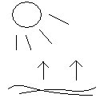

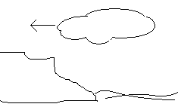
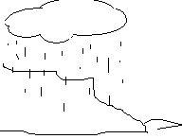
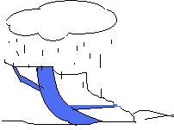
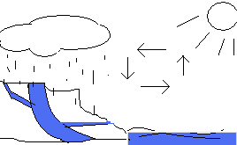
Storyboard the Water Cycle
1 Evaporation: Heat from sun causes evaporation | 2 Condensation Process: Vapour cools and condenses | 3 Movement of clouds overland
4 Precipitation: Rain | 5 Water catchment Rivers and streams into ocean | 6 Depict the whole cycle
Notes:
This is called chunking.
You break the big picture idea into its component chunks.
Then you have to make the transitions from one chunk to the next when taking the photographs.

Slide 9
Storyboarding
You must complete a storyboard for your topic and submit it with your final assignment.
Your story board should show sketch pictures of your basic idea and the words/text you will use to help explain each chunk.
Today’s class will be provided for you to research your topic (including web pages) and begin your storyboard.

Slide 10
Then What?
You have 3 weeks to get your photos taken in your own time
Week 10 tutorials will be in the computer lab to begin making the movie. You MUST have your photos with you on a flash stick for this tute.

Slide 11
Then What?
After the break, Week 10 tutes will be devoted to the poster construction:
Description of the innovation (what it is)
Science behind the Innovation (how it works – the technology involved)
How the innovation contributes to sustainable living (benefits for the environment)
Any drawbacks/disadvantages in pursuing the innovation (for the individual/community/environment)
Assessment of whether the innovation would be a better choice than current practices and why/whynot.
Posters and Slowmation files are due in Week 11

Slide 12
Then What
Week 12 tutes will be devoted to a slowmation and poster showcase.
In small groups you will be assigned 3 assignments to evaluate. This will require:
watch the slowmation
review its accompanying poster
Learn what you can about the particular technological innovations you have been assigned
Evaluate each assinment using a provided template

Slide 13
And THEN What?
Write up a synthesis of what you have learnt about technological innovations for sustainability.
Include a critical debate about which technological innovation(s) would be most suitable for transition to sustainability.
This forms the 700 word synthesis for Assessment Task 3 due Friday October 24th.

Slide 14
So….
Let’s work out groups and topics….

