Slide 1


Health impacts of the 2011 Summer floods in Brisbane
Katarzyna Alderman, Lyle Turner, Shilu Tong
School of Public Health and Social Work
Institute of Health and Biomedical Innovation
Queensland University of Technology s.tong@qut.edu.au Population Health Congress, Adelaide 9th—12th September 2012

Slide 2
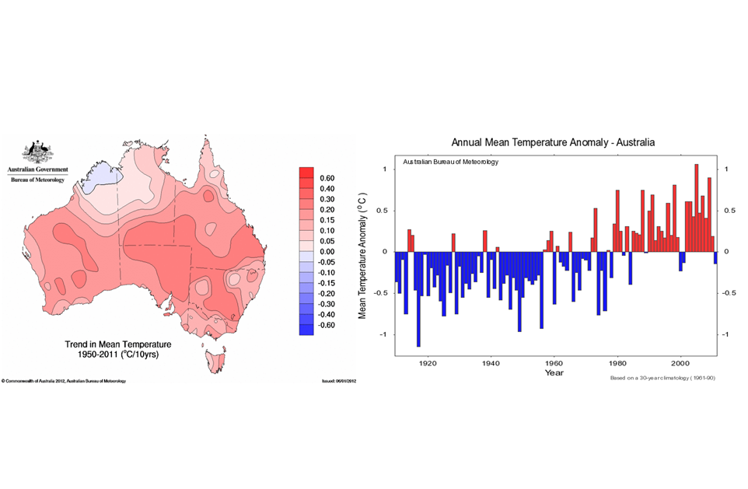
Temperature: Australian observations
(Australian Bureau of Meteorology, 2012)

Slide 3
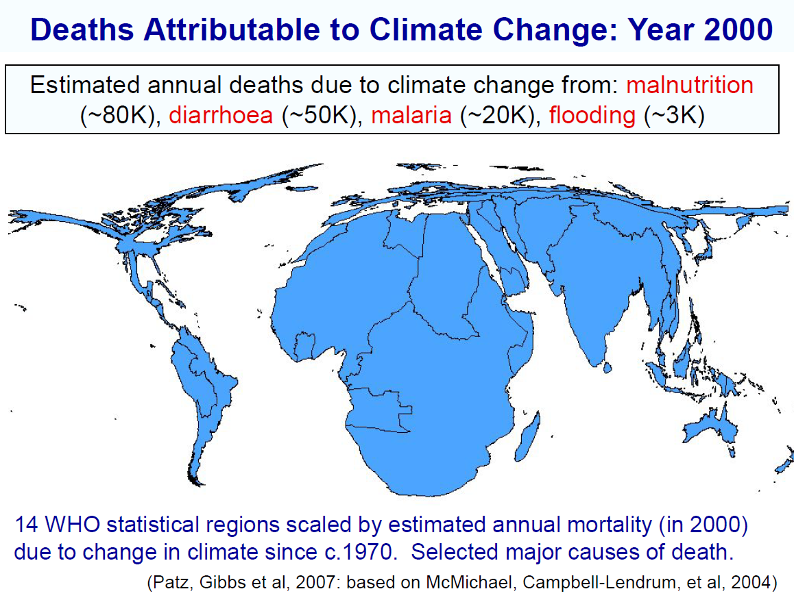

Slide 4
Flood events
Responsible for almost half of all victims of natural disasters, and $185 million economic losses over last decade (EM-DAT, 2011)
Expected to increase in frequency, intensity and cost (economic and social)
Both short- and long- term impacts on society, particularly in terms of health effects
Effects vary according to population differences and type of flooding event

Slide 5
2011 Queensland floods
Occurred in December 2010—January 2011
Responsible for 35 deaths
Damage to over 29,000 properties and economic losses of over $5 billion
Significant impact in South East Queensland, particularly Brisbane (flood prone areas)

Slide 6
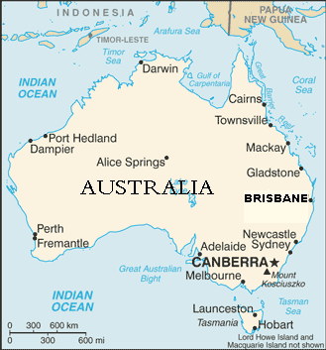
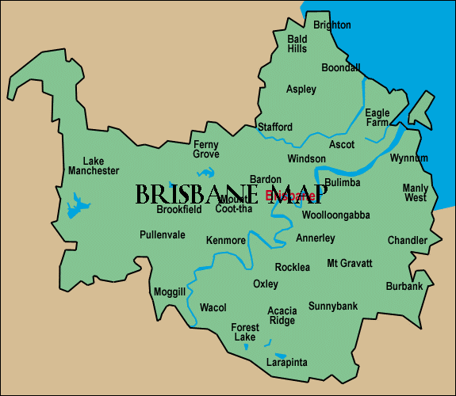

Slide 7
Health impacts of the flood events are less understood…
Aim: To investigate the physical and mental health impacts of the 2011 floods in Brisbane

Slide 8
Research design and methods
Community-based postal survey
3000 residents of 12 electorates in greater Brisbane region selected from electoral roll
Opt-out system used (initial participation letter)
Information collected: direct flood impact, sociodemographic characteristics, physical and mental health information

Slide 9
Direct flood impact:
overall indicator
damage to outside of property
water over floors
water over living area
water over entire house
damage to vehicles
family or friends came to stay > 2 days
In the first instance, looked at overall indicator

Slide 10
Outcome measures:
overall physical and respiratory health,
probable psychological distress, sleeping problems, probable post traumatic distress disorder
Association of direct flood impact with physical and mental health symptoms assessed using multivariable logistic regression

Slide 11
Table 1: Characteristics of survey respondents (N=960, Response rate: 32%)
Variable | Category | # Respondents (%)*
Age groups | 18 – 24 | 67 (7.0%)
 | 25 – 44 | 269 (28.0%)
 | 45 – 64 | 419 (43.6%)
 | 65+ | 204 (21.3%)
Gender | Male | 419 (43.6%)
 | Female | 541 (56.4%)
Income | < $26K | 159 (16.6%)
 | $26K – $52K | 220 (22.9%)
 | $52K – $78K | 164 (17.1%)
 | $78K – $165K | 288 (30.0%)
 | > $165K | 88 (9.2%)
Marital status | Single | 159 (16.6%)
 | Married or de facto | 674 (70.2%)
 | Divorced/separated | 82 (8.5%)
 | Widowed | 42 (4.4%)
Employment status | Employed (part/full/self) | 587 (61.1%)
 | Family carer | 67 (7.0%)
 | Retired | 200 (20.8%)
 | Permanently sick or disabled / student / unemployed / other | 65 (6.8%)
* Total percentages in some variables do not reach 100% due to missing values

Slide 12
Table 1 continued.
Variable | Category | # Respondents (%)*
Education status | Less than high school | 66 (6.9%)
 | High school | 330 (34.4%)
 | Some college/undergraduate degree | 351 (36.6%)
 | Graduate degree | 186 (19.4%)
Country of origin | Australia | 757 (78.9%)
 | Asia | 77 (8.0%)
 | Europe, US, Canada | 101 (10.5%)
 | Africa | 11 (1.1%)
 | Other | 14 (1.5%)
Language spoken at home | English, or English & another language | 882 (91.9%)
 | Other European language only | 11 (1.1%)
 | Asian only | 25 (2.6%)
 | Other | 42 (4.4%)
* Total percentages in some variables do not reach 100% due to missing values

Slide 13
Table 3: Association between health outcomes and direct flood impact, existing medical problems and sociodemographic variables
 | Worse overall health since floods | Worse respiratory health since floods | Increased psychological distress | Problems with sleeping | Probable PTSD
Direct flood impact
No (Reference) | 1 | 1 | 1 | 1 | 1
Yes | 5.3 (2.8, 10.1) * | 2.3 (1.1, 4.6) | 1.9 (1.1, 3.5) | 2.3 (1.2, 4.4) | 2.3 (1.2, 4.5)
Existing health problems
No problems (Reference) | 1 | 1 | 1 | 1 | 1
Problems | 2.9 (1.5, 5.7) | 2.6 (1.4, 4.9) | 4.4 (2.7, 7.4) | 3.3 (1.8, 6.2) | 2.9 (1.5, 5.5)
Property type
Own (Reference) | 1 | 1 | 1 | 1 | 1
Rent | 1.2 (0.6, 2.5) | 1.9 (1.0, 3.6) | 1.4 (0.9, 2.4) | 2.6 (1.4, 4.6) | 2.6 (1.4, 4.7)
Sex
Male (Reference) | 1 | 1 | 1 | 1 | 1
Female | 2.2 (1.1, 4.2) | 1.6 (0.9, 2.9) | 1.2 (0.8, 1.8) | 1.1 (0.6, 1.8) | 1.2 (0.7, 2.2)
* (Odds ratios and 95% CI). All OR values are adjusted for sex, age, property type, current health, direct flood impact, employment and education

Slide 14
Table 3 continued.
 | Worse overall health since floods | Worse respiratory health since floods | Increased psychological distress | Problems with sleeping | Probable PTSD
Age
18-24 (Reference) | 1 | 1 | 1 | 1 | 1
25-44 | 1.0 (0.2, 5.2) * | 0.6 (0.2, 1.9) | 0.9 (0.4, 2.2) | 2.3 (0.5, 11.2) | 2.0 (0.5, 7.5)
45-64 | 1.1 (0.2, 5.6) | 0.6 (0.2, 2.0) | 0.6 (0.3, 1.6) | 3.0 (0.6, 13.8) | 1.4 (0.4, 5.4)
65+ | 1.1 (0.2, 7.0) | 0.3 (0.1, 1.5) | 0.5 (0.2, 1.6) | 1.6 (0.3, 9.7) | 0.7 (0.1, 3.9)
Employment
Employed (Reference) | 1 | 1 | 1 | 1 | 1
Housekeeper/carer | 1.5 (0.6, 3.7) | 1.5 (0.6, 3.8) | 1.6 (0.8, 3.3) | 0.7 (0.2, 2.0) | 1.1 (0.4, 3.0)
Retired | 0.9 (0.3, 2.8) | 0.5 (0.1, 1.8) | 3.5 (1.8, 6.8) | 1.0 (0.4, 2.5) | 2.0 (0.8, 4.8)
Disabled/student/ unemployed/other | 0.8 (0.3, 2.5) | 1.9 (0.7, 5.1) | 1.1 (0.5, 2.4) | 0.7 (0.3, 2.1) | 1.6 (0.5, 4.7)
Education
High school (Reference) | 1 | 1 | 1 | 1 | 1
Completed university | 1.5 (0.6, 3.5) | 1.5 (0.7, 3.3) | 0.8 (0.4, 1.5) | 0.5 (0.2, 1.1) | 1.0 (0.4, 2.2)
Less than high school/other | 2.0 (0.7, 6.0) | 0.9 (0.3, 3.1) | 1.2 (0.6, 2.8) | 0.6 (0.2, 2.0) | 1.6 (0.6, 4.4)
Uncompleted university | 1.8 (0.9, 3.7) | 1.3 (0.7, 2.5) | 1.1 (0.7, 1.9) | 0.6 (0.3, 1.1) | 1.0 (0.5, 2.0)
* (Odds ratios and 95% CI). All OR values are adjusted for sex, age, property type, current health, direct flood impact, employment and education

Slide 15
Conclusions
Direct flood impact had significant effects on both physical and psychological health of residents
Improved support strategies may need to be integrated into existing disaster management programs
Particularly, impacts on mental health need to be properly assessed and managed
Future: Deeper examination of mental health effects, substance usage (alcohol, tobacco, medication), qualitative survey results

Slide 16
Acknowledgements
We would like to acknowledge the support of the Australian Research Council (DP1095752 to ST) and the NHMRC (SRF #553043 to ST).
We thank Irene van Kamp and colleagues from the Centre for Environmental Research, National Institute for Public Health and Environment (RIVM), Bilthoven, the Netherlands, for their help and advice in the design of the survey instrument.

