Slide 1

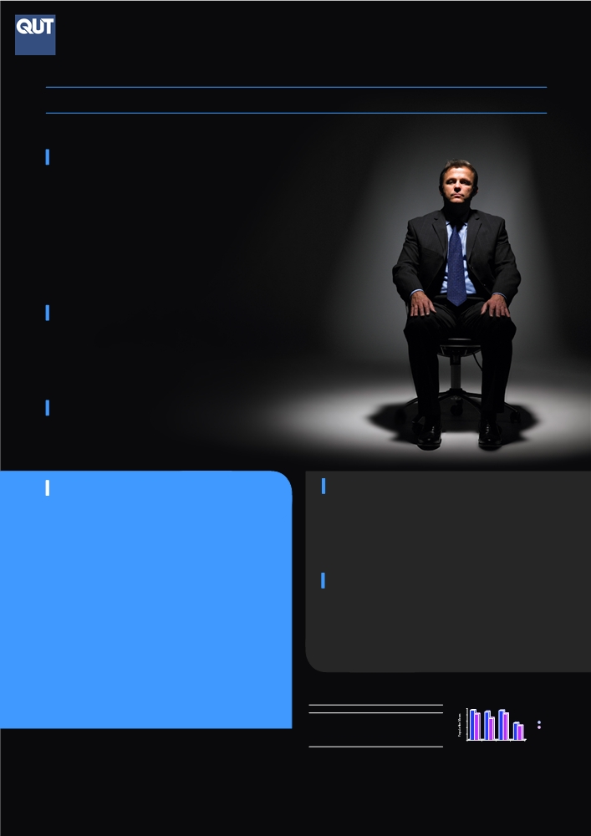
Identifying the Presence of Psychopathy in the Community
A Study into Social Functioning and Deception
Freya Samson, James Freeman, Gavan Palk | Queensland University of Technology | School of Psychology and Counselling
RATIONALE
● Preliminary research suggests approximately 1% of the population have psychopathic
tendencies (Boddy, 2006), traditionally assumed to result in criminal convictions (Neumann &
Hare, 2008).
● However research is now suggesting that some individuals with psychopathic tendencies can
successfully function within the community (Neumann & Hare, 2008)
● Currently, the impact that psychopathic tendencies have on a range of life outcomes (e.g.
relationship stability, substance use, employment & careers) remains unclear. (Boddy, 2006)
● The majority of psychopathy studies have used the following scales:
- Psychopathy Checklists (PCL-R) (Hare, 1991),
- Psychopathic Personality Inventory (PPI-R) (Lilienfeld & Widows, 2005) or
- The Self-Report Psychopathy (SRP-II) scale (Hare, 1985) on
○ Incarcerated, inpatient or university student samples. (Neumann & Hare, 2008)
● However, the appropriateness of self-report methods has been questioned given the psychopathic
tendency to deceive and manipulate in order to make a good impression. (Hare, 1991; Paulhus, 1998).
● As a result, research efforts that identify psychopathic traits and the corresponding impact upon life
outcomes may benefit from considering the effect of socially desirable responding on the assessment
process (MacNeil & Holden, 2006; Paulhus, 1998; Paulhus, Hemphill, & Hare, in press.).
AIMS
● To conduct one of the first studies to utilise the SRP-III (in press) with focus on a wide spectrum of non- incarcerated adult community members ranging from the unemployed to high level management and white collar workers;
● Examine the possible existence and prevalence of psychopathic traits within the community, focusing on Hare’s (2003) four core psychopathy constructs: (a) Interpersonal Manipulation, (b) Callousness, (c) Erratic Lifestyle and (d) Criminal Tendencies;
● Explore the relationship between psychopathy, impression management and self-deceptive enhancement to determine whether it is even possible to identify psychopathic tendencies of high functioning individuals, given the tendency of the psychopath to deceive.
RESEARCH QUESTIONS
1. Are there people living and working in the general community who exhibit psychopathic tendencies? If so, who are they and what impact do such tendencies have on interpersonal and occupational functioning?
2. Is it even possible to measure high functioning psychopathy via self-report methods, or is such a construct hidden behind impression management and self-deceptive enhancement?
METHOD
RESULTS
Participants
Means | Norms N = 194 |  |  |  | Current Study
 | Males |  | Females |  | Males |  | Females |  | Totals
 | M | SD | M | SD | M | SD | M | SD | M | SD
Interpersonal Manipulation (IPM) | 47.2 | 9.5 | 41.0 | 8.9 | 39.19 | 10.4 | 32.49 | 7.77 | 34.48 | 9.17
Callous Affect (CA) | 44.5 | 7.2 | 34.3 | 8.0 | 38.62 | 9.01 | 30.46 | 6.40 | 32.88 | 8.16
Erratic Lifestyle (ELS) | 46.5 | 9.0 | 41.4 | 8.2 | 43.24 | 9.50 | 35.02 | 8.84 | 37.46 | 9.78
Criminal Tendencies (CT) | 26.9 | 8.9 | 22.8 | 8.3 | 25.75 | 21.34 | 21.34 | 5.55 | 22.65 | 6.87
SRP-III Total Score | 165.2 | 27.4 | 139.6 | 25.4 | 147.0 | 33.2 | 118.73 | 23.12 | 127.46 | 28.5
Self-Deceptive Enhancement (SDE) | 2.20 | 2.30 |  |  | 3.00 | 3.27 | 2.80 | 3.00 | 2.88 | 3.05
Impression Management (IM) | 6.70 | 4.00 |  |  | 6.78 | 3.37 | 8.59 | 3.80 | 8.36 | 3.80
PDS Total Score | 8.90 | 3.70 |  |  | 9.43 | 4.71 | 11.20 | 5.28 | 11.22 | 5.30
● Sample N = 300 Age M = 40.61
● Female = 70.3% Male = 29.7%
● Most employed 85.75% and in a relationship 69.7%, earning between $50,000 - $75,000
Measures
● Self-Report Psychopathy Scale-III (SRP-III) (Paulhus, Hemphill & Hare, (in press).
-
40 Items measuring four subscales: Criminal Tendencies, Erratic lifestyle,
Interpersonal Manipulation and Callous Affect.
- Internal Validity (α = .81)
• Paulhus Deception Scales (PDS) (Paulhus, 1998).
40 Items measuring socially desirable responding components:
-
Impression Management (describing self in overly positive terms) and
Self-Deceptive Enhancement (exaggerating own virtues)
- Internal Validity (α = .85)
• Demographic Questionnaire
- Measuring key variables including age, gender, occupation, relationship
status, drug and alcohol consumption and conviction history
Procedure
● Convenience sample: participants approached by researchers, snowballing effect
● Psychopathic focus of study not highlighted in participant information sheet
to avoid biasing responses; survey presented as a general personality survey.
● Anonymous survey completion time: 15 minutes
● Data collection period: 6 months
● Survey was available in hard copy and electronic format
MAIN STUDY OUTCOMES
3 participants had total SRP-III scores that were 3 SD above the mean which suggests that 1% of the sample had psychopathic tendencies
Participants scored much higher on Impression Management tendencies (IM) than Self-Deception tendencies (SDE)
Correlations
SRP- III factors highly correlated
Significant negative relationships between SRP-III factors and Impression Management
Negative relationship between drinking and Impression Management
Salary, relationship quality, accommodation stability, drug use were not associated with SRP-III factors
Regression analyses revealed that higher SRP-III scores were associated with younger males who drank more alcohol

