Slide 1
ACL1002 POETRY & POETICS
Dr Natalie Kon-yu
Email: natalie.konyu@vu.edu.au
Notes:
No animations in this slide.
Students will want to have access to texts of the poems.
Give them time to arrange themselves if they need to look on with each other.

Slide 2
Lecture 4: ‘Poetry and Communication’
What does poetry communicate?
E.g. Communicating things or facts.
E.g. Communicating ideas or notions.
E.g. Communicating feelings or experiences.
E.g. Communicating what cannot be categorised.
At what ‘levels’ does poetry communicate its meanings (or meaningless-es)?
Notes:
Click to reveal each key topic and sub-bullet.

Slide 3
Does poetry communicate?
This apparently innocent and simple question is one bound to cause controversy among poetry circles and beyond.
50 years ago William J Rooney said:
“In the last seventy-five years the problem of poetry and communication has been the most insistent theme of most criticism.
The flow of opinion . . . has emphasized . . . the non-communicative aspects of poetry
The gradual emergence out of the late-Nineteenth into the Twentieth century of a deliberate, self-conscious emphasis on the literary product as somehow autonomous.”

Slide 4
Rooney’s position is still fairly dominant, and contemporary poetry editors of most literary magazines in Australia would hold a position similar to this one.
We can explore this question further by looking at a poem by the English Romantic poet John Keats. His 'Ode on a Grecian Urn' is one of the centrally important poems for a number of critics. It embodies the kind of poetic values that they were trying to elevate.

Slide 5
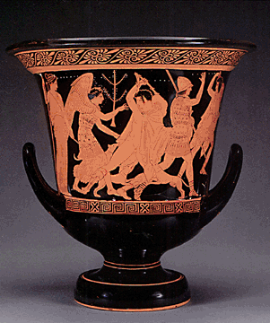

Slide 6
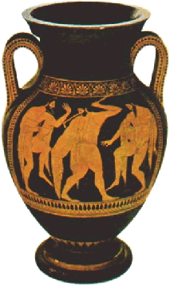

Slide 7
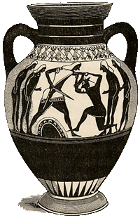

Slide 8
Keats’ ‘Ode on a Grecian Urn’
http://www.eecs.harvard.edu/~keith/poems/urn.html
What ideas are being explored in this poem?
Is this poem realistic?
What do you think motivates Keats to say (write) these lines?
Does he expect a particular response from us as readers?

Slide 9
Communicating Keats’ Ode
Keats' poem can be read as expressing an aesthetic that keeps the literary object apart from context, influence and indeed communication.
There are of course other opinions – that poetry is primarily about communication between people and that without communication it fails as an art form.
Cleanth Brooks writes ‘I think our initial question, 'What does the poem communicate?' is badly asked. It is not that the poem communicates nothing. Precisely the contrary. The poem communicates so much and communicates it so richly and with such delicate qualifications that the thing communicated is mauled and distorted if we attempt to convey it by any vehicle less subtle that that of the poem itself.’(pp. 72-73)

Slide 10
Communicating feeling/experience:
TS Eliot felt that "Genuine poetry can communicate before it is understood."
Whereas other ways of thinking might suggest that something needs to be understood before it communicates.
We’ll take an example from Icelandic pop group Sigur Ros
http://www.youtube.com/watch?v=HiOU9NAiYlQ
What is the song about?
Can we tell anything about the meaning from the sound?
What is the tone, mood or feeling we get from the music and the sound of the lyrics?
Notes:
No animations in this slide.
This slide just prompts the class to turn to the Blake poem.
Move on to next slide (1st edition facsimile) before discussing the poem.

Slide 11
A silver river illuminates the whole world and blue eyes
Cut the starry sky I make a wish and close your eyes now
Yes, do that, may it now come true
Oh no
At the speed of the stars
Inside my heart explodes, an airplane rumbles
Cracked open the earth sings
I make a wish and close your eyes now
Yes, do that, let's go dance
Everything is forgotten in bliss, and may it come true
I open my eyes
Oh no

Slide 12
My best friend whatever may happen
I swallow a tear and breathe in your hair
Making a ruckus, we cry in each other's arms
When we meet
When we kiss
Lips burning, holding hands
I see you waking up
I see you naked
Within me a lunatic sings
Always you wade, we run faster
Everything becomes smaller, I scream louder
Am about to wade, going away

Slide 13
How does Poetry communicate?
Poetry communicates substance through form via –
Rhythm
Sound
Words
Meaning

Slide 14
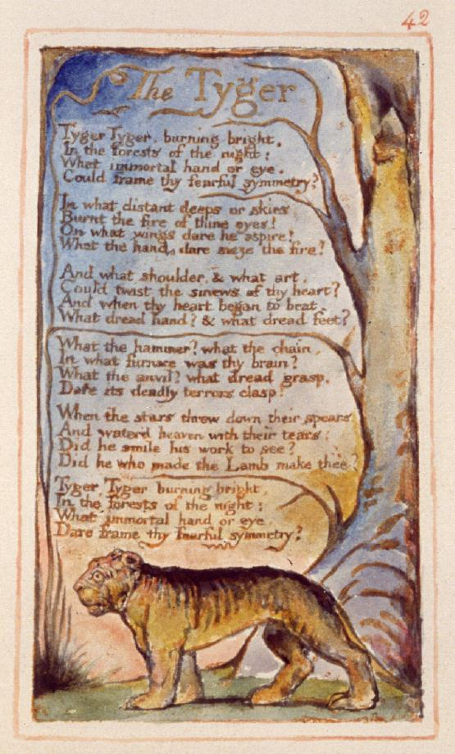
Notes:
No animations in this slide.
Discuss the basic meaning of ‘The Tyger’ before focusing on the mysterious angle.
How does this illustrated version alter our sense of the poem?
The previous two poems may have been influenced by this work.

Slide 15
William Blake’s ‘The Tyger’
What is the poem about?
Where has Blake’s Tyger been created?
Is there a religious aspect to this poem? How do we know that?
Is Blake commenting on the ability of poetry to describe the Tyger? If so, what is he saying about it?

Slide 16
Aunt Jennifer’s Tigers
Aunt Jennifer's tigers prance across a screen,
Bright topaz denizens of a world of green.
They do not fear the men beneath the tree;
They pace in sleek chivalric certainty.
Aunt Jennifer's fingers fluttering through her wool
Find even the ivory needle hard to pull.
The massive weight of Uncle's wedding band
Sits heavily upon Aunt Jennifer's hand.
When Aunt is dead, her terrified hands will lie
Still ringed with ordeals she was mastered by.
The tigers in the panel that she made
Will go on prancing, proud and unafraid.
Notes:
Click to reveal each bullet.
Discuss basic meaning. Then address the focal questions.

Slide 17
Communicating things or facts: ‘Aunt Jennifer’s Tigers’
What are the central facts at issue in this poem?
Are they particularly well suited to poetic expression? (Why or why not?)
How does the form of the poem amplify its meaning?
Notes:
Click to reveal each bullet and sub-bullet.
Discuss basic meaning. Then address the focal questions.
Give particular attention to the idea of ‘certainty’ around Aunt Jennifer’s impending death, which is integral to the fact of her fear, and which is deeply embedded in the versification (which is unadorned but regular, verging on obvious). This leads us into the next slide.

Slide 18
Inter-textual Communication: Rich’s Tigers and Blake’s Tyger
Do these two poems relate to one another?
How does our understanding of Blake’s Tyger effect how we read Rich’s tigers?
What other factors can contribute to a reading of this poem?
Is there a gendered reading to be made of Rich’s poem?

Slide 19
Sylvia Plath
http://www.youtube.com/watch?v=6hHjctqSBwM

