Slide 1







Teacher Earth Science Education Programme
PARTNERS
PRINCIPAL
PLATINUM
GOLD
Notes:
This slide must be displayed before talk commences

Slide 2
Teacher Earth Science Education Programme
PARTNERS
Teacher Earth Science Education Programme
PARTNERS
SILVER
The Australian National University
Department of Primary Industries, Vic
Earth Science Western Australia
Pitney Bowes Business Insight
PowerWorks
Queensland Resources Council
Rob Kirk Consultants
The University of Sydney
The University of Tasmania
BRONZE
Anglo Coal
Australian Nuclear Science and Technology Organisation
CS Energy
Department of Sustainability and Environment, Vic
Essential Petroleum
Flinders University
Gordon Wakelin King
Great Artesian Basin Coordinating Committee
Hot Dry Rocks
Macquarie University
Sandy Menpes
Monash Energy
Museum Victoria
Our Water Our Future, Vic
Petroleum Geo-Services
Primary Industries and Resources SA
Stanwell Corporation
Velseis
ZeroGen
Notes:
This slide must be displayed before talk commences

Slide 3
Teacher Earth Science Education Programme
Wet Rocks –
Learning about Groundwater
Presenter
Affiliation
Notes:
This talk discusses groundwater and its key part of the water cycle.
Prepared by Chris McAuley, Principal Hydrogeologist, Department of Sustainability and Environment, Victoria.
Support figures sourced from:
Lectures given by Chris McAuley
TESEP teaching package developed by Louse Goldie Divko (Department of Primary Industries, Victoria), Megan Bourke (independent education consultant) and Philomena Manifold (independent consultant)
Referenced sources

Slide 4
Wet Rocks
Overview of groundwater
Basics of groundwater
Management of groundwater resources
Management as an integrated resource with surface water
Management of groundwater as a hazard
Notes:
This presentation is designed to provide teachers with the basic knowledge of groundwater. It outlines the role of groundwater in the water cycle, how groundwater “flows” and how management of groundwater is approached. There is discussion of the interaction with surface water, and how surface and groundwater can be managed together. Finally there is a discussion on the consequences of contamination of groundwater.
This presentation can be used in conjunction with:
TESEP_PD5_Wet_Rocks_Teaching_Notes_V1_March2010.doc

Slide 5
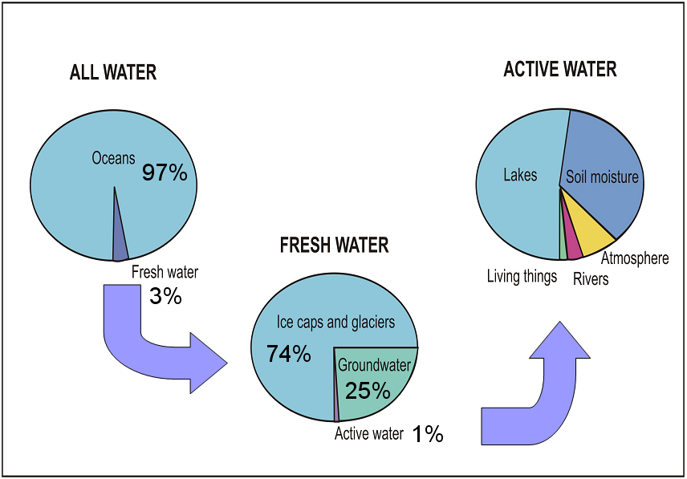
Overview of the Groundwater Resource
Notes:
Groundwater is a significant water resource. Although surface water is commonly thought of as the main supply of water for drinking, agriculture and the environment, in fact there is much more groundwater available. In some parts of the world, groundwater is the only reliable source of water.
Of the available groundwater, a significant proportion is suitable for drinking water. This far outstrips the available surface water.

Slide 6
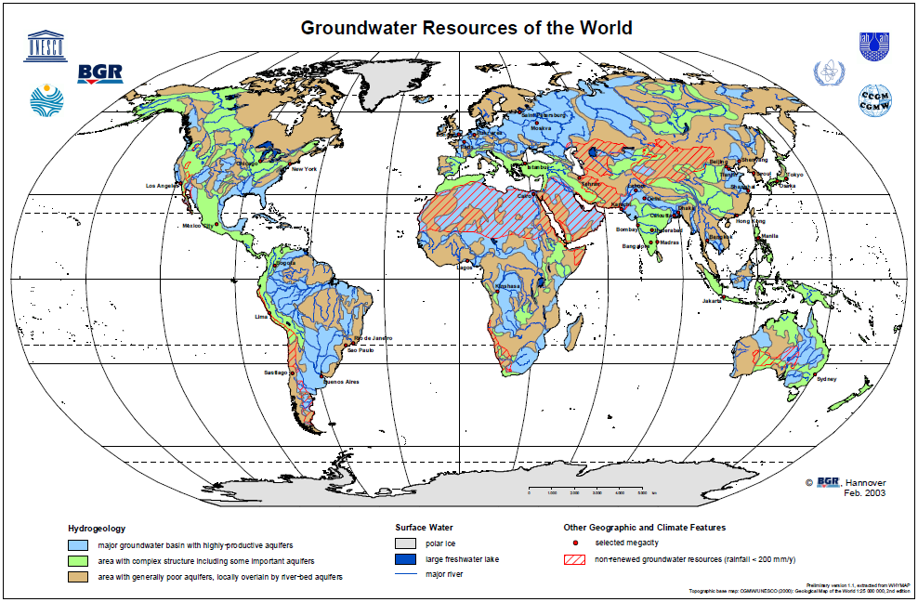
World Groundwater Resources
Source: http://www.whymap.org
Notes:
The importance of groundwater is global. Large and small resources are utilised in all continents of the world.
In many countries, the distance between the source of water and the need for water can be considerable. There is substantial effort in collecting water each and every day to meet basic human needs.
One of the key advantages of groundwater is that you don’t need pipes to connect you to a supply. You can be hundreds of kilometres from the nearest surface water and simply “tap” into the underground supply system. The capacity for groundwater to be used where it is needed makes it a very cost effective resource.

Slide 7
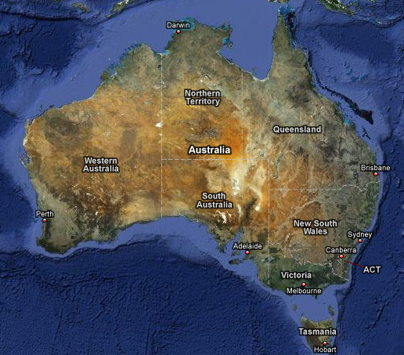
Importance of Groundwater to Australia
Groundwater as a % of total water use (2000)
Groundwater Use by Type
Rural (18%)
Other (1%)
63%
72%
35%
Urban / Industrial (29%)
Irrigation
(52%)
37%
10%
Groundwater Use 4986 GL
Surface Water Use 19109 GL
Total Volume 24095 GL
11%
7%
21% of total Australian use
4%
Source: Google Maps
National Land and Water Resources Audit (2000)
Notes:
Within Australia, different states have different levels of dependence on groundwater. Overall 21% of Australia’s total water use comes from groundwater. As our demand is increasing, and if our climate continues to dry, the level of groundwater use is likely to increase as well.
The figure above only refers to the use of groundwater for human activities. The environment is dependent on groundwater as well, and any use of groundwater must be shared with the environment.

Slide 8
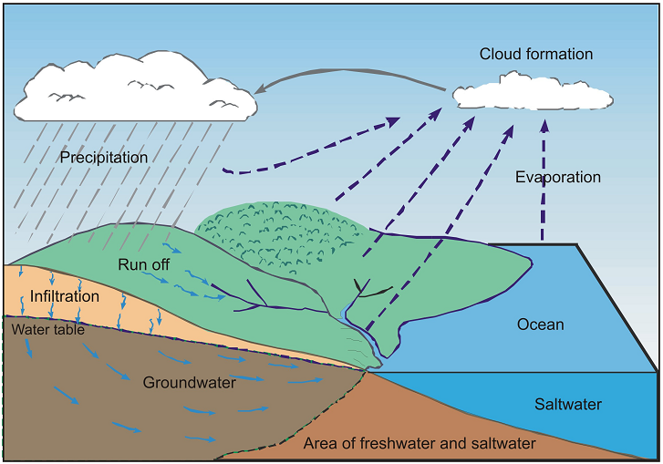
Groundwater Dynamics
Flow time: Hours to years
Flow time: Years to millennia
Notes:
The water cycle is the description of how water moves through our atmosphere, rivers, lakes, ocean, soil and rock. The concept is that use of water in any part of the cycle affects other parts of the cycle. Water resource management is the activity of deciding where water goes to in the cycle.
Most descriptions start with rainfall. Rain falling on the earth is either evaporated back from the earths surface, runs off the earths surface into rivers, waterways or lakes, or may soak into the soil. Water in rivers and waterways flows back to the ocean over days or perhaps years (for the worlds biggest rivers) to the ocean, where it is available for evaporation back into the atmosphere where it can form clouds.
The water that moves into the soil is available for vegetation to use. This process is called transpiration. The sum of moisture evaporated to the atmosphere from the soil directly and the water used by plants is called evapotranspiration.
Of the water that is not used by plants, some will be stored in the soil, and some will continue to move through the soil to become groundwater. This is called RECHARGE. In the majority of cases, groundwater will eventually flow to a waterway or to the ocean.

Slide 9
How does groundwater flow?
Are there “underground rivers”?
How does water flow through rock and soil?
Does groundwater flow “downhill”?
How long does it take for groundwater to flow?
How do you get it out?
Notes:
This section talks about the basics of how groundwater moves through the soil and rock, and how do you get it out of the ground.

Slide 10
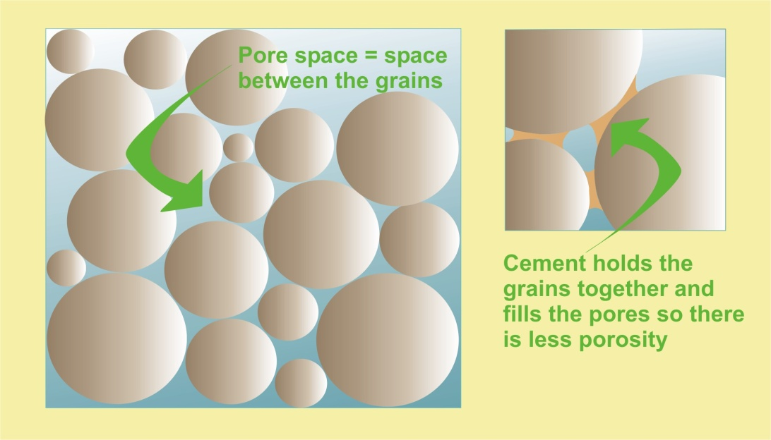
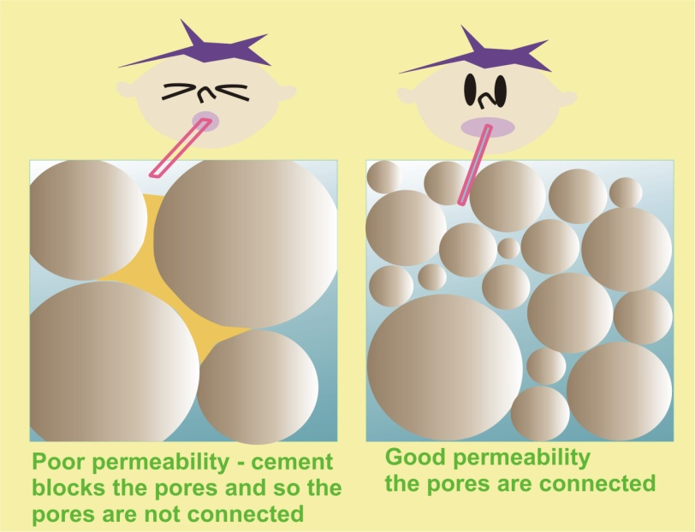
Porosity and Permeability
Porosity = the gaps between the soil and rock particles
Permeability = how well the gaps are connected to allow water to move between them
Notes:
Underground rivers do exist, but they are rare. They are only found where water flows through caves in limestone and lava tunnels in basalts.
Generally groundwater flows through gaps between particles of soil and rock. How well it flows depends on how many gaps there are (porosity) and how well connected the gaps are (permeability).
The measure used by hydrogeologists to describe how well water will move through rock and soil is the hydraulic conductivity. The units of measurement of hydraulic conductivity are length over time (L/T) – usually expressed as m/day or m/sec.
The higher the hydraulic conductivity, the easier it is for water to flow through the soil or rock. Gravels generally have high porosity and good permeability, resulting in high hydraulic conductivities. Clays have high porosity, but very low permeability, and hence low hydraulic conductivity.
Although the hydraulic conductivity is a measure of the capacity for water to flow through soil or rock, it also applies a physical constraint to how fast water can move. In this way it also describes the resistance of the soil or rock to flow. In a pipe, the resistance to flow is from the friction losses on the side of the pipe. In groundwater, resistance to flow is from the side walls of all of the very small pathways between the soil and rock particles formed by the porosity and permeability – and is much, much greater than any resistance in a pipe.

Slide 11
Flowing water underground
“Contours” of the groundwater surface
“Gradient” of the groundwater surface
3m
3m
3m
2.5m
2m
2m
1.5m
1m
1m
“Head” elevation
“Block” View
Bores measure the head elevation at specific points
“Map” View
Groundwater flows from the higher “head” to the lower “head” – the hydraulic head of the system.
Notes:
Groundwater flows not so much “down hill” as “down hydraulic gradient”. Flow is driven from where the surface of groundwater is at a higher elevation to areas of lower elevation. In many cases the surface of groundwater is a reflection of the surface of the ground – only smoothed out. However, there are also many cases where the surface of the groundwater has a different gradient and direction to the ground surface.
The head elevation of groundwater is measured by drilling bores into the groundwater and measuring the level of the water in the bore relative to some uniform measurement point (sea level or equivalent is often used). By contouring these points of measurement, the overall surface of groundwater can be interpreted.
If the section above was just an empty tray with no sand in it, and you poured water in from one end, the water level in the trays would (more or less) fill uniformly. Water would rapidly move from one end of the tray to the other and the water surface would be approximately level. Why doesn’t this happen in groundwater?
In a groundwater system, the porosity and permeability (hydraulic conductivity) of the soil or rock limits the speed of transfer between the top and bottom of the tray. In this way as you pour water into one end, it will form a hydraulic gradient from one end to the other as the speed of transfer of water is limited by the hydraulic conductivity. Over time the surface will level out.

Slide 12
Aquifers and Aquitards
Aquifer: A layer of soil or rock that has relatively higher porosity and permeability than the surrounding layers, enabling usable quantities of water to be extracted.
Aquitard: A layer of soil or rock that has relatively lower porosity and/or permeability than the surrounding layers, limiting the movement of groundwater through it and the capacity to extract useable quantities of water.
Notes:
The number of pores and crevices in soil and rock and how well they are connected determines how easily groundwater moves through the ground and how much groundwater comes from a particular layer. Where useable volumes of groundwater can be pumped from a soil or rock layer, the layer is called an aquifer.
If a rock or sediment layer is not porous or permeable (i.e. cannot hold a lot of water and does not let water through easily), then it is called an aquitard.

Slide 13
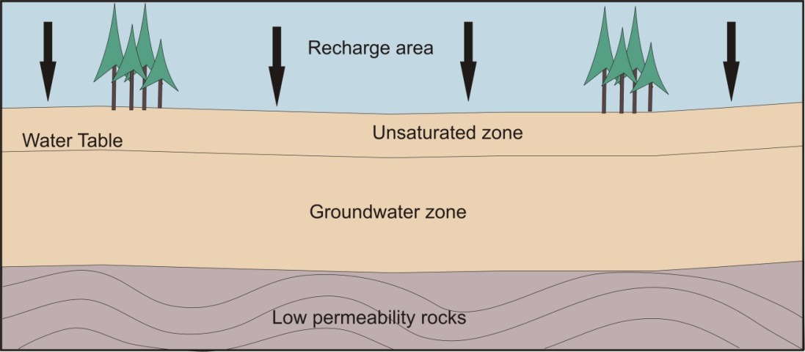
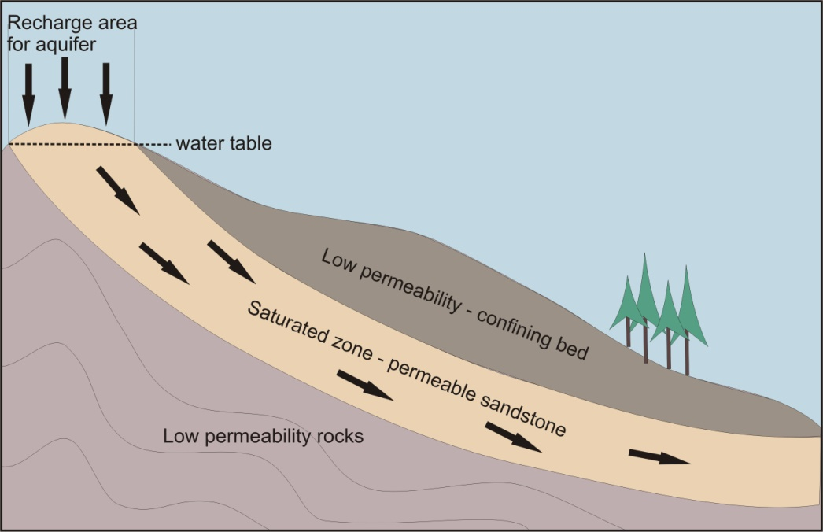
Confined and Unconfined Aquifers
Unconfined: Surface of the groundwater (the watertable) is at the same pressure as the atmosphere.
Confined: The “surface” of the groundwater is constrained by an aquitard. It is under pressure. If the aquifer is tapped, the water level will rise up in response to the pressure. The distribution of pressure is called the potentiometric surface.
Confined zone
Notes:
Aquifers may be unconfined or confined.
• An unconfined aquifer forms the water table. It behaves a bit like a bucket in which the water table is the level of water in the bucket.
• In a confined aquifer the groundwater is under pressure: its movement upward is capped by a layer of rock or soil that does not easily allow the water to move through it. This is called a confining layer or aquitard. When a bore intersects the aquifer, the water level rises above the top of the aquifer. How high it rises depends on the pressure. Where the pressure is high enough, the groundwater rises above the ground’s surface. This is commonly called a ‘free flowing’ or artesian bore.

Slide 14
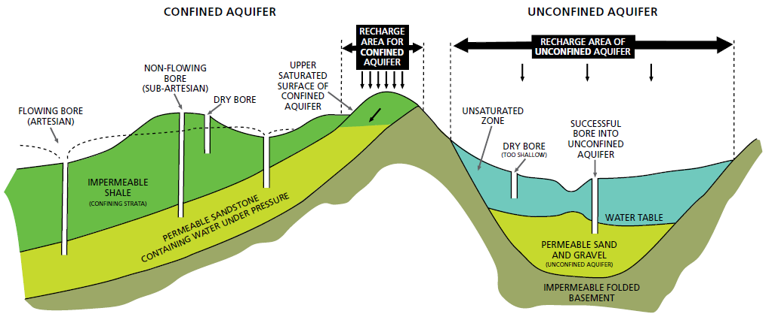
Multi-Aquifer Systems
Source: Groundwater Notes, Department of Sustainability and Environment, Victoria http://www.ourwater.vic.gov.au
Notes:
In reality, aquifers and aquitards often form layers beneath the ground. This produces multi-layer aquifer systems. Understanding the interaction between different layers is a key part of groundwater management.
When groundwater is pumped from an unconfined aquifer, the water comes from storage. That is, as you pump, pores drain out to provide the water. The volume of water pumped is equal to the volume of pores that have drained.
When groundwater is pumped from a confined aquifer, the water comes from expansion of the water. In a confined aquifer, the water is under pressure, that is, it is compressed or squeezed. When you pump the water, it locally reduces the pressure. In response, the water expands. The volume of water extracted is the volume created by the expansion of the water.

Slide 15
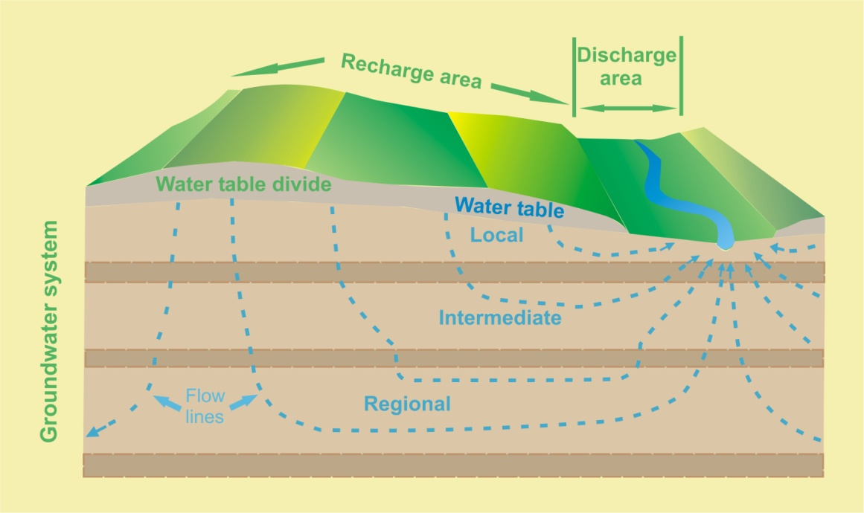
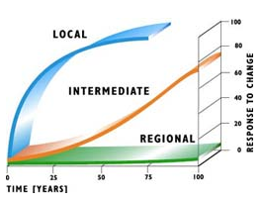
Scale of groundwater systems
Local systems – recharge and discharge areas within 5km of each other
Intermediate system – recharge and discharge areas within 50km of each other
Regional system - recharge and discharge areas grater than 50km of each other
Notes:
Groundwater moves very slowly through aquifers from an area of recharge to discharge. In some cases, aquifers extend over very large areas, whereas in other cases the areas are much smaller. Scientists who study groundwater divide these areas according to their size. These areas are known as groundwater flow systems. The three types of groundwater flow systems are known as local, intermediate and regional.
Local groundwater flow systems are generally shallow and groundwater moves from a recharge point to the nearest discharge point. Local flow systems are often only a few square kilometres in area and extend from a few metres to hundreds of metres. The groundwater that discharges from this system is usually quite young in age, ranging from one year to ten years to hundreds of years. Local flow systems are often close to each other.
Intermediate groundwater flow systems are deeper than local flow systems and can be tens to hundreds of square kilometres in area. The age of the groundwater discharging from this system can be from hundreds of years to tens of thousands of years. Intermediate flow systems extend from hundreds to thousands of metres and are often separated from each other by a groundwater or water table divide. A groundwater divide is usually a high point in the water table and the land surface where groundwater flows in divergent paths. This means that on either side of the high in the water table, groundwater will flow in opposite directions.
Regional groundwater flow systems are generally deeper and often cover hundreds to thousands of square kilometres. The age of groundwater discharged from these systems can be tens of thousands of years old to millions of years old. An example of a regional flow system is the Great Artesian Basin, where groundwater that is being discharged today in South Australia actually entered the aquifer two million years ago in Queensland.
The different scales of groundwater system have different “responsiveness” to change. Local systems have relatively lower volumes of water stored groundwater. Activities which change the amount of recharge to or discharge from a local system will have a proportionally more significant response than for larger systems. In this way, a management action in a local system may create an observable change in a relatively short timeframe (years). In intermediate and regional systems, the relative change has to be much bigger to generate an impact, and it may take decades to centuries to observe the change. When considering groundwater management, the responsiveness of the system needs to be considered.

Slide 16
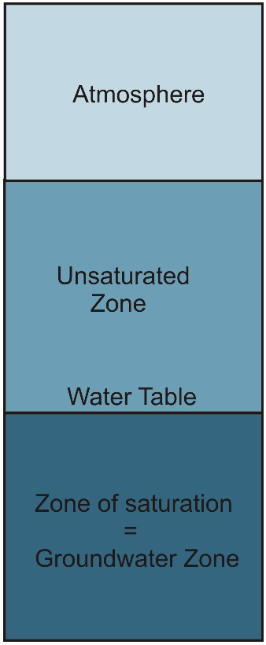
Groundwater Dynamics – Unconfined Aquifers
Water entering the soil
Water used from the soil
Soil storage (unsaturated zone)
Recharge
Change in saturated zone storage
Aquifer through-flow
Groundwater Pumping
Notes:
This diagram shows the component parts of the water cycle as they apply to groundwater. Each part of the process will be discussed further.
This is a simple representation of a volume cut through the ground. It captures the main processes that pass water into the groundwater and then flow through it. Much of groundwater management is based on trying to “balance” the various components of the water cycle.
From a groundwater perspective, one of the key components of the process is the volume of water that reaches the watertable to form groundwater. This is recharge. The amount of water that can pass through the unsaturated zone to the watertable to form recharge is a product of atmospheric processes (primarily rainfall), the amount that evaporates from the soil or is used by plants (collectively called evapo-transpiration) and how much water is stored in the soil profile as it moves through it.

Slide 17
Groundwater System Dynamics – Unconfined Aquifer
waterways
flooding
water supply
irrigation
Plant use Soil Evaporation
land-use
Pumping
Rainfall Infiltration
Discharge to the Environment
Recharge
Out-flow
In-flow
Notes:
In the overall water cycle, rainfall is often considered the starting point for recharge to groundwater. However, there are many other things that affect recharge. Water gets to the soil surface by a number of processes in our highly altered environment. Seepage from waterways, and in particular from flooding provides significant volumes of water that recharge groundwater. Likewise, irrigation supply networks and irrigation itself apply significant volumes of water to the soil and subsequently recharge. How much water is used from the soil by evapotranspiration processes is determined by the climate conditions and the type of land use.
Overall, the interaction of all these processes determines how much water enters the groundwater as recharge.

Slide 18
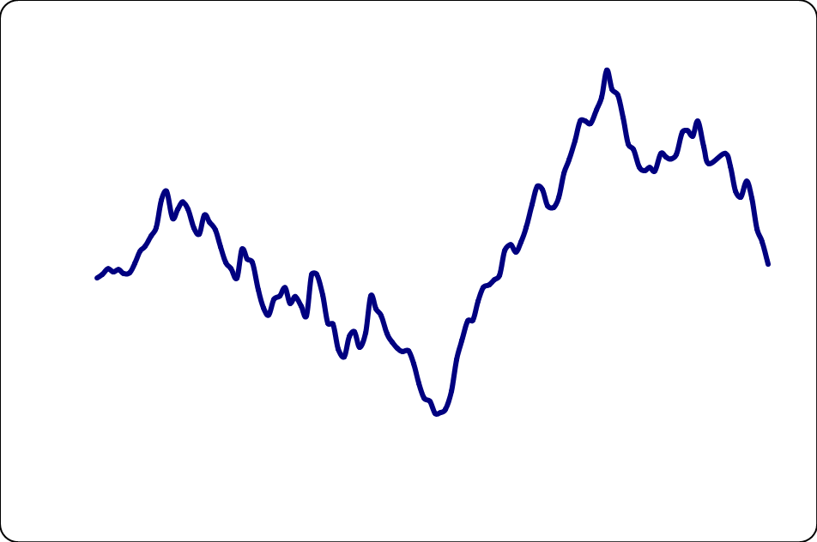
Rainfall variability
Cumulative rainfall residual
Falling
trend
Rising
trend
Falling
trend
Notes:
Changing rainfall, and what it means
As discussed, over much of the land surface, recharge is dependent on rainfall. Often when thinking about rainfall, we talk in “averages” over long periods. These numbers are often used to determine how much groundwater is available to be pumped out. But is the recharge from rainfall always constant?
The graph is a “cumulative residual” rainfall plot. The average rainfall (over the whole record length) is subtracted from the actual rainfall for a particular year to give the annual residual, then added to the sum of all previous residuals. So when the annual rainfall is less than the long term average, the residual will be negative. When the annual is greater than the average, the residual will be positive. Summing the residuals will give an indication of periods of time when rainfall is above or below average. These are climatic cycles.
In the above graph, from the 1900’s to the 1950’s rainfall was generally below average. From the 1950’s to the 1990’s, rainfall was generally above average. From the late 1990’s to the present, it is strongly below average.
If we think about recharge being at least in some way proportional to rainfall, and that the groundwater level is a measure of how much groundwater is in storage, then the longer term “trends” in net rainfall can give an indication of the trend (rising, falling or steady) of groundwater levels.

Slide 19
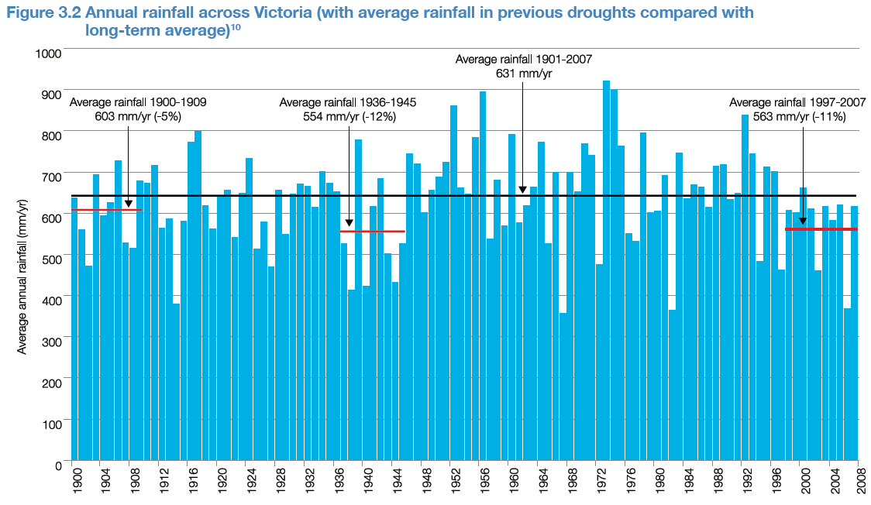
Ability to predict what is climate change
Notes:
Climate change is the long term shifting of our climate averages and patterns (See TESEP PD2 “Riding the Climate Change Rollercoaster”). However there is concern that climate may make “step changes” as particular processes “shift” substantially in response to forcing factors. In the south of Australia, there is a concern that a step change has already occurred, reducing rainfall by up to 11% on average already. This is affecting water resource planning.

Slide 20
Landuse impacts on recharge
1 | Sandy Loam, Light Clay over Fractured Rock; Basalt, Rhyolite, Rhyodacite, Ignimbrite
2 | Loam over Fractured Rock
3 | Sandy Loam, Light Clay over Sedimentary; Silt, Alluvium
4 | Loamy Sand, Medium Clay over Sedimentary; Silt, Alluvium
5 | Loamy Sand, Medium Clay over Sedimentary; Sand
6 | Sandy Loam, Light Clay over Sedimentary; Clay, Aeolian / Evaporates, Mudstone/Marl/ Laterite
Notes:
A key determiner of recharge is how much water that soaks into the ground evaporates back from the soil or is used by vegetation. This varies with the type of soil and the type of vegetation on the land.
The above graph shows some modelled solutions for the amount of recharge given different soil types and vegetation use. Annual pasture (has a growing season, then dies), crops (usually annual) and perennial pasture (grows through out the year) are all shallow rooted vegetation types. Roots generally don’t grow past 2 metres in depth. Native forests, plantation forests and woodland include varying densities of deep rooted trees. Tree roots, when mature, are generally thought to grow to at least 6 metres in depth. This enables them to capture water from a much greater part of the soil profile. In arid areas, the tap roots of some indigenous tree species often penetrate many 10’s of metres into the watertable and use groundwater directly.
The above graph shows that although soil type does affect the overall recharge, the vegetation type is much more significant. In particular, it can be seen that regardless of the type of shallow rooted vegetation, deep rooted vegetation has by far the biggest effect on recharge. In fact, the above graph indicates that under certain circumstances, the water requirement of deep rooted vegetation (trees) will actually be greater than the soil profile can deliver.

Slide 21
Unsaturated Zone Storage
Soil Moisture
Depth
Notes:
What happens in the soil profile?
The soil profile acts as a store of water. The more water stored in the soil profile, the greater the volume of water that soaks into the ground can pass through it to the watertable. The capacity for soil to pass water through it, is proportional to the moisture content in the soil.
Dry soil has very little capacity to pass water through it – not no capacity, but very little capacity. As moisture is added, it will be “stored” in the soil as increasing soil moisture. As the soil moisture increases, so too does the capacity for that moisture to move through the soil. Eventually, if the soil is fully saturated, the maximum capacity for passing water through it is reached.
The maximum rate of recharge to groundwater occurs when the profile has significant moisture in it. In this way groundwater is a bit like surface water – that is, the “wetter” the catchment when it rains, the more of that rain is likely to run-off and reach the waterways. The “wetter” the soil profile, the greater the proportion of rain that soaks in into the ground that is likely to reach the groundwater as recharge.
In this way recharge is not 1:1 proportional with rainfall – it depends on how much rainfall has occurred over what period. Recharge is likely to be significantly greater in wetter years than in drier years.

Slide 22
Significance of climate variability on recharge
Notes:
This graph maps a simple rainfall / recharge relationship. The blue and the red lines are a 1:1 proportional relationship with rainfall – where 10% (blue) and 5% (red) of rainfall goes to recharge.
The yellow lines assumes NO recharge until the rainfall total (for a given year) reaches the median plus one standard deviation, then 20% of the rainfall becomes recharge. This tries to simulate the importance of wetter years.
The bar chart shows the difference in the total volume of recharge per hectare per year. It shows the potential significance of higher rainfall periods on recharge volumes.
For comparison, an extra BAR CHART column has been added, showing how if instead of using the long term rainfall, only the period 1998 to 2008 (a dry period in south east Australia) was used. For the same recharge assumption, it shows a significant reduction in the amount of recharge that has occurred.

Slide 23
Groundwater Dynamics – Unconfined Aquifers
Water entering the soil
Water used from the soil
Soil storage (unsaturated zone)
Recharge
Change in saturated zone storage
Aquifer through-flow
Groundwater Pumping
Notes:
Once water has passed through the unsaturated zone and reached the saturated zone, it is termed recharge. In an unconfined aquifer, as water recharges it causes a change in storage in the aquifer. The water fills the pore spaces, and more of the aquifer becomes saturated – the tank fills, the water level rises. In unconfined aquifers, the amount of water entering and leaving the aquifer is measured as a change in the storage volume.

Slide 24
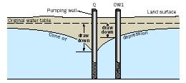
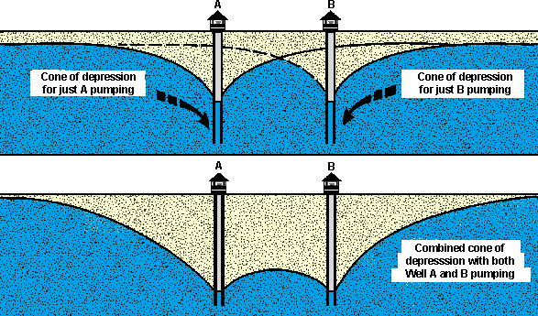
Groundwater Pumping
Takes water from storage by reducing level or pressure.
Changes flow patterns
Changes recharge / discharge relationships
Notes:
Another activity that affects the total volume in storage is groundwater pumping.
An individual bore pumping from an aquifer creates a cone of depression in the watertable. This is the zone, spreading radially out from the point of pumping, where water is removed from storage (in an unconfined aquifer). The volume of water pumped is equal to the volume of the aquifer (well, of the pore spaces within the aquifer) being “drained”.
In a confined aquifer, pumping creates a similar “cone of depression”, only in this case the cone represents the area over which the pressure in the aquifer is reduced. By reducing pressure, the water in the aquifer (which is compressed) expands. The volume pumped is the volume of water released by this “expansion” of the water.
When more than one well is “pumped”, each well generates a “cone of depression”. Where these cones intersect, the total drawdown, or lowering of the watertable (in an unconfined aquifer) is the sum of the drawdown from each individual pump.

Slide 25
Environment as a water user
waterways
flooding
water supply
irrigation
Plant use Soil Evaporation
land-use
Pumping
Rainfall Infiltration
Discharge to the Environment
Recharge
Out-flow
In-flow
Notes:
We have previously talked about how vegetation uses water in the soil profile. Groundwater itself can become an important part of the total water demand for an ecosystem where the watertable is close to the surface, or where the groundwater moves from the aquifer back into waterways of the surface (discharge).
Where groundwater provides a significant amount of water, ecosystems can be described as dependent on groundwater for their overall health. These are termed Groundwater Dependent Ecosystems.

Slide 26
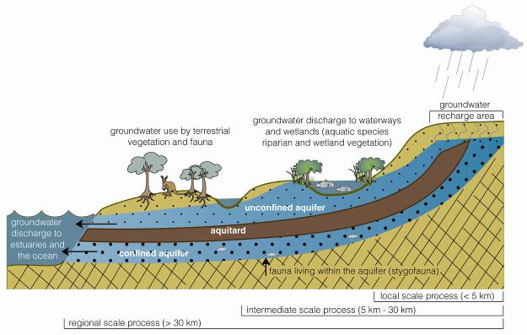
Groundwater Dependent Ecosystems
Notes:
There are three types of groundwater dependent ecosystems (GDEs):
ecosystems within aquifers, for example in caves and in the cracks and pores in aquifers themselves
surface ecosystems that depend on groundwater flowing (discharging) to the surface, for example river base flows and some wetlands and estuaries
ecosystems that tap into groundwater, for example terrestrial vegetation using groundwater directly from shallow aquifers.
Different GDEs can have different levels of dependence on groundwater:
An ecosystem is entirely dependent if it would be lost with only a slight change in key groundwater characteristics. Such ecosystems include the saline discharge lakes of the western Murray Basin.
Some ecosystems may be highly dependent on groundwater, and even moderate changes in groundwater discharge would cause substantial change to the ecosystem.
Some wetlands use groundwater and surface and/or soil water. They would be substantially changed if they stopped receiving groundwater or if groundwater inflows were reduced moderately at certain times.
Some ecosystems have limited or opportunistic use of groundwater, for example at the end of a dry season or during extreme drought. These include coastal floodplain swamp forests, Banksia woodlands and lignum shrublands along inland river systems. This water source may be critical to the survival of some ecosystems. For example, river base flows may maintain drought refuges during low flow periods.
Some ecosystems may appear to be groundwater dependent, but are entirely supported by rain or surface flows. Examples include the large seasonal floodplain lakes and instream ecosystems of the Murray and Darling Rivers.

Slide 27
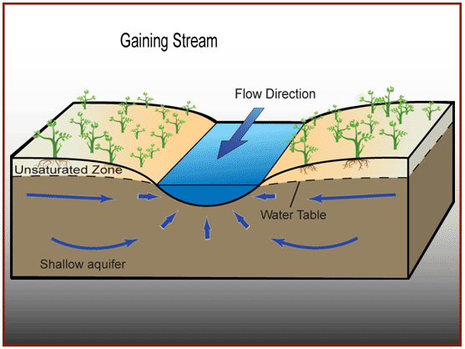
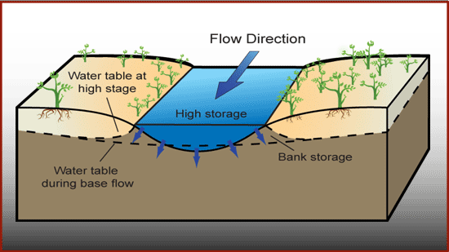
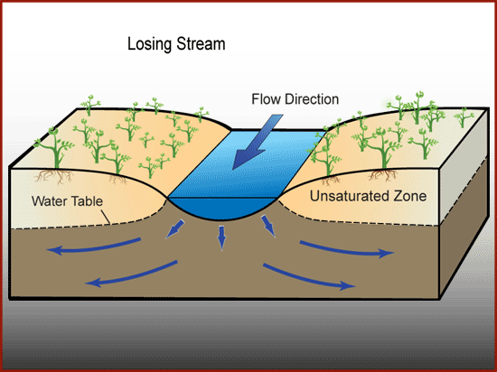
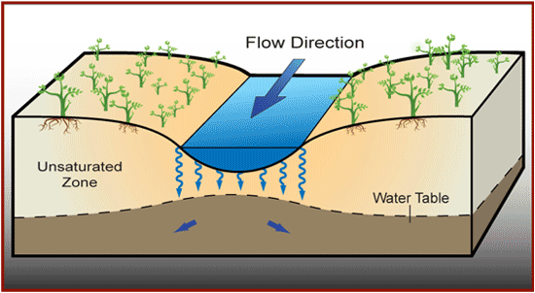
Groundwater and Waterways
Gaining during low flow, losing during high flow.
Gaining stream
Connected losing stream (loss varies with difference in level between river and groundwater)
Disconnected stream (rate of loss more or less constant)
Source: http://www.connectedwater.gov.au/processes
Notes:
Groundwater and surface water are commonly connected. Waterways can represent significant sources of recharge to aquifers. Likewise, groundwater can contribute significantly to flows within waterways, particularly in dry periods when there is no run-off. This is often referred to as a waterway’s “baseflow”.
In general, waterways and groundwater are described in one of three ways.
Connected gaining – this is where the groundwater level is connected to the waterway, and is higher than the waterlevel in the waterway. Thinking back to our previous slides on how groundwater moves, when the groundwater level is higher than the waterway level, groundwater moves into the waterway. The waterway is described as “gaining” – as in, it is gaining groundwater to become surface water flow.
Connected losing – This is where the groundwater and waterway are connected, that is there is a saturated zone beneath the waterway that connects with the watertable. But in this case, the waterway level is higher than groundwater level, and water recharges the groundwater. This is a “losing” system – that is the waterway is losing water to the groundwater.
Disconnected – This is where there is an unsaturated zone between the waterway and the groundwater. Some leakage can still occur from the waterway, but the rate of loss, and whether it reaches the groundwater, is dependent on the unsaturated zone flow processes.

Slide 28
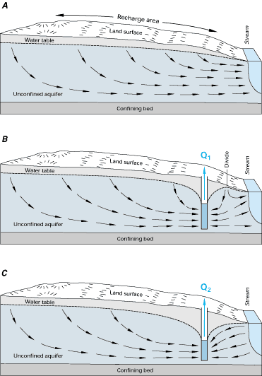
Groundwater use affects surface water and environment
Source: http://www.connectedwater.gov.au/processes
Notes:
When thinking about the water cycle, groundwater and surface water are ultimately connected. It all ends up back in the ocean and available for evaporation. A critical thing for groundwater managers is understanding how connected groundwater and surface water are, and how management of one affects the other. A key element is understanding the “time lag” between how an action in one affects the other. Where this time frame is within management timeframes, then integrated management is required.
The diagrams above show how pumping groundwater can interact with a waterway. In this case, a waterway that is receiving groundwater (connected gaining) is affected by pumping. Initially, pumping intercepts groundwater that was flowing to the waterway, reducing the discharge to the waterway. As pumping continues, water is actually drawn from the waterway to the bore, and it becomes a connected losing waterway.

Slide 29
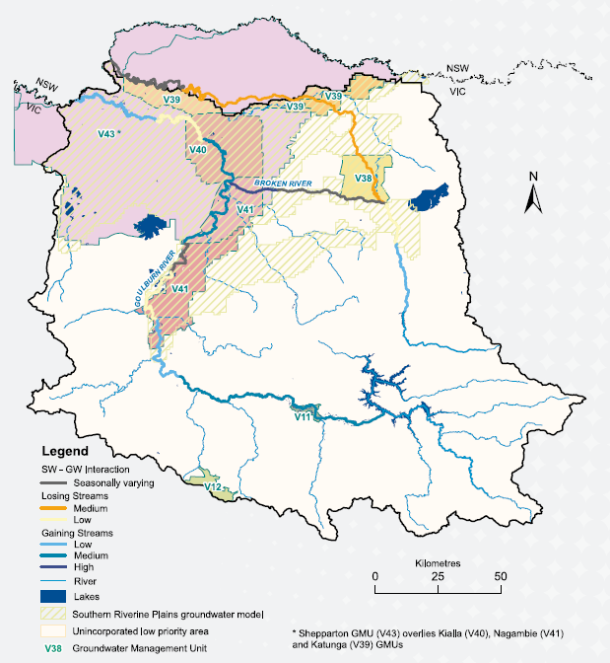
Groundwater/surface water “connectivity”
Example: Goulburn Broken catchment
“Losing streams” – surface water recharging groundwater
“Gaining streams” – groundwater base flow to surface water
Seasonally variable
Not connected
Source: CSIRO Sustainable Yields Project
http://www.csiro.au/files/files/pkgb.pdf
Notes:
Extensive work has been undertaken within the Murray Darling Basin looking at the degree of connectedness between waterways and groundwater. Such work notes that the degree and nature of connectedness varies with the seasons and with climate cycles.

Slide 30
Groundwater / surface water interaction
Notes:
Connectedness also varies with position in the landscape.
In upland areas, particularly where waterways are within steep valleys, groundwater more consistently discharges to waterways (connected gaining).
As the valleys become less steep, they are often filled with river gravels, sands and flood plain clays. These form alluvial aquifers. Water in the rivers and during flooding recharges the watertable, and as river levels decrease, groundwater flows into the waterway as baseflow.
As you move down further onto the plains, the connection between the waterway and groundwater becomes more variable. In general, water is more likely to move from the waterway into the groundwater.
In all cases in a groundwater basin, the groundwater will discharge from the aquifer at some point and rejoin surface water, or be evaporated to the atmosphere. In large basins like the Murray Basin, the water seeps upward through the other layers and into the Murray River. In many of our coastal aquifers, the water discharges back directly to the ocean.

Slide 31
Groundwater Management Basics
Rainfall
Water entering the soil
Land use (forest, agriculture, urban)
Water used from the soil
Soil storage (unsaturated zone)
Recharge
Change in saturated zone storage (groundwater levels)
Groundwater Pumping
Aquifer through-flow
Discharge (waterways, ocean, land)
Notes:
Groundwater management is about changing elements of the water cycle as they relate to groundwater. In any management problem, we try to change those things we can affect, often to manage a flow-on effect. In complex natural systems, this is an imprecise science.
Despite the best efforts of cloud seeding and the global impacts of CO2 emissions, for this exercise there is an assumption that we can not deliberately increase or decrease rainfall over a particular area.
Land forming and land use can change how much water enters the soil. In management, quite often a problem is generated by a change in land use, and then more land management is required to try and address it! Examples are the change from native vegetation to agriculture (salinity, nutrient contamination) and increasing urbanisation (reduced recharge, contamination).
Although there are methods to treat soils to change their moisture holding capacity (primarily to improve agricultural production), the main effect we can have on soil moisture content is changing how much water enters the soil (see above). So our capacity to affect soil moisture is more indirect. It follows then that our capacity to affect recharge is also an indirect consequence of how much water we allow to enter the soil profile.
Changes in recharge change the level of groundwater, the gradient driving groundwater flow and ultimately the amount of water that discharges from the groundwater system in a particular way. This may affect flows in waterways or other groundwater dependent ecosystems.
Management of groundwater predominantly involves how we interact with these principal parts of the water cycle. Regardless of the problem under management, it is generally about how to best manage these elements to achieve the required outcome. However, as with all complex systems, changing one thing produces more than one response.

Slide 32
Managing groundwater – as a resource
Sustainable yield is inherently intergenerational because it implies resource use in ways that are compatible with maintaining them for future generations.
Proposed National definition (2002):
”The groundwater extraction regime, measured over a specified planning timeframe, that allows acceptable levels of stress and protects the higher value uses that have a dependency on the water.”
Notes:
Using groundwater for agriculture, water supplies or for industrial uses really should be thought of as “sharing” the resource with the other users. Taking groundwater for one use means that another use will be impacted. Managing groundwater sustainably means equitably sharing its use between all users. This always requires compromises and trade-offs. Judgment on what is acceptable can be a complex process. It involves decisions that some people agree with, and others do not. Where possible, the best compromise between uses should be developed considering all users.

Slide 33
Sustainable Yield – a dynamic concept
Sustainability and SY are dynamic concepts that will continue to be refined
The challenge is to turn the principles of sustainability and groundwater sustainable yield into achievable policies and then practice.
Science alone cannot choose the correct interpretations for society but any interpretation must be based on sound hydrologic analysis and understanding, and community involvement.
Notes:
Sustainability should be seen as something to continuously strive for - the Holy Grail or Groundwater Utopia.
The definition of ‘unacceptable consequences/impacts’ is largely subjective and may involve many criteria. Also, groundwater sustainability must be defined in the context of the complete hydrologic system. For example, an acceptable rate of drawdown with respect to water levels, may reduce stream flow to an unacceptable level. But unacceptable for whom – the ecosystems that depend on the groundwater baseflow, or the irrigator or town who draws a supply from it.
In some cases, where there is little other water available, there is the potential to deliberately deplete a storage. An example is the highly saline confined aquifers in the Goldfields of Western Australia. They are pumped knowing that they will not refill.
Communities have a vested interest in decisions made about managing groundwater. Governments should not take the full risk of management.
Q When will we know when we’ve achieved it?
Q Is it achievable in a dynamic world of population changes, climatic changes, economic and social pressures?

Slide 34
Sustainable yield for an aquifer
Recharge
B
A
B
A
Hydraulic Properties
What are the elements of defining SY?
Annual aggregate abstraction volume
provision for groundwater dependent ecosystems
time element
social/economic aspects
Notes:
In this example, we are looking at a confined aquifer, although the basic principles apply to an unconfined aquifer as well. To understand the consequences of pumping groundwater, we need to know the basic elements of the system. There needs to be an understanding of the amount of water entering the system (recharge), and where this recharge is coming from – through the soil profile, or from waterways. There is a need to understand how water moves through the system (throughflow), and how it interacts with waterways or other ecosystems along its length (discharge). There is also a need to understand how pumping groundwater affects discharge to waterways, other ecosystems, leakage from layers above and below the aquifer, recharge to the aquifer and impacts on other users. This requires an understanding of how water moves through the aquifer (hydraulic properties) and how it moves through overlying and underlying layers.
Where decisions on the resource share are made based on a certain amount of recharge, then consideration of changes in the recharge rate must be considered. For example changes in rainfall (climate variability and change), land-use (to deep rooted vegetation or perhaps urban development) can affect the amount of recharge. This can ultimately affect the volume of water available.

Slide 35
Sustainable yield (cont)
A
B
Discharge Volume
Leakage impacts on water quality
Well hydraulics
Notes:
Where waterway flows and other ecosystems have very high values, then consideration as to how much taking water will impact on these water needs may be a critical determining feature in how much water can be taken for other uses. Maintaining specific volumes of water to these systems at different times of the year may be critical.

Slide 36
Wetland / Waterway Protection
Recharge
B
A
B
A
Hydraulic Properties
Management zone
Notes:
In this particular example, it is the flow of groundwater to a wetland or waterway that drives management decisions. So in this problem, the critical issue is maintaining flow TO an environmental value. All of the same elements of the system need to be considered, only this time, the emphasis is not on how much groundwater can be taken from the system, but ensuring that the wetland / waterway is continuously supplied with groundwater in volumes that retain its ecological function.
Here we want to ensure that groundwater pumping can not occur to affect the volume of water flowing to the wetland. Restriction may be placed on pumping, or in cases of real significance, prevented all together.
Likewise, where recharge to the aquifer occurs that is vital to the water supply to the system, anything that may affect this could be significant. Introduction of plantation forestry, expanding hard stand (urban) development – all these can impact on the water entering the system, and hence the water leaving the system to feed the wetland.
Groundwater pumping has the greatest impact where the drawdown cone directly intersects the wetland, lowering the groundwater level and reducing or preventing flow to the wetland.

Slide 37
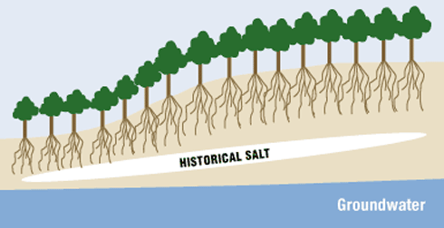
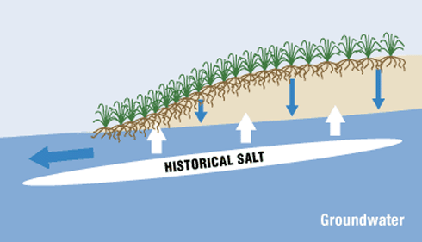
Dryland salinity management
(a) Prior to development
(b) With clearing and development
Note: Historical “salt” refers to concentrated solute
a
b
Impact:
2.5MHa of cultivated land (5%) affected by salinity
5.7MHa has immediate potential to be affected by salinity
Notes:
Dryland salinity is a process of environmental degradation that is a result of broad-scale change of land use. The replacement of native forests and woodlands with shallow rooted annual crops and grassland changed the amount of water entering the soil. The increased soil moisture in turn increased the rate of recharge. As more water reached the groundwater the level of groundwater started to rise.
The groundwater contained salts at concentrations that inhibited the plants’ capacity to uptake water, causing loss of production and ultimately replacement by species that could cope with higher salinities. Making the problem worse was that salt stored in the soil profile beneath the root zone of the previous vegetation was mobilised by the rising watertable. This increased the salt content in the water, and the impact on vegetation.
Where the watertable came within several metres of the surface (generally considered to be 2m, although this varies with soil type), groundwater could then be evaporated directly from the watertable. This concentrated the salt from the groundwater in the shallow soil profile. In the worst cases, salt plains or salt pans formed.

Slide 38
Salinity in a catchment
Recharge
B
A
Hydraulic Properties
B
A
Trade off in land-use can affect viability of the land and adjacent areas
Requires LARGE SCALE CONTROLS eg dewatering and interceptor networks, evaporation basins, stream regulation
Notes:
If we look back at our catchment “model” again, the same elements are in play. However this time the aim is to lower the watertable where it discharges to cause salinity. In this case, deep-rooted vegetation may be planted in the recharge zones to reduce the amount of water getting into the system, and ultimately discharging in the salinity area. Likewise direct pumping of groundwater can be used to manage groundwater levels immediately around the salt affected area. Of course, you have to decide what to do with the salty water you pump out!

Slide 39
Managing groundwater for construction
Dewatering bores
Mine or Building Basement / Foundation
In-pit pump
Watertable reduced for stability and to provide safe operating conditions
Notes:
When excavations are made deep enough into the ground, they will encounter groundwater. The groundwater often has to be managed to provide stability to the excavation, and provide a safe operating environment. For large open pit excavations, whether it be for a building foundation and car park, or a quarry or mine, bores may be required as part of the construction to “dewater” the ground before it is excavated. The watertable has to be continually managed throughout the life of the excavation. Depending on the rate of inflow to the excavation, this may be maintained by bores or in-pit pumping systems.
It is not uncommon for major buildings with deep basements to have continuous pumping systems built into their basements, continually managing the level of groundwater.
In dewatering excavations, the key element that is being managed is the level of groundwater in the aquifer. It is managed by extraction, using bores or in-pit pumps. In this case, the aim is to design a system of bores or pumps where the drawdown cones intersect to give the desired drawdown.

Slide 40
Saline intrusion into fresh aquifers
Saline lake or the sea
Sea / lake level
Notes:
Where groundwater is pumped adjacent to the sea, or a saline waterbody, there is the potential for the saline water from the waterbody to extend inland. Freshwater is less dense than salty water. Therefore it requires a thicker column of freshwater (greater volume) to displace a saline column of water. In all cases the fresh water has to be at a higher elevation than the adjacent waterbody in order to stop the salty water displacing the fresh water. It is this principle that provides fresh water to many low-lying island systems in the Pacific Ocean.
As the better quality groundwater is pumped, there is the potential for saline water to move landward. Excessive pumping can result in total depletion of the fresh water, as the salt water mixes in with it.
The opposite relationship also applies – if you increase the elevation of the sea or lake, the saline wedge will move inland. For low-lying Pacific nations, a rise in sea level means a loss of better quality groundwater.

Slide 41
Key management principles…
Regardless of the key issue for management, the same key elements of the water cycle apply – it is how you use them to achieve your objective that differs.
Groundwater systems are complex natural systems – the response to your management action is not always what you may expect. Always think of the range of potential outcomes.
Scale matters – there is a much greater likelihood of interacting with local systems in observable timeframes than with a regional system.

Slide 42
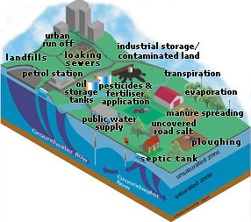
Threats of pollution on groundwater
The many sources of contamination to groundwater
Notes:
Provision of what we now consider to be basic necessities is built on extensive industrial development and supply and distribution systems. There is a legacy of this development. Invariably practices in the past (and many continue today) result in chemicals from industrial processes entering the groundwater. Where this groundwater is used by others for water supply, industry or by the environment, the presence of these chemicals can make it no longer “fit for purpose”.

Slide 43
Point Source and Diffuse Sources
Point source (localised) eg.
Leaking tanks
Spills
Landfills
Tar pits
Diffuse source
Agricultural chemical application (fertilizers / pesticides)
Large scale mining
Notes:
Contamination of groundwater can be broken into two main groups.
Point source contamination is related to a localised geographic area – a specific tank, a petrol station, a landfill.
Diffuse recharge occurs over an extensive area. The main diffuse sources of contamination are various forms of agriculture where pesticides or fertilizers are used over very large areas.

Slide 44
Point source
Type | Source | Contaminants
Industry | Manufacturing sites, refining sites, gasworks | Organic compounds, heavy metals
Waste disposal | Landfills Septic tanks | Heavy metals, organic compounds, BOD¹, COD², nutrients
Commercial | Petrol stations Dry cleaners | Petroleum hydrocarbons, chlorinated hydrocarbons
1: BOD - biological oxygen demand
2: COD – chemical oxygen demand

Slide 45
Diffuse sources
Type | Source | Contaminants
Agriculture | Intensive agriculture, irrigation | Pesticides, nutrients (fertilizers)
Large scale facilities | Defence sites, firing ranges, water treatment plants | Organic compounds, heavy metals, dioxins
Large scale mining | Tailings | Heavy metals

Slide 46
A complex picture...
Notes:
Processes of contamination are particularly complex. Once a contaminant enters the soil, its interaction with the soil will determine how it moves through it. Likewise once it enters the groundwater, its movement is constricted by the pathways available, and the interaction with both the soil material it is passing through and the groundwater itself.
The four key processes that dictate how a contaminant moves through the groundwater are advection, mechanical dispersion, decay / degradation and retardation.

Slide 47
Advective processes, concentrations – single point source
Single point source
t₁
t₂
t₃
1
C
t₁
C₀
0
1
C
t₂
C₀
0
1
C
t₃
C₀
0
Distance (x)
Notes:
Advective movement of a contaminant means that the contaminant will move at the source concentration at a uniform velocity through the aquifer. The velocity term is known as the average linear velocity, and is a product of the hydraulic conductivity, the gradient driving flow and the porosity of the material.
If a one-off “pulse” or spill enters the groundwater, then under advective processes, the source concentration would move through the aquifer without any form of reduction.

Slide 48
Concentrations – continuous point source
Continuous point source
t₁
t₂
t₃
At t₂
1
C
C₀
0
Distance (x)
Distance (x)
Notes:
If a continuous source of contamination is added into the groundwater system, then a “stream” of the source concentration will move through the aquifer.

Slide 49
Mechanical Dispersion
Dispersivity is a function of the porous media
Longitudinal
Transverse
Notes:
Mechanical dispersion occurs because not all the flow pathways through rock and soil are of the same length. If you think about a soil or rock, the pattern of the spaces between the grains (porosity) and the pathways that connect them (permeability) will be highly variable. As a contaminant moves through the soil or rock, parts of the contaminant will travel by different pathways through the pores and connecting passageways. As this occurs, the contaminant starts to disperse – that is the source concentration starts to diminish. However, if the total mass of contaminant does not change (it is not reacting with the soil or rock) then as its concentration decreases, the volume of the aquifer in which there is contaminant increases.

Slide 50
Dispersion of the solute
Continuous point source
Transverse (t)
Longitudinal (l)
At t₂
Results in spreading of the front
1
C
C₀
0
Distance (x)
Notes:
For a continuous source of contamination, what we see is a change in concentration of the contaminant down the flow path, particularly at the contaminant front.

Slide 51
Dispersion effect
Instantaneous point source
t₁
t₂
t₃
1
C
t₁
C₀
0
1
C
t₂
C₀
0
1
C
t₃
C₀
0
Distance (x)
Notes:
For a point source, the effect is to have a gradual reduction in the concentration down the flow path, but an increase in the area over which the contaminant occurs.

Slide 52
Reactions in solute transport
Initial assumption for advection – dispersion equation is that the porous media and the solute are non-reactive
However, in reality, the solute often interacts with the porous media, other components of the pore water and / or undergoes decay
Main processes are decay / degradation and retardation

Slide 53
Degradation and daughter products
C_{p}
C_{d}
Time or Distance
Assumes a first order kinetic reaction, in that the solute is lost to the pore water through the decay or degradation (ie only deals with the loss term)
Notes:
Degradation is where the contaminant, due to its own chemical make-up, will breakdown to create one or more new compounds. When observing this in the field, we observe the concentration of the primary contaminant reducing and the “daughter product” increasing.

Slide 54
Biodegradation
Where biological processes aid the breakdown of contaminants
Rate specific to:
Bacterial population
Nutrient / substrate availability
Solution chemistry (redox, pH)
Co-metabolites / toxins
Temperature
Laboratory determined
Notes:
A specific form of degradation is where biological processes break down the contaminant. This can occur in special circumstances where conditions are right to support the biological material that degrades the contaminant.

Slide 55
Retardation
Taken from “In-situ” presentation on “Groundwater Contamination and remediation
Notes:
The third main process is retardation.
As a mixture of contaminants moves through an aquifer (represented by the different colour green circles), some contaminants have a natural attraction to the soil and rock grains. This attraction slows the contaminants progress preferentially. As a result it appears that some contaminants move more slowly than others, producing a “separation” of contaminants as the mixture of contaminants moves down the flow path.
In some cases the “retardation” can be so effective, that the likelihood that the contaminant will be released is very small. In this case, the contaminant is described as “attenuated” – that is it is held so well that it is unlikely to enter the dissolved phase of the water again and can be assumed to be removed from the water.

Slide 56
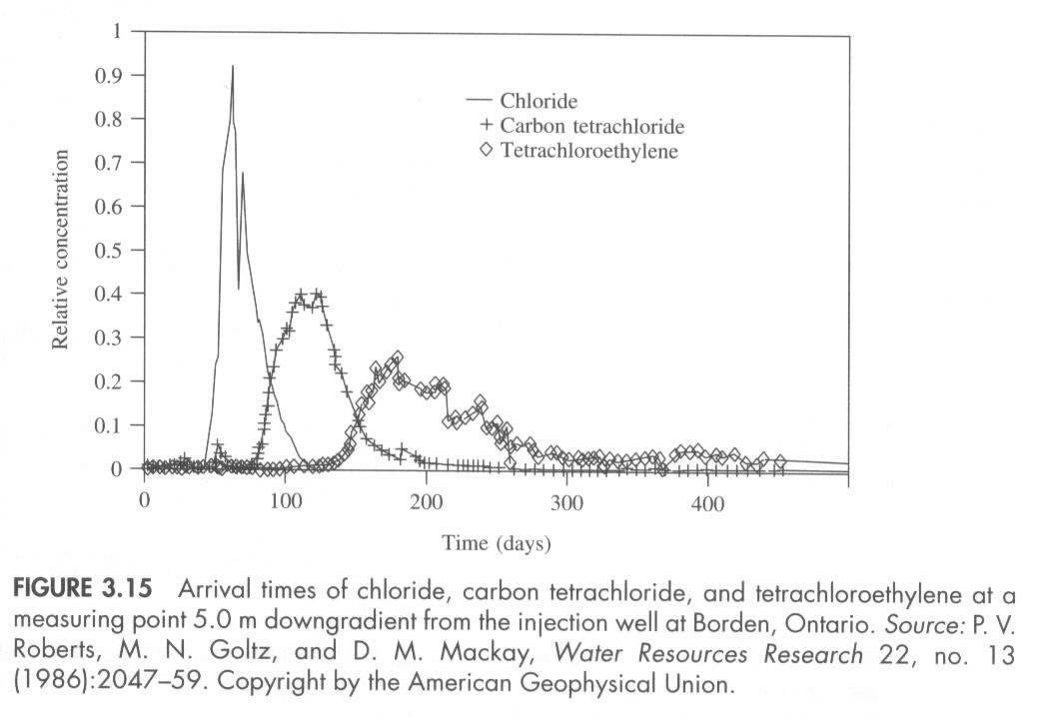
Effects in the field....
From Fetter, 1999, Contaminant Hydrogeology
Notes:
The example here is a complex mix of contaminants. It represent the concentration of each of the contaminants at a specific spot 5 metres from where the contaminant was introduced. It clearly shows the effects of advection, dispersion and in particular retardation of the different chemicals.

Slide 57
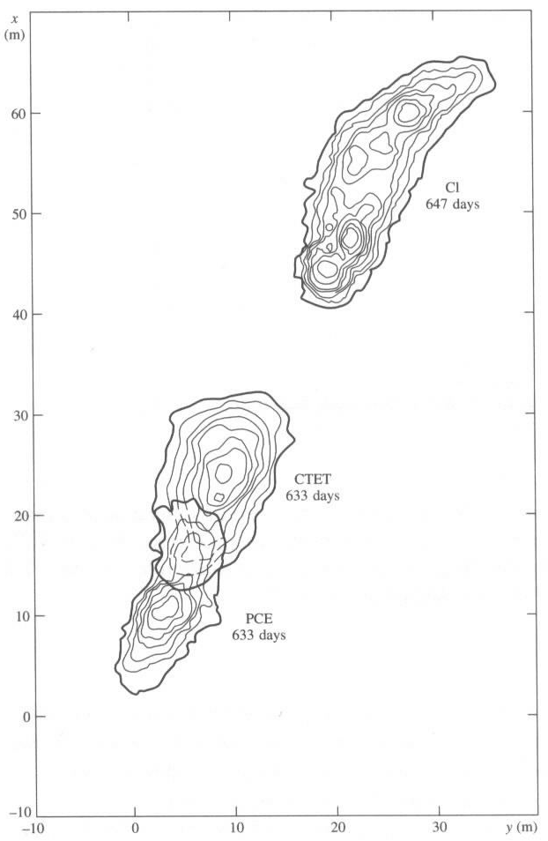
Effects in the field (cont.)
Chloride
Carbon Tetrachloride
Perchloroethene
From Fetter, 1999, Contaminant Hydrogeology
Notes:
If we look at this spatially and see how the different contaminant plumes move, we see a distinct separation of the plumes by chemical.

Slide 58
Contamination Summary
Generally a legacy issue.
Can be from localised “point sources” or distributed over large areas (“diffuse source”).
Once in the ground, interact with the material they are passing through.
Main processes affecting the concentration in the groundwater are advection, dispersion, degradation / decay and retardation.

Slide 59
Contributions
Prepared by Chris McAuley, Principal Hydrogeologist, Department of Sustainability and Environment, Victoria.
Support figures sourced from:
Lectures given by Chris McAuley
TESEP teaching package developed by Louse Goldie Divko (Department of Primary Industries, Victoria), Megan Bourke (independent education consultant) and Philomena Manifold (independent consultant)
Referenced sources

Slide 60

Geoscience Pathways
TESEP uses this fabulous website to distribute materials
www.geosciencepathways.org.au

Slide 61
Please partner!
TESEP will only succeed in the long term if we continue to grow our partnerships
Contact either
Executive Officer, Greg McNamara
eo@tesep.org.au
Chairperson, Jill Stevens
cp@tesep.org.au
to discuss the options

Slide 62





Partners
TESEP wishes to thank the following partners
PRINCIPAL
PLATINUM
GOLD

Slide 63
Partners
SILVER
The Australian National University
Department of Primary Industries, Vic
Earth Science Western Australia
Pitney Bowes Business Insight
PowerWorks
Queensland Resources Council
Rob Kirk Consultants
The University of Sydney
University of Tasmania
BRONZE
Anglo Coal
Australian Nuclear Science and Technology Organisation
CS Energy
Department of Sustainability and Environment, Vic
Essential Petroleum
Flinders University
Gordon Wakelin King
Great Artesian Basin Coordinating Committee
Hot Dry Rocks
Macquarie University
Sandy Menpes
Monash Energy
Museum Victoria
Our Water Our Future, Vic
Petroleum Geo-Services
Primary Industries and Resources SA
Stanwell Corporation
Velseis
ZeroGen

Slide 64
TESEP
Also wishes to thank:
Australian Geoscience Council
Australasian Institute of Mining and Metallurgy
Geoscience Australia
Minerals Council Australia

Slide 65
Thank you

