Slide 1

Assessing the effectiveness of the child safety net: Linkage of hospital and Child Protection Services data on ‘maltreated’ and ‘unintentionally injured’ children
Dr Kirsten McKenzie and Ms Debbie Scott
International Data Linkage Conference2nd-4th May 2012
CRICOS No. 00213J

Slide 2
Rationale for Research
International recognition of need for public health response to child maltreatment
Need for early intervention at health system level
Important role of health professionals in identifying, reporting, documenting suspician of maltreatment
Up to 10% of all children presenting at ED’s are victims and without identification, 35% reinjured and 5% die
In Qld, mandatory reporting requirement for doctors and nurses for suspected abuse or neglect
Notes:
Child maltreatment is a recognised public health problem worldwide, requiring a public health response which focuses on early identification and intervention across government agencies, particularly child protective services and health.
The World Health Organization has argued for improved uniformity in the reporting of child maltreatment-related injuries and deaths, and has emphasised the importance of health professionals in the assessment of suspected child maltreatment.
There are indications that up to 10% of all children presenting to an Emergency Department (ED) may be victims of child maltreatment [2]. Without identification, 35% may be re-injured and up to 5% may die from subsequent injuries.
Reporting requirements for health staff vary across states and territories, and in Qld (the jurisdiction which our research was conducted) there is a mandatory reporting requirement to child protective services where a doctor or nurse suspects a child has been abused or neglected.

Slide 3
Value of hospital data
Routinely collected hospital data a possible source of child maltreatment data outside of child protective services (CPS)
Injury circumstances routinely coded since early 90’s and detailed injury info since early 2000’s (including intent, perpetrator, mechanism, object, place, activity, injury nature and body region) as well as demographics, comorbidities, procedures, length of stay etc
However, event-based not person-based data, relies on clinical documentation and accurate coding
Notes:
One of the national epidemiological tools we have in Australia to understand health priorities and issues is national hospitalisation data which is collected for all patients for all public and private hospitals nationwide over time.
Routinely collected hospital data is a possible source of serious child maltreatment data outside of child protective services (CPS) (which relies on children being reported and recorded in the CPS system)
Injury circumstances have been routinely coded in hospitalisation data since the early 90’s and detailed injury information has formed part of the national dataset since the early 2000’s (including information about the documented intent, perpetrator, mechanism, object, place, activity, injury nature and body region) as well as demographics, comorbidities, procedures, length of stay etc
However, routine hospitalisation data is event-based not person-based data preventing the construction of histories and outcomes of patients, and it relies on good comprehensive clinical documentation and accurate clinical coding to be used as a reliable indicator.

Slide 4
Value of data linkage
Ability to construct person-based data
Admission/ED presentation history
Utilisation of different health services by patient
Sibling/parental health service utilisation
Prior and subsequent CPS services involvement
Notes:
Data linkage offers significant potential to enhance routinely collected hospitalisation data.
Data linkage within health databases allows for the construction of person-based data linking individuals across time and facilities
It allows for a detailed picture of emergency department presentation and admission patterns for the child and patterns of utilisation of other health service facilities
Extended data linkage can allow pictures of sibling and parental health service utilisation
Data linkage of health data with child protective services data can provide a picture of the child’s prior and subsequent involvement with child protective services, and risk factors for being known to child protective services.

Slide 5
Gaps in current knowledge
Accuracy of hospital-based coding of maltreatment and most reliable indicators
Completeness of cause of injury documentation
Accuracy of identification of maltreatment by clinicians
Compliance of doctors/nurses with reporting requirements
CPS histories/outcomes of children hospitalised due to injury (unintentional or intentional)
Risk factors for being known to CPS
Notes:
There are several gaps in our knowledge which need to be addressed in the area of use of health data for child maltreatment surveillance, and these gaps informed the development -of our ARC-Linkage funded research study which was conducted between 2008 and 2011. I wont be elaborating on all of these today, but will provide a reference list at the end for papers we have published so far from this work. So some of the gaps in our knowledge are:
How accurate hospital-based coding of maltreatment is and what the most reliable indicators are of maltreatment
The completeness of cause of injury documentation in medical records
The accuracy of identification of maltreatment by clinicians and health staff
How compliant doctors/nurses are with mandatory reporting requirements
The CPS histories/outcomes of children hospitalised due to injury (unintentional or intentional injuries)
Risk factors for being known to CPS if hospitalised due to an injury

Slide 6
Aims of research
Quantify the concordance of health and CPS data for index event
Identify CPS history/outcomes for index cases
Identify and compare risk factors for linkage for children with maltreatment-related hospitalisations and unintentional injury-related hospitalisations
Notes:
The aims of the research component which I am describing today were to:
Quantify the concordance of health and CPS data for index event
Identify CPS history/outcomes for index cases
Identify and compare risk factors for linkage for children with maltreatment-related hospitalisations and unintentional injury-related hospitalisations

Slide 7
Methods
Retrospective medical record review, recoding and data linkage study for 2 independent samples:
Cases with codes indicative of possible maltreatment
Cases with codes indicating an unintentional injury cause
20 hospitals Qld-wide (large/medium/small and urban/rural/remote) admissions between 2003-2006
On-site data collection and recoding by expert coders, including verbatim extracts of injury circumstances
Notes:
We undertook a retrospective medical record review, ICD recoding and data linkage study for 2 independent samples:
Cases with codes indicative of possible maltreatment (I wont discuss the code range today due to time limitations but our publication describe these in their entirety)
Cases with codes indicating an unintentional injury cause
20 hospitals Qld-wide were included with sampling aimed at including a representative mix of large/medium/small hospitals in urban/rural/remote locations. Admissions between 2003-2006 were included (to include data either side of new mandatory reporting requirements for nurses which was one component of the larger study).
Data was collected on-site data and recoded by expert coders, and a verbatim extract of all injury circumstances and risk factors was collected in an electronic database designed for the study.

Slide 8
Data Linkage Methods
Limited functionality of Qld data linkage facility for departmental data outside of health data, but whole-of-govt commitment for child safety matters
Health released names and aliases/ DOB/ gender/ known addresses/admission dates to CPS
CPS intake officer manually reviewed all cases and identified matches in system, and database analyst extracted CPS data
Unique identifier on health and CPS data provided to researcher who joined departmental data for deidentified cases
Notes:
At the time of undertaking this research, there was limited functionality of the Qld data linkage node for departmental data outside of health data, but there is a whole-of-govt commitment for child safety matters in Qld, so the legislation enabled linkage even if the systems were in their infancy.
As such, the process we followed was that, for our targetted sample, the health department released names and aliases/ DOB/ gender/ known addresses/admission dates (but no clinical data) directly to CPS (and CPS did not know whether the sample was from the maltreatment or unintentional injury sample).
A CPS intake officer manually reviewed all cases and identified matches in system using their standard intake procedure, and a database analyst then extracted CPS data for matched cases.
A unique identifier included on both the health and CPS data (but no identifying information) was provided to researcher who joined the clinical/departmental data for the deidentified sample.

Slide 9
Results
SAMPLE:
423 children maltreatment code sample with 93% CPS match
461 children unintentional injury code sample with 32% CPS match

Slide 10
Linkage results
Linkage between hospital and CPS data | Unintentional injury code sample |  | Any maltreatment code sample
 | n | % | n | %
Known to CPS
No | 313 | 67.90% | 29 | 6.86%
Yes | 148 | 32.10% | 394 | 93.14%
Recent CPS event*
No | 410 | 88.94% | 63 | 14.89%
Yes | 51 | 11.06% | 360 | 85.11%
TOTAL | 461 | 100.0% | 423 | 100.0%
Notes:
This table shows the linkage results for both samples for ever being known to CPS and for a recent CPS record (i.e. A notification or substantiation within 6 months either side of the index hospital admission).
85% of cases in the maltreatment code sample matched a recent CPS record and 11% of cases in the unintentional injury code sample matched a recent CPS record. Note that the annual Qld notification rate for children to CPS is less than 2.4% in the general community.

Slide 11
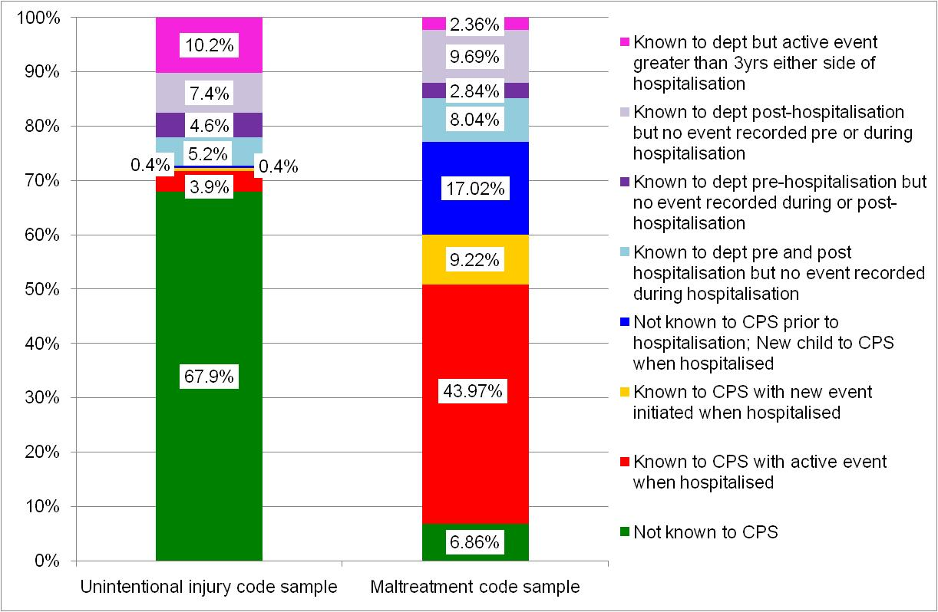
Notes:
This is a fairly detailed figure and probably difficult to read, but it is provided as an illustration to show what kind of patterns of CPS involvement can be examined via data linkage. We looked at:
whether children were known to CPS at all (in green)
whether they had an active CPS event at the time of hospitalisation (in red) or
whether the hospital stay triggered a new event for known children (in orange)
whether children werent known prior but were made known to CPS as a result of the hospital admission (in dark blue)
Whether children were known but did not have an event recorded pertaining to the hospitalisation (in light blue)
Whether they were known before, but not during or after OR known after but not during or before
And whether they had a more historical record in the CPS system but no record during the 3 year period either side of the index hospitalisation.
I wont elaborate on the findings here today, but wanted to provide this slide to show the potential of the info we can explore via linkage in this space.

Slide 12
Risk factors for recent CPS linkage for maltreatment code sample
Children <1 6x more likely than 15-17yo’s
Children documented as referred to hospital CPS 3.5x more likely than those with no referral documented
Children with codes to indicate other factors affecting health status 4.5x more likely than those without these codes
Children with more definitive maltreatment code 4.3x more likely than those with less definitive code
Notes:
The final aim in this component of the research was to examine the risk factors for being known to CPS for the two different samples we examined. For the maltreatment code sample, after controlling for age, sex, hospital size and locality, the following risk factors for linkage were identified:
Children under the age of 1 were more than 6 times more likely than children aged 15-17 to link to a recent CPS event
Compared to children who were not documented as being referred to the hospital child protection team or to CPS, children who were documented as being referred were 3.5 times more likely to link to a recent CPS event
Relative to children with no additional diagnosis from the ‘Factors affecting health status’ ICD-10 chapter, children with an additional diagnosis from this chapter were 4.5 times more likely to link to a recent CPS event
Children assigned a definitive maltreatment code were 4.3 times more likely to have a recent CPS event recorded than children assigned a possible maltreatment code.

Slide 13
Risk factors for recent CPS linkage for unintentional injury code sample
Children admitted to rural hospital 2.4x more likely than urban hospital
Children documented as being known to CPS 50x more likely than those with no CPS presence documented
Children with additional diagnosis codes 6.4x more likely than those without additional diagnosis codes
Notes:
In comparison, for the unintentional injury code sample, after controlling for age, sex, hospital size and locality, the following risk factors for linkage were identified:
The odds of linkage to a recent CPS event for children discharged from rural hospitals was 2.4 times higher than for children from an urban hospital.
Compared to those not documented as being known to CPS, children who were documented as being known to CPS were 50 times more likely to link to a recent CPS event.
Relative to children with no additional ICD-10 diagnoses, children with an additional diagnosis were 6.4 times more likely to link to a recent CPS event.

Slide 14
Conclusions
Hospital system for reporting children to CPS appears to be efficient in most cases in which maltreatment coded
Nearly 1/5 linked children in the present study were identified for the first time during the index hospitalisation -> importance of systematic monitoring and referral from hospitals
Around 1/15 children with a maltreatment code did not link to the CPS -> ? whether these children have slipped through the safety net
Notes:
The hospital system for reporting children to CPS appears to be efficient in the great majority of cases in which maltreatment is coded, with similar linkage rates identified to previous research.
Nearly one in five of the linked children in the present study were identified for the first time during the index hospitalisation, highlighting the importance of systematic monitoring and referral from hospitals.
However, around one in every fifteen children with a maltreatment code did not link to the CPS and consideration should be given to whether these children have slipped through the safety net.

Slide 15
Conclusions (continued)
1/3 of children who presented with an injury coded as being due to an unintentional cause were known to CPS, with 11% of this sample having a recent CPS event recorded
Possibility of maltreatment histories should be considered for children presenting with an unintentional injury
Notes:
Importantly, one-third of children who presented with an injury coded as being due to an unintentional cause were known to CPS, with 11% of this sample having a recent CPS event recorded.
This indicates that the possibility of maltreatment histories should be at least considered for children presenting with an unintentional injury.

Slide 16
Data linkage implications
Data linkage vital to construct the histories and subsequent CPS involvement
Data linkage highlighted risk factors for CPS matching to target in-hospital early identification and intervention
Issues re manual linkage approach required in this study -> improvements in system level capability for routine linkage in Qld
Notes:
Data linkage was vital to construct the histories and subsequent CPS involvement
Data linkage highlighted risk factors for CPS matching to target in-hospital early identification and intervention
The fact that manual linkage processes had to be used in this study though are problematic limiting the ability to undertake this research at a population level in Qld with the current resources, despite the huge potential of such an investigation for identifying risk factors and intervention opportunities. Improvements in the system level capability for routine linkage in Qld is needed to ensure such work could be undertaken routinely in the future.

Slide 17
Article details
McKenzie K, Scott D, Fraser J, Dunne M. 2012. Assessing the effectiveness of the child safety net: Linkage of hospital and Child Protection Services data on ‘maltreated’ and ‘unintentionally injured’ children. Injury Prevention.
McKenzie K, Scott D. 2011. Using Routinely Collected Hospital Data for Child Maltreatment Surveillance: Issues, Methods and Patterns. BMC Public Health 11:7.
McKenzie K, Scott D, Waller G, Campbell M. 2011. Reliability of Routinely Collected Hospital Data for Child Maltreatment Surveillance. BMC Public Health 11:8.

Slide 18
Acknowledgements
ARC-Linkage funding
Industry partners: Department of Communities, Queensland Health, Abused Child Trust
Data collectors: Garry Waller and Margaret Campbell

Slide 19




Questions?
k.mckenzie@qut.edu.au
Mark your Diaries!
Occupational Safety in Transport Conference
20-21 September 2012, Gold Coast
Registrations Open 5 March
http://ositconference.com
Mark your Diaries!
International Council on Alcohol, Drugs and Traffic Safety Conference (2013)
25-28 August 2013, Brisbane
http://t2013.com
CRICOS No. 00213J

