Slide 1
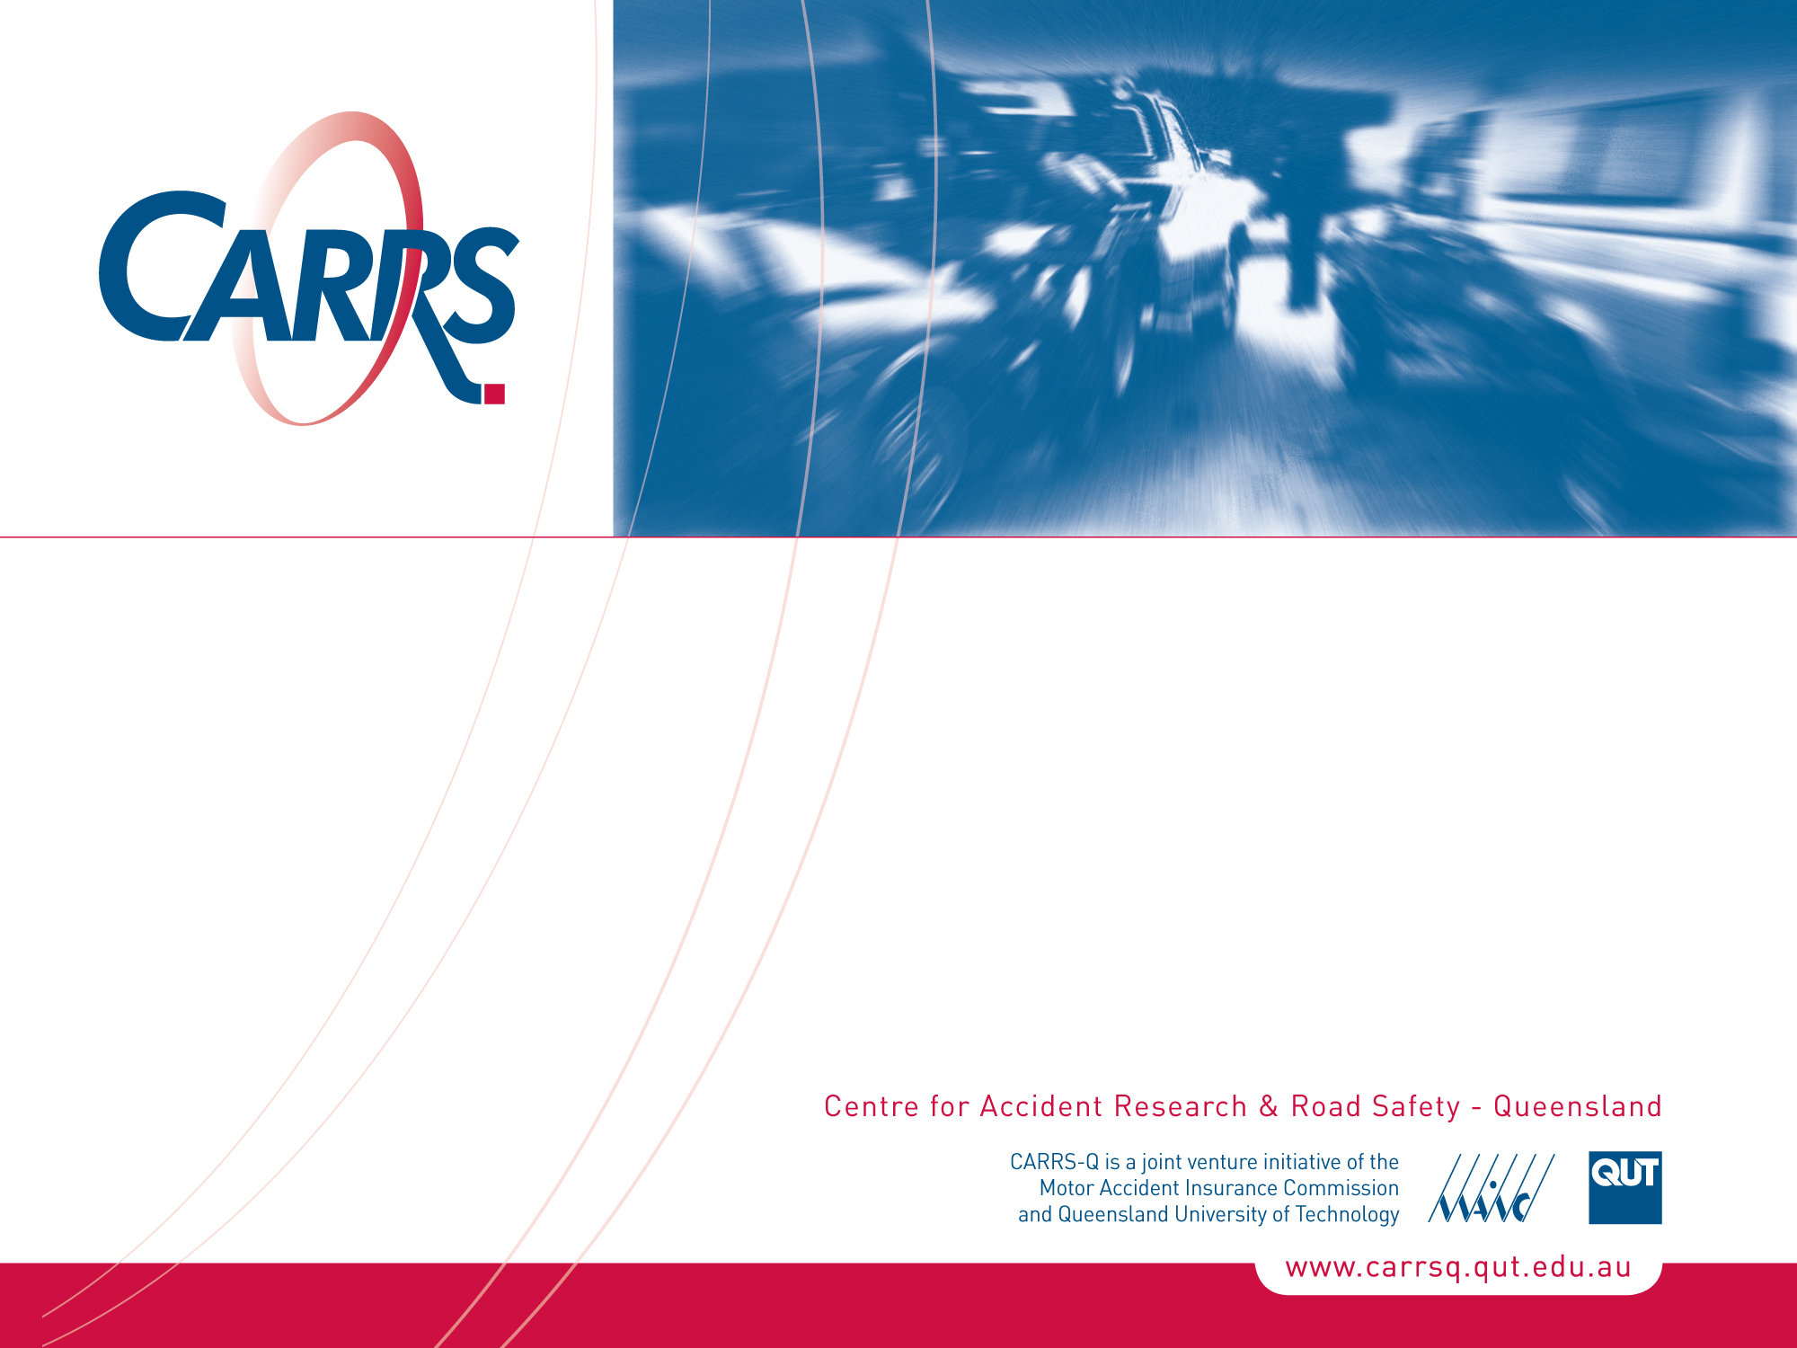
The Role of Cultural Beliefs in Contributing to Risky Road Use Behaviour in Pakistan
Ahsan Kayani, Mark King and Judy Fleiter, CARRS-Q
10th National Conference on Injury Prevention and Safety Promotion
Brisbane Convention and Exhibition Centre
2nd-4th November 2011
CRICOS No. 00213J

Slide 2
Overview
Road crash statistics for Pakistan
Role of beliefs in risky road use
Description of research
Main findings:
Fatalism
Superstition
Popular conceptions of religion
Influences on prevention, behaviour &practice
Implications

Slide 3
South Asian countries vs Australia, 2007: estimated fatalities, population and fatality rate per 100,000 population
Country | Estimated road crash fatalities 2007 | Population 2007 | Road fatalities per 100,000 population
Bangladesh | 20,038 | 158,664,959 | 12.6
Bhutan | 95 | 658,479 | 14.4
India | 196,445 | 1,169,015,509 | 16.8
Maldives | 56 | 305,556 | 18.3
Nepal | 4,245 | 28,195,994 | 15.1
Pakistan | 41,494 | 163,902,405 | 25.3
Sri Lanka | 2,603 | 19,299,190 | 13.5
Australia | 1,616 | 20,743,179 | 7.8
Source: Table A.2, Global Status Report on Road Safety

Slide 4
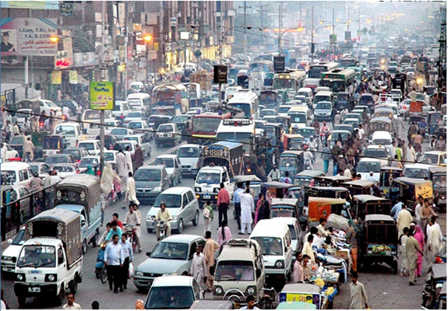

Slide 5
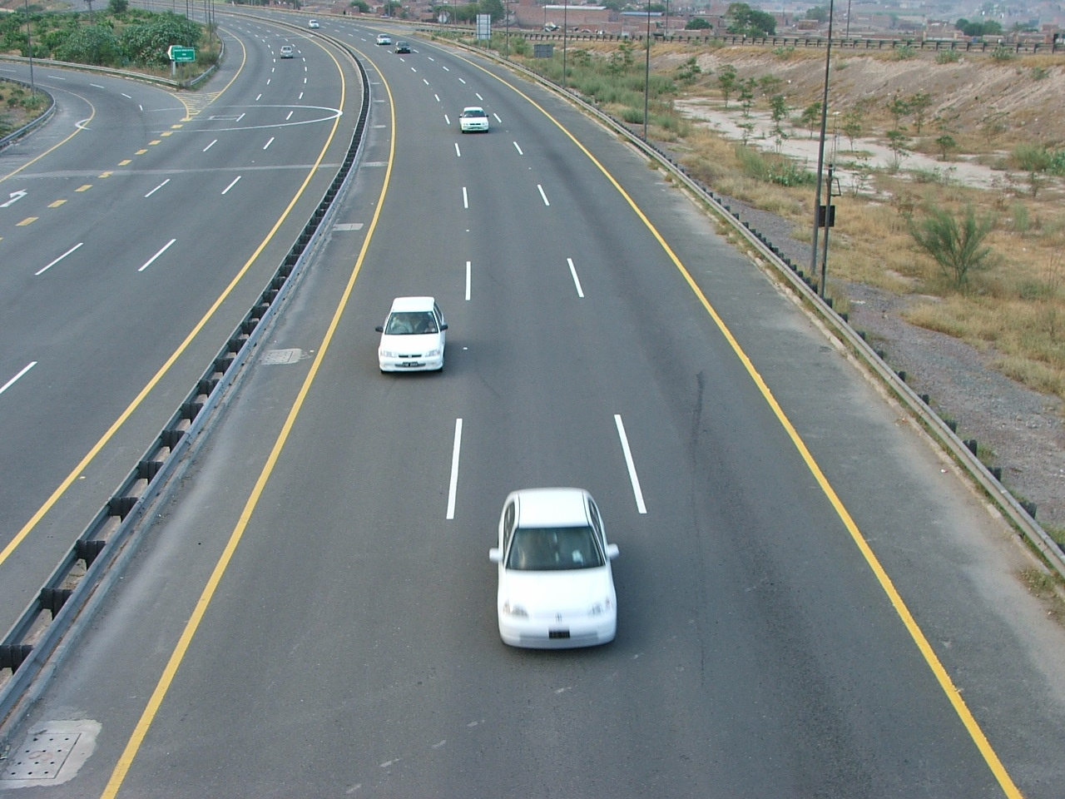

Slide 6
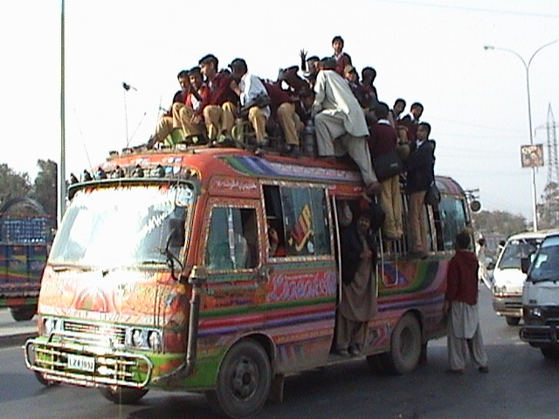

Slide 7
If I die in Pakistan, it’ll be because of a traffic accident, not a bomb or bullet. The real danger over there is on the road.
A driver here must embrace fatalism otherwise he could never summon up enough courage to drive an overloaded, badly balanced, a mechanically imperfect jeep along a track where, for hours on end, one minor misjudgment could send the vehicle hurtling hundreds of feet into the Indus.
Quotes from Greg Mortenson and Devla Murphy, in ‘Three Cups of Tea, One Man’s Mission to Promote Peace … One School at a Time.’

Slide 8
Role of beliefs in risky road use
Beliefs influence behaviour and responses to interventions
Fatalism: “the belief that events are predetermined and inevitable, thus affecting the interpretation of crash events and leading people to take more risks and disregard safety measures” (Hazen & Ehiri, 2006)
Little research

Slide 9
Conceptual framework
Based on the literature:
Fatalism: theological vs empirical
Superstition
Religion
Culture

Slide 10
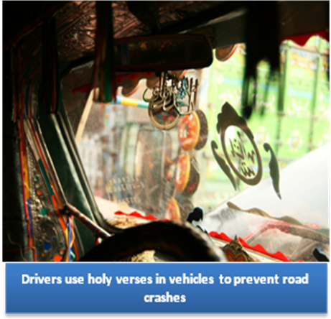
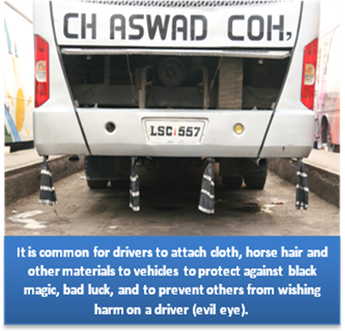

Slide 11
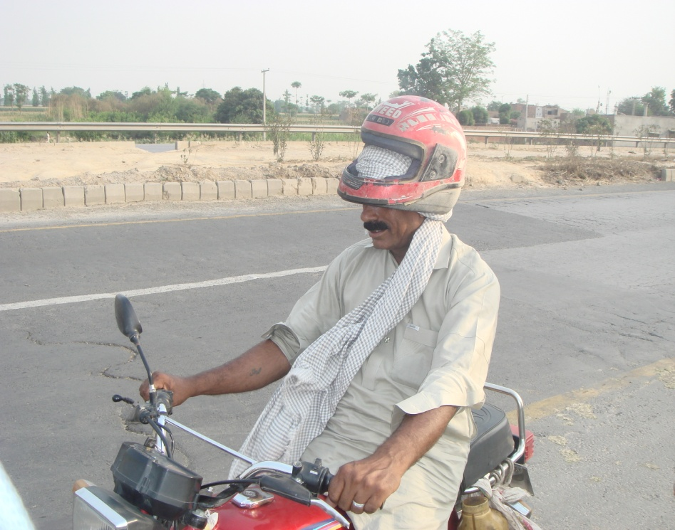

Slide 12
Description of research
Qualitative research:
What are the perceptions of road crash causation in Pakistan, in particular the role of fatalism, superstition, religious and cultural beliefs?
How do fatalism, superstition, and religious and cultural beliefs influence road user behaviour in Pakistan?
Do fatalism, superstition, and religious and cultural beliefs work as obstacles to road safety interventions in Pakistan?

Slide 13
Methodology
In-depth interviews in Lahore, Rawalpindi and Islamabad:
12 professional drivers (taxi, bus and truck)
4 car drivers
6 police officers
4 policy makers
2 religious orators
Wide range of ages and education
Interviews taped, transcribed, translated and analysed for themes

Slide 14
Fatalism
Pervasive
Religious underpinning (popular conceptions of religion)
Overlap with superstitious beliefs

Slide 15
The children who died in that accident would have died for some other reason anyway because death was their fate and that was their day. Death was fated for these children who were sitting on the top of bus. This was inevitable and the driver’s mistake just becomes the source of that accident. The sitting of the children on the top of the bus also became a source of death. If they had not had to face death they would not have sat there. It was also the driver’s destiny that it was in his fate to face difficulties of life in this way.
Male taxi driver, no education, aged 46
Interviewer: Can a driver avoid a road accident?
If it is in fate he can’t save [himself] and if it is not in fate then he can save himself. Even If someone is in a burning fire, if it is in his fate he will not be affected with it.
Male Bus driver, Middle School, aged 55

Slide 16
Superstition
Includes attribution to malignant acts of others:
Evil eye
Black magic – link with religion

Slide 17
Evil Eye
“I have personal experience [with evil eye]. I bought a coaster [29 seater bus] new model, with the latest shock system. I parked it at a petrol pump, the pump guy came and complimented us [saying] ‘What a nice coaster you have sir’. Then we started the vehicle and suddenly both rear shocks jammed. It was a zero meter [new] vehicle.”
Interviewer: Did the evil eye of that person cause the problem in the shocks?
“Yes, I believe so.”
Interviewer: Do you think it could have been a manufacturing fault or mechanical fault due to heavy jumping of the vehicle that caused the shocks break down?
“No, it was absolutely right that it had been affected by evil eye. Just when I took it on the road from the petrol pumps it started giving shocks, I went back to the pump again, crawled under the vehicle to check it but couldn’t see anything wrong with it. A person came to me and asked me about the matter. He asked me if any other man had ridden in the vehicle in the last few hours. I indicated to him about the man at the petrol pump who praised the vehicle. The person told me that this man has evil eye and that is why my vehicle got a fault.”
Male Truck Driver, Middle School, aged 40

Slide 18
Black Magic
Yes it [black magic] is used to give damage to people in their business, body, property. A vehicle is also a property. If someone does black magic on a vehicle, the people or driver inside the vehicle can face an accident. I believe in black magic and it also worked on the Prophet (Peace be upon Him).
Male Police Officer, Bachelor degree, aged 30

Slide 19
Popular concepts relating religion to crash causes
“Test of life”
Shahadat (martyrdom)
Punishment by God
Good deeds
Act of the devil

Slide 20
I’ve asked various religious people [orators] and they told me that death in traffic accidents gain us Shahadat.
Male Truck Driver, Primary School, aged 60
If someone has good deeds in life he does not face an accident.”
Int: Even if he is driving with mistakes?
Yes. If he is doing well in life and he does not make a sin, he will not face an accident.
Male Bus Driver, Middle School, aged 55
Yes it’s from Satan when I make a violation. When I am driving carefully and an accident occurs, it’s natural [in fate]. When I violate the traffic rules and have an accident then it’s Satan [who is involved].
Male Taxi Driver, Middle School aged 32

Slide 21
Influences on prevention, behaviour & practice
Dua (prayers) and other religious measures
Amulets, charms
Influence on driver behaviour
Influence on police activity
Under-reporting and pardoning

Slide 22
“At night, I and other drivers usually don’t use seat belt because police are not watching us. I myself sometimes drive while feeling sleepy as it is God who saves us. It is destiny or nature [fate] that can save us. Human beings have no control on anything. I just depend on nature that can save us.
Male Taxi Driver, Middle School, aged 32
“In Pakistan it is very common that people think it is natural to have loss and that this is in their fate. Many times it happens if someone is injured or killed [in a road crash] he [the driver] gives a written statement on the spot that the case should not be registered because it was in their fate.”
Male Police Officer, Matriculation, aged 52
Interviewer: “Do you think people give pardon even if the accident results in a death?”
“Yes, because people know that it’s [the crash occurred] because of fate so they give pardon. They think it was sudden and fate and [so] why [would] they start legal procedures or take money over the dead body of their loved ones?”
Male Truck Driver, Primary School, aged 59

Slide 23
Implications
Further information about beliefs can enhance health promotion efforts
Need to shift towards scientifically-based understanding of crash causation
Incorporate an understanding of local beliefs into broader countermeasure approaches
Foster police role in professional evidence-based approach

Slide 24
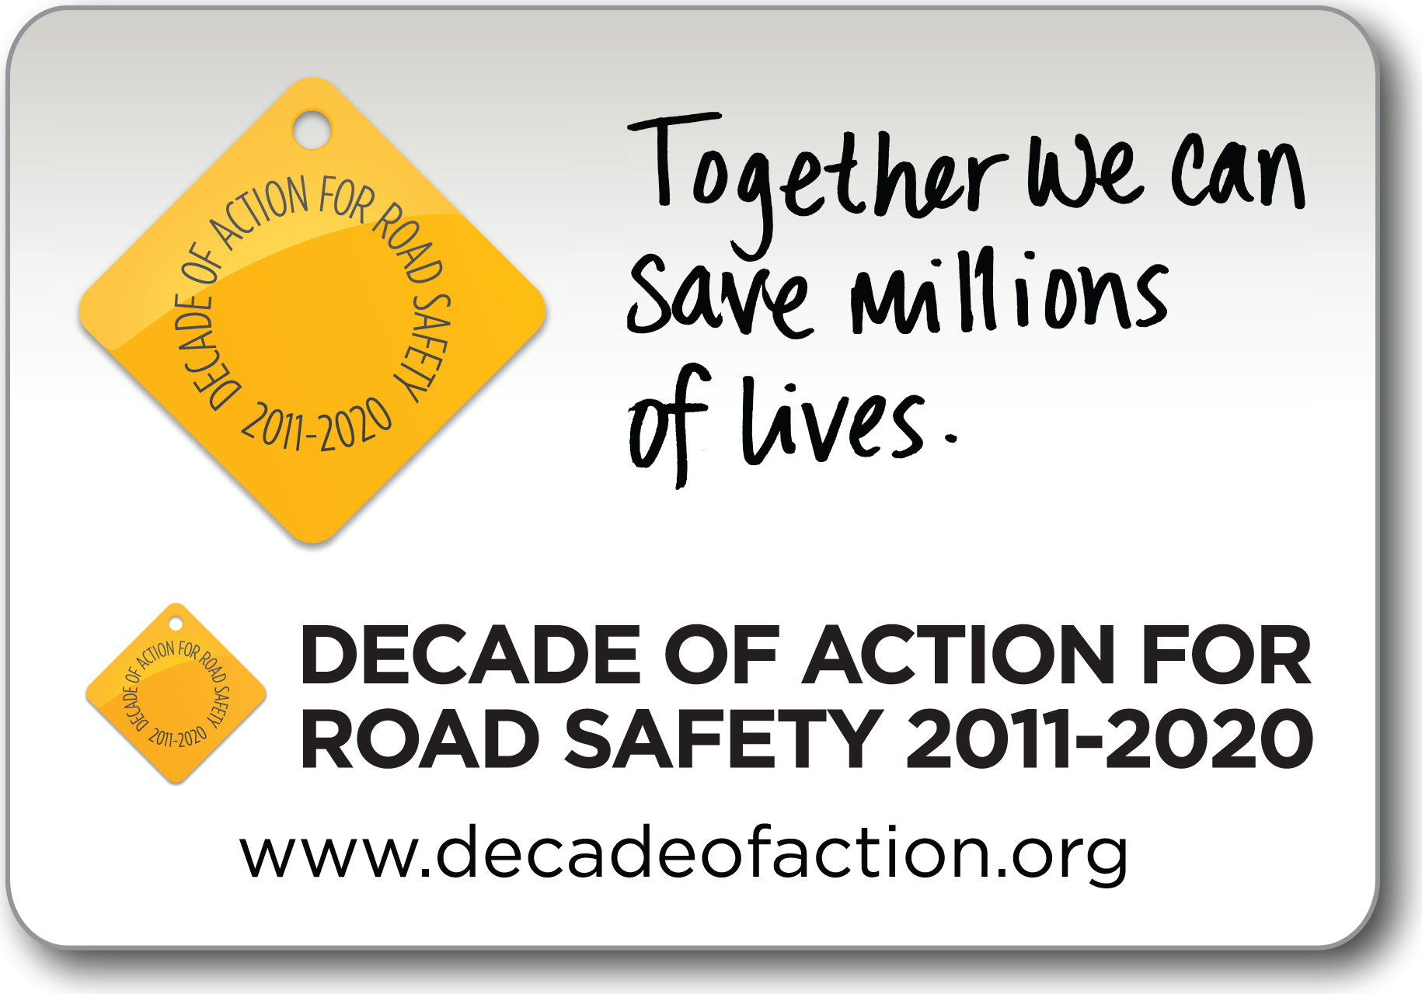
Mark your Diaries!
International Council on Alcohol, Drugs and Traffic Safety Conference (ICADTS T2013)
August 2013, Brisbane Convention and Exhibition Centre

