Slide 1


Physical activity, quality of life and cancer
Sandi Hayes
QUT, IHBI, School of Public Health

Slide 2
Exercise and cancer
The Physical activity and cancer control framework (PACC):
Treatment preparation/coping before treatment
Treatment effectiveness/coping during treatment
Recovery/rehabilitation
Disease prevention/health promotion
Survival
Palliation
Courneya KS, et al. (2007).Sem Oncol Nurs, 23:242-252.

Slide 3
Exercise and cancer: fitness
Figure 1: Harrison, et al. (2009). Psycho-oncology, 18:387-94.
Figure 2: Courneya., et al. (2003). Journal of Clinical Oncology, 21:1660-8.

Slide 4
Exercise and cancer: treatment- related symptoms
Figure 1: PTS unpublished data; Courneya., et al. (2003) JCO; Dimeo,. et al. (1999) Cancer.

Slide 5
Exercise and cancer: psychosocial concerns
Variable | N | Before | After | % change | p value
Beck Depression Scale
During-treatment group | 15 | 9.1+4.3 | 5.2+3.1* | –43.0% | <0.01
Following-treatment group | 93 | 10.7+7.0 | 8.0+6.9* | –25.6% | <0.01
Quality of life
During-treatment group | 8 | 22.7+2.2 | 25.3+2.1 | +11.5% | 0.04
Following-treatment group | 40 | 20.1+4.4 | 22.2+4.0 | +7.2% | 0.03
Schneider, et al. (2007). Annals of Oncology, 18:1957-62.

Slide 6
Exercise and cancer
Preservation or improvements: | Reductions:
Muscle mass, strength, power Cardiorespiratory fitness Physical function Physical activity levels Range of motion Immune function Chemotherapy completion rates Body image, self esteem and mood | Number of symptoms and side- effects reported, such as nausea, fatigue and pain Intensity of symptoms reported Duration of hospitalisation Psychological and emotional stress Depression and anxiety
Hayes S, et al. (2009). J Sci Med Sport;12:428-34 ;
Schmitz KH, et al. (2005). Cancer Epi & Biomarkers ;14.1588-95.

Slide 7
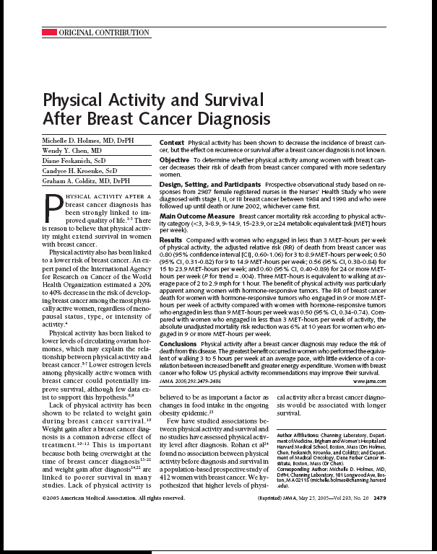
Exercise and survival following cancer
Total death
Cardiovascular disease
Osteoporosis
Diabetes
Hypertension
Other cancers
Recurrence:
3-8.9 METS (1.25 fold)
9-14.9 METS (2 fold)
15+ METS (1.8 fold)
* Walking at an average pace = 3 METs

Slide 8
Exercise and cancer
Helps people feel normal
One thing survivors can control
Helps them do ‘normal’ things ‘normally’

Slide 9
Exercise advice
Type
Anything is better than nothing
Frequency and Duration
Some is better than none, more is generally better than less
Intensity
Low to vigorous
Limits to our knowledge

Slide 10
Exercise: it’s important, feasible and it’s necessary
Cancer diagnosis = teachable moment
Many survivors stop exercising during treatment and do not restart after treatment is finished

Slide 11
Why aren’t survivors active? Mixed advice
Rest is best
Active is best
Own attitudes
Don’t know what specifically to advise
Limited resources

Slide 12
Why aren’t survivors active? Clinical concerns
Exercise and lymphoedema:
Exercise does not precipitate lymphoedema
Exercise does not exacerbate lymphoedema
Exercise may reduce incidence of lymphoedema exacerbations
Other-associated symptoms are also reduced with regular exercise
Schmitz et al (2009), Hayes et al (2009); Harris et al (2000); Ahmed et al (2006); Lane et al (2005); McKenzie et al (2003)

Slide 13
Why aren’t survivors active? Clinical concerns
Reduction in physical activity
Fatigue
Reduced physical function

Slide 14
So why aren’t survivors active?
Concerns of support people – fear
Personal reasons – not sure what to do, fears
Usual issues – such as time, it’s boring, too hot
Cancer specific issues – wig makes head too hot, can’t wear a bra, compression garments are restrictive

Slide 15
Where to from here?
How do we best assist people to become and stay active following a cancer diagnosis?

Slide 16
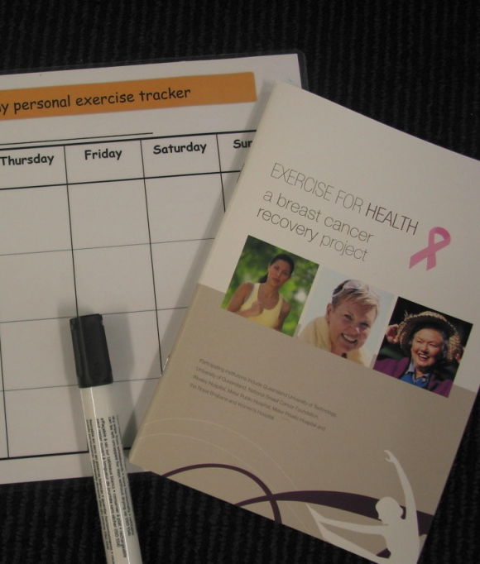
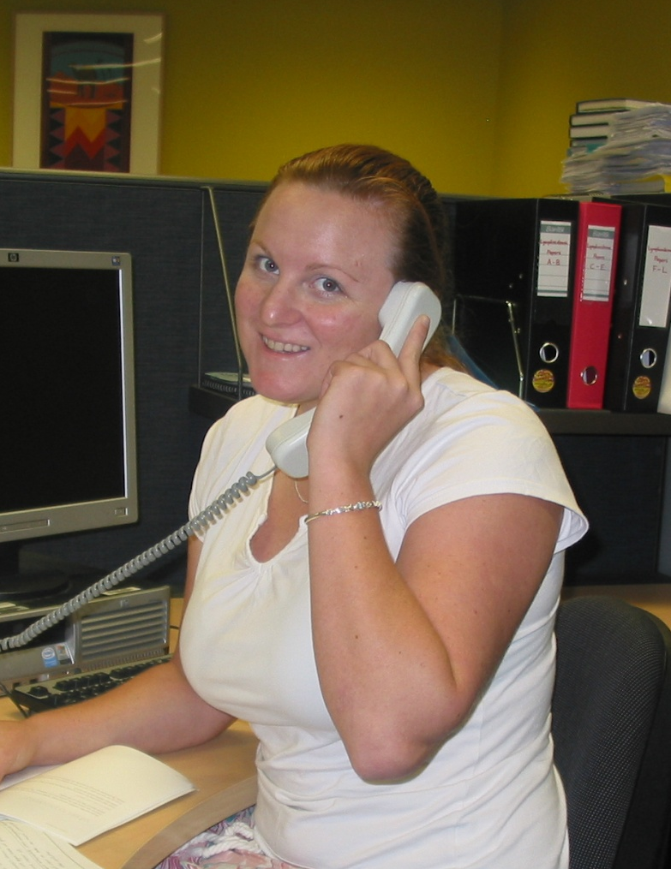
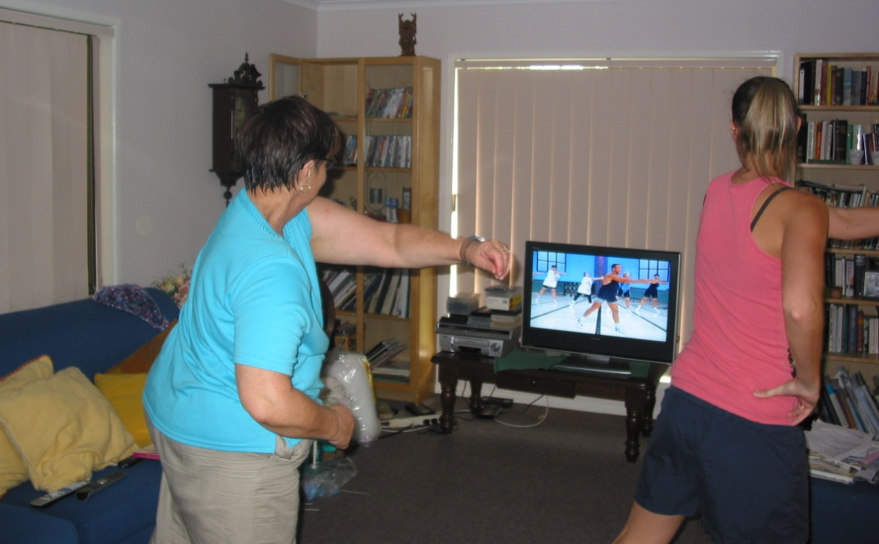
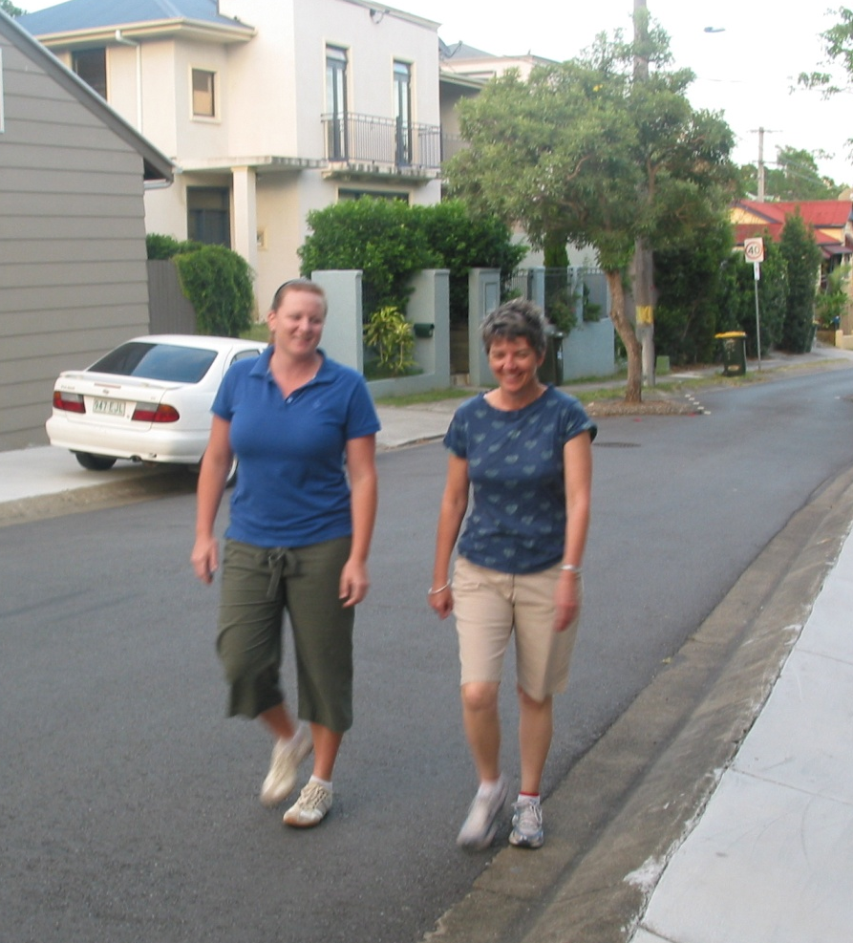
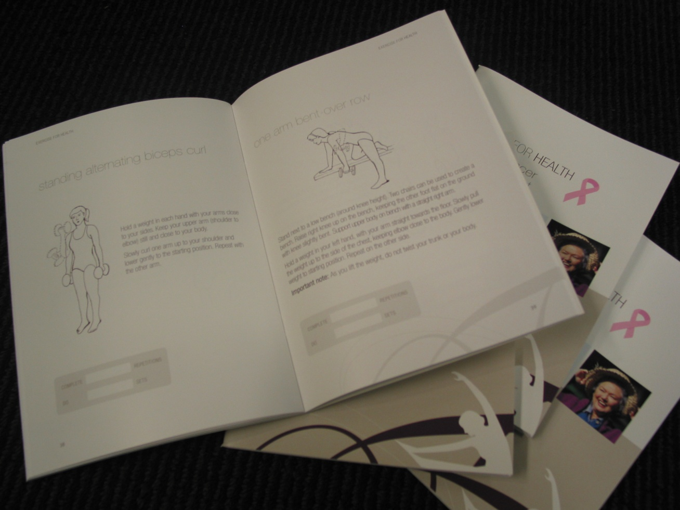


Slide 17
The dilemma
“If someone offered you a drug that could help prevent five major health concerns, including cardiovascular disease, cancer and diabetes, wouldn’t you rush to take it? If you were told that this same drug could keep your weight down, reduce the need for antidepressants, boost your self-confidence and reduce your chance of getting osteoporosis, wouldn’t you be emptying your coffers in order to stock up on supplies? Well, such a drug is available. It’s called exercise.”
Beverley Hadgraft, Qantas The Australian Way Magazine, January 2008

