Slide 1
Author’s Notes:
The slides presented here are a subset of those used for the AAANZ conference held at the Gallery of Modern Art (GOMA), Brisbane, Australia from 4-6 November, 2008.
Some images have been withdrawn pending permissions

Slide 2
Fashion design research: Research methodologies for emerging researchers Angela Finn AUT University Auckland, New Zealand

Slide 3
What happens when experienced practitioners are introduced to academic research and research methodology?

Slide 4
Methodology is the study of ‘the system of methods and principles used in a particular discipline’ (New Collins Dictionary.1986)… The aim of methodology is to help us understand, in the broadest possible terms, not the products of inquiry, but the process itself.
(Gray, C., & Malins, J. 2004)

Slide 5
Is it appropriate for practice based fashion researchers to adopt and adapt existing research methodologies to find a scholarly, academic voice?

Slide 6
Why should we care?
Madeleine Vionnet, …… aged ninety-six she was asked by Robert Freson, who was a photographer for the Sunday Times Magazine in London, if she would allow her photograph to be taken. Her reply was, “Sure, but you won’t be able to take what’s inside my head.”
Madeleine Vionnet draping the pattern for her design on an articulated artist model mounted on a piano bench, 1923. Photo by Thérèse Bonney
(Kirke, B. 1991).

Slide 7
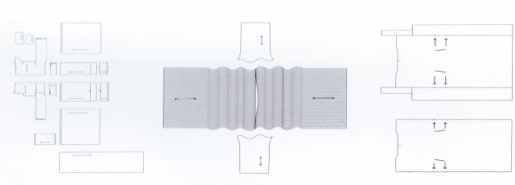
Looking at the final product, here a garment designed by Madeline Vionnet, the practitioner can not fully appreciate the innovation that has occurred though the development process
Modern texts attempt to capture this information by accompanying a ‘plan of action’ with images of her work
This plan has been created by a person who was not the creator…what insight could have been gained if the work had been captured by the designer herself?

Slide 8
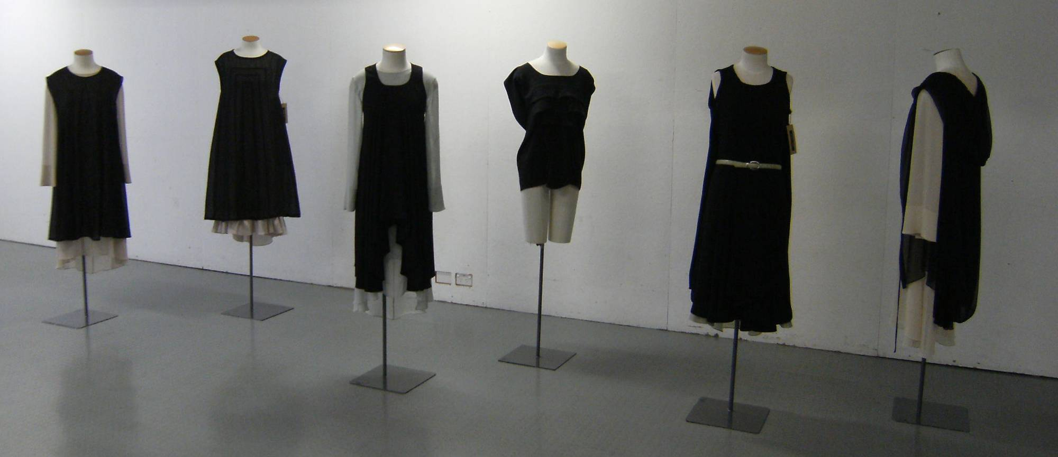
Fashion Manufacturing in New Zealand: Can design contribute to a sustainable industry?

Slide 9
What are the specific research questions addressed through this practice based research project?
How does the practice address the research questions?
What are the methods that have been used to investigate the possibilities of the research?
What was the scope of the research, what is the context of the research? How effective has the researcher been in seeking a solution?
What other questions could be asked as a result of this research?

Slide 10
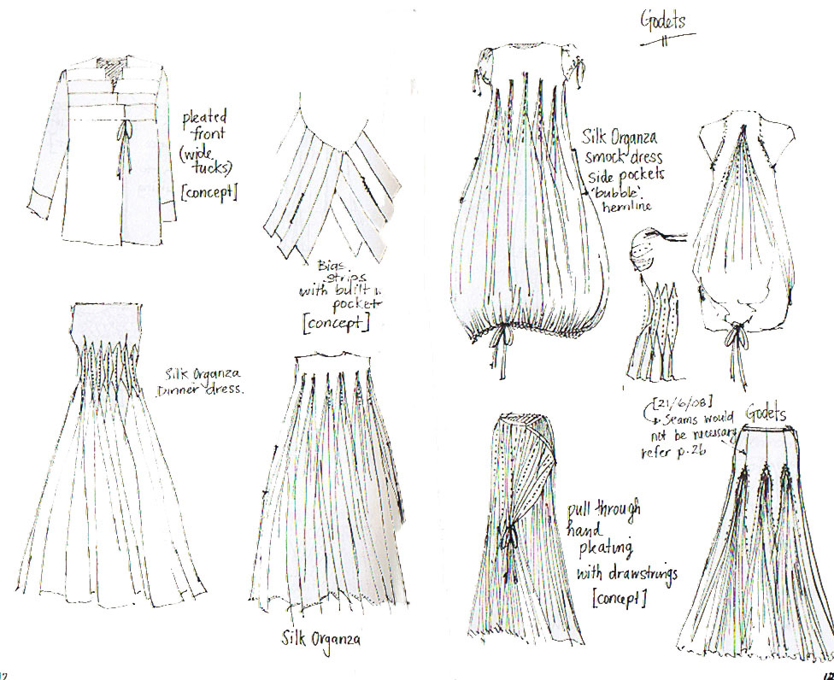
A designers sketchbook records concepts for development…

Slide 11
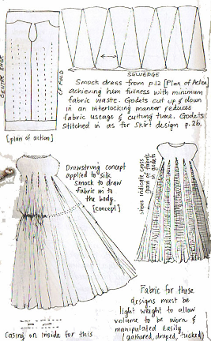
What are the methods that can be used to minimise redundancy and make research practice more effective?
A plan of action can be recorded to capture the initial approach that could be taken to a problem
Rudimentary toile made to 1:2 scale to test an initial design concept

Slide 12
Recording and reflecting on design concepts can lead to the same research being applied to a different problem (transferability)

Slide 13
A designer’s sketch communicates a concept to other designers and makers…but does it communicate to readers without this tacit knowledge?

Slide 14
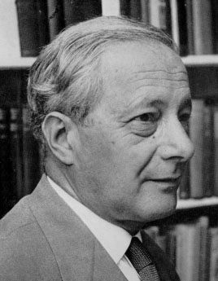
In his book Personal Knowledge (1962) Michael Polanyi challenges the accepted theories of knowing. His later writings refer to this concept as tacit knowledge…
To learn by example is to submit to authority. You follow your master because you trust his manner of doing things even when you cannot analyse and account in detail for its effectiveness. By watching the master and emulating his efforts in the presence of his example, the apprentice unconsciously picks up the rules of the art, including those which are not explicitly known to the master himself. These hidden rules can be assimilated only by a person who surrenders himself to that extent uncritically to the imitation of another (Mitchell, M. T. 2006).

Slide 15
Development of concepts that address research questions
A plan of action communicates the concept in terms of the original research question to readers with tacit knowledge of garment design and making.
Fabric minimisation
Cutting minimisation
Minimal seaming (single seam garment)
Limited use of high tech machinery
Minimisation or elimination of pattern and grading processes

Slide 16
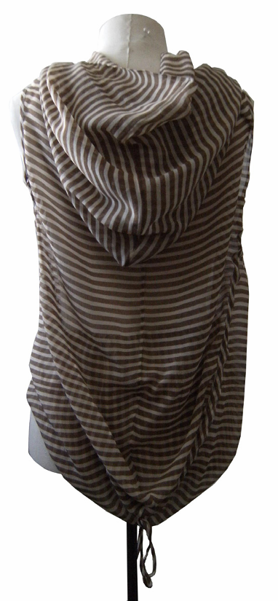
What is the best way to document prototypes to allow the designer to evaluate, improve, extend?

Slide 18
An examination of the methods and processes used by fashion design practitioners, as in the case of the examples discussed, could allow for the development of appropriate models for framing fashion design research.

Slide 19
The future for new and emerging researchers in the discipline of Fashion design appears to depend on the development and acceptance of a set of research methods that support rigorous inquiry and the dissemination of findings in an appropriate manner. The development of new methodologies, building on the accepted work of predecessors in Visual Arts, Education and Architecture, may be beneficial in advancing the development of a distinctive style that speaks most effectively and directly to readers from within the discipline of fashion design; ultimately those who would benefit most from the resultant research, as well as to researchers in the wider academic community.

Slide 20
Reference List Brewer, J & Hunter, A. (1989). Multimethod research: a synthesis of styles. Newbury Park, California: Sage. Gray, C., & Malins, J. (2004). Visualizing research: A guide to the research process in art and design. Aldershot, Hants: Ashgate Publishing Limited. Guba, E., & Lincoln, Y. (1985). Naturalistic inquiry. Newbury Park, California: Sage. Kirke, B. Madeleine Vionnet. California: Chronicle Books LLC. Mitchell, M. T. (2006). Michael Polanyi: The art of knowing. Wilmington, Del.: ISI Books.

Slide 21
Thank You

