Slide 1
Housing Affordability
Presentation 12 November 2008

Slide 2
Impact of Shifting Demographics: Implications for Housing Requirements and Public Policy
Gary Garner & Hoon Han
Gary Garner Lecturer, Property & Urban Development Queensland University of Technology School of Urban Development Faculty of Built Environment & Engineering. Phone: 07 3138 5327 g.garner@qut.edu.au | Dr Jung Hoon Han Postdoctoral Research Fellow Australian Housing and Urban Research Institute The University of Queensland Queensland 4072 07 3346 9689 jh.han@uq.edu.au

Slide 3
Preliminary Findings Related to the Conceptualisation, Sensitivity & Measurement of Holding Costs & Impact on Housing Affordability
International Cities Town Centres & Communities Society
ICTC 2008
Sydney Olympic Park, Sydney, Australia
7 – 10 October, 2008
Gary Owen Garner
Lecturer in Property & Urban Development, Queensland University of Technology,
Manager Regional & Urban Economic Strategies, THG Resource Strategists

Slide 4
The Impact of Planning Delays & Other Holding Costs on Housing Affordability
“Looking Forward Outback” - PIA QLD State Conference, Longreach
17-19 September 2008
Gary Owen Garner
Lecturer in Property & Urban Development, Queensland University of Technology,
Manager Regional & Urban Economic Strategies, THG Resource Strategists

Slide 5
Significance of Housing Affordability
Availability of affordable housing “central to supporting a decent life - entailing the maintenance of stable households connected to the main institutions in our society – jobs, services, family and social networks” (Berry, 2002).
Consistent with “overwhelming evidence that housing has a significant influence on, and is a significant driver of, life fulfilment and quality of life” (Garner, 2006).

Slide 6
Historical context of Housing Affordability in Australia
Affordability emerged as part of the policy language in the 1980’s (Gabriel et al., 2005)
a response to mortgage interest rates of the order of 17 per cent and a housing price boom.
used to inform policy reports such as the National Housing Policy Review and, later, the National Housing Strategy (1991).
Over last few years has re-emerged again as a consequence of
rising house prices placing pressure on lower income households and,
increasingly, middle income households seeking to purchase their first home.
Affordability:
same problem,
different causes

Slide 7



The Issue of Holding Costs
Housing affordability - increasing prominence despite strong economic growth and prosperity.
A major consideration for any new development.
Multi-dimensional, complex and interwoven.
One impact factor is holding costs.
The nature and extent of its impact requires clarification.
its contribution may be of greater significance than commonly held - especially where the time taken for regulatory assessment is excessive.

Slide 8
The Impact
Preliminary analysis suggests even small shifts in the regulatory assessment period can significantly affect housing affordability.
Other costs associated with “holding” also impact housing affordability, however these costs cannot always be easily identified.
The real impact is felt by those whom can least afford it - new home buyers can easily pushed into un-affordability.

Slide 9

Mortgage Stress Defined
The 30/40 rule: Such low income households are considered to place themselves in a position of “housing stress”.
More generally described as “Mortgage Stress” - the situation in which homebuyers are paying 35 per cent or more of their income on home loan repayments (Kryger, 2003).
An alternative definition, adopted by the National Housing Strategy, is based on the proportion of income paid for housing by income units in the lowest 40 per cent of the income distribution range.
Definitions of mortgage stress apply the general rule that financial institutions will not allow a household to take out a housing loan if the monthly home loan repayment, calculated over a 25 year term exceeds one-third of monthly household income.

Slide 10
Mortgage Stress.. Not all as it may seem
Not all households paying 30-35 % or more of their income in loan repayments are necessarily experiencing stress
can be demonstrated that someone on a very high income who has chosen to have a very large mortgage and still has a lot of money to live on after that could technically be defined as being in stress if you just used the 30 per cent rule
therefore, the definition of mortgage stress should refer to the bottom 40 per cent of income earners who were spending more than 30 per cent of their income on home loan repayments
mortgage stress refers particularly to the high risk that a stressful situation might arise.

Slide 11
Some reasons for poor affordability
Gen Y expectations
Baby Boomer expectations…

Slide 12
Where do old people live?
The thematic map shows the proportion of people aged over 65 years by SLA in South East Queensland Region.
The range of the proportion is from 1.6 per cent to 38.1 per cent
The darker SLA refers to a higher proportion where older people live

Slide 13
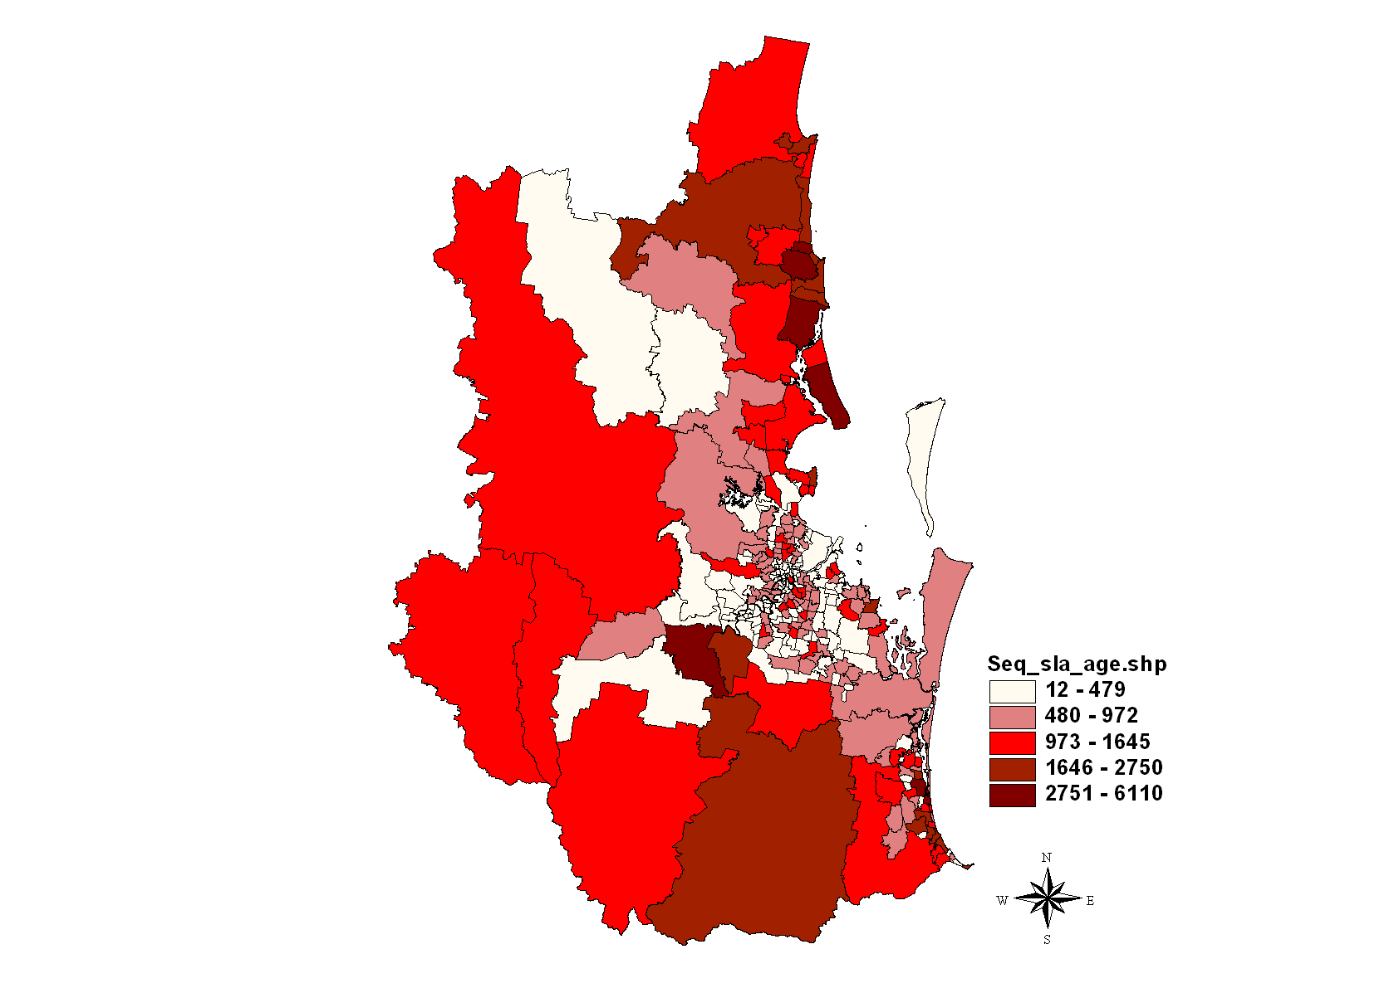
Numbers of older people

Slide 14
Heavy concentrations (proportions and numbers)
Sea change / coastal areas
Semi-rural / rural
Metropolitan

Slide 15
Where do old people live?
The thematic map shows the proportion of people aged over 65 years by SLA in Brisbane metropolitan region.
The range of the proportion is from 1.6 per cent to 38.1 per cent
The darker SLA refers to a higher proportion where older people live

Slide 16
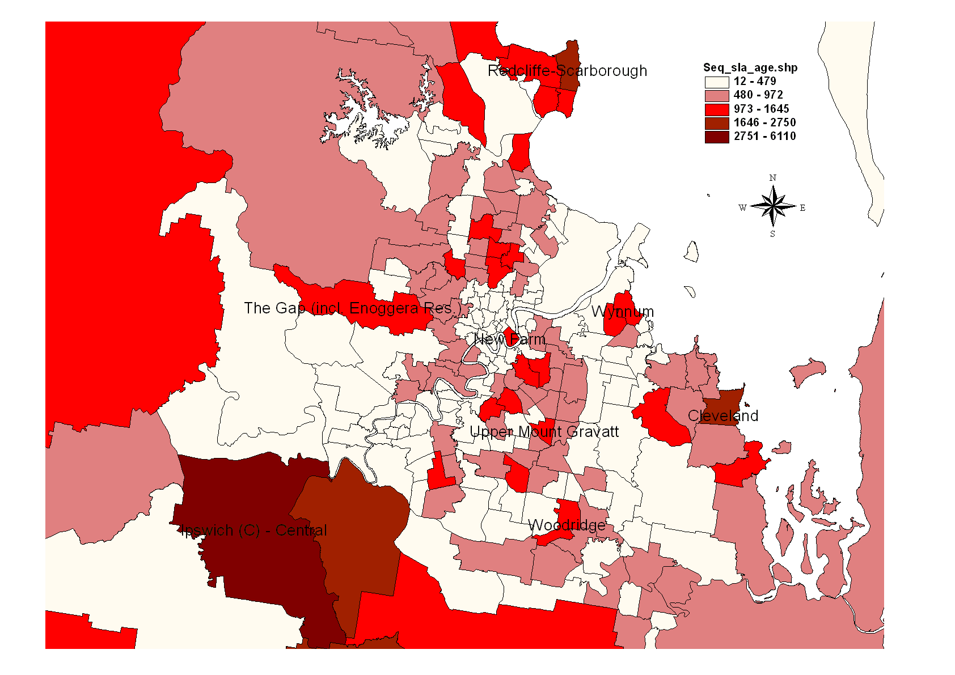
Numbers of older people

Slide 17
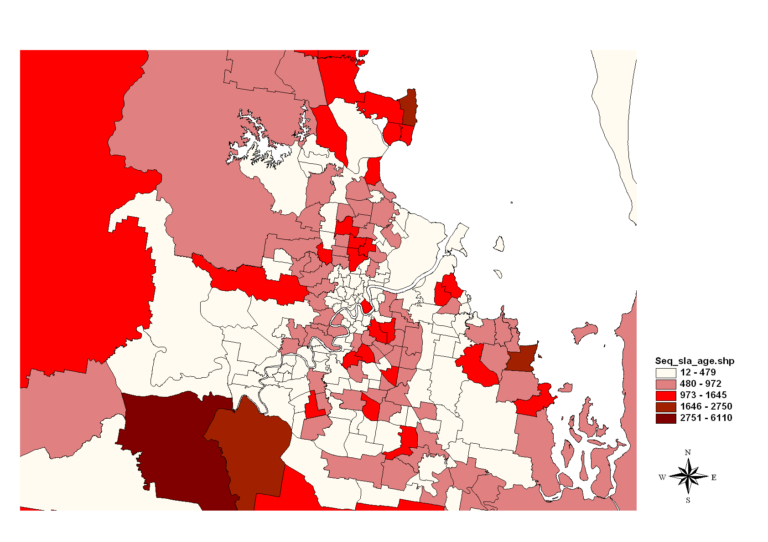
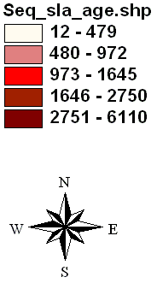
Heavy concentrations (proportions and numbers)
Redcliffe-Scarborough
Brighton
Aspley-Chermside-Kedron-Everton Prak
Sea change / coastal
Suburban (middle ring / outer)
Wynnum
Suburban (inner) / urban renewal
New Farm
Coorparoo – Camp Hill
Moorooka - tarragindi
Cleveland-Victoria Point
Upper Mt Gravatt
Woodridge
Ipswich

Slide 18
Sea change
Traditional – remain in “older inner suburb”
Traditional – change to or remain in “middle ring” or outer suburb
Traditional – remain in outer metropolitan or semi-rural
Heavy concentrations (proportions and numbers)
Redcliffe-Scarborough
Brighton
WHY?
Aspley-Chermside-Kedron-Everton Prak
Sea change / coastal
Suburban (middle ring / outer)
Wynnum
Suburban (inner) / urban renewal
New Farm
Coorparoo – Camp Hill
Moorooka - tarragindi
Cleveland-Victoria Point
Upper Mt Gravatt
Woodridge
Ipswich

Slide 19
Heavy concentrations (proportions and numbers)
WHY?
The “middle ring”: Very few older people

Slide 20

Preliminary Economic Model Examining the Effects of Time for a Property Development project
Preliminary Findings Related to the Conceptualisation, Sensitivity & Measurement of Holding Costs & Impact on Housing Affordability

Slide 21
Assumptions
Interest rate (cost) - 9.00%
Development Timing: (all post Identification of suitable site and site purchase)
Assessment period: Planning & Building Consents including DA – typically 18 months
Funds raising (debt and / or equity) 3 months
Construction and development 9 months
Total development time from acquisition - 30 months
Undeveloped Land Cost - $37,500 per lot equivalent based on gross yield area
Acquisition costs - 3% of acquisition and land costs per lot p.a
Development Costs, $75,000 per lot
Interest Costs on development - based on 30% of total development period = 9 months @ 9%
Selling Costs @ 4.7% gross realisation
Developers Margin - 20% of Total costs
Gross realisation = $165,000 per lot.

Slide 22
BASE CASE SCENARIO | Assumptions used |  | Gross | Per Lot
Interest rate (cost) | 9.00% | per annum
Development Timing: | Base Case
Identification of suitable site and site purchase | 0.00 | months
Planning & Building Consents including DA | 18.00 | months |  | 18
Funds raising (debt and / or equity) | 3.00 | months
Construction and development | 9.00 | months
Other | 0.00 | months
TOTAL development time from acquisition | 30.00 | months
Undeveloped Land Cost |  |  | $7,500,000 | $37,500
Acquisition costs | 3.00% |  | $225,000 | $1,125
 |  |  | $7,725,000 | $38,625
Loss of Interest over a development period of | 30 | months | $1,857,189 | $9,286
Number of lots | 200
Rates, special council charges and land tax say (% of acquisition and land costs per lot p.a.) | 3.53% |  | $681,828 | $3,409
Development Costs, say | $75,000 | per lot | $15,000,000 | $75,000
Interest Costs on development - based on (30% of total development period) | 9 | months @ 9% | $1,001,516 | $5,008
Total Development costs including interest |  |  | $18,540,533 | $92,703
Total Costs of Development incl. acquisition |  |  | $26,265,533 | $131,328
Developers Margin | 20% | of Total costs | $5,253,107 | $26,266
Sale price before selling costs |  |  | $31,518,639 | $157,593
Selling Costs @ | 4.7% |  | $1,481,376 | $7,407
Gross realisation |  |  | $33,000,016 | $165,000
TOTAL HOLDING COSTS FOR PROJECT |  |  | $2,858,705 | $14,294

Slide 23
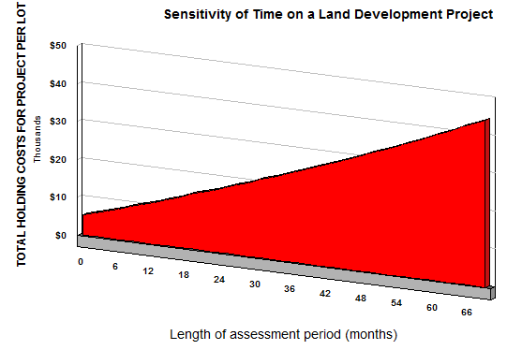

Slide 24
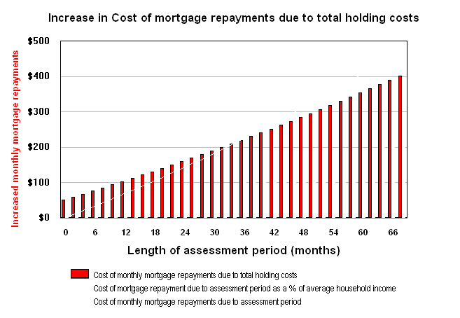

Slide 25
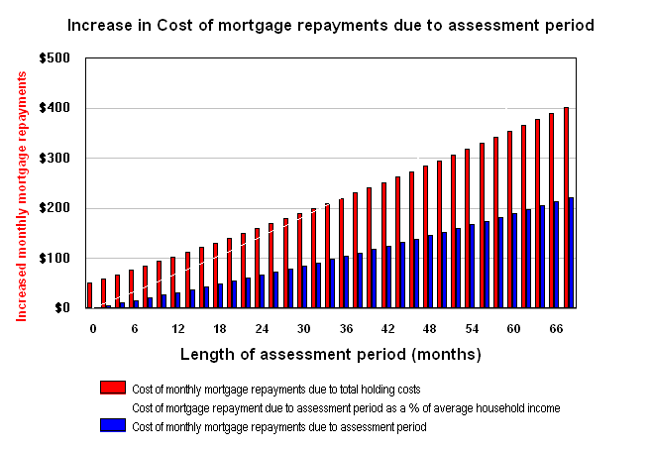

Slide 26
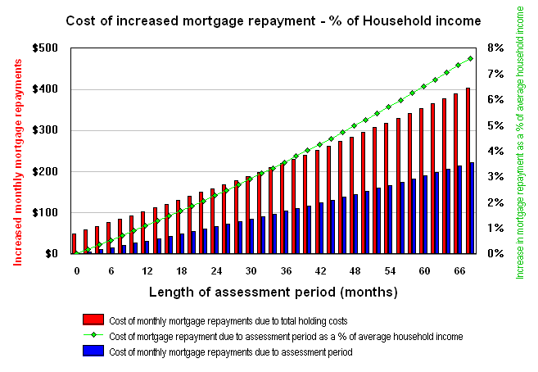

Slide 27
Preliminary Results
Assumptions having greatest impact include interest rates & development timing (incorporating holding period).
Typical (“base case”) scenario: total holding costs equate to approximately $15,000 per lot (assuming 18 months regulatory assessment)
For every month the assessment time is delayed, the end-user will pay approximately an extra $500 more.
If time reduced by 6 months, holding costs reduce to just over $11,000 per lot.
If time is increased by 6 months, holding costs increase to $17,000 per lot.
If timeframes are further extended (exceeds 5 years), holding costs could climb to $40,000 per lot and beyond
Effectively raises average cost of each allotment from $165,00 (Base model assumption) to over $200,000

Slide 28
Affordability: quantum of additional costs and impact upon the end-purchaser
Since new home buyers typically obtain finance to complete their purchase, if the cost of acquisition rises, then so does their mortgage.
Therefore, impact can be based on calculating the additional monthly mortgage repayment required to cover the costs of extended assessment
The impact of these costs can then be examined in terms of average household income.
In this way, the impact of assessment time can be directly related to housing affordability since it is looked at in the context of the “30/40 affordability rule”

Slide 29
Interest rate impact
Preliminary Findings Related to the Conceptualisation, Sensitivity & Measurement of Holding Costs & Impact on Housing Affordability

Slide 30
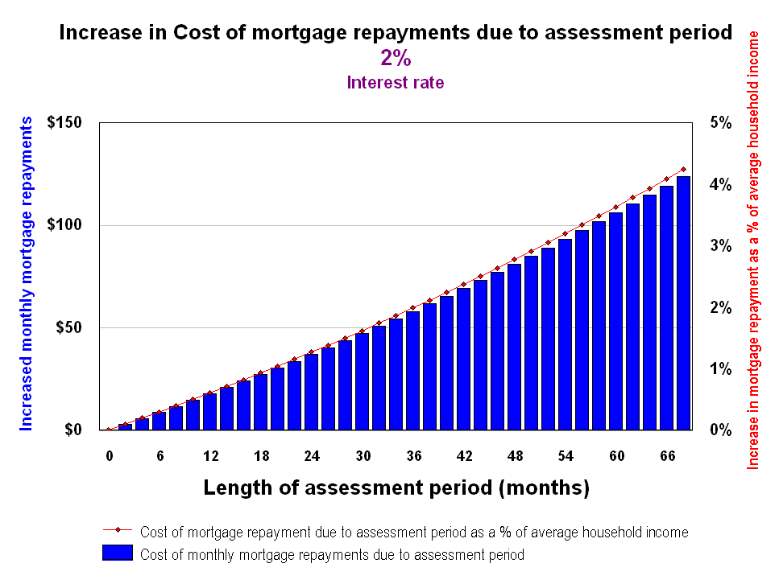

Slide 31
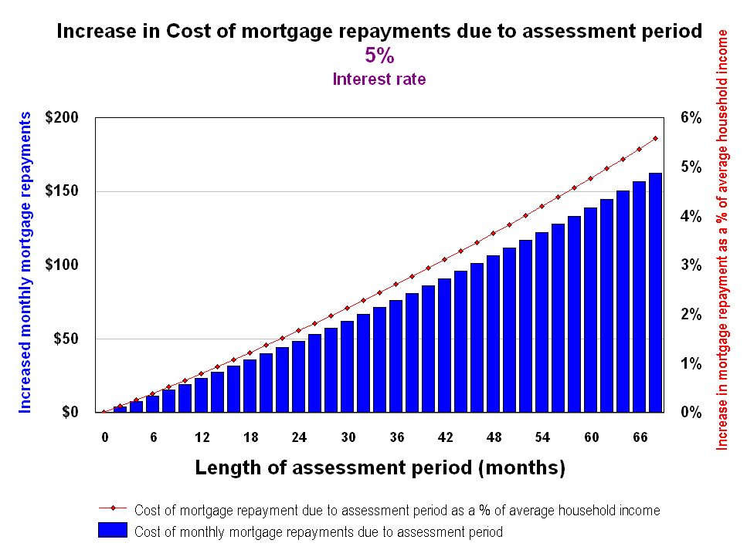

Slide 32
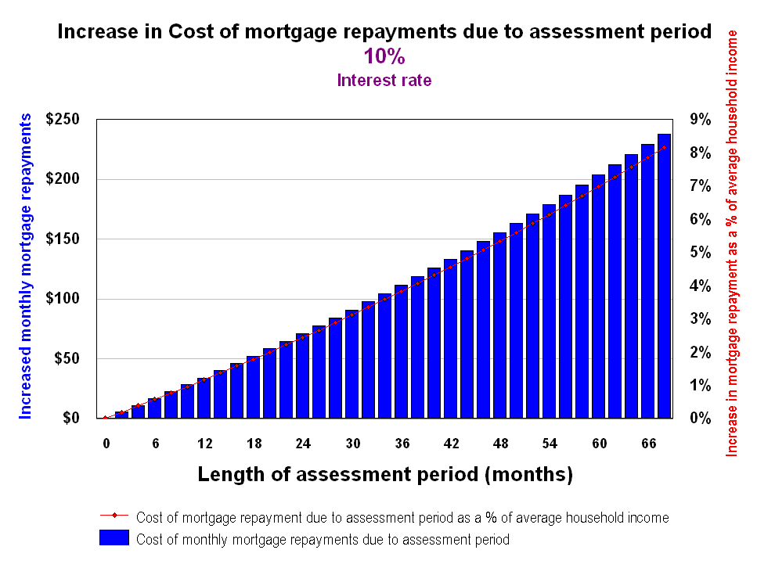

Slide 33


Slide 34


Slide 35
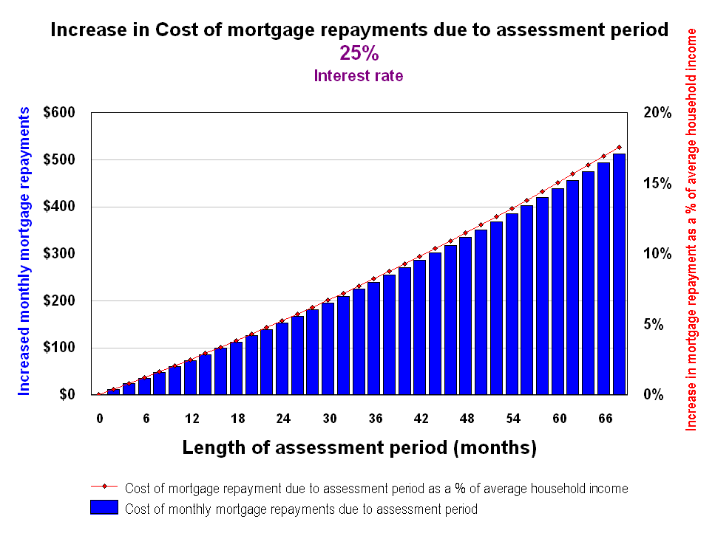

Slide 36
Increased Costs and Housing Affordability – Measurement of the Impact Upon Mortgages
Percentages would be even higher for those in the bottom 40% of household income distribution - in concert with the “30/40 affordability rule”.
Such consumers (especially first home buyers) are therefore potentially pushed into the realms of un-affordability and mortgage stress.
Even a 6 month reduction in assessment period equates to a approximately 2% reduction in the percentage of household income devoted to mortgage repayments.
This highlights that even small shifts in assessment period can significantly affect housing affordability, and emphasises the need for timely processing by regulatory authorities.

Slide 37
Conclusions
housing affordability - a complex issue even narrowed to holding cost impact
has many facets and requires a multi-dimensional approach
whilst recognising that holding costs are only one contributor, it is nevertheless clearly significant.
Research is indicative only with regards the potential impact of holding costs - but the implications have clear potential for mortgage stress
Various models utilised for both defining and measuring holding costs
ultimate conceptualisation relying upon derivations of the Present Value / discounting approach.

Slide 38
Conclusions
Elements of holding cost have linkages with regulatory assessment periods
A few ambiguities emerge as a result of this research indicating evidence that there can be opposing effects.
More research required into it’s underlying nature and effects including analysis over time.
Analysis is also required across multiple regional areas, case study analysis and cross-referencing with a international comparison study. This needs to be conducted over time (the issue of housing affordability itself has a space and time variance).

Slide 39
You Tube documentary
And what about the impact from the sub-prime mortgage debacle?
http://au.youtube.com/watch?v=5OtKt3ezHY0

