Slide 1

Critical Thinking and the Education of Psychologically Literate Citizens
Diane F. Halpern and Heather A. Butler
Claremont McKenna College

Slide 2

The Need for Psychological Literacy
It’s a complex and technical world
Average users spend 12 hours a week on the internet (Kerr, 2009)
Information is literally at our fingertips
Both Good AND Bad
Are our students prepared?

Slide 3
Call for Educational Reform
Academia scrutinized; Public demands accountability
Most faculty are not teaching for transfer
What should our graduates know?
What should our graduates be able to do?

Slide 4
Psychological Literacy
Knowledge about psychological concepts
Willingness and ability to think scientifically
McGovern et al. (2010)
Psychological Literacy and Critical Thinking are overlapping constructs

Slide 5
Psychological Literacy
having a well-defined vocabulary and basic knowledge of the critical subject matter of psychology;
valuing the intellectual challenges required to use scientific thinking and the disciplined analysis of information to evaluate alternative courses of actions;
taking a creative and amiable skeptic approach to problem solving;
applying psychological principles to personal, social, and organizational issues in work, relationships, and the broader community;
acting ethically;
being competent in using and evaluating information and technology;
communicating effectively in different modes and with many different audiences;
recognizing, understanding, and fostering respect for diversity; and
being insightful and reflective about one’s own and others’ behavior and mental processes.

Slide 6
Critical Thinking
Critical Thinking (Halpern, 1998; 2003)
the use of cognitive skills or strategies that increase the probability of a desirable outcome.
purposeful, reasoned, and goal-directed thinking
involved in successful problem solving, formulating inferences, calculating likelihoods, and making decisions
Critical thinking is a skill and a disposition

Slide 7
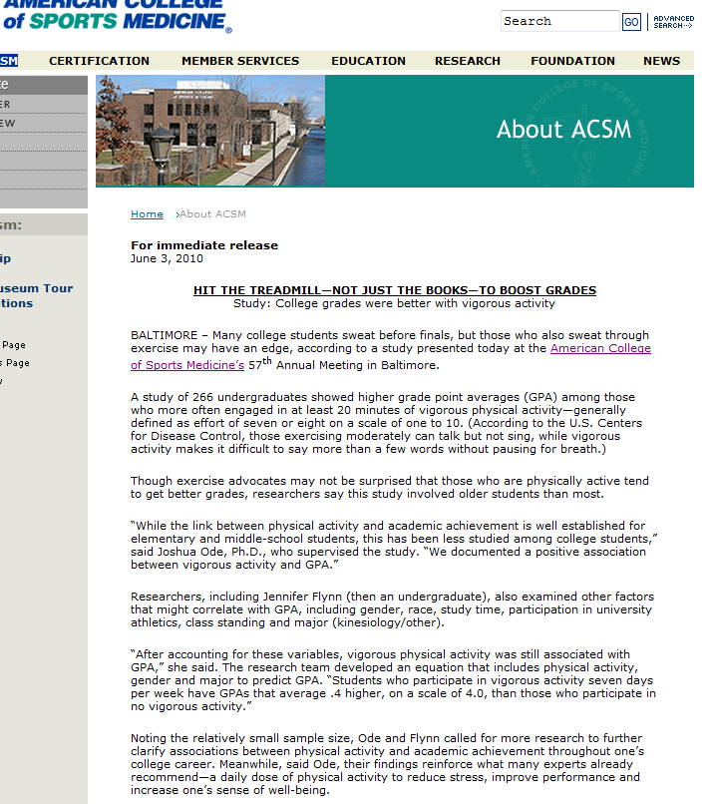

Slide 8
Critical Thinking and Psychological Literacy
Psychological Literacy consists of content knowledge of psychology and critical thinking

Slide 9
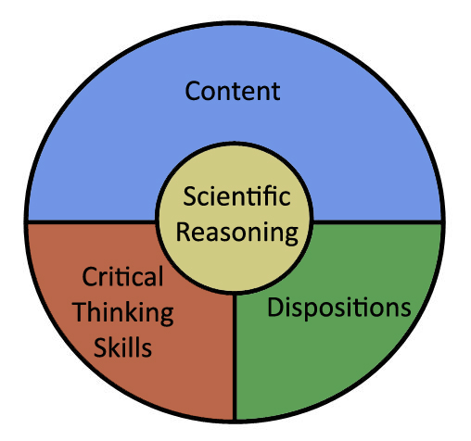
Psychological Literacy

Slide 10
Teaching Psychological Literacy
Halpern (1998; 2003) four-part model for teaching critical thinking:
Explicitly learning critical thinking skills
Developing a disposition or attitude toward effortful thinking and learning
Direct learning activities with the goal of transfer
Making metacognitive monitoring explicit

Slide 11
Teaching Psychological Literacy
Teaching critical thinking skills
Recognize semantic slanting and guilt by association
Seeking out contradictory evidence
Making RISK: BENEFIT assessments
Understand basic research principles
Synthesize information from a variety of sources

Slide 12
Teaching Psychological Literacy
Encouraging a Critical Thinking Disposition
Encourage students to plan ahead
Be flexible and avoid dogmatic thinking
Be persistent in solving complicated problems
Be willing to self-correct, admit error, and change their mind
Be mindful of what and how they are thinking

Slide 13
Teaching Psychological Literacy
Teaching for transfer
Draw a diagram or other organizing, graphic display
Explain why a particular answer was selected
What was the second best choice, and why?
State the problem in at least two ways
List two solutions to a problem
Identify the persuasive technique being used

Slide 14
Teaching Psychological Literacy
Encouraging Metacognitive Monitoring
Require students to:
Identify the strategies they use to solve problems
Explain their reasoning
Explain how they allocated their resources
Evaluate evidence that supports and refutes the argument.

Slide 15
Scientific Reasoning
The skills needed to think critically and be psychologically literate overlap with the skills needed for scientific reasoning.
Using the scientific method to evaluate research and design new studies.

Slide 16
Assessing Psychological Literacy
The assessment of learning outcomes is key
Global need for assessment Redden (2010)
Europe (47 countries) - The “Bologna Process”
African Union
Latin American
Caribbean Higher Education Area
United States

Slide 17
Assessing Psychological Literacy
What might the assessment include?
Evaluation of scenarios related to a variety of psychological knowledge
Should I try the new weight loss drug?
Will the Baby Einstein videos make my child smarter?
If I serve as a juror on a case that involves an eyewitness, can I assume the eyewitness is credible?

Slide 18
Contact Information
Dr. Diane F. Halpern
Trustee Professor of Psychology
Claremont McKenna College
850 Columbia Ave.
Claremont, CA 91711
(909) 607-9647
Diane.Halpern@cmc.edu
WWW.DianeHalpern.com

