Slide 1
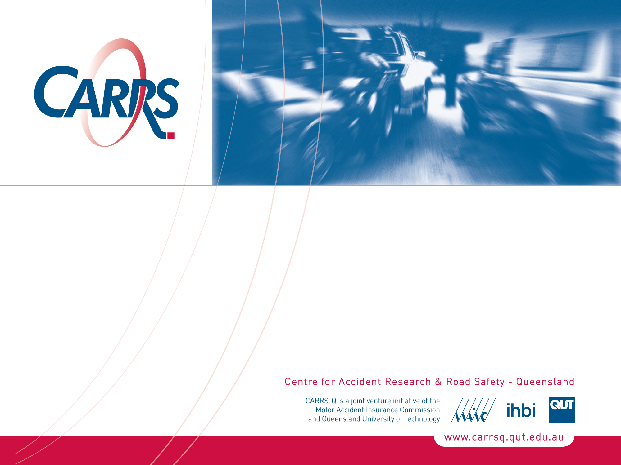
Interactions between pedestrians and cyclists in the city centre
Narelle Haworth
Amy Schramm
Asia-Pacific Cycle Congress, 2011
CRICOS No. 00213J

Slide 2
Background
CRICOS No. 00213J
Density of cars, pedestrians and cyclists is high in city centres
Pedestrian concerns about injury threat from cyclists but little data
Relevance for Brisbane
Queensland allows footpath cycling by adults
CityCycle scheme aims to increase riding in city centre
Notes:
Participation has increased as a result of rising fuel costs, health and environmental concerns, increased traffic congestion and government initiatives.
The introduction of the CityCycle scheme may increase the number of cyclists (particularly inexperienced cyclists), in an area where there is motor vehicle and pedestrian high density.
2

Slide 3
Aims of the research
Observe bicyclist-pedestrian interactions
Measure amount of road and footpath cycling
Understand rider and location factors contributing to footpath cycling
Provide baseline data for future assessment of CityCycle scheme

Slide 4
Data collection
46 observation periods in October 2010
2-hour periods on weekdays
7-9 am, 9-11 am, 2-4 pm, 4-6 pm
All observations in dry weather
1992 cyclists observed
Notes:
The observations were conducted on Monday 4 October to Thursday 7 October 2010 from 7-9am, 9-11am, 2-4pm, and 4-6pm to capture commuter cycling as well as the short trips that are the target of the CityCycle scheme. This period was during the school term and did not include any public holidays. It was the first week of the introduction of the CityCycle scheme but relatively few pods and bicycles were operational. The weather was fine on all days of the study.

Slide 5
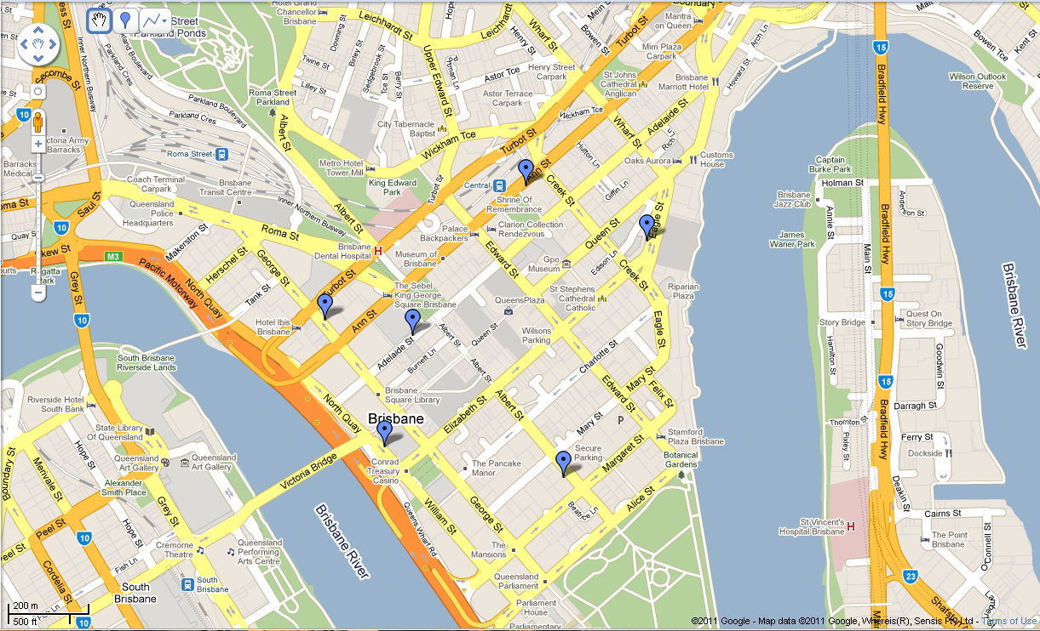
Observation sites
One- or two-way traffic, bike markings or not
Notes:
Trained observers counted cyclists at six CBD locations selected in terms of width of footpath, presence or absence of on-road bicycle facilities, one-way or two-way traffic and pedestrian volumes. These locations were Ann St outside Central Railway Station, Eagle St opposite Riparian Plaza, Adelaide St outside City Hall, George St between Ann and Turbot Sts, William St outside the Old Treasury Building and Albert St between Margaret and Mary Sts. All are near CityCycle stations, and considered to be routes to key points in the city.

Slide 6
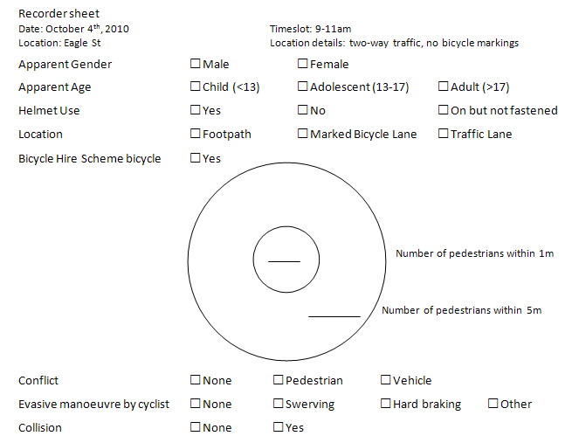
Observation sheet
Notes:
A simple form was developed for recording observations (see Appendix). The variables collected for each cyclist included: apparent gender, apparent age (child, adolescent, adult), helmet use; and location of cyclist (road or footpath). The number of pedestrians within a 5 metre radius was estimated as a measure of pedestrian density and the number of pedestrians within 1 metre of the cyclist was counted as an indicator of potential for collision. The number of cyclist conflicts with motor vehicles and pedestrians (e.g. evasive manoeuvres such as swerving or hard braking) was noted.
Given that whether they were on the road or on the footpath and the presence of pedestrians could change as cyclists rode along, observers were instructed to draw an imaginary line across the footpath and street and only record data as cyclists passed that line. Observers recorded only those cyclists who were riding at the time, no records were made of people walking bicycles.

Slide 7
General characteristics
Average cyclist volumes:
7-9am = 26/hr ▪ 4-6pm = 33/hr
9-11am = 11/hr ▪ 2-4pm = 14/hr
86% male
98% adults, 2% adolescents
1.1% no helmet, 1.3% not fastened
22% rode on the footpath
1.2% were riding a CityCycle bicycle
Notes:
Preliminary analysis of the data – yet to do site comparisons.

Slide 8
Proximity of pedestrians

Slide 9
Conflicts
1.1% cyclists had conflict with a pedestrian; 0.6% had conflict with a vehicle
76% of conflicts with pedestrians occurred on the footpath
Adolescents and riders not correctly wearing helmets over-represented
No collisions were observed

Slide 10
Discussion
Useful method
Relatively few conflicts with pedestrians and vehicles, despite pedestrian and vehicle volumes
Conflicts with pedestrians more likely on the footpath, vehicle conflicts exclusively on the road
Adolescents and riders not correctly wearing helmets
Notes:
While not a category on the record, some enthusiastic observers noted if a bicycle was travelling against the traffic flow – indicating some cyclists use the footpath to continue along the most direct route, and negotiate the one-way streets in the CBD.
The differences in gender may reinforce the idea of different perception of risk. Willingness to travel on the footpath may also reflect desired travel speed – research from Japan indicates that bicycles travelling on the footpath reduce speeds, dependent on pedestrian volume.

Slide 11
Future Work
Follow-up surveys to measure the effects of the CityCycle scheme on bicycle use in the CBD
Extend to school holidays to observe more adolescents

Slide 12
Questions?
Mark your Diaries!
International Council on Alcohol, Drugs and Traffic Safety Conference (T2013)
August 2013, Brisbane Convention and Exhibition Centre

