Slide 1





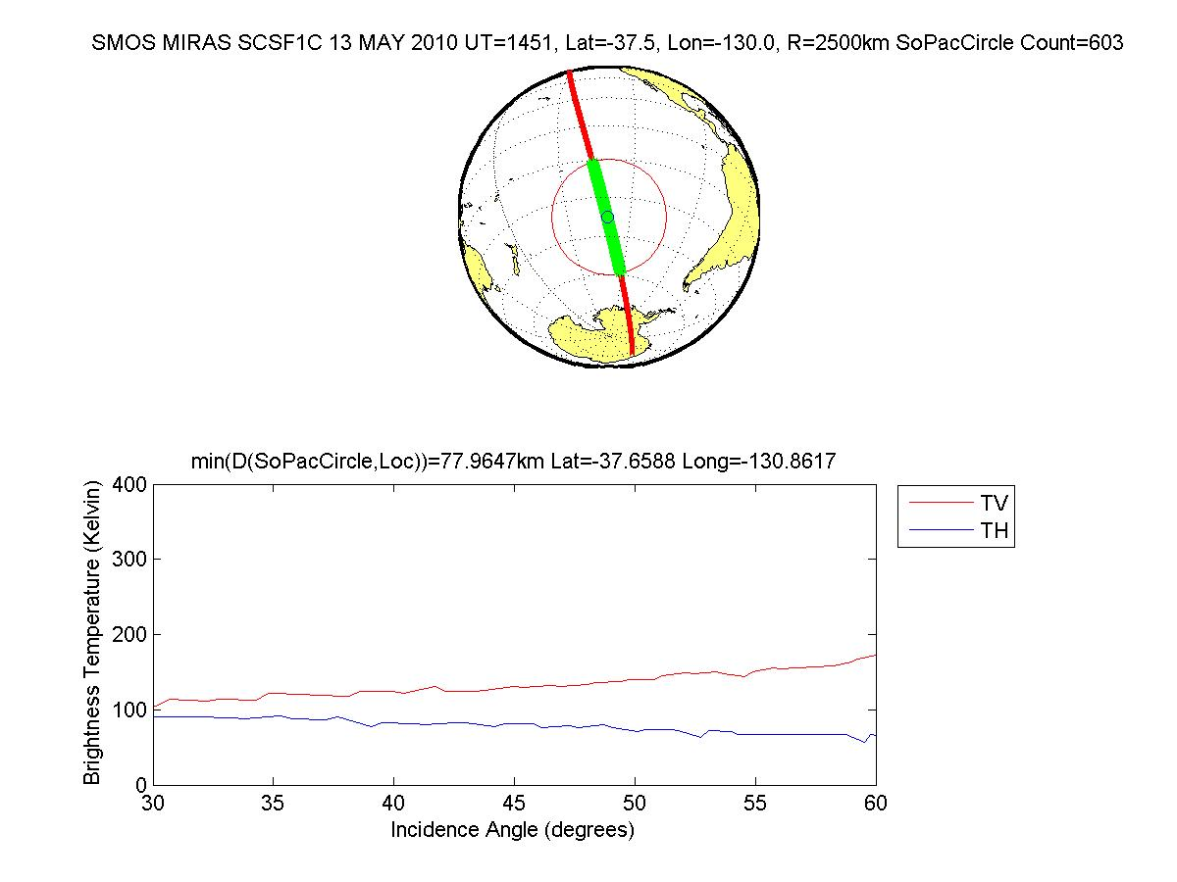
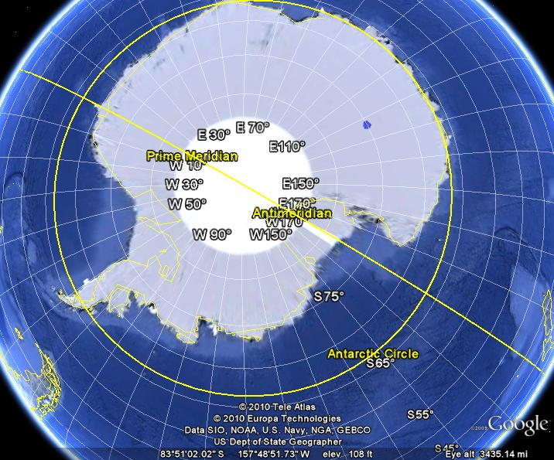
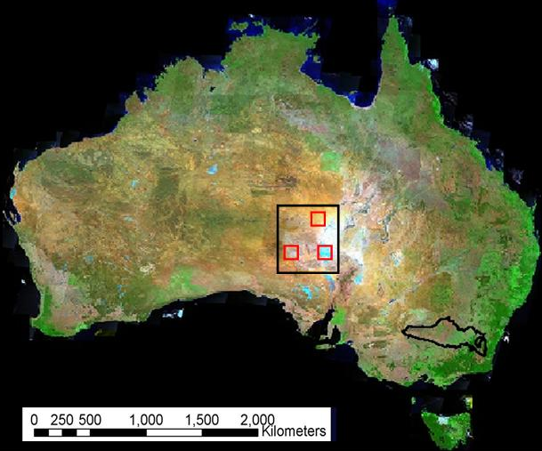
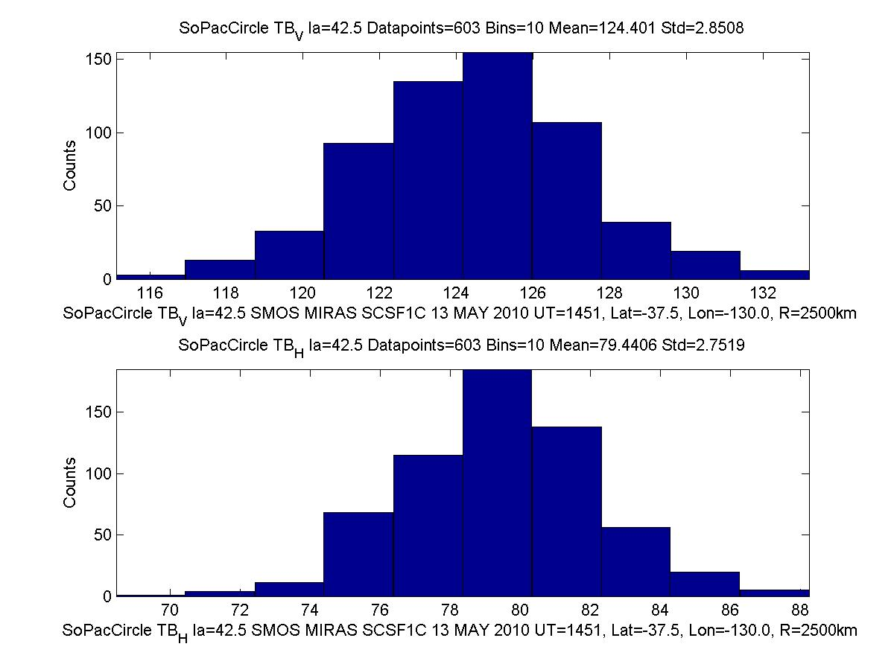
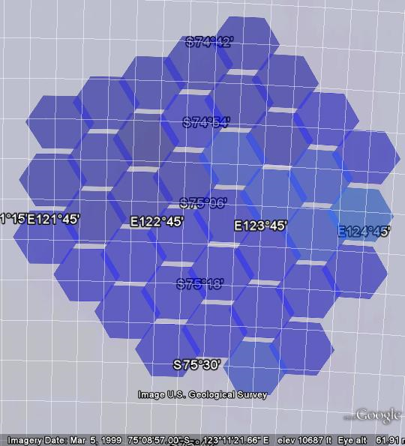
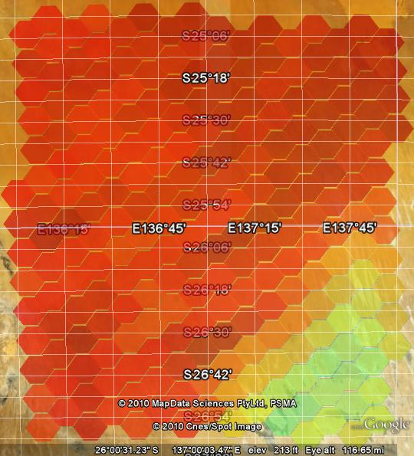
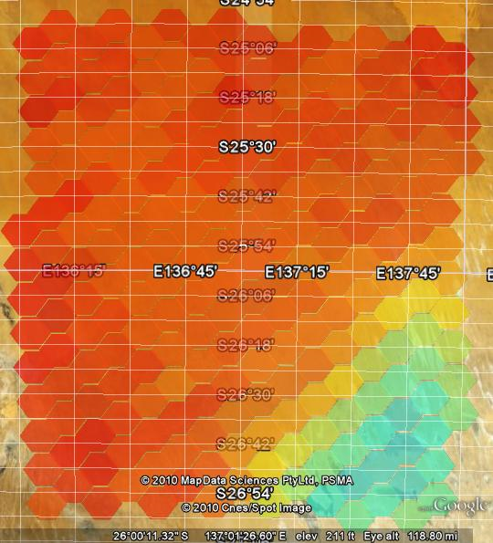
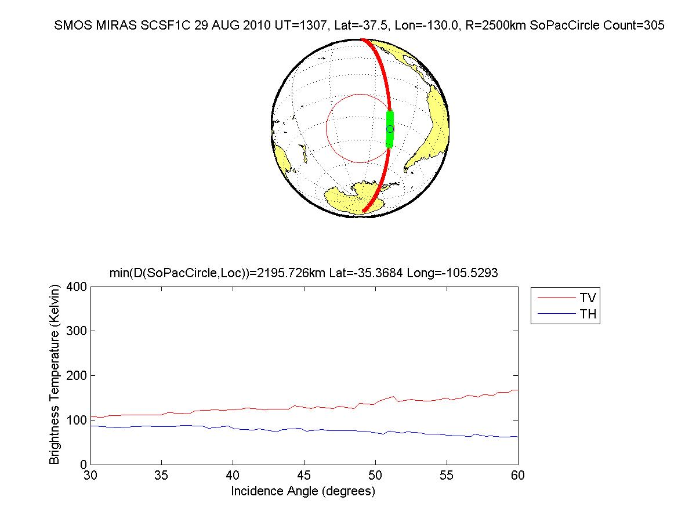
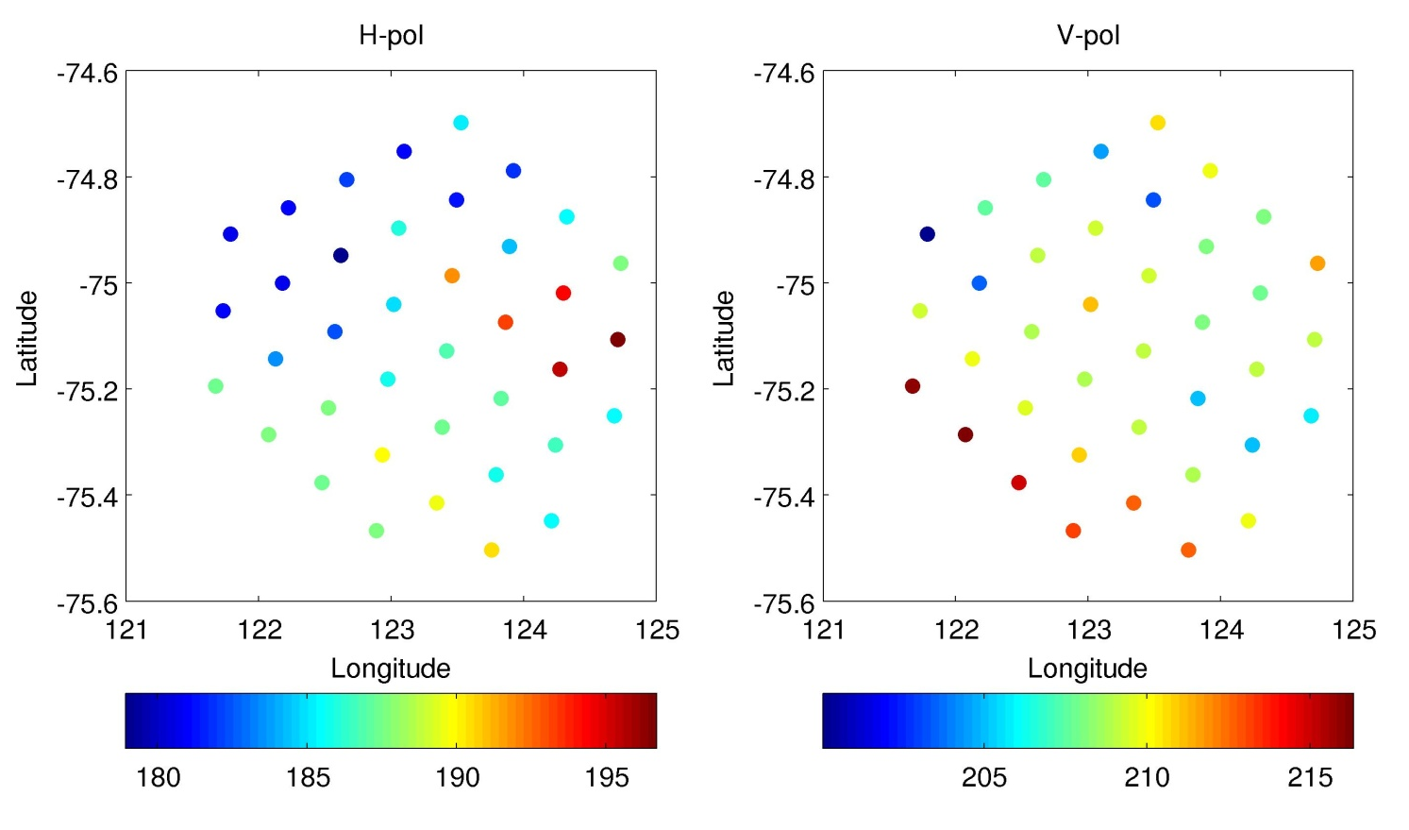
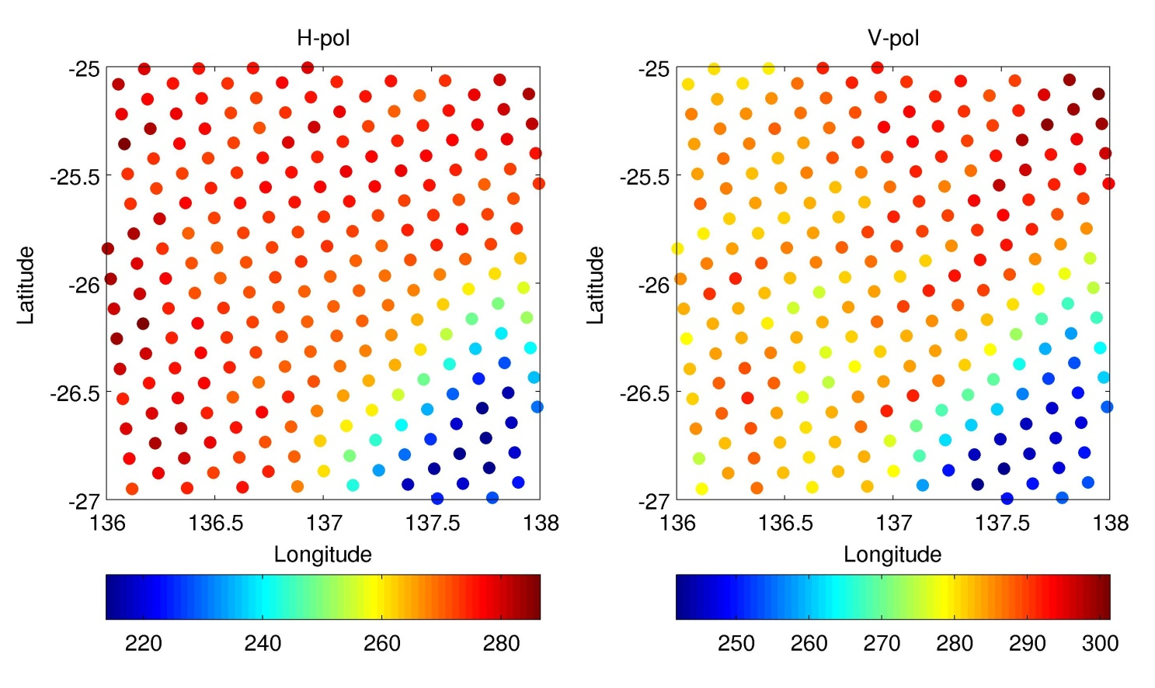
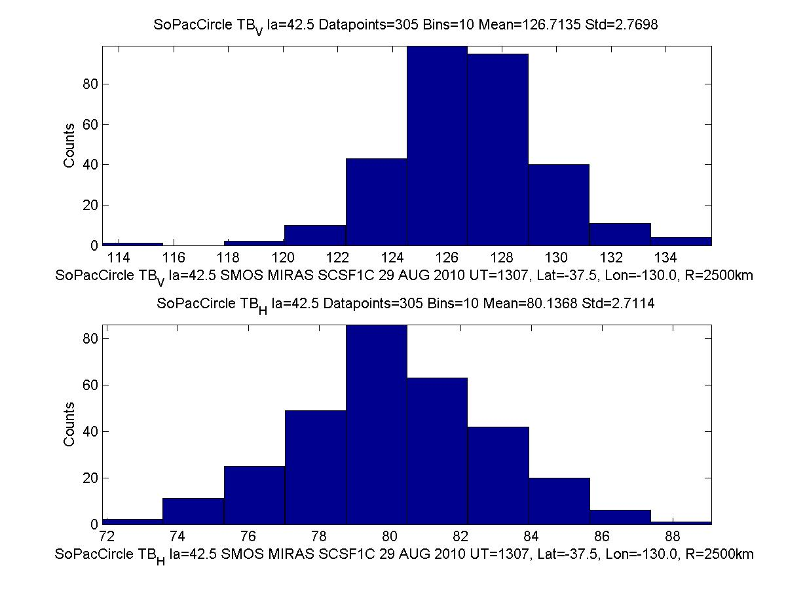
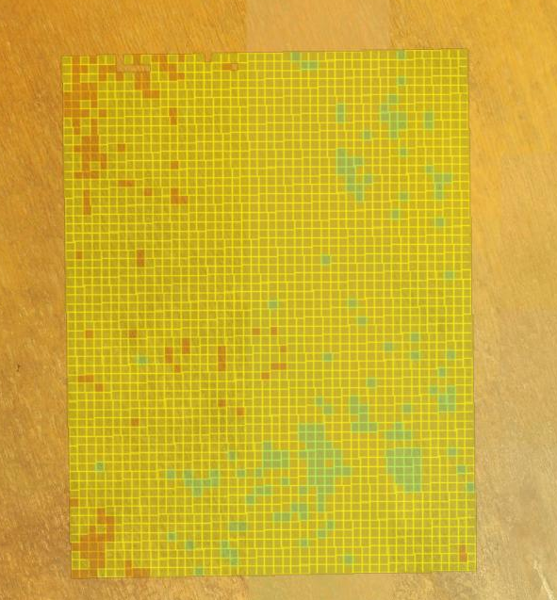
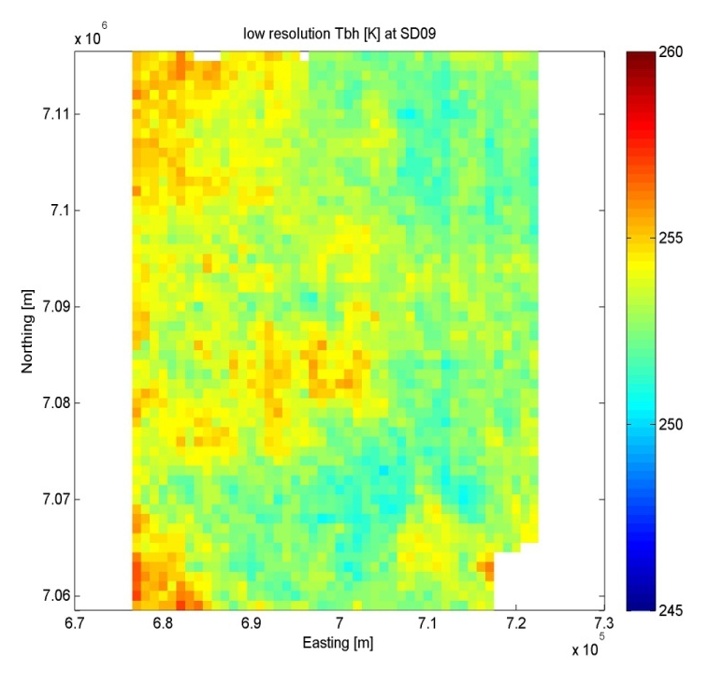
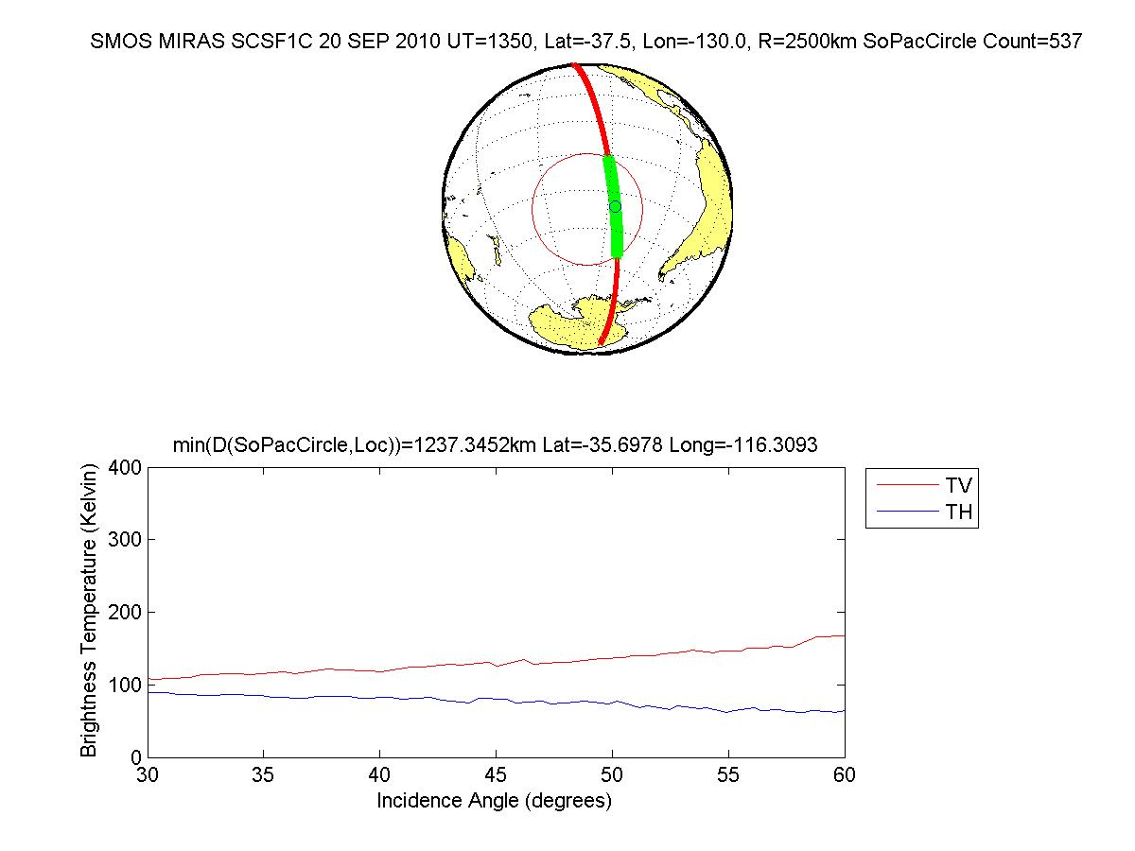
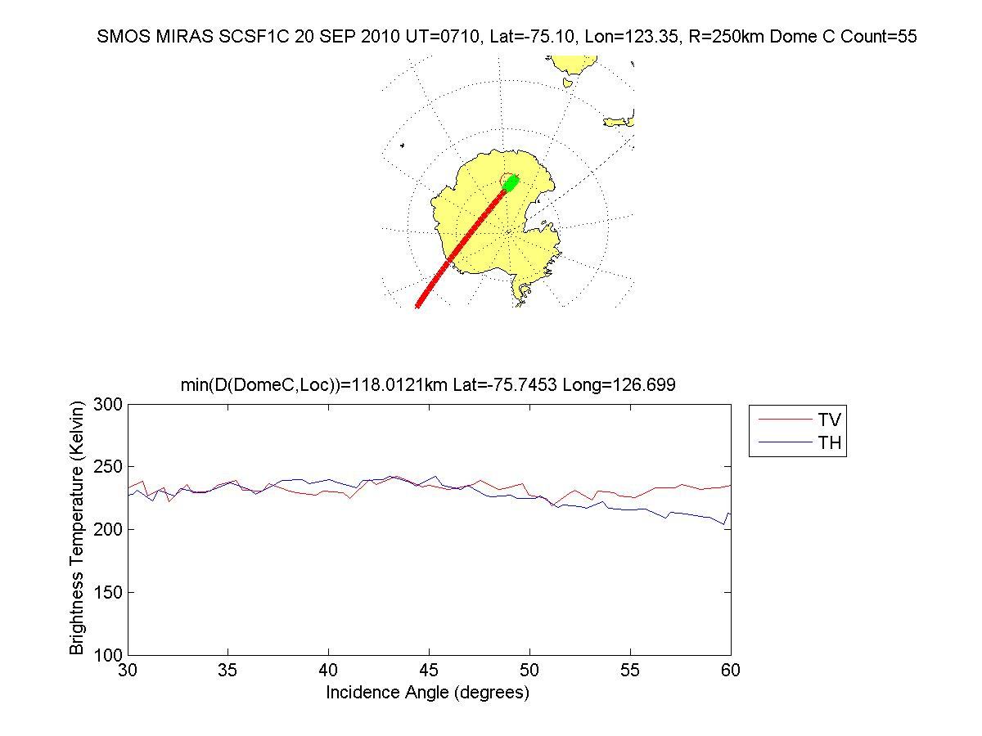
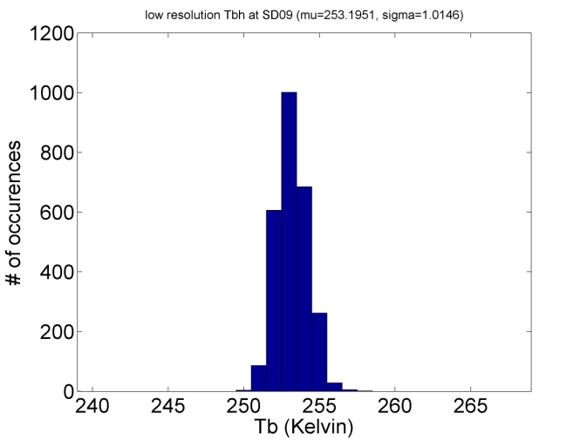
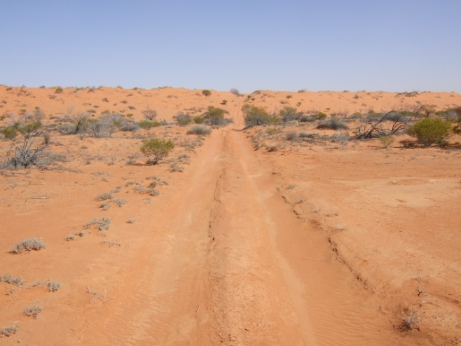
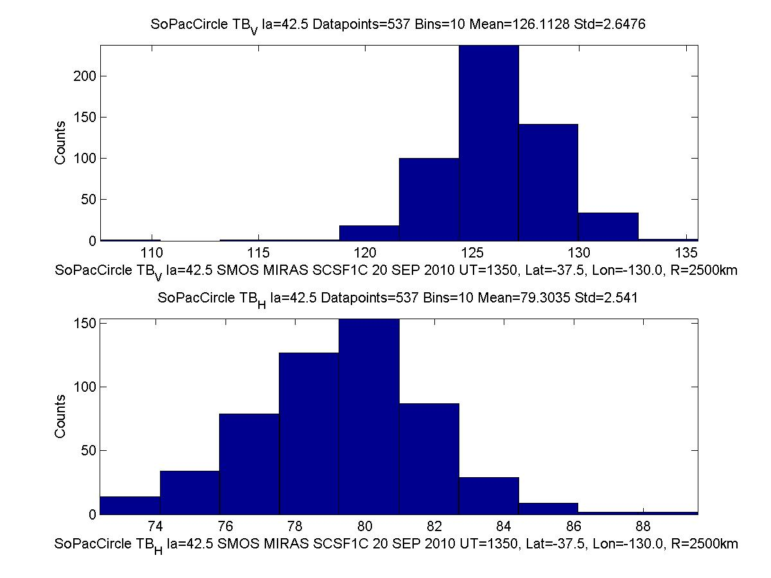
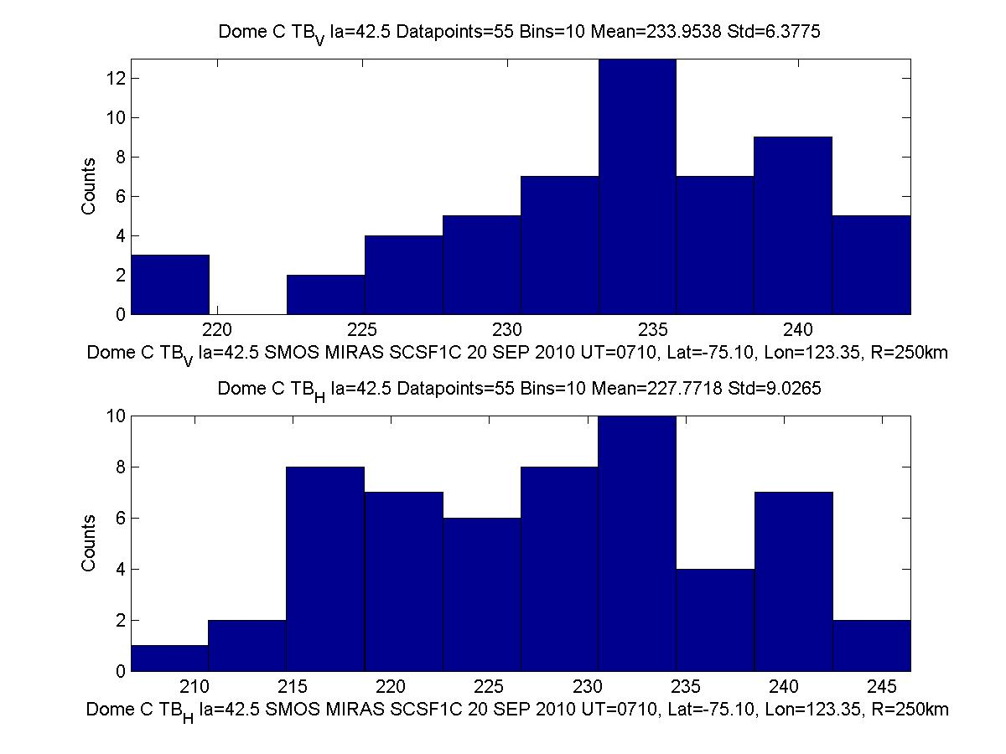
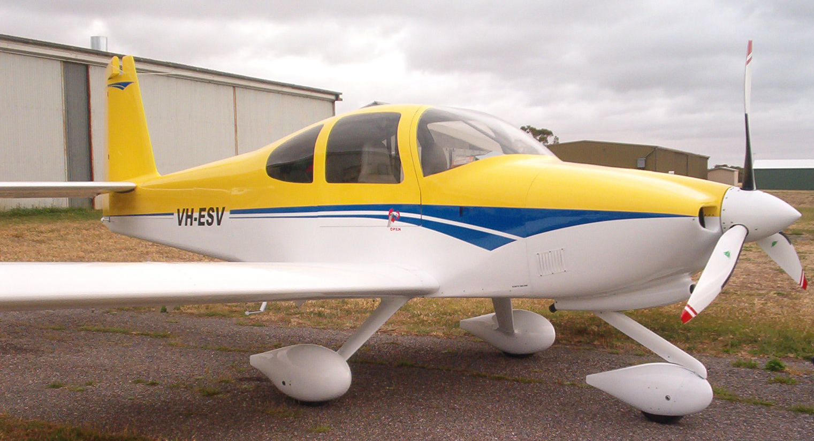
SMOS/MIRAS Calibration Using Earth Scene Targets
¹E.J.Kim, ²J.Walker, ²C.Rüdiger, ³J.Costelloe, ²Y.Nan, ²S.Peischl, ³M.Allahmoradi, ⁴A.Marks
¹NASA Goddard Space Flight Center, USA
²Department of Civil Engineering, Monash University, Australia
³Department of Civil and Environmental Engineering, University of Melbourne, Australia
⁴CSIRO, Australia
Abstract
Absolute brightness temperature calibration of spaceborne microwave radiometers with large antenna apertures and large fields of view, such as the MIRAS radiometer on SMOS presents unique challenges. Even instruments with apertures half as large as MIRAS face the same issues. Pre-launch viewing of suitable calibration targets is problematic since a thermally-uniform target large enough to be beam filling for such large apertures is not practical, especially on orbit. Instead, large homogeneous Earth
scene present a ready alternative. Targets for MIRAS include the oceans, Dome-C in Antarctica, and deserts.
This paper will examine SMOS brightness temperature observations of these candidate areas and consider the advantages and limitations of each to evaluate their suitability, including the issues to be considered for absolute brightness temperature calibration.
As the same targets will also be available for Aquarius and SMAP calibration, the potential for inter-satellite calibration will be briefly discussed.
Southern Pacific Ocean
The Southern Pacific Ocean region between Australia New Zeeland and South America between 30 and 45 South is studied as a calibration target in a 2500km circle around Lat=37.5 South, Lon=130.0 West. For three different half orbits SMOS MIRAS SCSF1C data indicate suitability as a calibration target with stable TB_{H} and TB_{v} as shown:
13 MAY 2010 UT=1451,
,
29 AUG 2010 UT=1307,
20 SEP 2010 UT=1350.
Low standard deviation statistics for TB_{V} and TB_{H} across a large swath of the Southern Pacific Ocean on three different days of the year make this a potential calibration target, worthy of further consideration.
Dome-C Antarctica
The Dome-C region is hypothesized to be extremely stable with time. Tower-based L-band Tb measurements by Macelloni et al have demonstrated this at a point. The spatial variability (or lack thereof) can be measured by aircraft (e.g., proposal by Kim et al), but a suitable opportunity must be identified. SMOS has now provided some measurements, seen below.
Simpson Desert Australia
Deserts like the Simpson in Australia are another potential vicarious calibration target. Airborne measurements were made in 2008 and 2009 using the PLMR L-band radiometer. Supporting ground truth was also collected. The Simpson site was the upper red box in the map below.
Arid Zone
Murrumbidgee
V
N = 603
Mean=124.40 K
Stdv = 2.85 K
Conclusions
SMOS brightness temperatures for ocean, Dome-C in Antarctica, and the Simpson Desert in Australia have been collected for different times of the year in order to begin assessing the usefulness of these areas as target areas for absolute calibration. In all cases the incidence angle used is near 42.5 degrees.
A preliminary analysis suggests that the South Pacific Ocean offers brightness temperatures with a narrow (<3 K) standard deviation that could serve as a practical calibration target. However, additional statistics need to be analyzed, for a larger number of months as well as for other locations within the South Pacific, before the full space-time behavior of this target can be assessed. Forward modeling of the ocean Tb’s and comparison vs. the SMOS observations is also needed to complete the evaluation.
The Dome-C results so far show a fairly large standard deviation. However, the histogram is currently based on a very low number of data points. Further analyses over a longer time period are expected to show much smaller standard deviation, similar to analyses by other researchers. One question we are attempting to answer is the exact size & shape of the target ‘zone’ in Antarctica.
The Simpson Desert appears to have promise as a calibration target based on aircraft & SMOS observations. Rain periods must be screened out, and again, the exact size & shape of the target ‘zone’ must still be determined.
Intercalibration among SMOS, Aquarius (June 2011 launch), and SMAP (2015? launch) will be feasible provided there is time overlap between SMOS-Aquarius (very likely) and Aquarius-SMAP or SMOS-SMAP (maybe). Differences in footprint size and incidence angle will also need to be carefully addressed.
(above) Blue area inside red circle is the Dome-C site.
(left) SMOS grid cells in a 100 km diameter around Dome-C.
H
N = 603
Mean=79.44 K
Stdv = 2.75 K
H (left) and V (right) pol Tb images from SMOS. The cooler Tb’s in the lower right corner are from wetter conditions around Lake Eyre.
Note: color scales of above & below figures is different.
Note: color scales of above & below figures is different.
N = 305
Mean=126.71 K
Stdv = 2.77 K
Brightness temperature (K). Note color scale covers a very small range of Tb! This is desirable for use as a calibration target.
Brightness temperature (K). Same region as before, but without the background image. Aside from the lower right corner, the spatial variability is low—desirable for a calibration target.
V
Note: color scales of above & below figures is different.
55 pixels shown in green from a single orbit at UT=0710, 20 September 2010, near the equinox are insufficient to determine suitability of a small calibration target such as a 250 km red circle encompassing the Dome C, Lat=-75 Lon=123.35
H
N = 305
Mean=80.14 K
Stdv = 2.71 K
Tb (K) from the aircraft radiometer, overlaid on visible image (left) and without overlay (right). the spatial variability is very low (see Tb histogram)—desirable for a calibration target.
Acknowledgements:
M. Theriot^{1,2}, C. Utku^{1,3}, A. Toure¹, G. De Lannoy¹, J. Geiger¹, Y. Tian¹, A. Swaroop² , D. Kirschbaum¹, M. Muza¹, C. Marquess¹, P. Jaiswal¹, R. Izzo¹, V. Rathod¹, A. Mahmoodi⁴
1. NASA Goddard Space Flight Center, USA. 2. Sigma Space Corporation, Lanham, Maryland, USA. 3. GEST University of Maryland Baltimore County, USA. 4. Array Software, Toronto, Ontario, Canada.
V
N = 537
Mean=126.11 K
Stdv = 2.65 K
V
N = 55
Mean= 233.95 K
Stdv = 6.38 K
H
N = 537
Mean= 79.30 K
Stdv = 2.54 K
H
N = 55
Mean= 227.77 K
Stdv = 9.03 K

