Slide 1
Victorian Tertiary Admissions Centre
Parents and student seminar Applying 2013

Slide 2
What is VTAC?
Application services
Tertiary courses
Admissions tests (STAT and DULSAT)
Scholarships 2013
SEAS 2013
VTAC also
Calculates and issues the Australian Tertiary Admission Rank (ATAR) for VCE students
Provides various information and enquiry services including telephone, email, blog, Twitter, and RSS feeds
Conducts information sessions (online and seminars)
Notes:
The Victorian Tertiary Admissions Centre is the central office that administers the application and offer process for places in tertiary courses at university, TAFE providers and independent tertiary colleges. We receive and forward application information and supporting documentation to the course selection authorities at institutions.
Provides up to date information online (including information about course changes) through the VTAC Blog. This information is immediately available for applicants who subscribe using RSS and Twitter and on Facebook after a short delay.
VTAC provides various information and enquiry services including telephone, email, blog, Twitter and RSS feeds. Information sessions are conducted online and in person.
VTAC does not make selection decisions. Selection decisions are made by institutions and VTAC sends out letters on behalf of institutions.
VTAC provides online applications for courses, admissions tests, Special Entry Access Schemes and Scholarships.
VTAC is conducting an online seminar for all applicants on 13 September: “Getting the best out of your VTAC application, a forum for all applicants”

Slide 3
Resources
VTAC Guide 2013 – available from newsagents (RRP: $12 incl. GST) or free download to your device from www.vtac.edu.au
ABC of Applying – copies distributed to VCE students
Choice – copies distributed to all Year 10 students – book dispels myths and hints for getting the best out of your VCE study choice.
Distributed to students
ABC of Scaling
ABC of Offers
Notes:
All publications are available on the VTAC website.
The VTAC Guide 2013 lists all of the courses offered through VTAC, explains the application process and provides information on the institutions offering courses through VTAC.
The ABC of Applying is a companion to the VTAC Guide for parents and Year 12 students.
Choice is the companion to the VICTER publication.
The ABC of scaling and ABC of offers will be sent to applicants when the ATAR is released in December, and when the offers are released in January respectively. They explain how scaling works, and how the offer process works.
Note: Applicants can register for course updates by subscribing to the RSS Feed at www.vtac.edu.au

Slide 4
Resources continued…
Blog for everyone http://vtacmedia.wordpress.com
Facebook – preferred method for parents and students Facebook.com/vtacguide
Twitter - @vtacguide

Slide 5

Newspaper supplements
VICTER 2015 - for year 10 students available: Tuesday 24 July 2012
ATAR and Change of Preference available Monday 17 December 2012
Tertiary Offers
available Thursday 17 January 2013
Notes:
VICTER Supplement available in The Age and Herald Sun.

Slide 6
What’s new in 2013
Application methods
Printed Guide now a reference book Definitive information online.
Courses listed with direct applications – not through VTAC
Most courses listed you apply through VTAC
VTAC user account – is where all applicants get their information and their account details after registration.
Notes:
Direct applications
A number of courses listed in this VTAC Guide will accept applications directly to the institution.
These courses are clearly identified with an application indicator within the course entry. These courses are included in the course listings and on CourseSearch. They are not included in CourseSearch!!
Applications through VTAC
Where students must register and then apply through VTAC system.
More information further down track – courses listed as through VTAC must be applied for via the VTAC system. Courses listed as direct are with the institution too.
A number of VTAC institutions also have put their post graduate courses in the Guide, but via direct applications.
New terminology
VTAC user account (replaces MyInfo) – is the account an applicant must have to apply for courses, scholarships or SEAS
Negotiated course (replaces Irregular Offer) – same system, different name.
ALSET (replaces DULSAT) – doesn’t really affect year 12 students applying to courses in Victoria
Personal History online (replaces Pi Form) – new name, same process.

Slide 7
What’s in the printed Guide
Majors index and selection data index
Course listings in Guide - detail online.
Institutions listed in strict alphabetical order
Chapters include: SEAS, Scholarships, Accommodation, Enrolment and deferment policies, Credit transfer, pathways and recognition of prior learning
Notes:
Majors index is still in the printed Guide, even though the majors aren’t listed in courses.
Selection data index is available in print, but included in course entry online.
Course listings are included, but the detail is online. Already we have had a large number of new and cancelled courses. The PDF will be updated.
Institutions are listed in strict alpha order – even those institutions that include direct applications only
Chapters in the VTAC Guide include:
SEAS
Scholarship
Accommodation
Enrolment and deferment
Credit transfer, pathways and recognition of prior learning

Slide 8
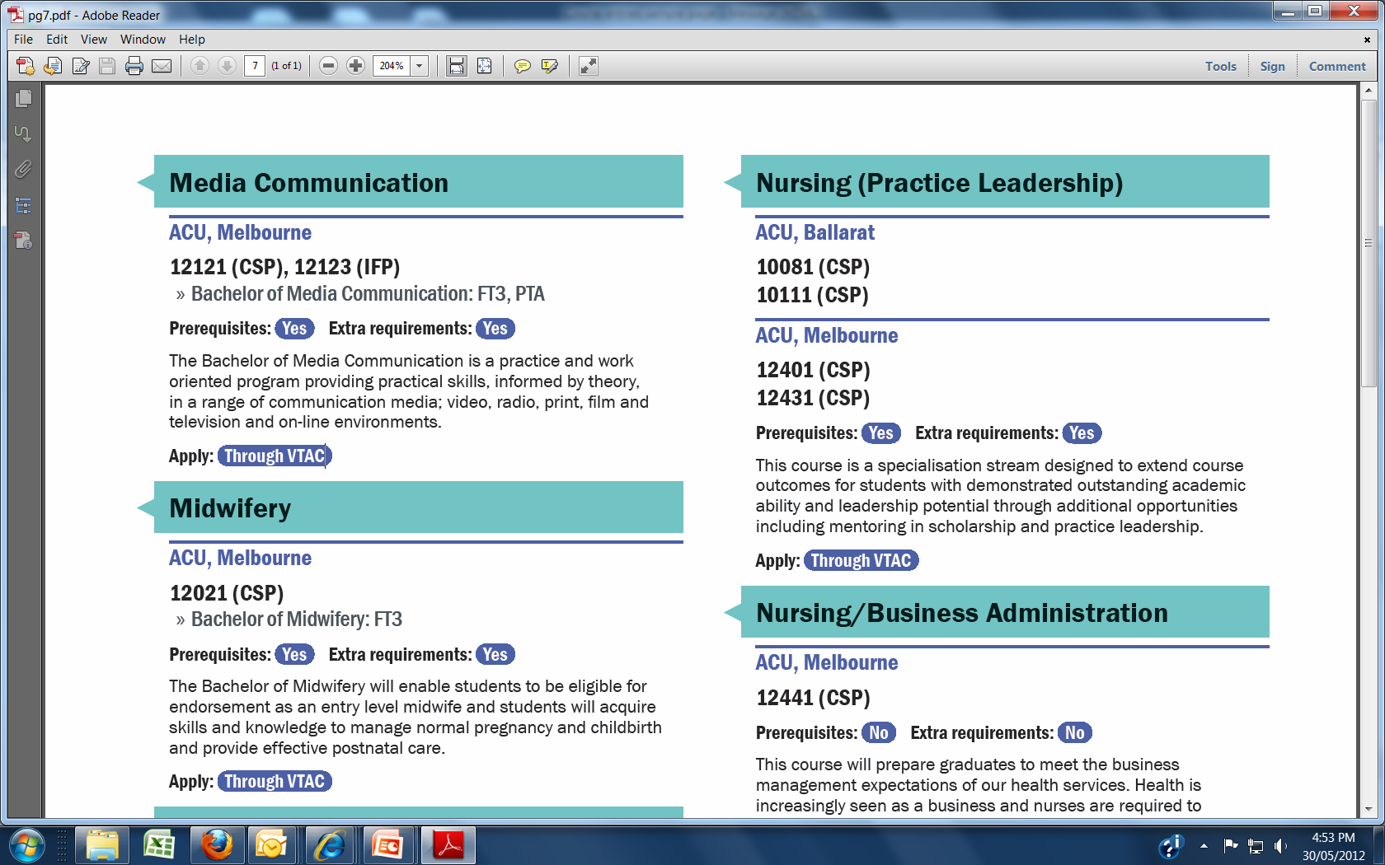
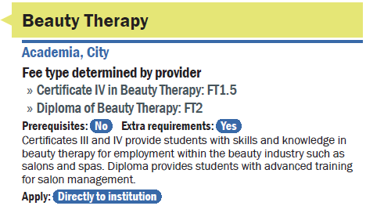
Sample course entry in printed Guide
Notice the course codes
The prerequisite indicator
Extra requirement indicator
Application indicator
No course codes and the indicator for applying is directly to the institution.
Notes:
How entries and listed and what to expect in the printed Guide?
Course listings in printed Guide, detail online.
Institutions and their courses are listed in strict alphabetical order
The listings in the printed Guide include an indicator for prerequisites and extra requirements. In some cases, the extra requirements will only apply to non-year 12 applicants.
The application status:
Courses through VTAC have a VTAC course code to indicate fee type and selection data (will be in a separate index)
Courses via direct applications have an indicator type - no course code.

Slide 9
Qualifications through VTAC
VET qualifications
Higher education
Certificate I
Certificate II
Certificate III
Certificate IV
Diploma
Advanced Diploma
Note: VTAC accepts and publicises courses from Certificate II and above
Undergraduate
Advanced Diploma
Associate Degrees
Bachelor
Post graduate
Masters
Graduate entry teaching
Note: A number of postgraduate and master courses are via direct application.
Notes:
VET stands for Vocational Education and Training.
VET courses provide professional and semi-professional qualifications with an emphasis on practical skills and vocational pathways to further training, higher education or employment.
VET courses are generally offered by private providers and TAFEs.
The qualifications included in the VTAC Guide start at Certificate II and go up to the Advanced Diploma.
A number of TAFE institutes also offer higher education courses -
There are three types of higher education courses listed with VTAC: Undergraduate: The majority of higher education courses with applications through VTAC are bachelor degrees and a few associate degrees.
The remaining two levels are not relevant to year 12 students but may be of interest for planning:
Graduate entry teaching which is not relevant to year 12 students require an undergraduate qualification, such as a degree, as a prerequisite.
Other graduate courses – which are not relevant to year 12 students
require an undergraduate or VET qualification and/or relevant work experience as a prerequisite. These courses are included in this guide with the above coloured banner.

Slide 10
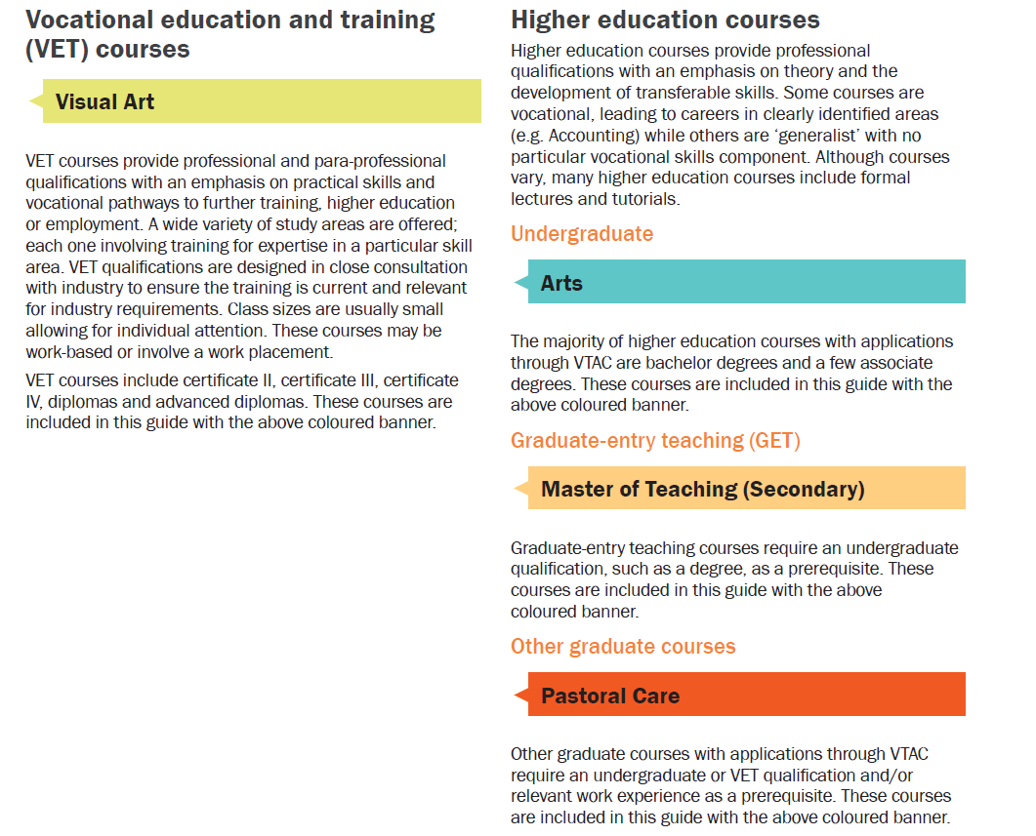
VET and Higher education - colour coding
Notes:
All courses are now integrated there are no separate sections for GET courses so you need to be aware of this. Colour coding, prerequisites and courses codes are key to getting it right. With that said no year 12 student will be permitted to apply for a graduate course.

Slide 11
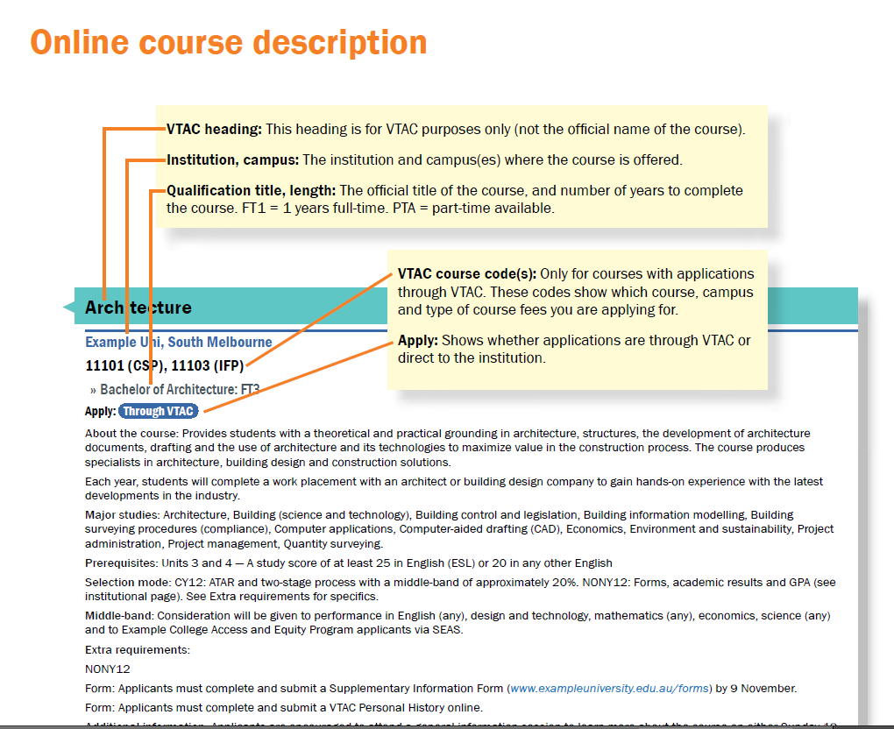
Notes:
The colour at the top indicates what type of qualification this course is registered under. In this case it’s a VET course.
The next line is the campus and course codes.
Followed by the application indicator.

Slide 12
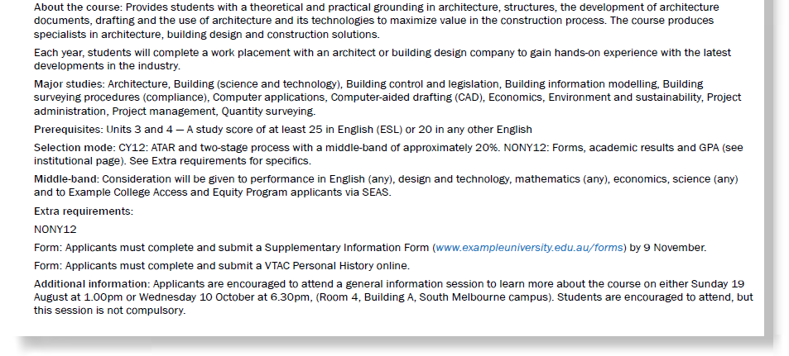
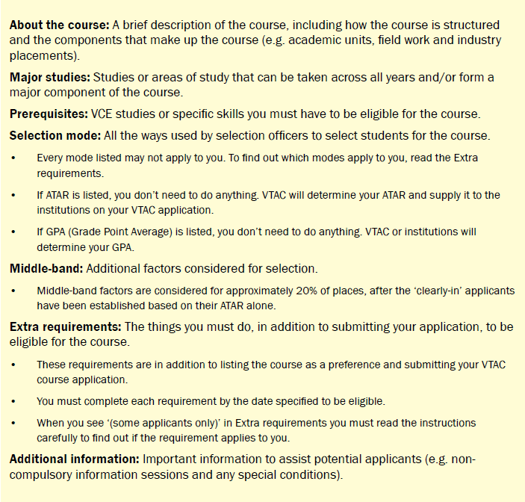
Notes:
About the course: A brief description of the course, including how the course is structured and the components that make up the course (e.g. academic units, field work and industry placements).
Major studies: Studies or areas of study that can be taken across all years and form a major component of the course. Majors are not included in the print course entry, but are included in the printed Majors Index. You can sort on a major in VTAC CourseLink and are included in the online course entry.
Prerequisites: VCE studies or specific skills you must have to be eligible for the course.
Selection mode: All the ways used by selection officers to select students for the course. The mode is broken down into current year 12 and non-year 12. Always read the extra requirements.
Middle-band: Additional factors considered for selection. Middle-band factors are considered for approximately 20% of places, after the ‘clearly-in’ applicants have been established based on their ATAR alone.
Extra requirements: The things you must do if CY12 and All applicants is listed– if you don’t do these you won’t be considered. ‘Some applicants only’ means you must read the instructions carefully to find out if the requirement applies to you.
Additional information: Important information to assist potential applicants (e.g. non-compulsory information sessions and any special conditions).

Slide 13
Application process for courses through VTAC
Register
Receive VTAC ID and PIN
Login to VTAC User Account
Apply for courses
Apply for STAT/DULSAT
Apply for Scholarships
Institution can make early offers via VTAC to Non-Year 12 applicants in early December.
Main round offers in January 2013.
Round 2 offers in February 2013.
Apply for SEAS
Notes:
This screen is a visual overview of the application process. We will discuss the process in greater depth in upcoming slides.
The first stage is to register.
Students must register using the same details they did when they enrolled.
After registration, the student will be allocated a VTAC ID and PIN.
They can then apply for courses etc.

Slide 14
Courses via direct application
Applicants apply to institution
Institution decides to make an offer or not
Institution can make early offers whenever they choose
Notes:
When a course indicates that it is a direct application. Then the applicant deals directly with the institution and not VTAC.
VTAC is simply a tool to advise applicants of what else is available and does not have any input into the direct process.

Slide 15
The course application
Can list up to 12 courses/preferences on the course application
Always list the courses in the order you want to get into them
If incorrectly registered
will be charged a non-year 12 processing fee
VTAC cannot guarantee results will be matched
Notes:
Students can list 12 preferences on their course application.
The list can be a mix of 12 different courses from different institutions and/or from the same institution. Mix them anyway you want EXCEPT:
Always list the courses in the order you most want to get into them.

Slide 16
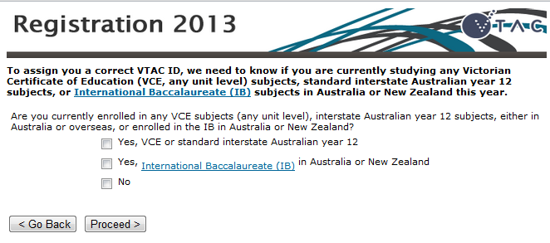
Notes:
Every year schools contact us telling us that their students have incorrectly registered.
I’m not sure how this happens because as you can see, its pretty straight forward.

Slide 17
Course application continued…
Last day for timely applications is Friday 28 September 2012.
Can still defer payment - No invoices when applying.
Payment is via:
Credit card/Visa or MasterCard Debit
PayPal
Don’t pay by the due date, the application won’t be processed and passed on.

Slide 18
Special consideration: Special entry access schemes
Different types of special consideration:
SEAS through VTAC
Others directly to the institution
The Special Entry Access Scheme (SEAS) is the umbrella program run by a number of institutions through VTAC.
The Special Entry Access Scheme (SEAS) is for applicants who have experienced educational disadvantage.
Notes:
Applicants must attend all interviews, sit any required tests, submit all required folios, and fill in all required forms, etc.
Courses with prerequisites Consideration of SEAS circumstances may be given to performance slightly below the stated minimum study score for a prerequisite.
Such consideration is determined by each institution in accordance with their selection policy. Applicants cannot be exempted from having to complete the prerequisite study.

Slide 19
SEAS continued…
To access the SEAS application, applicants must:
Register with VTAC and create their VTAC user account and
Submit a course application – SEAS only becomes available after the course application has been submitted.
No course application, no SEAS.
Support documentation must be in by the closing date.
Students can go in and change/resubmit their SEAS as many times as they like before the closing date.
Opens 9.00am Monday 6 August Closes: 5.00pm Tuesday 9 October
Notes:
You can find SEAS on our website under: Am I eligible – it is part of the eligibility process.
It has also been cross referenced on our website under:
Special consideration
Mature age consideration
SEAS

Slide 20
SEAS categories include
Category one: Personal information and location
Category 2: Non-English speaking background
Category 3: Difficult circumstances
Category 4: Disadvantage financial background
Notes:
Category one is designed for applicants who wish to be considered for information already provided in their registration and/or course application associated with mature age consideration, Recognition as an Indigenous Australian, Living or school postcode, Under-represented schools – institutions have a list and details of this list are in the SEAS chapter, Gender such as males or females in under-represented disciplines i.e. women in engineering; men as primary school teachers.
Category 2: applicants must have been born in a non-English speaking country outside of Australia and arrived in Australia on or after 1 January 2003 (Monash 2007 and Melbourne 2006). This does differ for some universities so check the criteria in the Guide.
Category 3: is for applicants who have been prevented from reaching their full educational potential because of family or other life circumstances – the students need to indicate whether or not the circumstances are long or short term. Examples of types of difficulties may include Refugee; family problems, abuse, sick family member, homelessness.
Category 4: is for applicants prevented from reaching their full educational potential because of a disadvantaged financial background. Applicants will need to indicate whether the circumstances are long or short term. Examples include:
Individual or family poverty; Excessive financial obligations; Economic hardship. For this category VTAC can get the information from CentreLink if the student provides us with permission via their CRN.

Slide 21
SEAS categories include:
Category 5: Disability or medical condition
Category 6:
Schools Access La Trobe (SALT)
University of Ballarat (REEP)
Victoria University (PPP) schemes.
Other institutions recognise these factors, but take their applications via Category 1.
Applicants should apply for Category 1 to be considered for other university under-represented schools schemes.
Notes:
Category 5: Is for applicants who are disadvantage as a result of a disability or medical condition. Applicants will need to indicate whether the circumstances are long or short term. Please remind applicants that if they require support or assistance with course extra requirements such as interviews, folio presentations or information sessions, should refer to individual institutional pages in the VTAC Guide for further information regarding who to contact for advice.
Category 6: Is for current Year 12 students who attend schools that are explicitly nominated under the:
Schools Access La Trobe (SALT)
University of Ballarat (REEP)
Victoria University (PPP) schemes.
Other schools recognise these factors, but take their applications via Category 1.
Applicants should apply for Category 1 to be considered for other university under-represented schools schemes.

Slide 22
Scholarships
The scholarships application:
Opens 9.00am Monday 6 August Closes 5.00pm Friday 19 October 2012
All students are encouraged to apply - let the system sort out if you are eligible or not.
Victorian universities provide their own scholarships to assist students both through VTAC and directly.
Scholarships determined via the VTAC scholarships application may be awarded to:
students suffering with financial difficulties
Indigenous Australians and
other equity and access groups as defined by each institution.
Notes:
All students should be encouraged to complete a scholarships application
Let the system decide whether or not they are eligible for what scholarship.
Scholarships not through VTAC - see page 50 of the VTAC Guide or check out the complete list online.
Commonwealth scholarships: The Student Start-Up and Relocation Scholarships are available to students receiving income support and administered by Centrelink.
The Indigenous Commonwealth Scholarships are administered by institutions and allocated to students who have had their Indigenous status confirmed and meet the criteria on the Centrelink website.
Merit scholarships: To be considered, applicants must apply for courses through VTAC and do not need to lodge a VTAC Scholarship Application.
Where an institution offers merit scholarships, students who have listed that institution on their course preference list and met any additional course or institutional eligibility will automatically be assessed by that institution.
Institutions will award scholarships to students academic achievement if they have studied an Australian Year 12 or the International Baccalaureate (IB) in 2012.
Where an institution offers merit scholarships, students who have listed that institution on their course preference list and met any additional course or institutional eligibility will automatically be assessed by that institution.

Slide 23
The Australian Tertiary Admission Rank (ATAR)
The ATAR:
Is not a score out of 100 it is reported as a rank between 0.00 and 99.95
Allows tertiary institutions to compare students who have completed different combinations of VCE studies.
Is calculated by VTAC solely for use by institutions.
An ATAR of 75.00 means that a student with that ATAR has achieved VCE results that places them in the top 25% of the Year 12 age group.
Notes:
The ATAR The Australian Tertiary Admission Rank (ATAR) is calculated by VTAC solely for the use of tertiary institutions to compare the overall achievement of students who have completed different combinations of VCE studies.
VTAC forwards the ATAR along with application information to selection authorities at institutions. The change to ATAR, the nationally agreed name used by all Australian states and territories (except Queensland), is a change in name only. There is no change to the calculation.

Slide 24
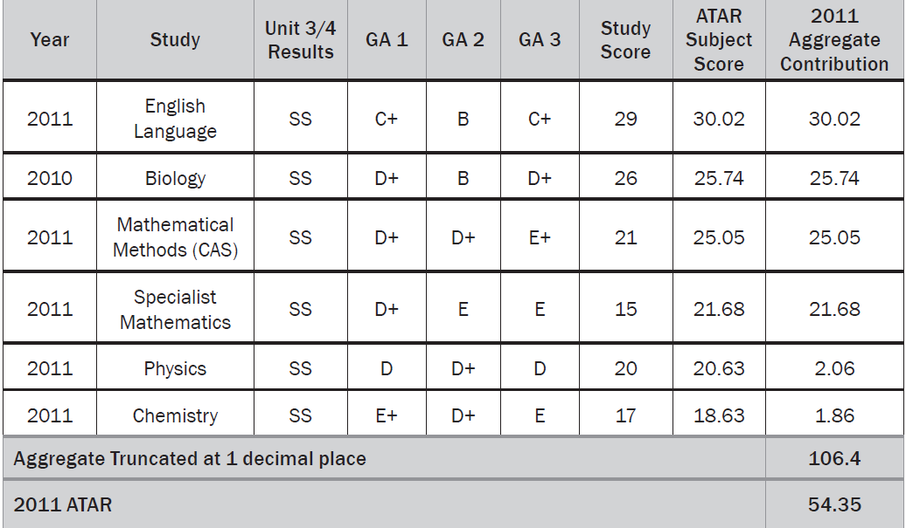
The ATAR continued…
Notes:
Note with this student all but one study was scaled up and yet the ATAR is in the 50’s.
While it’s a bit late in year 12, when choosing studies, students are better off choosing studies that:
they enjoy
are good at
reflect what they are interested in studying at tertiary level
help provide them with more career options .
Scaling ensures that all studies are treated equally in the ATAR calculation, so that students are not advantaged or disadvantaged by the studies they undertake.

Slide 25
The ATAR continued
To qualify for an ATAR a student must:
qualify for the VCE
achieve study scores in at least four permissible Unit 3 and 4 VCE studies, including one from the English group
ATARs are released to students:
Monday 17 December 2012 from 7am.
All students who are eligible to receive an ATAR, irrespective of whether or not they have applied, can access their ATAR online or via SMS. Two ways to access the ATAR on that day:
Internet at resultsandatar.vic.edu.au
SMS – must preregister for instructions go to www.vtac.edu.au/sms
Notes:
VTAC calculates an ATAR for all VCE students who have successfully completed the VCE and satisfied minimum tertiary entrance requirements.
Only applicants who have at least four VCE study scores in an acceptable combination will have an ATAR calculated.
If you are a current VCE student:
Students VCE study scores, ATAR and ATAR subject scores will be available to students via internet and SMS services. 7.00am Monday 17 December.
Students who have applied for courses through VTAC this year and have paid their VTAC fees will be sent an ATAR statement.
For interstate only: If you are studying an interstate Year 12, VTAC receives your results and ranks from your state admissions centre/authority. Interstate Year 12 results (except Queensland) provide you with an ATAR. Queensland uses a ranking system (OP) which is not equivalent to the ATAR.
A conversion table for the Queensland OP to the ATAR is available on the QTAC website (www.qtac.edu.au).

Slide 26
Change of preference
Change of preference opens on Monday 17 December 2012 at 11am.
All students are able to change their course preferences up until 12noon Monday 24 December 2012.
Institutional change of preference days, these are worth checking out (see December 2012 Bulletin).
Notes:
Year 12 students will get their results at 7am on Monday 17 December 2012.
Change of preference for this group will reopen at 11am on the same day and close at 12noon on Monday 24 December 2012.

Slide 27
Golden rules of change of preference
Before changing preferences students should check:
Last years selection data – don’t panic if the ATAR is slightly lower, still put it down. Selection data fluctuates annually.
Extra requirements to make sure they are complete
Prerequisites – to make sure they meet them.

Slide 28
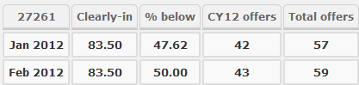
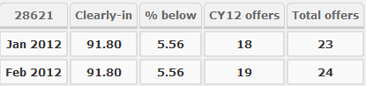
How to read selection data
The Clearly in: is the ATAR at or above which everyone who applied and was eligible for this course received an offer.
The % below is the percentage of offers made to applicants with an ATAR lower than the clearly in.
This also gives you some idea on the percentage of people who had an ATAR lower than the clearly in but received bonuses to boost them up into the offered group.
Notes:
The Clearly in: is the ATAR at or above which everyone who applied and was eligible for this course received an offer.
The % below is the percentage of offers made to applicants with an ATAR lower than the clearly in.
This also gives you some idea on the percentage of people who had an ATAR lower than the clearly in but received bonuses to boost them up into the offered group.
In example 1: the percentage below the clearly in ATAR in January, when most of the offers are made, was 47.62 percent. This means that 47.62% of applicants got in with an ATAR lower than the clearly in either by bonuses or special consideration.
In example 2: the percentage below the clearly in was 5.56%. This means that 5.56% got in with an ATAR lower than the clearly in of 91.80. However it doesn’t mean that the course didn’t bonus people it just means that even if they did the competition and level of ATAR for this course was very high.

Slide 29
The offer Rounds
If students do not pay their processing fee they won’t be considered for offers.
All offers are provisional and subject to accurate information being supplied by the applicant.
Rounds of offers:
Early round offers – for non-year 12 applicants
International VCE and Victorian IB round
Main round offers – majority of offers to all applicants at any preference for graduate entry teaching and undergraduate places.
Round two offers – smaller number of offers – filling places
After round 1:
Negotiated offer (for all applicants)
Supplementary offers (for all applicants)
Notes:
If students do not pay their course application processing fee by the due date, their application will not be sent to the course selection authorities.
After the course selection authorities have considered applications, they will advise VTAC who they wish to offer a place in the course. VTAC then advises applicants of the highest offer on their preference list.
In round two, students will be considered for course preferences higher than the offers they have received.
VTAC will again advise students of the highest offer made (if any).
All offers are provisional. Any offer received by a student is subject to them meeting eligibility and submitting a true and correct application.
Note: Submitting an application does not guarantee an offer

Slide 30
Offers continued…
Always accept an offer you receive
Never wait to see if you get a better offer in round two
If you don’t accept any of the offers you have been made, you are not eligible for a supplementary offer
Negotiated offers are no guarantee for an offer, unless the institution accepts you

Slide 31
Negotiated offers
Ensure course requirements have been met, including extra requirements such as interviews, folios etc.
Check place availability with the course selection officer and what additional documentation you may have to provide. Then:
Complete the negotiated offer request in the VTAC user account
If the status is pending, the student can choose to change their course request.
If the status is approved, the student will receive an offer in the next round and is not eligible for any further offers.
If the status is rejected the student can submit another request for another course.

Slide 32
Supplementary offers
Some institutions may make supplementary offers after Round 2 if they have places available.
Applicants may receive supplementary offers if they:
Have not received an offer in a previous round
Have given VTAC and have not been granted a negotiated offer
Note: if you son or daughter rejects an offer, they are not eligible for a supplementary offer
Supplementary offers are processed weekly
Applicants may receive two or more offers at the same time
Applicants will need to decide which offer to accept
Notes:
Some institutions may make supplementary offers after Round 2 if they have places available.
applicants may receive supplementary offers if they
have not received an offer in any of the previous offer rounds (Early, Round 1, Round 2)
have not been granted an offer for a negotiated offer;
have given VTAC permission to release their application to all courses with vacancies. Applicants gave this permission either at the time of applying, or later in their VTAC user account.
Supplementary offers will be processed weekly.
Applicants may receive two or more offers at the same time,
They will need to choose which offer to accept—you should not

