Slide 1


Slide 2
What will be delivered by Friday 27 July 2012 to VCE providers
Reference copies (not purchased)
VTAC Guide 2013 includes SEAS and Scholarships
Choice
ABC of Applying
VTAC Calendar
VICTER no longer printed available with regular updates at www.vtac.edu.au and in media supplement
Notes:
If you have not received your publications:
Check with the office
Check with the library
Check under tables, chairs and in the principal’s office
Email schoolsliaison@vtac.edu.au and we will provide you with the name of who signed for the boxes.

Slide 3
What’s new in 2013
Application methods
Courses listed with direct applications
Courses apply through VTAC
New terminology
VTAC user account (replaces MyInfo)
Negotiated offer (replaces irregular offer)
Personal History online (replaces Pi Form)
Notes:
Direct applications
A number of courses listed in this VTAC Guide will accept applications directly to the institution.
These courses are clearly identified with an application indicator within the course entry. These courses are included in the course listings and on CourseSearch. Courses via direct application not included in CourseLink
Applications through VTAC
Where students must register and then apply through VTAC system.
More information further down track – courses listed as through VTAC must be applied for via the VTAC system. Courses listed as direct are with the institution too.
A number of VTAC institutions also have put their post graduate courses in the Guide, but via direct applications.
New terminology
VTAC user account (replaces MyInfo) – is the account an applicant must have to apply for courses, scholarships or SEAS
Negotiated course (replaces Irregular Offer) – same system, different name.
ALSET (replaces DULSAT) – doesn’t really affect year 12 students applying to courses in Victoria
Personal History online (replaces Pi Form) – new name, same process.

Slide 4
Higher education studies and the ATAR
From 2012 Higher Education studies will include first-year university studies and advanced standing TAFE courses recognised by the VCAA.
Where a student completes a higher education VCE study and the average mark overall the HE units awarded is at least:
90, the Higher Education increment will be 5.0.
80 but less than 90, the Higher Education increment will be 4.5
70 but less than 80, the Higher Education increment will be 4.0
60 but less than 70, the Higher Education increment will be 3.5
50 but less than 60, the Higher Education increment will be 3.0.
The study can count as a fifth or sixth study increment.
Notes:
The VCAA provides for very able students to have an opportunity to undertake some approved Higher Education study as part of the VCE. Such studies are recognised as Higher Education studies contributing to completion of the VCE. These Higher Education studies include first-year university studies and advanced standing TAFE courses recognised by the VCAA.
For students undertaking such a study, it may count as an increment (fifth or sixth study) in the ATAR provided that it is passed, that VCAA conditions were met, and subject to the restricted study combinations outlined by VTAC.
An increment will be awarded for the Higher Education study.
Where a student completes a higher education VCE study and the average mark overall the HE units awarded is at least:
90, the Higher Education increment will be 5.0.
80 but less than 90, the Higher Education increment will be 4.5
70 but less than 80, the Higher Education increment will be 4.0
60 but less than 70, the Higher Education increment will be 3.5
50 but less than 60, the Higher Education increment will be 3.0.

Slide 5
Your best resources (subscribe, subscribe, subscribe)
Social media
Blog for everyone http://vtacmedia.wordpress.com
Blog for careers practitioners http://vtacschools.wordpress.com
Facebook – preferred method for parents and students facebook.com/vtacguide
Twitter @vtacguide
VTAC CourseLink – online resource for careers teachers
Schools liaison
Is here to provide you with advice and assistance associated with policies and procedures
Not here as your first port of call to obtain dates and times that you’ve forgotten
To contact VTAC Schools liaison directly: schoolsliaison@vtac.edu.au
Notes:
Blog for everyone:
Course updates (new/cancelled) are updated weekly on blog, Facebook and Twitter.
Monitor and respond efficiently
Create events i.e. change of preference event in 2011
Students and parents can interact and answer and help each other – this happened quite a bit last year
Some articles had over 18,000 reads i.e. the one about SEAS
Blog for careers practitioners
More than 200 careers professionals have subscribed to careers professionals blog to date
Some articles had more than 10,000 reads recorded
Targetted information but info from general also linked across
Highly recommended because this is where we post popular FAQs as they arise.
This year we will be running more events on Facebook and we are thinking of running some careers practitioner webinars via the blog. Will get back to you about this.
Query Topic
Frequency
Percentage of Email Enquiries
Enquiries about offers/courses
7
4%
Special Entry Access Scheme
38
21%
CourseLink
29
16%
Preferences (Reports)
30
16%
ATAR Calculation and Information
22
12%
International Baccalaureate
10
5%
VTAC Guide Distribution
12
7%
Social Media
2
1%
Front Office Queries
34
18%
Key Points
1 in 5 email enquiries (20%) are specifically about policy and procedural issues.
Between September and December 2011, IPS staff answered nearly 1200 phone calls.
Almost 20% of enquiries directed to the IPS schools liaison address were questions that should have been directed to customer service
65% of email enquiries from teachers are regarding four specific topics: SEAS, CourseLink, accessing preferences, and the ATAR Calculation.

Slide 6
What’s in the printed Guide
Majors index and selection data index
Course listings in Guide - detail online.
Institutions listed in strict alphabetical order
Chapters include: SEAS, Scholarships, Accommodation, Enrolment and deferment policies, Admissions tests, Credit transfer, pathways and recognition of prior learning.
Notes:
Majors index is still in the printed Guide, even though the majors aren’t listed in courses.
Selection data index is available in print, but included in course entry online.
Course listings are included, but the detail is online. Already we have had a large number of new and cancelled courses. The PDF will be updated.
Institutions are listed in strict alpha order – even those institutions that include direct applications only
Chapters in the VTAC Guide include:
SEAS
Scholarship
Accommodation
Enrolment and deferment
Credit transfer, pathways and recognition of prior learning

Slide 7
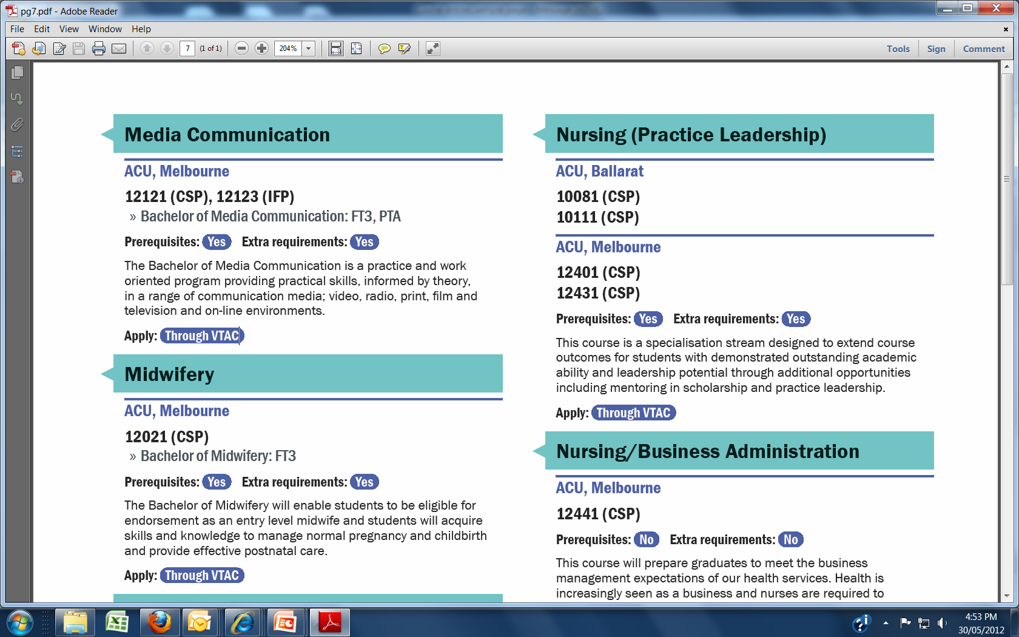
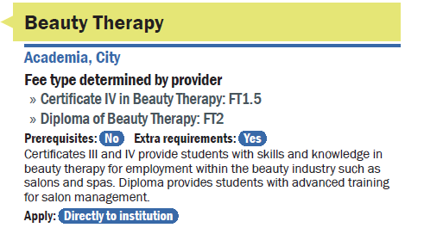
Sample course entry in printed Guide
Notice the course codes
The prerequisite indicator
Extra requirement indicator
Application indicator
No course codes and the indicator for applying is directly to the institution.
Notes:
How entries and listed and what to expect in the printed Guide?
Course listings in printed Guide, detail online.
Institutions and their courses are listed in strict alphabetical order
The listings in the printed Guide include an indicator for prerequisites and extra requirements. In some cases, the extra requirements will only apply to non-year 12 applicants.
The application status:
Courses through VTAC have a VTAC course code to indicate fee type and selection data (will be in a separate index)
Courses via direct applications have an indicator type - no course code.

Slide 8
The course entries
Your guide to the VTAC Guide and online course entries
Notes:
In this section we are going to go through how to read a course entry and more importantly how to understand a course entry.

Slide 9
Qualifications through VTAC
VET qualifications
Higher education
Certificate I
Certificate II
Certificate III
Certificate IV
Diploma
Advanced Diploma
Note: VTAC accepts and publicises courses from Certificate II and above
Undergraduate
Advanced Diploma
Associate Degrees
Bachelor
Post graduate
Masters
Graduate entry teaching
Note: A number of postgraduate and master courses are via direct application.
Notes:
VET stands for Vocational Education and Training.
VET courses provide professional and semi-professional qualifications with an emphasis on practical skills and vocational pathways to further training, higher education or employment.
VET courses are generally offered by private providers and TAFEs.
The qualifications included in the VTAC Guide start at Certificate II and go up to the Advanced Diploma.
A number of TAFE institutes also offer higher education courses -
There are three types of higher education courses listed with VTAC: Undergraduate: The majority of higher education courses with applications through VTAC are bachelor degrees and a few associate degrees.
The remaining two levels are not relevant to year 12 students but may be of interest for planning:
Graduate entry teaching which is not relevant to year 12 students require an undergraduate qualification, such as a degree, as a prerequisite.
Other graduate courses – which are not relevant to year 12 students
require an undergraduate or VET qualification and/or relevant work experience as a prerequisite. These courses are included in this guide with the above coloured banner.

Slide 10
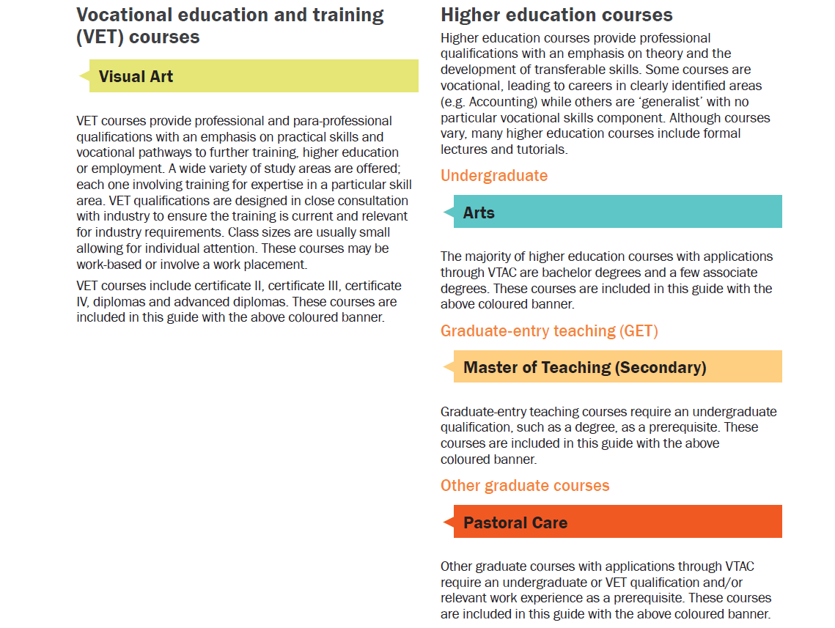
VET and Higher education - colour coding
Notes:
All courses are now integrated there are no separate sections for GET courses so you need to be aware of this. Colour coding, prerequisites and courses codes are key to getting it right. With that said no year 12 student will be permitted to apply for a graduate course.

Slide 11
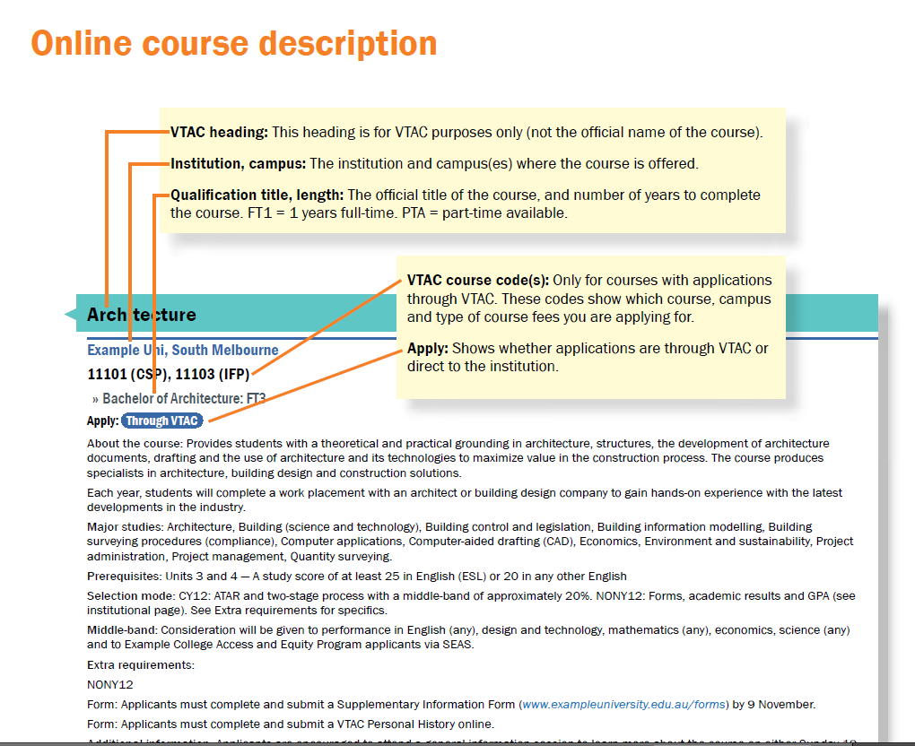

Slide 12
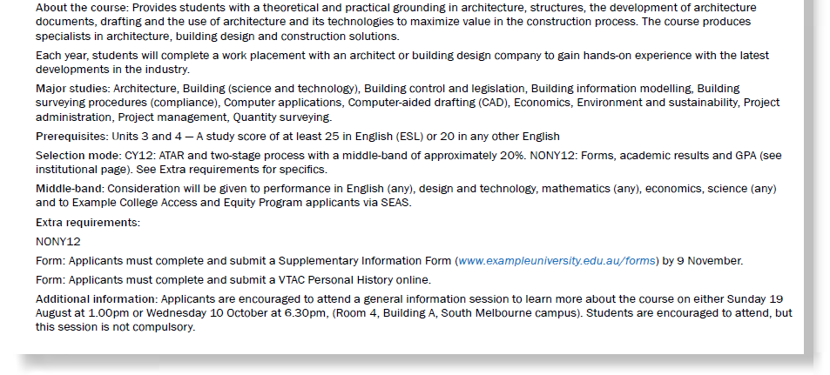
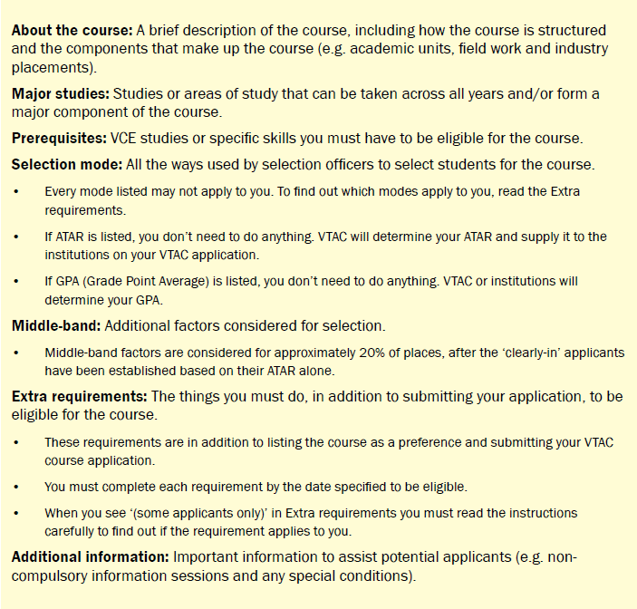
Notes:
About the course: A brief description of the course, including how the course is structured and the components that make up the course (e.g. academic units, field work and industry placements).
Major studies: Studies or areas of study that can be taken across all years and form a major component of the course. Majors are not included in the print course entry, but are included in the printed Majors Index. You can sort on a major in VTAC CourseLink and are included in the online course entry.
Prerequisites: VCE studies or specific skills you must have to be eligible for the course.
Selection mode: All the ways used by selection officers to select students for the course. The mode is broken down into current year 12 and non-year 12. Always read the extra requirements.
Middle-band: Additional factors considered for selection. Middle-band factors are considered for approximately 20% of places, after the ‘clearly-in’ applicants have been established based on their ATAR alone.
Extra requirements: The things you must do if CY12 and All applicants is listed– if you don’t do these you won’t be considered. ‘Some applicants only’ means you must read the instructions carefully to find out if the requirement applies to you.
Additional information: Important information to assist potential applicants (e.g. non-compulsory information sessions and any special conditions).

Slide 13
Case study: Courses, qualifications and course types
Case study 1:
Quick quiz
You have a VCE student in your school who is 20 and wanting to apply for VET courses this year.
What types of courses does the student need to apply for?
What other factors should you counsel the student on?
Does the student apply as a current year 12 or mature age student?
What other factors should be considered?
Are VET courses through VTAC the same as they are in VCE?
One of our international students has just become a permanent resident. What should they do?
Can international students apply for a Negotiated course?
Can a Year 12 student accidentally apply for postgraduate or graduate entry teaching courses through VTAC?
Can New Zealand citizens and permanent residents apply for a Commonwealth supported place through VTAC?

Slide 14
Three things you now know about: courses, qualifications and types
1
2
3

Slide 15
The application process
Courses, SEAS, Scholarships

Slide 16
Application process for courses through VTAC
Register
Receive VTAC ID and PIN
Login to VTAC User Account
Apply for courses
Apply for STAT/DULSAT
Apply for Scholarships
Institution can make early offers via VTAC to Non-Year 12 applicants in early December.
Main round offers in January 2013.
Round 2 offers in February 2013.
Apply for SEAS
Notes:
This screen is a visual overview of the application process. We will discuss the process in greater depth in upcoming slides, it is more for your information.

Slide 17
Courses via direct application
Applicants apply to institution
Institution decides to make an offer or not
Institution can make early offers whenever they choose
Notes:
When a course indicates that it is a direct application. Then the applicant deals directly with the institution and not VTAC.
VTAC is simply a tool to advise applicants of what else is available and does not have any input into the direct process.

Slide 18
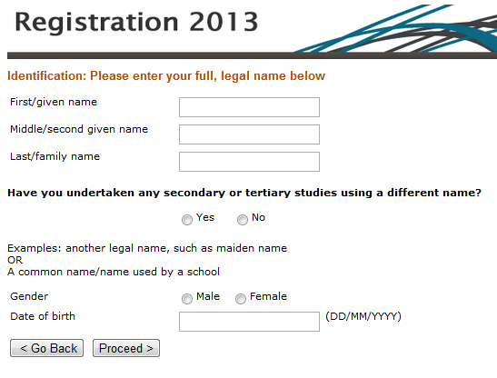
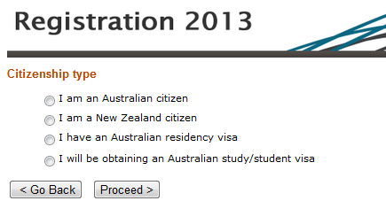
STEP 1: VTAC Registration Process
Register with VTAC – have VTAC ID and PIN allocated.
Once registered the user account is activated and live until the last business day of July 2013.
Who can register to apply:
Australian citizen
Australian permanent resident
New Zealand citizen
Temporary resident currently studying an Australian year 12 or International Baccalaureate in Australia or New Zealand
Notes:
The registration process
Before they can apply, they need a VTAC ID (identification) and PIN (personal identification number).
To receive their VTAC ID and PIN, they must register with VTAC.
Once they register, their user account will remain active until the last business day of July 2013.
When you register for a VTAC user account, VTAC categorises you as either a:
• current Year 12 student, or
• non-Year 12 applicant.
The program does this based on the information that the application provides. It is important to answer all the questions accurately.
The reason for the difference is that institutions sometimes use different selection criteria for current Year 12 students and non-Year 12 applicants.
A demonstration of the registration process is available from the VTAC website.

Slide 19
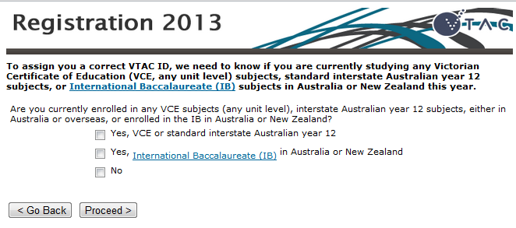
STEP 1: VTAC Registration Process continued…
VTAC considers applicants a current Year 12 student if:
currently studying VCE (or Adult VCE) or enrolled in at least one Unit 1 and 2 VCE study sequence
were enrolled in at least one Unit 3/4 VCE study did not officially withdraw by Monday 30 April 2012
currently studying Senior Level VCAL, interstate year 12, IB in Australia and New Zealand.
Notes:
VTAC considers applicants to be a current Year 12 student if:
they are currently studying VCE (or Adult VCE)
they are enrolled in at least one Unit 1 and 2 VCE study sequence
they were enrolled in at least one Unit 3 and 4 VCE study sequence and did not officially withdraw by Monday 30 April 2012
The following groups are also considered current year 12 students:
studying Senior Level VCAL
interstate Australian Year 12 (e.g. HSC, NTCE, QLD Senior Certificate, SACE, TCE, WACE)
studying International Baccalaureate (IB) in Australia or New Zealand.

Slide 20
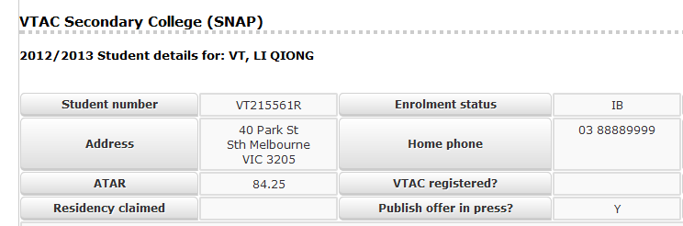
VTAC CourseLink Registration Page
To check if a student has registered:
Go to CourseLink Student data
Select the student who claims they have registered
If blank, the student hasn’t registered, if ‘Y’ then they have.
Y
Notes:
To check whether students have registered through VTAC you go into Student data and select a Year 12 student. There will be a Y in the VTAC registered box if they have registered. Note here the student has registered and not applied as yet. Remember these are samples only

Slide 21
Four tips to assist in the registration process
They must be enrolled in VCE studies to be eligible to register.
Students must enter exactly the same information they used for enrolling earlier this year. If they come to you and say VTAC won’t let them in, check VASS or CourseLink to confirm what details they initially provided.
If the student swears that they have registered, get them to check their User Account to see if they are registered as a CY12 or NONY12.
If the student is an international student get them to supply a local address.

Slide 22
Step 2: The course application
Can list up to 12 courses/preferences on their course application
Always list the courses in the order you want to get into them
If incorrectly registered
Will be charged a non-year 12 processing fee
VTAC cannot guarantee results will be matched
Student must contact VTAC (not schools liaison) to update their details. May be an administrative fee, depends on where the process is at. Contact 1300 364 133
Notes:
Once they have registered, they can log into the VTAC User Account and:
Apply for courses’
Apply for STAT/DULSAT (doesn’t apply to Year 12 students applying in Victoria)
Apply for Scholarships
Once the student has submitted their course application they can apply for SEAS, this does not appear in their user account until the course application has been submitted.
Always list the course preferences in the order you want to get into them.
The VTAC system is based on the assumption that if you list a course at number 1, then it is the course you most want to get into.
Never advise a student to list a course based on how easy it is perceived to get into that course.
If there are any details missing from their application, VTAC will also contact the student and send out reminders. These are sent to email accounts and available in their User Account. All decisions about offers are made by course authorities at the institutions, not by VTAC.

Slide 23
Step 2: The course application continued…
Last day for timely applications and no late fees is Friday 28 September 2012 at 5.00pm
No invoices. Can still defer payment
Payment is via:
Credit card/Visa or MasterCard Debit
PayPal
Don’t pay by the due date, the application won’t be processed and passed on.
Remember some courses don’t accept late applications and some courses have earlier deadlines.
Notes:
The rules are quite strict here and all students should be aware of the issues that will come with the second last dot point if payment not made by due date

Slide 24
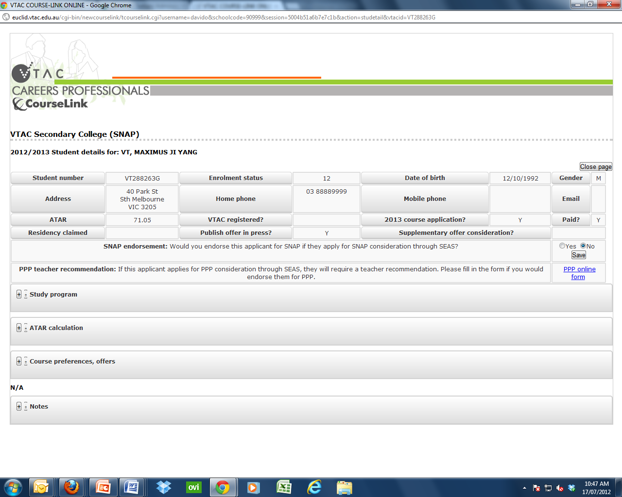
Where to access student course preferences on CourseLink
Go to CourseLink Student data
Select a student who has applied
You will then be directed to this page automatically
Notes:
By going into Student data selecting a year 12 student you can see the range of preferences entered by individual students. Expand the heading to see the preferences and also a record of how many times and when the student has changed or updated their course listings. These listings are updated by 10.00 am daily (except weekends).
By going into School date you can see at a glance where the preferences are for all student who have entered them

Slide 25
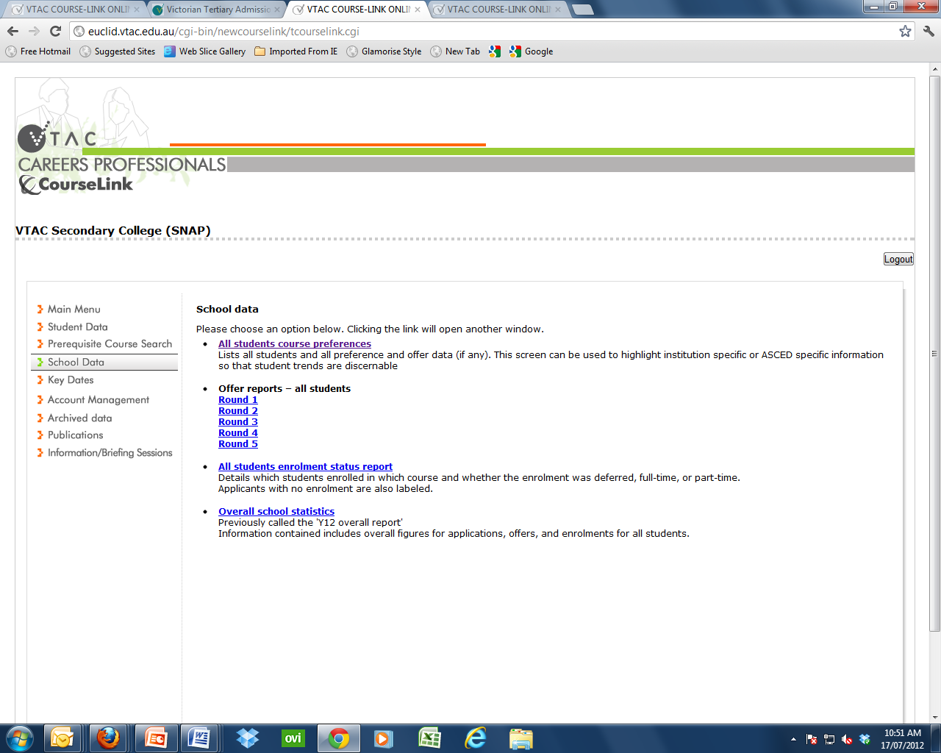
Where to access all of your student course preferences on CourseLink
Go to School data and select All student course preferences. A screen will appear that provides you with the latest update to all of your student course preferences.
Notes:
By entering into School data you will see where all your students have entered preferences at this time of year of course the list is empty
You can select by institution or by field of study to get a balance Once ewe have preferences it will be a more interesting screen
Later in the year at offer time you will see highlighted all the preferences offered to your students

Slide 26
Case studies: The registration and course application process
Case study 2: registration
Case study 3: course application
A number of our students have approached us indicating they cannot register on the VTAC site.
What should they do?
What can you do?
We have a number of New Zealand and permanent residents in our school. Are they eligible to apply for a Commonwealth supported place?
What advice should you give these students?
Will they be eligible for nominating for a deferred HECS payment?

Slide 27
Golden rules of the course application
Always register with exactly the same information that students provided when enrolling
Always list the courses in the order you want to get into them
Consider the selection data from last year, but use it as a guide only. It’s last year’s data and may change
Check to see if the courses your students are interested in, but haven’t listed has yet, have extra requirements and accept students at change of preference

Slide 28
Three things you now know about: Registration and the course application
4
5
6

Slide 29
Special consideration: Special entry access schemes
Different types of special consideration:
SEAS through VTAC
Others directly to the institution
The Special Entry Access Scheme (SEAS) is the umbrella program run by a number of institutions through VTAC.
The Special Entry Access Scheme (SEAS) is for applicants who have experienced educational disadvantage.
Notes:
The Special Entry Access Scheme (SEAS) is the umbrella program run by most institutions to which applicants will be applying for courses through VTAC. The Special Entry Access Scheme (SEAS) is for applicants who have experienced educational disadvantage.
The SEAS program allows selection officers to grant special consideration for course entry to applicants.
SEAS consideration will not exempt applicants from completing the extra requirements for a course.
Applicants must attend all interviews, sit any required tests, submit all required folios, and fill in all required forms, etc.
Courses with prerequisites Consideration of SEAS circumstances may be given to performance slightly below the stated minimum study score for a prerequisite.
Such consideration is determined by each institution in accordance with their selection policy. Applicants cannot be exempted from having to complete the prerequisite study.

Slide 30
Special entry access schemes (SEAS) continued…
To access the SEAS application, applicants must:
Register with VTAC and create their VTAC user account and
Submit a course application – SEAS only becomes available after the course application has been submitted.
No course application, no SEAS.
Opens 9.00am Monday 6 August Closes: 5.00pm Tuesday 9 October
Notes:
You can find SEAS on our website under: Am I eligible – it is part of the eligibility process.
It has also been cross referenced on our website under:
Special consideration
Mature age consideration
SEAS

Slide 31
SEAS categories include:
Category 1: Personal information and location
Category 2: Non-English speaking background
Category 3: Difficult circumstances
Category 4: Disadvantaged financial background
Notes:
Category one is designed for applicants who wish to be considered for information already provided in their registration and/or course application associated with mature age consideration, Recognition as an Indigenous Australian, Living or school postcode, Under-represented schools – institutions have a list and details of this list are in the SEAS chapter, Gender such as males or females in under-represented disciplines i.e. women in engineering; men as primary school teachers.
Category 2: applicants must have been born in a non-English speaking country outside of Australia and arrived in Australia on or after 1 January 2003 (Monash 2007 and Melbourne 2006). This does differ for some universities so check the criteria in the Guide.
Category 3: is for applicants who have been prevented from reaching their full educational potential because of family or other life circumstances – the students need to indicate whether or not the circumstances are long or short term. Examples of types of difficulties may include Refugee; family problems, abuse, sick family member, homelessness.
Category 4: is for applicants prevented from reaching their full educational potential because of a disadvantaged financial background. Applicants will need to indicate whether the circumstances are long or short term. Examples include:
Individual or family poverty; Excessive financial obligations; Economic hardship. For this category VTAC can get the information from Centrelink if the student provides us with permission via their CRN.

Slide 32
SEAS categories include:
Category 5: Disability or medical condition
Category 6:
Schools Access La Trobe (SALT)
University of Ballarat (REEP)
Victoria University (PPP) schemes
Other schools recognise these factors, but take their applications via Category 1. Applicants should apply for Category 1 to be considered for other university under-represented schools schemes.
Notes:
Category 5: Is for applicants who are disadvantage as a result of a disability or medical condition. Applicants will need to indicate whether the circumstances are long or short term. Please remind applicants that if they require support or assistance with course extra requirements such as interviews, folio presentations or information sessions, should refer to individual institutional pages in the VTAC Guide for further information regarding who to contact for advice.
Category 6: Is for current Year 12 students who attend schools that are explicitly nominated under the:
Schools Access La Trobe (SALT)
University of Ballarat (REEP)
Victoria University (PPP) schemes.
Other schools recognise these factors, but take their applications via Category 1.
Applicants should apply for Category 1 to be considered for other university under-represented schools schemes.

Slide 33
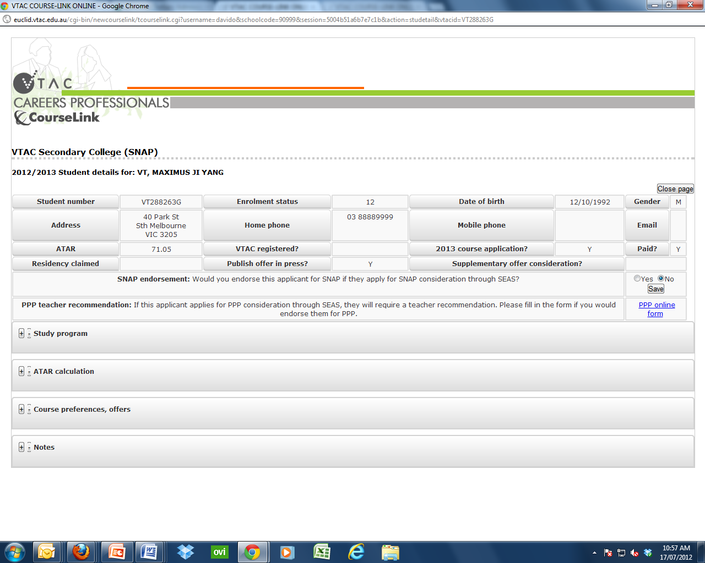
CourseLink: SNAP endorsement and PPP teacher recommendation
Notes:
For SNAP
This has changed from previous years as SNAP used to be a form
This year you only need to indicate Yes we endorse this applicant or no we do not endorse this applicant.
This can be changed up until closing date 9 October. The SNAP endorsement is only active for SNAP schools
For PPP
For schools recognised by VU PPP there will be an indicator on this page.
In these cases the school has to download the form and follow the instructions.

Slide 34
Impact statements and Statements of support
Statement of support
Are required for categories 3, 4, 5 and 6
Statements of support about the responsible persons observation and/or medical opinion of the student. Statements such as I agree or just as the student says don’t cut it.
Impact statements
Impact statements are required for categories 3, 4 and 5.
Impact statements are about the impact and not the incident.
Notes:
The impact statements and Statements of support are integral to both SEAS and scholarships.
The impact statement is not about what happened, but rather how it impacted and led to educational disadvantage.
Last year we still had a lot of students who just wrote down what happened to them and worse, a lot of statements of support that simply said things along the lines of:
Yes I agree with what …. Said.
Yes it was bad.
Yes …. had glandular fever
The impact means how it affected the student i.e. difficult circumstances where a parent is a drug addict the affect is – the student has to look after themselves/siblings/parent; lots of responsibility; little time to study; no privacy etc.

Slide 35
Case studies: SEAS
Case study 4:
Case study 5:
My principal wants to know whether our school is classified as an under-represented school.
How do we find out?
Can we apply to be an underrepresented school?
Who decides who is and isn’t an underrepresented school?
We have a student who was born in Australia and the family moved back to a Non English speaking country where English was never spoken when they were 3 months old. The student arrived back in Australia in 2008 and is completing their VCE this Year.
Is the student eligible for Category 2: non English Speaking background?
Please explain.
Notes:
The institutions make decisions based on data they collect over the years indication where there has been a shortage of School leavers applying for their courses. Cannot be applied for by school
If a student was born in Australia any family movements from then is not grounds for category 2
If born in Australia you are ineligible

Slide 36
SEAS case studies and quick quiz
Case study 6:
Quick Quiz 2
A parent comes to you wanting you to provide a statement of support indicating that their son/daughter has a learning disability.
What do you do?
What do you ask?
What should you do?
Once a student submits their SEAS can they edit it?
Can students apply for more than one category?
Can you supply a statement of support electronically?
Can a statement of support for SEAS be used for scholarships?

Slide 37
Three things you now know about: SEAS
7
8
9

Slide 38
Scholarships
The scholarships application:
Opens 9.00am Monday 6 August Closes 5.00pm Friday 19 October 2012
Victorian universities provide their own scholarships to assist students both through VTAC and directly.
Scholarships determined via the VTAC scholarships application may be awarded to:
students suffering with financial difficulties
Indigenous Australians and
other equity and access groups as defined by each institution.
Notes:
All students should be encouraged to complete a scholarships application
Let the system decide whether or not they are eligible for what scholarship.

Slide 39
Types of scholarships
Commonwealth scholarships
Merit scholarships
Institutional access and equity scholarships
Scholarships not through VTAC – check out the complete list online.
Notes:
Scholarships not through VTAC - see page 50 of the VTAC Guide or check out the complete list online.
Commonwealth scholarships: The Student Start-Up and Relocation Scholarships are available to students receiving income support and administered by Centrelink.
The Indigenous Commonwealth Scholarships are administered by institutions and allocated to students who have had their Indigenous status confirmed and meet the criteria on the Centrelink website.
Merit scholarships: To be considered, applicants must apply for courses through VTAC and do not need to lodge a VTAC Scholarship Application.
Where an institution offers merit scholarships, students who have listed that institution on their course preference list and met any additional course or institutional eligibility will automatically be assessed by that institution.
Institutions will award scholarships to students academic achievement if they have studied an Australian Year 12 or the International Baccalaureate (IB) in 2012.
Where an institution offers merit scholarships, students who have listed that institution on their course preference list and met any additional course or institutional eligibility will automatically be assessed by that institution.

Slide 40
Types of scholarships through VTAC
Commonwealth scholarships include Student Start-Up and Relocation Scholarships
are available to students receiving income support
administered by Centrelink
Indigenous Commonwealth Scholarships
Institutional access and equity scholarships
Merit scholarships
Notes:
When submitting a scholarships application the student will have their registration details automatically populated to the scholarships application.
When submitting a scholarships application, the institutions want to know:
About your background, languages at home, postcode, Indigenous status
Whether or not you have been disadvantaged financially, household structure
Whether or not you or your parents are eligible for CentreLink benefits - if not then you can still complete this section, but we will want some proof.
The scholarships people are also interested in:
any community and leadership experiences you have
any difficult circumstances that have impacted upon your education
any medical condition or disability that have impacted upon your education
how a scholarship will benefit your studies in 2013

Slide 41
Three things you now know about: Scholarships
7
8
9

Slide 42
The Australian Tertiary Admission Rank
Your guide to understanding scaling and the ATAR calculation

Slide 43
Golden rules of providing advice to Year 10 students in relation to scaling
Just because a study is scaled up doesn’t mean you’ll get a high ATAR
All studies to be treated equally in the ATAR
Just because you do a LOTE doesn’t mean you’ll get an extra 5 added to your ATAR.
You are better off choosing studies that:
you enjoy
you are good at
reflect what you are interested in studying at tertiary level
help provide you with more career options if you are undecided.
VTAC will be running an online Webinar in 2013 to assist careers teachers counsel Year 10 students.
Notes:
These notes are more for your information than discussion today. However we do wish to draw your attention to the fact that next year, we will be running a seminar and providing you with a Year 10 presentation to assist you with parents nights and your counselling.

Slide 44
The Australian Tertiary Admission Rank (ATAR)
The ATAR:
Is not a score out of 100 it is reported as a rank between 0.00 and 99.95
Allows tertiary institutions to compare students who have completed different combinations of VCE studies.
Is calculated by VTAC solely for use by institutions.
An ATAR of 75.00 means that a student with that ATAR has achieved VCE results that places them in the top 25% of the Year 12 age group.
Notes:
The ATAR The Australian Tertiary Admission Rank (ATAR) is calculated by VTAC solely for the use of tertiary institutions to compare the overall achievement of students who have completed different combinations of VCE studies.
VTAC forwards the ATAR along with application information to selection authorities at institutions. The change to ATAR, the nationally agreed name used by all Australian states and territories (except Queensland), is a change in name only. There is no change to the calculation.

Slide 45
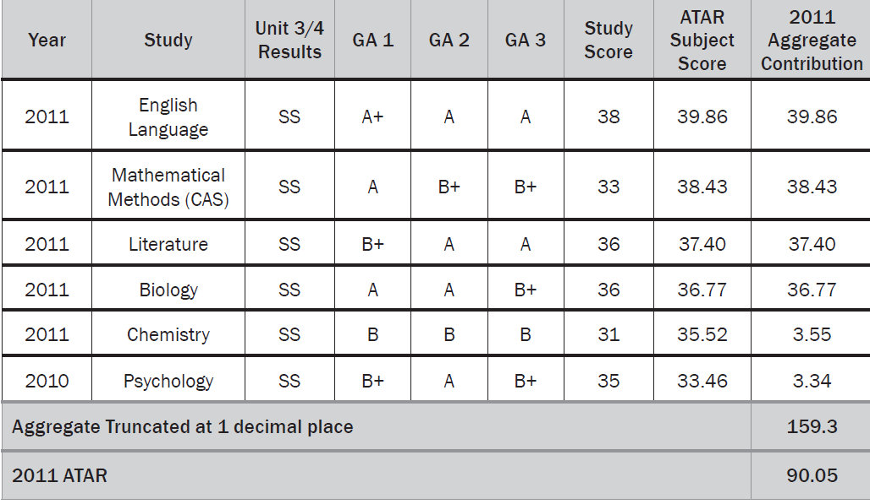
How the ATAR is calculated
Notes:
The ATAR is developed from an aggregate produced by adding the results for up to six studies as follows:
• the ATAR subject score in one of English, English (ESL), Literature or English Language
• the next best three scaled study scores permissible (which together with the English study make the “primary four”)
• 10% of any fifth and sixth permissible scores that are available (these are called increments).
If you have more than six results, the six permissible results that give the highest ATAR are used.
Studies used in the calculation of the ATAR may be taken over any number of years; however the time taken to complete VCE studies may be taken into account by institutions when considering applicants.
You are then ranked in order of these aggregates—the highest rank being 99.95 and then decreasing in steps of 0.05. The group of students with the highest aggregates will be assigned the highest rank of 99.95. The lowest automatically reported ATAR is 30.00, with ATARs below 30.00 being reported as ‘less than 30’.

Slide 46
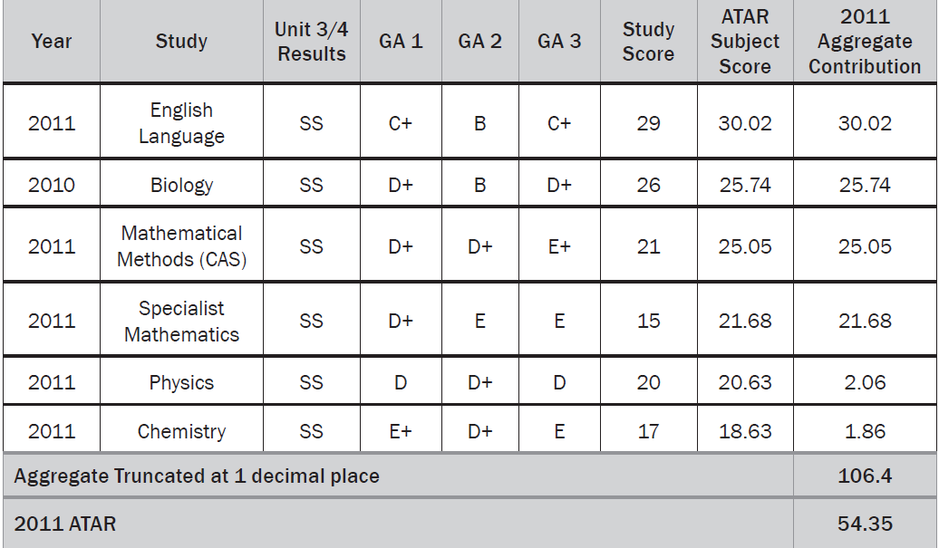
The ATAR continued…
Notes:
Note with this student all but one study was scaled up and yet the ATAR is in the 50’s.
While it’s a bit late in year 12, when choosing studies, students are better off choosing studies that:
they enjoy
are good at
reflect what they are interested in studying at tertiary level
help provide them with more career options .
Scaling ensures that all studies are treated equally in the ATAR calculation, so that students are not advantaged or disadvantaged by the studies they undertake.

Slide 47
The ATAR continued…
To qualify for an ATAR a student must:
qualify for the VCE
achieve study scores in at least four permissible Unit 3 and 4 VCE studies, including one from the English group
When is the ATAR available to schools?
Careers teachers will have access to the ATARs from 4pm Sunday 16 December 2012
ATAR statements will be delivered to VTAC applicants (who have paid) from Tuesday 18 December.
Notes:
VTAC calculates an ATAR for all VCE students who have successfully completed the VCE and satisfied minimum tertiary entrance requirements.
Only applicants who have at least four VCE study scores in an acceptable combination will have an ATAR calculated.
If you are a current VCE student:
Students VCE study scores, ATAR and ATAR subject scores will be available to students via internet and SMS services. 7.00am Monday 17 December.
Students who have applied for courses through VTAC this year and have paid their VTAC fees will be sent an ATAR statement.
For interstate only: If you are studying an interstate Year 12, VTAC receives your results and ranks from your state admissions centre/authority. Interstate Year 12 results (except Queensland) provide you with an ATAR. Queensland uses a ranking system (OP) which is not equivalent to the ATAR.
A conversion table for the Queensland OP to the ATAR is available on the QTAC website (www.qtac.edu.au).

Slide 48
ATAR released to secondary students
The ATAR will be released to all eligible VCE students on Monday 17 December 2012 from 7am.
All students who are eligible to receive an ATAR, irrespective of whether or not they have applied, can access their ATAR online or via SMS.
Two ways to access the ATAR on that day:
Internet at resultsandatar.vic.edu.au
SMS – must preregister for instructions go to www.vtac.edu.au/sms

Slide 49
ATAR release to schools and privacy
Careers teachers access the ATARs (privacy applies) from 4pm Sunday 16 December 2012.
This is provided to schools for the purpose of counselling students – strict rules apply.
All data is owned by the student not the school so unless a school has the permission of each individual student lists in staff rooms; discussions with class teachers etc are not permitted.
Notes:
VTAC supplies a file of ATAR data to schools for the purpose of information and counselling.
Through the VCAA enrolment process, students authorise the release of ATARs to their school, some years, students withhold their ATARs.
The permission and authority is limited to the use of ATARs for individual counselling.
The ATAR data is made available on the condition that:
Its not released to anyone (include other teachers and parents) without the express written permission of VTAC and the student(s)
files are held under the control of the Principal or careers teacher to ensure that lists are posted in staff rooms or notice boards
files are only available to those responsible counselling
Appropriate security is in place
Identifying information is not used for any other purpose without the express permission of the student.

Slide 50
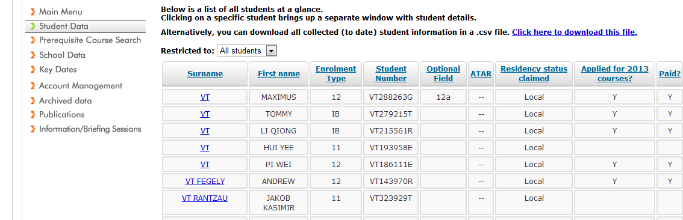
CourseLink ATAR release screen
From this screen you can sort by Surname, Enrolment type, Optional field (i.e. house), ATAR (highest to lowest); application status, paid status.
You can also click on the name and go directly to the individual’s file.
Click here to download allows you to produce a CSV (excel) file which allows you to filter the information.
Notes:
Login to student data the following screen comes up. This will if you select year 12 students only show you the range of ATARs in your school
You can go to click on to download this file and by filtering you will get the result ATARs

Slide 51
ATAR release to schools
No use may be made of the ATAR file, before 10.00am on Monday 17 December 2012, by which time students will have had sufficient opportunity to ascertain their ATAR.
Notes:
No use may be made of the ATAR file, before 10.00am on Monday 17 December 2012
The reason this file is released is for the strict purpose of identifying students who may be at risk or require course counselling and record keeping.
It may not be used to contact students before 10.00am advise them of their ATAR or to get permission to send out a media release or any other reason that will advise a student of the contents of the file or interfere with their right to privacy.
After 10.00am and with the prior written consent of students this information may be used for information and promotional purposes as part of the determination of school based awards.
Last year we were advised of two significant breaches of privacy.
In both instances it was an honest mistake. However in both instances the breach was serious and VTAC has to be able to demonstrate that privacy is tantamount however In both instances the data was withheld and a formal investigation was undertaken.

Slide 52
Case studies: Scaling and The ATAR
Case study 7:
Case study 8:
A student has successfully completed three VCE VET studies, two of which are scored and one is unscored. The student has also successfully completed English and further mathematics.
Will they be eligible for an ATAR?
What studies will be included in the ATAR?
How will the unscored VET be treated?
A student comes to you and tells you they have not received an ATAR. You know the student has passed the VCE and all has study scores for:
English, mathematical methods, specialist mathematics, further mathematics. They have not successfully completed economics.
Why didn’t they get an ATAR? Is it a mistake?
What advice should you give the student in terms of applying for courses?

Slide 53
Victorian International Baccalaureate
If your school has submitted the results release form to Cardiff then the IB results will be released to your school in early January.
Students can obtain their results from their IB co-ordinator in early January.
If an Victorian IB student sits the GAT and have applied for courses they will be eligible to receive a notional ATAR and statement.
Notes:
VTAC calculates a notional ATAR for Victorian IB students who have sat the GAT.
Their IB results will be released to your school (if your school has submitted the results release service) from the IB Curriculum and Assessment Office (Cardiff, UK) in early January.
Victorian IB students who have applied through VTAC will receive a Notional ATAR statement.
If a school hasn’t submitted a results release form to Cardiff, VTAC does not get the results. This sometimes affects interstate applicants.
A notional ATAR is created for: all applicants who have studied International Baccalaureate in Victoria, qualified for the IB Diploma and sat the GAT (or received formal exemption). Getting your results Victorian Year 12 students.

Slide 54
Other ways to access an ATAR statement
VCE students at an International campus
To produce ATAR statements for Overseas students studying the VCE in countries other than Australia
A charge of $15.00 per statement plus a $12.00 P&H fee for delivery to the Aust school.
VTAC contacts all schools in September and schools subscribe by sending the following details to VTAC
VCAA ID
Student names
School address both Aust and international
Deadline for 2012 is Friday 26 October 2012.
Submissions after this time will incur an administrative fee of $1,000.

Slide 55
Domestic VCE students who don’t apply through VTAC Previous VCE students who have lost their statement
Download and complete the Request for VTAC documentation form from the VTAC website (www.vtac.edu.au)
an administration fee applies
Include a copy of photo identification which includes their signature. Fax and address details are included on the form.

Slide 56
Three things you now know about: the ATAR, scaling and ATAR statements
10
11
12

Slide 57
Change of preference
Change of preference opens on Monday 17 December 2012 at 11am.
All students are able to change their course preferences up until 12noon Monday 24 December 2012.
Institutional change of preference days, these are worth checking out (see December 2012 Bulletin).
Notes:
Year 12 students will get their results at 7am on Monday 17 December 2012.
Change of preference for this group will reopen at 11am on the same day and close at 12noon on Monday 24 December 2012.

Slide 58
Golden rules of change of preference
Before changing preferences students should check:
Last year’s selection data – don’t panic if the ATAR is slightly lower, still put it down. Selection data fluctuates annually.
Extra requirements to make sure they are complete
Prerequisites
Check that a course you are moving or adding allows this at change of preference.

Slide 59
Case studies: Change of preference
Case study 9:
Case study 10:
A parent comes into your office with a handwritten list of preferences that they say that their son/daughter has requested they change.
You know the student is overseas and the parent swears the student has given permission for the parent to change their preferences around.
What do you do?
What factors should you consider?
What risks, if any, are you putting yourself and school at?
A student has approached you and has received an ATAR a deal higher than expected.
What advice do I give to the student?
Change all their preferences?
Leave it as is?

Slide 60
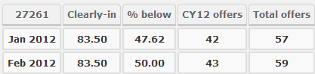
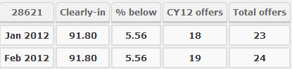
How to read selection data
The Clearly in: is the ATAR at or above which everyone who applied and was eligible for this course received an offer.
The % below is the percentage of offers made to applicants with an ATAR lower than the clearly in.
This also gives you some idea on the percentage of people who had an ATAR lower than the clearly in but received bonuses to boost them up into the offered group.
Notes:
The Clearly in: is the ATAR at or above which everyone who applied and was eligible for this course received an offer.
The % below is the percentage of offers made to applicants with an ATAR lower than the clearly in.
This also gives you some idea on the percentage of people who had an ATAR lower than the clearly in but received bonuses to boost them up into the offered group.
In example 1: the percentage below the clearly in ATAR in January, when most of the offers are made, was 47.62 percent. This means that 47.62% of applicants got in with an ATAR lower than the clearly in either by bonuses or special consideration.
In example 2: the percentage below the clearly in was 5.56%. This means that 5.56% got in with an ATAR lower than the clearly in of 91.80. However it doesn’t mean that the course didn’t bonus people it just means that even if they did the competition and level of ATAR for this course was very high.

Slide 61
Three things you now know about: Change of preference
13
14
15

Slide 62
The offer system

Slide 63
The offer rounds
If students do not pay their processing fee they won’t be considered for offers.
All offers are provisional and subject to accurate information being supplied by the applicant.
Rounds of offers:
Early round offers – for non-year 12 applicants
International VCE and Victorian IB round
Main round offers – majority of offers to all applicants at any preference for graduate entry teaching and undergraduate places.
Round two offers – smaller number of offers – filling places
Negotiated offer
Supplementary offers
Notes:
If students do not pay their course application processing fee by the due date, their application will not be sent to the course selection authorities.
After the course selection authorities have considered applications, they will advise VTAC who they wish to offer a place in the course. VTAC then advises applicants of the highest offer on their preference list.
In round two, students will be considered for course preferences higher than the offers they have received.
VTAC will again advise students of the highest offer made (if any).
All offers are provisional. Any offer received by a student is subject to them meeting eligibility and submitting a true and correct application.
Note: Submitting an application does not guarantee an offer

Slide 64
How the offer system works
You submit your VTAC course application and pay your processing fee now or defer payment.
VTAC is advised as to who has and hasn’t received an offer. VTAC advises the applicants via MyInfo
VTAC processes the application and sends it and other documentation to the listed institutions
The course application is considered along with SEAS and middle-band
VTAC notifies students of the highest offer The student accept by enrolling, rejects or defers the course
Applicants are eligible for offers of higher preferences in future rounds Subject to places being available and meeting eligibility
Notes:
A student submits their VTAC course application and pays their processing fees:
Submitting an application does not guarantee an offer
Remember processing fees are payable by credit card or PayPal. There are no invoices.
Students can also select to defer their payment – so it doesn’t have to be paid on the spot.
To find out if a student has or hasn’t paid, the student can check their user account at VTAC or you can check their status on CourseLink.
After the application is submitted VTAC processes the application and supplies it to the course authorities for each course listed. Course authorities consider the course application and take into account the SEAS application (if one has been submitted).
Course authorities advise VTAC if they want to make you an offer
VTAC notifies applicants of the highest offer for the current round and the student decides whether or not to accept, reject or defer the offer.

Slide 65
How the offer system works continued…
Applicants are eligible for offers of higher preferences in future rounds Subject to places being available and meeting eligibility
After round 1:
After round 2:
Apply for a negotiated offer:
Courses listed lower than offered
Courses not listed on VTAC application
Supplementary offers
If a student does not receive any offer and has given permission – may be eligible for a Supplementary offer
Notes:
Negotiated offers. What are they? Who can apply for one? How many do they submit?
Supplementary offers. are all applicants eligible
Applicants (including international VCE) can apply after the main round of offers
Applicants apply for a negotiated offer if they want to be considered for a:
course preference listed lower than an offer they have received
course not listed on their application Applicants should not rely on the negotiated offer option to get into the course they want. Not all courses accept negotiated-offer requests.

Slide 66
Golden rules of receiving an offer
Always accept an offer you receive
Never wait to see if you get a better offer in round two
If you don’t accept any of the offers you have been made, you are not eligible for a supplementary offer
Negotiated offers are no guarantee for an offer, unless the institution accepts you

Slide 67
Negotiated offers
Ensure course requirements have been met, including extra requirements such as interviews, folios etc.
Check place availability with the course selection officer and what additional documentation you may have to provide.
Then:
Complete the negotiated offer request in the VTAC user account
If the status is pending, the student can choose to change their course request.
If the status is approved, the student will receive an offer in the next round and is not eligible for any further offers.
If the status is rejected the student can submit another request for another course.
Notes:
Applicants must complete the negotiated-offer request in their VTAC user account
The request is forwarded to the course selection officer to consider.
They can track the progress of their negotiated- offer request via their VTAC user account.
If the status of the negotiated-offer request is ‘Pending’, it is still awaiting a response from the selection officer.
While the request is ‘Pending’ they can choose to remove it and submit another request for a different course. Through their VTAC user account
If the status of the applicants negotiated-offer request is ‘Rejected’, they will not be offered a place in that course.
Applicants can submit another request for a different course.
Or they can wait to be considered for higher preferences on your course application. Approved status:
If the status of the negotiated-offer request is ‘Approved’, they will be offered a place in that course. they will receive an offer letter by mail in the next offer round.

Slide 68
Supplementary offers
Some institutions may make supplementary offers after Round 2 if they have places available.
Applicants may receive supplementary offers if they have given VTAC permission—they give this permission when applying or via their VTAC user account and have:
not received an offer in any of the previous offer rounds (Early, Round 1, Round 2)
not been granted an offer for a negotiated offer
Supplementary offers are processed weekly
Applicants may receive two or more offers at the same time
Applicants will need to decide which offer to accept
Notes:
Some institutions may make supplementary offers after Round 2 if they have places available.
applicants may receive supplementary offers if they
have not received an offer in any of the previous offer rounds (Early, Round 1, Round 2)
have not been granted an offer for a negotiated offer;
have given VTAC permission to release their application to all courses with vacancies. Applicants gave this permission either at the time of applying, or later in their VTAC user account.
Supplementary offers will be processed weekly.
Applicants may receive two or more offers at the same time,
They will need to choose which offer to accept—you should not

Slide 69
Offers for direct applications
Student may get more than one offer, depending on how many direct applications they have put in
No preference system
Could get offers earlier than January (main round).
They are still eligible for a VTAC offer even if they get a direct offer.
Check that when they accept the direct what, if any the penalties for withdrawing are.

Slide 70
Case studies
Case study 11: offers
Case study 12: offers
A student has approached you and is not sure if they ticked the box for supplementary offers
What should they do?
Can they fix this even though round 1, main offers had been released?
A student approaches you and didn’t get an offer after round 2 and has ticked permission for a supplementary offer. Should they:
Wait to see if they get a supplementary offer or
Apply for a Negotiated offer?

Slide 71
Three things you now know about: Offers
16
17
18

