Slide 1
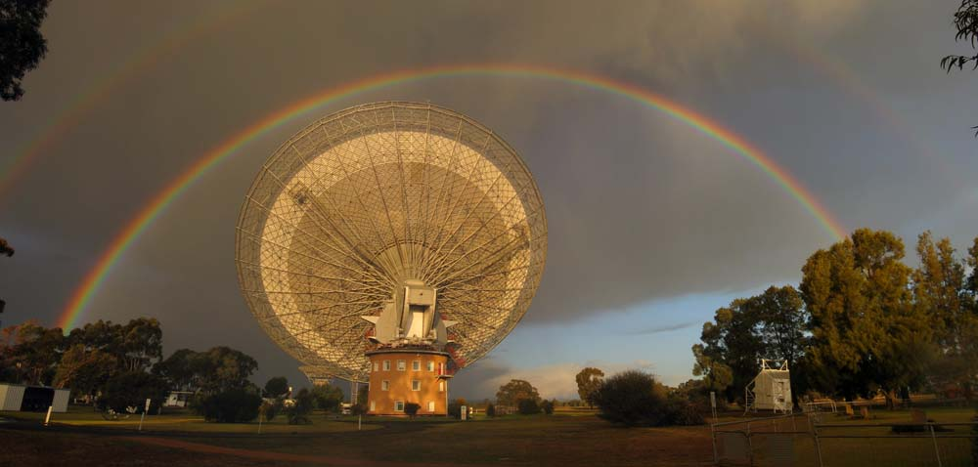
Spectrum Management: Parkes & ATCA
Briefing for ATUC members
Erik Lensson | Head, ATNF Engineering Operations
30 October 2012
CSIRO ASTRONOMY AND SPACE SCIENCE

Slide 2
Background
Eastern seaboard spectrum management, - RALI MS-31, (Parkes, ATCA, Mopra…) - RFI & NBN S-band wireless access rollout - Upcoming UHF spectrum auctions - CASS RFI monitoring initiatives (Technologies & Ops) - Implications for Parkes future instrumentation
ASKAP and MRO are in the (70,687km²) Radio Quiet Zone, - Band Plan, (legally binding) and - RALI MS-32 Procedures:
> MRO/RQZ spectrum issues not discussed today

Slide 3
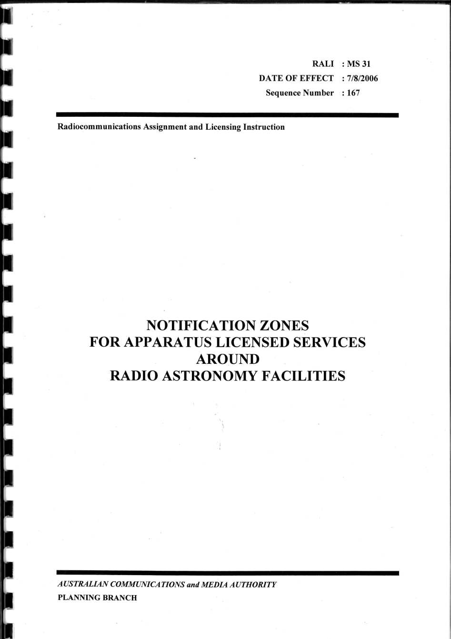
RALI MS-31
FN AUS87 recognition of unlicensed (‘fortuitous’) reception;
Goodwill coordination/negotiation;
Power density thresholds;
Parkes, ATCA, Mopra, CDSCC;
Mt Pleasant, Ceduna;
Apparatus licence only;
Procedure, 5 day turnaround;
‘atnf-spectrum@csiro.au’

Slide 4
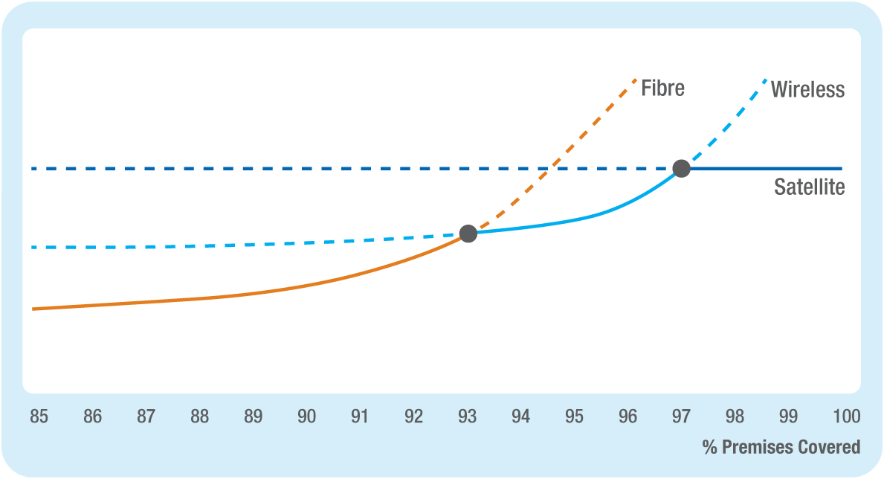
Service Delivery Model*
*per CEO Mike Quigley @ RADCOMMS 2012
‘Universal Broadband’ - Wholesale network; - Consumers deal through local retailers; - 12 Mb/s peak user throughput.

Slide 5
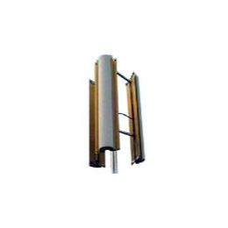
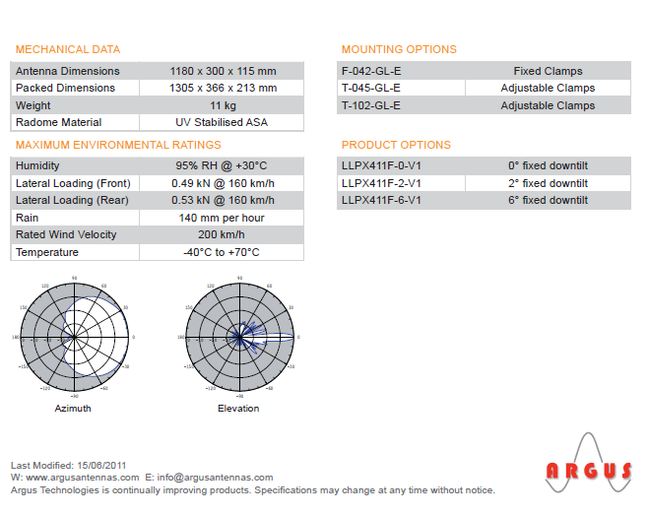
NBN Wireless
S-band (2300 – 2400 MHz) fixed wireless access
3GPP ‘LTE’ standard wireless technology in 20 MHz channels
TDD transmissions, 40/0.66 Mb/s down, 9/0.15 Mb/s up;
Hundreds of stations across rural & regional Australia
Ericsson $1.1B contract for design, build & operate (10yrs)

Slide 6

ATCA & Other Observatories
Mopra
Mt Pleasant (UTAS)
Ceduna

Slide 7

Other UHF Band$
694 – 820 MHz, UHF “Digital Dividend”. Auction April 2013. 126 MHz in 20 MHz lots. Caps on bidders;
2500 – 2690 MHz “ENG/TOBN vs 4G Wireless” “Simultaneous auction scheduled with 700 MHz, 20 MHz lots;
1427.9 – 1510.9 MHz “Mobile Broadband”, ACMA Discussion Paper (May 2012), 19 submissions, telcos, broadcasters, government agencies & CSIRO. Pending...
‘Midweek RFI’ and other new aeronautical and spaceborne emitters… many in the ‘redshift’ bands below 1400 MHz…

Slide 8
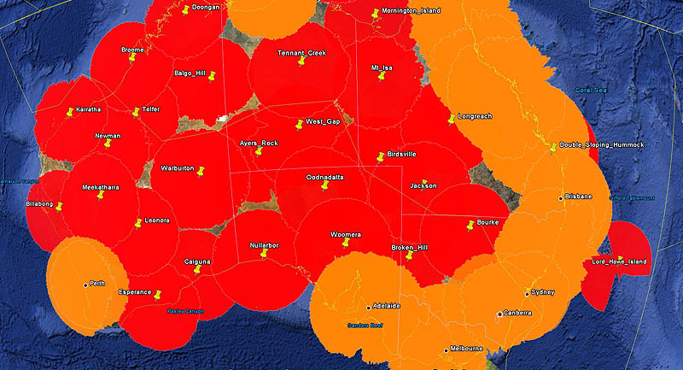
Aircraft ADS-B, 1090 MHz, 200 W/@20,000 ‘

Slide 9
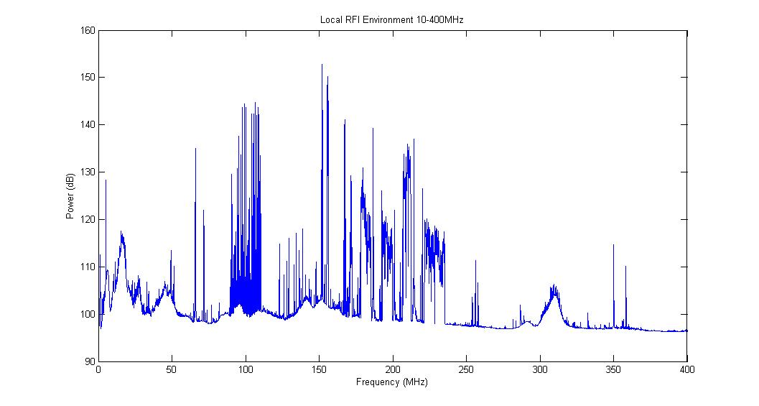
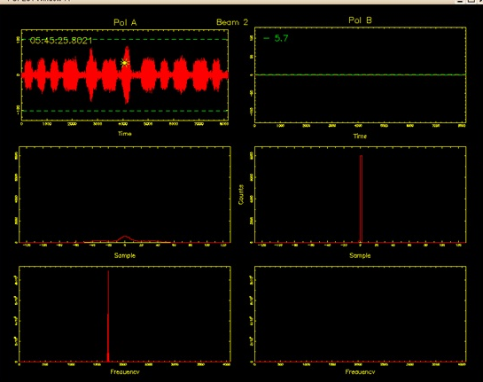
Parkes RFI Survey
Nominal coverage 25 MHz to 6 GHz in 50 MHz steps
Supports proposed 0.7 – 4 GHz broadband receiver
Need deep spectral and transient surveys at Parkes;
Development system based on SKA hardware + BEDLAM transient detector (Ron Beresford, Paul Roberts, Aidan Hotan, Aaron Chippendale)
Commissioning tests for full system ~end November
8 μs
BEDLAM

Slide 10
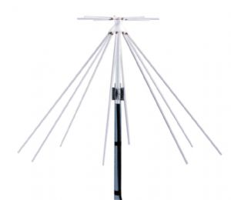
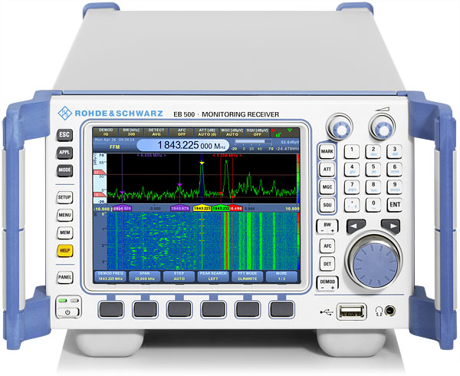
Operations RFI/EMC Monitoring System
(COTS) Rohde & Schwarz EB-500 Receiver;
20 MHz to 3.6 GHz, real-time 20 MHz FFT, scan & log;
Remote web interface – integrate with ACMA RADCOM database and ATNF RFI analysis software;
Observer or engineer located at SOC or any observatory, can check for RFI at any site/s;
One EB-500 unit purchased and evaluated;
Priority: MRO, Parkes & Narrabri;

Slide 11
Planning Wideband Receivers
Dynamic range extremely important, need to accommodate the highest level interferers in any part of the RX passband;
High 3IP LNA vs low Tsys (mutually exclusive?);
Filtering (pre/post LNA)?
Design with gaps in coverage? (where?, how big?);
RFI sampling, canceller design;
Antenna sidelobe characterisation (‘all-sky survey’);
Time invariant vs transient RFI;

Slide 12
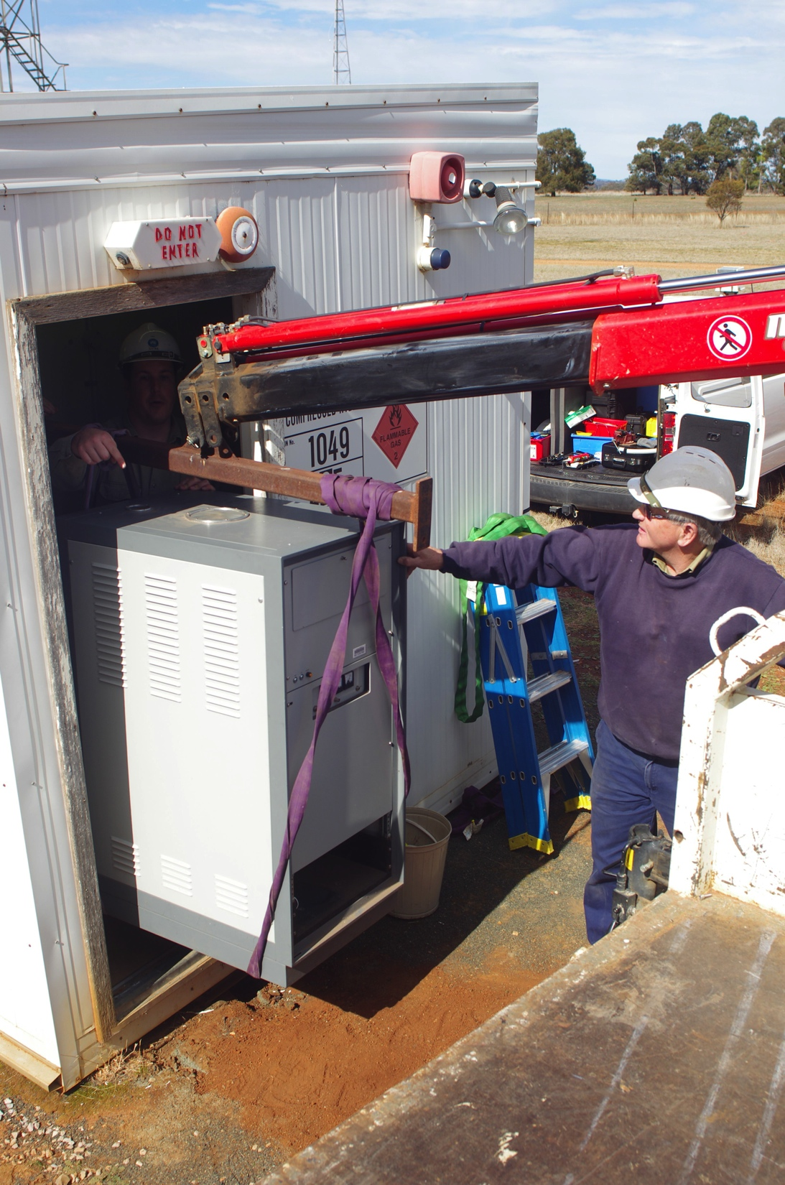
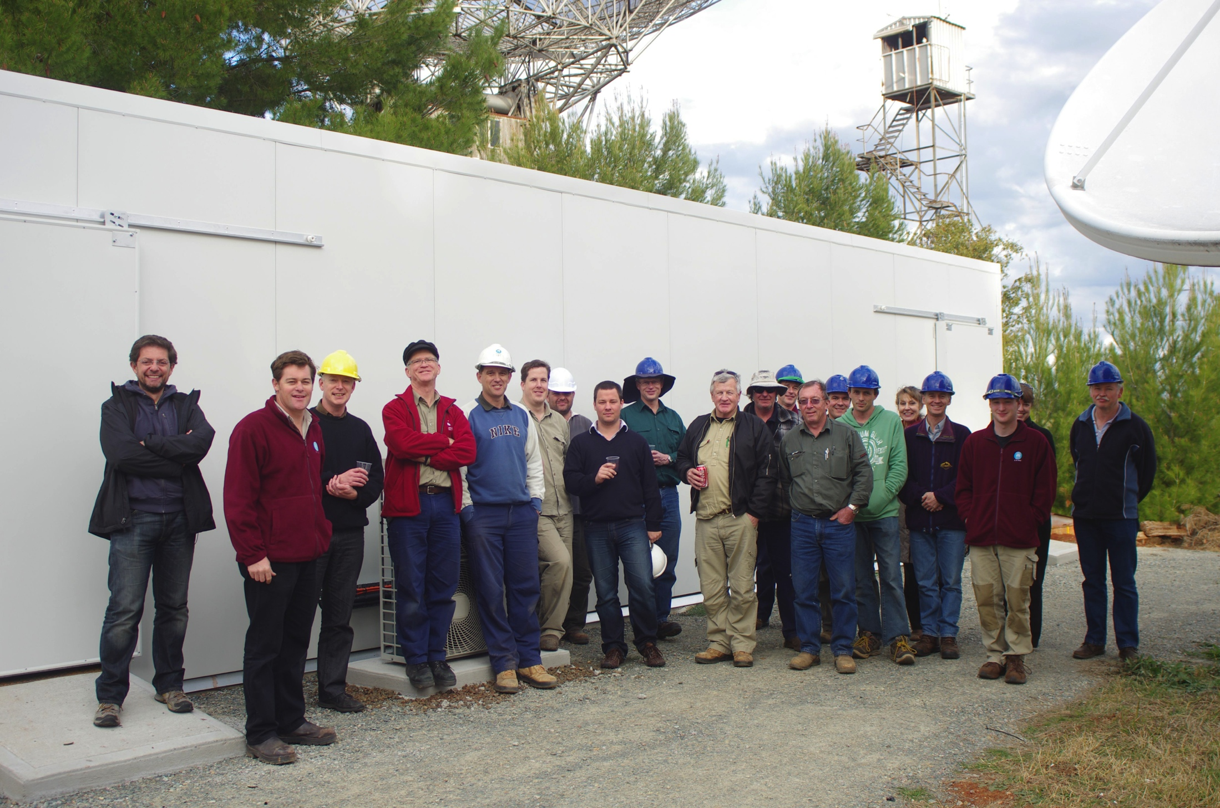
Other: Parkes Maser
PKS-ATCA Team led by Tim Wilson
and Ken Reeves ☑

Slide 13
Thank you
CSIRO Astronomy and Space Science
Erik Lensson Head, ATNF Engineering Operations
t +61 2 6861 1733
e erik.lensson@csiro.au
w http://www.atnf.csiro.au/
CSIRO ASTRONOMY AND SPACE SCIENCE

