Slide 1



The Carbon Farming Initiative and Agricultural Emissions
This presentation was prepared by the University of Melbourne for the Regional Landcare Facilitator training funded through the Australian Government’s Carbon Farming Initiative Communications Program

Slide 2
This presentation provides options available to increase carbon storage in land management systems
PART 7: OPTIONS FOR ABATEMENT – CARBON STORAGE

Slide 3
Kyoto and Non-Kyoto sinks
The Carbon Farming Initiative
Kyoto sinks
Reforestation
Afforestation
Kyoto sources
Enteric methane
Nitrous oxide
Non-Kyoto sinks
Soil C sequestration
Managed forests
Non-forest revegetation

Slide 4
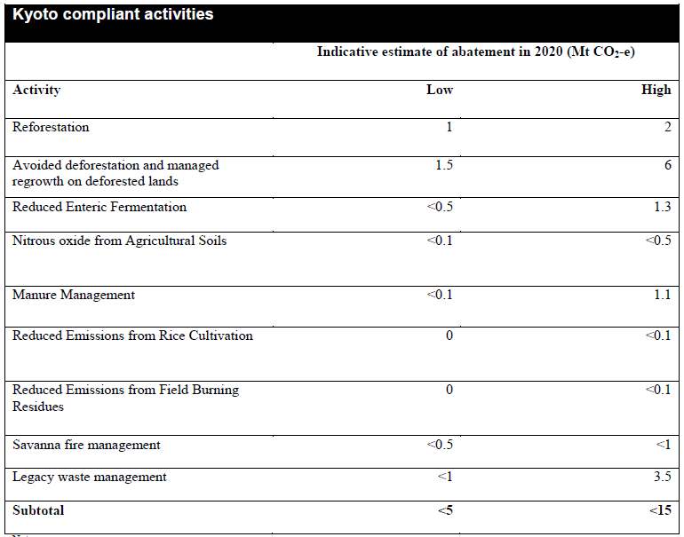
Indicative Abatement from CFI
Australia’s Annual Emissions 565 Mt CO₂-e yr⁻¹
DCCEE 2011

Slide 5
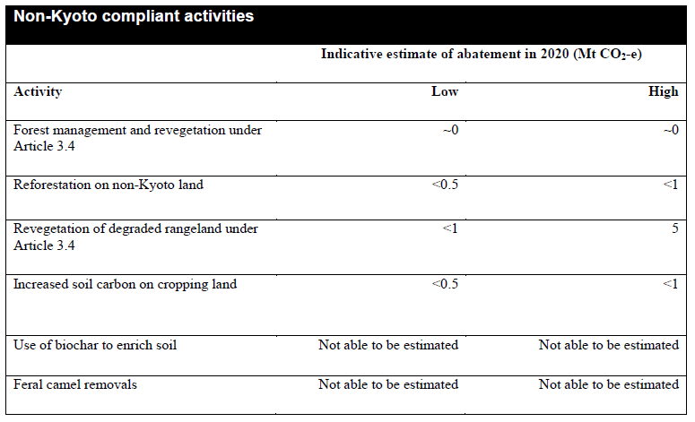
Indicative Abatement from CFI

Slide 6
Soil carbon
Many AUS soils have low soil C levels
→ old and weathered nature. Warm and dry climate
Large losses of soil C since conversion of native vegetation to agriculture
AUS farmers have adopted practices that reduce soil disturbance
Adoption of no-till and conservation farming practices
Adoption levels 90% in some areas
Rapid increases in last 5-10 years
Soil carbon loss can be reduced or soil carbon increased by:
Promotion of more plant growth
Adding organic matter from offsite sources
Garnaut Climate Change review update 2011

Slide 7
Soil carbon
Potential to increase soil carbon at any location depends:
Soil type
Water and nutrient availability
Temperature
Management history
Mitigation options with potential but little data:
Addition of large amounts of organic materials
Maximising pasture phases in mixed cropping systems
Shift from annual to perennial species
Considerable uncertainties for all of these opportunities
Few studies have tracked effects of management changes on soil carbon over an extended period
Risks – drought can reverse potential increases in soil carbon
Garnaut Climate Change review update 2011, Chapter 4

Slide 8
Can we quantify changes?
Will not be able measure in short-term
CFI will allow a deeming method
i.e. modelling
Various industry models can be used
If peer reviewed and validated.
Add measured points as means of validation
Source: Jeff Baldock

Slide 9
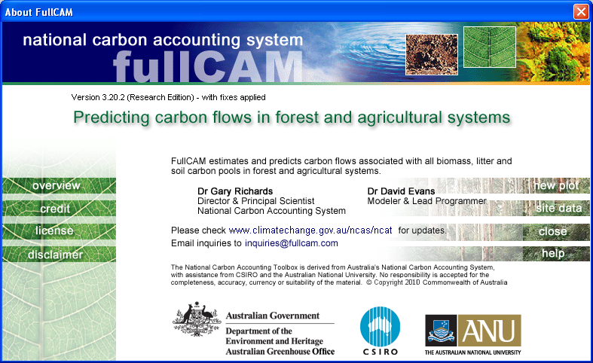
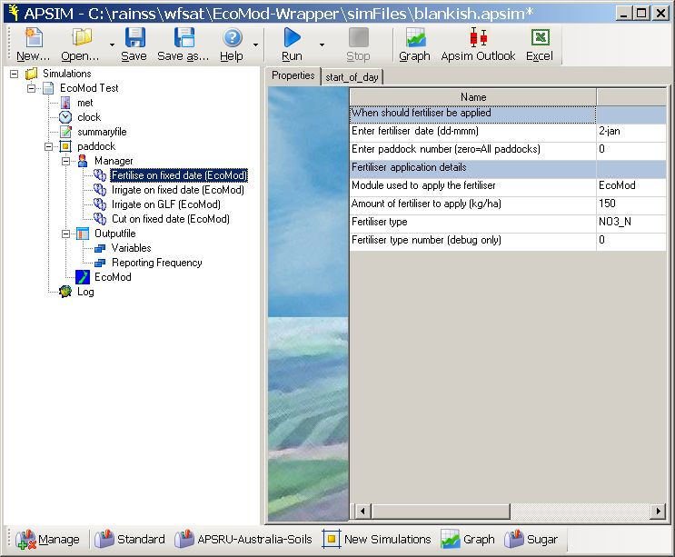
How prepared are our models?
To underpin a CFI offset method?
Must be validated and peer reviewed
Should align with quantifiable pools
To allow validation and peer review

Slide 10
Soil Carbon Models
Differing definitions in models
Alignment with measurable pools

Slide 11
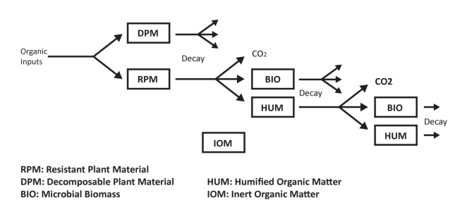
Roth C Model

Slide 12
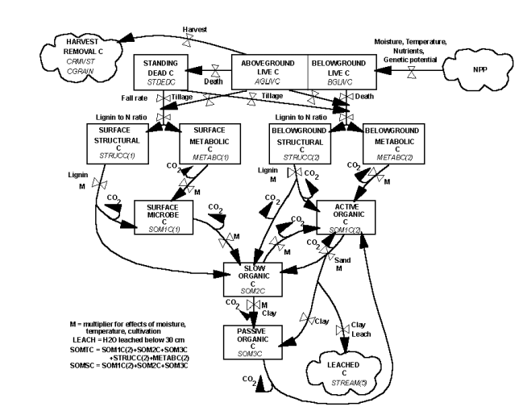
Century Model

Slide 13
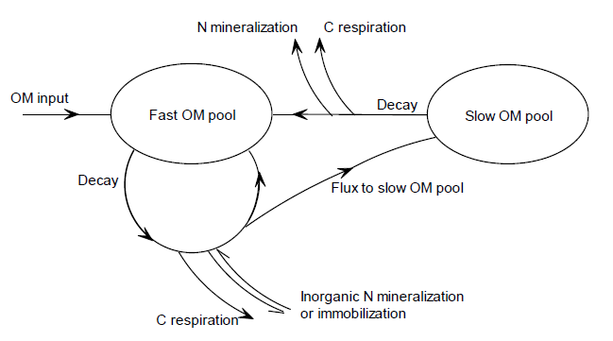
DairyMod & SGS

Slide 14
How prepared are our models?
Alignment of pools with measureable data
Model can be initialised without historical data
Model can be validated
Demonstrated for RothC (Skjemstad et al. 2004)
Various models used in Aus
Can produce similar results (eg. Ranatunga et al.)
If the assumptions are similar
Even if pools not all the same
Top down must align with bottom up accounting
Industry models and inventory must align

Slide 15
Final Thoughts
Priority for soil carbon to become part of the CFI as an offset method
Ensure models work on common assumptions
But must be
Validated and peer reviewed
Capable of long term (10 year) simulation
Price and Permanence – the big sleepers in soil C trading!

Slide 16
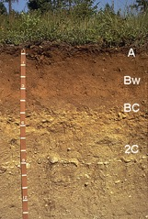
Final Thoughts
Building soil carbon is good practice
Trading soil C is a separate discussion
Non-Kyoto offsets may be lower priced
Rate of change in Soil C is slow (decades)
Reaches a saturation point, not permanently increasing
Rainfall and management are significant determinant of input vs losses of soil carbon

Slide 17
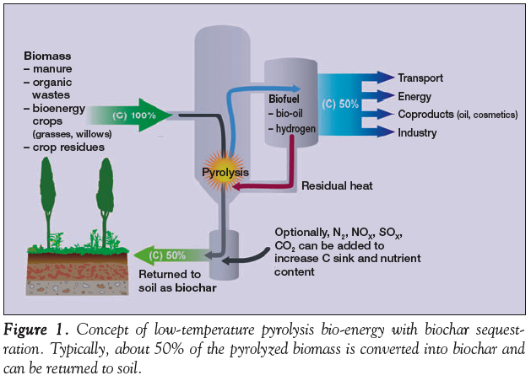
Biochar
Lehmann (2007) Front Ecol Env 5: 381

Slide 18
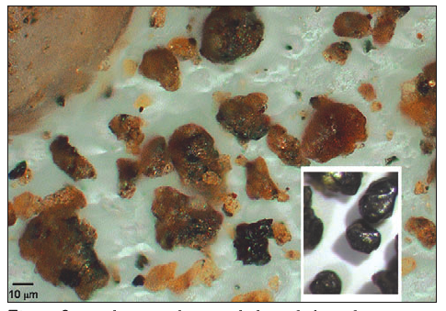
Biochar
Biochar can be produced from biological sources
→ wood, agricultural crop residues, green waste, biosolids
Gas produced in the biochar production process:
→ Production of electricity, conversion to liquid fuels
Biochar has a greater stability than the material from which it is made
→ Potential long-term carbon store
Biochar can improve soil fertility
→ Potential biosequestration benefits through enhanced plant growth
Garnaut Climate Change review update 2011, Chapter 4

Slide 19
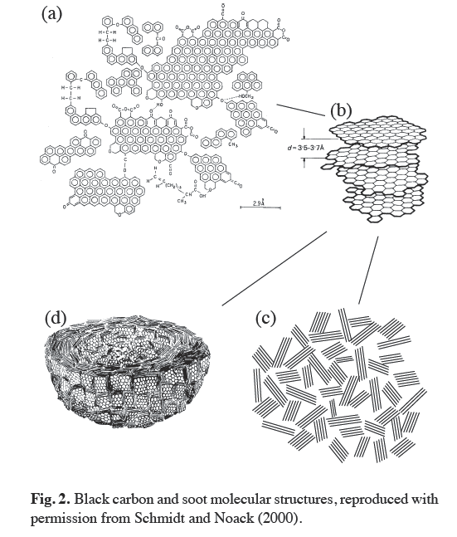
Biochar
Mitigation potential of biochar depends on life-cycle emissions from:
production of biochar feedstock and changes in land-use
production, transport and storage of biochar
displacement of fossil fuel emissions
Economic viability of biochar production and application
cost of feedstock and pyrolysis
impact on crop yield and fertiliser requirements
returns from renewable energy and a carbon price
Garnaut Climate Change review update 2011, Chapter 4

Slide 20
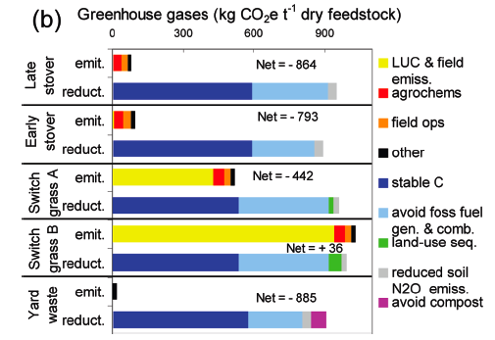
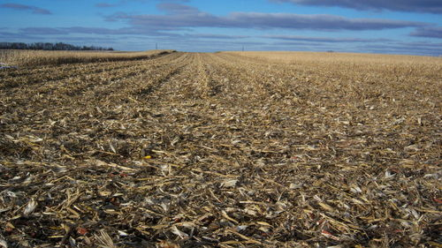
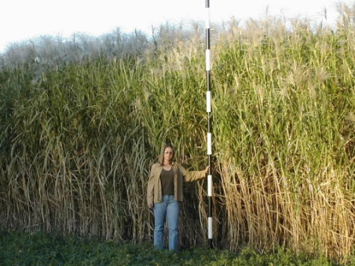
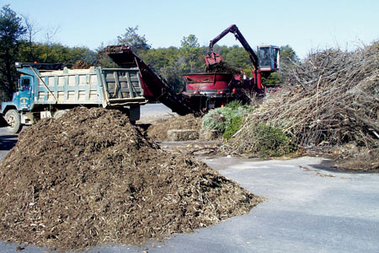
Biochar – life cycle analysis
Different models to calculate production emissions
Waste biomass streams have greatest potential
Energy crops can be GHG positive, emit more GHG than they sequester
Agric residues have potential for GHG reductions, moderate potential to be profitable
Assumption: 80% of biochar is stable in soil!
Roberts et al (2010) Env Sci Tech 44: 827

Slide 21
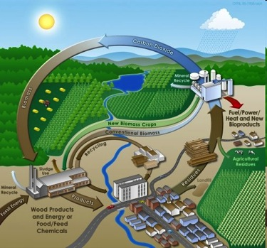
Biochar
Mallee species
Integrated tree processing:
→ Produce eucalyptus oil, bioenergy & biochar
only profitable if bioenergy production is
close to plantation
due to high production cost (harvesting &
transport) & low product price for wood energy
In US:
Bioenergy & biochar production economically
attractive at emissions permit price >US$37
Polglase et al (2008)

Slide 22
Biochar
Biochar is a promising theoretical concept
→ multiple environmental benefits
reduced fossil fuel emissions
C storage in soil
potentially improved soil fertility
HOWEVER
Most of the theoretical benefits need validation in the field
Beware of perverse outcomes (sustainability issues)
Economy of scale need to be tested
Industry needs to develop

Slide 23
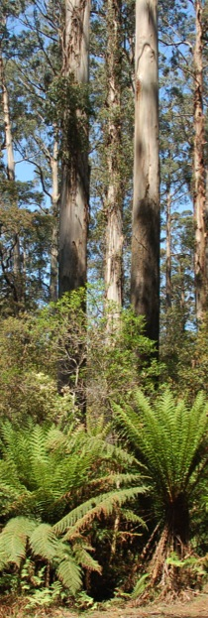
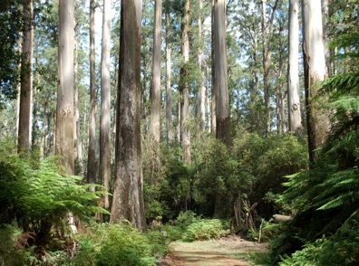
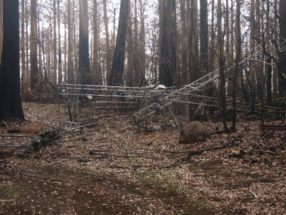
Managed existing forests
Conservation forests
Native forests cover 147 M ha of land in AUS = 20% of land mass
23 M ha in conservation reserves
9.4 M ha in public land timber production permitted
Rest public land other purposes and private land
Forests (pre 1990)
136 Mt CO₂-e yr⁻¹ for 100 yrs, assumes C stocks at 40%
capacity, timber harvesting ceases in 14 M ha
CSIRO: if native forest harvesting is to cease = 47M t CO₂ eq yr
Risks:
Fire, Diseases
Forests close to “carbon carrying capacity”

Slide 24
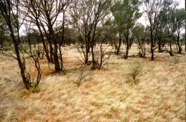
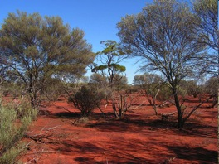
Non forest re-vegetation
Rangeland rehabilitation in Arid Australia
Vast areas of wooded land – red centre
Arid and semi arid rangelands
70% of AUS land mass - 550 M ha
Restoration of rangelands by reducing grazing pressure or palatable shrubs like saltbush, tagasaste, perennial shrubs
286 Mt CO₂-e yr⁻¹ 20-50 yrs
(improve degraded rangeland all grazing land
358 M ha = 0.2 t C ha⁻¹yr⁻¹)
CFI methodology for rangeland rehabilitation is being developed at present

Slide 25

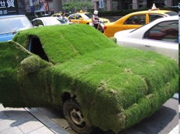
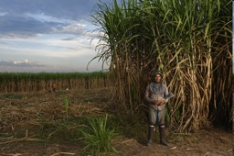
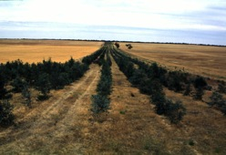
Non forest re-vegetation - biofuels
Biofuels
First generation biofuels = 1% of global transport fuel consumption
(sugarcane, corn, sugar beets, potatoes…)
To satisfy global demand = 75% of worlds agricultural land
Second generation biofuels:
→ Waste biomass, lignocellulosic material, algae, Pongamia, Jatropha
Opportunity for Mallee species (coppiced)
Research needed to identify best cropping systems for AUS

Slide 26

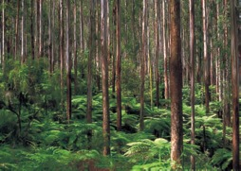
Reforestation and afforestation
Plantation and production forests
Doubling the plantation estate could increase C sequestration in plantations
In AUS to 50 Mt CO₂ by 2020
C storage by forest ecosystems:
1. Storage of C in forest biomass and soil
2. Storage of C in forest products – paper, furniture, construction
3. Displacement – use of biofuels to replace fossil fuels
4. Substitution – use of wood products that replace fossil fuel intensive products (concrete, steel, aluminium, plastic)

Slide 27
Reforestation and afforestation
Carbon accounting over two rotations
Substitution C
Displacement C
Forest product C
Carbon (t / ha)
Forest biomass C
Soil carbon

Slide 28
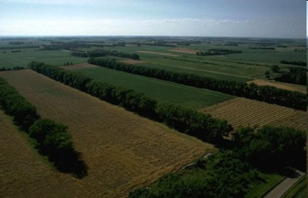
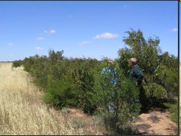
Reforestation and afforestation
Environmental carbon plantings
Revegetation of cleared or degraded land
Potentially available land = 200 M ha
climatic suitability
soil suitability
species characteristics
profitability compared to current land-use
rainfall interception

Slide 29
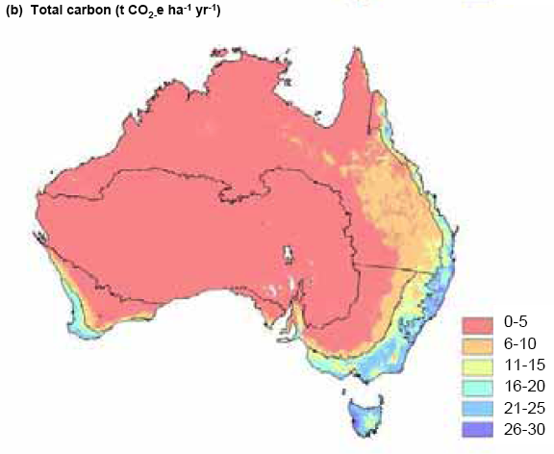
Reforestation and afforestation
Environmental carbon plantings
Total carbon in live biomass for 20 y.o. environmental plantings (t CO₂-e ha⁻¹yr⁻¹) normalised for 20 yrs
Polglase et al. (2008)

Slide 30
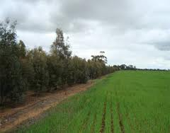
Reforestation and afforestation
Carbon forest plantings
CSIRO (2009): at a C price of $20/t CO₂ & incentives for biodiversity benefits = 350 M t CO₂ yr⁻¹
Mixed native species
Mallees
Other benefits for biodiversity, NRM or farm productivity
Planted in blocks, widely spaced rows, along stream banks
Corridor for native species
At least 20 businesses & non for profit organisations are offering carbon forest offsets in Australia:
Greening Australia, Greenfleet, Landcare Carbon Smart, CO2 Australia…
http://www.carbonoffsetguide.com.au/
Opportunities in a wider range of climate zones
In areas where agric. production is marginal and plantations fail
Diversification of income for farmers

Slide 31
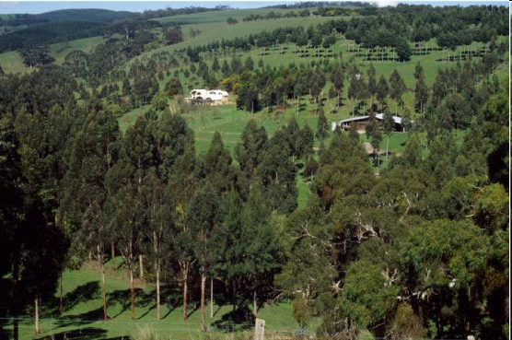
Reforestation and afforestation
Agroforestry
Farming practices and forestry options
Integration of trees and shrubs into farming landscapes for conservation and profit
Using trees to improve the environmental, social and economic values of their land

