Slide 1



The Carbon Farming Initiative and Agricultural Emissions
This presentation was prepared by the University of Melbourne for the Regional Landcare Facilitator training funded through the Australian Government’s Carbon Farming Initiative Communications Program

Slide 2
This presentation explains the nitrogen cycle in agricultural production systems and the various pools of nitrogen
PART 3: THE NITROGEN CYCLE IN AGRICULTURAL SYSTEMS
Notes:
This section takes 15 minutes to present

Slide 3
The nitrogen cycle
Content
The nitrogen cycle in agricultural systems
Fluxes between nitrogen pools
Forms of nitrogen and their fate

Slide 4
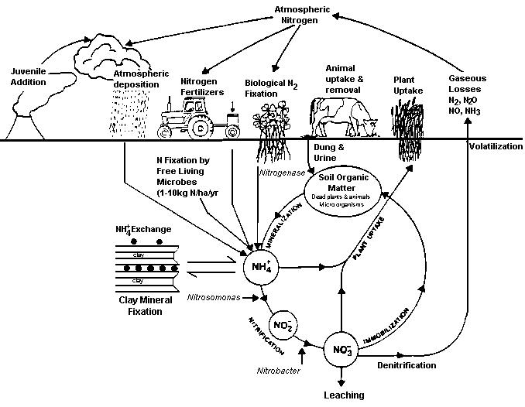
The nitrogen cycle
Whitehead 1995

Slide 5
The nitrogen cycle
Atmosphere
N₂ (nitrogen)
78% of the atmosphere
O₂ = 21%, CO₂ = 0.04%
Fixed by legumes into plants and soil
N₂O (nitrous oxide)
0.32 ppm (0.00003%)
Eckard 2011

Slide 6
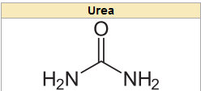
The nitrogen cycle
Main forms of soil & plant N
NH₃ – Ammonia
Organic matter
Fertilisers
Urea, DAP, UAN etc.
Major source of plant N
oxygen
amide ion
amide ion
Eckard 2011

Slide 7
The nitrogen cycle
Main forms of soil & plant N
NH₄⁺ – Ammonium
Soil solution
Loosely bound on cation exchange
Positive charge attached to clay
Exchangeable
Clay-fixed (non-exchangeable)
Does not readily leach
Major source of plant N (nitrogen)
Preferential uptake in colder, wetter soils
Rapidly converts to NO₃⁻ (nitrate ion)
In warm, well-drained soils
Eckard 2011

Slide 8
The nitrogen cycle
Main forms of soil & plant N
NO₃ (nitrate ion)
Major source of plant nutrition
Drier soils
Accumulates in some plants
e.g. Brassicas, annual ryegrass, kikuyu, cereal grains
Breaks down to NO₂ in rumen – toxicity
Soluble in water – leaches
NO₂ (nitrite ion)
Transient in plants and soils
Main form of toxicity in ruminants
Eckard 2011

Slide 9
The nitrogen cycle
Main forms of soil & plant N
Soil organic matter N
Decomposed residues
Amides, proteins etc
Microorganisms (microbial biomass)
C: N ratio
Usually 10:1 to 40:1
Major source of plant N
Through mineralisation
Eckard 2011

Slide 10
The nitrogen cycle
Mineralisation
Microbial breakdown of soil organic matter to ammonium
The main mechanism for supplying N to plants
Nitrification
Microbial conversion of ammonium to nitrate
Ammonia sources
Urine, decaying organic matter, fertiliser
Warm, moist (not waterlogged) soils
Denitrification
Microbial conversion of nitrate to N₂ and N₂O gasses
Warm, waterlogged soils
N₂O is a powerful greenhouse gas
Immobilisation
Microbial assimilation of soil nitrogen into OM
OM
organic matter
NH₄⁺
ammonium ion
NO₃⁻
nitrate ion
N₂
N₂O
nitrogen
nitrous oxide
Eckard 2011

Slide 11
The nitrogen cycle
Nitrogen balances in Agricultural systems
Biological efficiency
Less than 50%
N Inputs | Dairy | Grains
N fertiliser | 150 | 90
N₂ fixation | 80 | 0
Atmosphere | 8 | 8
Feed | 45 | 0
Total Input | 283 | 98
N output in product
Milk | 80
Meat | 8
Grain |  | 40
Total Outputs | 88 | 40
N Surplus | 195 | 58
Efficiency (%) | 31 | 41
Eckard et al 2007

