Slide 1
Christmas Decorations in the Rainforest
by Celia Berrell

Slide 2
The jun gle knows noth ing of Christ mas
but still seems to put on a treat
of vis u al sea son al splen dour
through rain clouds
and sun shine and heat

Slide 3
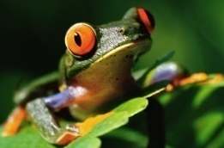
At night time the fire flies are flash ing
and fung i glow lum in ous green
The leaves by the creeks are be jew elled
with col our ful tree frogs in teams

Slide 4
The beet les are fly ing and crawl ing
They glis ten in shim mer ing hues
And baub les of fruit hang a wait ing
in por cel ain white reds and blues

Slide 5
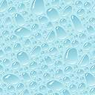
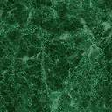
The tree snakes are draped on the bran ches
and but ter flies hang up side down
There’s no need to add de co ra tions
The Jun gle Did
all on its own!

