Slide 1

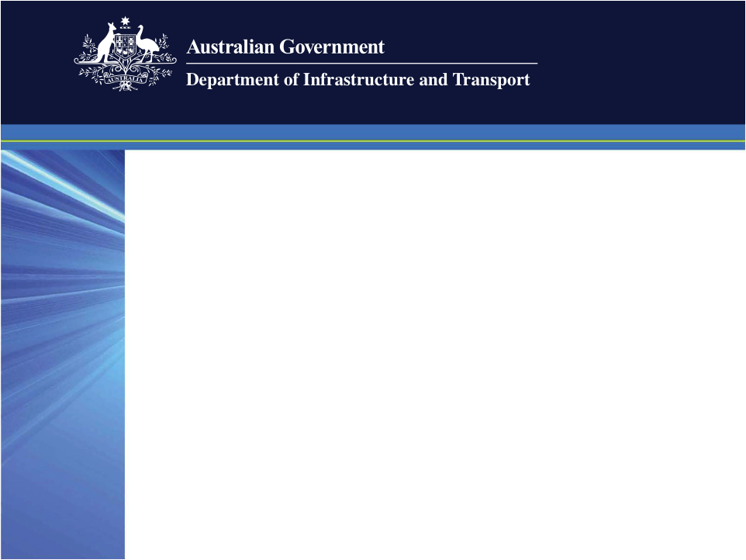
Regulatory Landscape for Leased Federal Airports
Archerfield Airport Community Aviation Consultation Group
(AACACG)
2 November 2011
Helen Gannon
Aviation & Airports

Slide 2

Privatisation – Quick Recap
All key Federal airports previously belonged to the Federal Airports Corporation - Government owned
Occurred from 1997-2003 (Archerfield in 1998 – part of Phase 2)
Reflected a desire to encourage better aeronautical infrastructure investment and enhance competition in Australia

Slide 3
Government Regulation – How?
Under contractual agreements - head leases (and sale agreements) with airport lessee companies
Legislative measures - (Airports Branch context only):
- Airports Act 1996 and associated Regulations
= Airports Regulations 1997
= Airports (Environment Protection) Regulations 1997
= Airports (Building Control) Regulations 1996
= Airports (Control of On-Airport Activities) Regulations 1997
- other Regulations for security, airspace protection, environment etc
Airport specific legislation (eg. Sydney Airport Demand Management Act 1997)

Slide 4
Master Plans
Master Plans (MP) have a 20 year strategic horizon for airport future intentions
Updated every 5 years
High level planning document that sets the development objectives for the airport and include proposals for land use
Provide an assessment of airport user needs for services and facilities
Include a public comment period
Minister is the decision maker

Slide 5
Major Development Plans
Required for large developments - such as
- constructing new runways / taxiways, or extending them
- constructing new passenger terminals or extending them
- non-aeronautical developments where the cost is > A$20m
- development that is deemed to have significant community impact
- environmentally-significant developments
- ‘sensitive developments’
Include a public comment period
Minister is the decision maker

Slide 6
Aviation White Paper
‘Flight Path to the Future’ released 16 December 2009
Better integration with state and local government planning
Strengthens community consultation
Identifies uses which are not compatible with airport sites

Slide 7
2010 Legislative Amendments
Airports Act 1996 - Airports Amendment Bill 2010
- greater integration of on-airport and off-airport planning
- Minister may determine a major development plan is not required for certain aeronautical developments
- Airport Environment Strategy (AES) and ground transport plan incorporated into airport MP
- new significant community and sensitive development MDP triggers
- clearer definition of ‘business day’
- up to 10 extra business days for Minister’s decision on MP or MDP
Airports Regulations 1997
- consequential / transitional amendments following amendment of Act

Slide 8
Strengthened Master Plans
Additional requirements for the first five years
plan for ground transport system on landside of airport
detailed information on the proposed developments for non- aeronautical purposes
likely effect of proposed developments
detailed AES incorporated into MP – no longer separate
Now only one public consultation and approval process for MP and AES

Slide 9
Significant Community Impact
Applies regardless of the size or cost of a development
MDP will be required if a development will conflict with the local planning scheme around the airport or causes concern among the community
Like all MDPs, must undergo full public consultation - therefore gives the community the chance to have their concerns addressed
Draft guidelines circulated for public comment - nearing finalisation

Slide 10
Sensitive Developments
Applies to developments which may be incompatible with airport operations
- residential dwellings
- schools, pre-schools and non-aviation educational facilities
- hospitals and community care facilities
Airport lessee company must demonstrate why development is not sensitive and seek Minister’s approval to proceed with a MDP
If the Minister approves preparation of a MDP, full public consultation must be undertaken as part of the process
Approval of preparation of MDP does not mean approval of MDP

Slide 11
Airport Planning & Community Engagement
Planning Coordination Forums (PCFs) for all capital city airports
promote integration of on and off airport planning and development
voluntary for other leased Federal airports
Community Aviation Consultation Groups (CACGs) for all leased Federal airports
mechanism to ensure appropriate community engagement on airport planning and operations
enable airport operators, residents affected by airport operations, local authorities, airport users and other interested parties to exchange information on issues relating to airport operations and the impacts of these operations on surrounding communities
independently chaired
PCF & CACG guidelines released by Minister Albanese 18 February 2011

Slide 12
Thank You

