Slide 1
Concrete 2011 Time to Dump the Rectangular Stress Block?
Doug Jenkins - Interactive Design Services

Slide 2
Introduction
Everything should be made as simple as possible,
... but not simpler. Albert Einstein

Slide 3
Introduction
Are the rectangular stress block provisions for the calculation of ultimate bending capacity “too simple”?
It depends

Slide 4
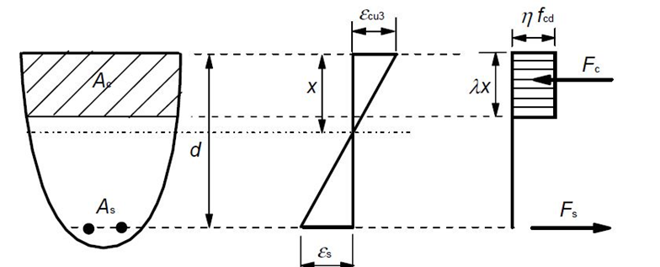
Background
Eurocode 2 Rectangular Stress Block

Slide 5
Background
All the major international concrete codes have provisions for a rectangular stress block.
For concrete strengths up to 50 MPa the AS 3600 provisions are almost identical to those in ACI 318.
The current AS 3600 has provisions for a reduced stress factor for concrete strengths above 50 Mpa, whereas ACI 318 uses a constant stress factor, and has no specified upper limit on concrete strength.
Eurocode 2 has provisions for rectangular, parabolic-linear, and non-linear stress blocks

Slide 6
Rectangular Block Advantages
Simplicity
Well-validated, experimentally and in practice
Good agreement with more complex stress blocks for rectangular cross sections.

Slide 7
Rectangular Block Disadvantages
Significant error in calculated moment capacity for non-rectangular sections
Adjustment of stress factor required for concrete strengths greater than 50 MPa
Alternative stress blocks allow the same provisions to be applied for all concrete strengths and cross sections without an associated loss of accuracy

Slide 8
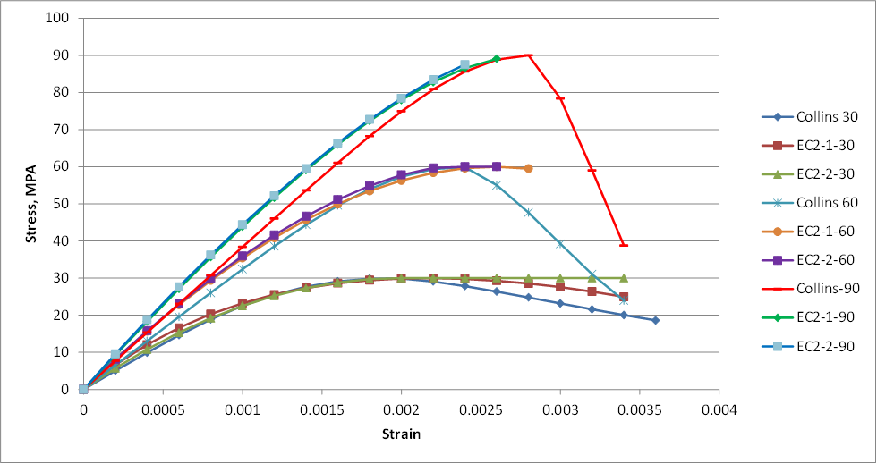
Alternative Stress Blocks

Slide 9
Equivalent Stress Block Calculation
Find factors α (stress factor) and γ (depth factor) such that the area under the rectangular stress block and the lever arm about the neutral axis are equal to the equivalent values for a curvilinear stress block:
Find the lever arm of the curvilinear stress block for unit stress block depth, LA_{c}
Find γ such that the rectangular stress block lever arm, La_{c,} is equal to LA_{c}:
(1 – γ/2) = La_{c}
γ = 2(1 – La_{c})

Slide 10
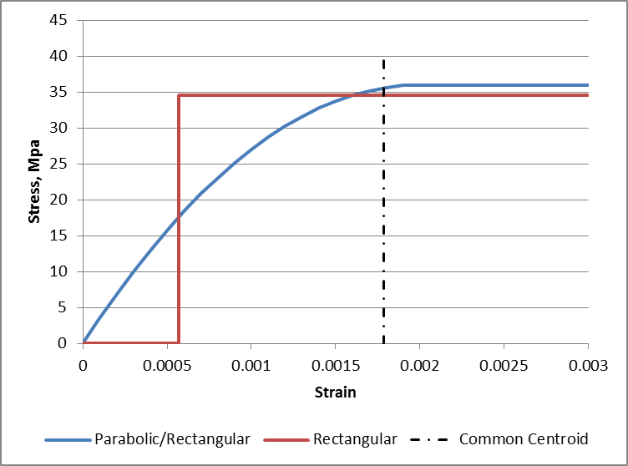
Equivalent Stress Block Calculation
Find α such that the area under rectangular stress block is equal to the area under the curvilinear stress block:

Slide 11
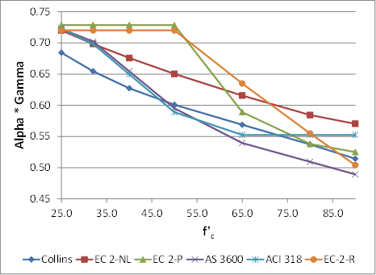
Equivalent Stress Block Parameters

Slide 12
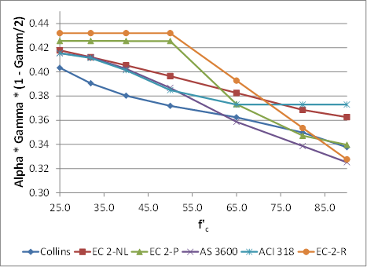
Equivalent Stress Block Parameters

Slide 13
Alternative Stress Block Comparison
Calculations in accordance with AS 3600 Cl. 8.1.2
No capacity reduction or partial safety factors applied
Cylinder strength factored by 0.9, in accordance with AS 3600
Reinforcement : elastic-plastic stress-strain curve, yield stress = 500 MPa, elastic modulus = 200 GPa.
Section ultimate bending capacity calculated about the centroid of the gross concrete section
Ultimate strain adjusted to maximise capacity
Three sections compared at 32 MPa, 65 MPa and 90 MPa

Slide 14
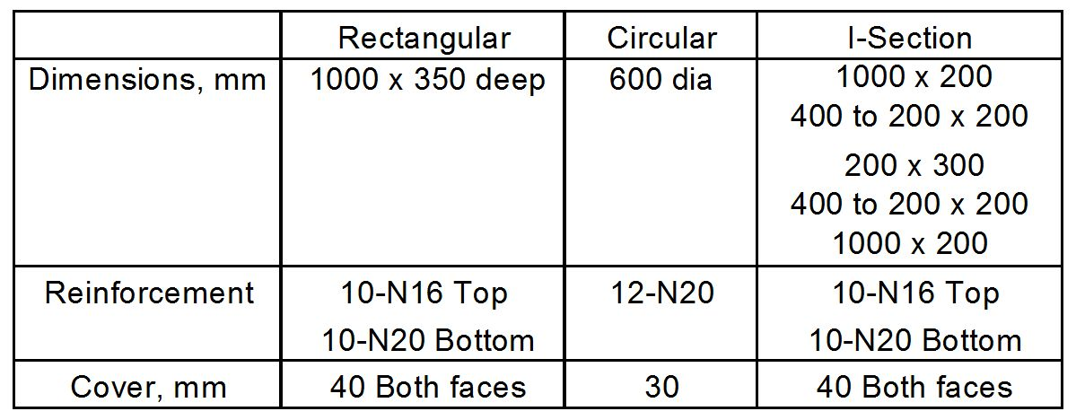
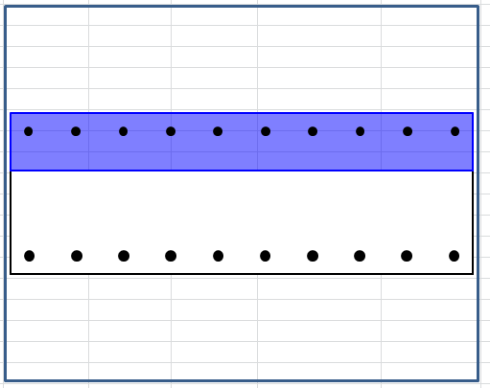
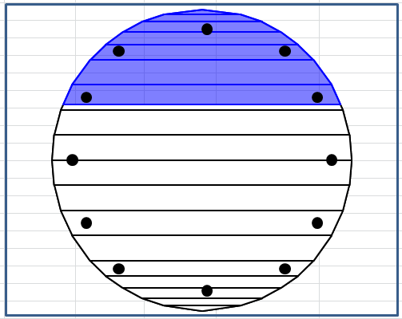
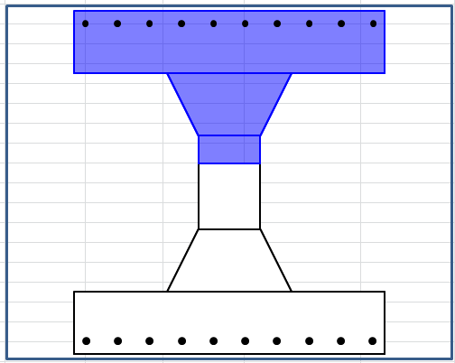
Alternative Stress Block Comparison

Slide 15
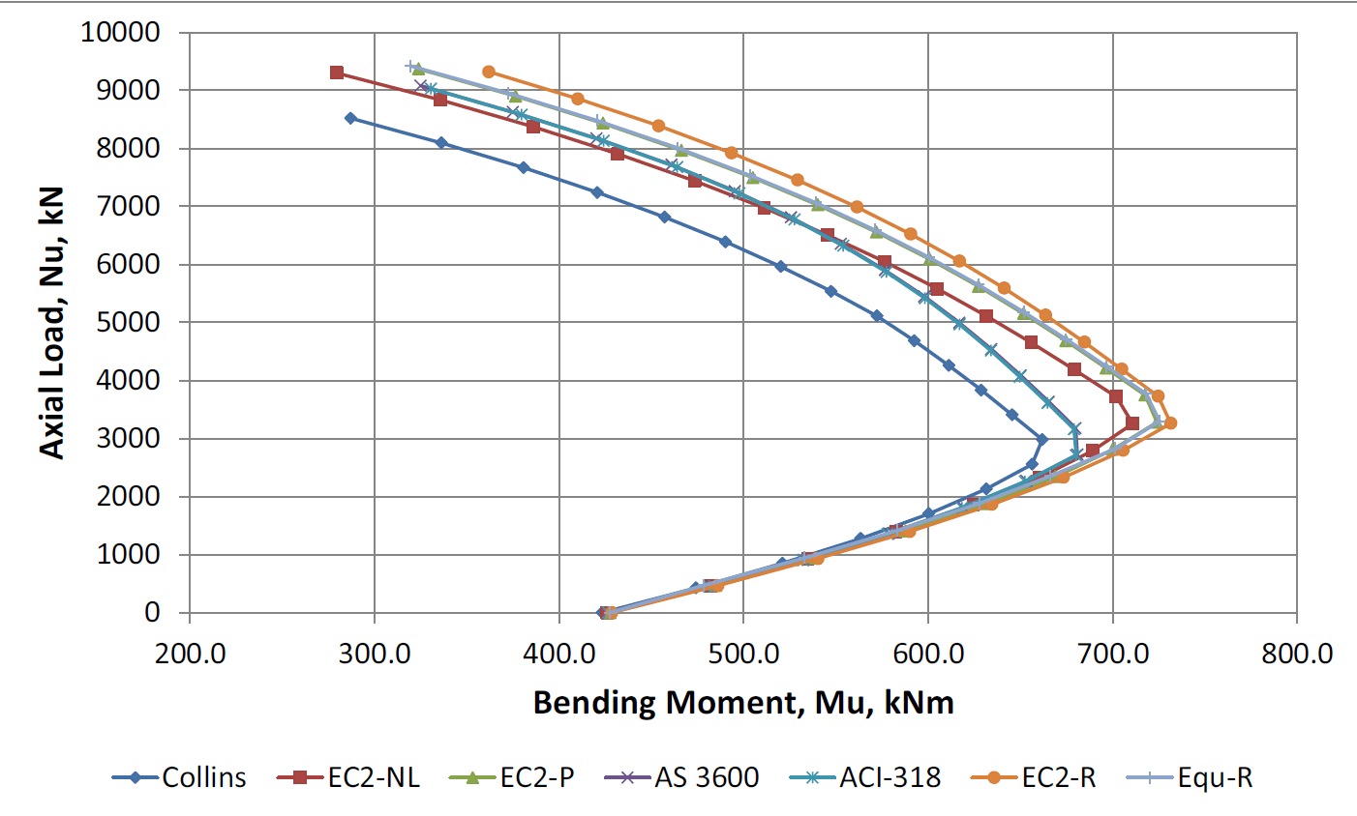
Rectangular Section; 32 MPa

Slide 16
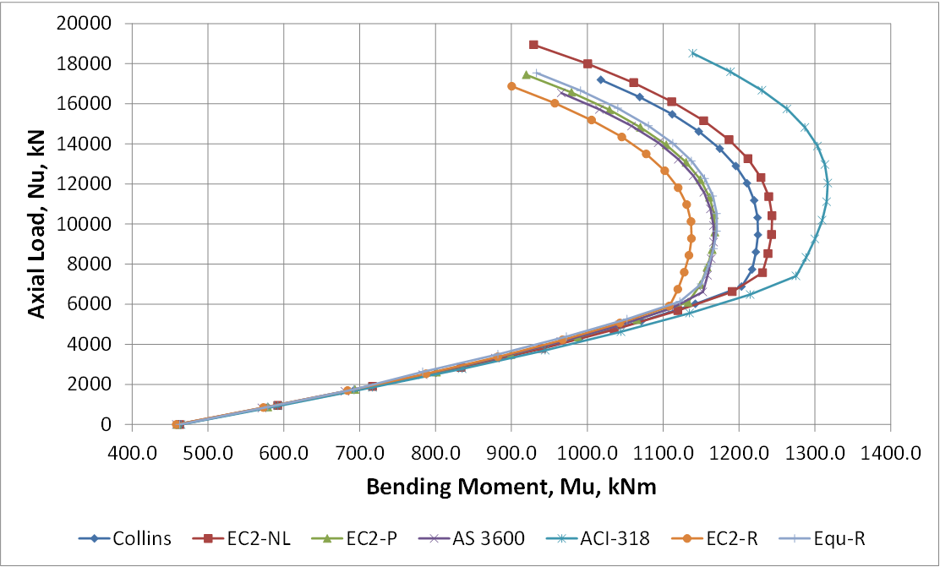
Rectangular Section; 90 MPa

Slide 17
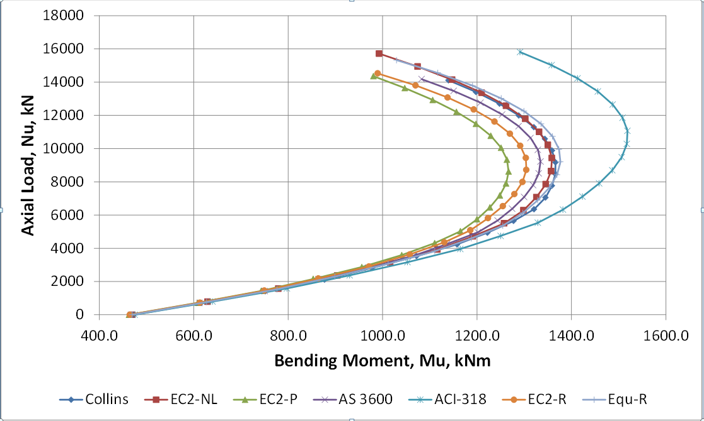
Circular Section; 90 MPa

Slide 18
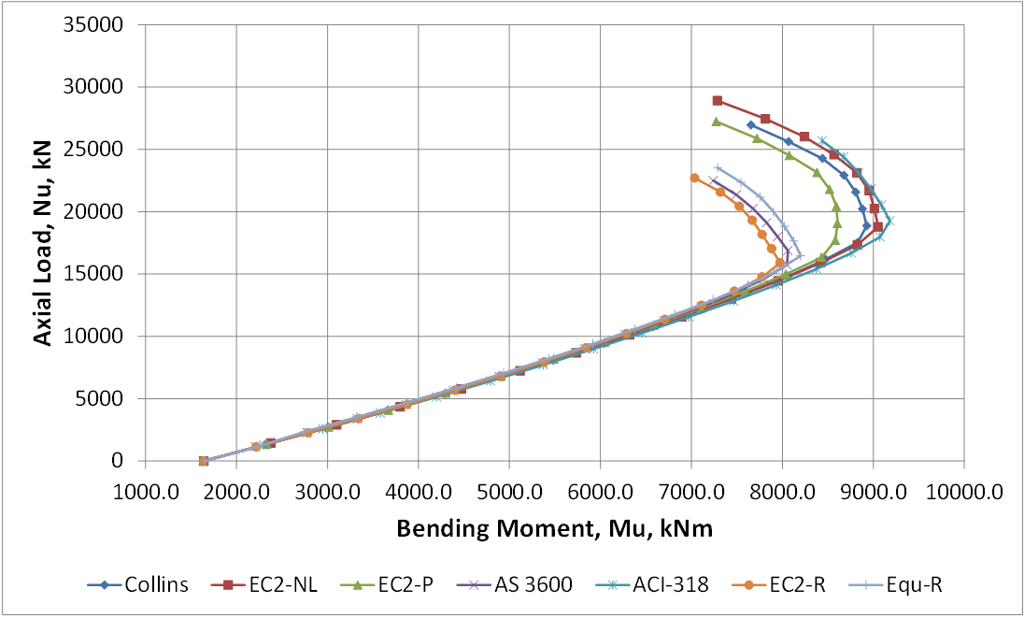
I Section; 90 MPa

Slide 19
General Conclusions
Eurocode 2 parabolic/rectangular block (EC2-P) consistent with non-linear curves, and more conservative for high strength grades, used as benchmark.
“Equivalent rectangular stress block” (Equ-R) results were almost identical to the EC2-P block for rectangular cross sections.
Equ-R results up to about 10% unconservative with a circular section, or 10% conservative with an I section.
ACI 318 results very unconservative with 90 MPa concrete.

Slide 20
General Conclusions
Eurocode 2 rectangular stress block (EC2-R) did not correlate well with EC2-P results: least conservative at 32 MPa and most conservative at 90 MPa.
AS 3600 rectangular stress block results similar to EC 2 equivalent stress block.
Eurocode 2 recommends reduction of concrete stress by 10% when width of compression zone reduces towards the compression face.

Slide 21
Recommendations
Retain rectangular stress block for compatibility with existing software and design charts, but:
Introduce a parabolic-rectangular stress block with similar form to Eurocode 2.
Provide simple procedure for deriving parameters for an equivalent rectangular stress block for use with rectangular compression zones.
Recommend parabolic-rectangular block for non-rectangular sections with significant axial load.
Review Eurocode parameters for concrete grades 80 MPa and higher.

Slide 22

Further Information and Software
http://newtonexcelbach.wordpress.com/

