Slide 1
Integ systems pty ltd
Serving the Mining Industry

Slide 2
It is the desire of Integ System to partner with clients to see measurable improvements in plant reliability performance and develop cost effective change that benefit all parties.

Slide 3
SERVING INDUSTRY

Slide 4
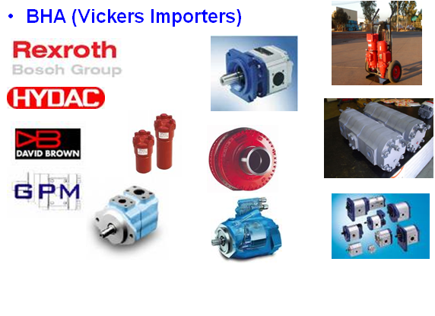
Exclusive Goldfields Distributor For:-
THW
THW (VICKERS IMPORTERS)

Slide 5
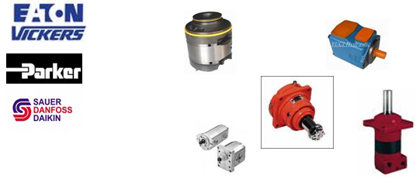
Integ systems Can access the following product brands
These trade names are used for reference only. Integ Systems Pty Ltd is in no way affiliated with these companies.

Slide 6
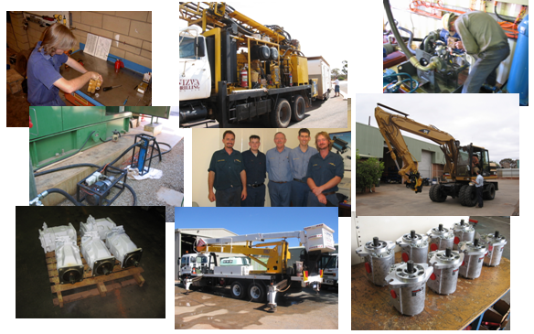
SERVICE Integ Systems offers a modern workshop facility with qualifed Fluid Power technicians capable of servicing all your hydraulic, lubrication and filtration needs.

Slide 7
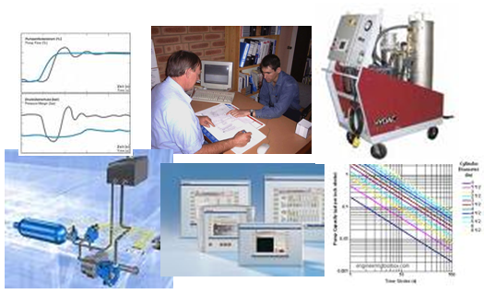
DESIGN Integ Systems offers design of new Hydraulic, Lubrication, Filtration and Pneumatic Systems and modification, upgrades to existing circuits.

Slide 8
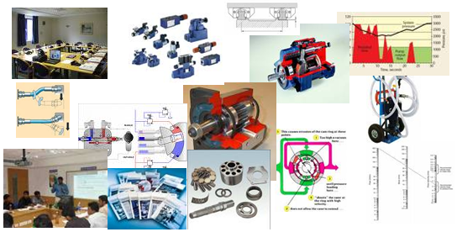
Training We also offer training in Hydraulics, Filtration, Lubrication and will if required put together custom training programs to meet a clients specific needs.

Slide 9
CONTACT INFORMATION
Address:- Unit 4/2 Keogh Way, Kalgoorlie, WA 6430
Mailing:- Po Box 10576, Kalgoorlie, WA 6433
PH:- 08-9091133 Fax:- 08-90911355
ABN: 14 080 369 222

