Slide 1

Developing and testing a model of aggressive driving
Alexia Lennon, Barry Watson, Narelle Haworth, Ray Bingham
Directions in Road Safety Symposium
Adelaide May 2011
CRICOS No. 00213J

Slide 2
Current program of research
ARC Discovery funding 2011-2014
APAI PhD scholar appointed to the project (April)
4 sub-studies
Study 1: Refining the model; operationalising variables(?)
Study 2: Testing the model
Study 3: Checking operationalisation and testing of model in simulated driving conditions
Study 4: Pilot study to examine external validity of model in semi-naturalistic conditions (instrumented vehicle data)
CRICOS No. 00213J

Slide 3
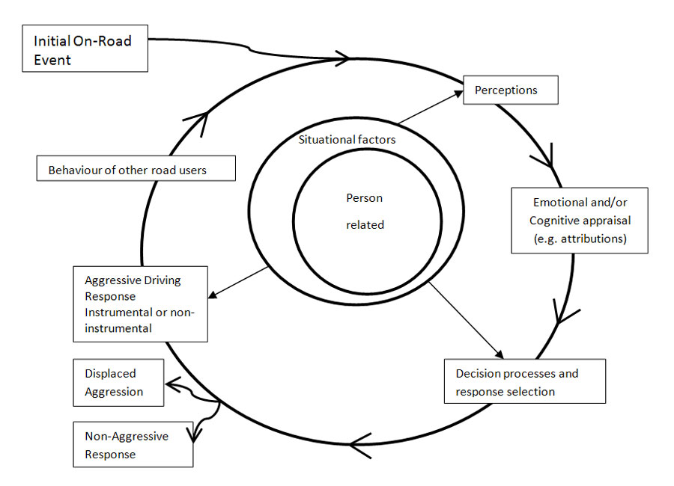
The model

Slide 4
Study 1: Refining the model
Aims:
Examine cognitive, affective, & appraisal processes components of model
Explore function of aggressive driving behaviours
Inform development of driving scenarios
Mixed methods design
1A: driver diaries (n = 156); structured; 2 weeks of entries focussed on thoughts, emotions and conflict events as recipient & perpetrator;
plus standardised instruments (eg. DAX; DAS)
1B: follow-up interviews (drivers w high levels incidents)

Slide 5
Anticipated outcomes:
Better identification of trigger events, functions of aggressive driving behaviour
Identification of critical issues
Identification/verification of critical variables to include for later studies
Refinement of model

Slide 6
Study 2: Internet survey
Aims:
Explore generalisability of model
Refine model
Address key issues
Method
Internet survey with video streaming of simulated driving scenarios
Seeking representative sample general driving pop n = 300
Variables: state/trait anger; hostility; anxiety; sensation seeking; anger expression (driving); driving history; emotional, cognitive and behavioural responses to vignettes

Slide 7
Anticipated outcomes
Refinement of model esp cognitive/affective appraisal processes, functions of AgDr, attributions re other driver behaviour;
Examine validity of model
Identify/explore mediational role(?) of emotions/cognitions on self-reported behaviour
Inform scenarios for Study 3

Slide 8
Study 3: Driving simulator
Aims
In depth refinement and testing of specific components of model in more real world conditions
Examine relationship victimisation/perpetration by focus on perceptions of other driver intent
Method
Advanced driving simulator; small sample (n =78)
Standardised instruments; 20-30 min simulated drive; interviews to recall internal experiences assoc w key events
Categorise perceptions of ‘other driver’ intent

Slide 9
Unresolved issues
Recruitment
Representativeness
Operationalisation
Validity

Slide 10
Mark your Diaries!
10th National Injury Prevention & Safety Promotion Conference, Brisbane
November 2-4th 2011,
Brisbane Convention and Exhibition Centre

