Slide 1
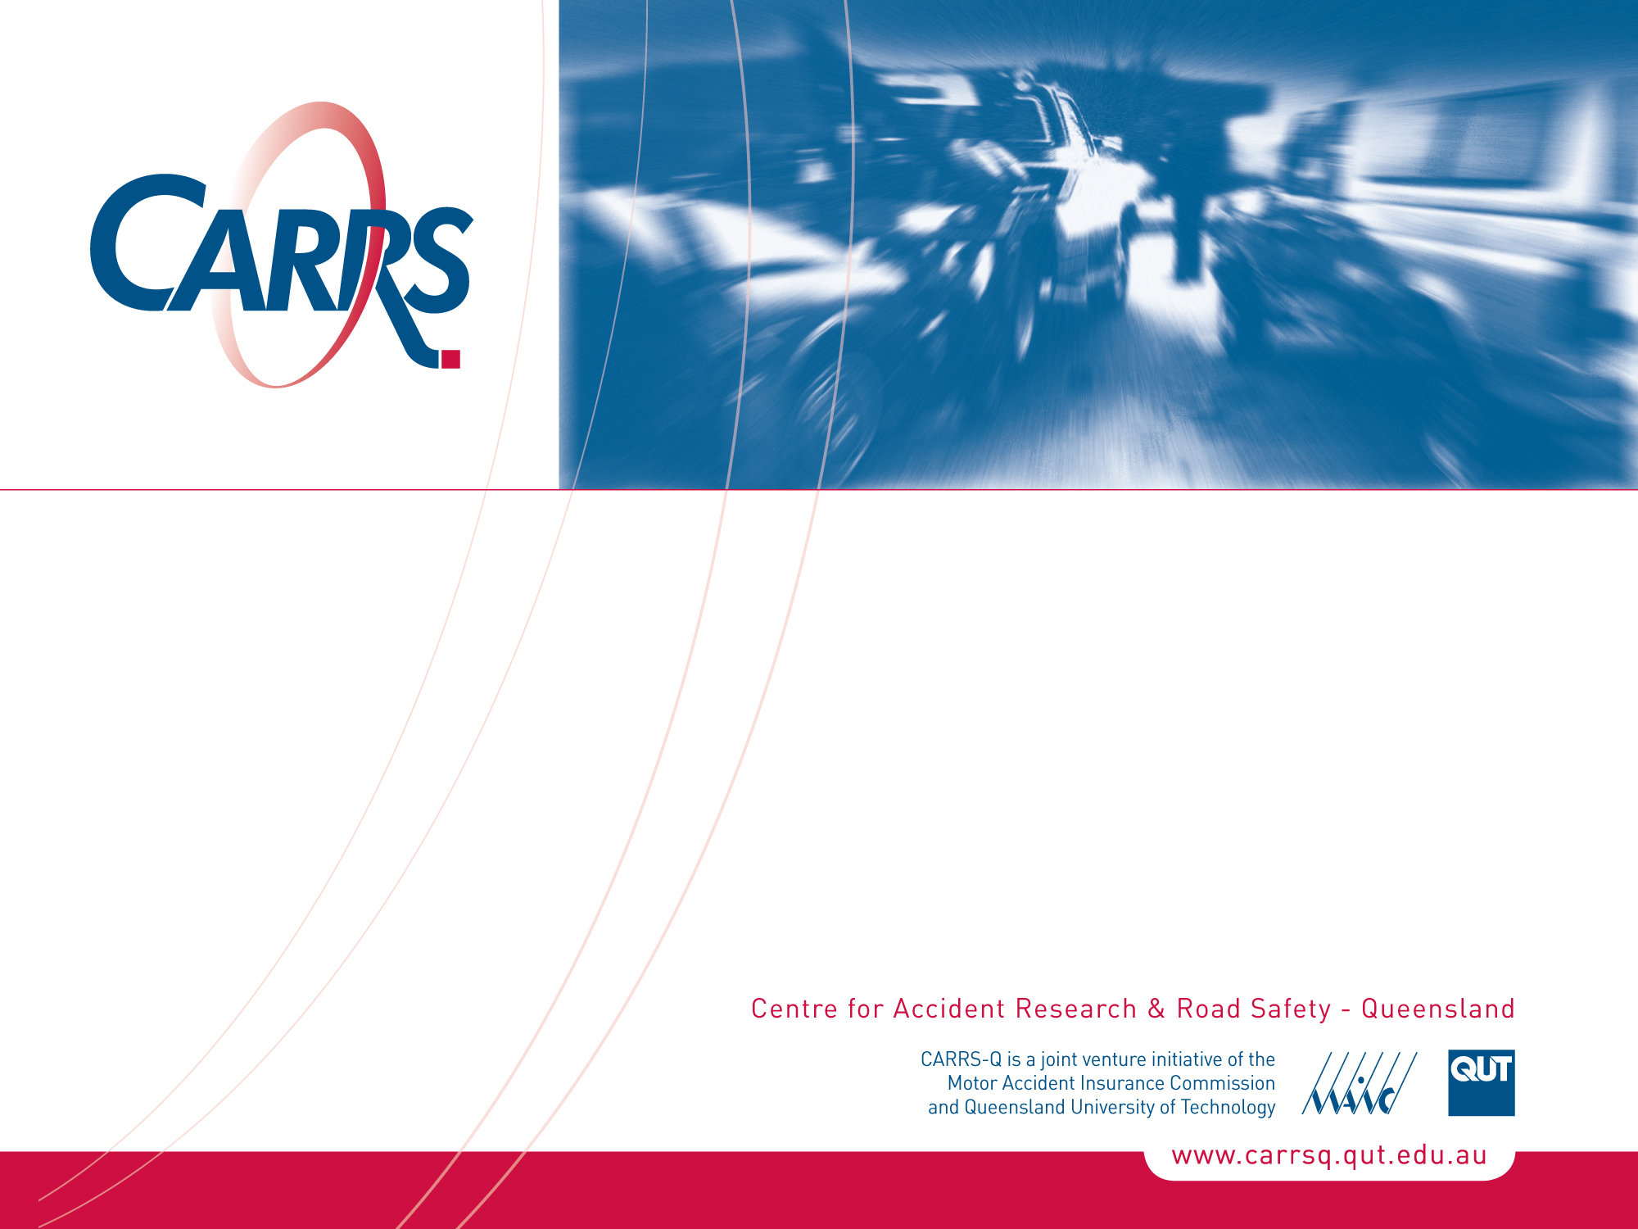
Social influences on Chinese drivers: Cultural context & traffic law enforcement
Dr Judy Fleiter
ITMA World Congress, Chongqing, May 13-16 2011
CRICOS No. 00213J

Slide 2
Acknowledgements
Chinese Academy of Sciences
Institute of Psychology, Graduate Management School
Prof Shi Kan, Gao Liping, Qiu Chen
Queensland University of Technology
School of Psychology & Counselling, CARRS-Q
Prof Barry Watson, Dr Alexia Lennon, Dr Mark King
CAA - China Automobile Association
2008 Endeavour Cheung Kong Fellowship
ITMA 2011 Congress Organisers

Slide 3
Presentation Overview
Research aims
Project description
Findings
Conclusions

Slide 4
Aims
Investigate the role of social influence factors on drivers in China
Provide information to inform road safety policy in China

Slide 5
The Project
Part of a larger program of research investigating speeding in Australia and China
Social, personal and legal influences on driving speeds
Qualitative & Quantitative investigations with drivers in both countries
Qualitative findings from Chinese drivers presented today

Slide 6
Road Use in China
Large-scale recent economic growth
Rapidly increasing rates of motorisation
Changing nature of car ownership
Reduction in % of professional drivers in the fleet
Increase in private vehicle ownership
Escalating rates of
new vehicles
new drivers Riley, 2002; WHO, 2004

Slide 7
Road Crashes in China
No. 1 non-disease killer ahead of other disasters (e.g., Flood, Fire & Earthquake)
Identified as leading cause of death for younger, productive members of society (aged below 45 years)
Leading cause of working-life years lost
(Pendyala & Kitamura, 2007; Wang et al, 2003)

Slide 8
Impact of Motorisation
China’s 1.3 billion people own 2% of vehicles in the world
Yet represent 15% of all global road fatalities
Traffic-related mortality has escalated by 81% in the 2 decades since 1987
Wang et al, 2008

Slide 9
Role of Social Influence
Shown to be highly influential on drivers in other countries
Passengers
Others road users
Community norms
Police

Slide 10
Social Influence in China (1)
Chinese society is strongly based on
Social rules
Customs
Relationships (Guanxi)
Therefore, reason to believe they will play a role in driver behaviour/road use

Slide 11
Social Influence in China (2)
To date, limited road user research
Xie & Parker, 2002:
Highlighted need to consider culturally-specific issues
Interpersonal networks
Some concepts relating to Chinese driving culture may not have been identified from research conducted in ‘Western’ contexts.
Notes:
One study that did investigate such issues highlighted the need to consider culturally-specific issues such as interpersonal networks and social hierarchy when examining driver behaviour in China [14]. The findings suggested that there are some concepts relating to Chinese driving culture that may not necessarily have been identified from research conducted in western contexts and that research conducted in China (and other Asian countries) must be considered in light of such concepts.

Slide 12
Method
Focus group interviews - January 2008
35 Licensed drivers (CAA members in Beijing)
Sample demographics
71% Male
Aged 21-49 Years (M=30.8 yr, SD=6.2)
Years driving 0.5-22 years (M=6.9 yr, SD=6.7)
Thematic analysis

Slide 13
Research Themes
Role of family, coach, accompanying driver
Influence of groups (racing)
Influence of others to avoid penalty

Slide 14
Findings
Learning to drive
Influence of family
Influence of driving instructor (‘coach’)
Influence of observing others

Slide 15
Role of Family
Evident, though not commonly discussed
Influence of fathers (majority male drivers)
“I got my licence in Beijing, but my Father has a great effect on me because I usually drive at home [another Province]. He shares his driving experience with me. The aim of the coach [driving instructor] is to just make you pass the exam. I learn a lot of other things from my Father.” Male, 24 years
Suggests limited role of coach beyond just gaining licence

Slide 16
Role of Coach (1)
Contrary opinions expressed
Speaker 1: “The first person [to influence you is] the coach. His driving habits will influence you.” Male, 23 years
Speaker 2: “Yes, you absolutely are influenced by his [coach] driving habit.” Male, 41 years

Slide 17
Role of Coach (2)
Commonplace for novice drivers to receive instruction on purpose-specific driving tracks, rather than on the road network
After-licensing role of coach
“When I began to learn driving, I drove on the simulated road under the direction of the driving coach. After I got my licence, I would ask a person (from the driving school) for accompany training. When I drive on the real road, I think the direction of this accompanying coach for training is more important [than a coach for teaching driving].” Female, 36

Slide 18
Role of Others (2)
“There are many girls around who drive very slowly which makes me annoyed. You can learn how to drive fast. Maybe I don’t know as much as men about cars, but I improve myself by asking others and participating in car clubs….
I learned to drive fast when I was a passenger with others and then I practised when I drove by myself.” Female, 30 years

Slide 19
Influence of Others - Racing
Racing others widely discussed
“You can’t drive slowly like a snail if you drive out to play together with friends who like to speed very much. We feel cool when speeding, especially in a race with boys.” Female, 26 years
Racing in a club setting
“There were no clubs when I was young like there are now [for meeting people to race]. I am jealous of the younger generation [they have greater opportunities to race now]. I have raced with a policeman in the past because there were no clubs.” Male, 40 years

Slide 20
Influence of Others
Avoiding detection and penalty
Many strategies consistent with previous research from other countries (e.g., speed camera site learning, radar detectors)
But, the influence of others related to:
Direct interaction with police
After apprehension to avoid penalty

Slide 21
Interaction with Police to Avoid Penalty
Show business card of influential person
Acting ‘shamelessly’

Slide 22
Role of Others After Apprehension
Demerit point sharing
“There are many people who have a licence but no car.” Male, 37
Asking others to cancel the penalty
Speaker 1: “You ask someone important to cancel the record.” Male,37
Speaker 2: “Why do you ask for someone’s help? It is too troublesome because you need buy a present to express your thanks.” Female, 27
Speaker 1: “Yes it’s not easy to ask somebody important to do this but it is worth asking someone if you are going to lose all your points.” Male, 37

Slide 23
Discussion (1)
Large range of social influence factors noted, many are consistent with previous findings from other countries
Would not have been surprising to find limited social influence in China because not everyone drives
Family, coach and other acquaintances appear influential, especially when learning to drive

Slide 24
Discussion (2)
Off-road learning may not adequately teach all skills required to negotiate traffic
Importance of the role of coach – not surprising because of large number of novice drivers
Other countries use supervised (on-road) practice of novice drivers
Pilot study: Trial of free on-road practice, Beijing
Hopeful of introducing greater support for novice driver WHO, The George Institute, 2010

Slide 25
Discussion (3)
The role of clubs – absent from literature
Socially-based driving clubs commonly discussed
Social networking opportunities for drivers
Particularly popular with new drivers, especially if peers do not have a car
‘Racing’ is an area of concern for authorities

Slide 26
Discussion (4)
Demerit point sharing
Complicated by many people in Beijing having licence but not driving Fleiter et al, 2008
Social networks to cancel penalties
Guanxi (relationships, transfer of social capital via network of people, central to Chinese way of life)
Luo, 2007

Slide 27
Discussion (5)
Findings consistent with previous research: Social networks and avoiding legal punishments for traffic violations
Xie & Parker, 2007
Potential barriers to implementing effective traffic law enforcement strategies

Slide 28
Study Limitations
Qualitative research
Limits generalisability of findings but richer data
Convenience sampling – potential bias
Future research should consider broader sampling base
Presence of ‘foreign’ researcher at all interviews
Openness of responses suggests that participants did not appear to feel need to withhold information

Slide 29
Conclusion
As the UN Decade of Action for Road Safety begins
Reminder that culturally-relevant issues should be considered
The role of other people should not be underestimated
Future research to be conducted by me with Zhejiang Police College, Hangzhou
Postdoctoral Research Fellowship (2011-2015)

Slide 30
References
Fleiter JJ, Lennon A, Watson B. Choosing not to speed: A qualitative exploration of differences in perceptions about speed limit compliance and related issues. In Australasian Road Safety Research Policing Education Conference, Melbourne, 17-19 October, 2007.
Hu G, Wen M, Baker TD, Baker SP. Road-traffic deaths in China, 1985–2005: Threat and opportunity. Injury Prevention 2008; 14:149-153.
Luo Y. Guanxi and business New Jersey: World Scientific, 2007.
Peden M, Scurfield R, Sleet D, Mohan D, Hyder AA, Jarawan E et al. World report on road traffic injury prevention 2004. Geneva.
Pendyala RM, Kitamura R. The rapid motorisation of Asia: Implications for the future. Transportation 2007; 34:275-279.
Riley K. Motor vehicles in China: The impact of demographic and economic changes. Population and Environment 2002; 23:479-494.
Wang SY, Chi GB, Jing CX, Dong XM, Wu CP, Li LP. Trends in road traffic crashes and associated injury and fatality in the People's Republic of China, 1951-1999. Injury Control and Safety Promotion 2003; 10:83-87.
Wang SY, Li YH, Chi GB, Xiao SY, Ozanne-Smith J, Stevenson M, Phillips, M. Injury-related fatalities in China: An under-recognised public-health problem. The Lancet (British edition) 2008; 372:1765
World Health Organisation. China Novice Driver Training Pilot Study Clinical Trial Registration ChiCTR-TRC-10000800. The George Institute for International Health. http://apps.who.int/trialsearch/trial.aspx?trialid=ChiCTR-TRC-10000800.
Xie C, Parker D. A social psychological approach to driving violations in two Chinese cities. Transportation Research Part F 2002; 5:293-308.

Slide 31

Thank you
Questions?
j.fleiter@qut.edu.au
You are invited to join us in Brisbane for the
International Council on Alcohol, Drugs and Traffic Safety Conference (T2013)
26-29 August 2013, Brisbane

