Slide 1

Designing University, Government and Industry community engagement to build informed and effective interventions in the area of road safety
Clare Murray
AUCEA National Conference, 11 July 2011
CRICOS No. 00213J

Slide 2
What is CARRS-Q?
Centre for Accident Research & Road Safety – Queensland (CARRS-Q) was established in 1996 as joint initiative of:
QUT
Motor Accident Insurance Commission (MAIC)
Based in the School of Psychology & Counselling, Faculty of Health
Primary role is to undertake research and training to improve safety on Queensland roads and in the workplace
CRICOS No. 00213J

Slide 3
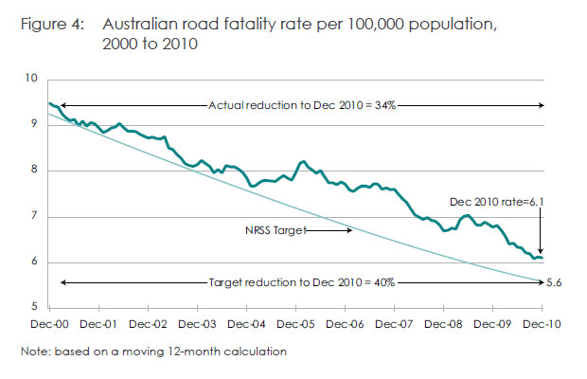
Road Safety in Australia
CRICOS No. 00213J

Slide 4
Queensland Road Toll: 1960-2008
Year
Sources: Queensland Transport, 2009; ATSB, 2009

Slide 5
Community Road Safety
Imprecise term which overlaps with similar terms including:
Local government road safety
Safe communities
Characteristics are:
Action initiated and managed at local level
Action to tackle problems in local area
Involvement of the local community and local groups as service deliverers
CRICOS No. 00213J

Slide 6
Examples of Community Road Safety Initiatives
Queensland
No formal State level CRS program although the Department of Transport and Main Roads supports a number of community activities
Driver Reviver
School safety program
Community committees formed around specific issues/geographical areas
Local Councils employ road safety officers who also support local initiatives
CRICOS No. 00213J

Slide 7
Key objectives of CRS
Creating an informed community
Mobilising local resources to road safety ends
Promoting effective action
Integrating activities

Slide 8
History of the Queensland Road Safety Awards
Established in 2000 in partnership with the Royal Automobile Club of Queensland (RACQ)
Designed to recognise the work of individuals and groups who have designed programs, innovations or initiatives dedicated to improving road safety
Schools, Communities, Government and Industry are eligible to nominate
Nominated projects must be above core business for Local and State Government agencies
Partners include RACQ, Transport and Main Roads, Queensland Police Service, Leighton Contractors Pty Ltd and Radio Station 96.5
CRICOS No. 00213J

Slide 9
The need for the Workshop
Award program nominations were reducing
Nominated projects were becoming less informed by research and did not feature evaluation
Community road safety advocates were asking for a way in which they could be informed about what they should be doing
CRICOS No. 00213J

Slide 10
Partners and Stakeholders - Workshop
Leighton Contactors
Queensland Department of Transport and Main Roads
Queensland Police Service
RACQ
QUT
CRICOS No. 00213J

Slide 11
Development of the Workshop
Call for speakers
Invited speakers
Funded delegate program
Criteria for selection of speakers
Criteria for funded delegates
CRICOS No. 00213J

Slide 12
Call for participants
CARRS-Q database
Previous winners and nominees
Stakeholder employees
Members of the public via media campaign
Criticism – many attendees already in road safety ‘family’
CRICOS No. 00213J

Slide 13
Workshop Program
Keynote speakers
Mary Williams, OBE, Brake UK
Superintendent Col Campbell, QPS
Selected speakers
Local council projects
Not-for-profit initiatives
Community led programs
Government policies
Youth and education programs
CRICOS No. 00213J

Slide 14
Participant Feedback
Participant
Desire to have workshop every year
Expand program to allow specific topics to be covered in more depth e.g. RS in schools
Great for networking and meeting others doing similar work around Queensland
Great to hear about projects happening in other States that can influence work in Queensland
CRICOS No. 00213J

Slide 15
Stakeholder Feedback
Good to provide teaching opportunity to those working in the area already
Need to allow more stakeholders to address workshop
Invite winners from previous years to present on project since winning QRSA
Some stakeholders happy with lower profile than others

Slide 16
Was it successful?
Maximum capacity registrations
More presentations submitted than we could program
Positive participant feedback
Proof will be in quality of future QRSA nominations
Will another 200 people attend in 2011?
CRICOS No. 00213J

Slide 17
Limitations and Criticism
Lack of follow up provided
Plans for online resources not possible due to funding and staff limitations
No further work was done with participants post workshop
Many participants were already part of road safety ‘family’
No facilitated follow up between participants

Slide 18
Future Developments
Workshop is occurring again in 2011 in conjunction with regular QRSA
Theme is Innovation and hope to include presentations on road safety projects being done differently
Dependent on final speaker numbers, 2 streams may be programmed to allow for more in-depth discussions on specific topics
CRICOS No. 00213J

Slide 19

Questions?
clare.murray@qut.edu.au
www.carrsq.qut.edu.au/qrsa
Mark your Diaries!
International Council on Alcohol, Drugs and Traffic Safety Conference (T2013)
26-29 August 2013, Brisbane

