Slide 1

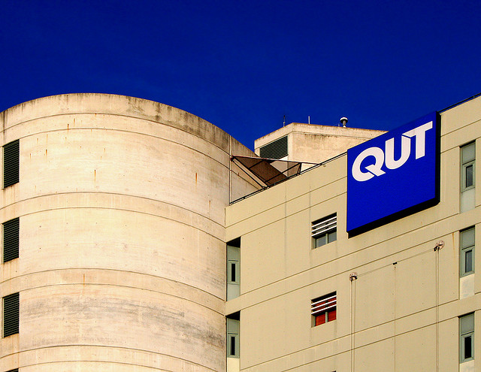
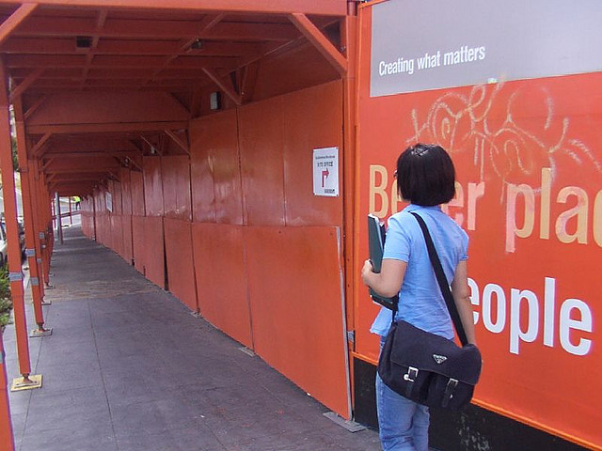
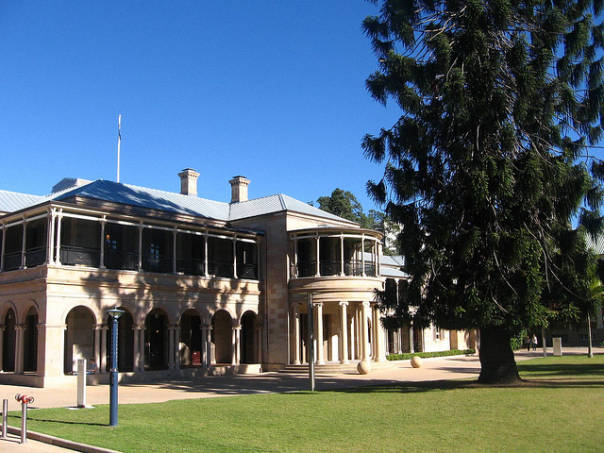
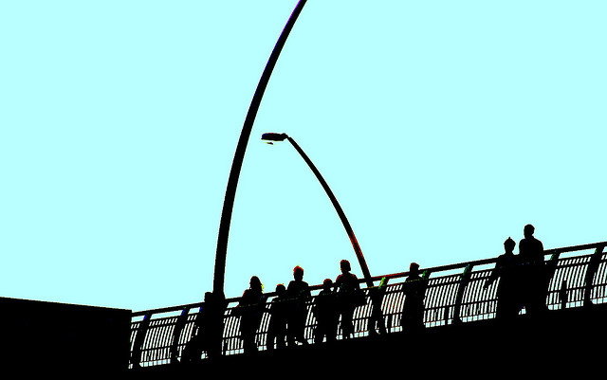
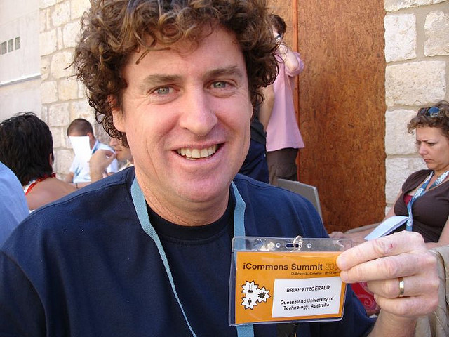

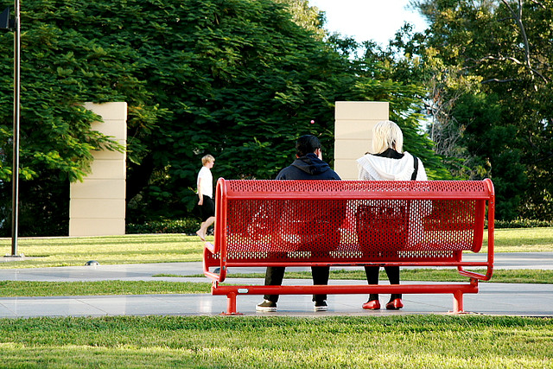
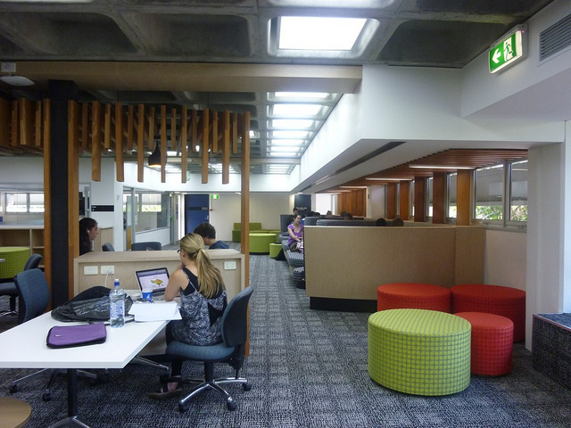
Upskilling in Scholarly Communication Practices
Stephanie Bradbury
Research Support Librarian, Queensland University of Technology, Brisbane, Australia
Introduction
As the research landscape continues to change with new technologies, advances in data management and new means, expectations and polices surrounding scholarly communication, the role of the Library and Librarian in supporting research is shifting.
At the Queensland University of Technology (QUT), the Library has made a positive impact on the scholarly communication practices of QUT researchers in the last decade in several ways:
A university-wide deposit mandate on self-archiving was introduced in 2003. It states that QUT authors must place the author’s accepted manuscript version of refereed research articles and conference papers in the digital repository QUT ePrints.
Liaison Librarians remind their researchers to self-deposit their accepted manuscript versions of peer-reviewed research outputs into QUT ePrints, and provide training and support when needed.
The Library pays author publication fees for true gold road open access publishers including:
BioMed Central
Public Library of Science
Hindawi Press
Liaison Librarians actively assist researchers in the gold road publishing process.
Liaison Librarians play a key role in educating their researchers on university policy and the latest advances in scholarly communication. However, their knowledge and skills related to scholarly communication practices have largely been learnt on the job or self-taught. QUT Library wanted to investigate how Liaison Librarians rated their skills in various practices related to eResearch, including scholarly communication.
Figure 1. Percentages of responses to rating of skills in managing copyright related to publications
Method
Figure 2. Percentages of responses to rating of skills in depositing the fulltext into QUT ePrints
In 2009, QUT Library and High Performance Computing and Research Support Group (HPC) undertook two surveys that investigated the eResearch practices and skill levels of QUT researchers and divisional research support staff, including Liaison Librarians. The surveys, designed as a skills audits, were part of a Building eResearch Capability and Capacity project.
The surveys asked Researchers to rate how they would describe their skill level in a selection of eResearch practices and Divisional respondents to rate how they would describe their ability to support researchers in the same selection of eResearch practices. The categories of eResearch skills were identical. They were:
The scale used for the Divisional Research support staff, including Liaison Librarians was:
The scale used for Researchers was:
The surveys were broad in scope and asked respondents a wide range of questions relating to eResearch practices and how they learn about new advances in the practices, including:
list their top three eResearch training requirements;
indicate how they like to learn new technologies.
The survey was open for two weeks and a coffee voucher was offered as an incentive for staff members and researchers to complete it. 73 staff members completed the survey, of which 24 were Liaison Librarians (n=24). 254 researchers completed the survey (n=254) of which 33.1% (n=84) were higher degree research students.
Nine practices of scholarly communication were included in the survey. The question was presented as:
How would you describe your ability to support researcher in scholarly communication practices of:
Managing copyright in relation to publishing (e.g. negotiating publisher agreements)
Depositing the fulltext of a manuscript into QUT ePrints
Publishing in an open access journal
Publishing work with a creative commons License
Managing references using EndNote
Managing references using software other than EndNote (e.g. Zotero, BibTex)
Calculating bibliometric indicators that measure research impact (e.g. h-index)
Citing a dataset in a publication
This poster focuses on the survey results of Liaison Librarians and researchers to the first four Scholarly Communication practices listed above (a-d).
Scholarly Communication practices | Data collection & analysis techniques |  | Using visualization tools
Data management practices |  | Using collaborative technologies
Using computation tools or activities |  | Managing different types of data
Figure 3. Percentages of responses to rating of skills in applying Creative Commons License
No knowledge | Awareness only | Aware: Can refer for further help | Basic skills | Competent | Advanced skills
Not applicable to my research | Unaware | Aware: No Experience | Basic skills | Competent | Expert
Figure 4. Percentages of responses to rating of skills in publishing in an Open Access journal
Conclusions
Currently, only a minority of QUT researchers (36.1%) are confident about their ability to upload material to QUT ePrints and a surprising number admitted they were unaware that the option existed - even though the deposit 'mandate' has been in place for over six years. Perhaps these were relatively new to QUT. In contrast, the majority of Liaison Librarians (75%) rated themselves as competent or highly skilled in the area and only a tiny minority (4%) reported having no experience. Consequently, the survey confirmed that QUT Liaison Librarians have the skills needed to promote, train and support researchers in this process.
The Librarians reported significantly higher levels of awareness than researchers about publishing in an open access journal and Creative Commons (CC) licences but there was very little difference between the two groups in terms of skills. Most researchers and many librarians regularly disseminate presentations (from conference or teaching sessions) so, clearly, there is scope for more training for both groups in how to choose and apply a Creative Commons license.
The skill level ratings of researchers and librarians were very similar in the area of publishing in an open access journal. However, many more researchers than librarians reported no awareness of the concept. We concluded that there is scope for additional training and awareness raising for researchers in this area (publishing in gold open access journals) and scope for training for both groups.
It would appear from the results that the researchers were more confident about their skills in the area of copyright management than the librarians. However, it is possible that a higher proportion of the librarians understood the implications of the University's Eprint Deposit mandate and Intellectual Property Policy (which requires QUT researchers to retain certain rights) than the researchers who rated themselves as skilled in this area. There is scope for further awareness raising to researchers on copyright management plus more investigation is required here.
Results
To present a clearer picture of skill levels, the rating results were combined as below and percentages presented in Figures 1-4. Divisional Research Support staff ratings of “Awareness only” and “Aware: Can refer for further help” were combined. As well as “Competent” and “Advanced Skills”.
And Researchers’ ratings of “Not applicable to my research” and “Unaware” were combined. As well as “Competent” and “Advanced Skills”.
No knowledge | Awareness only | Aware: Can refer for further help | Basic skills | Competent | Advanced skills
Acknowledgement
Thank you to Paula Callan, eResearch Access Coordinator QUT, for assistance in summarising the conclusions.
Not applicable to my research | Unaware | Aware: No Experience | Basic skills | Competent | Expert
Photography Acknowledgements
Monkyc.net. (2006). http://www.flickr.com/photos/monkeyc/136375121
Kraal, B. (2010). http://www.flickr.com/photos/newnowknowhow/4701363903/
Dalziel_86. (2006). http://www.flickr.com/photos/dalziel_86/81463031/
Jackmanson, D. (2007). http://www.flickr.com/photos/djackmanson/470738012
Creativecommons. (2007). http://www.flickr.com/photos/creativecommons/559937689
Baker, C. (2009). http://www.flickr.com/photos/monitors/3559652912
S13_eisbaer. (2010). http://www.flickr.com/photos/s13_eisbaer/4261259811/
haikugirlOz (2010). http://www.flickr.com/photos/angels_have_the_phone_box/4947544618/
Stephanie Bradbury, Research Support Librarian
Queensland University of Technology
s.bradbury@qut.edu.au

