Slide 1
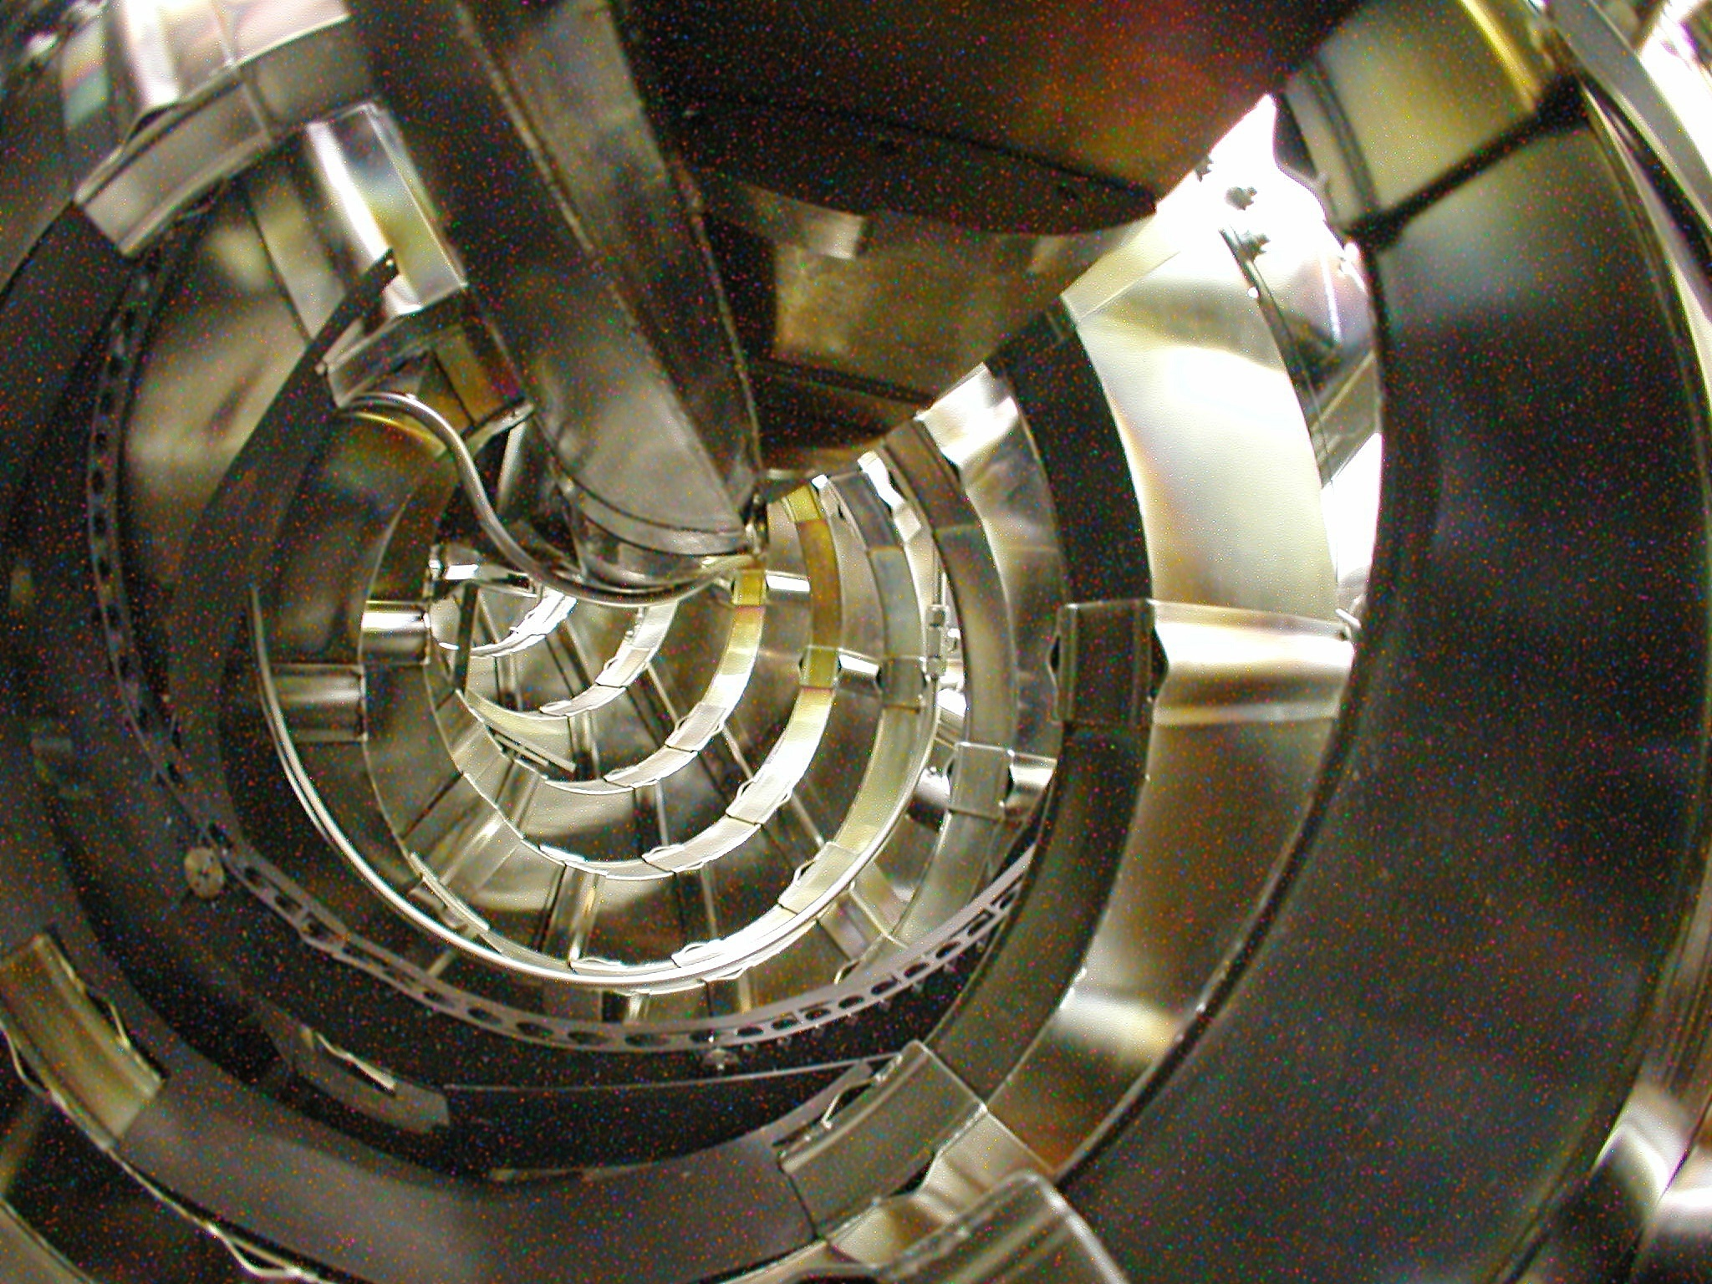
The Australian Plasma Fusion Research Facility: Results and Upgrade Plans
B.D. Blackwell, J. Howard, D.G. Pretty, J.W. Read, H. Punzmann, J. Bertram, M.J. Hole, F. Detering, C.A. Nuhrenberg, M. McGann, R.L. Dewar, J. Bertram Australian National University, and *Max Planck IPP Greifswald,

Slide 2
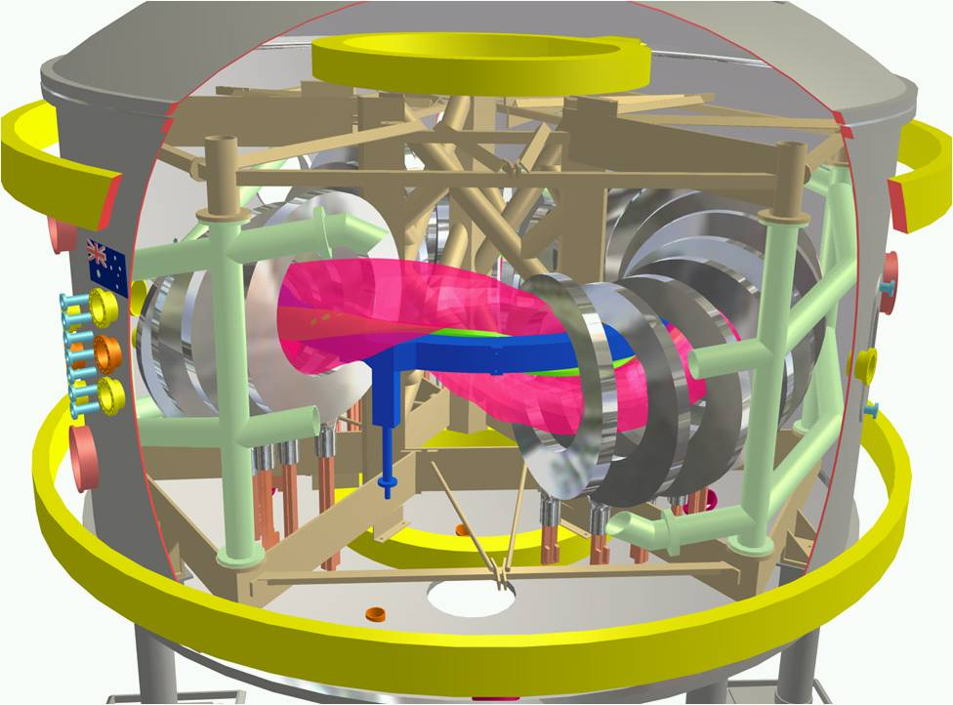

The Australian Plasma Fusion Facility: Results and Upgrade Plans
Introduction
H-1 Plasma and Facility
Plasma configurations, parameters
Facility Upgrade
Aims Key areas
New diagnostics for Upgrade
Recent Results: MHD Modes in H-1
Data mining
Alfvénic Scaling
Optical Measurements
Radial Structure
Stellarator Fusion
Recent Progress
Reactor Considerations
Conclusions/Future

Slide 3

H-1NF: National Plasma Fusion Research Facility
A Major National Research Facility established in 1997 by the Commonwealth of Australia and the Australian National University
Mission:
Detailed understanding of the basic physics of magnetically confined hot plasma in the HELIAC configuration
Development of advanced plasma measurement systems
Fundamental studies including turbulence and transport in plasma
Contribute to global research effort, maintain Australian presence in the field of plasma fusion power
The facility is available to Australian researchers through the AINSE¹ and internationally through collaboration with Plasma Research Laboratory, ANU.
¹⁾ Australian Institute of Nuclear Science and Engineering
limited collaborative funding expires June 2010 – Canberra is only 3 hours away.

Slide 4
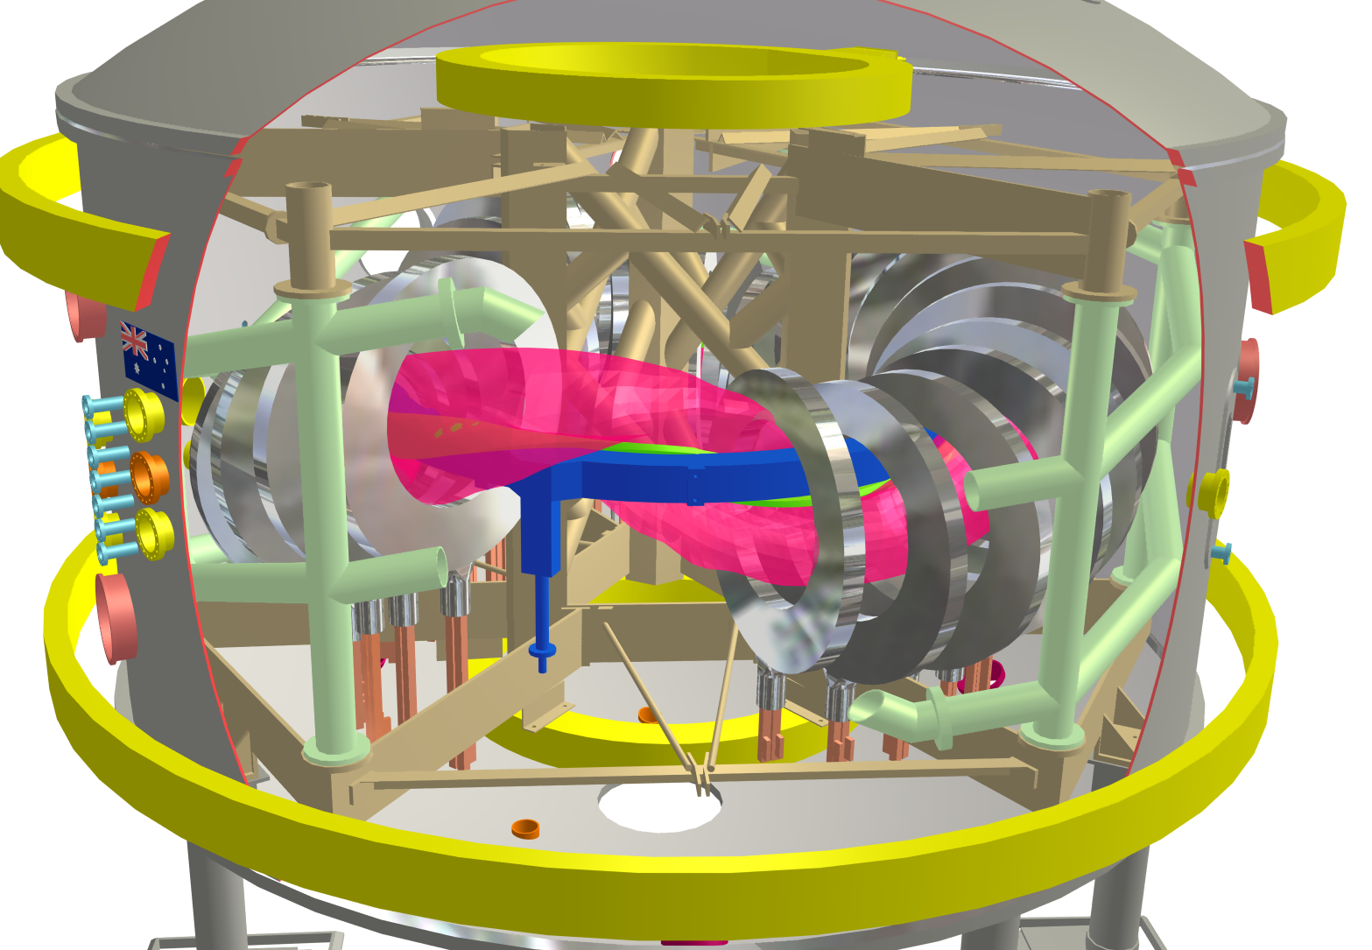
H-1 CAD
Notes:
Important:
– toroidal connection, relation to boundary conditions
– twisted field lines.

Slide 5
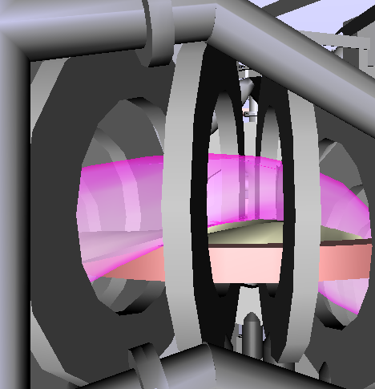
H-1 Heliac: Parameters
3 period heliac: 1992
Major radius 1m
Minor radius 0.1-0.2m
Vacuum chamber 33m² excellent access
Aspect ratio 5+ toroidal
Magnetic Field ≤1 Tesla (0.2 DC)
Heating Power 0.2MW 28 GHz ECH 0.3MW 6-25MHz ICH
Parameters: achieved to date::expected
n 3e18 :: 1e19
T <200eV(T_{e})::500eV(T_{e})
β 0.1 :: 0.5%
Notes:
Parameters 10¹⁸, 0.5T, Hydrogen / Helium

Slide 6
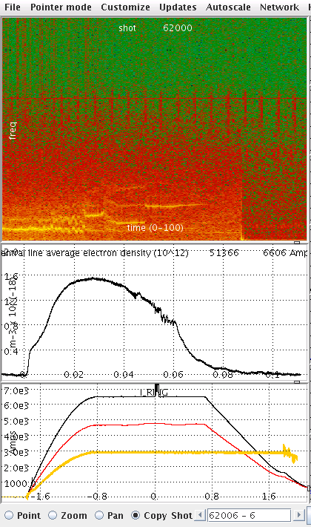
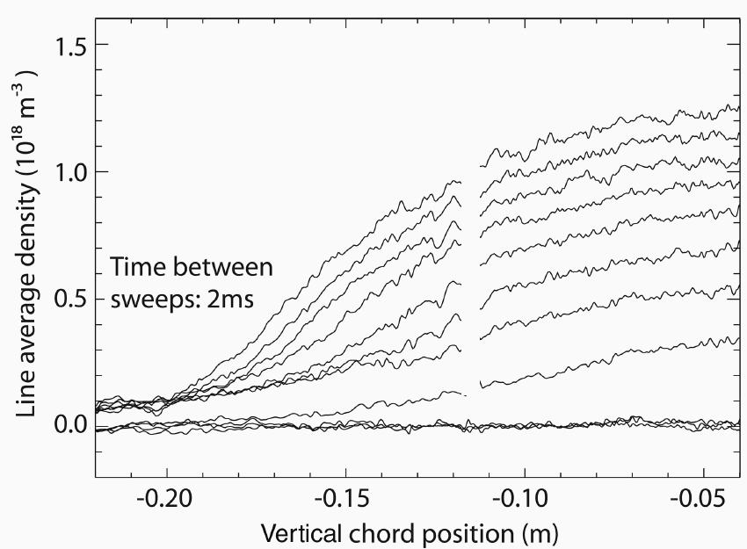
H-1 Plasma Production by ICRF
ICRF Heating:
B=0.5Tesla, ω = ω_{CH} (f~7Mhz)
Large variation in n_{e} with iota
Backward Wave Oscillator Scanning Interferometer (Howard, Oliver)
Axis
Notes:
Coils in Large vacuum tank allow flexibility, good access but AREA, GAS Reservoir.

Slide 7
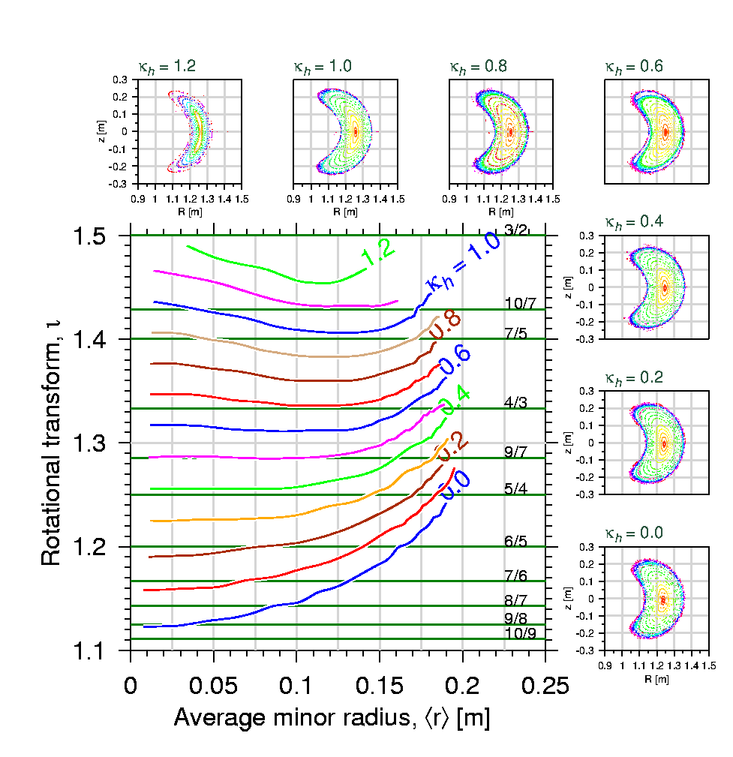
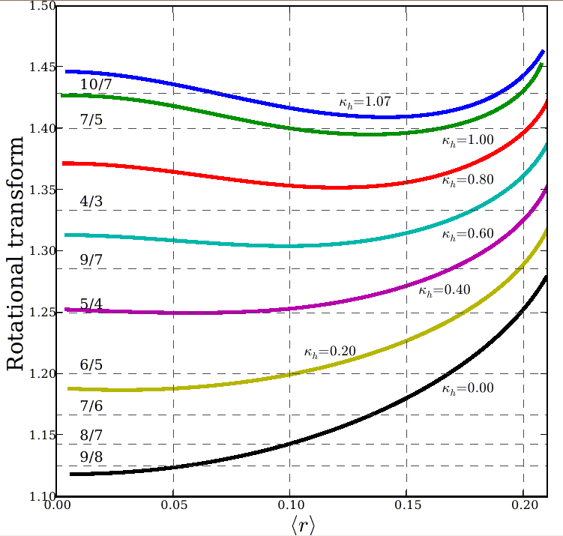
H-1 configuration (shape) is very flexible
“flexible heliac” : helical winding, with helicity matching the plasma, ⇒ 2:1 range of twist/turn
H-1NF can control 2 out of 3 of transform (ι) magnetic well and shear Δι (spatial rate of change)
Reversed Shear → Advanced Tokamak mode of operation
low shear
ι = 4/3
ι = 5/4
medium shear
Centre
Edge
Notes:
Flexible heliac:
I will concentrate today on the effect of twist per turn.
This graph also illustrates magnetic shear, the rate of change of twist with position.
H1 is a medium to low shear device.

Slide 8
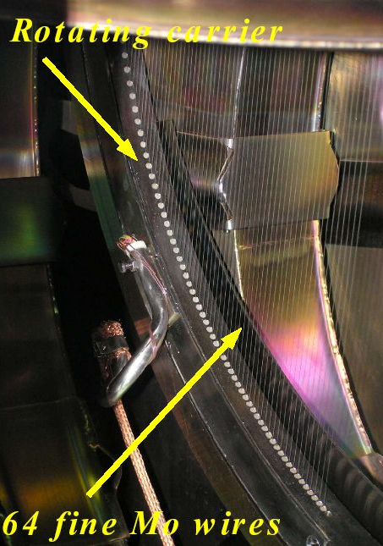
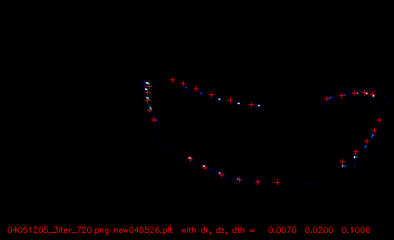
Experimental confirmation of configurations
Santhosh Kumar
Rotating wire array
64 Mo wires (200um)
90 - 1440 angles
High accuracy (0.5mm)
Moderate image quality
Always available
Excellent agreement with computation
T.A. Santhosh Kumar B.D.Blackwell, J.Howard
Iota ~ 1.4 (7/5)

Slide 9
The Australian Plasma Fusion Facility: Results and Upgrade Plans
Introduction
H-1 Plasma and Facility
Plasma configurations, parameters
Facility Upgrade
Aims Key areas
New diagnostics for Upgrade
Recent Results: MHD Modes in H-1
Data mining
Alfvénic Scaling
Optical Measurements
Radial Structure
Stellarator Fusion
Recent Progress
Reactor Considerations
Conclusions/Future

Slide 10

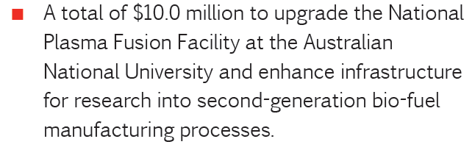
National Plasma Fusion Research Facility Upgrade
Rudd Government’s “Super Science Package”
Boosted National Collaborative Infrastructure Program using the “Educational Infrastructure Fund”
→ Restrictions on this fund limit use to infrastructure
→ ~$7M over 4 years for infrastructure upgrades
2009 Australian Budget Papers
Funding agreement to be signed this year
Quarterly Milestones

Slide 11
Aims of Facility Upgrade
Consolidate the facility infrastructure required to implement the ITER forum strategy plan
Try to involve the full spectrum of the ITER Forum activities
More specifically:
Improve plasma production/reliability/cleanliness
RF production/heating, ECH heating, baking, gettering, discharge cleaning
Improve diagnostics
Dedicated density interferometers and selected spectral monitors permanently in operation
Increasing opportunities for collaboration
Ideas?
Increasing suitability as a testbed for ITER diagnostics
Access to Divertor – like geometry, island divertor geometry

Slide 12
RF Upgrade
RF (7MHz) will be the “workhorse”
Low temperature, density limited by power
Required to initiate electron cyclotron plasma
New system doubles power: 2x100kW systems.
New movable shielded antenna to complement “bare” antenna
(water and gas cooled).
Advantages:
Very wide range of magnetic fields in Argon
New system allows magnetic field scan while keeping the resonant layer position constant. e.g. to test Alfven scaling MHD
Additional ECH source (10/30kW 14/28GHz) for higher Te

Slide 13
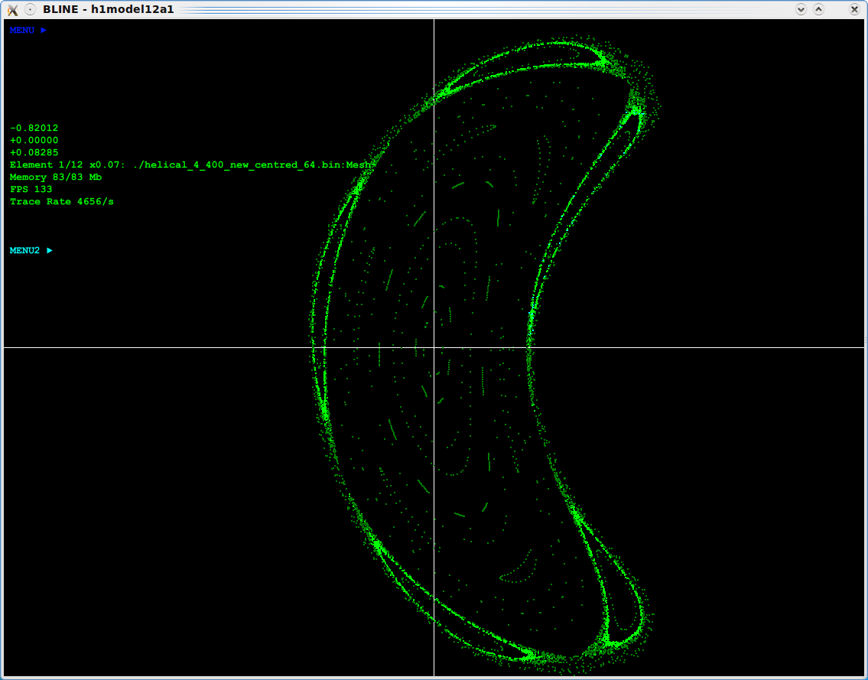
Improved Impurity Control
Impurities limit plasma temperature (C, O, Fe, Cu)
High temperature (>~100eV) desirable to excite spectral lines relevant to edge plasma and divertors in larger devices.
Strategy : Combine -
Glow discharge cleaning for bulk of tank
Pulsed RF discharge cleaning for plasma facing components.
antenna (cooled) and source (2.4GHz)
Low temperature (90C) baking
Gettering – Titanium or Boron (o-carborane)

Slide 14
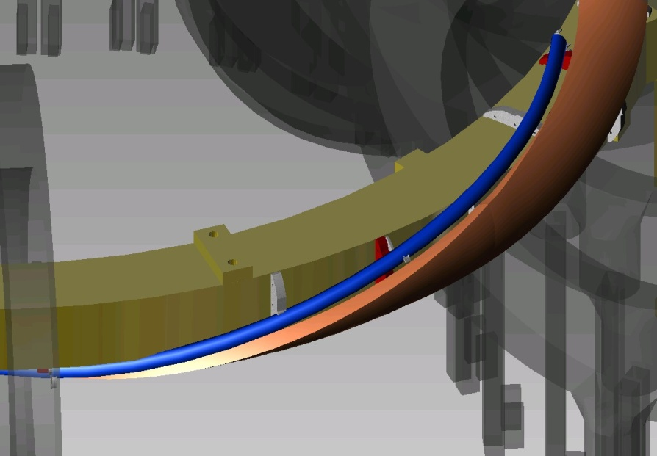
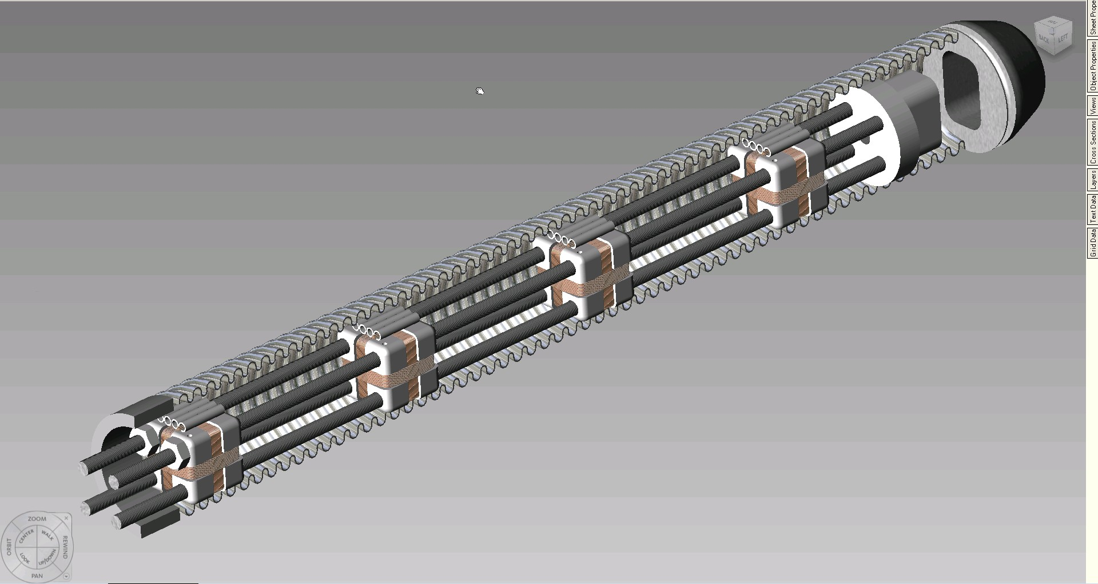
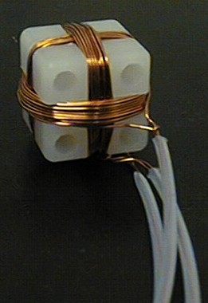
New Toroidal Mirnov Array
View of plasma region through port opening
Mounted next to Helical
Coils inside a SS thin-wall bellows (LP, E-static shield)
Access to otherwise inaccessible region with
largest signals and
with significant variation in toroidal curvature.

Slide 15
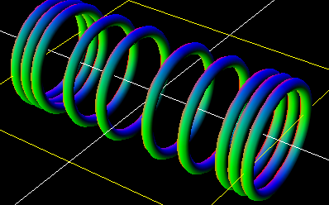
Small Linear Satellite Device – PWI Diagnostics
Purpose:
Testing various plasma wall interaction diagnostic concepts
spectroscopy - laser interferometry - coherence imaging
Features:
Much higher power density than H-1
Clean conditions of H-1 not compromised by material erosion diagnostic tests
Simple geometry, good for shorter-term students, simpler projects
Shares heating and magnet supplies from H-1
Circular coils ex Univ Syd. Machines (“Supper II”)
Magnetic Mirror/Helicon chamber?
Mirror coils at one or both ends

Slide 16
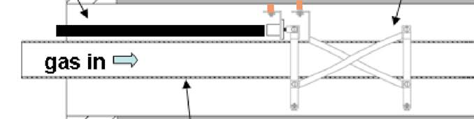
Helicon H+ source Concept
Based on ANU, ORNL work
Gas Flow
Water cooled target
n_{e} ~ 10¹⁹ m⁻³
m=+1 Helicon Antenna
Directional
Quartz/ceramic tube
Helicon Antenna is an efficient plasma source in Ar
High Density (>10¹⁸ m⁻³) more difficult in H
Combination of higher power and non-uniform magnetic field has produced n_{e} ~ 10¹⁹ m⁻³in H
Mirror Coils
(Mirror coils at one end should be sufficient – mainly to provide field gradient rather than full mirror effect.)

Slide 17
Present and Future Plasma-Surface Devices
Table from VanRooij 2008
 | NAGDIS -II (Japan) | PSI-2 Germany | PISCES-B USA | LENTA (Russia) | Pilot-PSI (EU) | Magnum-PSI: 2010 | H-1 Satellite
Source Type | Penning (PIG) |  |  | e-Beam | Cascaded Arc |  | Helicon
Power [kW] | 10.5 | 6.5 | ? | 7.5 | 45 | 270 | 5-10
Pressure source [Pa] | 10 | 0.1-1 | 0.1-1 |  | 10⁴ | 10⁴ | 1…2
Pressure target [Pa] | 0.1 | 0.01-0.1 | 10−3−1 | 0.2-7 | 1.-10 | <10 | <1
Ti target [eV] | 50 | <15 | 10-500 | 5 | 0.1-5 | 0.1-10 | 1
Te target[eV] | 10 | <30 | 3..50 | 0.5-20 | 0.1-5 | 0.1-10 | 1..5
ni target[m−3] | 6·10¹⁹ | 10¹⁹ | 10¹⁷−10¹⁹ | 10¹⁹ | 10²¹ | 10²⁰ | 10¹⁹
Ion flux target [m⁻²s⁻¹] | 10²² | 10²² | 10²¹−10²³ | 5·10²¹ | 2·10²⁵ | 10²⁴ | ?10²²
Energy flux target [MW/m²] | 0.01 | 0.1 |  |  | 30 MW/m² | 10 MW/m² | >1 MW/m²
B[T] | 0.25 | 0.1 | 0.04 | 0.2 | 1.6 | 3 | 0.5
Beam diameter target [cm] | 2 | 6..15 | 3..20 | 2.5 | 1.5 | 10 | 2
Distance to target [m] | 2.8 | 2.5 | 1.5 | 2 | 0.5-1 |  | 0.5
Heating method | RF | cathode | dc bias | e⁻ inject | dc bias | dc bias+RF | dc bias+ECH
Extra heating [kW] | 56(80) | 6;5 |  | 30 | 10 | 50 | >10
H-1 Satellite Parameters comparable with best non-arcing devices - > 1MW/m2 with bias

Slide 18
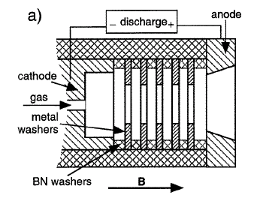
Additional Power/Plasma Sources
Sheath acceleration increases power density, but if >30-50V → physical sputtering (not normal in fusion simulators, but may be useful to increase erosion?)
E-beam can increase dissipation, but ion bombardment damage of LaB6 cathode if pressure too high? Solid LaB₆ Cathode, >10A emission
Sterling Scientific washer gun → H+ 10¹⁹-10²⁰
5-15eV under the right conditions, can generate a relatively clean plasma (low W) denHartog: Plasma Sources Sci. Technol. 6 (1997) 492–498.
(also useful for a simple way of obtaining first plasma)
15mm

Slide 19
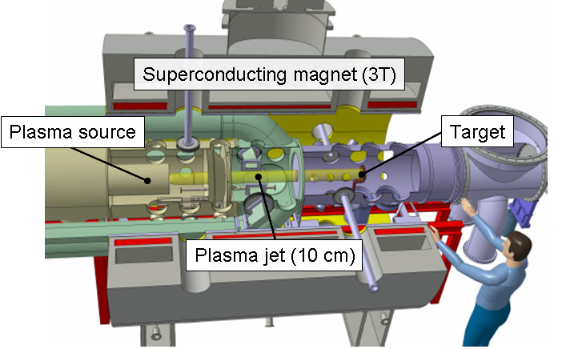
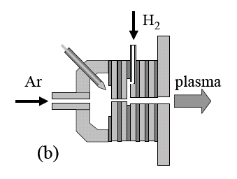
Future Plasma Surface Interaction Facilities
Magnum PSI
Source:
Cathode
Cascaded plates
Plasma source uses Resonant CX
Ar⁺ + H₂→ArH⁺ + H → dissociation, easier ionization
Tests on this facility would be a logical next step following successful initial tests on the H1 Facility.

Slide 20
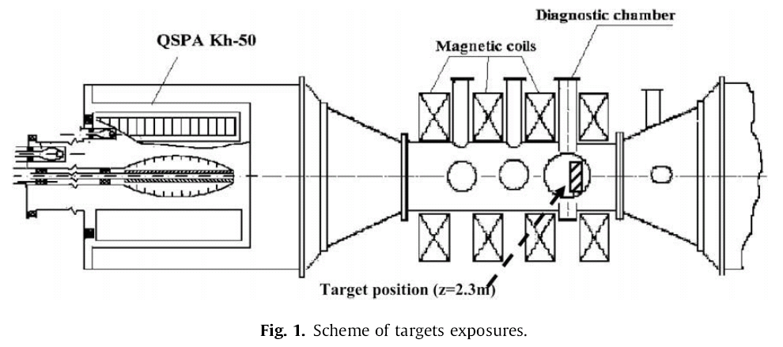
High Pulsed Power – Edge Localised Mode (ELM) Simulator (Kharkov)
Coaxial Plasma Gun
1m
Garkusha, Makhlaj, Chebotarev, Landman et al, 2009
Institute of Plasma Physics , Kharkov, Ukraine
Pulse duration ~ 0.25 ms
Energy loads of 0.2–2.5 MJ/m²
Peak power 10GW/m²
Also:
M. NAKATSUKA, K. ANDO et al APS-DPP 2009
CIEMAT $10MEu combined PSI/ELM gun
Target at 2.3m
Carbon and Tungsten target tests (ITER)
Tungsten melts at 0.6MJ/m²
Ejects droplets at 1.1MJ/m²
For carbon, Intense heat generates vapour shield at >0.5MJ/m² reducing damage.

Slide 21
The Australian Plasma Fusion Facility: Results and Upgrade Plans
Introduction
H-1 Plasma and Facility
Plasma configurations, parameters
Facility Upgrade
Aims Key areas
New diagnostics for Upgrade
Recent Results: MHD Modes in H-1
Data mining
Alfvénic Scaling
Optical Measurements
Radial Structure
Stellarator Fusion
Recent Progress
Reactor Considerations
Conclusions/Future

Slide 22
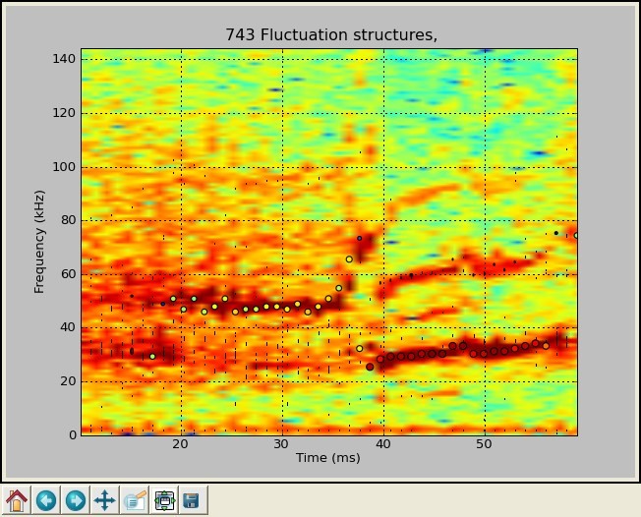
MHD/Mirnov fluctuations in H-1

Slide 23
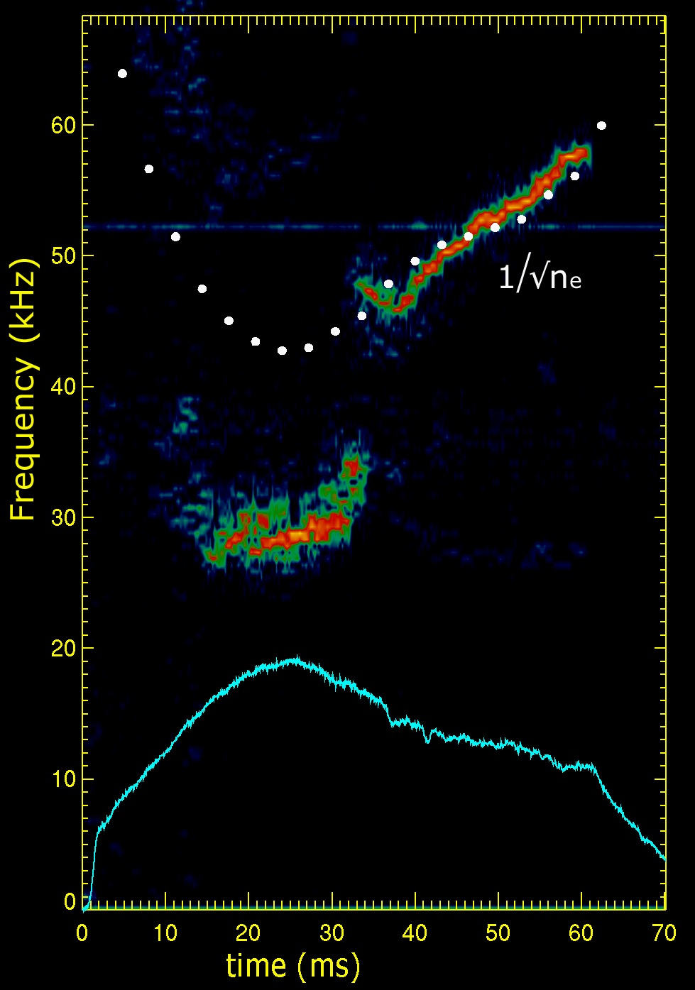
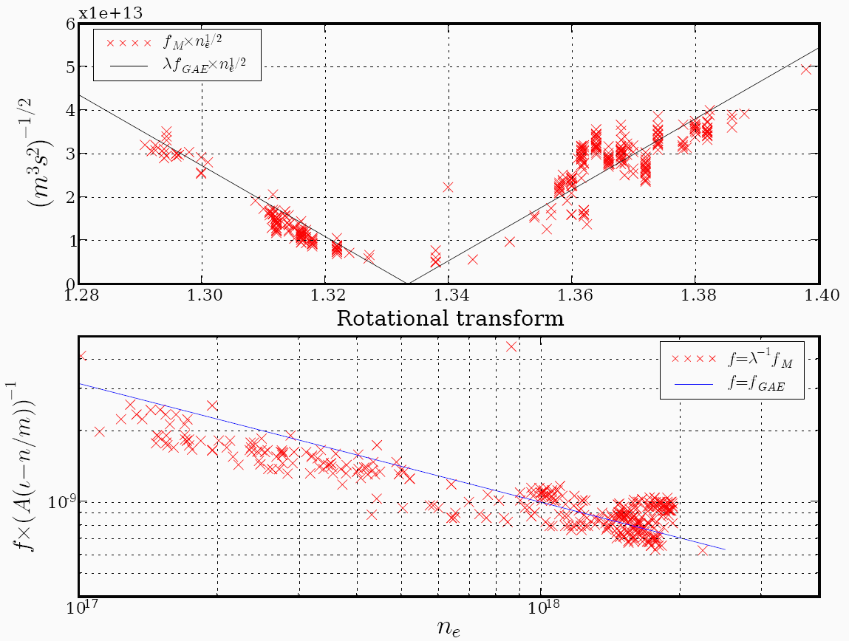
Identification with Alfvén Eigenmodes: n_{e}
Coherent mode near iota = 1.4, 26-60kHz, Alfvénic scaling with n_{e}
m number resolved by bean array of Mirnov coils to be 2 or 3.
V_{Alfvén} = ^{B}/_{√(μoρ)} ∝ ^{B}/_{√ne}
Scaling in √n_{e} in time (right) and over various discharges (below)
phase
¹/_{√ne}
_{ne}
f ∝ ¹/_{√ne}
Critical issue in fusion reactors:
V_{Alfvén} ~ fusion alpha velocity → fusion driven instability!
Notes:
Density scaling indicates Alfven velocity
Critical issue for fusion reactors, as alpha velocity ~ Alfven velocity

Slide 24
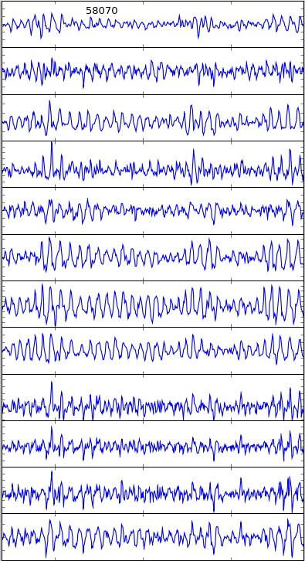
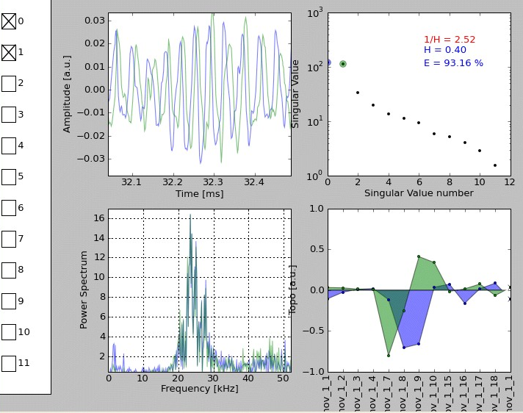
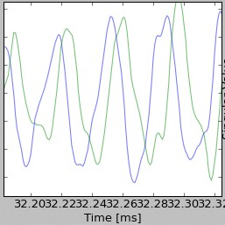
Preprocessing(1): SVD
Divide each time signal into 1ms pieces, then within these,
Singular value decomposition “separates variables” time and space” for each mode
27/18 probe signals → one time function (chronos) C(t)
one spatial function (topos) T(x) F_{mode} ⁼ C(t) ⋅ T(x)
per mode (actually 2 or 3 in practice, sin-like and cos-like, →travelling wave)

Slide 25
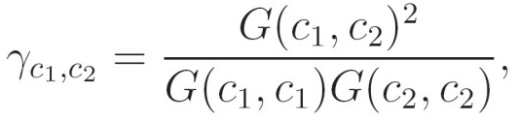
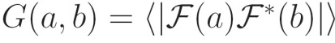
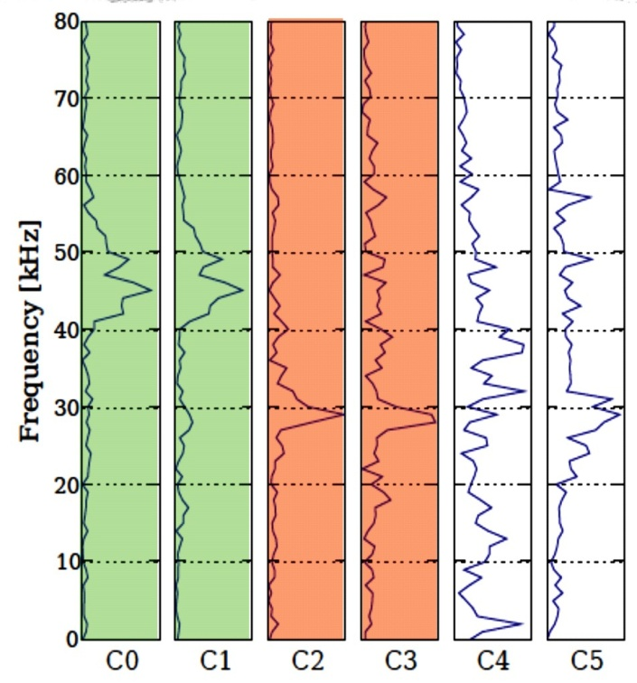
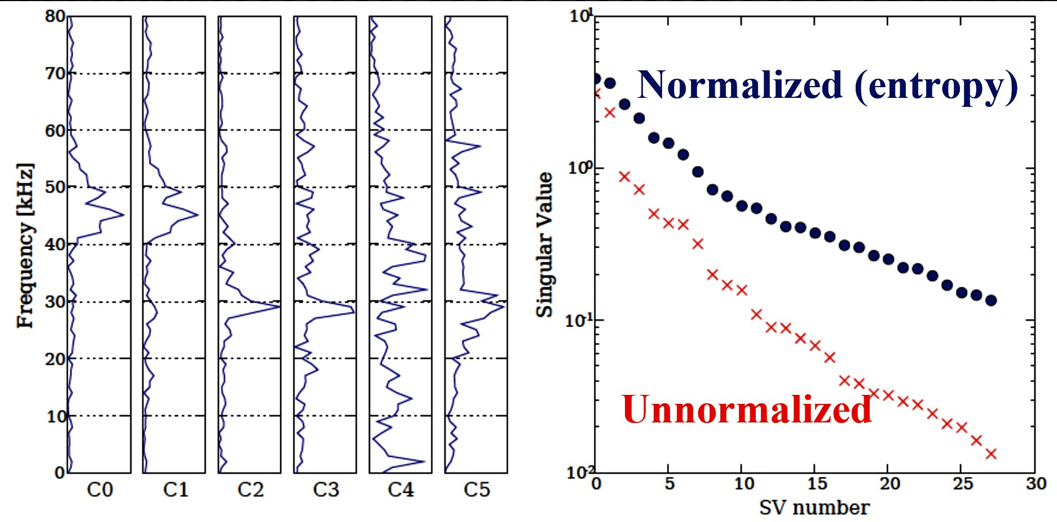
Preprocessing: SVDs grouped into “flucstrucs“
Singular value decomposition “separates variables” time and space” for each mode
27/18 probe signals → one time function (chronos) C(t)
one spatial function (topos) T(x) F_{mode} ⁼ C(t) ⋅ T(x)
per mode (actually 2 or 3 in practice, sin-like and cos-like, →travelling wave)
Group Singular Vectors with matching spectra
> 0.7

Slide 26
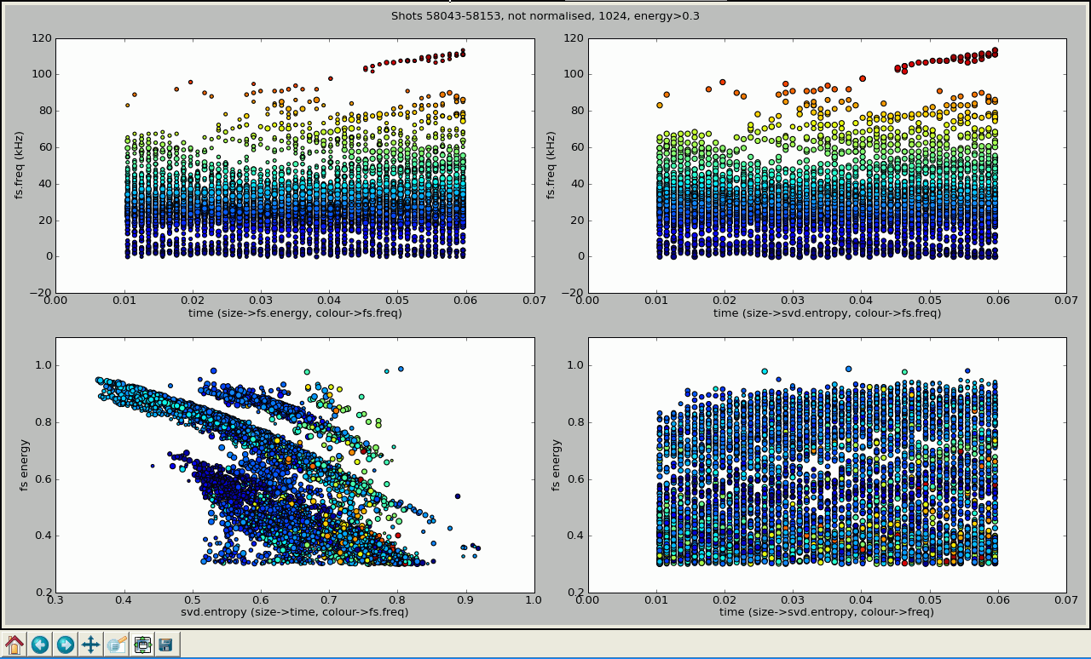
Tens of thousands of data points

Slide 27
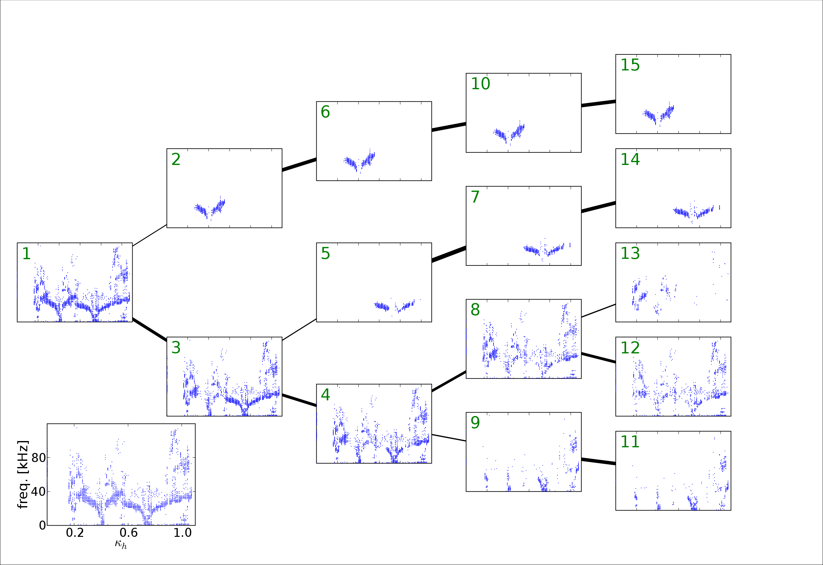
Data Mining Classification by Clustering
D. Pretty
Full dataset

Slide 28
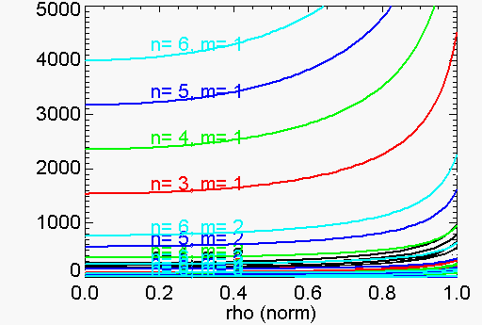
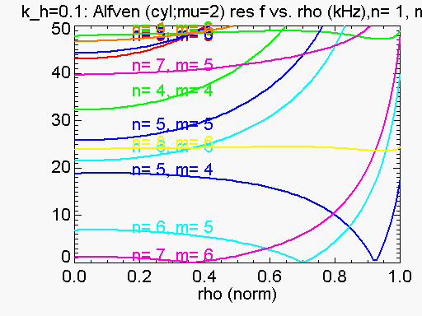
Identification with Alfvén eigenmodes: k||, twist
Why is f so low? - V_{Alfven}~ 5x10⁶ m/s
ω_{res =} k|| V_{Alfvén} = k|| ^{B}/_{√(μoρ)}
k|| varies as the angle between magnetic field lines and the wave vector
for a periodic geometry the wave vector is determined by mode numbers n,m
Component of k parallel to B is ∝ ι - n/m
k|| = (m/R₀)(ι - n/m)
ω_{res} = (m/R₀)(ι - n/m) ^{B}/_{√(μoρ)}
Low shear means relatively simple dispersion relations – advantage of H-1
Small near resonance
Alfvén dispersion (0-5MHz)
Alfvén dispersion (0-50kHz)
Near rationals, resonant freq. is low
}
Notes:
Need a wider range iota

Slide 29
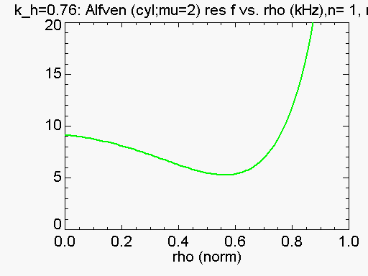
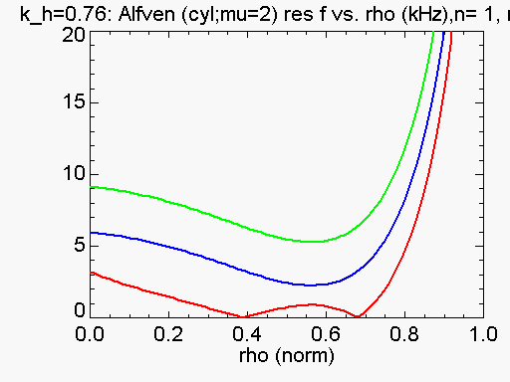
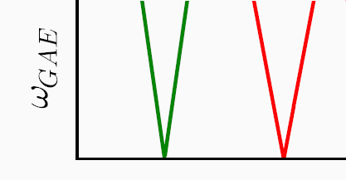
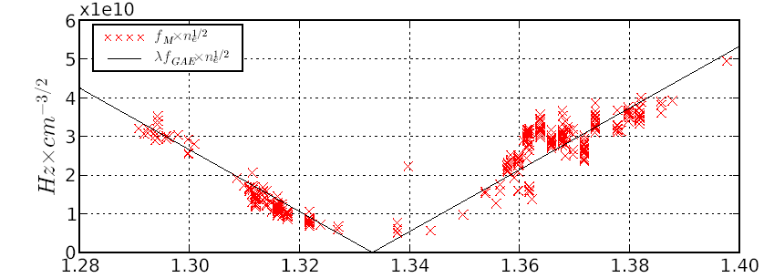
Identification with Alfvén eigenmodes: k||, iota
ω_{res} = k|| V_{A =} (m/R₀)(ι - n/m) ^{B}/_{√(μoρ)}
k|| varies as the angle between magnetic field lines and the wave vector
k|| ∝ ι - n/m
iota resonant means k||, ω → 0
Expect F_{res} to scale with δ iota
Resonant ι
ι = 4/3
ιota →
Notes:
We can also see that k|| and freq will go to zero at resonance i=n/m. Freq will increase with δ iota as we move away from res.
However iota is not quite constant with radius – so we must consider the change in the radial profile.

Slide 30
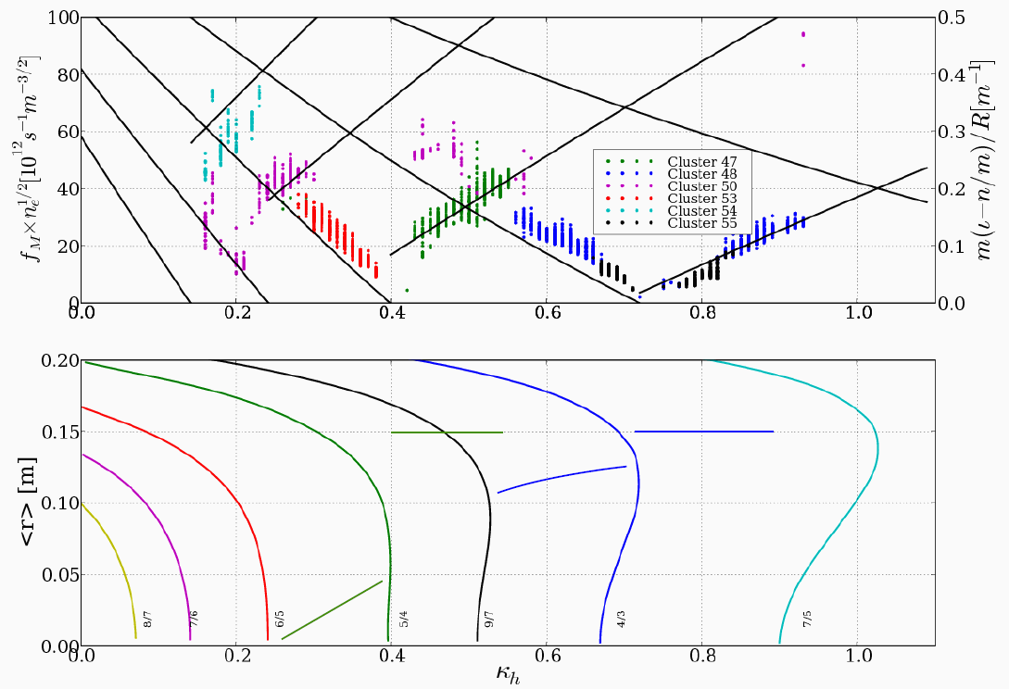
Overall fit assuming radial location
Better fit of frequency to iota, n_{e} obtained if the location of resonance is assumed be either at the zero shear radius, or at an outer radius if the associated resonance is not present.
Assumed mode location
ι ~ 5/4
Notes:
Similar effect if the assumed location is the radius of zero shear, but 5/4 region is better fit by a sudden jump

Slide 31

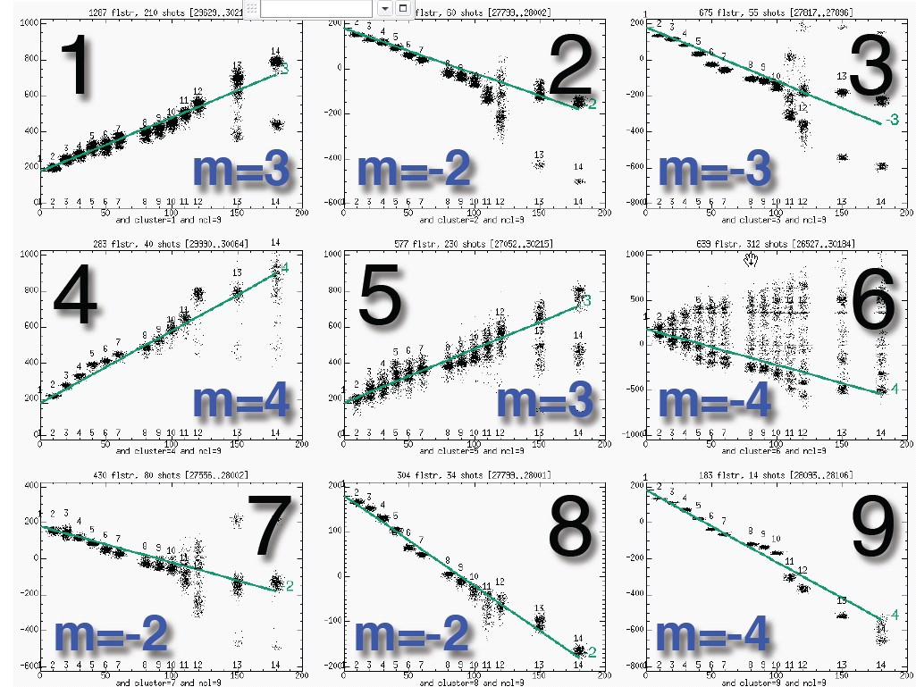
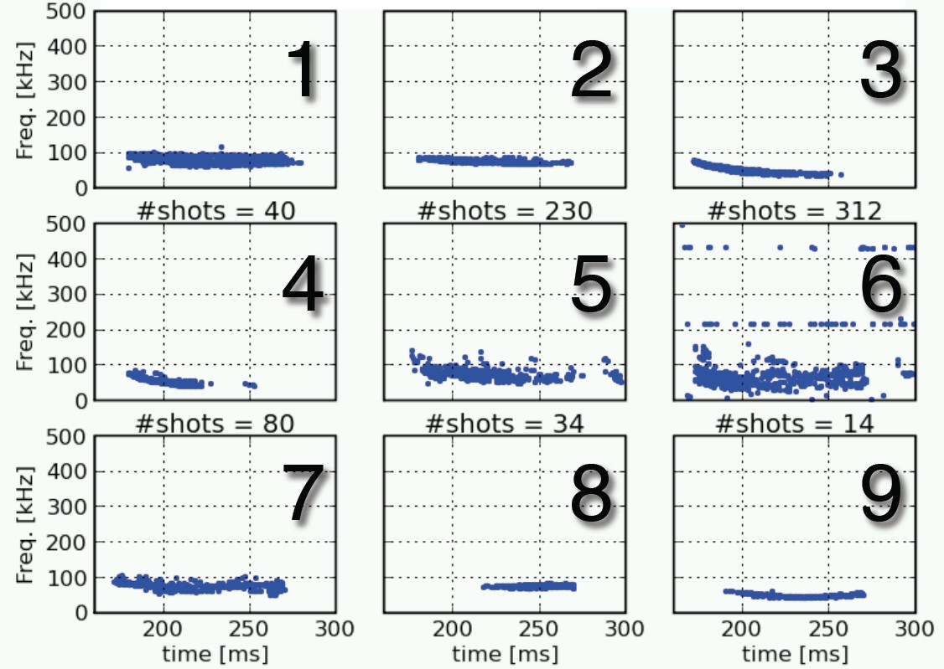
Heliotron J (Kyoto): Good fits to m=2,3,4 in both senses (-ve → B₀ reversal)

Slide 32
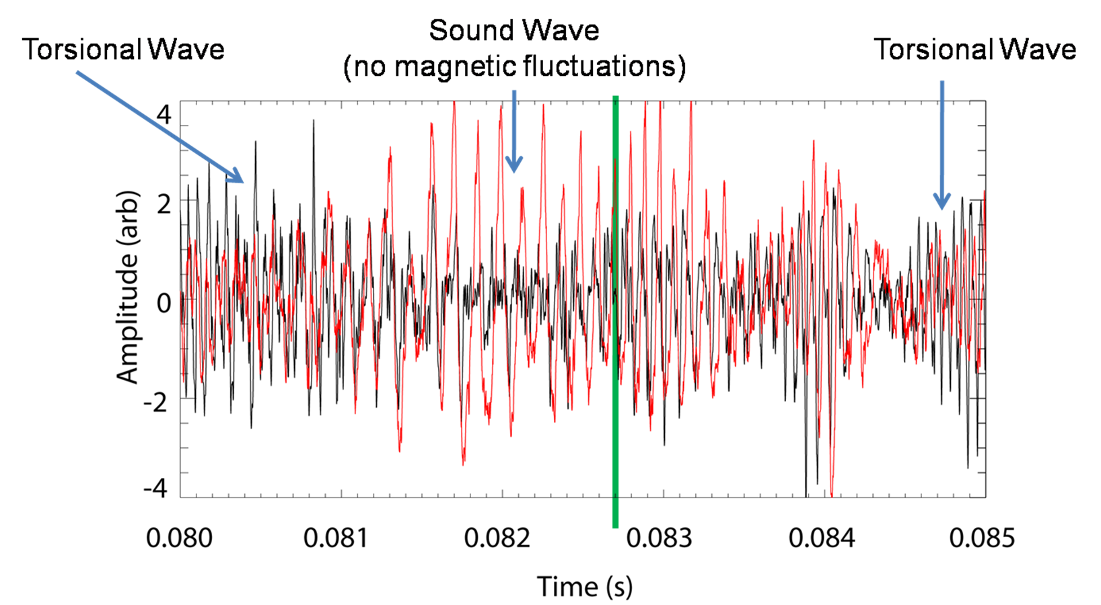
Phase flips, character changes near rational
The sense of the phase between the magnetic and light fluctuations changes about the resonance
More “sound-mode” like. (red is ~ n_{e} from visible emission )
As k||→ 0, λ|| → ∞, so quasineutrality ⇒ ion sound speed dominates
Iota scanning in time ➔

Slide 33
CAS3D: 3D and finite beta effects
Carolin Nuhrenberg
Gap forms to allow helical Alfven eigenmode, and beta induced gap appears at low f
Beta induced gap ~5-10kHz
Coupling to “sound mode”

Slide 34
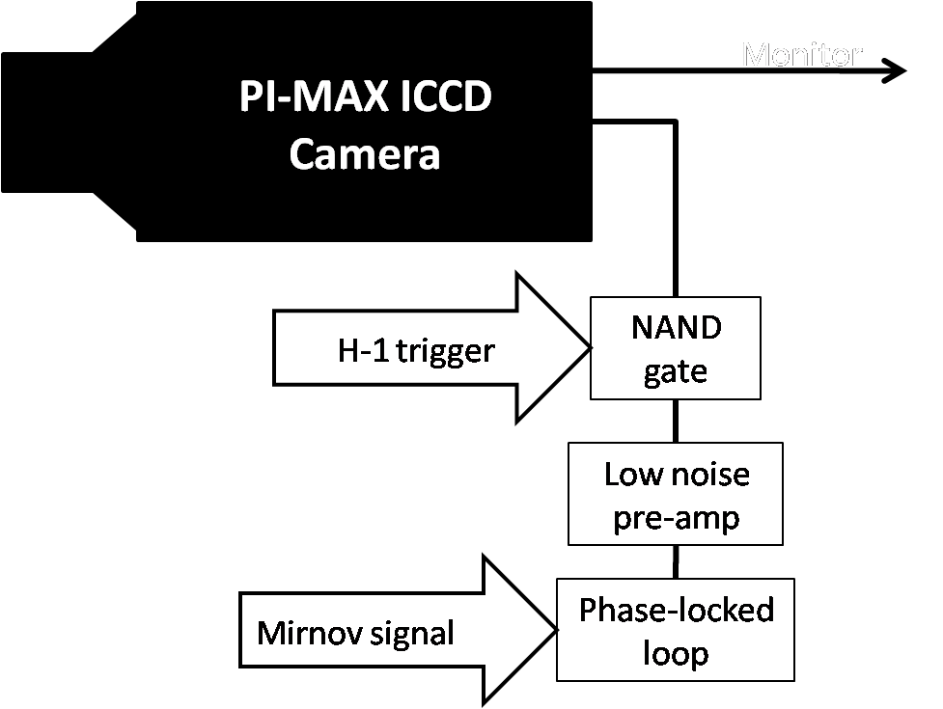
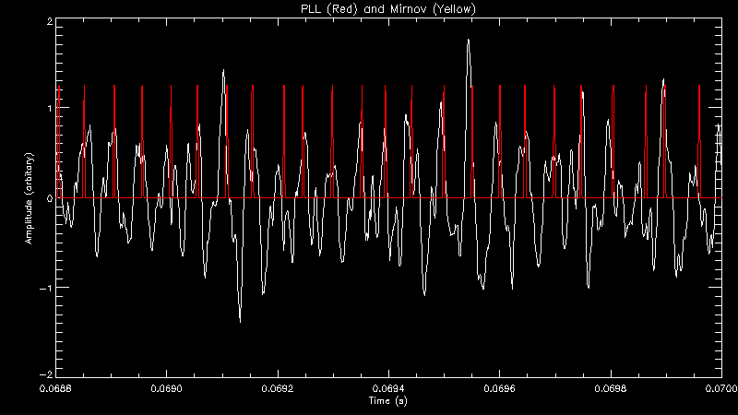
MHD: synchronous 2D imaging
John Howard, Jesse Read
Mirnov coil used as a reference signal.
PLL then matches the phase of its clock to the reference.
PLL output pulses drive the ICCD camera.
Delay output to explore MHD phase
Performance
Amplitude
Time (s)

Slide 35
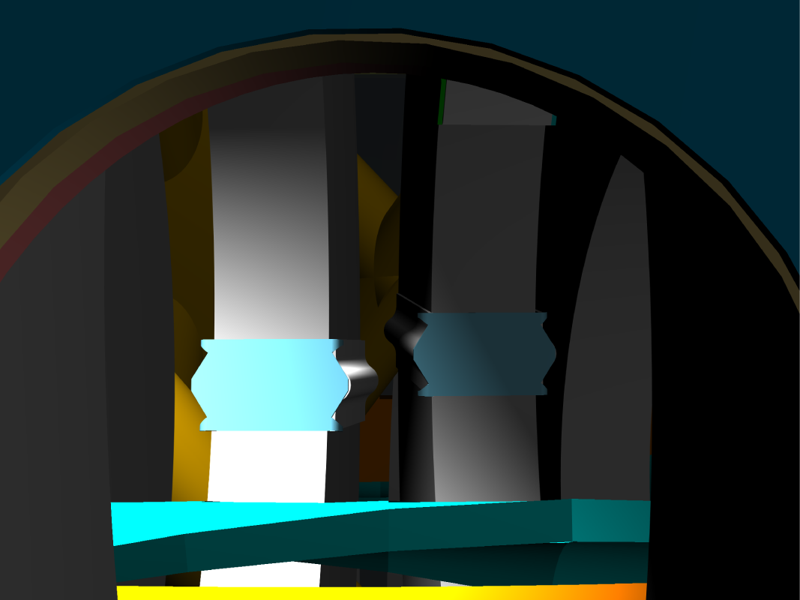
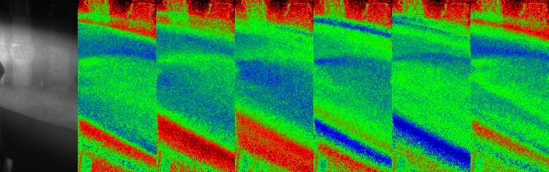
Mode structure via synchronous 2D imaging
John Howard, Jesse Read
Intensified Princeton Instruments camera synchronised with mode using the intensifier pulse as a high speed gate. (256x256)
Total light or Carbon ion line imaged for delays of 0....1 cycle
Averaging is performed in the camera image plane, background removed by subtracting an unsynchronised shot.
Intensity (arbitrary units)
Toroidal Field Coils
Helical Conductor

Slide 36
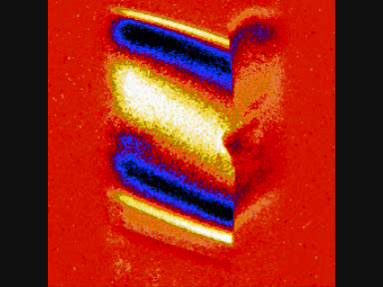
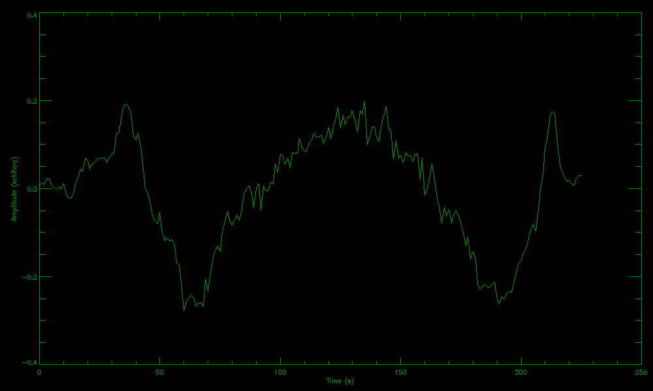
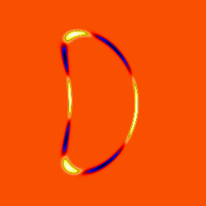
Interpretation
Intensity Profile
Amplitude (arbitrary units)
Vertical Position
Profile segment line
Images clearly show the mode’s helical structure.
Even parity, four zero crossings ➔ m ≥ 4.
Images at different time delays (between PLL pulse and camera gate) shows mode rotation.
Mode structure and rotation direction determined by comparing to a model.

Slide 37




Mode Tomography
John Howard, Jesse Read
Better to do the inverse problem
arbitrary radial profile, m=4, n=5
Match sightline integrals with data
Use data from 18 different phases
Mode appears narrow in radius
Model
Mode
Data and reconstruction
Result of asymmetry (plasma not central in camera view)
Sin/cos cpts
Peaked at r/a ~0.7
Model (poloidal cross-section)
Image (DC removed)
0.4 0.6 _{(r/a)} 0.8 1.0

Slide 38


Alfvén Eigenmode structure in H-1
John Howard, Jason Bertram, Matthew Hole
Compare cylindrical mode with optical emission measurements
Test functions for development of a Bayesian method to fit CAS3D modes to experiment.

Slide 39
The Australian Plasma Fusion Facility: Results and Upgrade Plans
Introduction
H-1 Plasma and Facility
Plasma configurations, parameters
Facility Upgrade
Aims Key areas
New diagnostics for Upgrade
Recent Results: MHD Modes in H-1
Data mining
Alfvénic Scaling
Optical Measurements
Radial Structure
Stellarator Fusion
Recent Progress
Reactor Considerations
Conclusions/Future

Slide 40
Substantial progress over the last 3 decades
The three requirements:
temperature
density
confinement time
LHD 2008
For a fusion power plant, we need to improve the confinement time
Two ways to increase the confinement time:
Improve the effectiveness of the magnetic bottle
Make the device larger

Slide 41

Progress comparison to # CPU transistors per unit area on Si wafer
ITER
Fusion progress exceeds Moore’s law scaling

Slide 42

What about the last 15 years?….
Politics of ITER agreement, cost
Advanced modes of tokamak operation
Eliminate transformer (necess. for continuous operation)
Disruption/Instability/ELM control
Compact tokamaks (Compass, NSTX, MAST)
(Spherical tokamak for high beta)
Stellarators have made great progress
Performance parameters
Compact size (Aspect ratio halved)
Quasi-symmetry improves confinement

Slide 43


Stellarators break Tokamak barriers in density, twist and β/(I/a.B₀)
Twist (1/q_{cylindrical})

Slide 44

Parameters achieved in the LHD Stellarator:2008
80x W7AS, 10 x short
Neutral Beam Injection
n_{e}τ_{E}T_{i} ~ 0.25 x10²⁰
~ 40x short of Q~1

Slide 45

Stellarator Reactors: ITER successor?
The Breakthrough (’80s) 3D MHD, and inverse problem, quasi-symmetry
Garabedian, Nuhrenberg, Hirshman, Merkel, Dewar……
The Promise:
Continuous operation (no transformer)
No Disruptive Instabilities (no plasma current)
Quasi-symmetry
(good confinement)
The Concept:
ARIES CS: compact
stellarator reactor
P_{Thermal}: 2GW
Radius: 8.3M
Magnetic Field 14.4/5.3T

Slide 46





Stellarator Reactors: Challenge of Size
F. Najmabadi US/Japan Workshop on Power Plant Studies
ARIES CS compact
stellarator rea
Fatter is better!
Compact stellarator reduces size to comparable with advanced tokamaks
Notes:
from F. Najmabadi US/Japan Workshop on Power Plant Studies 2006

Slide 47


Stellarator Reactors: Challenge of Shape
Coils are not linked – allows removal for maintenance – but….
Advanced Shape → High Local Field
14.4T for 5.3Tesla average field
Implications for superconductor material
Higher forces than tokamak – needs additional support tube
Insufficient room for blanket at “cusp” point – shield only

Slide 48
Conclusions
Large device physics accessible – e.g. Alfvénic modes observed
We show strong evidence for Alfvénic scaling of magnetic fluctuations in H-1, in n_{e}, iota and ω.
The driving mechanism is not understood, unexplained factor of ~3 in the frequency
Interferometer and optical diagnostics (CCD camera and PMT array) → valuable mode structure Information
First results are in qualitative agreement
Stellarators as the step beyond ITER?
Promise of simple, continuous operation and stability
Challenge of size, shape and complexity
Tokamaks clearly better performers now, but stellarators catching up!
Recent LHD result - record density

Slide 49
Future
New Toroidal Mirnov Array
Bayesian MHD Mode Analysis
Toroidal visible light imaging (CII 525nm)
Correlation of multiple visible light, Mirnov and n~ _{e} data
Spatial and Hybrid Spatial/Temporal Coherence Imaging
Facility upgrade!
Develop divertor and edge diagnostics
Study stellarator divertors, baffles e.g. 6/5 island divertor
Develop PWI diagnostics (materials connection)
Linear “Satellite” device for materials diagnostic development – multiple plasma sources, approach ITER edge

