Slide 1
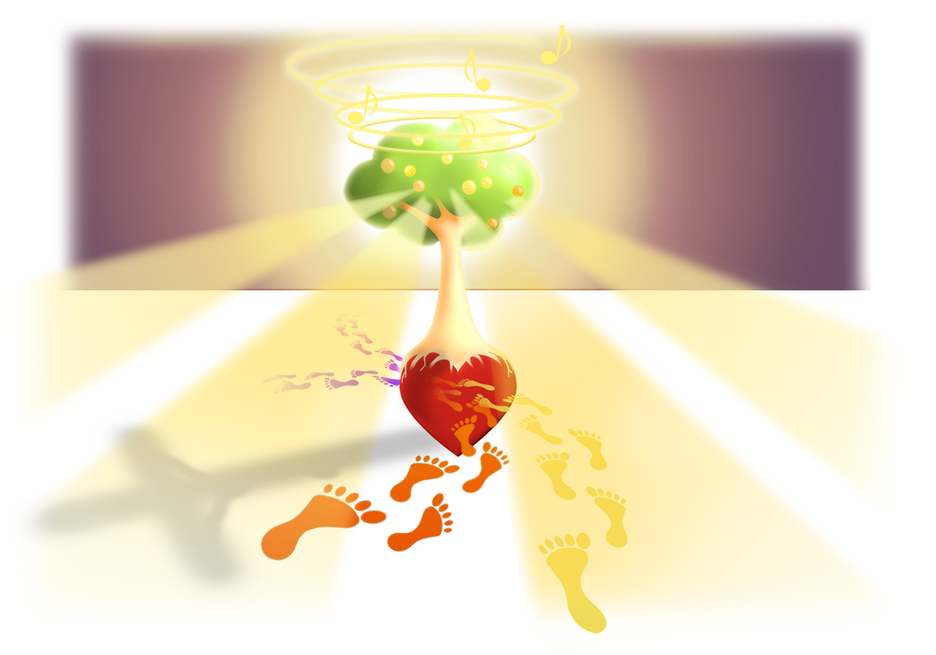
SESSION 12
COME IN

Slide 2
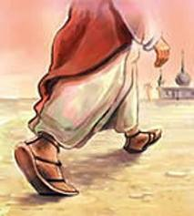
Receive the Power
Every nation, every tribe,
come together to worship You.
In Your presence we delight,
we will follow to the ends of the earth.

Slide 3
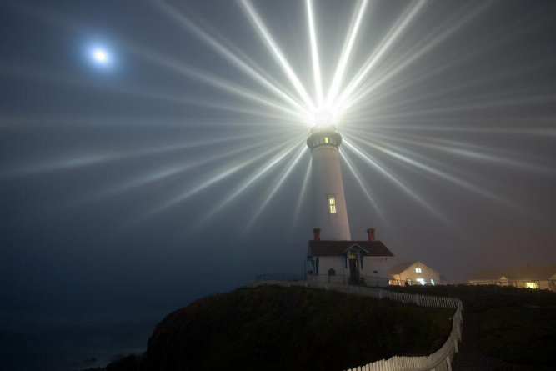
Receive the Power
Alleluia! Alleluia!
Receive the Power, from the Holy Spirit!
Alleluia! Alleluia!
Receive the Power to be a light unto the world!

Slide 4
Receive the Power
As Your Spirit calls to rise we will answer and do Your Will. We’ll forever testify of Your mercy and unfailing love.

Slide 5
Receive the Power
Alleluia! Alleluia!
Receive the Power, from the Holy Spirit!
Alleluia! Alleluia!
Receive the Power to be a light unto the world!

Slide 6
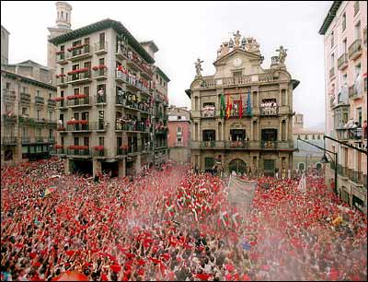
Las Direcciones [Finding directions]
Maybe remember… “per dodo” Ur lost like a dodo
¡Hola!
Estoy perdido!
I’m lost.
Podrias ayudarme?
Can you help me?
Donde queda el bano?
Where is the toilet?
Yo no hablo Espanol
I don’t speak Spanish
Yo quiero….
I want….
Me gusta …
I like….
Cuanto Cuesta?
How much does it cost?
Espéreme, por favor.
Please wait
Maybe remember… 當地 (dorng dei)

Slide 7
SESSION 12
COME IN
The sun has moved to shine through the tree, symbolizing God shining through us. Being a true witness is all about inviting god into us and let him shine through us, through our lives.

Slide 8
SESSION 12
COME IN
I am a walking loudspeaker
-Reflection

Slide 9
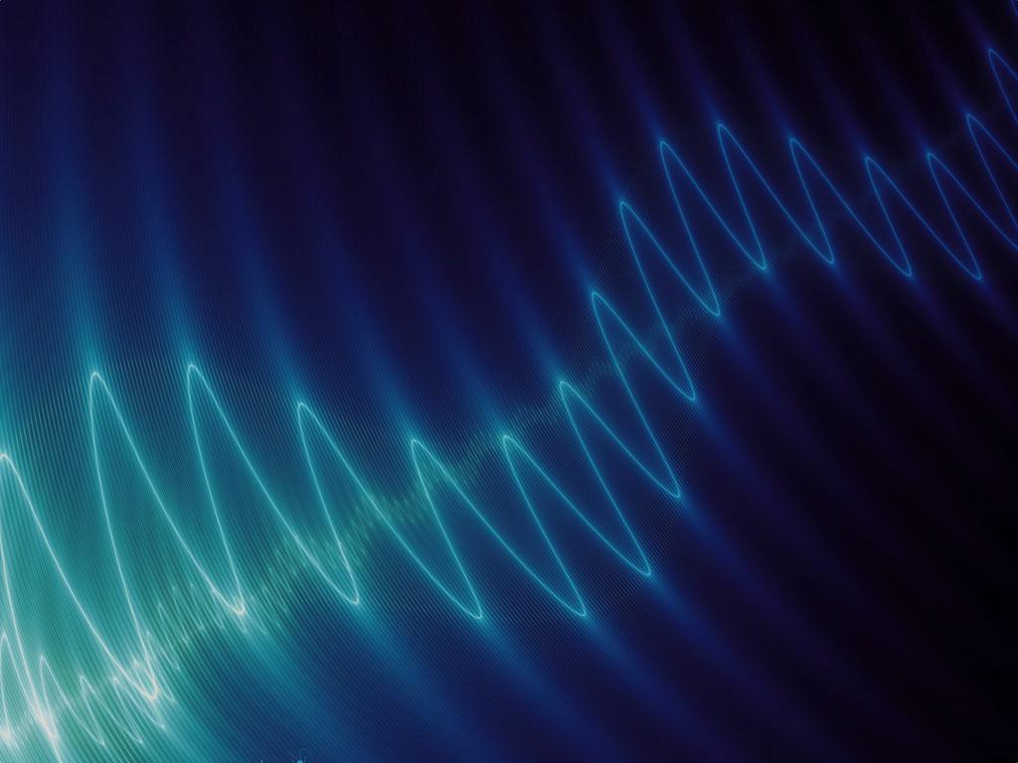
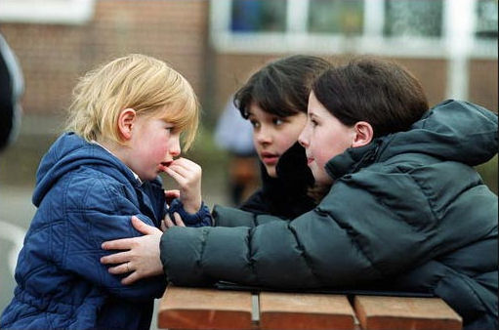
Are we aware
our body language :
Reveals our interest in a person
Reveals any hidden intentions
Reveals our patience
Reveals our sincerity in what we say
Can reveal that we care, even without words

Slide 10

How we spend our
MONEY
reveals our
ATTITUDE
towards it

Slide 11

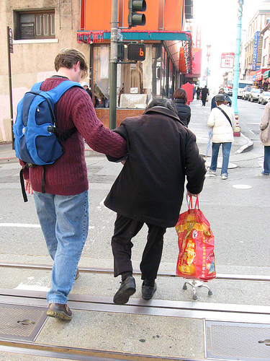
you make
Decisions
often reveal your priorities

Slide 12
The things we
own
&
value
reveal who we are

Slide 13

How is the way you dress:
Speaking to
men?
women?
the next generation?

Slide 14
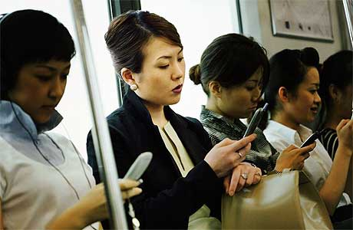
How we use our time…
reveals our attitude towards
death

Slide 15
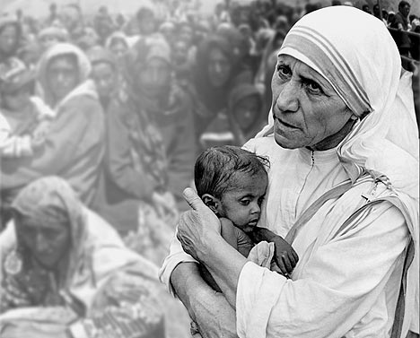
Our
humility
before God
reveals our humility towards others

Slide 16
How we treat
strangers
reveals
our respect for all people

Slide 17
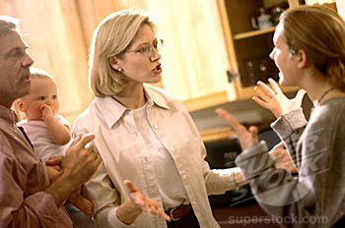
Often how we
treat our family
prefigures how we will eventually
treat our friends

Slide 18

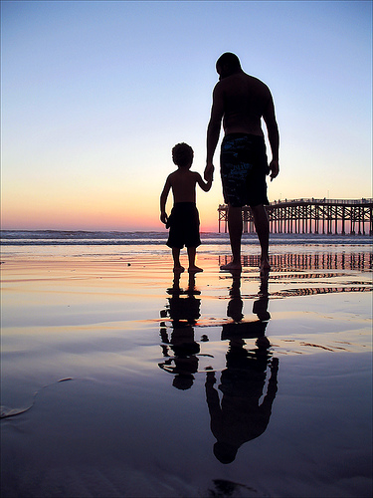
Our relationship with people…
relationship
reflects
our
with God

Slide 19
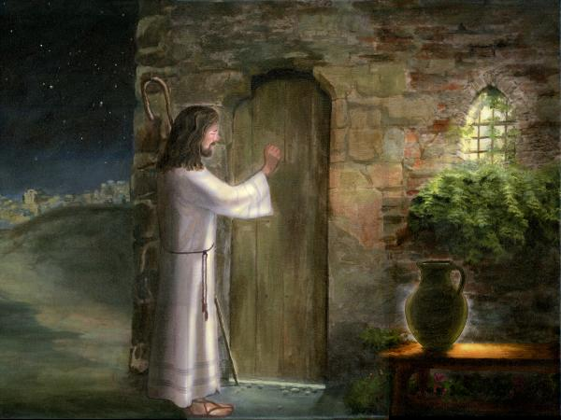
How we live every day is already speaking volumes to the world -
What do we want to witness through our lives to the world -
Only by first inviting Jesus to COME IN can we actually witness Him!

Slide 20
SESSION 12
COME IN

Slide 21
What Would Jesus Do?

Slide 22
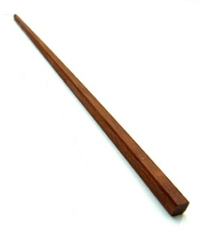
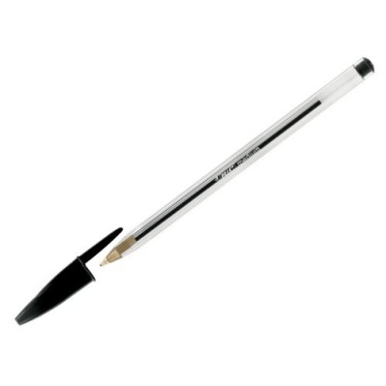
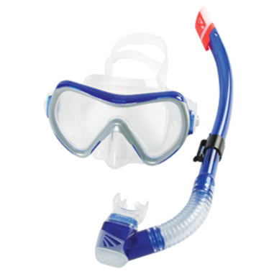


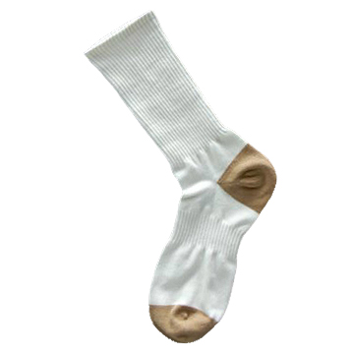
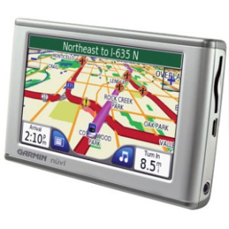

A chopstick
Pen
A snorkle
WWJD?
Roll of sticky tape
Fish bowl
A sock
Headband
GPS

Slide 23
A chopstick
Pen
A snorkle
WWJD?
What would Jesus do?
Roll of sticky tape
Fish bowl
A sock
Headband
GPS

Slide 24

Tools of the Journey: Flash Witness

Slide 25
SESSION 12
COME IN

Slide 26
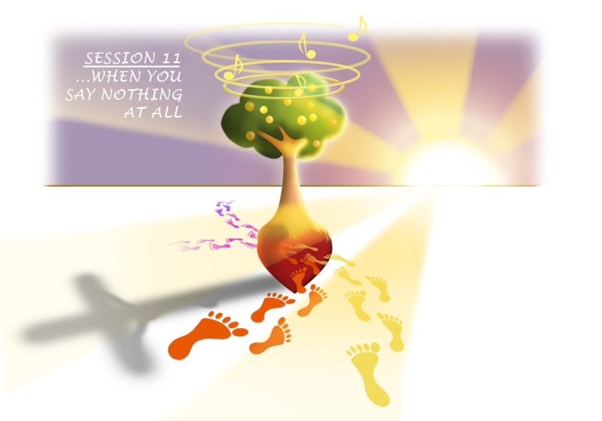
Group Discussion
The walking loudspeaker reflection
- Are we aware our body language :
Reveals our interest in a person
Reveals any hidden intentions
Reveals our patience
Reveals our sincerity in what we say
Can reveals that we care, even without words
- How we spend our money reveals our attitude towards it
- Decisions you make often reveals your priorities
- The things we own and value reveals who we are
- How is the way you dress:
Speaking to men?
Speaking to women?
Speaking to the next generation?

Slide 27
Group Discussion
The walking loudspeaker reflection
- How we use our time reveals our attitude towards death
- Our humility before God reveals our humility towards others
- How we treat strangers reveals our respect for all people
- Often how we treat our family prefigures how we will eventually treat our friends
- Our relationship with people reflects our relationship with God
Summary of aim of night:
- How we live every day is already speaking volumes to the world. - Reflect on what we want to witness through our lives to the world, - Only by first inviting Jesus to COME IN can we actually witness Him!

Slide 28
SESSION 12
COME IN

Slide 29
SESSION 12
COME IN
“You will receive power when the Holy Spirit comes upon you, and you will be my witnesses to the ends of the earth” – Act 1: 8

Slide 30
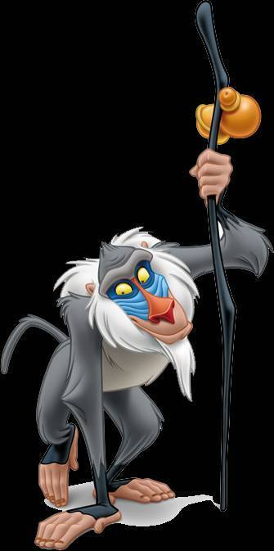
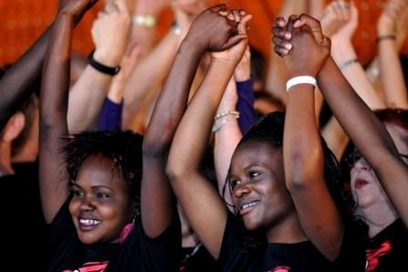
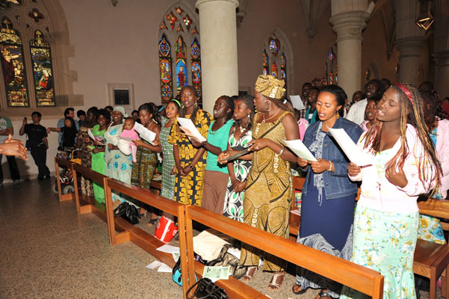
The world of
World Youth Day
BaBa Yetu The Lord’s Prayer in Swahili (African)
All people in all cultures express and witness their faith differently. How do you express your faith? How does our Chinese Church express her faith? Why is the highlight and finale of World Youth Day a Mass? What do u feel is unique about any Catholic Mass?

Slide 31
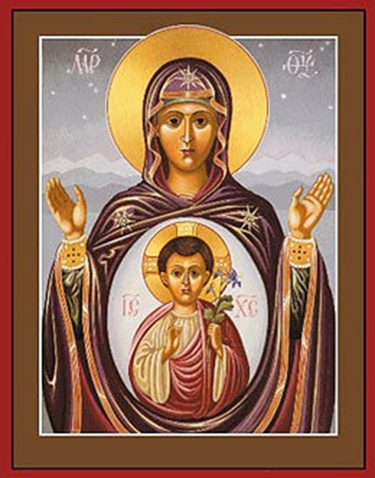
Final Prayer –
Mary’s Song (The Magnificat) - Luke 1:46
“My soul magnifies the Lord, and my spirit rejoices in God my Savior, for he has looked on the humble estate of his servant. For behold, from now on all generations will call me blessed; for he who is mighty has done great things for me, and holy is his name….
…he has filled the hungry with good things, and the rich he has sent away empty. He has helped his servant Israel, in remembrance of his mercy, as he spoke to our fathers, to Abraham and to his offspring forever.” Amen
When Mary said yes, God literally ‘came in’…

Slide 32
Receive the Power
Every nation, every tribe,
come together to worship You.
In Your presence we delight,
we will follow to the ends of the earth.

Slide 33
Receive the Power
Alleluia! Alleluia!
Receive the Power, from the Holy Spirit!
Alleluia! Alleluia!
Receive the Power to be a light unto the world!

Slide 34
Receive the Power
As Your Spirit calls to rise we will answer and do Your Will. We’ll forever testify of Your mercy and unfailing love.

Slide 35
Receive the Power
Alleluia! Alleluia!
Receive the Power, from the Holy Spirit!
Alleluia! Alleluia!
Receive the Power to be a light unto the world!

Slide 36
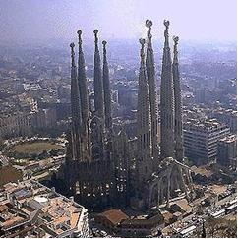
Despedidas (Leaving-takings)
Adiós
Chao
Hasta luego
Hasta manana
Hasta pronto
Hasta la vista
Nos vemos
Have a banana
La Sagrada Familia Church, Barcelona

Slide 37
SESSION 12
COME IN

Slide 38

Youth Group AGM Sunday 17th July, 12:30pm CCC Hall
Commission Mass & Spanish Party Sunday 24th July, 10:45pm CCC church and hall
Last Sweet n’ Sour Course Wednesday 27th July, 7:59pm
Days In Dioceses Friday 5th August, 10am

