Slide 1
Uranium Workload Colorado
Table 1. New mining claim filings by year, with uranium.
CY ACTIVE NEW CLAIMS ACTIVE NEW URANIUM
FILED IN CO FILINGS IN CO
2003 230 120
2004 342 274
2005 3208 2725
2006 5787 5205
2007 12900 10730

Slide 2
COSO staffing
Table 2. COSO adjudication staffing and workload over time.
Location: COSO non-Coal Adjudication
Year: 1991 2000 2008 2007
Subject: TO TO TO
EW units * EW- 175 EW-20,500
Branch chief 1 - - -
Supervisor 1 - -
Staff 5 4 2
Clerks 3 - -
Student 1 - 1
Sub Ttl 10.5 5 2.5

Slide 3
FO staffing
Table 3. Field office solid minerals staffing and workloads
Year: 1991 1991 2000 2000 2008 2007
Subject: TO units TO units TO units
Location:
Craig District office 4 - -
LSFO 1 2 2
KRFO - 1 -
WRFO 2 1 1
Sub Ttl 7 4 3
Montrose District 3 - -
UFO 1 2 1
Gunnison FO - 1 1/2
San Juan PLC 1 (BLM only) 2 1
Sub Ttl 5 5 2.5
Canon City District 2 - -
San Luis PLC - (BLM only) 2 1
RGFO 1 2 2
Sub Ttl 3 3 3
GJ District 1 - -
GJFO 2 1 1
GSFO - 1 1
Sub Ttl 3 2 2
Staffing Totals: 29.5 19 15 EX+FL-15* EX+FL-36*
Workload totals: NI-46** NI- 104
NJ-2 NJ-3
EW- 175 EW-20,500

Slide 4
LR2000 units of accomplishment in 1990- Uranium
FY PE FO Units state total
2003 EX All 0 0
FL All 0 0
2004 EX UFO 1 1
FL All 0 0
2005 EX All 0 0
FL GJFO 7
WRFO 1 8
2006 EX All 0 0 FL GJFO 3
GUFO 1
SJPLC 1 5
2007 EX All 0 0
FL SJPLC 10 (22)
UFO 15 25(37)
2008 (60% date) EX GJFO 1 1
FL RGFO 1
SJPLC 6
UFO 5
GJFO 2 14

Slide 5
Additional workloads for staff at FOs with significant Uranium workloads
FO # Solid #of addl AML planning oil and gas coal S and G
Minerals Staff O & G staff & solid leasable
SJPLC 1 5 X XX XX XX
AML - wedding Bell district, Competitive Gravel pit w/RMP amendment, multiple FO areas, Potash leasing EA.
UFO 1 0 XX XXXXX X XXX X
New RMP , O and G -surface only Coal operating mines, new leases , potash leasing EA, DOE U leasing .
GJFO 1 0 XX XXXXX XXX XXX X
New RMP, Subsurface and surface oil and gas, G.W. hydrology, New Coal mine w/ EIS, potash leasing EA, paleontology.
RGFO 1 1 XXXX X XX X
Mining info demands from metropolis, Large paleo program, travel time issues, U leasing, urban interface minerals issues
AML program : Leadville , granite, St Kevin-Sugarloaf, Hecla, Central City, Gold hill , Buena vista, Cripple creek mining districts

Slide 6
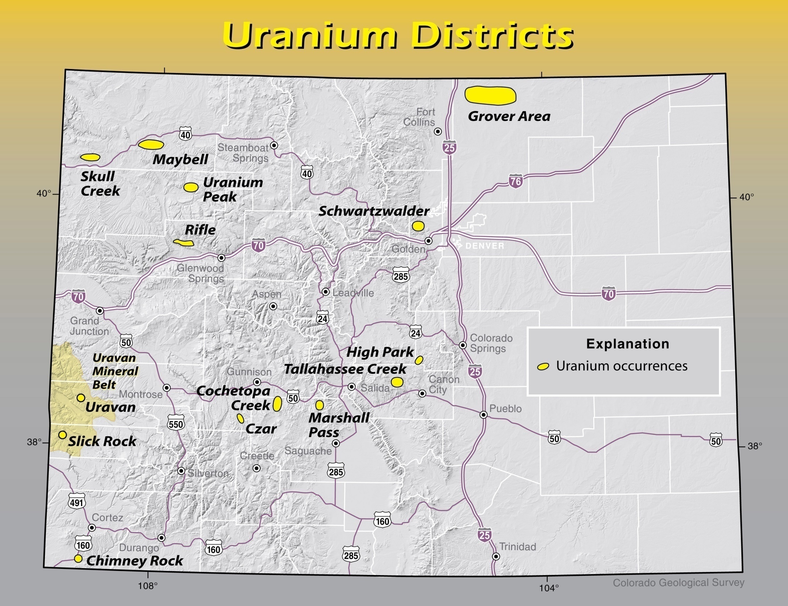

Slide 7
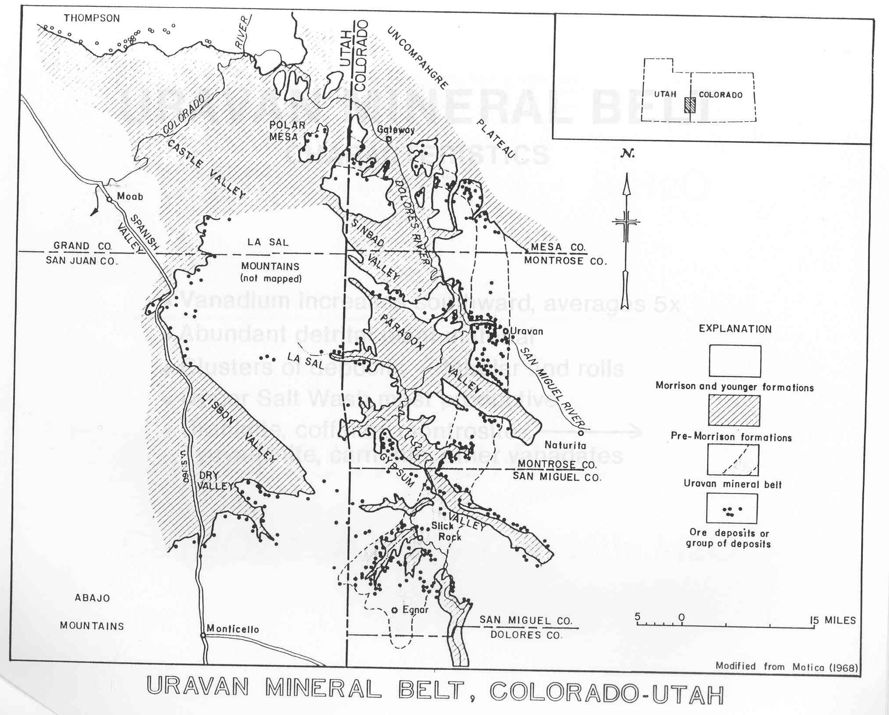

Slide 9
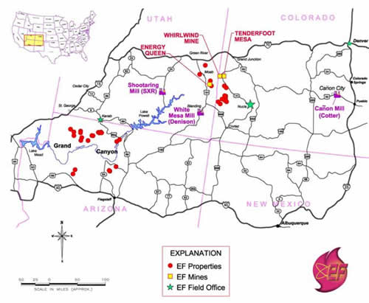
Energy Fuels Uravan projects (5/08)

Slide 10
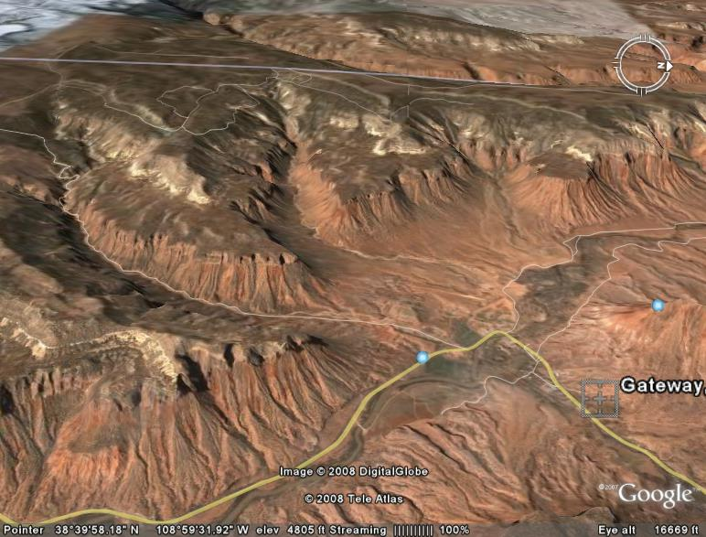
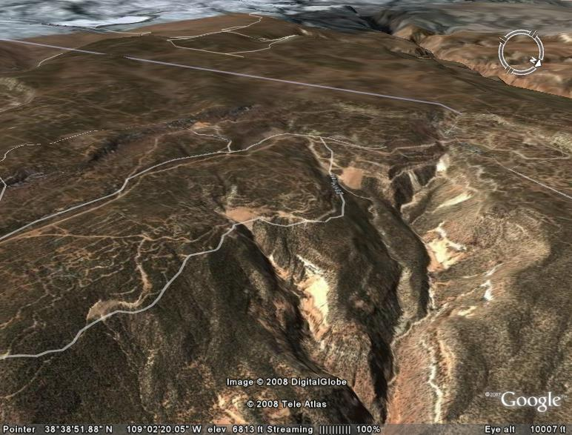
Energy Fuels Whirlwind Minesite GJFO EA 5/08

Slide 11
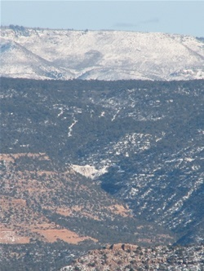
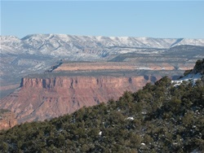
Energy Fuels Torbyn/ Peaches minesite
Existing energy fuels uranium minesite at tenderfoot mesa
Tenderfoot mesa from energy fuels Whirlwind minesite

Slide 12
Other Colorado Uranium Issues
Leasable Uranium
DOE Uranium 1948-1954 land orders set aside known uranium mining areas for federal uranium supplies – leasable by AEC, now DOE. (specific sites in Uravan mineral belt- Historic mining - conventional mining )
Acquired lands (Bankhead –Jones lands)
All minerals are Leasable
(Pawnee Grasslands -FS surf/ BLM mins 31 applications,. In-Situ mining?)
Split Estate Issues
NOITL (notice of intent to locate)- letter to landowner (cc-BLM) 30 day segregation - prior to location of mining claim for surface owner contact.
(approx . 700 , covering 29,000 acres)
If surf. owner agreement- same as federal lands
if no surf. owner agreement: Full EA by BLM required for any claimant work on pvt. surf. Issue in South Park- In-situ or conventional mining

Slide 13
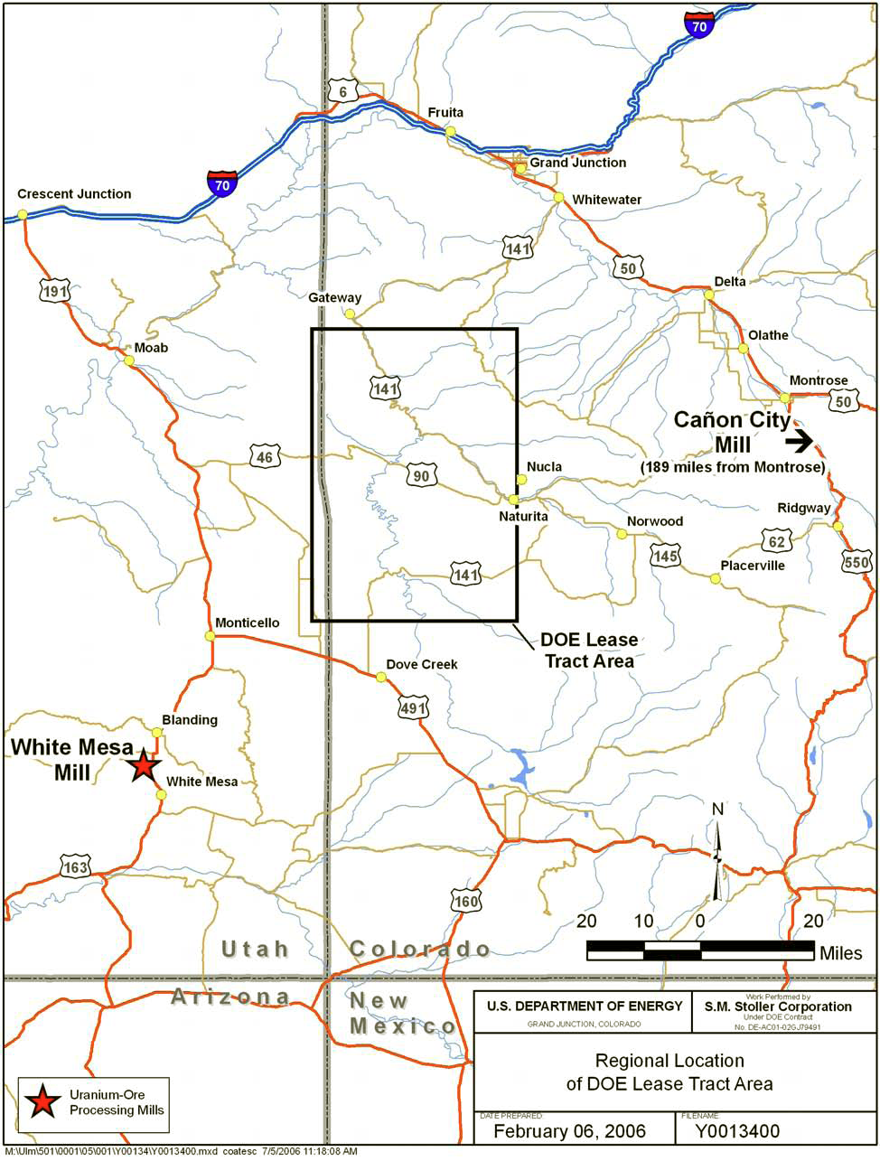

Slide 14
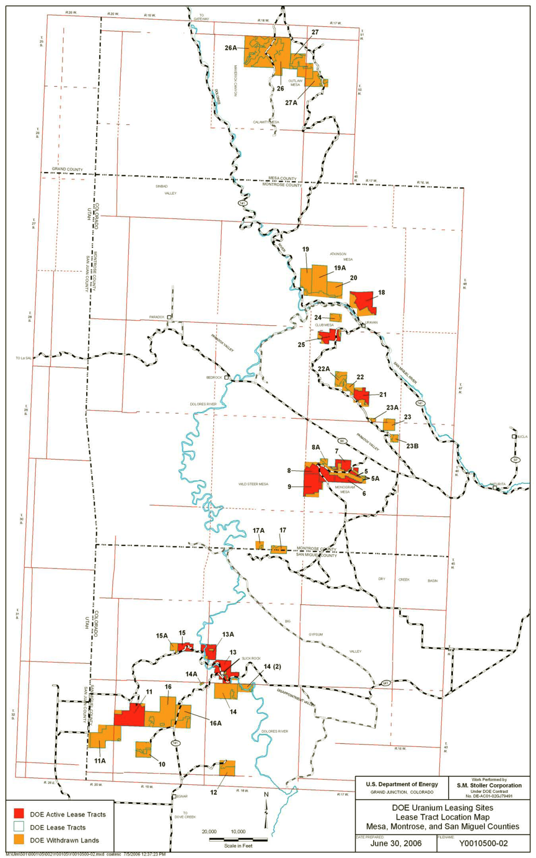

Slide 15
Emerging Uranium issues in Colorado
- lawsuits and appeals of POO EAs-
DOE leasing EA now in court
BLM Whirlwind EA delayed 2 months with reviews, input, and So planning review prior to likely court appeal
NIMBY activity in San Miguel (Telluride) and San Juan (Durango/ Dolores) counties.
High Recreation use area (river SRMA, Scenic Bi-ways, Gateway resort)
Split Estate residential subdivisions on Known Uranium Deposits
In-Situ potential in Tertiary basins
FS surface (grassland) with leasable and locatable lands at known uranium deposits
Additional workload associated with adjacent DOE leases and coordination

