Slide 1

Deep Geological Repository Development Process in the Czech Republic
Jiří Slovák
Radioactive Waste Repository Authority
Head of Geological Repository Development Dpt.
Radioactive Waste Repository Authority
1

Slide 2
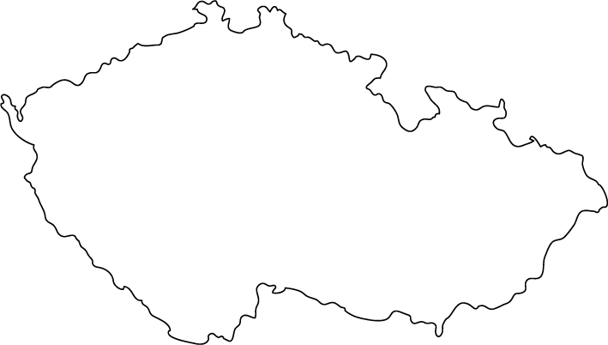
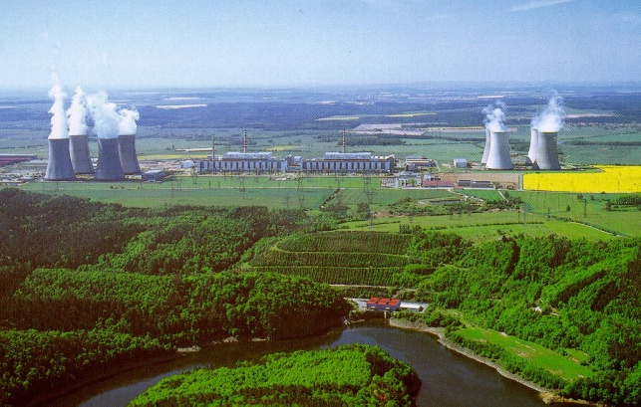
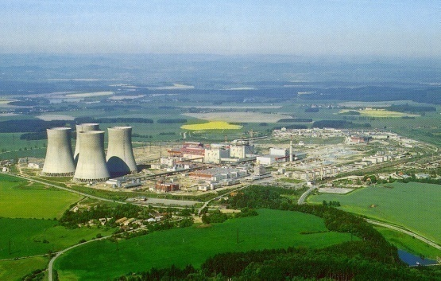
Nuclear sites in the Czech Republic
Richard
Bratrství
Řež
Praha
Dolní Rožínka
Temelín
Dukovany
NPP in operation
Research Reactor
Uranium mine
Repository
SF Storage

Slide 3
HLW / SNF Management
Amount
HLW 3000 m³
SNF - EDU – 1940 t (40 years operation)
SNF - ETE – 1790 t (40 years operation)
Storage at sites of NPPs EDU, ETE or Skalka (potential underground storage capacity for all SNF production)
Final disposal at DGR (operation from 2065)
Enough time for options (reprocessing, partitioning and transmutation)
Ref. : www.surao.cz

Slide 4
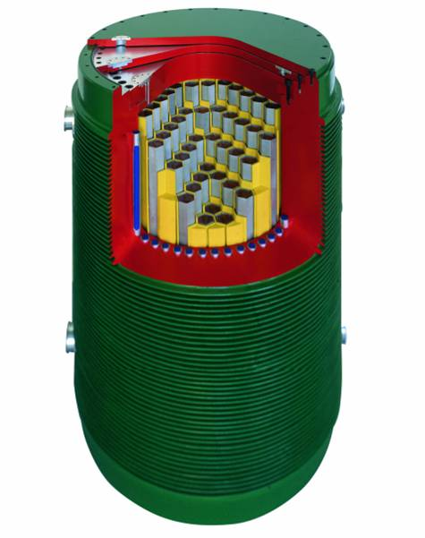
HLW / SNF Management
CASTOR – 440/84
Transport storage container
Capacity 84 fuel bundles
Weight of full container 116 t
2,6 x 4,1 m

Slide 5
LEGISLATIVE BACKGROUND
In 1997 Act on the Peaceful Uses of Nuclear Energy and Ionizing Radiation (Atomic Act) entered into force and stipulate for the management of radioactive waste on the area of Czech Republic the following general principles:
The state guarantees safe disposal of all radioactive waste.
An owners of radioactive waste shall bear all costs associated with its management from the time of origin to its disposal.
To provide for activities associated with radioactive waste disposal, the Ministry of Industry and Trade shall set up a Radioactive Waste Repository Authority as a State organization - established on 1st June 1997 as the result of Ministry of Industry and Trade Decision
5

Slide 6
RAWRA statement in the Czech RWM
RAWRA´s main responsibilities are set out in Article 26 Paragraph 3 of the Atomic Act, according to which RAWRA is obliged to:
…among others…
ensure the preparation, construction, commissioning, operation and closure of radioactive waste repositories and the monitoring of their impact on the environment
ensure and co-ordinate research and development in the field of radioactive waste management
For performing RAWRA roles the Czech government adopted on 15th May 2OO2:
THE CONCEPT of Radioactive Waste and Spent Nuclear Fuel Management in the Czech Republic
(RWM Concept)
RADIOACTIVE WASTE REPOSITORY AUTHORITY
6

Slide 7
DGR Siting in the Czech republic
Stages
Stage 1 – Evaluation of the whole territory of the Czech Republic (study of archive geological data)
Stage 2 – Narrowing the area of sites (geological research works without drilling – geological research)
Stage 3 – Site characterization (geological works with drilling – geological survey)

Slide 8
Current status of DGR development program
Siting
Latest step - preliminary airborne geophysical survey of 6 potential sites (2005)
Host rock – pseudo-homogenous granite blocks – each about 10km2
All selected sites – public opposition
Government decision (June 2nd 2004) - to interrupt ongoing geological surveys at he sites until 2009
The Spatial Development Policy of the Czech Republic
(approved by government, May 17th 2006)
In this document:
6 evaluated sites have been reserved as potential sites for future exploration and evaluation for DGR – to reserve these sites to 2015

Slide 9
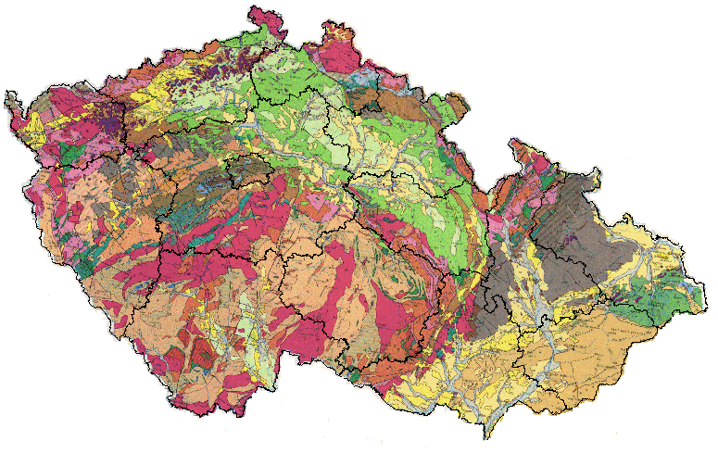
Site selection process
1 Lubenec 2 Pačejov nádraží 3 Božejovice 4 Pluhův Žďár 5 Rohozná-Růžená 6 Budišov
1
3
2
5
4
6
Preselected sites for DGR – granitic rock

Slide 10
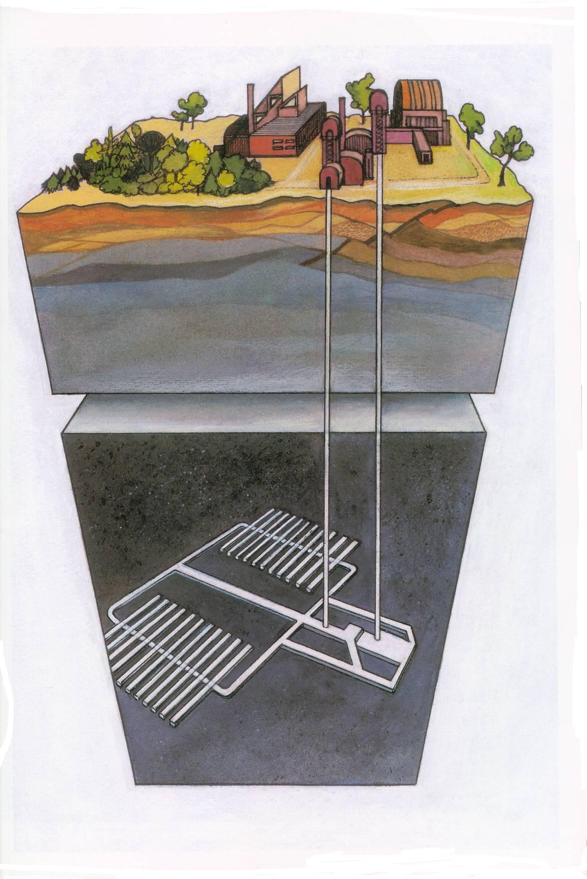

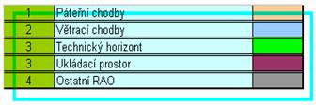
Reference Design – visualisation
Optim. Reference Design – visualisation 2004

Slide 11
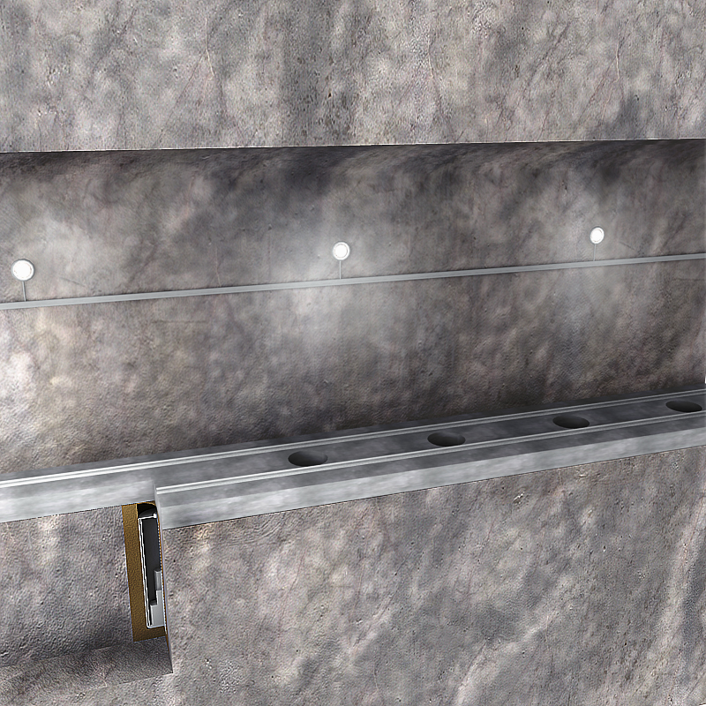
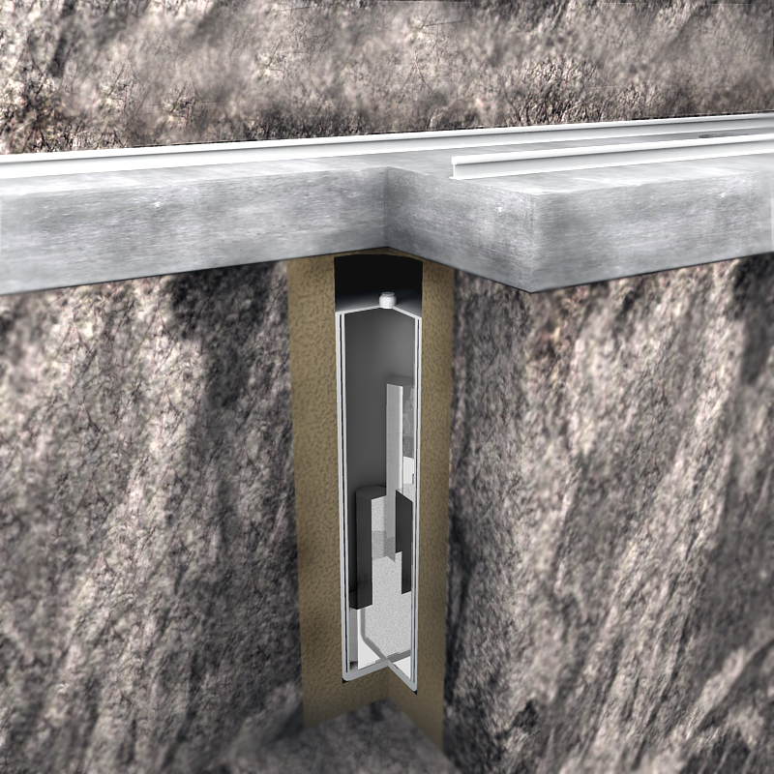
Reference Design – visualisation
Visualisation of disposing vertical drill
Detail of disposed waste - section

Slide 12
DGR in the Czech Republic Upcoming R&D
Relevant projects in the presence
Near Field R&D project – finished in July 2008
Far field project – ongoing,to be finished in the end of 2009
No geological exploration at the sites – expected to start in 2010
No existing geological study of behavior and characterization of host rocks (granites)
No real site specific data
Upcoming projects (to start in 2008, 2009)
Projects supporting future sites evaluation (continuously and prior to site evaluation)
Methodology for suitable site evaluation
Criteria of evaluation
Data for Safety Case modeling
Reference design of DGR (to start in 2nd half of 2008)
Site selection projects – (start in 2010)

Slide 13
Supposed Site selection projects
Geological surveys on site
Parallel geophysical and geochemical landscape survey
Drilling of boreholes (one or two at each site)
Rock characterization
Environmental site specific studies
Feasibility Studies
Preliminary Safety Case
E.I.A.

Slide 14
Near future and RAWRA´s approach (1)
Motivation program for selected sites (one + one as backup site)
local communities must be aware of potential rewards
motivation program for exploration process - support for the public involved in the selection program
Information campaign – general across the whole Czech Republic and specific for regions with potential sites
Notes:
Ad Bod1: + The potential communities compete about profit

Slide 15
Near future and RAWRA´s approach (2)
The other way to get solutions (if motivation is unsuccesfull is
Military Domains
Currently started project „Critical bibliography search of existing geological information about military domains in the Czech rep.“
The goal is to find potential area of existing military domain with potential sitting of DGR

Slide 16
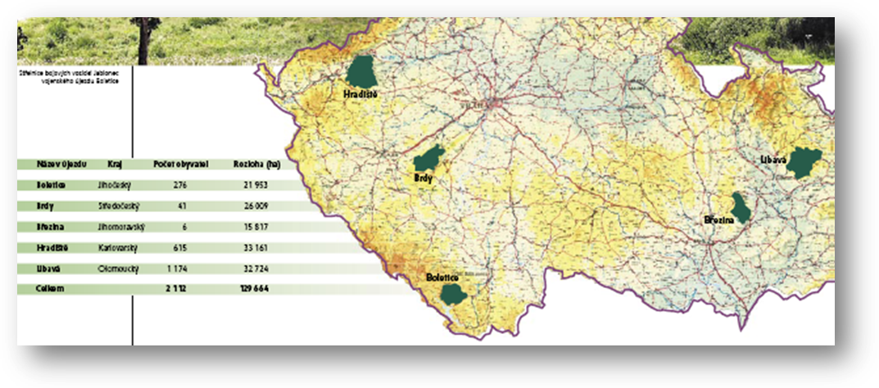
Military domains in the Czech Republic

Slide 17
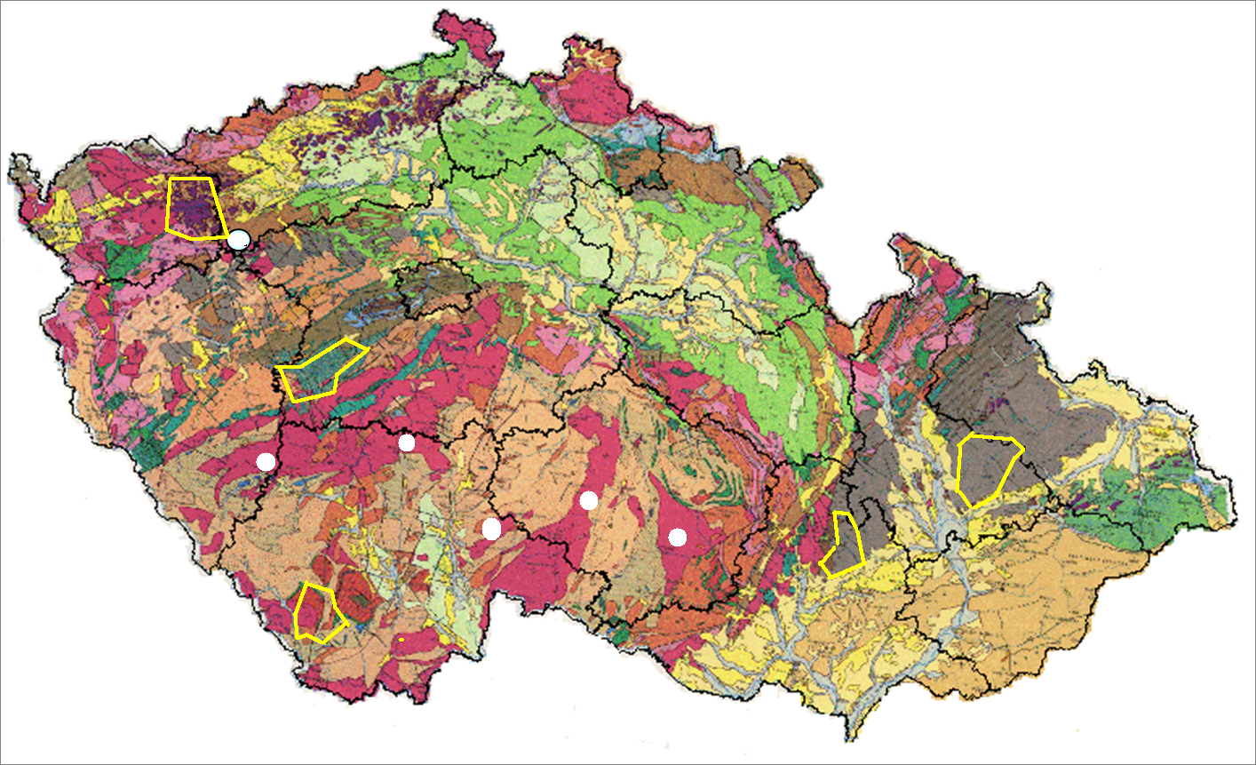
Military Domains in the Czech republic – Geology

Slide 18
Military Domains in the Czech republic – Geology (2)
MD | Area (km²) | Geological conditions
Hradiště | 332 | Complex of volcano sedimentary rocks, source term of termal and spa springs with possible influence by underground mining
Brdy | 260 | Complex of permeable and semipermeable sedimentary rocks. Two small granitic rocks bodies
Boletice | 220 | Granitic roks and granulites (metamorphosed granites)
Březina | 158 | Complex of permeable and semipermeable sedimentary rocks. High number of diferent tectonic disruptions, zones and faults
Libavá | 327 | Complex of permeable and semipermeable sedimentary rocks. High number of diferent tectonic disruptions, zones and faults. The risks to impast sours areas of mineral waters springs

Slide 19
Summary of GR development program in the Czech Republic (1)
Siting Strategy
1 + 1 sites in 2015 (2020) – criterial evaluation from 6 (or more) sites
2030 – URL
2065 – operation of DGR
Regulations
no specific regulation for DGR development – aplication of IAEA standards
Host rock
Granites, granitic rocks (metamorphoused granites)

Slide 20
Summary of GR development program in the Czech Republic (2)
Waste Characteristics
HLW 3000 m3
SNF - EDU – 1940 t (40 years operation)
SNF - ETE – 1790 t (40 years operation)
Geometry:
Shafts or Inclines – no specific
Final repository in depth 500m or more
Engineered Barriers
Adopted Scandinavian concept

Slide 21
Future Strategy of R&D in the RWM – issues and goals
Support of the GR site selection process
Site evaluation methodology
Evaluation criteria
Site specific data and characteristics
Support for long term safety of GR
Models and its validation for long term behaviour of geological repository (NF – FF, EDZ evolution, HG transport, T-H-M-C processes
Definition and characteristics of source term (both SNF – HLW)
Container

Slide 22
Future Strategy of R&D in the RWM - approach
(+) Stronger partnership in international projects
EC founded
Other internationals
Bilateral – WMO
(+) Project supported future site selection process
Site specific data – used possibility to study geological phenomena in the underground
The Josef Gallery (CTU Prague)
Bedřichov water supply tunnel
Uranium mine Rozna
(+) Project supported long term behavior of disposal compounds (container, buffer material, IB, … )
Use special laboratory at CTU and NRI Řež
(-) Postponed technical assistance P&T projects - up to selected two sites

Slide 23
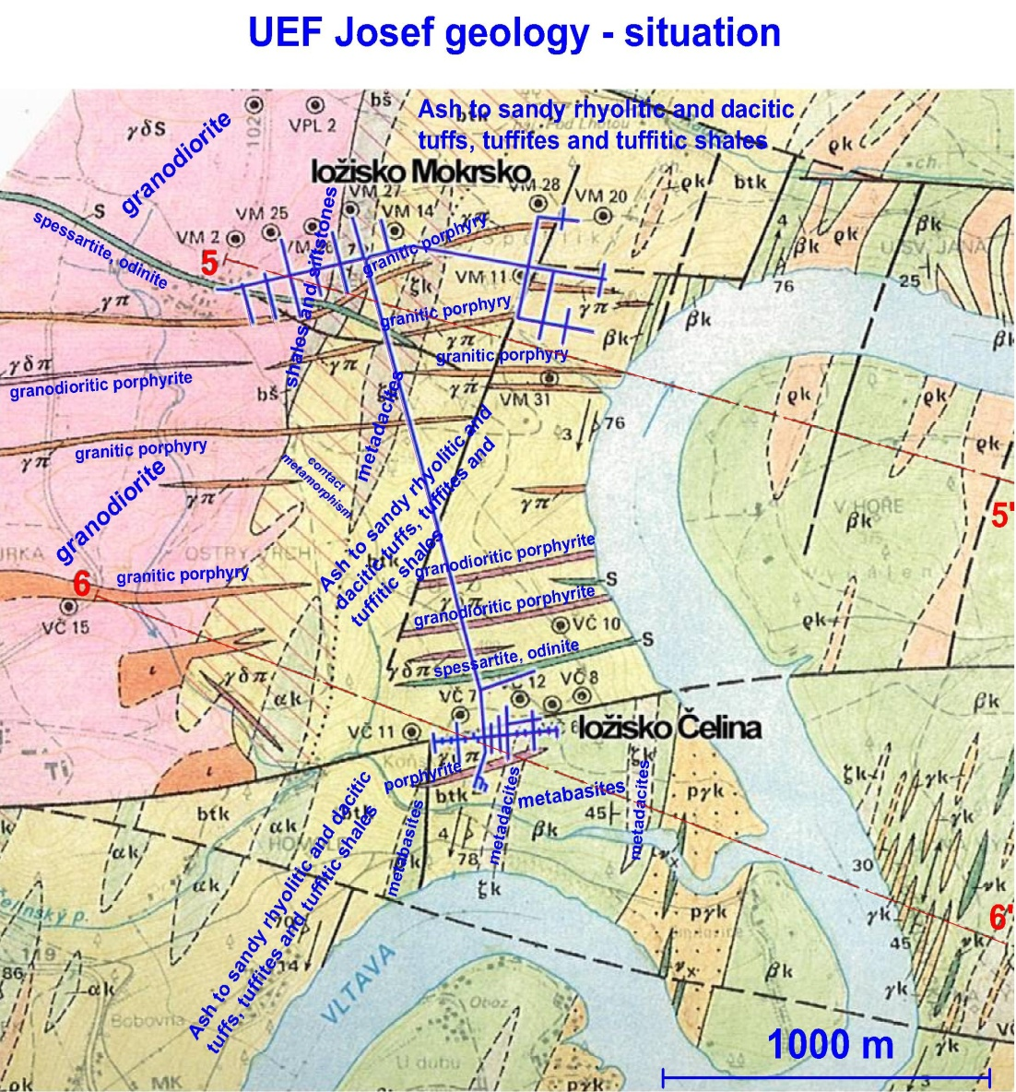
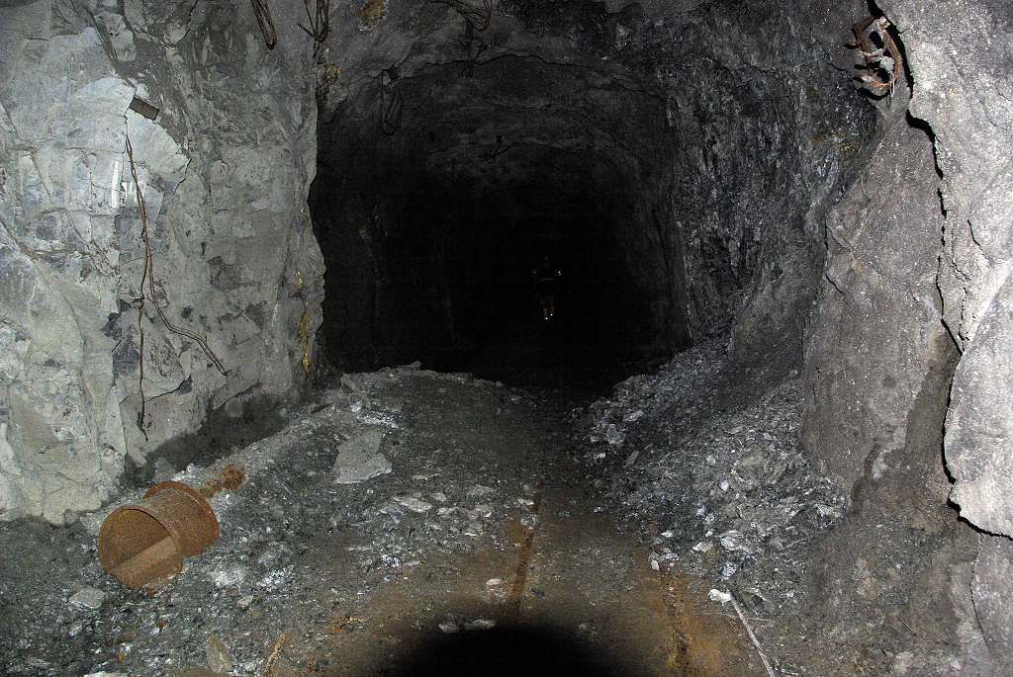
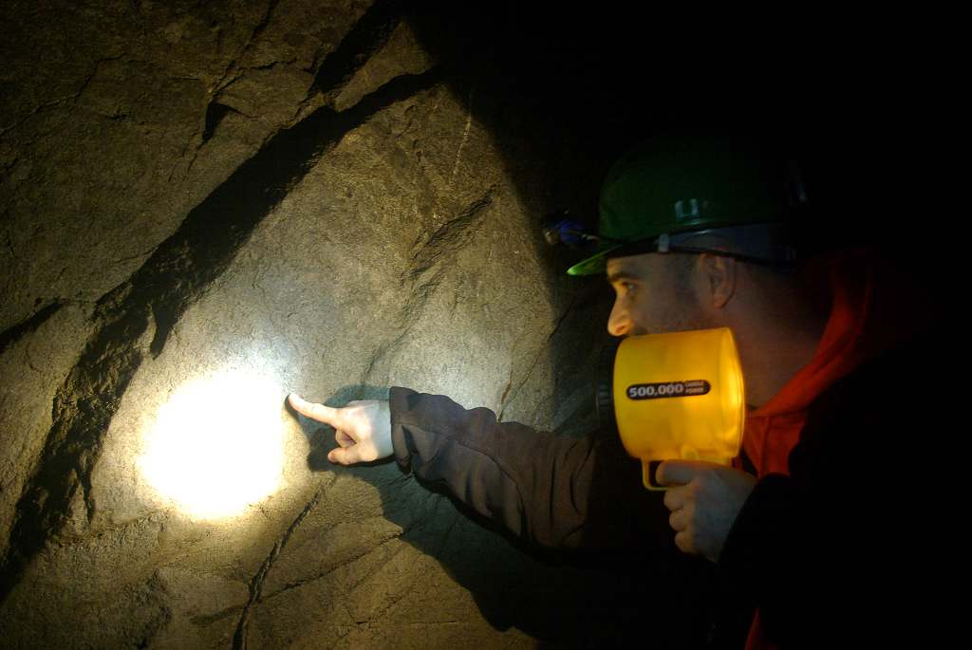
The Josef Gallery Research facility, operated by CEG (since 2/2007)
Former exploration drift and galleries – 80m below surface
Granites with high sequences of fractures
EDZ 20 years old – last mining activity in the end of 80s

Slide 24
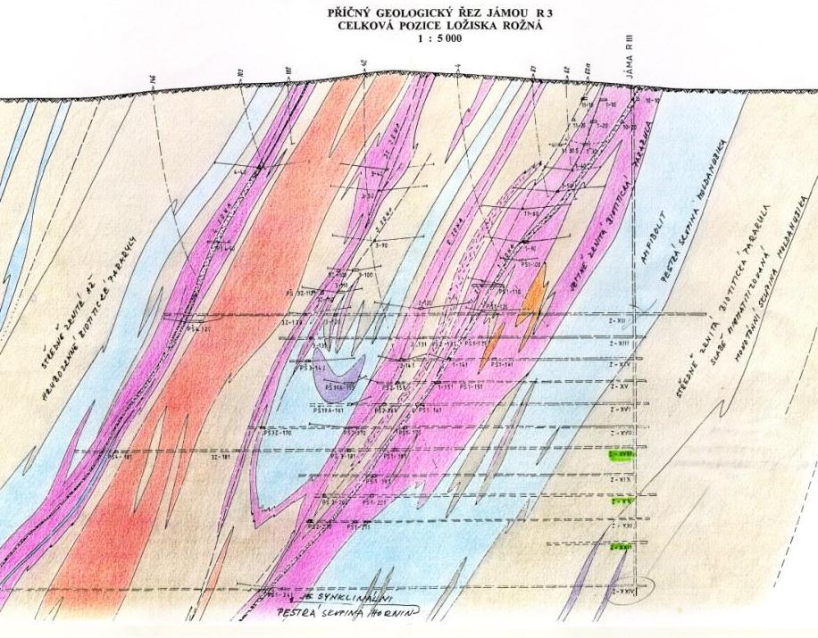
Rozna Mine – main drift Z - XVIII Operated by DIAMO (state owned)
Main drift in the open U – mine – 900m below surface
Granitic rocks with high sequences of fractures
EDZ 35 years old – last mining activity in the end of 70s
Mine will be open till 2012

Slide 25
Conclusions – and expectations from IAEA TC
RAWRA works to obtain real site (1+1 backup) for DGR
Motivation program and increasing communication with public
Finding suitable site in the existing military domains (state property)
Our first goal is to have 6 + 1(or 2) potential sites
For better negotiation with public
Better position (of RAWRA) how to reach site selection of 1+1 backup
Expectations – general ideas and approach what and why to used potential in –situ experiments at sites
Josef gallery
Rozna mine
To improve knowledge and to collect data needed for DGR development program in Czech (in actual stage)

Slide 26
Thank you for your attention

