Slide 1
NOAA Transition Team Briefing
Staff Offices

Slide 2
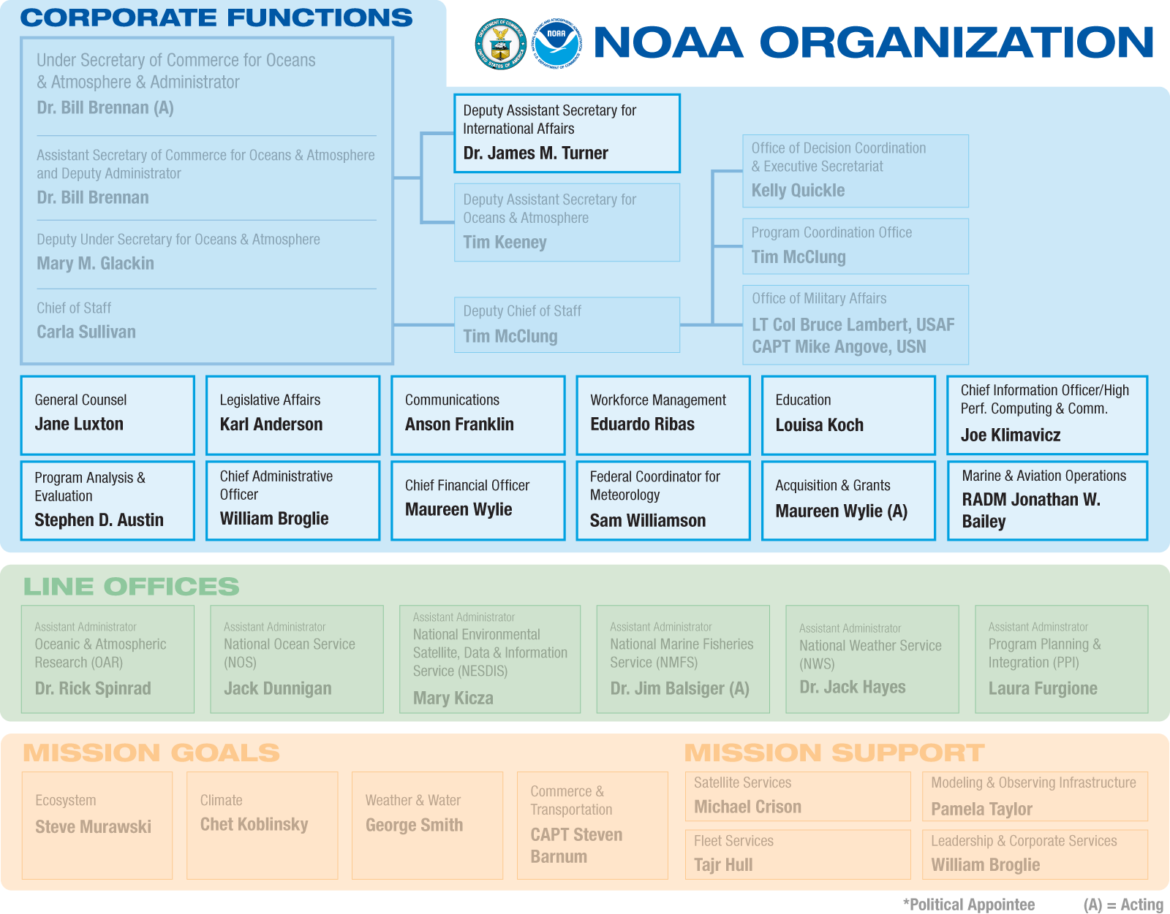
NOAA Organization
Notes:
NOAA is organized around three main components: Operating Branches, Corporate Functions,
and Goals. Operating Branches are the Line Offices and Staff Offices that provide the resources to
execute the programs. Corporate Functions are performed at the headquarters level, and include
NOAA Administration corporate-level offices and support staff (such as the Chief Financial Officer
and Chief Administrative Officer). Goals convert high-level goals and strategies into specific and
actionable programs.
Program managers staff their programs through LO/SOs, which are supported by Corporate
Functions and Regional Teams. They manage the assigned activities derived from the goals and
strategies of the Goal Teams, and are responsible for staffing, managing, communicating and
monitoring programs. If a program crosses multiple LOs, or is sufficiently complex, it may be
designated a matrix program, which requires greater coordination across NOAA.

Slide 3
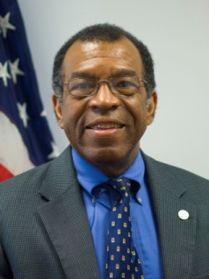

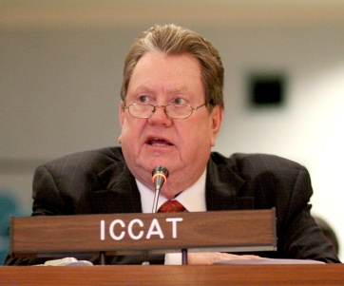
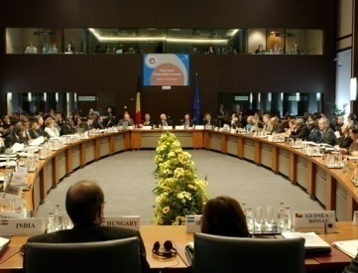
Staff Offices International Affairs
NOAA’s scope – oceans and atmosphere – is inherently global, and therefore, international engagement is integral to NOAA’s Mission
Serves as the principal advisor to the Under Secretary and Administrator on international policy issues
Represents NOAA and the United States with foreign governments and international fora
Establishes policies, guidelines, and procedures for NOAA’s international programs
Provides direction, support and coordination to NOAA’s line offices
Develops initiatives and implements projects, technical assistance,
Exchange of expertise with NOAA’s capabilities to international partners.
Dr. James M. Turner

Slide 4
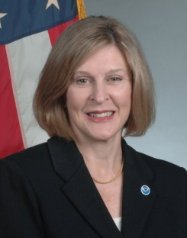
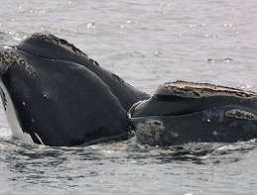
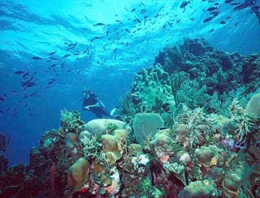
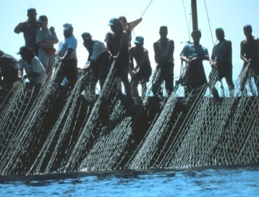
Staff Offices General Counsel
Provides legal services and guidance for all matters that may arise in the conduct of NOAA’s mission.
NOAA legal issues include those relating to:
Management of the nation’s marine fisheries
Protection of marine mammals and threatened and endangered species
Mitigation and restoration of natural resource damages
Management of National Marine Sanctuaries
Coastal zone management
Jane Luxton

Slide 5
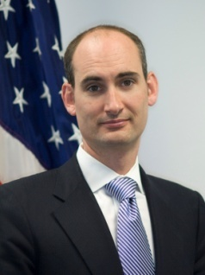
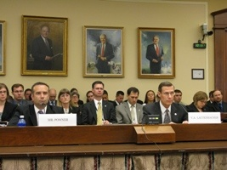
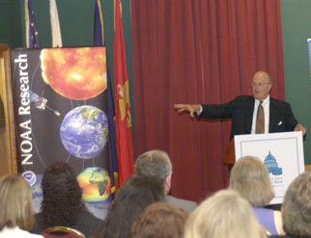
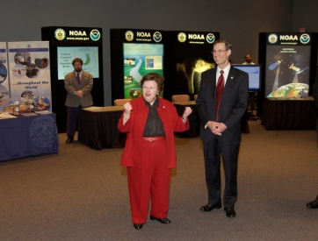
Staff Offices Legislative Affairs
With NOAA, the Department of Commerce, and the Administration:
Responsible for overall legislative strategy for NOAA
Identifies and tracks all legislation of interest to NOAA
Manages NOAA’s participation in congressional hearings
With Congress:
Rolls out President’s annual budget request to Congress
Communicates the Administration’s position on issues, programs, and legislation
Responds to all congressional inquiries
Briefs Members of Congress and their staff on NOAA programs, issues, and activities
Karl Anderson
Notes:
NOAA’s Corporate Functions, also commonly known as Staff Offices (SOs), develop the strategic direction for the agency and lead the management of resources and delivery of services. The major elements of the corporate structure include the offices of the Administrator, the Deputy and
Assistant Administrators and offices charged with corporate management functions, such as the Chief Financial Officer and the Chief Administrative Officer.
Office of Legislative Affairs (OLA) coordinates all NOAA contacts with Congress (except those relating to appropriations) and is responsible for the planning, direction, and coordination of legislative programs that are of immediate concern to the Under Secretary. OLA also maintains a summary of all of the NOAA programs or activities based in, or focused on, states or territories at http://www.legislative.noaa.gov/NIYS0107/noaainyourstate.html and a brief overview of major NOAA facilities around the country for each of our Line Offices with a color map and short summaries of what each facility does at http://www.legislative.noaa.gov/policybriefs.html. The general web site
is http://www.legislative.noaa.gov and includes copies of all testimony from congressional hearings.
To carry out its mission, the OLA:
Develops, coordinates, and implements the overall legislative strategy for NOAA and identifies and tracks all legislation of interest to NOAA and keeping the Office of the Under Secretary and Assistant Administrators informed;
Coordinates and communicates the Administration’s position on issues and programs of interest to NOAA on proposed pending legislation through views letters and congressional testimony at hearings;
Manages every aspect of NOAA’s participation in congressional hearings including advising NOAA senior management of official requests for witnesses, ensuring that the witnesses are properly briefed, and overseeing the preparation and clearance of NOAA testimony, including providing drafting assistance for the written and/or oral testimony as requested;
Responds to all congressional inquiries in a timely manner through personal visits,
e-mail, phone, fax, and mail;
Briefs Members of Congress and their staff regularly on important NOAA programs, issues, and activities;
Provides congressional staff with technical drafting assistance, views letters for legislation, opportunities to meet with NOAA experts, and ensures congressionally-mandated reports order by NOAA authorizing committees are completed on time;
Ensures good communication and coordination among legislative activities within Line, Program, and Staff offices; and
Coordinates with the Department of Commerce Office of Legislative and Intergovernmental Affairs.
On an annual basis, these activities encompass over:
21,000 e-mails and phone calls with Members and congressional staff
1,000 briefings and meetings with Members and congressional staff
30 oversight and legislative hearings
400 Questions for the Record in follow-up to hearings
125 letters of incoming correspondence from Members requiring prepared response
1,900 NOAA grants that are reviewed by the OLA and the Hill notified (Representative in whose district the work is based, both Senators, and other Members as relevant)

Slide 6

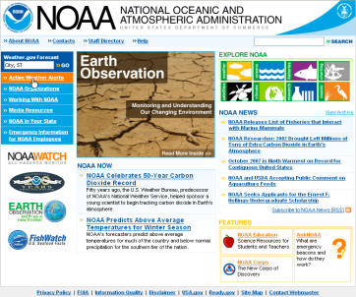
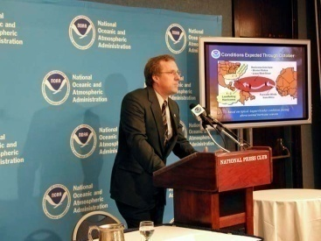
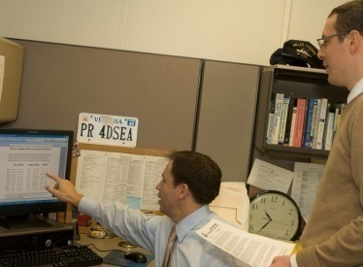
Staff Offices Communications
Promotes NOAA through web-based products and traditional public affairs vehicles
Exercises functional authority over all agency media relations efforts
30 public affairs officers in headquarters, line and field offices
Manages approval and distribution of all agency press releases
Coordinates communications efforts of line offices
Developing constituent relations arm with centralized database
Oversees agency website (NOAA.gov) and internal communications website (NOAAWorld)
Anson Franklin
Notes:
NOAA’s Corporate Functions, also commonly known as Staff Offices (SOs), develop the strategic direction for the agency and lead the management of resources and delivery of services. The major elements of the corporate structure include the offices of the Administrator, the Deputy and
Assistant Administrators and offices charged with corporate management functions, such as the Chief Financial Officer and the Chief Administrative Officer.
Office of Communications (OC) coordinates all NOAA interviews with NOAA leadership and
coordinates External Affairs including questions on policy issues, budget and legislation,
constituent affairs, stakeholder relationships, intergovernmental affairs, business/industry liaison,
and exhibits. www.noaa.gov/media
Major outputs:
News releases – based on newsworthy issues NOAA Communications produces news releases directed to national, regional and local media to ensure prompt coverage of NOAA related accomplishments and story lines. In 2007 more than 250 news releases were issued.
Video presentations – NOAA’s video studio in Silver Spring produces feature length and shorter video presentations for internal NOAA clients. These videos are presented to a wide variety of audiences including NOAA employees and constituents. The studio also supports the media outreach efforts of NOAA communications by producing broadcast quality video clips (b-roll) and speaker support program.
Opinion/editorial articles – based on newsworthy issues NOAA Communications writes opinion/editorial articles for NOAA leadership. These items are created to ensure opinions of the agency are reported promptly and factually.
News conferences – NOAA Communications coordinates the planning and production of news conferences and media availabilities on newsworthy issues. The frequency of news conferences and/or media availabilities can vary. The largest and most heavily subscribed news conference each year is the announcement of the outlook for the Atlantic hurricane season.
NOAA homepage content – NOAA Communications is responsible for the production and content of the agency’s homepage on the Web. NOAA.gov regularly ranks in the top 10 of all federal Web sites.
NOAA World online newsletter – this online newsletter is designed to keep NOAA employees and contractors informed about NOAA activities. Available both online and in PDF format this publication includes regular features about NOAA’s work in the regions and what is going on at NOAA's corporate levels.
Services:
Interview preparation and coordination – NOAA public affairs officers will work closely with subject matter experts to prepare for a media interview. This includes assisting with messaging, tips on dealing with reporter(s), accompanying the subject matter expert during the interview, and conducting any follow-up actions required.
Media training – NOAA public affairs officers provide training to NOAA personnel who may interact with the media. This training includes pointers on preparing for an interview, pitfalls to avoid, how to formulate your message, tips on non-verbal communications.
Constituent relations – NOAA’s Office of Communications coordinates activities with business and industry, public interest groups, academic institutions, state and local government in conjunction constituent personnel in the line and program offices. OC ensures this audience is regularly advised of NOAA activities and engaged when appropriate.
Exhibit management – NOAA’s Office of Communications coordinates NOAA presence at a wide variety of trade exhibitions across the nation and internationally. OC works closely with all line and program offices to ensure consistent themes and appearances are met.

Slide 7
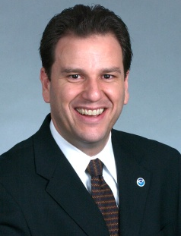

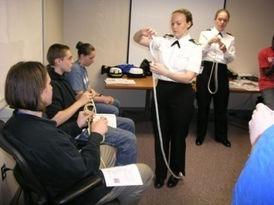
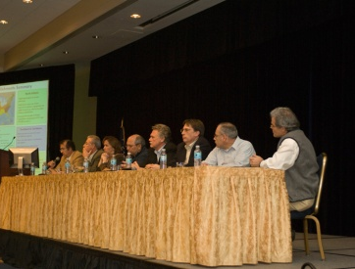
Staff Offices Workforce Management
Provides NOAA-wide leadership with:
Recruitment and hiring activities to retain a diverse, highly skilled and motivated workforce
Administration of NOAA’s Senior Executive Resources Program
Strategic human capital planning and policies
Labor-management and employee relations consultation
Performance management and incentive awards
Benefits and retirement administration
Development Program Services
NOAA Leadership Competencies Development Program
NOAA Rotational Assignment Program
NOAA Leadership Seminar
Appointment and development of NOAA Presidential Management Fellows
Eduardo Ribas
Notes:
NOAA’s Corporate Functions, also commonly known as Staff Offices (SOs), develop the strategic direction for the agency and lead the management of resources and delivery of services. The major elements of the corporate structure include the offices of the Administrator, the Deputy and
Assistant Administrators and offices charged with corporate management functions, such as the Chief Financial Officer and the Chief Administrative Officer.
Workforce Management Officer (WFMO) is the principal human resources manager for NOAA. The WFMO provides policies, programs, and processes that facilitate the recruitment, hiring, development, and retention of a diverse, highly skilled, motivated, and effective workforce capable of accomplishing the Agency’s mission.
Major Outputs
The WFMO provides NOAA-wide leadership of the following workforce management functions:
Recruitment and hiring activities
Strategic human capital planning and policies
Performance metrics and accountability reports
Labor-management and employee relations
Performance management and incentive awards
Executive resources activities
Distance learning tools
Leadership development
Training and career development programs
Human resources data management and automation
(Additional Information): Workforce Management Office (WFMO) provides policies, programs, and processes that facilitate the recruitment, hiring, development, and retention of a diverse, highly skilled, motivated, and effective workforce capable of accomplishing the Agency’s mission. The WFMO provides
NOAA-wide leadership to workforce management functions including strategic human capital
planning, labor-management and employee relations, performance management and incentive
awards, executive resources, distance learning, leadership development, training and career
development, and human resources data management and automation
initiatives. www.wfm.noaa.gov
Major Outputs
These services result in products such as human capital management policies, and performance metrics and accountability reports, both internally and to the Department of Commerce, in the course of monitoring NOAA’s overall progress in achieving the goals of the NOAA Strategic Human Capital Management Plan.
Additionally, human capital management services result in development programs such as:
NOAA Leadership Competencies Development Program -- a competitive, intermittent 18-month, leadership development program providing a series of training and learning experiences for a cadre of GS-13/14/15 NOAA employees who have high potential for assuming greater leadership responsibilities in the agency;
NOAA Leadership Seminar -- a three-day, off-site retreat primarily for GS-13/14 employees to learn about NOAA’s priorities directly from those in key leadership positions;
NOAA Rotational Assignment Program – an annual program offering all employees the opportunity to compete for short-term (typically 3-6 months) developmental assignments in their current or a different NOAA organization; and
Appointment and development of NOAA Presidential Management Fellows – a two-year program managed by the Office of Personnel which has an excellent reputation for attracting outstanding men and women who have recently completed the requirements for their masters, doctoral or other terminal degree.

Slide 8


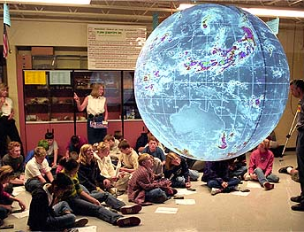
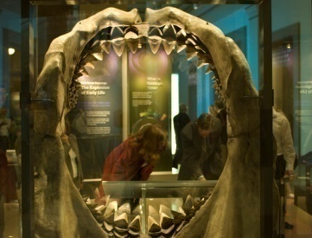
Staff Offices Education
Provides leadership for building synergy and common purpose among the education activities of NOAA Line Offices and Programs
Supports Environmental Literacy through local, regional and national education grants
Provides student opportunities through scholarships, fellowships and internships
Promotes a more diverse future workforce in Science, Technology, Engineering, and Mathematics (STEM) fields
Disseminates NOAA-related content through museums, science centers and aquariums
Louisa Koch
Notes:
NOAA’s Office of Education (OEd), in conjunction with the NOAA Education Council, provides advice and counsel to the Under Secretary on matters pertaining to education. http://www.oesd.noaa.gov
Products:
Interagency Working Group on Ocean Education Meetings: implements recommendations of the U.S. Ocean Action Plan, compares Agency-funded programs and identifies common priorities and collaborations across Federal agencies to increase ocean literacy and build a future workforce
NOAA Education Strategic Plan 2008: a 20-year plan for NOAA’s Education Initiatives across the Agency. The Plan is being submitted to Congress in response to the America COMPETES Act of 2007
Education Council Meetings : coordinates education activities across NOAA and oversees the implementation of NOAA’s Education Plan and Policy; assists in creating education evaluation and assessment frameworks for NOAA education programs
PPBES Environmental Literacy Tracking: an annual strategic assessment of all of NOAA’s environmental literacy activities and recommend options that represent strategic opportunities to leverage partnerships and maximize benefit
Services:
Education Outreach Center: provides educational outreach materials from across NOAA lines and programs in support of agency conferences and community outreach events through requests from formal and informal educators, students, researchers, emergency services personnel, and NOAA employees
Regional Education Grants - Bay-Watershed Education & Training Grants (B-WET): funding provided for projects that promote Meaningful Watershed Educational Experiences (MWEEs) for students and professional development for teachers. Regions where B-WET currently operates: Chesapeake Bay, California, and Hawaii. In 2008, B-WET expanded to include three new regions: New England, Gulf of Mexico, and the Pacific Northwest.
National Education Grants – Environmental Literacy Grants Program (ELG): competitively selected education awards totaling $20.1M to 40 different recipients in FY05-08. A few projects were co-funded with other NOAA offices.
Scholarship Programs: MSI Undergraduate Scholarship Program, MSI Graduate Sciences Program, Ernest F. Hollings Undergraduate Scholarship Program, Nancy Foster Graduate Scholarship Program
Cooperative Science Centers: are a collaborative partnership with more than thirty universities that provide formal education to students in coursework directly related to NOAA’s mission. Cooperative Science Centers have been designated through competitive processes at minority serving institutions since 2001.
Science On a Sphere Museum Partners Network: a network created and supported by NOAA of over 30 museums, science centers, aquariums, and zoos that have Science On a Sphere installed in their public exhibit areas and are interested in working closely with NOAA to keep this dynamic visualization technology current and showing the most up-to-date data on Earth System Science.
Training: Designing Education Projects Course: designed to aid in the development of education programs and materials that are based on sound design and project planning and include key components of needs assessment, project design, and evaluation so that NOAA education professionals will have the skills and tools to assess target audience needs and determine the focus and direction for their education investments thereby extending the reach and impact of these projects to the audience they want to reach.
NOAA Education Products and Services *Leadership of the Education Council* - Building synergy and common purpose across the full range of NOAA offices and programs to produce the NOAA Education Plan and the International Year of the Reef education kit, the International Polar Year education kit and more. *Supports Environmental Literacy through national , regional and local education grants* - Highly competitive grants promoting experiential learning in the K-12 environment and national and regional improvements in science and environmental education *Provides Scholarship, Fellowships and Internships* - Supporting over 200 students per year to obtain degrees in science, technology, engineering, math and education and gain professional work experience in programs across NOAA. *Promotes a More Diverse Future Workforce *- Partnering with Minority Serving Institutions to increase the number of students getting bachelors, masters and PhD degrees in the NOAA-related sciences to affect the workforce in NOAA and the Nation *Connecting with Museums, Science Centers and Aquariums *- Partnering with informal education institutions through the Science on a Sphere, the Ocean Today Kiosk and other innovative platforms to provide current climate, weather, ocean and coastal content to more than 20 million people each year

Slide 9
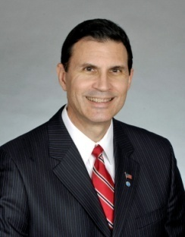
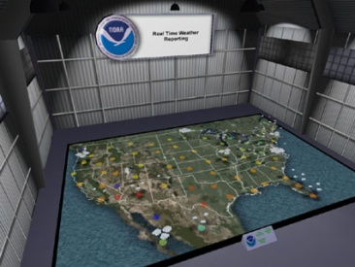
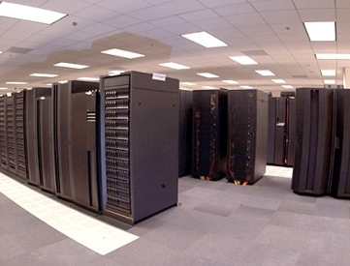

Staff Offices Chief Information Officer/High Performance Computing & Communication
NOAA-wide leadership to:
Develop, Manage & Ensure Quality Information Technology (IT) Investments
Manage High Performance Computing and Communications Infrastructure
Ensure NOAA’s Business Continuity and Protect Information and IT Resources
NOAA-wide IT services for:
Electronic Messaging, Network, and Web Services
Administrative and Financial Systems Support
Helpdesk and Systems Support
Joe Klimavicz
Notes:
9
NOAA’s Corporate Functions, also commonly known as Staff Offices (SOs), develop the strategic direction for the agency and lead the management of resources and delivery of services. The major elements of the corporate structure include the offices of the Administrator, the Deputy and Assistant Administrators and offices charged with corporate management functions, such as the Chief Financial Officer and the Chief Administrative Officer.
Chief Information Officer and Director, High Performance Computing and
Communications is responsible for implementing the Clinger-Cohen Act, Federal Information Security Management Act, and other statutory requirements regarding the acquisition, and use of NOAA’s information technology resources.
Services
High Performance Computing and Communications
Homeland Security Program
IT Security Program
IT Capital Planning and Investment Control
Enterprise Architecture
Program Management of Enterprise IT investments
IT Workforce Management and Development
Enterprise IT Services
Electronic Messaging
Network Services
Web Services
Administrative and Financial Systems Support
Helpdesk and Systems Support
Implements Legislation with Policies and Guidance
Clinger-Cohen Act
Government Performance and Results Act
E-Government Act
Federal Information Security and Management Act
Privacy Act
Information Quality Act
Federal Records Act
Rehabilitation Act – Section 508
Telecommunications Act
Paperwork Reduction Act
Government Paperwork Elimination Act

Slide 10
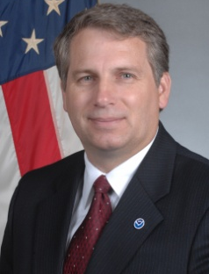
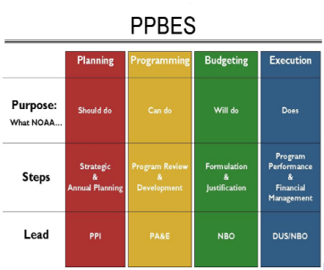
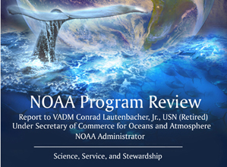
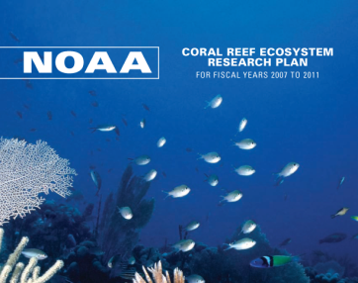
Staff Offices Program Analysis & Evaluation
Develops evaluations and assessments of NOAA’s plans, programs, and requirements.
Analytical support to all parts of NOAA
Some examples of PA&E products:
Program Review: Current programmatic capacities and capabilities are compared to the NOAA mission requirement.
Program Development: The development of an integrated, fiscally balanced 5 year plan based on inputs from NOAA Goal and Sub-goal teams.
Specialized analytical studies: PA&E provides independent analytical support to NOAA Leadership, goal teams, and offices.
Develop NOAA’s fiscal plan
Stephen D. Austin
Notes:
NOAA’s Corporate Functions, also commonly known as Staff Offices (SOs), develop the strategic direction for the agency and lead the management of resources and delivery of services. The major elements of the corporate structure include the offices of the Administrator, the Deputy and
Assistant Administrators and offices charged with corporate management functions, such as the Chief Financial Officer and the Chief Administrative Officer.
Office of Program Analysis and Evaluation (PA&E) conducts independent and objective
analysis. The Office provides evaluations and assessments of plans, programs, and
requirements. PA&E reviews all significant program initiatives and major requirements, and
provides analytical support to all parts of NOAA. PA&E is responsible for the Programming
phase of PPBES. www.ppbs.noaa.gov
Major Outputs
Products:
Program Review: Current programmatic capacities and capabilities are compared to the NOAA mission requirement.
The major output of Program Review is Fiscal and Programming Guidance.
Program Development: The development of an integrated, fiscally balanced 5 year plan based on inputs from NOAA Goal and Sub-goal teams. The major output of Program Development is the Program Decision Memorandum.
Specialized analytical studies: PA&E provides independent analytical support to NOAA Leadership, goal teams, and offices. Completed analytical products include:
Ship and Aircraft modernization plan development support
Ship fuel cost forecast modeling
Impact of unfunded pay raises on NOAA mission accomplishment
Hurricane forecast improvement analysis
Fleet project allocation modeling
Facilities project optimization model
Fleet maintenance correlation analysis
VERA (Voluntary Early Retirement Authority) cost analysis
Legal support requirements analysis
Services:
Identify the fiscal implications of NOAA plans, including the NOAA Strategic Plan. Propose solutions to meet the goals stated in the NOAA Strategic Plan and other documents within limited resources.
Indentify trade-offs between NOAA goals, find alternative solutions, recommend effective solutions to NOAA Leadership.
Develop the fiscal plan that makes the greatest progress towards NOAA goals described in the Strategic Plan.
Specialized analytical studies

Slide 11
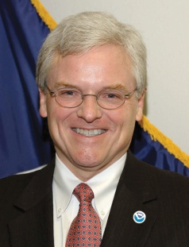
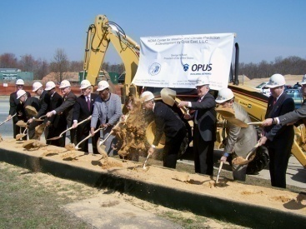

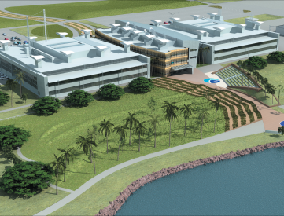
Staff Offices Chief Administrative Officer
Provides comprehensive, NOAA-wide leadership and services in the areas of:
Facilities management (i.e., real and personal property)
Freedom of Information Act (FOIA)
OIG/GAO liaison
Safety, environmental compliance, and energy conservation
Administrative issuances and records management
Other administrative program services
Administers the NOAA-wide Civil Rights and Equal Employment Opportunity programs
Serves as the Leadership and Corporate Services Sub-Goal Lead
William Broglie
Notes:
NOAA’s Corporate Functions, also commonly known as Staff Offices (SOs), develop the strategic direction for the agency and lead the management of resources and delivery of services. The major elements of the corporate structure include the offices of the Administrator, the Deputy and
Assistant Administrators and offices charged with corporate management functions, such as the Chief Financial Officer and the Chief Administrative Officer.
The Office of the Chief Administrative Officer (CAO) provides comprehensive, NOAA-wide services and technical and programmatic guidance, as well as staff support to the Office of the Under Secretary, in the areas of facilities management (i.e. real and personal property, project planning and management); Freedom of Information Act (FOIA); commercial services management; OIG/GAO liaison; safety and environmental compliance; administrative issuances; records management; and other administrative support services. The office also administers the NOAA-wide Civil Rights and Equal Employment Opportunity programs. The CAO also serves as the Leadership and Corporate Services Sub-Goal lead under NOAA’s planning, programming, budget, and execution system (PPBES). The areas under the direction of the CAO are;
Real Property Facilities and Logistics Office
Audits and Information Management Office
Office of Civil Rights
Safety and Environmental Compliance Office
Deemed Export Program
Products:
Long-Range Facility Modernization and Capital Investment Plans
Homeport Investment Plan
Reports to Line Offices annually on the condition of NOAA facilities subsequent to the annual Integrated Facilities Inspection Program (IFIP) survey
Economic (Net Present Value) analyses on facility capital investments
Standard policies and processes for real property, including construction work in progress, project planning, project management, and progress/performance metrics
Quarterly reports for all major (prospectus level) construction projects
Standard policies and processes for personal property
Standard NOAA-wide policies and processes for deemed export and foreign national access controls
Monthly Report on Current OIG/GAO Reviews
Monthly Report on Open OIG/GAO Recommendations
Monthly Referrals and Investigations Report
NOAA’s Annual FAIR Act Inventory
Commercial Services (OMB Cir. A-76) Feasibility Study Reports
Monthly FOIA reports
NOAA-wide Affirmative Employment and Under-Representation policies, data and reports
Annual NOAA Safety Program goals and training programs
NOAA-wide policies and working procedures promoting safety and environmental
Compliance
NOAA policies and processes for administrative issuances and records management
Services:
Program execution and oversight of Homeland Security Presidential Directive 12 (HSPD-12)—Physical access controls
Security Guard Contract Services for National Capital Region, Boulder, and Seattle
Transportation Subsidy
Logistics Support: Warehousing, Property Disposal, Fleet, Vehicle and Building Management
Manages NOAA's national real property acquisition and asset management programs, including responsibilities for policy development and guidance, program execution, performance management, audit resolution, and customer relations
Manages NOAA’s annual facility condition assessment nationwide
Negotiates leases (capital and operating), licenses and other real property agreements; conducts appraisals and other required surveys and analyses
Conducts National Environmental Policy Act (NEPA) studies and determinations for real property acquisitions and disposals Ensures compliance with financial auditing requirements for real property, processes and distributes rental payments, and manages the real property database
Manages the total project life-cycle for major (prospectus level) construction projects, and repair restoration projects; including business case analyses, planning, scoping, design, construction, and commissioning of new facilities
Coordinates the development of acquisition support vehicles for construction projects, and provides executive level oversight
Manages NOAA programs for personal property and logistics services
Coordinates OIG/GAO audit and reviews of NOAA programs and issues, and ensures timely resolution of audit findings and recommendations
Administers NOAA’s Freedom of Information Act (FOIA) Program
Oversees NOAA’s commercial services management program
Provides informal counseling in response to EEO complaints of discrimination
Provides advice to all principal Line and Staff Office officials and managers concerning all aspects of NOAA's EEO/Civil Rights/Affirmative Employment Programs
Manages NOAA-wide occupational health and safety, and environmental compliance programs
Conducts safety investigations for all Level A (fatality, serious injury or significant financial damage) incidents
Manages NOAA’s deemed export program which exists to prevent the diversion of sensitive dual use technologies to countries of concern
Program oversight for Continuity of Operations Plans (COOP), Occupant Emergency Plans (OEP), and Shelter in Place (SIP) for NOAA facilities
Support for NOAA-compliance with Federal Advisory Committee Act (FACA)
Support for promulgation of NOAA administrative issuance (Order and Circulars)

Slide 12
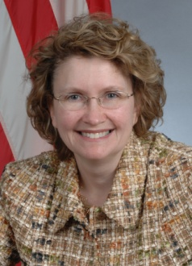
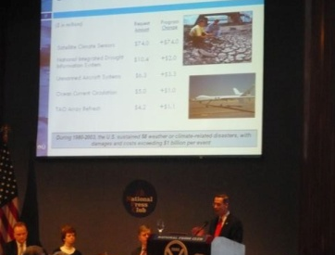
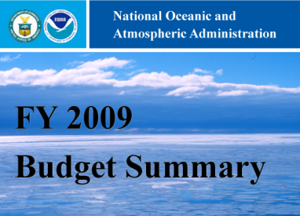
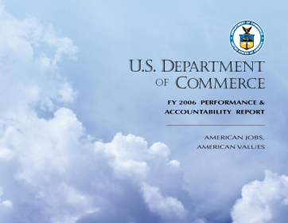
Staff Offices Chief Financial Officer
The CFO’s office directs the activities of both the offices of Budget and Finance:
NOAA Budget
Develops the annual budget submission to DOC, OMB, and Congress
Prepares analysis of DOC and OMB passbacks and maintains control tables
Performs variance reporting and closeout activities
Liaison to DOC, OMB, and Congress for all appropriations related matters
NOAA Finance Office
Handles financial reporting
Oversees financial systems and travel policy and systems
Manages the NOAA Data Warehouse
Maureen Wylie
Notes:
NOAA’s Corporate Functions, also commonly known as Staff Offices (SOs), develop the strategic direction for the agency and lead the management of resources and delivery of services. The major elements of the corporate structure include the offices of the Administrator, the Deputy and
Assistant Administrators and offices charged with corporate management functions, such as the Chief Financial Officer and the Chief Administrative Officer.
The Chief Financial Officer (CFO) is the principal financial manager for NOAA as directed by the CFO Act of 1990. The CFO oversees the Budget and Finance Offices.
NOAA’s Budget Office:
Major Outputs:
Annual Budget Decision Memorandum- Communicates final fiscal year budget decisions to NOAA leadership.
NOAA Budget- Develops an annual budget submission for DOC, OMB, and Congress. Prepares analysis of DOC and OMB passbacks and develops control tables.
Annual Performance Plan- Develops and submits a plan with each budget to operationalize NOAA’s Strategic Plan.
Congressional Rollout Products – Creates the budget blue book, one-pagers, and presentations that summarizes NOAA’s overall budget request and highlights NOAA’s requested changes.
Apportionment and Reapportionment Schedule- Summarizes each Line Office’s budgetary resources and applications and submits to DOC and OMB.
Monthly Variance Reports- Tracks Line Office planned versus obligated spending.
Appropriations Staff Liaison- Coordinates NOAA interactions with DOC, OMB, and House and Senate Appropriations staff; responds to questions resulting from Congressional hearings; analyzes Senate and House marks.
Performance Assessment- Coordinates reporting for Government Performance and Results Act (GPRA), President’s Management Agenda (PMA), Program Assessment Rating Tool (PART), and DOC Secretarial Priorities.
NOAA’s Finance Office:
Major Outputs:
Financial Reporting – Prepares internal and external reports and audits on NOAA’s financial resources, assets, liabilities, costs, obligations, and income, including the annual NOAA financial statements.
Financial Systems- Oversees the DOC financial accounting and purchase card systems for NOAA, including Commerce Business System (CBS) and Commerce Purchase Card System (CPCS).
Travel Policies and Systems- Manages the policies, operations, and systems for travel manager, travel cards, and relocation.
NOAA Data Warehouse- Maintains the financial management data warehouse, including querying and reporting capabilities.
Chief Information Officer and Director, High Performance Computing and
Communications is responsible for implementing the Clinger-Cohen Act, Federal Information Security Management Act, and other statutory requirements regarding the acquisition, and use of NOAA’s information technology resources.
Services
High Performance Computing and Communications
Homeland Security Program
IT Security Program
IT Capital Planning and Investment Control
Enterprise Architecture
Program Management of Enterprise IT investments
IT Workforce Management and Development
Enterprise IT Services
Electronic Messaging
Network Services
Web Services
Administrative and Financial Systems Support
Helpdesk and Systems Support
Implements Legislation with Policies and Guidance
Clinger-Cohen Act
Government Performance and Results Act
E-Government Act
Federal Information Security and Management Act
Privacy Act
Information Quality Act
Federal Records Act
Rehabilitation Act – Section 508
Telecommunications Act
Paperwork Reduction Act
Government Paperwork Elimination Act
The Office of the Chief Administrative Officer (CAO) provides comprehensive, NOAA-wide services and technical and programmatic guidance, as well as staff support to the Office of the Under Secretary, in the areas of facilities management (i.e. real and personal property, project planning and management); Freedom of Information Act (FOIA); commercial services management; OIG/GAO liaison; safety and environmental compliance; administrative issuances; records management; and other administrative support services. The office also administers the NOAA-wide Civil Rights and Equal Employment Opportunity programs. The CAO also serves as the Leadership and Corporate Services Sub-Goal lead under NOAA’s planning, programming, budget, and execution system (PPBES). The areas under the direction of the CAO are;
Real Property Facilities and Logistics Office
Audits and Information Management Office
Office of Civil Rights
Safety and Environmental Compliance Office
Deemed Export Program
Products:
Long-Range Facility Modernization and Capital Investment Plans
Homeport Investment Plan
Reports to Line Offices annually on the condition of NOAA facilities subsequent to the annual Integrated Facilities Inspection Program (IFIP) survey
Economic (Net Present Value) analyses on facility capital investments
Standard policies and processes for real property, including construction work in progress, project planning, project management, and progress/performance metrics
Quarterly reports for all major (prospectus level) construction projects
Standard policies and processes for personal property
Standard NOAA-wide policies and processes for deemed export and foreign national access controls
Monthly Report on Current OIG/GAO Reviews
Monthly Report on Open OIG/GAO Recommendations
Monthly Referrals and Investigations Report
NOAA’s Annual FAIR Act Inventory
Commercial Services (OMB Cir. A-76) Feasibility Study Reports
Monthly FOIA reports
NOAA-wide Affirmative Employment and Under-Representation policies, data and reports
Annual NOAA Safety Program goals and training programs
NOAA-wide policies and working procedures promoting safety and environmental
Compliance
NOAA policies and processes for administrative issuances and records management
Services:
Program execution and oversight of Homeland Security Presidential Directive 12 (HSPD-12)—Physical access controls
Security Guard Contract Services for National Capital Region, Boulder, and Seattle
Transportation Subsidy
Logistics Support: Warehousing, Property Disposal, Fleet, Vehicle and Building Management
Manages NOAA's national real property acquisition and asset management programs, including responsibilities for policy development and guidance, program execution, performance management, audit resolution, and customer relations
Manages NOAA’s annual facility condition assessment nationwide
Negotiates leases (capital and operating), licenses and other real property agreements; conducts appraisals and other required surveys and analyses
Conducts National Environmental Policy Act (NEPA) studies and determinations for real property acquisitions and disposals Ensures compliance with financial auditing requirements for real property, processes and distributes rental payments, and manages the real property database
Manages the total project life-cycle for major (prospectus level) construction projects, and repair restoration projects; including business case analyses, planning, scoping, design, construction, and commissioning of new facilities
Coordinates the development of acquisition support vehicles for construction projects, and provides executive level oversight
Manages NOAA programs for personal property and logistics services
Coordinates OIG/GAO audit and reviews of NOAA programs and issues, and ensures timely resolution of audit findings and recommendations
Administers NOAA’s Freedom of Information Act (FOIA) Program
Oversees NOAA’s commercial services management program
Provides informal counseling in response to EEO complaints of discrimination
Provides advice to all principal Line and Staff Office officials and managers concerning all aspects of NOAA's EEO/Civil Rights/Affirmative Employment Programs
Manages NOAA-wide occupational health and safety, and environmental compliance programs
Conducts safety investigations for all Level A (fatality, serious injury or significant financial damage) incidents
Manages NOAA’s deemed export program which exists to prevent the diversion of sensitive dual use technologies to countries of concern
Program oversight for Continuity of Operations Plans (COOP), Occupant Emergency Plans (OEP), and Shelter in Place (SIP) for NOAA facilities
Support for NOAA-compliance with Federal Advisory Committee Act (FACA)
Support for promulgation of NOAA administrative issuance (Order and Circulars)
Office of International Affairs (OIA) supports and promotes national policies and interests in ecosystem-based management, climate change, Earth observation, and weather forecasting.
OAI endeavors to maximize the mutual benefits of international exchange with its global
partners. www.international.noaa.gov
Major Output: Effective engagement with the international community in support of NOAA’s mission objectives, leading to the outcome that the international community (including international organizations, governments, non-governmental entities and other partners) is supporting and working with NOAA toward NOAA’s mission objectives.
1. Policy development – develop and coordinate NOAA and USG policy for use in the interagency context and in international fora; to secure NOAA and USG agreement on views and policies to be carried to the international community
2. Represent NOAA and USG views (or Achieve NOAA and USG objectives) at International and interagency meetings
3. Direct/Manage/Support
3a. Direct (Provide guidance and advice regarding) NOAA's international engagement
3b. Manage NOAA's international engagement (coordinate, communicate, collaborate) - this includes the IAC and related, circulating information, compiling NOAA responses to inquiries, managing the USAID and other umbrella agreements, review of international agreements, maintaining information products, etc.
3c. Provide staff support to NOAA Leadership's international engagement
4. Implement Projects and Provide (and coordinate the provision and exchange of) technical assistance, expertise, capacity building within NOAA’s capabilities to international partners.
Office of Program Analysis and Evaluation (PA&E) conducts independent and objective
analysis. The Office provides evaluations and assessments of plans, programs, and
requirements. PA&E reviews all significant program initiatives and major requirements, and
provides analytical support to all parts of NOAA. PA&E is responsible for the Programming
phase of PPBES. www.ppbs.noaa.gov
Major Outputs
Products:
Program Review: Current programmatic capacities and capabilities are compared to the NOAA mission requirement.
The major output of Program Review is Fiscal and Programming Guidance.
Program Development: The development of an integrated, fiscally balanced 5 year plan based on inputs from NOAA Goal and Sub-goal teams. The major output of Program Development is the Program Decision Memorandum.
Specialized analytical studies: PA&E provides independent analytical support to NOAA Leadership, goal teams, and offices. Completed analytical products include:
Ship and Aircraft modernization plan development support
Ship fuel cost forecast modeling
Impact of unfunded pay raises on NOAA mission accomplishment
Hurricane forecast improvement analysis
Fleet project allocation modeling
Facilities project optimization model
Fleet maintenance correlation analysis
VERA (Voluntary Early Retirement Authority) cost analysis
Legal support requirements analysis
Services:
Identify the fiscal implications of NOAA plans, including the NOAA Strategic Plan. Propose solutions to meet the goals stated in the NOAA Strategic Plan and other documents within limited resources.
Indentify trade-offs between NOAA goals, find alternative solutions, recommend effective solutions to NOAA Leadership.
Develop the fiscal plan that makes the greatest progress towards NOAA goals described in the Strategic Plan.
Specialized analytical studies
Acquisition and Grants Office (AGO) reviews solicitations for grant applications, processes
applications, negotiates awards, manages administrative and financial aspects of awards,
monitors progress against expenditures, resolves audit problems, and closes out awards as
projects are completed. www.ago.noaa.gov
Major Outputs
The NOAA Acquisition and Grants Office (AGO) is a corporate activity to purchase quality goods and services at a reasonable price from external vendors and to administer financial assistance awards (grants) to qualified recipients in support of NOAA’s mission.
Acquisition Service Operations
The purpose of this activity is to purchase gods and services through the use of contracts, simplified acquisition procedures, Bankcard transactions and interagency agreements and memoranda of understanding. These purchases are requested by each NOAA customer as specified by their requirements and are subject to all applicable federal laws, policies and regulations related to procurement. Simplified acquisitions procedures provide streamlined techniques to reduce the administrative burden of awarding lower dollar value or commercially available item procurements that account for the majority of purchases. Bankcards are issued to authorized government employees and typically can be used for purchases up to $2500 per month.
During FY 2007, AGO successfully completed 14,283 procurement transactions worth a total value of $1.1445 billion.
Financial Assistance Service Operations
The purpose of this activity it to provide technical and administrative support to NOAA programs that give financial assistance (authorized by statute) to a wide variety of non-federal recipients to produce results intended to enhance NOAA’s mission. This support involves all phases of the grant administration process including pre-award actions such as providing technical guidance during initial pre-selection activities, announcing and publishing requests for grant applications, conducting administrative review and award of recommended applications, monitoring award progress and terms and conditions and closing out of completed grant awards.
During FY 2007, AGO issued 1,955 grant awards worth a total of $ 924 million.
Workforce Management Officer (WFMO) is the principal human resources manager for NOAA. The WFMO provides policies, programs, and processes that facilitate the recruitment, hiring, development, and retention of a diverse, highly skilled, motivated, and effective workforce capable of accomplishing the Agency’s mission.
Major Outputs
The WFMO provides NOAA-wide leadership of the following workforce management functions:
Recruitment and hiring activities
Strategic human capital planning and policies
Performance metrics and accountability reports
Labor-management and employee relations
Performance management and incentive awards
Executive resources activities
Distance learning tools
Leadership development
Training and career development programs
Human resources data management and automation
(Additional Information): Workforce Management Office (WFMO) provides policies, programs, and processes that facilitate the recruitment, hiring, development, and retention of a diverse, highly skilled, motivated, and effective workforce capable of accomplishing the Agency’s mission. The WFMO provides
NOAA-wide leadership to workforce management functions including strategic human capital
planning, labor-management and employee relations, performance management and incentive
awards, executive resources, distance learning, leadership development, training and career
development, and human resources data management and automation
initiatives. www.wfm.noaa.gov
Major Outputs
These services result in products such as human capital management policies, and performance metrics and accountability reports, both internally and to the Department of Commerce, in the course of monitoring NOAA’s overall progress in achieving the goals of the NOAA Strategic Human Capital Management Plan.
Additionally, human capital management services result in development programs such as:
NOAA Leadership Competencies Development Program -- a competitive, intermittent 18-month, leadership development program providing a series of training and learning experiences for a cadre of GS-13/14/15 NOAA employees who have high potential for assuming greater leadership responsibilities in the agency;
NOAA Leadership Seminar -- a three-day, off-site retreat primarily for GS-13/14 employees to learn about NOAA’s priorities directly from those in key leadership positions;
NOAA Rotational Assignment Program – an annual program offering all employees the opportunity to compete for short-term (typically 3-6 months) developmental assignments in their current or a different NOAA organization; and
Appointment and development of NOAA Presidential Management Fellows – a two-year program managed by the Office of Personnel which has an excellent reputation for attracting outstanding men and women who have recently completed the requirements for their masters, doctoral or other terminal degree.
NOAA’s Office of Education (OEd), in conjunction with the NOAA Education Council, provides advice and counsel to the Under Secretary on matters pertaining to education. http://www.oesd.noaa.gov
Products:
Interagency Working Group on Ocean Education Meetings: implements recommendations of the U.S. Ocean Action Plan, compares Agency-funded programs and identifies common priorities and collaborations across Federal agencies to increase ocean literacy and build a future workforce
NOAA Education Strategic Plan 2008: a 20-year plan for NOAA’s Education Initiatives across the Agency. The Plan is being submitted to Congress in response to the America COMPETES Act of 2007
Education Council Meetings : coordinates education activities across NOAA and oversees the implementation of NOAA’s Education Plan and Policy; assists in creating education evaluation and assessment frameworks for NOAA education programs
PPBES Environmental Literacy Tracking: an annual strategic assessment of all of NOAA’s environmental literacy activities and recommend options that represent strategic opportunities to leverage partnerships and maximize benefit
Services:
Education Outreach Center: provides educational outreach materials from across NOAA lines and programs in support of agency conferences and community outreach events through requests from formal and informal educators, students, researchers, emergency services personnel, and NOAA employees
Regional Education Grants - Bay-Watershed Education & Training Grants (B-WET): funding provided for projects that promote Meaningful Watershed Educational Experiences (MWEEs) for students and professional development for teachers. Regions where B-WET currently operates: Chesapeake Bay, California, and Hawaii. In 2008, B-WET expanded to include three new regions: New England, Gulf of Mexico, and the Pacific Northwest.
National Education Grants – Environmental Literacy Grants Program (ELG): competitively selected education awards totaling $20.1M to 40 different recipients in FY05-08. A few projects were co-funded with other NOAA offices.
Scholarship Programs: MSI Undergraduate Scholarship Program, MSI Graduate Sciences Program, Ernest F. Hollings Undergraduate Scholarship Program, Nancy Foster Graduate Scholarship Program
Cooperative Science Centers: are a collaborative partnership with more than thirty universities that provide formal education to students in coursework directly related to NOAA’s mission. Cooperative Science Centers have been designated through competitive processes at minority serving institutions since 2001.
Science On a Sphere Museum Partners Network: a network created and supported by NOAA of over 30 museums, science centers, aquariums, and zoos that have Science On a Sphere installed in their public exhibit areas and are interested in working closely with NOAA to keep this dynamic visualization technology current and showing the most up-to-date data on Earth System Science.
Training: Designing Education Projects Course: designed to aid in the development of education programs and materials that are based on sound design and project planning and include key components of needs assessment, project design, and evaluation so that NOAA education professionals will have the skills and tools to assess target audience needs and determine the focus and direction for their education investments thereby extending the reach and impact of these projects to the audience they want to reach.
Office of General Counsel (OGC) OGC provides legal services and guidance for all matters that may arise in the conduct of NOAA's mission. OGC's headquarters office is managed by the General Counsel, two Deputy General Counsels, and an Assistant General Counsel-Headquarters who oversee a series of 13 primary subdivision offices headed by Assistant General Counsels (Fisheries; Ocean Services; Enforcement and Litigation), and Senior Counselors (International; Atmospheric and Space Services and Research). Legal issues at NOAA include those relating to coastal zone management; operation of weather and environmental satellites; management of the nation's marine fisheries; protection of marine mammals and threatened and endangered species; mitigation and restoration of natural resource damages; monitoring oceanic, atmospheric, and climatic data; and mapping and charting U.S. waters.
NOAA GC Significant Outputs
Legal representation in federal lawsuits
Against NOAA
Legal representation in natural resource damage
Recovery cases
Legal representation in Enforcement cases
Enforcement training programs conducted
Legal review of Endangered Species Act
Consultations
Legal review of ESA biological opinions
Legal review of NOAA’s mandatory fishway prescriptions
for new or relicensed hydropower plants
Legal review of fishery management plans or
Amendments
Legal review of federal register notices, proposed
Rules, and final rules
Legal review of annual fish specifications and
Fishery closure orders
Legal review of petitions for disaster assistance
Legal review of liquefied natural gas deepwater
Port applications
Legal review of fishing vessel buyouts
Legal review of ESA recovery plans and status reviews
Legal review of sanctuary management plans,
Amendments, and updates
Legal review of national estuarine research reserve plans
Legal review of coastal management program
amendments
Legal review of memoranda of agreement
Legal review of coastal zone management act
Non-point source pollution program packages
Legal support at fishery management council meetings
(in days)
Legal support at international meetings (#meetings)
Legal agreements review or negotiated
Legal review of commercial satellite licenses,
Amendments, foreign agreements, etc.
Legal review of cooperative research arrangements
Legal advice on NOAA’s deemed
Export compliance program
Legal review and response on subpoenas
Legal review of FOIA requests
Legal review of press releases and controlled
Correspondence
Legal review of Proposed International Agreements,
Between NOAA and Foreign Government Entities
Legal review of action, information, issue, and position
Papers submitted to international organizations
(Additional Information):
NOAA Office of General Counsel
Significant Outputs
Counsel to the National Marine Fisheries Service:
The NOAA Office of General Counsel, Office of Fisheries (GCF) provides legal counsel to the National Marine Fisheries Service (NMFS). GCF lawyers work on substantive and procedural laws relating to living marine resources, including the Magnuson-Stevens Fishery Conservation and Management Act, the Endangered Species Act, and the Marine Mammal Protection Act. This includes legal review of fishery management plans or amendments, annual fish specifications and Fishery closure orders, Endangered Species Act consultations, biological opinions, recovery plans, petitions for disaster assistance, liquefied natural gas deepwater port applications, fishing vessel buyouts, status reviews, and NOAA’s mandatory fishway prescriptions for new or relicensed hydropower plants. These lawyers also provide support at fishery management council meetings and the meetings of international bodies, such as the International Whaling Commission and the International Convention for the Conservation of Atlantic Tunas. In addition, these lawyers provide support in the development of legislation related to NMFS programs.
Counsel to the National Ocean Service:
The NOAA Office of General Counsel, Office of Ocean Services (GCOS) provides legal counsel to NOAA’s National Ocean Service. GCOS attorneys support implementation of the Coastal Zone Management Act, including drafting consistency appeal determinations for the Secretary of Commerce, working with federal and state agencies in reviewing coastal management plans, and helping develop national estuarine research reserves. GCOS also supports implementation of the National Marine Sanctuaries Act by working closely with experienced scientists and program managers to develop and implement management plans, policies, and regulations governing the nation’s 13 national marine sanctuaries, and the newly designated Papahanaumokuakea Marine National Monument. Additionally, GCOS attorneys provide legal support to the Office of Ocean and Coastal Resource Management, the Office of Coast Survey, and NOAA's Office of Marine and Aviation Operations, including the NOAA Corps.
Counsel on International Issues:
The NOAA Office of General Counsel, Office of International Law (GCIL) provides legal counsel to NOAA on international law, particularly the United Nations Law of the Sea (LOS) Convention and other international agreements regarding marine environmental and maritime issues. The Office provides legal analysis, guidance, drafting assistance, and other legal services to assure that NOAA’s policy development and activities are consistent with, and take into account, the LOS Convention and other rules of international law. GCIL further helps NOAA program and headquarters staff protect NOAA’s interests in the context of interagency and international working groups. Finally, GCIL is called upon to review action, information, issue, and position papers submitted to international organizations and help develop domestic legislation.
Civil Enforcement:
The NOAA Office of General Counsel, Office of Enforcement and Litigation (GCEL) coordinates and implements the NOAA General Counsel's delegated authority as NOAA's civil prosecutor. The office prosecutes civil penalty cases, permit sanctions, and administrative forfeitures; provides support to the U.S. Department of Justice in prosecution of law enforcement cases in Federal courts and formulates NOAA's position in such cases; establishes national law enforcement policy in conjunction with NOAA Fisheries Enforcement and NOAA program offices; provides legal support to NOAA Fisheries Enforcement and other NOAA offices, including the Sustainable Fisheries Division and Protected Resources Division; and advises NOAA officials on specific enforcement cases and general enforcement trends and issues.
Counsel to the National Weather Service, Office of Oceanic and Atmospheric
Research, & the National Environmental Satellite, Data, & Information Service:
The NOAA Office of General Counsel, Office of Weather (GCW) provides legal counsel on a wide range of issues to the NWS, NESDIS, and OAR, including negotiation of international environmental satellite agreements, legal review of commercial remote sensing satellite licenses, license amendments, foreign agreements and support to related monitoring and compliance matters, cooperative research and development arrangements, subpoenas, and FOIA requests. In addition, GCW serves as legal counsel to the interagency Climate Change Science Program.
Counsel on Natural Resource Damages:
The NOAA Office of General Counsel, Office of Natural Resources (GCNR) provides legal counsel to NOAA’s Natural Resource Damage Program to promote recovery of past costs and to ensure restoration to compensate the public for injuries caused to our Nation's natural resources by releases of hazardous substances from thousands of waste sites, numerous oil spills, and physical impacts (e.g., vessel groundings) to unique resources located in National Marine Sanctuaries. In many cases, NOAA works cooperatively with responsible parties to identify injuries to the natural resources and to plan and carry out the appropriate restoration work.
Counsel on Regulatory Matters:
NOAA GC provides legal counsel on regulatory and statutory requirements, policy development, and the availability of guidance and assistance from outside sources. Representation also includes the negotiation of environmental settlements for non-compliance and defense of actions under state and federal law. This includes review of federal register notices, proposed rules, and final rules.
Office of Legislative Affairs (OLA) coordinates all NOAA contacts with Congress (except those relating to appropriations) and is responsible for the planning, direction, and coordination of
legislative programs that are of immediate concern to the Under Secretary. OLA also maintains a
summary of all of the NOAA programs or activities based in, or focused on, states or territories
at www.legislative.noaa.gov/NIYS0107/noaainyourstate.html and a brief overview of major NOAA
facilities around the country for each of our Line Offices with a color map and short summaries of
what each facility does at www.legislative.noaa.gov/policybriefs.html. The general web site
is www.legislative.noaa.gov
To carry out its mission, the OLA:
Develops, coordinates, and implements the overall legislative strategy for NOAA and identifies and tracks all legislation of interest to NOAA and keeping the Office of the Under Secretary and Assistant Administrators informed;
Coordinates and communicates the Administration’s position on issues and programs of interest to NOAA on proposed pending legislation through views letters and congressional testimony at hearings;
Manages every aspect of NOAA’s participation in congressional hearings including advising NOAA senior management of official requests for witnesses, ensuring that the witnesses are properly briefed, and overseeing the preparation and clearance of NOAA testimony, including providing drafting assistance for the written and/or oral testimony as requested;
Responds to all congressional inquiries in a timely manner through personal visits,
e-mail, phone, fax, and mail;
Briefs Members of Congress and their staff regularly on important NOAA programs, issues, and activities;
Provides congressional staff with technical drafting assistance, views letters for legislation, opportunities to meet with NOAA experts, and ensures congressionally-mandated reports order by NOAA authorizing committees are completed on time;
Ensures good communication and coordination among legislative activities within Line, Program, and Staff offices; and
Coordinates with the Department of Commerce Office of Legislative and Intergovernmental Affairs.
On an annual basis, these activities encompass over:
21,000 e-mails and phone calls with Members and congressional staff
1,000 briefings and meetings with Members and congressional staff
30 oversight and legislative hearings
400 Questions for the Record in follow-up to hearings
125 letters of incoming correspondence from Members requiring prepared response
1,900 NOAA grants that are reviewed by the OLA and the Hill notified (Representative in whose district the work is based, both Senators, and other Members as relevant)
Office of Communications (OC) coordinates all NOAA interviews with NOAA leadership and
coordinates External Affairs including questions on policy issues, budget and legislation,
constituent affairs, stakeholder relationships, intergovernmental affairs, business/industry liaison,
and exhibits. www.noaa.gov/media
Major outputs:
News releases – based on newsworthy issues NOAA Communications produces news releases directed to national, regional and local media to ensure prompt coverage of NOAA related accomplishments and story lines. In 2007 more than 250 news releases were issued.
Video presentations – NOAA’s video studio in Silver Spring produces feature length and shorter video presentations for internal NOAA clients. These videos are presented to a wide variety of audiences including NOAA employees and constituents. The studio also supports the media outreach efforts of NOAA communications by producing broadcast quality video clips (b-roll) and speaker support program.
Opinion/editorial articles – based on newsworthy issues NOAA Communications writes opinion/editorial articles for NOAA leadership. These items are created to ensure opinions of the agency are reported promptly and factually.
News conferences – NOAA Communications coordinates the planning and production of news conferences and media availabilities on newsworthy issues. The frequency of news conferences and/or media availabilities can vary. The largest and most heavily subscribed news conference each year is the announcement of the outlook for the Atlantic hurricane season.
NOAA homepage content – NOAA Communications is responsible for the production and content of the agency’s homepage on the Web. NOAA.gov regularly ranks in the top 10 of all federal Web sites.
NOAA World online newsletter – this online newsletter is designed to keep NOAA employees and contractors informed about NOAA activities. Available both online and in PDF format this publication includes regular features about NOAA’s work in the regions and what is going on at NOAA's corporate levels.
Services:
Interview preparation and coordination – NOAA public affairs officers will work closely with subject matter experts to prepare for a media interview. This includes assisting with messaging, tips on dealing with reporter(s), accompanying the subject matter expert during the interview, and conducting any follow-up actions required.
Media training – NOAA public affairs officers provide training to NOAA personnel who may interact with the media. This training includes pointers on preparing for an interview, pitfalls to avoid, how to formulate your message, tips on non-verbal communications.
Constituent relations – NOAA’s Office of Communications coordinates activities with business and industry, public interest groups, academic institutions, state and local government in conjunction constituent personnel in the line and program offices. OC ensures this audience is regularly advised of NOAA activities and engaged when appropriate.
Exhibit management – NOAA’s Office of Communications coordinates NOAA presence at a wide variety of trade exhibitions across the nation and internationally. OC works closely with all line and program offices to ensure consistent themes and appearances are met.
Office of the Federal Coordinator for Meteorology (OFCM) ensures the effective use of Federal meteorological resources by leading the systematic coordination of operational weather requirements, services, and supporting research among 15 Federal agencies and offices.
Major Outputs
The OFCM facilitates information sharing, planning, coordination, and collaboration through a collection of interagency groups to reduce duplication and maximize performance of the federal weather enterprise.
- Tropical cyclone strategic R&D
The OFCM is moving forward on the priorities outlined in the Interagency Strategic Research Plan for Tropical Cyclones: The Way Ahead. This plan is the foundation for NOAA’s Hurricane Forecast Improvement Project and is the underpinning for NOAA, Navy, NASA, and NSF tropical cyclone research initiatives.
- National Space Weather Program (NSWP)
Space weather involves conditions on the Sun, in space between the Sun and Earth, and on and around Earth that affect technological systems and health. Recently, the NSWP agencies prepared the Space Weather Implementation Plan for the Grand Challenges in Disaster Reduction and the report Impacts of NPOESS Nunn-McCurdy Certification and Potential Loss of ACE Spacecraft Solar Wind Data on National Space Environmental Monitoring Capabilities in response to a request from the Office of Science and Technology Policy.
- Multifunction Phased Array Radar (MPAR)
This capability has the potential to replace several aging legacy air and weather surveillance radar systems at a significant savings of approximately $5 billion in acquisition and lifecycle costs. NOAA, the Departments of Defense and Homeland Security, and the Federal Aviation Administration support the MPAR effort. This multi-agency risk reduction program is critical to assessing capabilities and technical risks in time for an FAA acquisition decision as early as FY2011.
- Weather Information for Surface Transportation (WIST)
In the U.S. alone, there are about 1.5 million weather-related highway crashes per year, with more than 500,000 people injured and more than 5,000 killed. Weather also adversely affects rail, pipeline, and maritime transportation. The OFCM established WIST in 1999 and more recently co-hosted the 3rd National Symposium and provided keynote addresses at the 4th Symposium as well as the “Safety in Mobility” conference in Velden, Austria.
- National Wildland Fire Weather Needs Assessment
At the request of the Western Governors Association, the OFCM through its Joint Action Group for the Wildland Fire Weather Needs Assessment conducted an extensive survey of the federal agencies and the fire weather community to develop a comprehensive assessment.
- National Aviation Weather Program (NAWP)
The OFCM evaluated aircraft accident statistics for the 10-year national goal of reducing fatal weather-related aviation accidents by 80 percent. They are assessing areas needing further work and ways to maintain the success achieved, with a final report to be released in the spring of 2009.
- Volcanic Ash
The Working Group for Volcanic Ash published the National Volcanic Ash Operations Plan for Aviation and Support of the ICAO International Airways Volcano Watch, and the OFCM continues to work with the FAA and the USGS on volcano monitoring in Alaska to minimize volcanic ash impacts on aviation.
- Lightning Data Requirements
The OFCM coordinated the interagency collection, organization, and prioritization of lightning data requirements used as input to a National Weather Service procurement supporting all of the agencies for lightning data services beginning in 2010.
- National Operations Plan Updates
The National Severe Local Storms Operations Plan and the National Post-Storm Data Acquisition Plan are in final draft and coordination. These plans provide the federal agencies with coordinated, interagency operational guidance in their respective areas of responsibilities.
- Civil Air Patrol Aerial Support Services
The OFCM manages an agreement with the Air Force for CAP services for pre- and post-storm damage assessments, hydrology and flooding surveys, and glacier ice dam analysis in Alaska.
- Annual Interdepartmental Hurricane Conference (IHC)
The IHC is the single annual venue to bring together all of the federal agencies to address issues, needs, requirements, and priorities for tropical cyclone observing and forecasting, and to assess and improve the end-to-end U.S. warning system. The agencies address plans and action items and develop the year’s National Hurricane Operations Plan. Typical attendance is 200 people from 9-12 agencies.
- Annual Symposium on Space Weather (with American Meteorological Society)
The symposium provides a venue to share operational improvements, research results, new data sources and products, developments in modeling, and exploration of new spacecraft capabilities.
- Interagency Plans
The OFCM’s federal plans represent significant interagency investments to define crosscutting issues, needs, requirements, and priorities and to develop coordinated and collaborative approaches to multi-agency problems.
- Interagency Reports
The OFCM’s federal reports assess multi-agency problems, provide crosscutting analyses of activities and issues, and document the status and progress of interagency efforts and programs.
- Federal Meteorological Handbooks (FMHs)
The FMHs prescribe standardized and coordinated procedures used by Federal agencies in the collection, recording, and reporting of weather information. They are also de facto standards for non-federal entities and provide a means to ensure U.S. compliance with necessary international standards as prescribed by the World Meteorological Organization and the International Civil Aviation Organization.
More information and OFCM publications are available at http://www.ofcm.gov/
Office Marine and Aviation Operations (OMAO) is the principal manager of NOAA’s wide variety of specialized aircraft and ships. The goal is to provide critical support for NOAA’s mission by meeting the agency’s data collection requirements that ensures continuous observation of critical environmental conditions. Services:
Ship and Aircraft Services
OMAO provides ship and aircraft programs for continuous observation of critical environmental conditions by:
Providing ship and aircraft support in accordance with the Fleet and Aircraft Allocation Plans and project planning schedules;
Using effective and efficient approaches to operate and maintain 18 active and 1 inactive NOAA ship and 12 active and 1 inactive NOAA aircraft that provide critical mission support;
Upgrading NOAA’s fleet of ships and aircraft in accordance with FY Fleet Replacement funding;
Working in partnership with the Programs, continue efforts to acquire and support AUVs and UAS’ equipped with associated sensors to help collect NOAA data; and
Establishing OMAO’s role in NOAA’s AUV and UAS programs.
NOAA Diving Program
OMAO manages the NOAA Diving Program in support of Line Office diving needs by:
Servicing and distributing diving equipment to NOAA personnel;
Providing dive training and certification for NOAA divers and external partners;
Formulating and maintaining policies, procedures, plans and processes needed to train and certify divers; and
Supporting field operations for specialized advanced and/or remote diving operations.
NOAA Small-Boat Safety Program
OMAO coordinates the NOAA Small-Boat Safety Program by:
Inspecting class 3 and larger boats annually;
Providing engineering assistance;
Developing small boat training curricula and course presentations;
Formulating and maintaining policies, procedures, plans and processes necessary to promote small boat safety in accordance with NAO 209-125, NOAA Small Boat Safety Program utilizing the Small Boat Safety Board; and
Providing NOAA with a comprehensive plan (budget and resources) showing the needs and outputs to fully fund the safety program.
NOAA Corps Officers to Support NOAA’s Mission
OMAO recruits and trains NOAA Corps officers to meet NOAA needs by:
Providing NOAA Corps officers for NOAA platforms and to Line Offices;
Recruiting and training NOAA Corps officers through Basic Officer Training Classes (BOTC);
Providing NOAA with a revised Officer Assignment Plan to support NOAA data collection activities; and
Providing NOAA with NOAA Corps salary requirements to establish a funding line for the NOAA Corps within OMAO’s budget.
NOAA’s Teacher At Sea Program
OMAO partners with the National Marine Fisheries Service and Office of Education to manage the NOAA Teacher at Sea Program (TAS) and pilot Teacher in the Air program in support of NOAA’s outreach and education activities by:
Supporting teachers from kindergarten through college levels and from varied backgrounds to participate in the programs;
Increasing teachers’ awareness of the maritime and science fields through teacher research experiences; and
Identifying, facilitating, and coordinating education-related partnerships with other NOAA Line Offices, schools, institutions of higher learning, educational associations, private industry, and other federal, state, local, and international governments.
NOAA Aviation Safety Program
OMAO will develop the NOAA Aviation Safety Program in support of Line Office needs by:
Formulating and maintaining policies, procedures, plans and processes necessary to promote aviation safety in accordance with NAO 209-124, Aviation Safety Policy utilizing the Aviation Safety Board;
Group purchasing, inventorying, and maintaining standardized Aviation Life Support Equipment (ALSE);
Providing oversight of an Aviation Life Support Equipment contract;
Providing Commercial Aviation Services vendor inspections;
Implementing an Aviation Safety Awards program; and
Developing and Aviation Safety Medical training module.
Program Coordination Office (PCO) provides staff support to NOAA Leadership and represents
NOAA leadership in their liaison with NOAA Assistant Administrators and their
staffs.

Slide 13
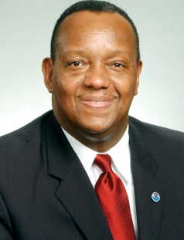
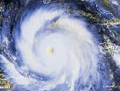
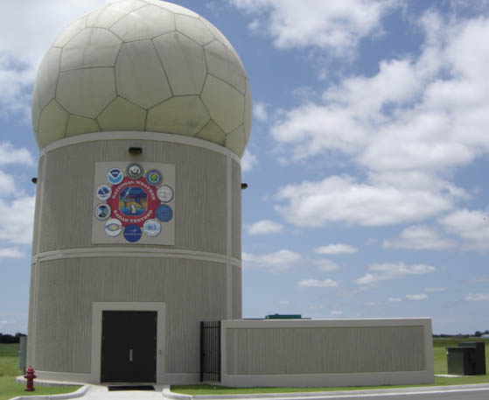
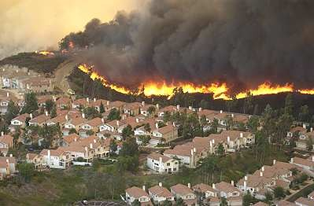
Staff Offices Federal Coordinator for Meteorology
Leads the coordination of operational weather requirements, services, and supporting research among 15 Federal agencies and offices.
Fosters information sharing, planning, coordination, and collaboration across the weather enterprise.
Facilitates interagency leveraging
Assesses issues, capabilities, needs, requirements, priorities, shortfalls, and planning
Makes recommendations to decision makers
Resolves interagency differences
Facilitates improved products and services
Focuses supporting research and transition to operations
Prescribes standardized procedures
Samuel P. Williamson
Notes:
NOAA’s Corporate Functions, also commonly known as Staff Offices (SOs), develop the strategic direction for the agency and lead the management of resources and delivery of services. The major elements of the corporate structure include the offices of the Administrator, the Deputy and Assistant Administrators and offices charged with corporate management functions, such as the Chief Financial Officer and the Chief Administrative Officer.
Office of the Federal Coordinator for Meteorology (OFCM) ensures the effective use of Federal meteorological resources by leading the systematic coordination of operational weather requirements, services, and supporting research among 15 Federal agencies and offices.
Major Outputs
The OFCM facilitates information sharing, planning, coordination, and collaboration through a collection of interagency groups to reduce duplication and maximize performance of the federal weather enterprise.
- Tropical cyclone strategic R&D
The OFCM is moving forward on the priorities outlined in the Interagency Strategic Research Plan for Tropical Cyclones: The Way Ahead. This plan is the foundation for NOAA’s Hurricane Forecast Improvement Project and is the underpinning for NOAA, Navy, NASA, and NSF tropical cyclone research initiatives.
- National Space Weather Program (NSWP)
Space weather involves conditions on the Sun, in space between the Sun and Earth, and on and around Earth that affect technological systems and health. Recently, the NSWP agencies prepared the Space Weather Implementation Plan for the Grand Challenges in Disaster Reduction and the report Impacts of NPOESS Nunn-McCurdy Certification and Potential Loss of ACE Spacecraft Solar Wind Data on National Space Environmental Monitoring Capabilities in response to a request from the Office of Science and Technology Policy.
- Multifunction Phased Array Radar (MPAR)
This capability has the potential to replace several aging legacy air and weather surveillance radar systems at a significant savings of approximately $5 billion in acquisition and lifecycle costs. NOAA, the Departments of Defense and Homeland Security, and the Federal Aviation Administration support the MPAR effort. This multi-agency risk reduction program is critical to assessing capabilities and technical risks in time for an FAA acquisition decision as early as FY2011.
- Weather Information for Surface Transportation (WIST)
In the U.S. alone, there are about 1.5 million weather-related highway crashes per year, with more than 500,000 people injured and more than 5,000 killed. Weather also adversely affects rail, pipeline, and maritime transportation. The OFCM established WIST in 1999 and more recently co-hosted the 3rd National Symposium and provided keynote addresses at the 4th Symposium as well as the “Safety in Mobility” conference in Velden, Austria.
- National Wildland Fire Weather Needs Assessment
At the request of the Western Governors Association, the OFCM through its Joint Action Group for the Wildland Fire Weather Needs Assessment conducted an extensive survey of the federal agencies and the fire weather community to develop a comprehensive assessment.
- National Aviation Weather Program (NAWP)
The OFCM evaluated aircraft accident statistics for the 10-year national goal of reducing fatal weather-related aviation accidents by 80 percent. They are assessing areas needing further work and ways to maintain the success achieved, with a final report to be released in the spring of 2009.
- Volcanic Ash
The Working Group for Volcanic Ash published the National Volcanic Ash Operations Plan for Aviation and Support of the ICAO International Airways Volcano Watch, and the OFCM continues to work with the FAA and the USGS on volcano monitoring in Alaska to minimize volcanic ash impacts on aviation.
- Lightning Data Requirements
The OFCM coordinated the interagency collection, organization, and prioritization of lightning data requirements used as input to a National Weather Service procurement supporting all of the agencies for lightning data services beginning in 2010.
- National Operations Plan Updates
The National Severe Local Storms Operations Plan and the National Post-Storm Data Acquisition Plan are in final draft and coordination. These plans provide the federal agencies with coordinated, interagency operational guidance in their respective areas of responsibilities.
- Civil Air Patrol Aerial Support Services
The OFCM manages an agreement with the Air Force for CAP services for pre- and post-storm damage assessments, hydrology and flooding surveys, and glacier ice dam analysis in Alaska.
- Annual Interdepartmental Hurricane Conference (IHC)
The IHC is the single annual venue to bring together all of the federal agencies to address issues, needs, requirements, and priorities for tropical cyclone observing and forecasting, and to assess and improve the end-to-end U.S. warning system. The agencies address plans and action items and develop the year’s National Hurricane Operations Plan. Typical attendance is 200 people from 9-12 agencies.
- Annual Symposium on Space Weather (with American Meteorological Society)
The symposium provides a venue to share operational improvements, research results, new data sources and products, developments in modeling, and exploration of new spacecraft capabilities.
- Interagency Plans
The OFCM’s federal plans represent significant interagency investments to define crosscutting issues, needs, requirements, and priorities and to develop coordinated and collaborative approaches to multi-agency problems.
- Interagency Reports
The OFCM’s federal reports assess multi-agency problems, provide crosscutting analyses of activities and issues, and document the status and progress of interagency efforts and programs.
- Federal Meteorological Handbooks (FMHs)
The FMHs prescribe standardized and coordinated procedures used by Federal agencies in the collection, recording, and reporting of weather information. They are also de facto standards for non-federal entities and provide a means to ensure U.S. compliance with necessary international standards as prescribed by the World Meteorological Organization and the International Civil Aviation Organization.
More information and OFCM publications are available at http://www.ofcm.gov/

Slide 14

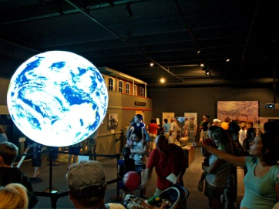

Staff Offices Acquisition & Grants
Purchases quality goods and services at a reasonable price from external vendors
Solicits proposals from industry
Awards and administers contracts
Administers financial assistance awards (grants) to qualified recipients in support of NOAA’s mission
Manages administrative and financial aspects of awards
Reviews and processes applications
Maureen Wylie (Acting)
Notes:
NOAA’s Corporate Functions, also commonly known as Staff Offices (SOs), develop the strategic direction for the agency and lead the management of resources and delivery of services. The major elements of the corporate structure include the offices of the Administrator, the Deputy and
Assistant Administrators and offices charged with corporate management functions, such as the Chief Financial Officer and the Chief Administrative Officer.
Acquisition and Grants Office (AGO) reviews solicitations for grant applications, processes
applications, negotiates awards, manages administrative and financial aspects of awards,
monitors progress against expenditures, resolves audit problems, and closes out awards as
projects are completed. www.ago.noaa.gov
Major Outputs
The NOAA Acquisition and Grants Office (AGO) is a corporate activity to purchase quality goods and services at a reasonable price from external vendors and to administer financial assistance awards (grants) to qualified recipients in support of NOAA’s mission.
Acquisition Service Operations
The purpose of this activity is to purchase gods and services through the use of contracts, simplified acquisition procedures, Bankcard transactions and interagency agreements and memoranda of understanding. These purchases are requested by each NOAA customer as specified by their requirements and are subject to all applicable federal laws, policies and regulations related to procurement. Simplified acquisitions procedures provide streamlined techniques to reduce the administrative burden of awarding lower dollar value or commercially available item procurements that account for the majority of purchases. Bankcards are issued to authorized government employees and typically can be used for purchases up to $2500 per month.
During FY 2007, AGO successfully completed 14,283 procurement transactions worth a total value of $1.1445 billion.
Financial Assistance Service Operations
The purpose of this activity it to provide technical and administrative support to NOAA programs that give financial assistance (authorized by statute) to a wide variety of non-federal recipients to produce results intended to enhance NOAA’s mission. This support involves all phases of the grant administration process including pre-award actions such as providing technical guidance during initial pre-selection activities, announcing and publishing requests for grant applications, conducting administrative review and award of recommended applications, monitoring award progress and terms and conditions and closing out of completed grant awards.
During FY 2007, AGO issued 1,955 grant awards worth a total of $ 924 million.

Slide 15
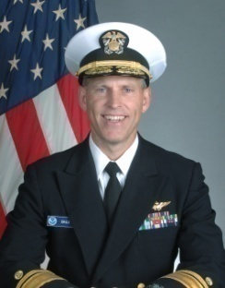
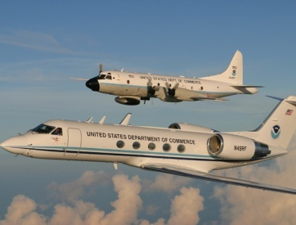
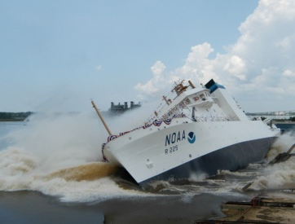
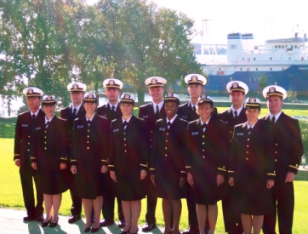
Staff Offices Marine & Aviation Operations
Operates and maintains NOAA’s specialized fleet of 18 ships and 12 aircraft
Provides continuous observation of critical environmental conditions
Serves as technical acquisition lead for new ships and aircraft
Directs the following programs:
NOAA Commissioned Corps
Provides operational leaders Agency-wide
NOAA Dive Program
Trains, certifies, and equips NOAA divers, and promulgates diving regulations and safety standards for the Agency
Small Boat and Aviation Safety Programs
Provide safety standards and training for NOAA components operating small vessels or utilizing aircraft
RADM Jonathan W. Bailey
Notes:
Office Marine and Aviation Operations (OMAO) is the principal manager of NOAA’s wide variety of specialized aircraft and ships. The goal is to provide critical support for NOAA’s mission by meeting the agency’s data collection requirements that ensures continuous observation of critical environmental conditions. Services:
Ship and Aircraft Services
OMAO provides ship and aircraft programs for continuous observation of critical environmental conditions by:
Providing ship and aircraft support in accordance with the Fleet and Aircraft Allocation Plans and project planning schedules;
Using effective and efficient approaches to operate and maintain 18 active and 1 inactive NOAA ship and 12 active and 1 inactive NOAA aircraft that provide critical mission support;
Upgrading NOAA’s fleet of ships and aircraft in accordance with FY Fleet Replacement funding;
Working in partnership with the Programs, continue efforts to acquire and support AUVs and UAS’ equipped with associated sensors to help collect NOAA data; and
Establishing OMAO’s role in NOAA’s AUV and UAS programs.
NOAA Diving Program
OMAO manages the NOAA Diving Program in support of Line Office diving needs by:
Servicing and distributing diving equipment to NOAA personnel;
Providing dive training and certification for NOAA divers and external partners;
Formulating and maintaining policies, procedures, plans and processes needed to train and certify divers; and
Supporting field operations for specialized advanced and/or remote diving operations.
NOAA Small-Boat Safety Program
OMAO coordinates the NOAA Small-Boat Safety Program by:
Inspecting class 3 and larger boats annually;
Providing engineering assistance;
Developing small boat training curricula and course presentations;
Formulating and maintaining policies, procedures, plans and processes necessary to promote small boat safety in accordance with NAO 209-125, NOAA Small Boat Safety Program utilizing the Small Boat Safety Board; and
Providing NOAA with a comprehensive plan (budget and resources) showing the needs and outputs to fully fund the safety program.
NOAA Corps Officers to Support NOAA’s Mission
OMAO recruits and trains NOAA Corps officers to meet NOAA needs by:
Providing NOAA Corps officers for NOAA platforms and to Line Offices;
Recruiting and training NOAA Corps officers through Basic Officer Training Classes (BOTC);
Providing NOAA with a revised Officer Assignment Plan to support NOAA data collection activities; and
Providing NOAA with NOAA Corps salary requirements to establish a funding line for the NOAA Corps within OMAO’s budget.
NOAA’s Teacher At Sea Program
OMAO partners with the National Marine Fisheries Service and Office of Education to manage the NOAA Teacher at Sea Program (TAS) and pilot Teacher in the Air program in support of NOAA’s outreach and education activities by:
Supporting teachers from kindergarten through college levels and from varied backgrounds to participate in the programs;
Increasing teachers’ awareness of the maritime and science fields through teacher research experiences; and
Identifying, facilitating, and coordinating education-related partnerships with other NOAA Line Offices, schools, institutions of higher learning, educational associations, private industry, and other federal, state, local, and international governments.
NOAA Aviation Safety Program
OMAO will develop the NOAA Aviation Safety Program in support of Line Office needs by:
Formulating and maintaining policies, procedures, plans and processes necessary to promote aviation safety in accordance with NAO 209-124, Aviation Safety Policy utilizing the Aviation Safety Board;
Group purchasing, inventorying, and maintaining standardized Aviation Life Support Equipment (ALSE);
Providing oversight of an Aviation Life Support Equipment contract;
Providing Commercial Aviation Services vendor inspections;
Implementing an Aviation Safety Awards program; and
Developing and Aviation Safety Medical training module.

