Slide 1
Introduction to Quasi-Elastic Neutron Scattering (QENS)
Presented to National School on Neutron and X-ray Scattering
Ken Herwig Deputy Director
Neutron Scattering Science Division, Oak Ridge National Laboratory
September 29, 2008

Slide 2
OUTLINE
Background
Neutrons and QENS
Connection to Molecular Dynamics Simulations
The Elastic Incoherent Structure Factor (EISF)
The Role of Instrumentation
Restricted Diffusion Examples
Experiment Design – an example
Water - Excel Spread Sheet – an illustration
Recent Applications
References and Summary

Slide 3
Background (Why Should I Care?)
Applicable to wide range of science areas
Biology – dynamic transition in proteins, hydration water
Chemistry – complex fluids, ionic liquids, porous media, surface interactions, water at interfaces, clays
Materials science – hydrogen storage, fuel cells, polymers
Probes true “diffusive” motions
Range of analytic function models
Useful for systematic comparisons
Close ties to theory – particularly Molecular Dynamics simulations
Complementary
Light spectroscopy, NMR, dielectric relaxation

Slide 4
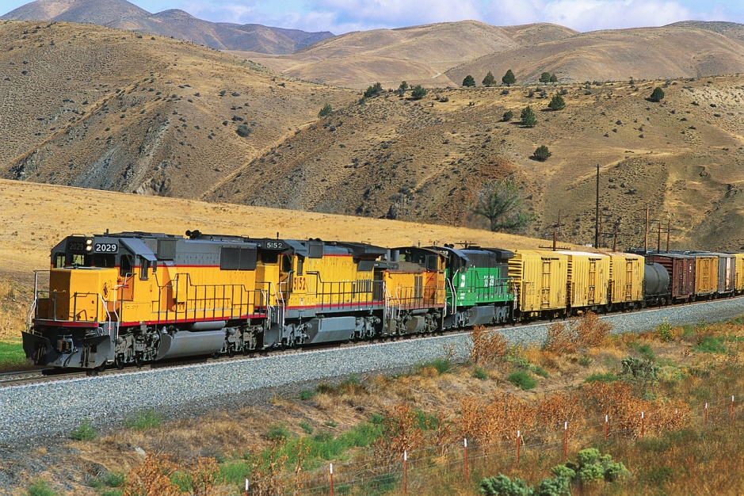
Quasi-Elastic Neutron Scattering
Neutron exchanges small amount of energy with atoms in the sample
Doppler Effect

Slide 5
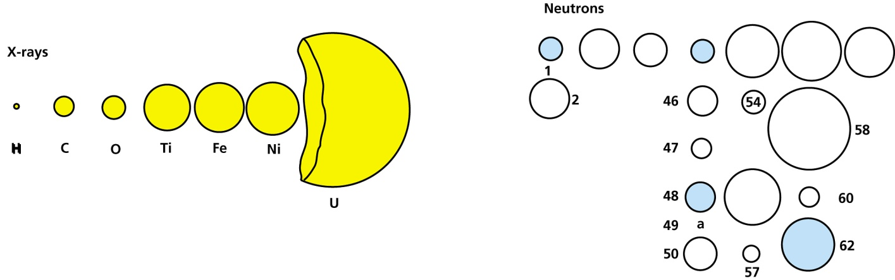
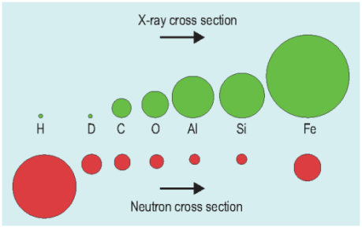
Neutrons, QENS, and the Large Incoherent Cross-section of H
1
C
O
Ti
Total
Fe
Ni
U
2
46
54
47
58
48
56
60
50
57
62
Isotopic sensitivity – random nuclear cross-section with element and isotope
H-D contrast, light element sensitivity in presence of heavy elements
H large incoherent cross-section – self-correlation function
Magnetic moment
Wavelength and energy match excitations in condensed matter (Geometry and time): Where are the atoms and how do they move?
neutrons λ ~ Å; E ~ meV; spectroscopy – no selection rules
x-rays λ ~ Å; E ~ keV
light λ ~ 1000 Å; E ~ eV
Small absorption cross section – can penetrate sample cells

Slide 6
A Neutron Experiment
scattered neutron
detector
incident neutron
sample
Measure scattered neutrons as a function of Q and ω −> S(Q,ω).
ω = 0 −> elastic
ω ≠ 0 −> inelastic
ω near 0 −> quasielastic

Slide 7
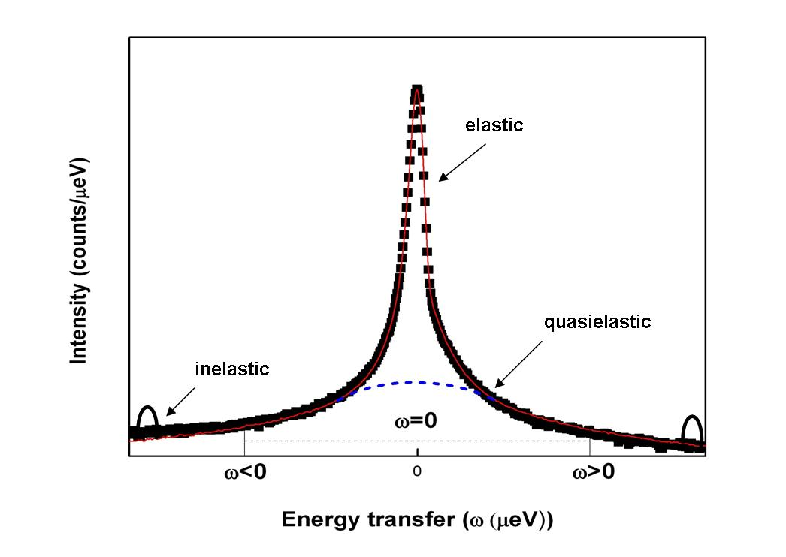
QENS Spectra

Slide 8
Intermediate Scattering Function and S(Q,ω)
Intermediate Scattering Function
time dependent correlation function
incoherent scattering –> no pair correlations, self-correlation function
calculable from atomic coordinates in a Molecular Dynamics Simulation
S_{inc}(Q,ω) – the Fourier transform of I_{inc}(Q,t)

Slide 9
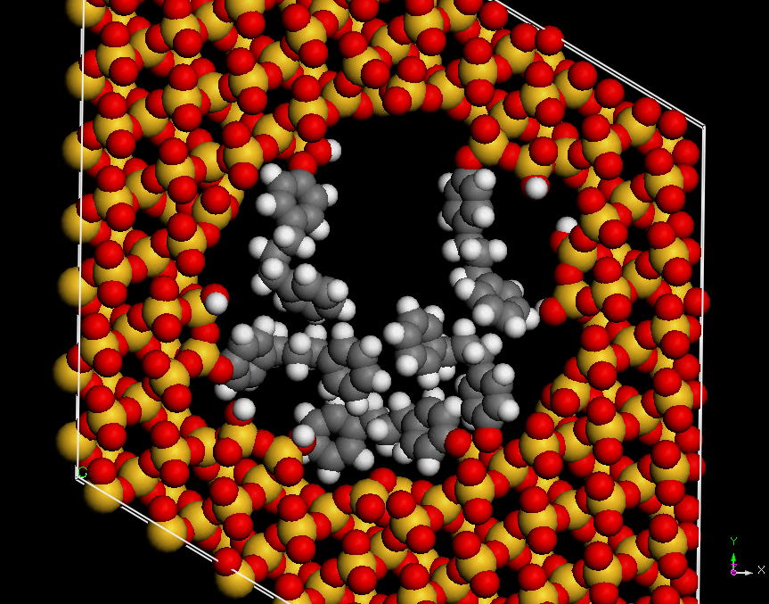
QENS and Molecular Dynamics Simulations
Same atomic coordinates used in classical MD are all that is needed to calculate I_{inc}(Q,t)
1,3 diphenylpropane tethered to the pore surface of MCM-41

Slide 10
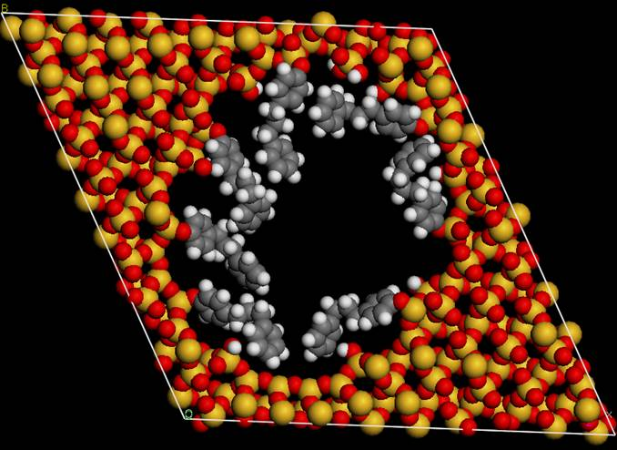
The Elastic Incoherent Structure Factor (EISF)
A particle (H-atom) moves out of volume defined by 2π/Q in a time shorter than set by the reciprocal of the instrument sensitivity, dω(meV) – gives rise to quasielastic broadening.
The EISF is essentially the probability that a particle can be found in the same volume of space at some subsequent time.
The ratio of the Elastic Intensity to the total Intensity
2π/Q

Slide 11
QENS and Neutron Scattering Instruments
Probe Diffusive Motions
Length scales set by Q, 0.1 Å⁻¹ < Q < 3.7 Å⁻¹, 60 Å > d > 1.7 Å.
Time scales set by the width of instrument energy resolution, typically at least 0.1 meV (fwhm) but higher resolution -> longer times/slower motion
Energy transfers ~ ± 2 meV (or less)
High resolution requirements emphasizes use of cold neutrons (but long λ limits Q)
Incident neutron wavelengths typically 4 Å to 12 Å (5.1 meV to 0.6 meV)
Why a variety of instruments? (Resolutions vary from 1 μeV to100 μeV)
Terms in the resolution add in quadrature – typically primary spectrometer (before sample), secondary spectrometer (after the sample)
Improvement in each resolution term cost linearly in neutron flux (ideally)
Optimized instrument has primary and secondary spectrometer contributions approximately equal
Factor of 2 gain in resolution costs at a minimum a factor of 4 in flux

Slide 12
Role of Instrumentation
Currently about 25 neutron scattering instruments in the world useful for QNS (approximately 5 in the U. S.)
U.S. instruments – Opportunity is Good- Competition is Strong
NIST Center for Neutron Research
Disc Chopper Spectrometer
High Flux Backscattering Spectrometer
Neutron Spin Echo
Lujan – Los Alamos National Laboratory
Rebuild of QENS instrument from IPNS
Spallation Neutron Source
BaSiS – near backscattering spectrometer (3 μeV)
Cold Neutron Chopper Spectrometer (CNCS) (10 – 100 μeV)
Neutron Spin Echo (t to 1-2 μsec)
Trade-offs
Resolution/count rate
Flexibility
Dynamic range
Neutron λ vs Q (
large λ −> high resolution -> long times/slow motions
large λ −> limited Q-range, limited length scales

Slide 13
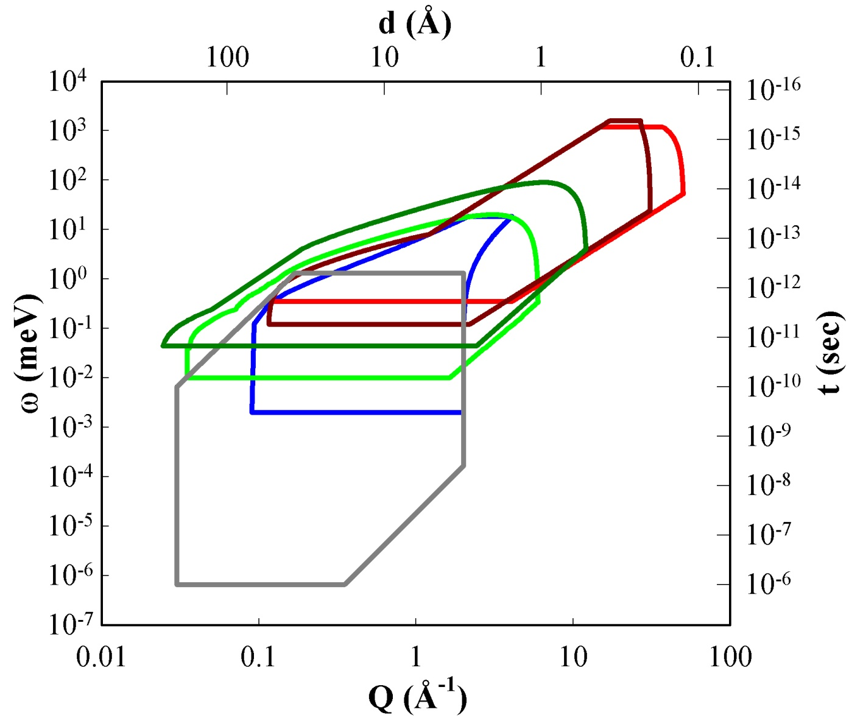
The SNS Inelastic Instrument Suite
Momentum Distributions
Itinerant Magnets
Hydrogen Modes
Larger Objects
ARCS Fermi Chopper
SEQUOIA Fermi Chopper
HYSPEC
Cold Neutron Chopper Spectrometer
Backscattering
Neutron Spin Echo
Crystal
Fields
Molecular Vibrations
Electron-Phonon Interactions
Lattice and Spin Excitations
Small Molecule Diffusion
Molecular Reorientation
Tunneling Spectroscopy
Large Scale Motions
Polymers and Biological Systems
Slower Motions
Glassy Dynamics
Ultracold Neutrons Fundamental Physics

Slide 14
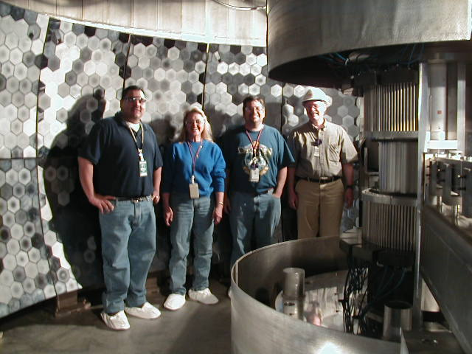
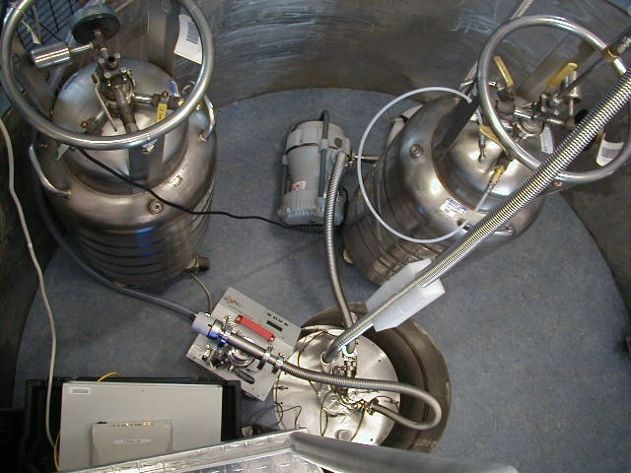
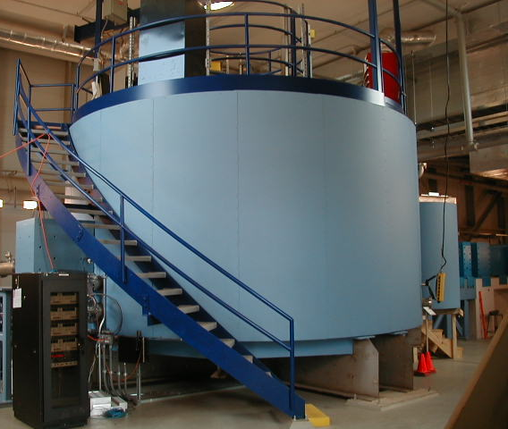
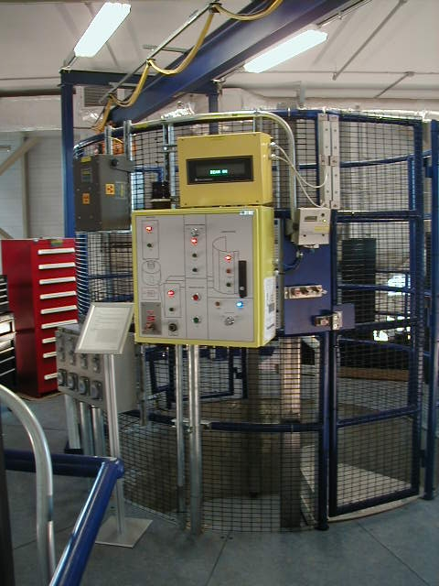
BaSiS - SNS Near Backscattering Spectrometer

Slide 15
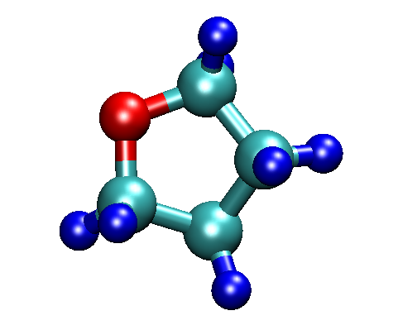
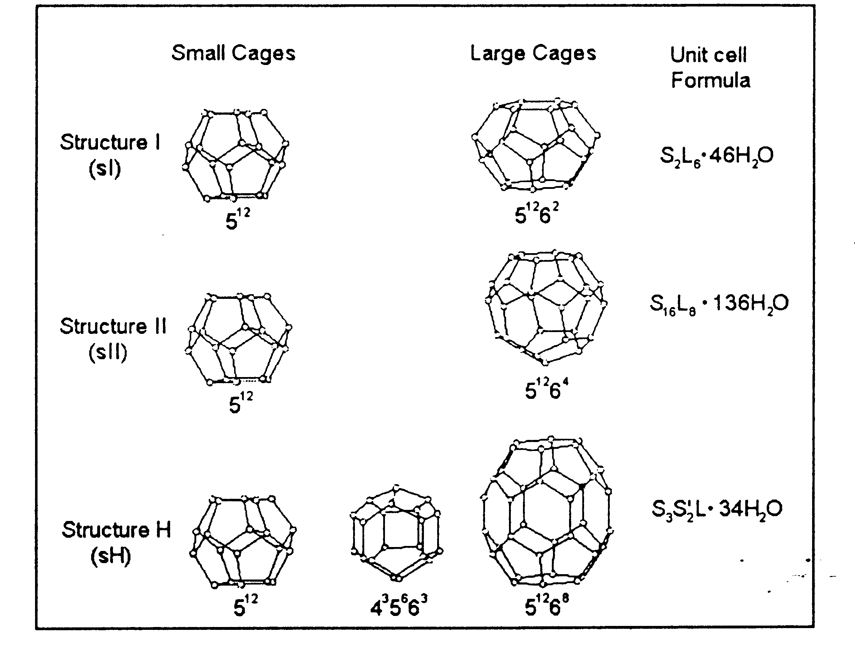
Examples – THF Clathrate Hydrate
Structure II
Cubic
Large Cages 5.9 Å - 6.9 Å
Avg. radius 4.73 Å

Slide 16
Elastic Scan (Fixed Window Scan)
Motions Too Fast for HFBS
T_{M} = 277 K

Slide 17

Restricted Diffusion – Tethered Molecules
Samples – typical 0.7 g
240 K < T < 340 K
Simple Fit – Lorentzian + δ
Pore Radius (nm) | Coverage (molecules/nm²)
1.63 | 0.85 (saturation)
2.12 | 1.04 (saturation)
2.96 | 0.60 0.75 1.61 (saturation)
MCM-41 (2.9 nm pore diameter) high DPP coverage

Slide 18
What if I don’t have Molecular Dynamics or other Theory? Simple Analytical Model – e.g. Diffusion in a Sphere
2r
EISF:
Volino and Dianoux, Mol. Phys. 41, 271-279 (1980).

Slide 19
Sum over H-atoms
l_{i}
DPP
O
Si
O
Si
Fits to Data

Slide 20
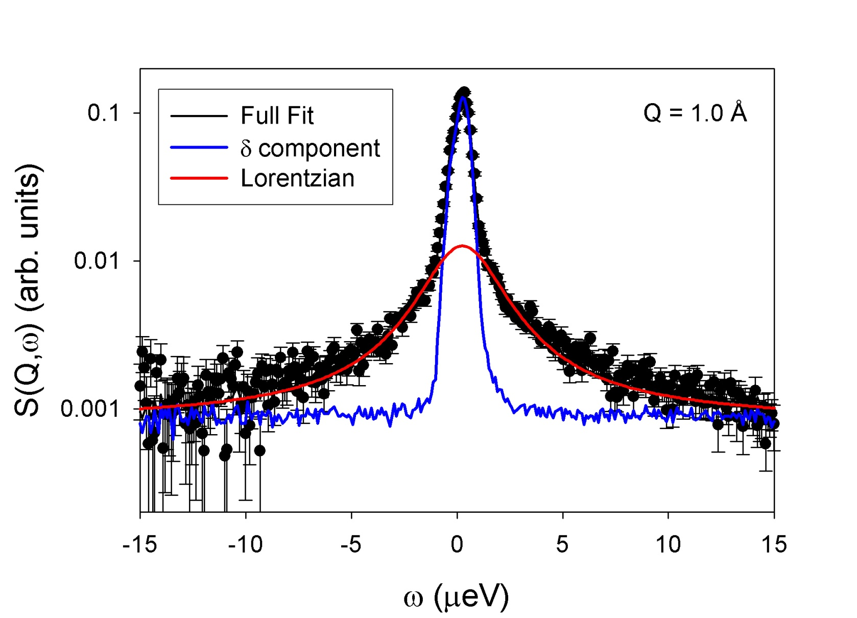
Fit to data (HFBS – NCNR) 29.6 Å diameter pore, 320 K, Q = 1 Å⁻¹

Slide 21
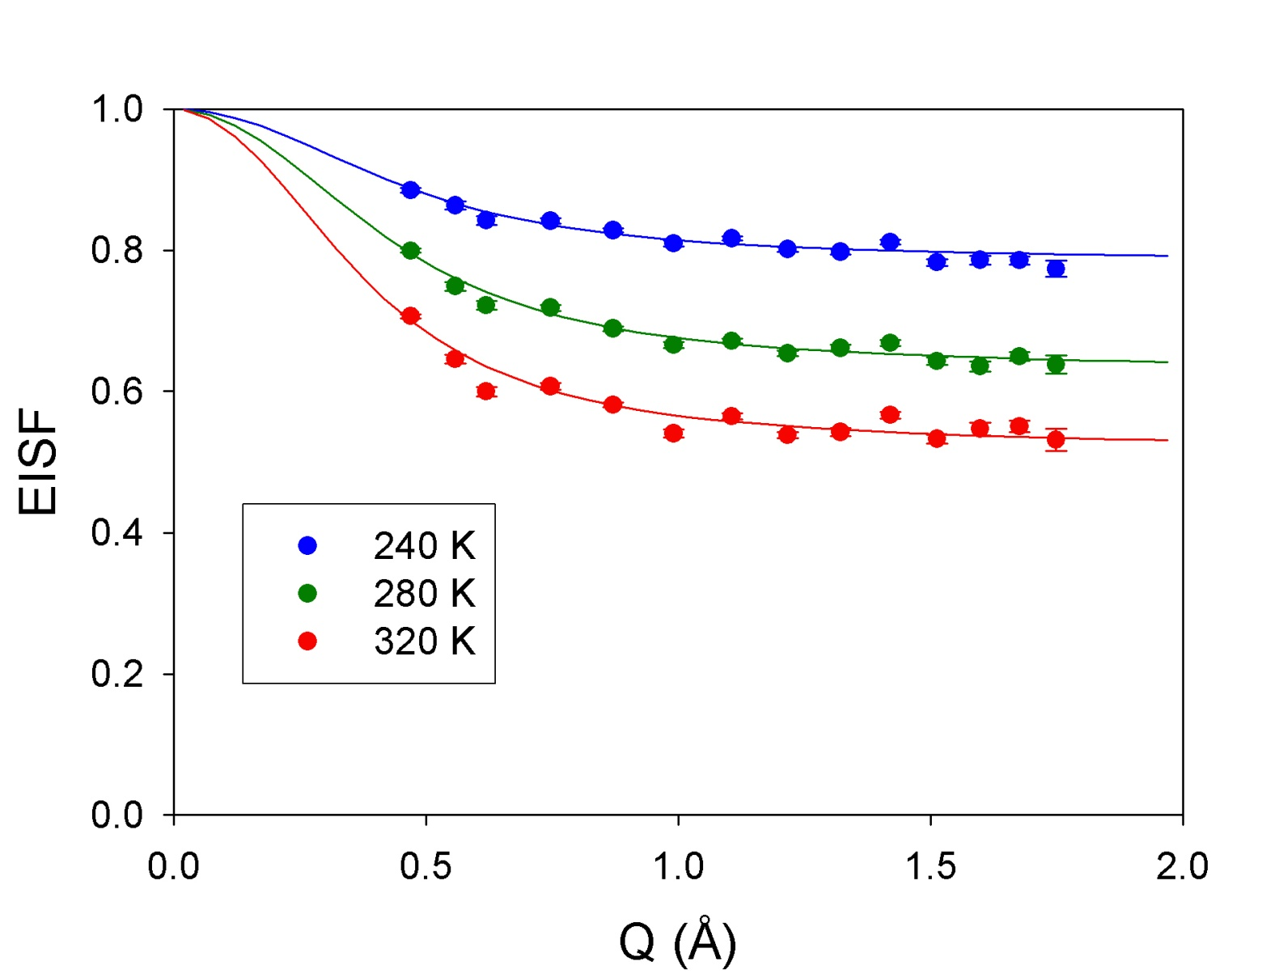
EISF – 29.6 Å radius DPP sample, saturation

Slide 22
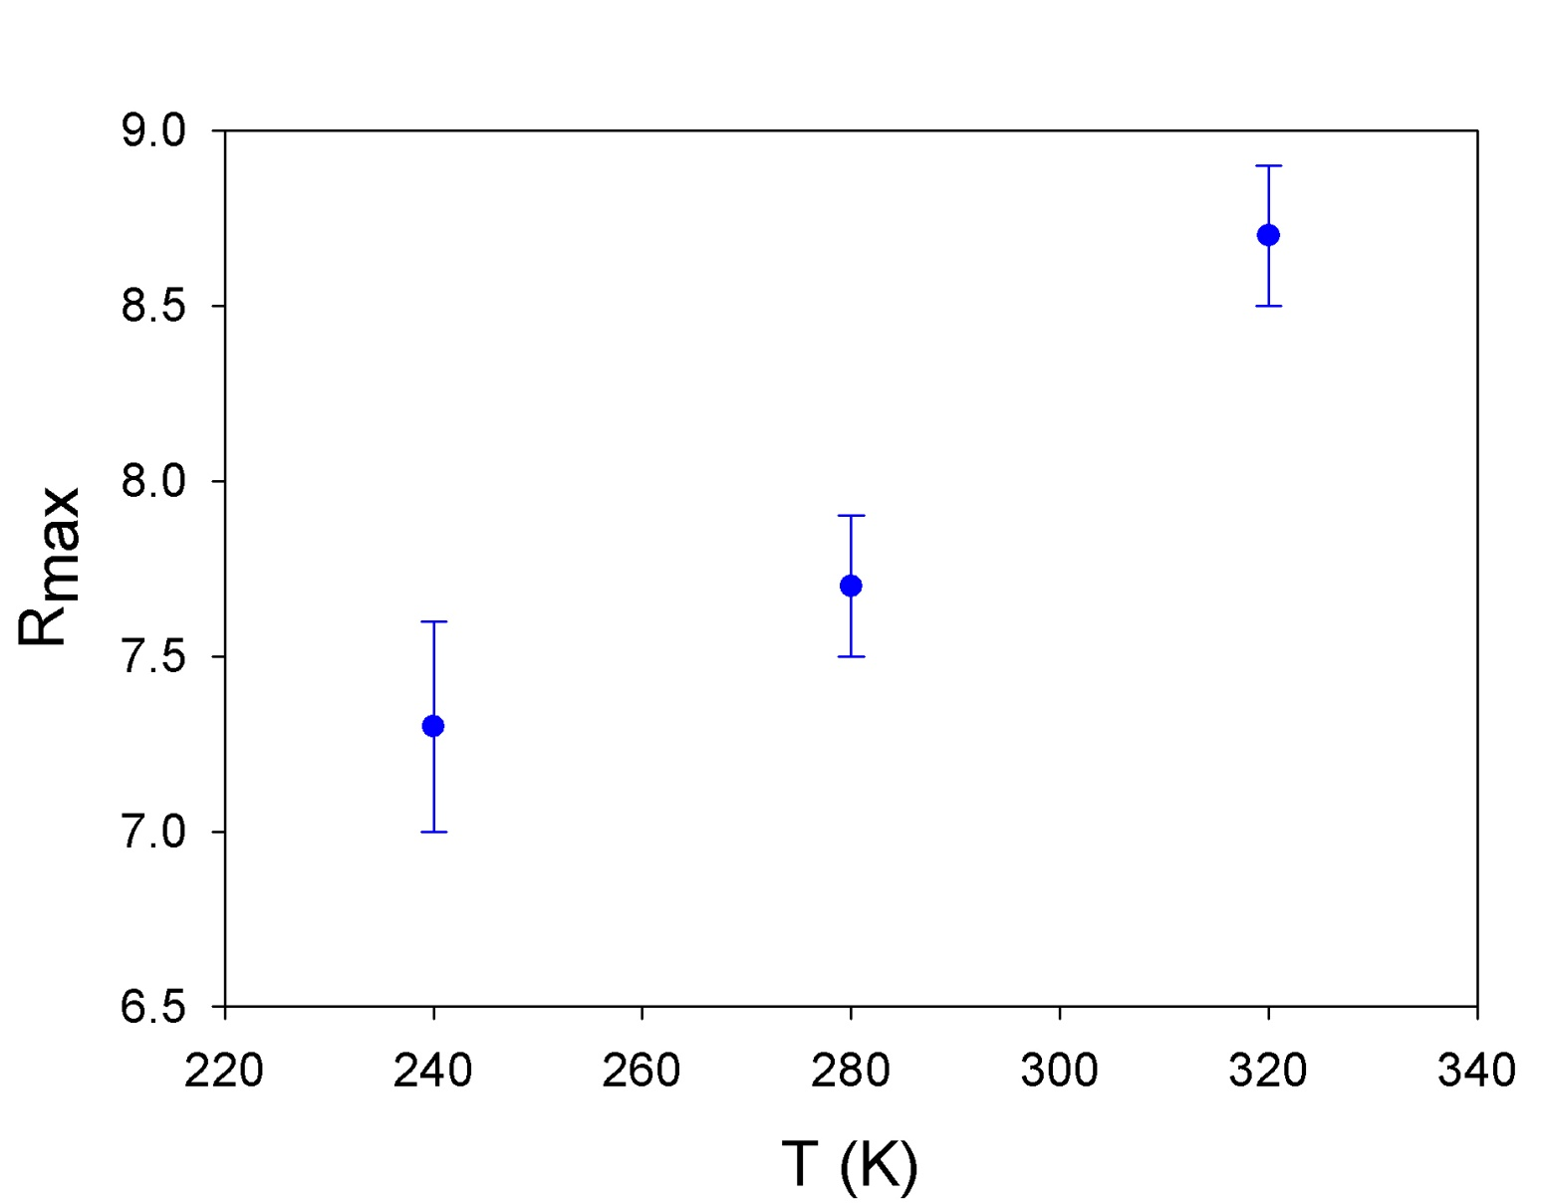
29.6 Å radius DPP sample, saturation

Slide 23
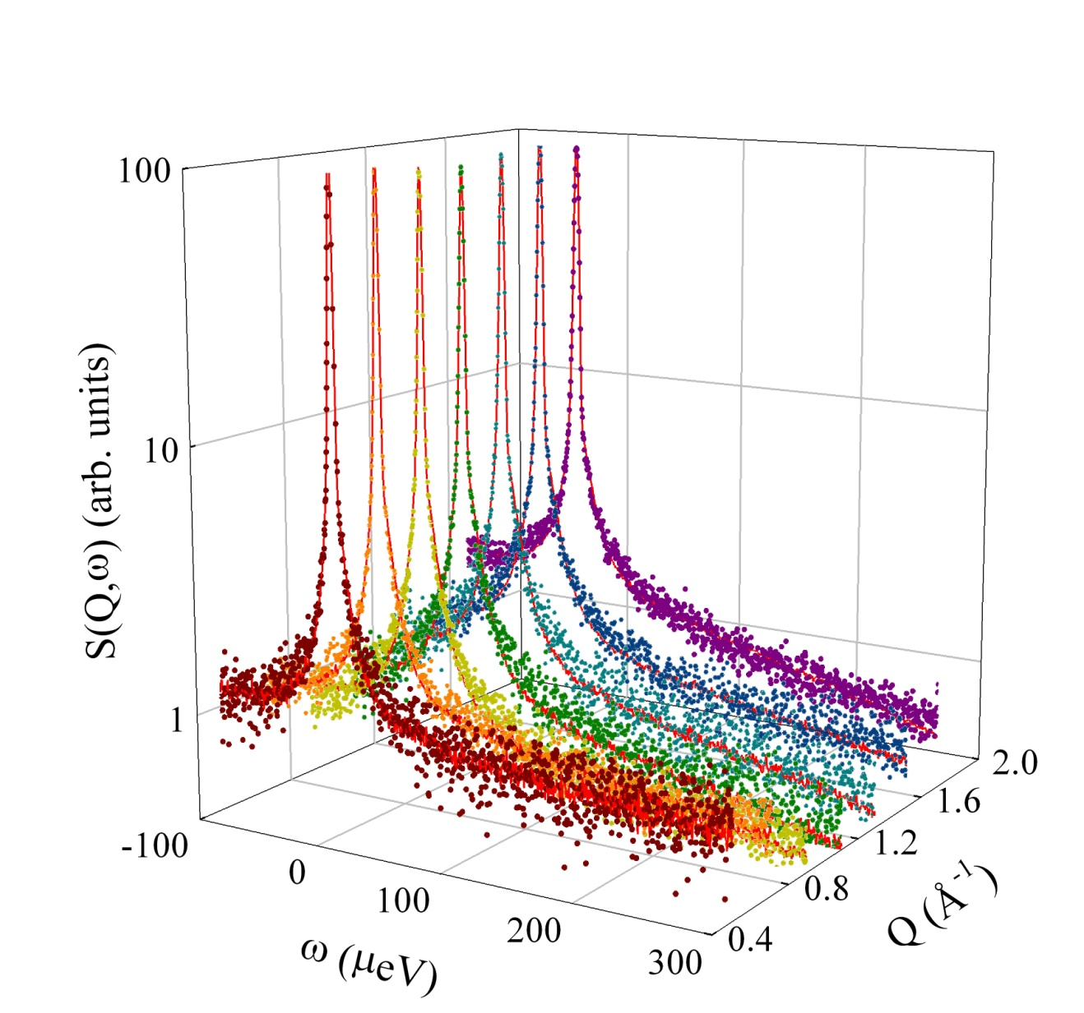
DPP – 29.6 Å diameter pores – 370 K (BaSiS - SNS)

Slide 24
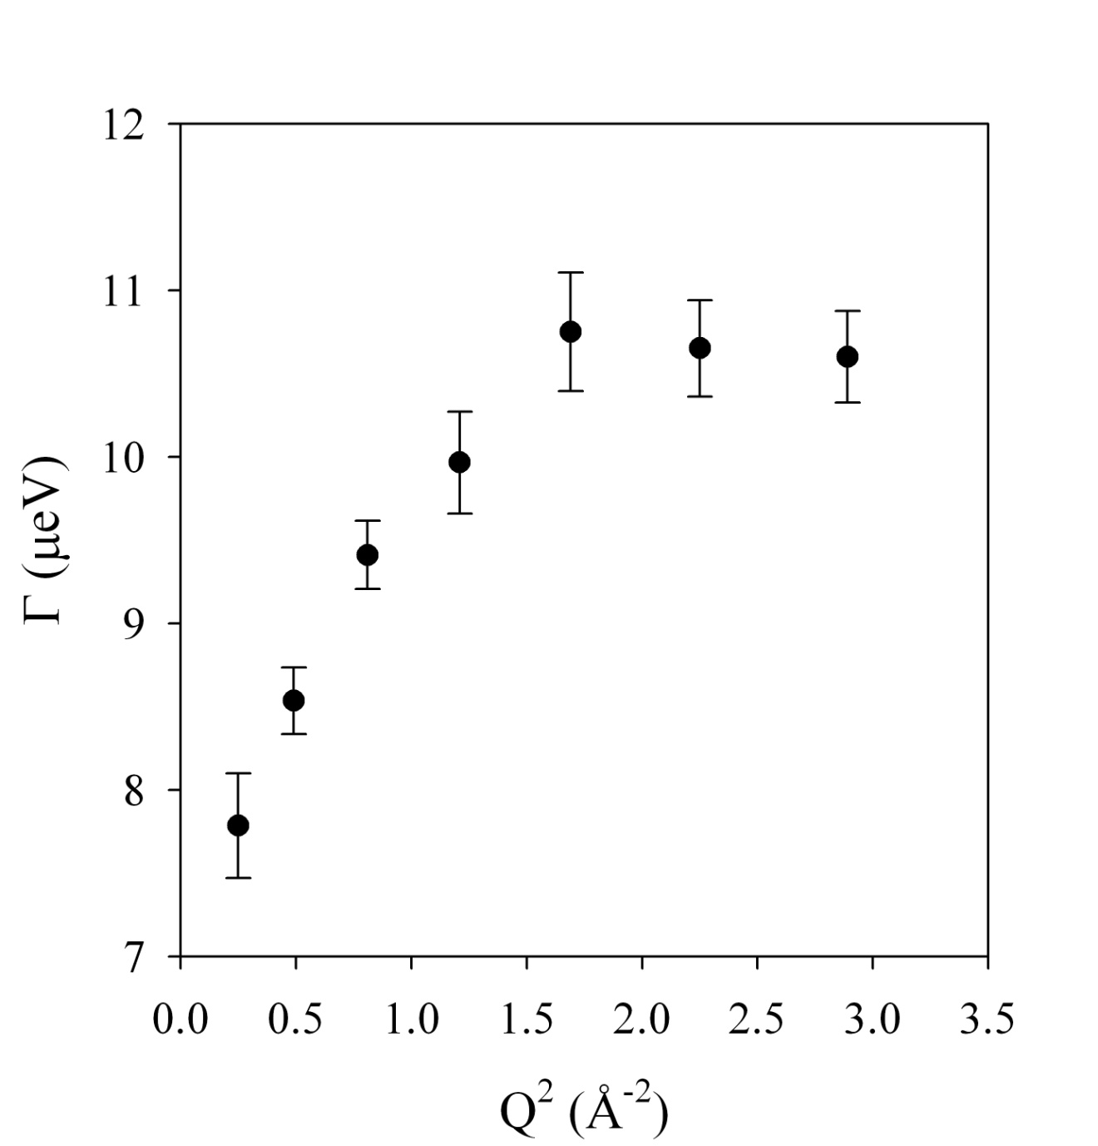
Lorentzian Γ(Q)
Non-zero intercept
−> restricted motion

Slide 25
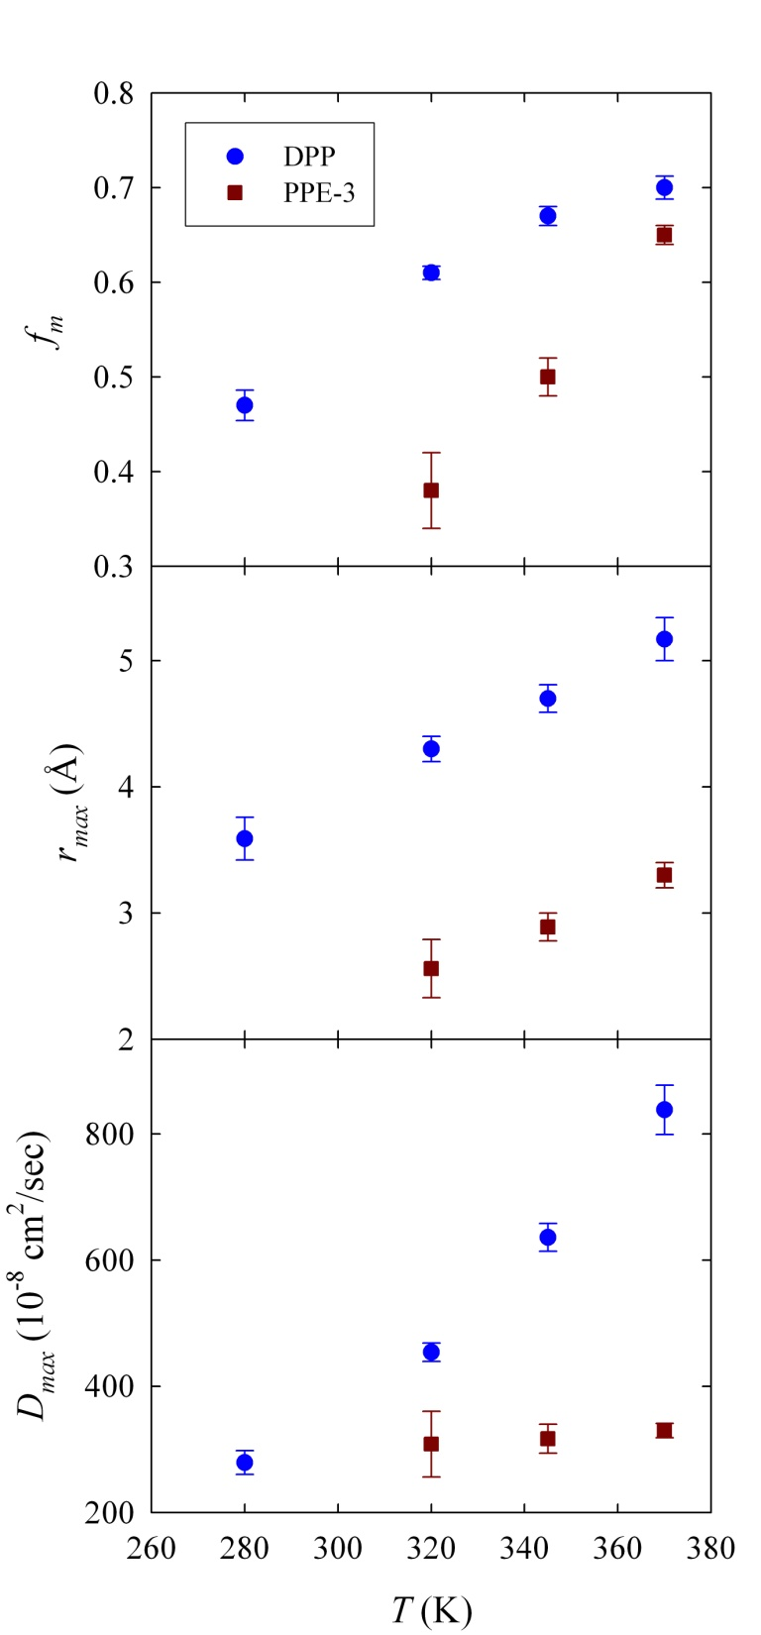
Detailed Fits

Slide 26
Experiment Design
σ is the microscopic cross section (bn/atom) 10⁻²⁴ cm²
n is the number density (atom/cm³)
Σ is the macroscopic cross-section (cm⁻¹)
The transmission, T, depends on sample thickness, t, as:
Good rule of thumb is T = 0.9
5 – 15 mmole H-atoms for 10 cm² sample (BaSiS, HFBS, CNCS, DCS)

Slide 27
An Example – Water

Slide 28
Models
Rotation on the Surface of a Sphere
Translational Motion
Jump Diffusion

Slide 29
Excel Spread Sheet Model
Oscillation
Isotropic Rotation
Jump Translational
<u²>^{½}
Debye-Waller
τ_{r}
Rotational Correlation Time
r_{g}
Radius of Gyration
D_{t}
Translational Diffusion Constant
τ_{t}
Residence Time
l
Mean Jump Distance

Slide 30
Some Examples – courtesy D. A. Neuman (QENS – 2006 talk)

Slide 31
Silica Melts – a Model System for Lava
Courtesy of Florian Kargl
SiO₂ + Na₂O, K₂O, Al₂O₃, Fe₂O₃, CaO, MgO ...
effusive (flow) or explosive (fragmentation) eruption:
– H₂O content in magma chamber (up to ≈15 mole%)
– viscosity of the anhydrous silicate melt (composition)

Slide 32
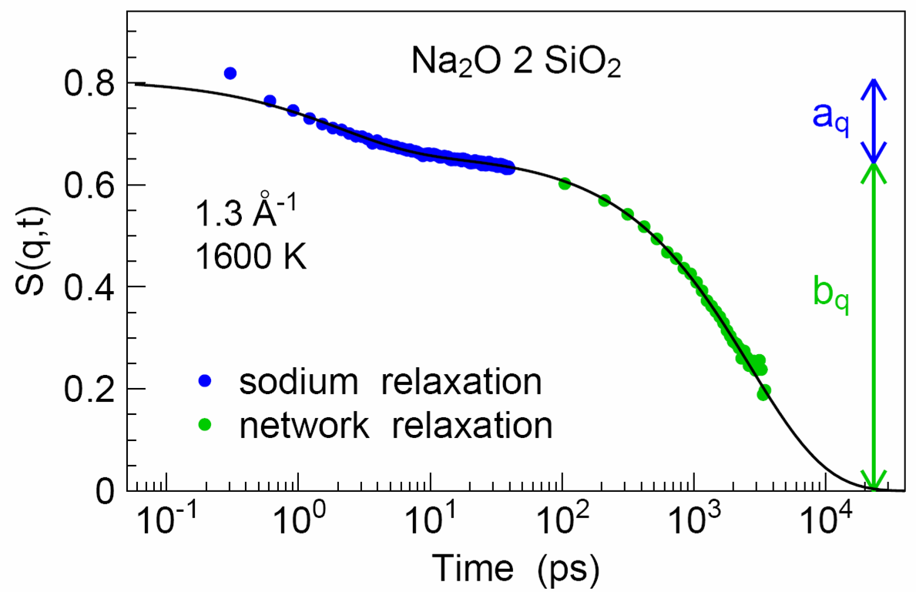
Silica Melts
fast sodium relaxation on picosecond time scale
=> sodium diffusion (IN5)
Si-O network relaxation on nanosecond time scale
=> viscous flow (HFBS)
A. Meyer, H. Schober, D. B. Dingwell, Europhys. Lett. 59, 708 (2002)

Slide 33
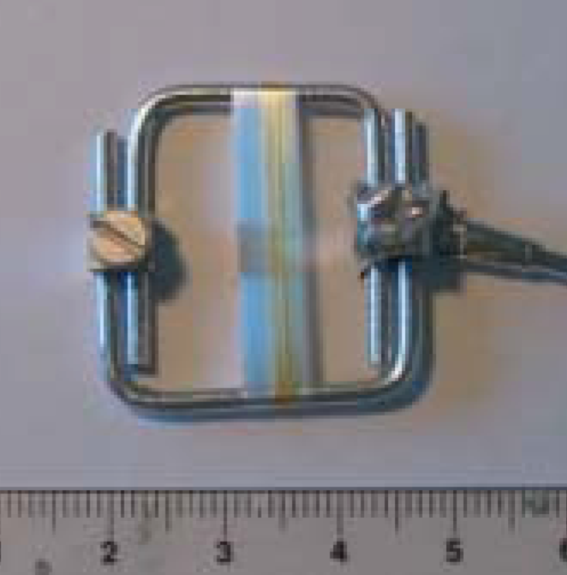
Spider Silk and Water
Spider dragline silk possesses outstanding mechanical properties. It is spun at ambient temperature and pressure using water as a solvent. It is therefore crucial to understand the role of adsorbed water to spider silk.
T. Seydel, M. Koza, D. Sapede, C. Riekel, T. Forsyth, F. Vollrath, ILL annual report, 58 (2003).

Slide 34
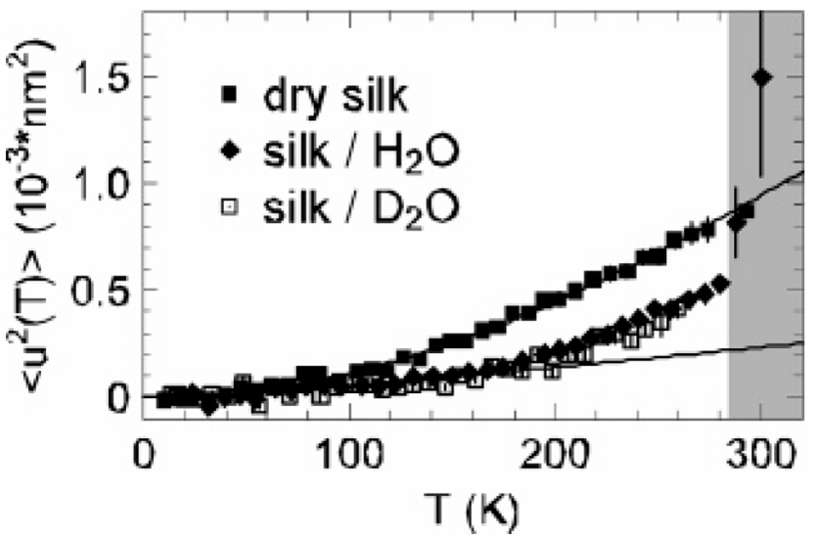
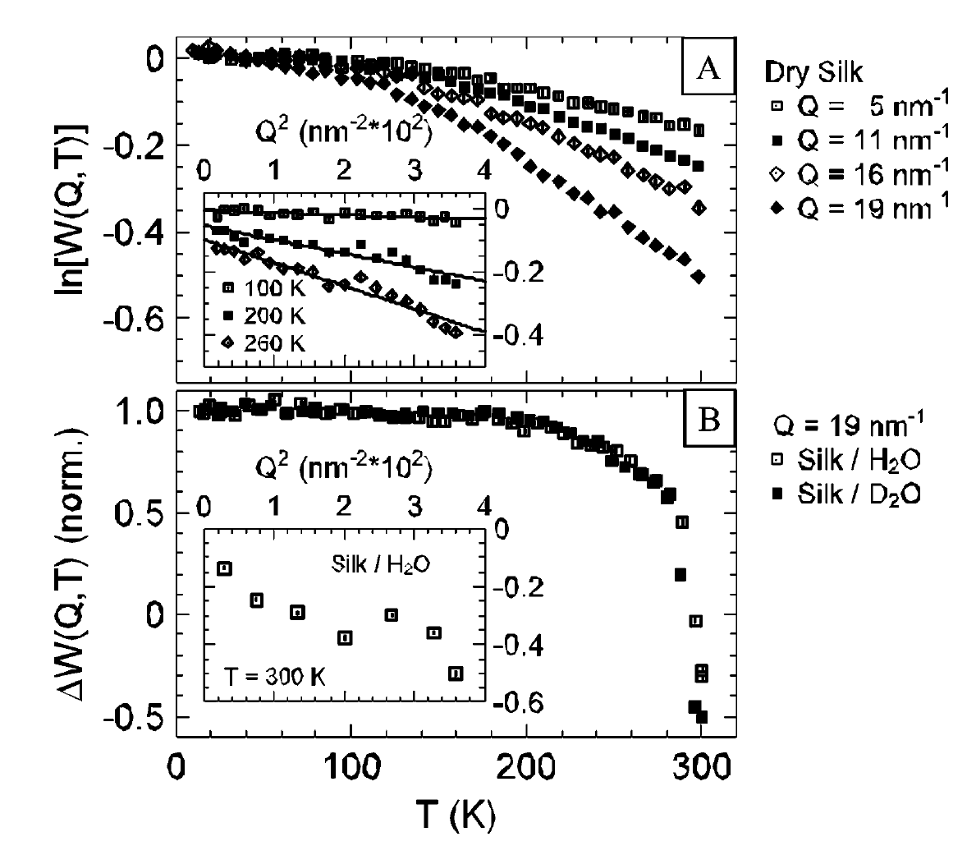
Spider Silk
The mobility of the polymer chains is enhanced by the presence of water.
D. Sapede, T. Seydel, V.T. Forsyth, M.M. Koza, R. Schweins,
F. Vollrath, and C. Riekel, Macromolecules 38, 8447 (2005).
Data from IN16

Slide 35
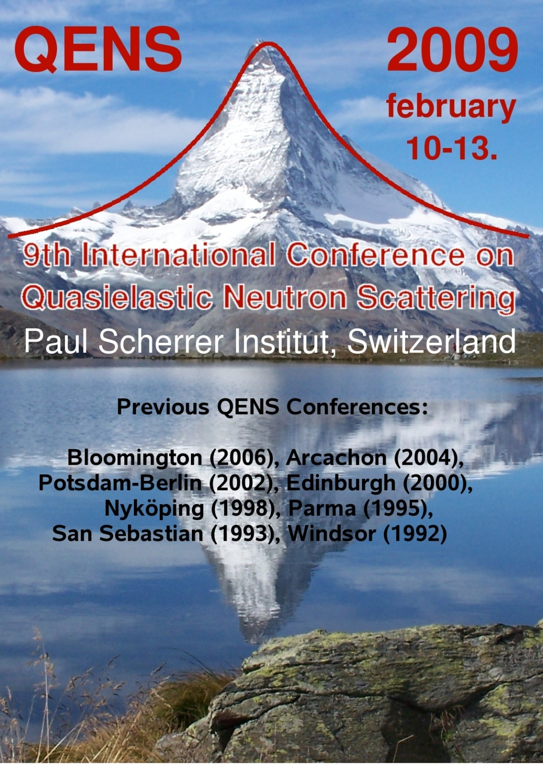
Reference Materials - 1
Reference Books
Quasielastic Neutron Scattering, M. Bee (Bristol, Adam Hilger, 1988).
Methods of X-Ray and Neutron Scattering in Polymer Science, R. –J. Roe (New York, Oxford University Press, 2000).
Quasielastic Neutron Scattering and Solid State Diffusion, R. Hempelmann (2000).
Quasielastic Neutron Scattering for the Investigation of Diffusive Motions in Solids and Liquids, Springer Tracts in Modern Physics, T. Springer (Berlin, Springer 1972).
QENS 2009 – typically 150 participants

Slide 36
Reference Materials - 2
Classic Papers
L. Van Hove
Phys. Rev. 95, 249 (1954)
Phys. Rev. 95, 1374 (1954)
V. F. Sears
Canadian J. Phys. 44, 867 (1966)
Canadian J. Phys. 44, 1279 (1966)
Canadian J. Phys. 44, 1299 (1966)
G. H. Vineyard
Phys. Rev. 110, 999 (1958)
S. Chandrasekhar
“Stochastic Problems in Physics and Astronomy”, Rev. Mod. Phys. 15, 1 (1943) (not really QNS but great reference on diffusion models)
Data Analysis – DAVE – NIST Center for Neutron Research http://www.ncnr.nist.gov/dave/

Slide 37
SUMMARY
QENS is an excellent technique to measure diffusive dynamics
Length scales/geometry accessible through Q-dependence
Large range of time scales ( sub-picosecond < t < nanosecond (μsec for NSE)
H-atom sensitivity
Instrument selection is a critical decision – the resolution must match the time scale of the expected motion
World-class instrumentation is currently available in the U.S.
New instruments are on the way with the promise of new capabilities/higher flux
Software – DAVE at the NCNR at NIST – available from the NCNR Web site
Need much closer coupling to theoretical modeling, especially molecular dynamics simulations – coherent QNS

