Slide 1

Bridging Emergency Management:
Incorporating the Engineering Discipline with Emergency Management
Daniel Martin, MA, CEM, CFM
North Dakota State University
Department of Anthropology, Sociology, & Emergency Management

Slide 2
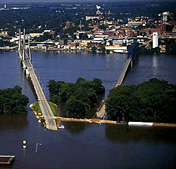
Objectives
Engineer’s Role in EM
Situational Awareness
State of our Infrastructure
Engineering – EM Link
Photo by: Unknown

Slide 3
Tools of the Engineering Profession
Critical and analytical focus
Technical subject matters
Construction/Public Works
Civil
Structural
Environmental
Other knowledge & experience
Modeling & Analysis
Heavy equipment
Contracting
Procurement
Permitting, Rules, & Regulations
Political advocate

Slide 4
Engineering in Emergency Ops
Just a few to consider….
Response
Emergency Debris Removal
Utilities
Secure critical systems
Damage Assessment
US&R – Structural integrity evaluations
Recovery
Reconstruction
Debris Management
Environmental Considerations
Mitigation
Resiliency
Redundancies
Structural improvements
Development Trends

Slide 5
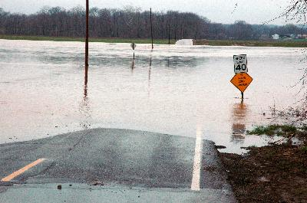
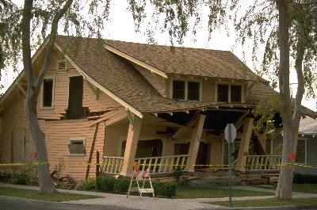
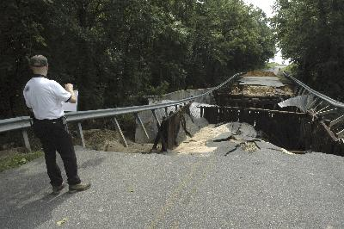
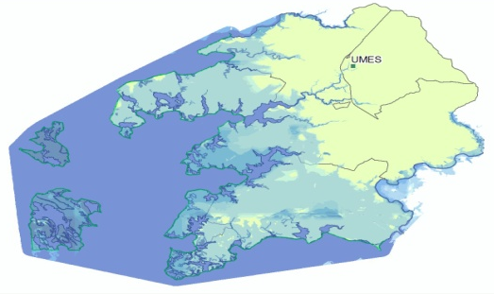
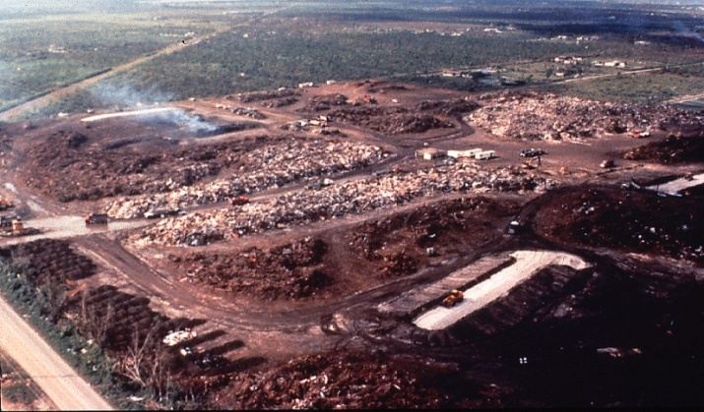
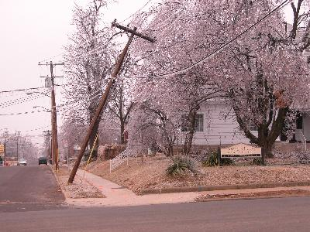
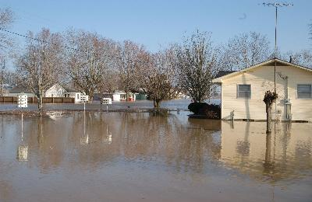
Engineers Involvement in Past Disasters
Roadway Washouts
Photo by: Michael Raphael (FEMA)
US&R Building Evaluations
Photo by: Andrea Booher (FEMA)
Building Triage
Photo by: Unknown
Photo by:
L. Skoogfors (FEMA)
Damaged Critical
Infrastructure
Photo by: Unknown
Modeling
Utility Restoration
Photo by: Michael Raphael (FEMA)
Debris Operations
Photo from: FEMA E201 Debris Operations Course
Flood Control
Photo by: John Shea (FEMA)

Slide 6
Situation
As development expands and technologies advance, infrastructures become:
Regionally, nationally, and globally interconnected,
Increasingly complex, and
Critical to our functioning society.
The Infrastructure Security Partnership, “Regional Disaster Resilience: A Guide for Developing an Action Plan”, American Society of Civil Engineers, Reston, VA, 2006.
Martin, D. “Bridging Emergency Management: A Professional Assessment of the Minneapolis Bridge Collapse and Other Infrastructure Failures”, Journal of Emergency Management, Vol. 5(6), pp 41-43.

Slide 7
Situation: Increased Vulnerability
Increasing likelihood of multiple infrastructural breakdowns that reach beyond geographical and functional borders.
Multi-hazard vulnerability
Advancing infrastructure networks
Lack of adequate maintenance
Rosenthal, U., Boin, R.A. and Comfort, L.K, ‘The Changing World of Crisis and Crisis Management’, in Rosenthal, U., Bolin, R.A. and Comfort, L.K. (Eds) Managing Crisis: Threats, Dilemmas, and Opportunities, Charles C. Thomas, Springfield, 2001; pp. 5-27.
Quarantelli, E.L., Lagadec, P. and Bolin, A., ‘ A Heuristic Approach to Future Disasters and Crisis New, Old, and In-Between Types’, in Rodriguez, H., Quarantelli, E.L. and Dynes, R. (Eds), Handbook of Disaster Research, Springer, New York, 2006; pp. 16-41.
American Society of Civil Engineers, “Report Card for America’s Infrastructure”. Available at http://www.asce.org/reportcard/2005/index.cfm. Accessed on August 10, 2007.
Martin, D. “Bridging Emergency Management: A Professional Assessment of the Minneapolis Bridge Collapse and Other Infrastructure Failures”, Journal of Emergency Management , Vol. 5(6), pp. 41-43.

Slide 8

American Society of Civil Engineers (ASCE)
Founded in 1852
Oldest national civil engineering organization
Represents 140,000+ civil engineers in private practice, government, industry, and academia
501(c)(3) nonprofit educational and professional society

Slide 9
The Status of US Infrastructure
ASCE Infrastructure Report Cards
$1.6 trillion (est.)is needed over a five-year period to improve our nation's infrastructure to an acceptable level
American Society of Civil Engineers, “Report Card for America’s Infrastructure”. Available at http://www.asce.org/reportcard/2005/index.cfm. Accessed on August 10, 2007.

Slide 10
ASCE Research Method
Studied the status of America’s infrastructure.
Determine the integrity of infrastructure networks
Method
Panel of 24 of the nation's leading civil engineer
Analyzed hundreds of studies Surveyed the engineering community
The results of these studies were ‘Report Cards’.
1988, 1998, 2001, 2005, 2009 (In Development)

Slide 11
ASCE Report Card Results
Category | 1988 | 1998 | 2001 | 2005
Aviation | B- | C- | D | D+
Bridges | C+ | C- | C | C
Dams | n/a | D | D | D
Drinking Water | B- | D | D | D-
Energy | n/a | n/a | D+ | D
Hazardous Waste | D | D- | D+ | D
Navigable Waterways | n/a | n/a | D+ | D-
Parks and Recreation | n/a | n/a | n/a | C-
Rail | n/a | n/a | n/a | C-
Roads | C+ | D- | D+ | D
Schools | n/a | F | D- | D
SECURITY **** | n/a | n/a | n/a | I
Solid Waste | C- | C- | C+ | C+
Transit | C- | C | C- | D+
Wastewater | C | D+ | D | D-
*** Security is a new classification for the ASCE report cards. It will be implemented in the 2009 report card.
American Society of Civil Engineers, “Report Card for America’s Infrastructure”. Available at http://www.asce.org/reportcard/2005/index.cfm. Accessed on August 10, 2007.

Slide 12
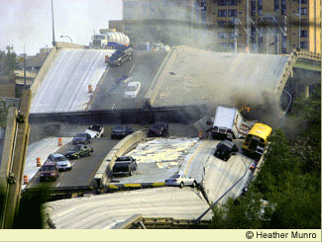
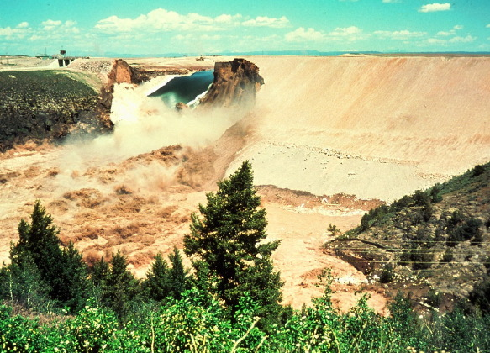
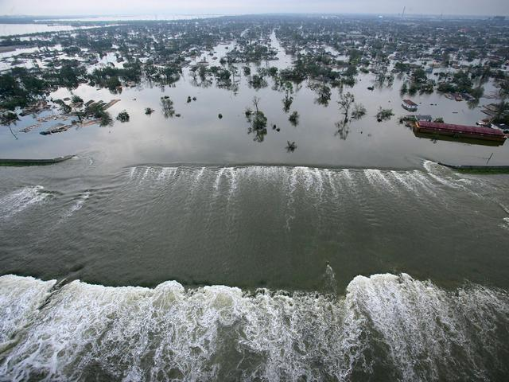

Historical Infrastructure Failures
Just to name a few…
Grand Teton Dam Failure
Minneapolis Bridge Collapse
Photo by: Eunice Olson, 5 June 1976
Hurricane Katrina – N.O. Levees
2003 NE Power Outage
Photo by: Unknown (www.takegreatpictures.com)
Photo by: Unknown (ABC News)

Slide 13
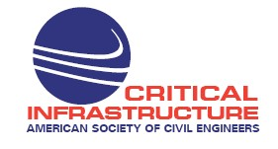
ASCE Committee for Critical Infrastructure
Vision:
ASCE is a recognized leader in incorporating sensible security into multi-hazard planning, design, preparedness, procurement, construction, operation and management, mitigation, response, and recovery of critical infrastructure

Slide 14
ASCE - Committee for Critical Infrastructure
Mission:
CCI provides insight and guidance to ASCE on its internal and external activities related to multi-hazard planning, design, preparedness, procurement, construction, operation and management, mitigation, response, and recovery for critical infrastructure, including security. CCI identifies, influences, and facilitates ASCE critical infrastructure activities.

Slide 15
Bridging the EM & Engineering Professions
ASCE CCI
Partnerships
The Infrastructure Security Partnership (TISP)
International Association of Emergency Managers (IAEM)
Red Cross
Infrastructure Champion Program
National & regional workshops
Mileti (2007)
DRRAC
DRAT

Slide 16
ASCE CCI Infrastructure Champions Program
a grassroots network of engineering leaders advocating the value of critical infrastructure assets and their resiliency.
Actions:
Promote the involvement of the engineering profession in all phases of emergency management.
Elevate awareness and educate

Slide 17
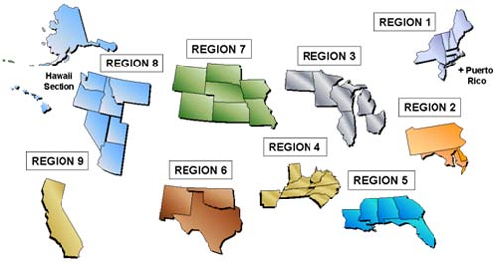
Bridging Engineering & Emergency Management Professions
ASCE National IC Regions

Slide 18
The Engineering - EM Link
Engineering is the cornerstone of proactive emergency management
Coordinated efforts to assess and report local infrastructure vulnerabilities
Increase understanding of social constructs
Increase situational awareness of our infrastructure needs
Increase professional recognition of EM
Leverage of the emergency management & engineering community to develop proactive solutions

Slide 19

Question
&
Answers
Daniel Martin, MA, CEM, CFM
North Dakota State University
Department of Anthropology, Sociology, & Emergency Management

