Slide 1
C3PR v2 Overview
Session Date: ##/##/### Session Length: ## minutes Target Audience: End Users

Slide 2
Session Details: Participants & Logistics
Introduction of Trainer(s)
Audience Introductions
Name, Role, Organization
Reason for Attending
Facility Logistics
Classroom access, restrooms, phones, etc
Notes:
If you are conducting this class in person this slide should inform participants of class room rules, restroom locations or things that help the participants feel comfortable in the environment

Slide 3
Am I in the right place? What is C3PR and who will use it?
WHAT: caBIG cancer patient trial registration tool
WHY:
Designed to standardize and automate the registration process
Coordinate multicenter trials
Single interface
WHO: For Clinical Trial Managers and Clinical Trial Patient managers and registrars
HOW (1) Requires familiarity with Clinical Trials and basic registration options.
HOW (2) Requires familiarity with web browsers
Notes:
This slide will explain why C3PR was created. Its emphasis will be operational rather than analytical, though some time may be spent explaining the enhanced research.

Slide 4
What am I going to do? How to use this presentation
You can use this presentation alone, or can switch between it and the C3PR live site to try things presented
https://sbdev1000.semanticbits.com:8031/C3PR/public/login
Login as: SYSTEM_ADMIN
Password: system_admin
Notes:
Change username and password, and possibly public site.

Slide 5
What will I learn? Session Goals
By the end of this training, you will be able to:
Set up C3PR for use
Create a trial
Create participant (patient)
Associate a patient with a trial
Deal with epochs, randomization and reservations
Notes:
Notes: Using SMART objectives Specific, Measurable, Attainable, Relevant, Testable objectives are important to the success of any training program especially ones designed for adult learners. Some of the verbs used in writing SMART objectives are:
Compute
Cover
Demonstrate
Describe
Determine
Distinguish
Enter
Establish
Explain
List
Locate
Practice
Prepare
Present
Provide
Show
Use
Locate
Practice
Prepare

Slide 6
Session Details: Lesson Plan
Lesson 1: Pre-use requirements and setup types
Lesson 2: Basic navigation
Lesson 3: Creating Trials
Lesson 5: Adding patients
Lesson 6: Associating patients with trials
Lesson 7: Things you may not have seen before
Notes:
In pre-use, mention must be made of variations in setup, that is, in some instances trials will be imported automatically, in others they will not.

Slide 7
Lesson 1: Pre-use requirements and setup types
Who sets up C3PR
Local versus hosted
Possible setups (imported versus entry)
What needs to be setup before you can us it?
Notes:
More content dependent upon final configuration options.

Slide 8
Lesson 1 Review & Questions
What is the level of support at your center?
What CTMS are you using?
Notes:
Resources available for which setup option may or may not be recognized by the end users.

Slide 9
Lesson 2: Basic navigation
Layout
Search options
Button searches
Google type searches
Tabs, and directed tabs
Required field designations
Save, save and continue, continue
Notes:
More content dependent upon final configuration options. Add screenshots
This first screenshot is the basic/beginning layout for C3PR. There are the different task categories at the top and the search shows how to search for studies as studies is in white at the top.

Slide 10
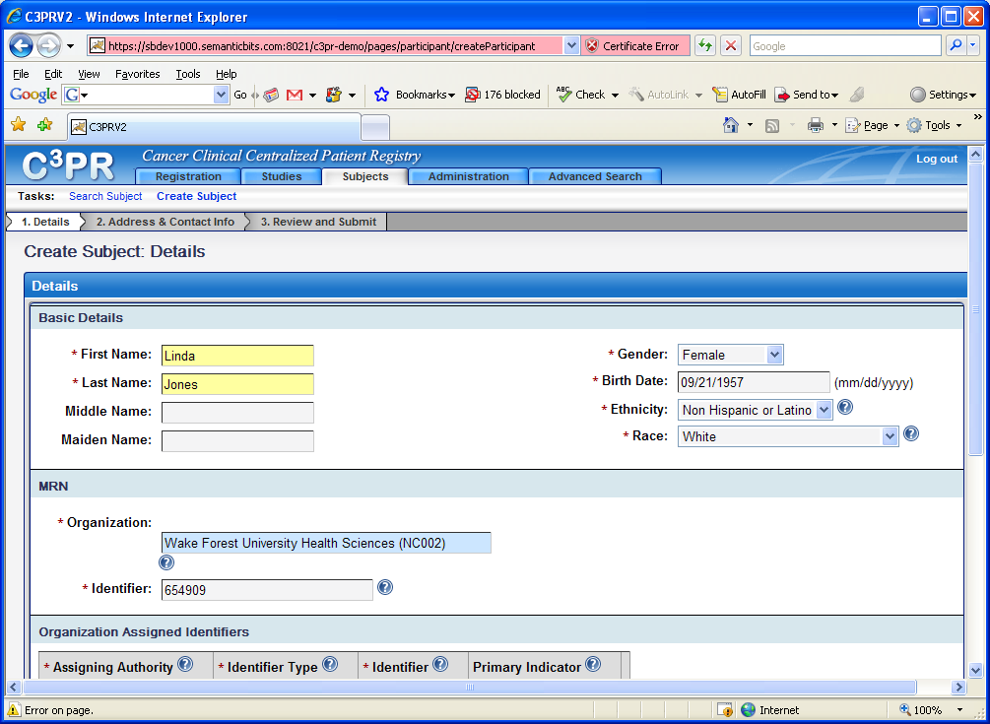
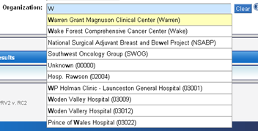
Basic Navigation: Button and google search
Notes:
This screen shot shows the *required fields, the blue google search and also shows the ? which provides instructions.

Slide 11
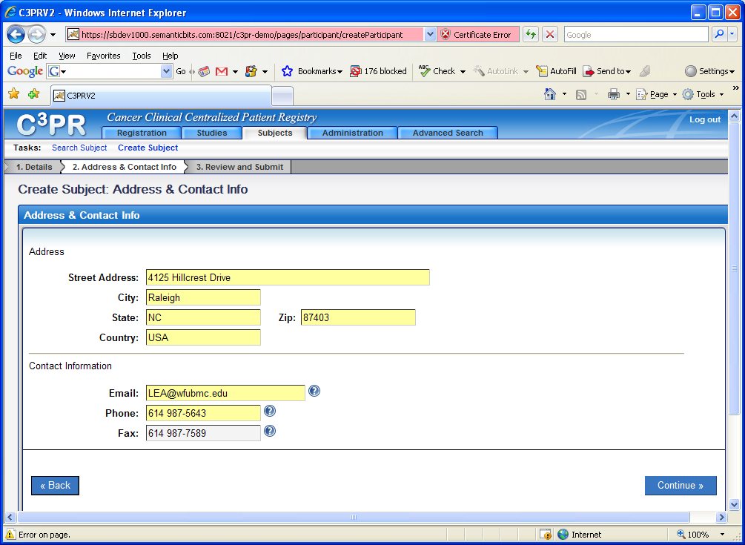
Basic Navigation: Tabs and Directed Tabs
Notes:
This shows the continue and back buttons.

Slide 12
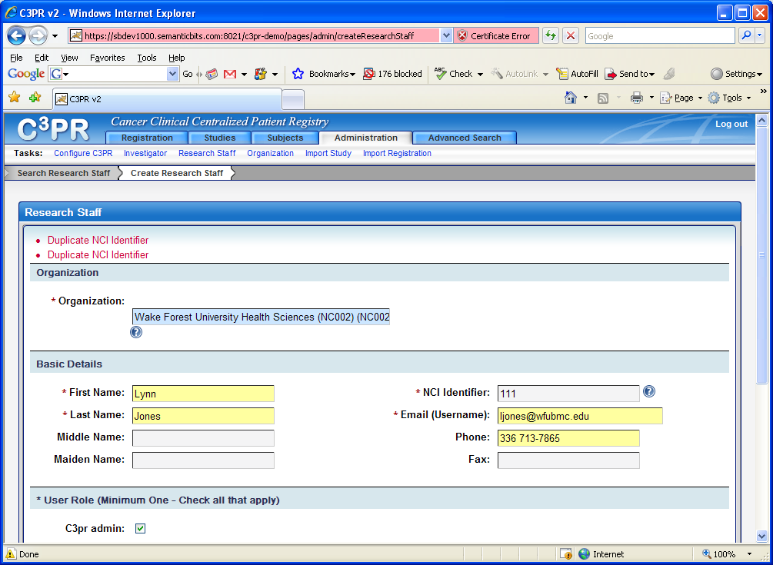
Basic Navigation: Problem message
Notes:
This is an example of a problem message noted in the basic details. Does not allow to save until this is corrected.

Slide 13
Lesson 2 Review & Questions
How do you know what button to press, and when to wait
Browser behavior
Notes:
Depending how different the browser is in IE or Firefox this may need to ask users what they are using… if they would actually knew

Slide 14
Lesson 3: Creating Trials
Who should do this?
Create or import
Key fields that drive reports and rules.
Multicenter trials
Coordinating center versus affiliate
Notes:
It is important that this be clearly defined, ie, who defines trials and what the institutional practice is
Clinical Trials Managers should create trials.
The first screen shot shows the lay out when creating a study. Note that studies at the top is in white. Then a selection is made to either search for a study or create a study which is a task selection. Be sure that investigators and research staff have been defined before you start!

Slide 15
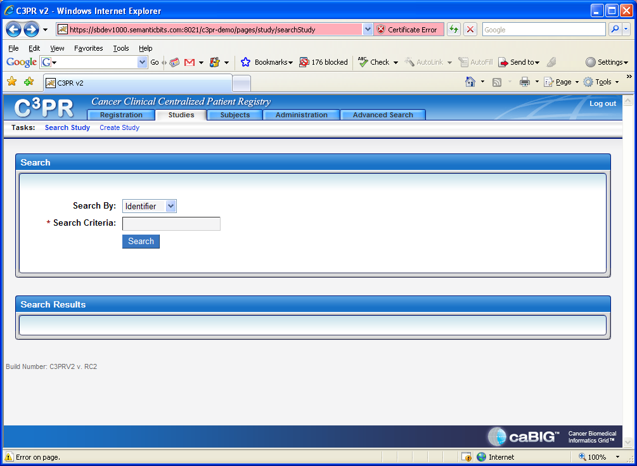
Creating Trials
Notes:
This shows that studies on the top has been selected. The next step is to select create study under tasks.

Slide 16
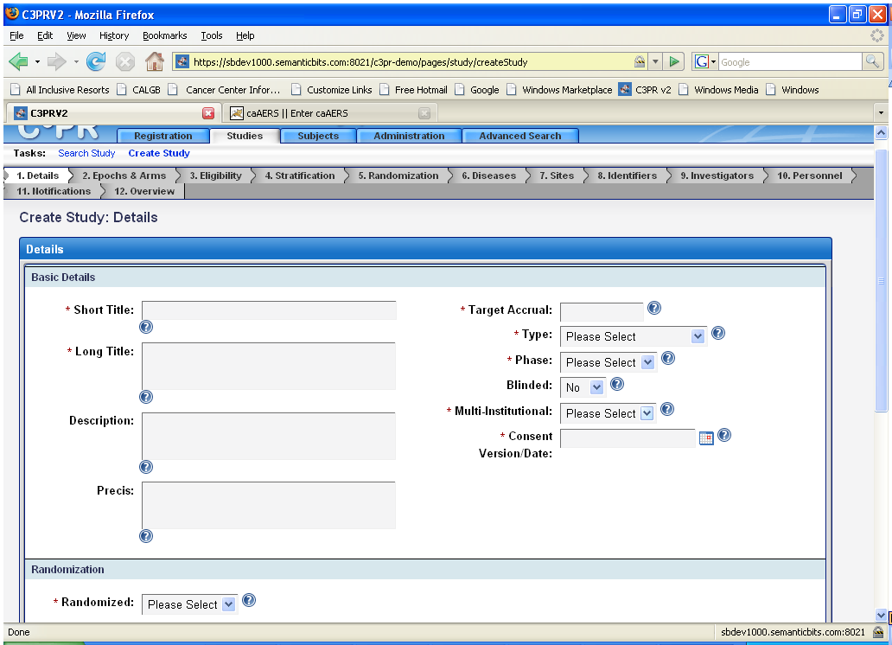
Create Study Details
Notes:
Note required fields, inline help, dropdown boxes and directed tabs

Slide 17
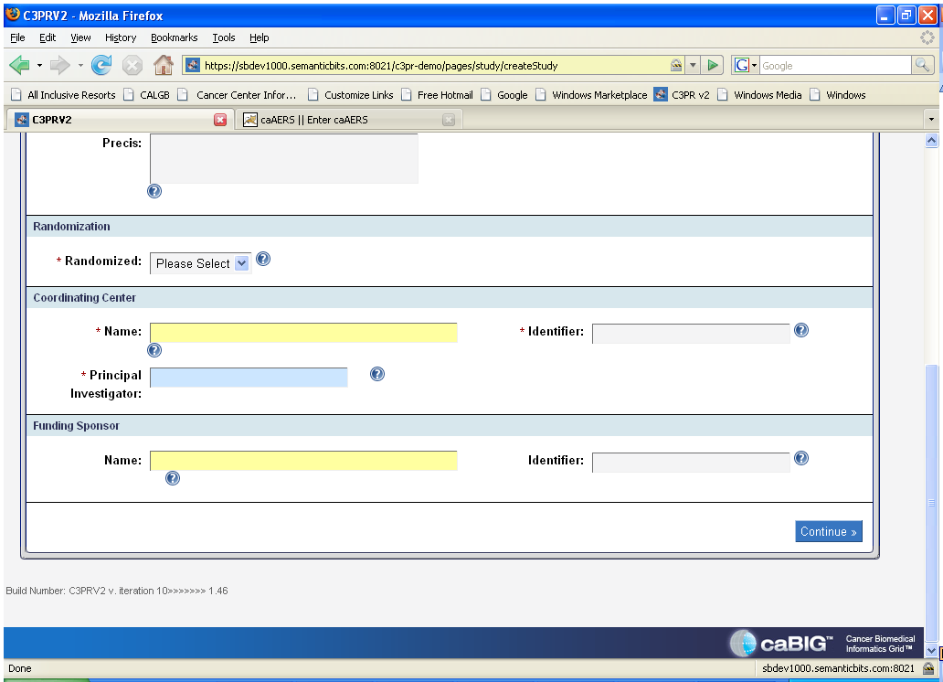
Create Study Details continued

Slide 18
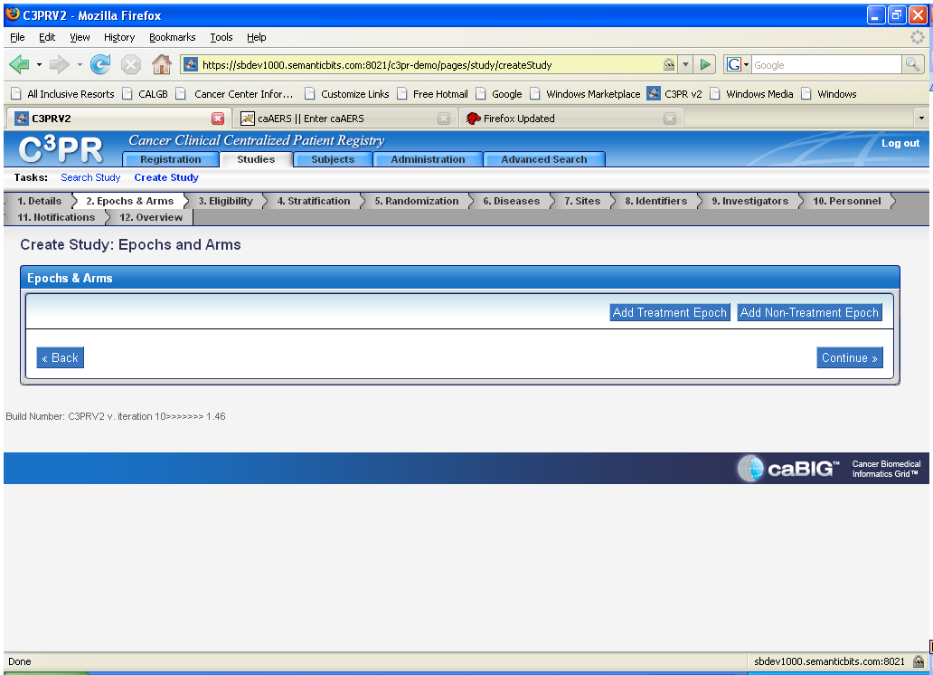
Create Study Epochs and Arms
Notes:
Note add epoch buttons. Spend some time explaining epochs, and the need to have at least one

Slide 19
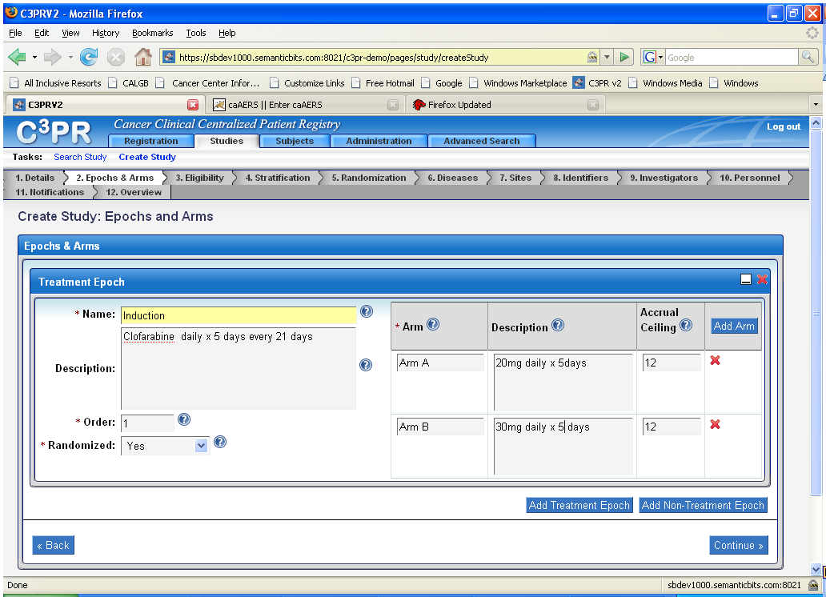
Create Study: Epochs and Arms
Notes:
Explain red x’s

Slide 20
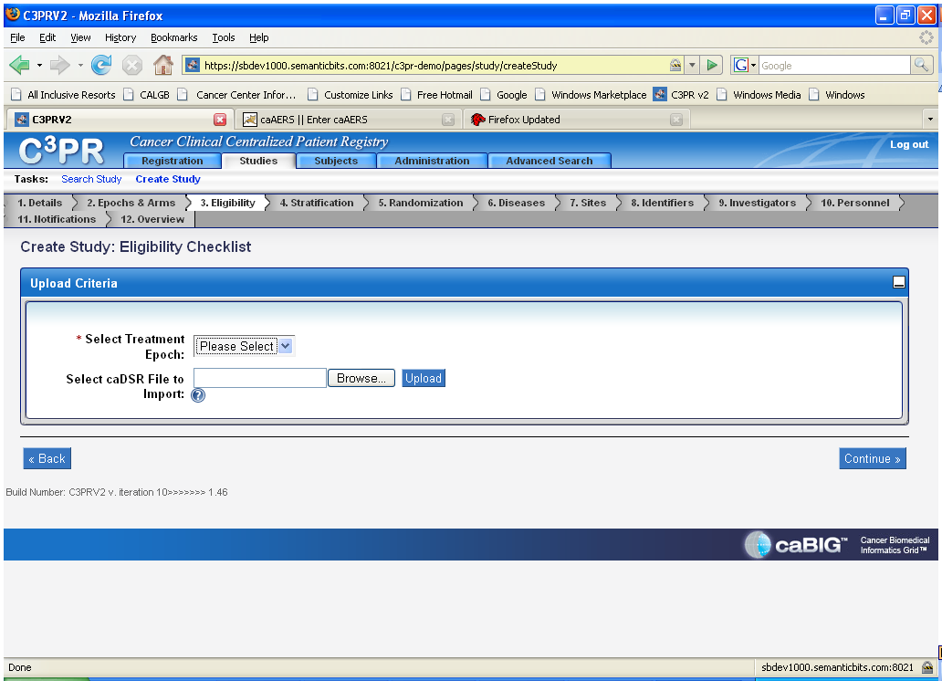
Create Eligibility Checklist
Notes:
Note that eligibility is for treatment epochs, not just registration?

Slide 21
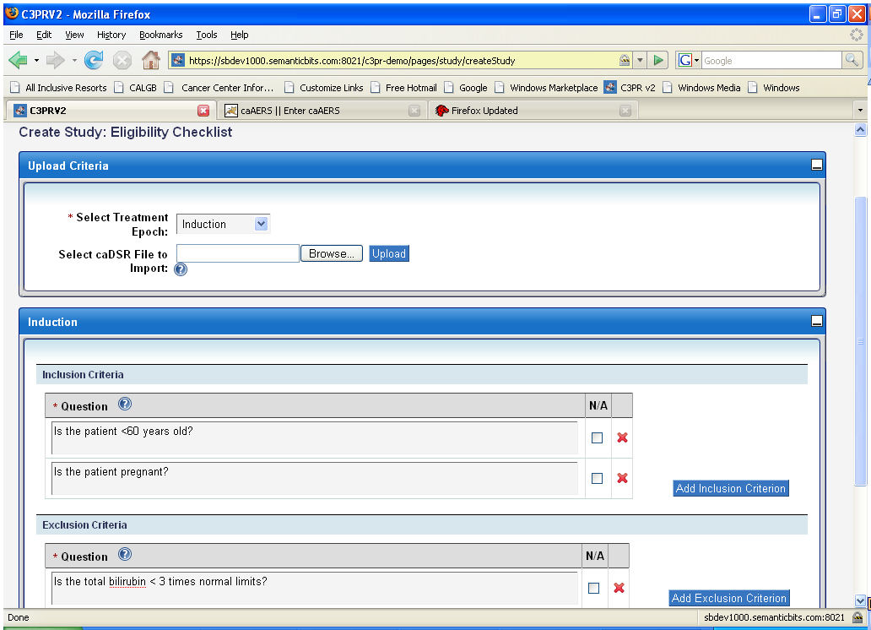
Create Eligibility Checklist Continued
Notes:
Explain that inclusion is always answered yes, exlcusion always no, or the patient is not eligible, explain that NA allows the user to say NA (pregnant for a male?)

Slide 22
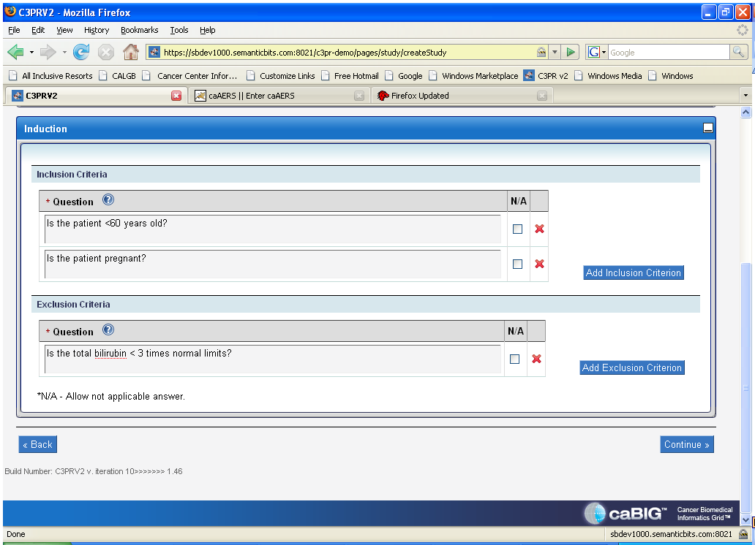
Create Eligibility Checklist Continued

Slide 23
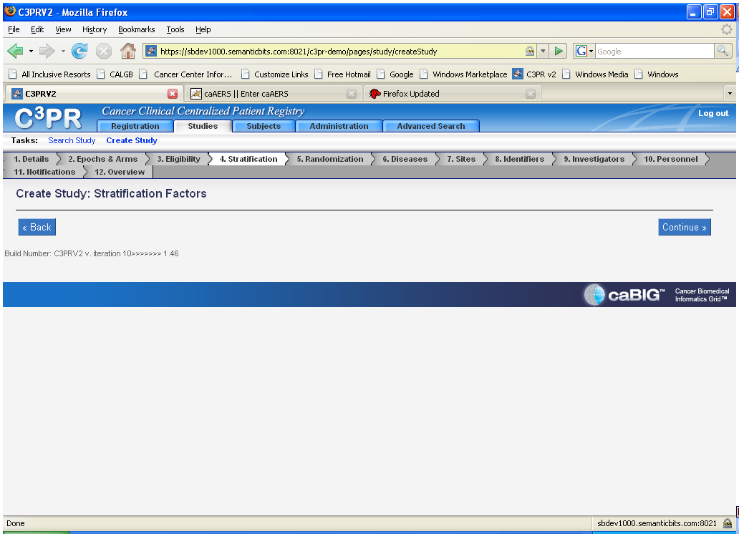
Create Stratification Factors
Notes:
Not required

Slide 24
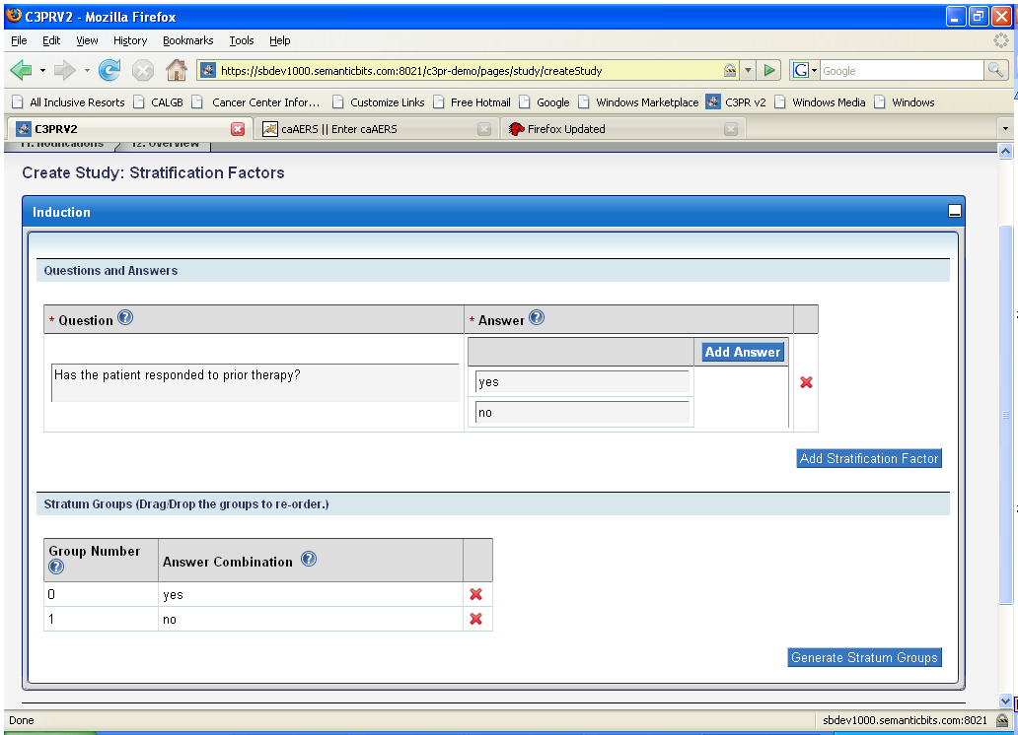
Create Stratification Factors
Notes:
Not that the strata are automatically created from the questions.

Slide 25
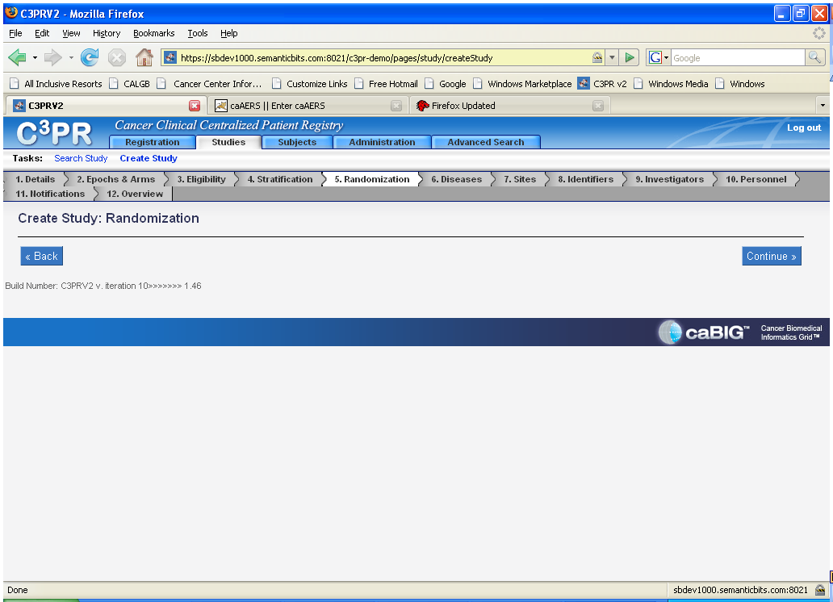
Set up Randomization if needed
Notes:
Discuss the different kinds of randomization.

Slide 26
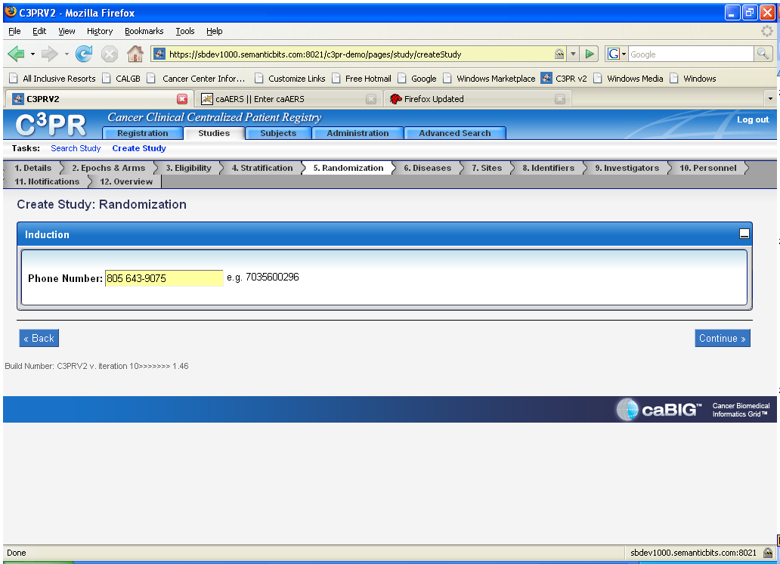
Example: Phone Randomization
Notes:
This example is phone call out.

Slide 27
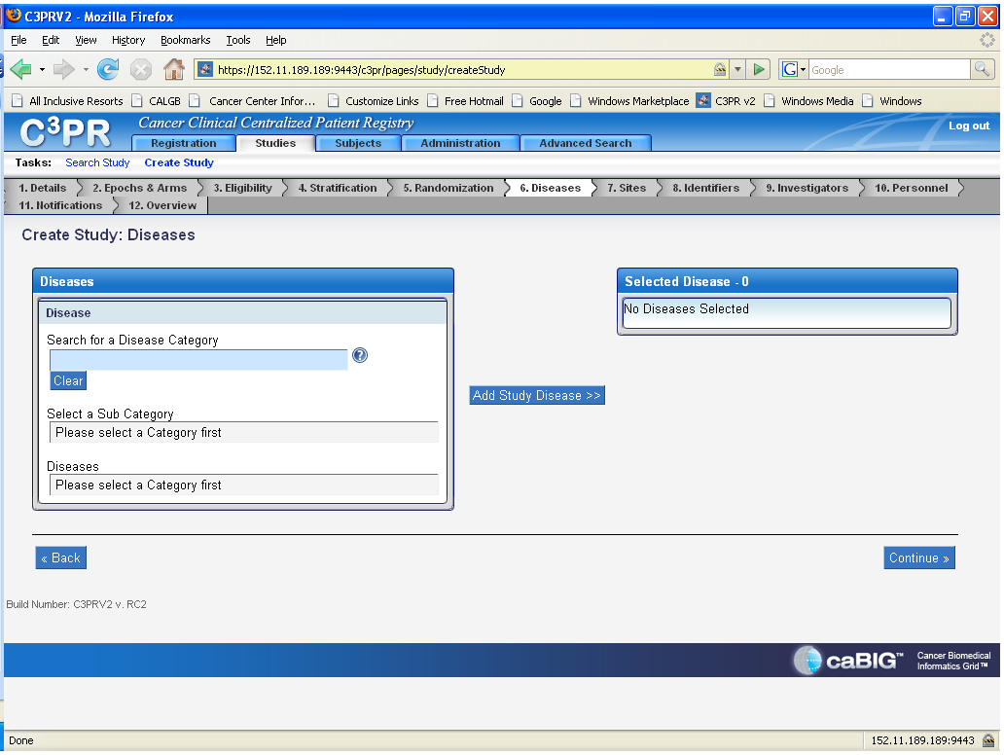
Associate diseases with study
Notes:
To select a disease, begin typing in the disease catagory such as leukemia. A search will start.

Slide 28
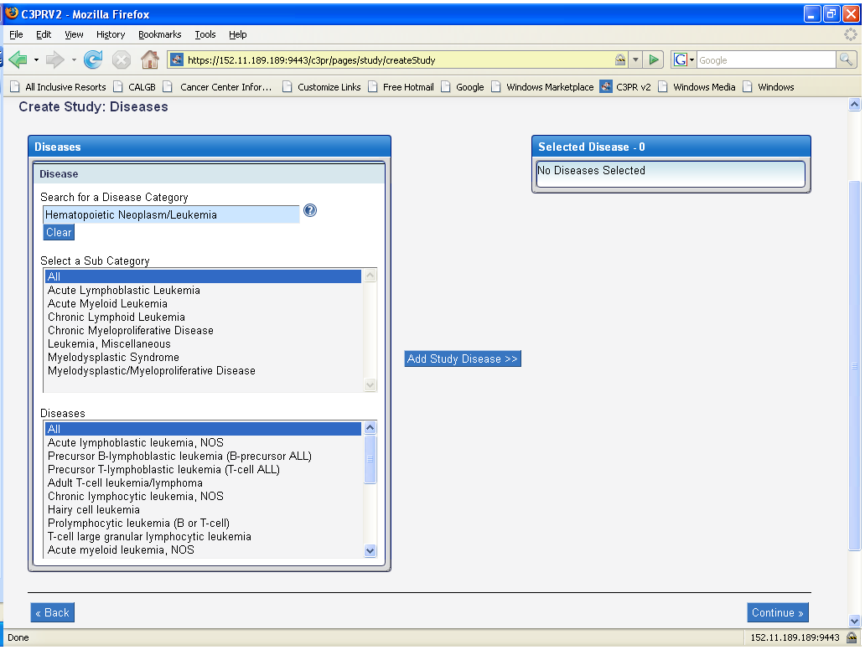
Associate diseases with study
Notes:
Once the disease category is selected, then you must select a sub category and diseases or can select all.

Slide 29
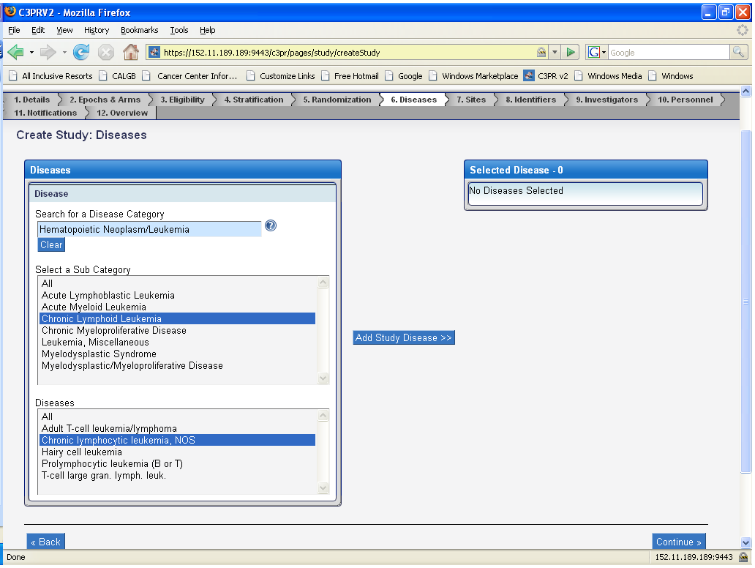
Create Study: Diseases continued
Notes:
As shown in this screenshot, the sub category of CLL and the disease of CLL was chosen. You then click on “Add Study Diseases”.

Slide 30
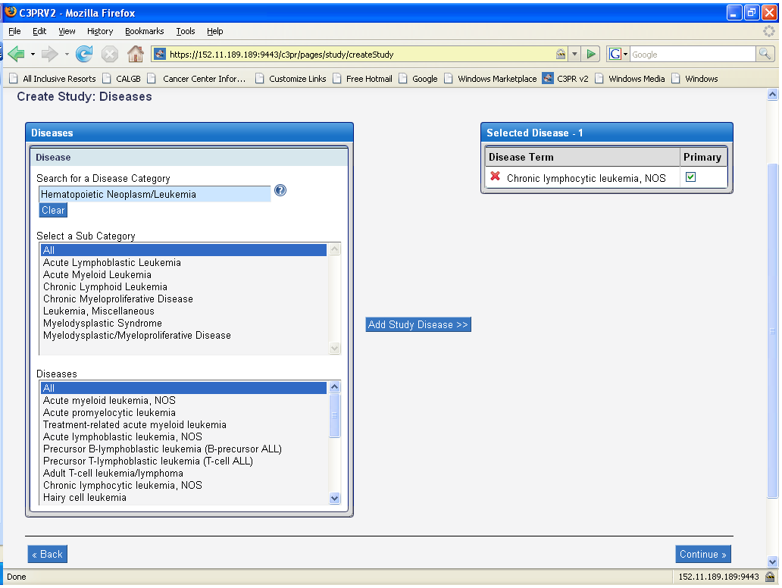
Create Study: Diseases continued
Notes:
Once the sub category and the disease was chosen, you click on the add study disease tab and then the selected disease box in the right hand corner has the disease term entered. You then select if it is primary.

Slide 31
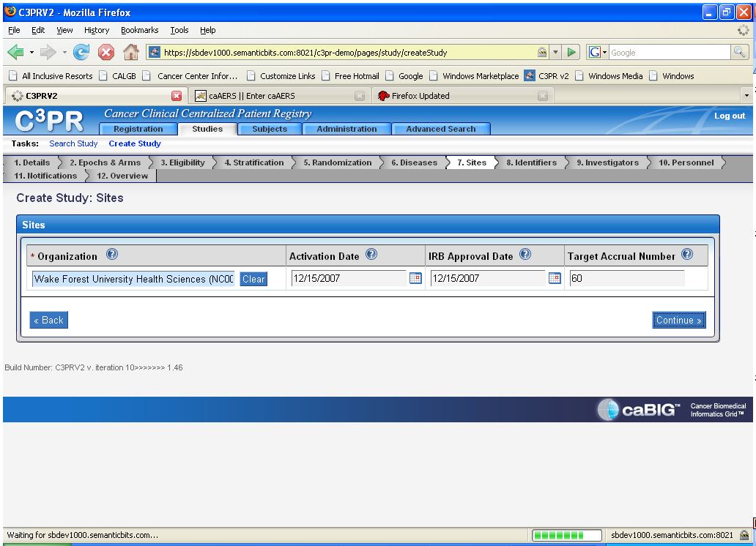
Study Sites
Notes:
Note that the Activation Date is the date when a site begins participation in a study.
The IRB Approval Date is the date the institutional review board or research ethics board authorized approval or re-approval of the study protocol.
The target accrual number is the total number of patients/subjects/participants needed for the protocol at this site.

Slide 32
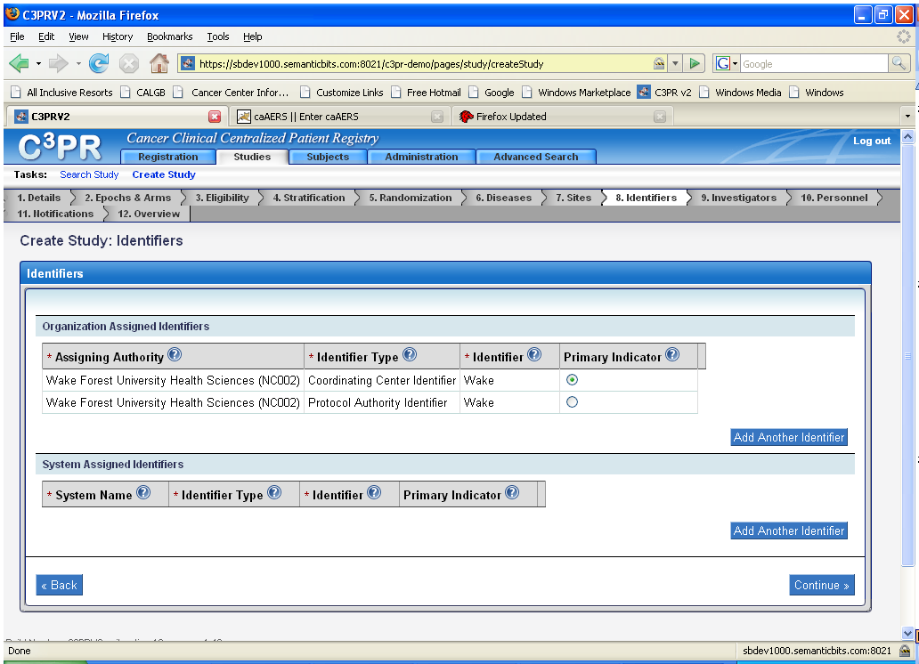
Study Identifiers
Notes:
Make sure that users understand what an identifier is, and what a primary indicator is.

Slide 33
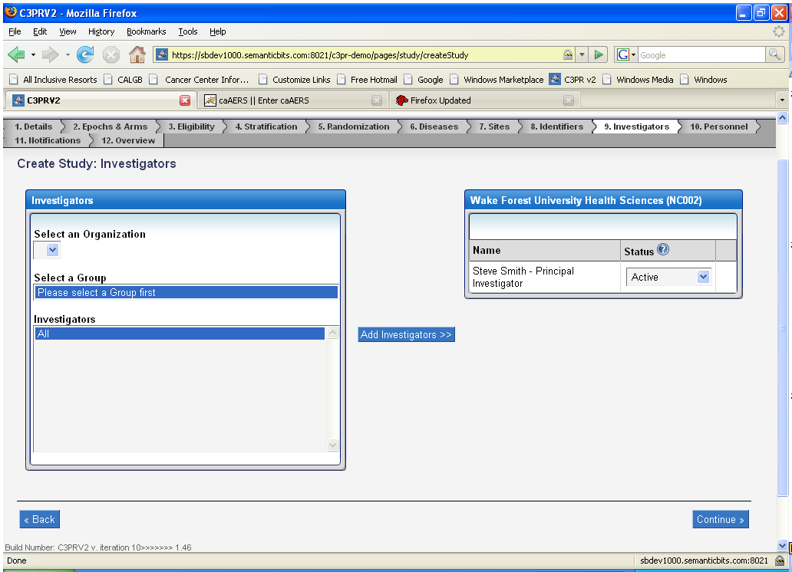
Study Investigators
Notes:
Point out that a investigator has to be created up front. Very important, if you get to this point without having created an investigator, all your work is lost!
You can only add investigators specific to the site

Slide 34
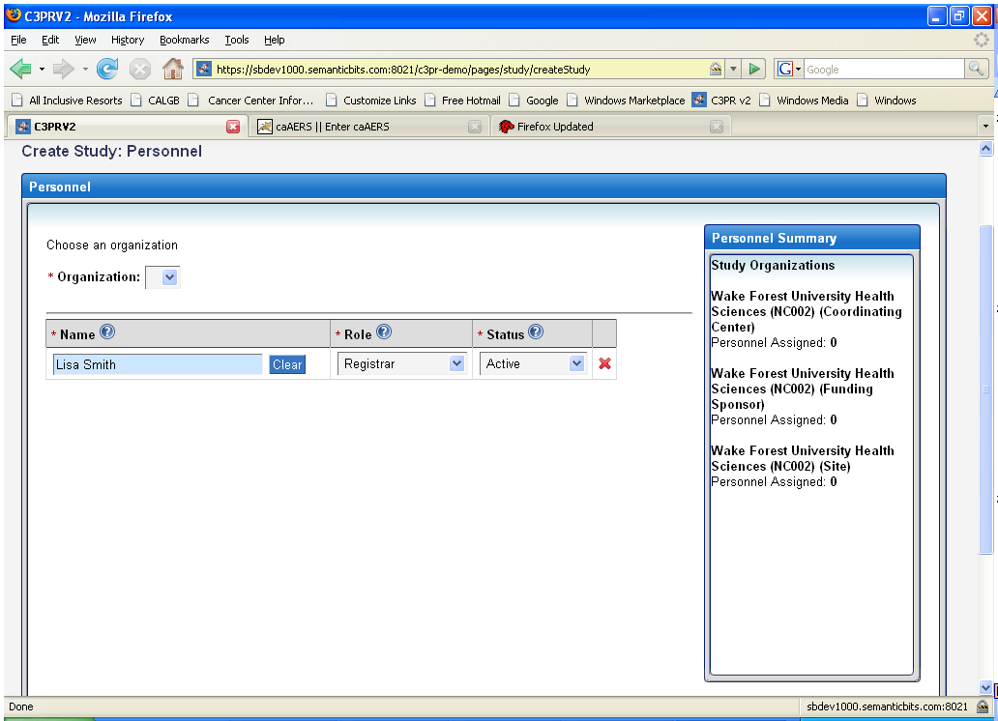
Study Personnel
Notes:
Same warning about adding first and site specificity as investigators

Slide 35
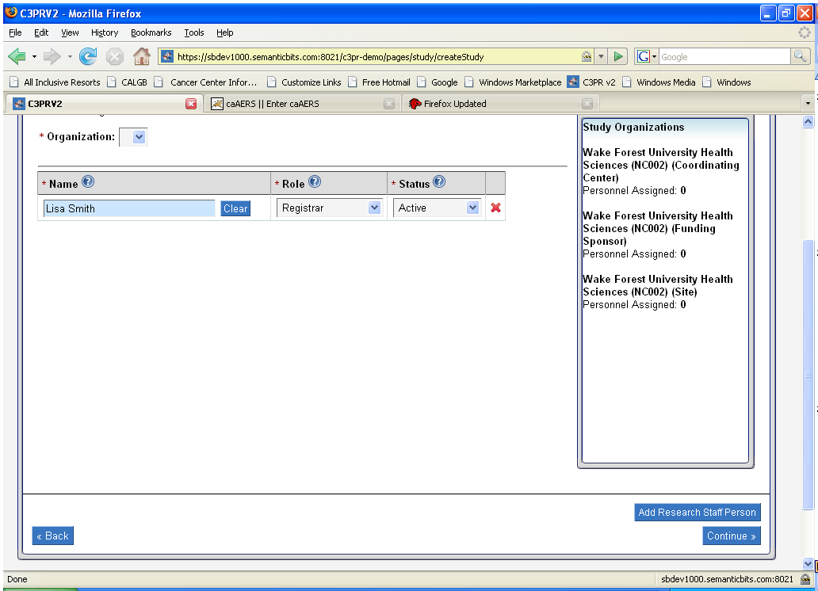
CREATE STUDY/Personnel continued
Notes:
This screenshot shows that there is a way to add research staff, button on the bottome right corner.

Slide 36
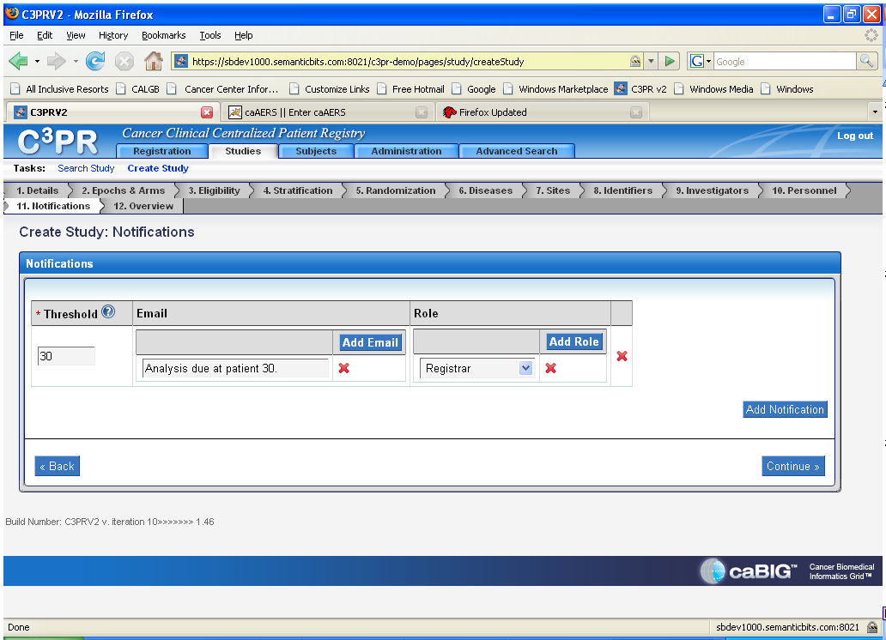
Study Notifications
Notes:
Threshold means the portion of accrual to be met for notification of accrual to a study.

Slide 37
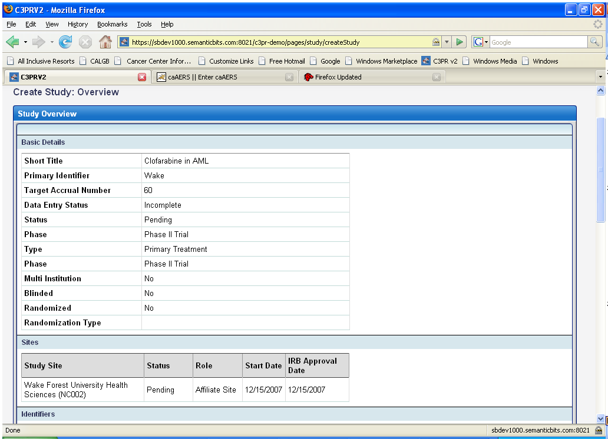
Create Study:Overview
Notes:
This is the end, but you are not done….

Slide 38
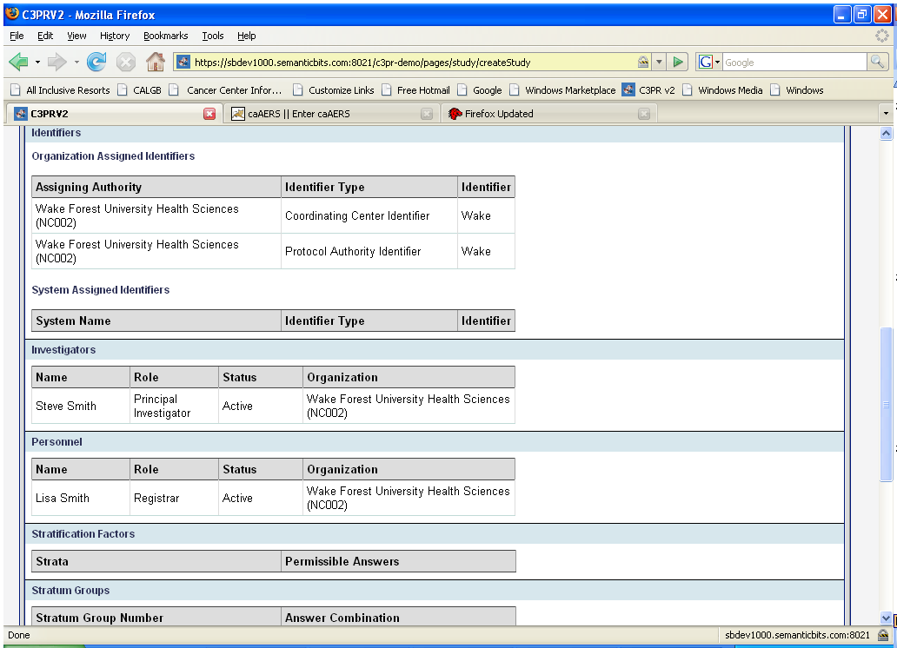
Create Study:Overview continued

Slide 39
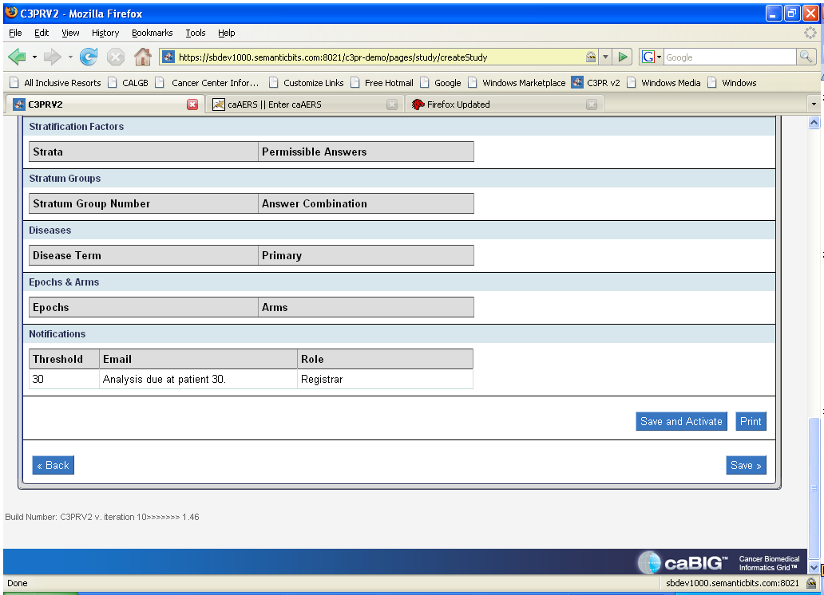
Create Study:Overview continued
Notes:
Once you scroll to the bottom, and click save or you can click on save and activate. You can save it with missing data, and then come back and edit and activate the trial

Slide 40
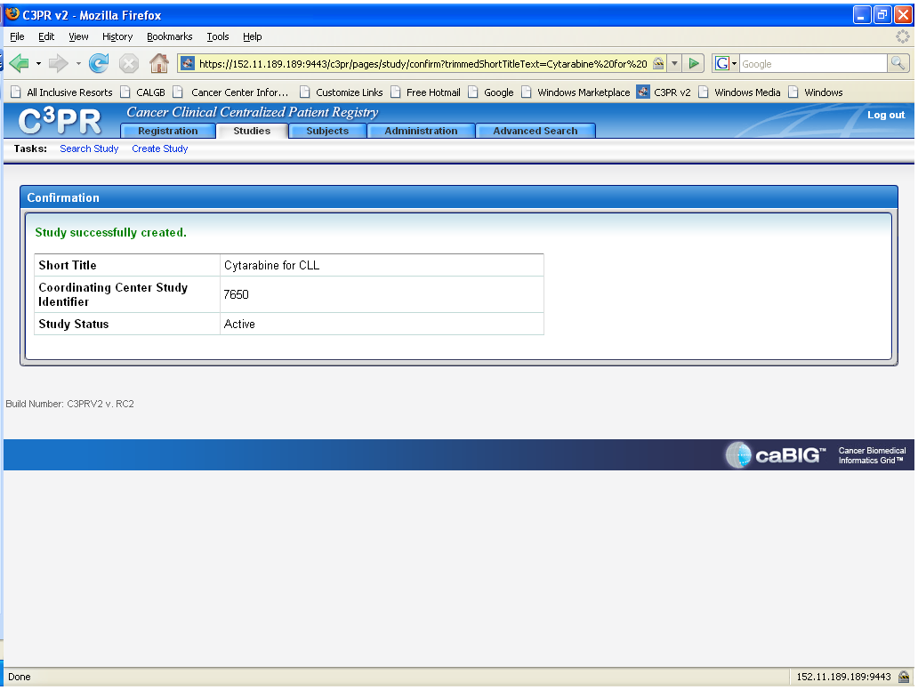
Create Study: Confirmation
Notes:
Save and activate was chosen and now a confirmation is shown.

Slide 41
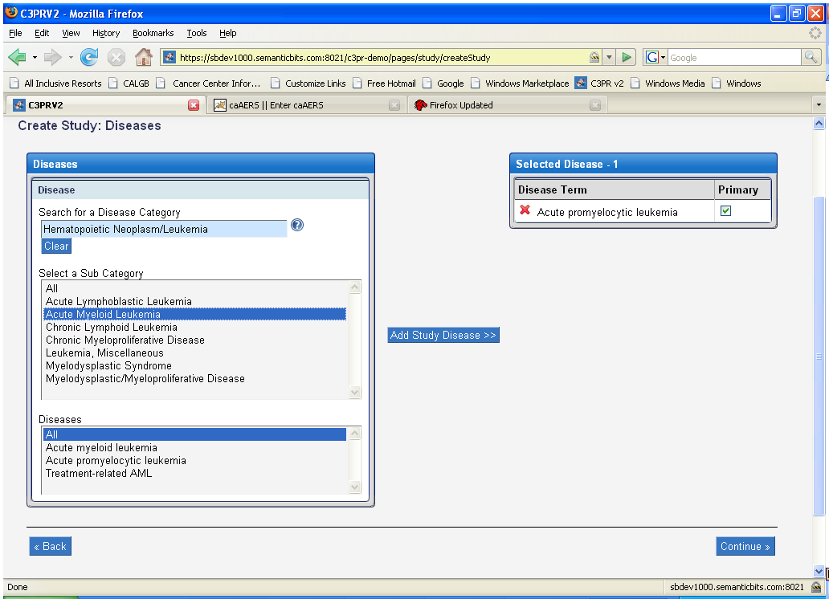
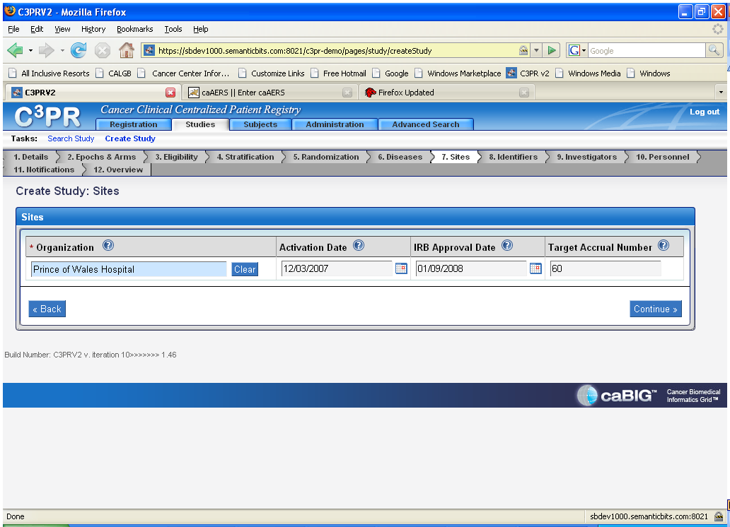
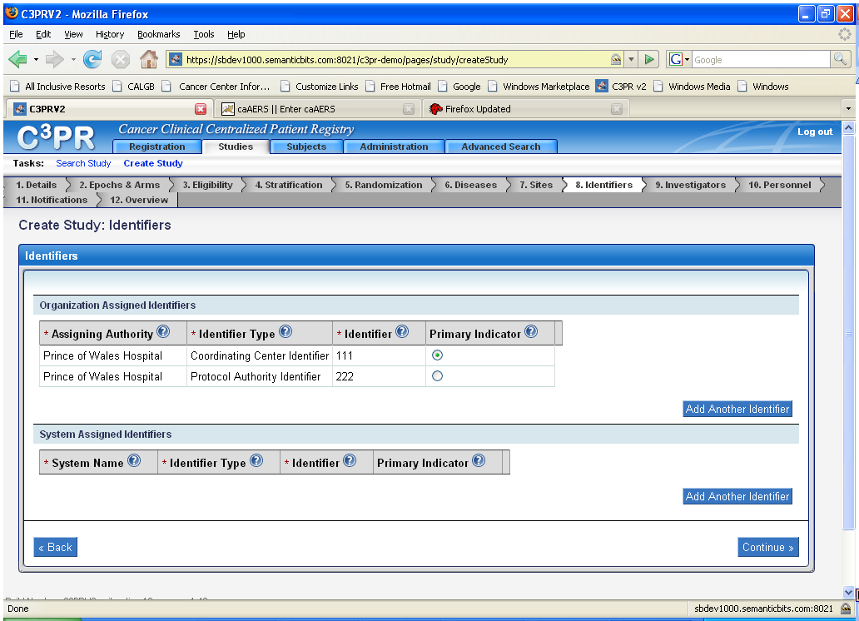
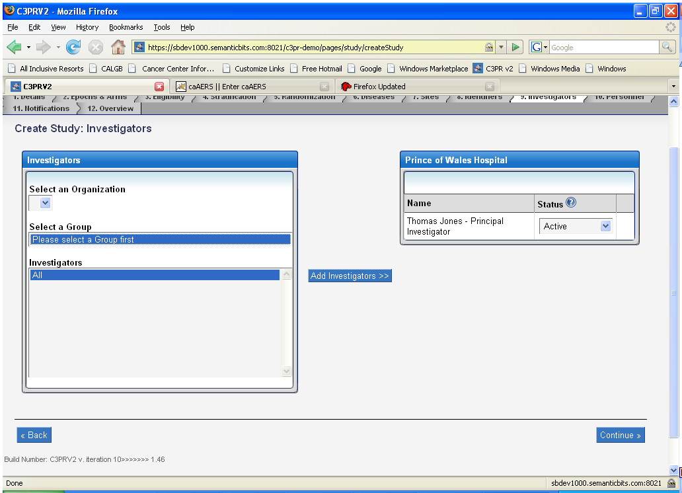
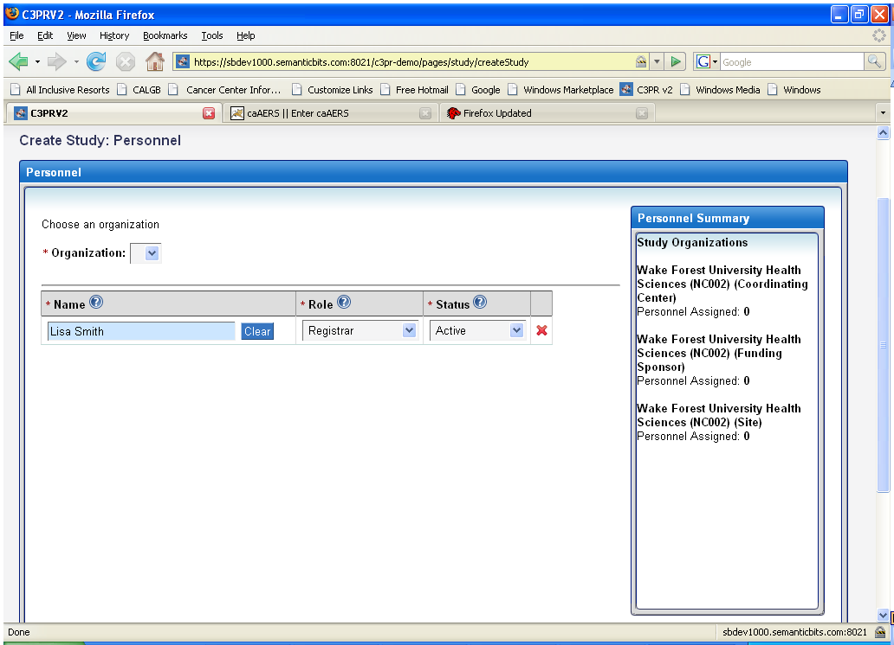
Lesson 4 Review & Questions
How much detail is needed?
Which trials?
Notes:
How older trials and trials not controlled by the center are handled needs to be reviewed

Slide 42
Lesson 5: Adding patients
Who should do this?
Create at time of registration or before?
Notes:
More content dependent upon final configuration options. Multiple screenshots should be inserted based on the final version.
Adding patients can be done by the registrar, C3PR administrator, site coordinator and registrar. -
The decision to create a patient before or at the time of registration is probably related to time management. By creating a patient prior to registration, you will complete much of the work associated with registration as shown in the next screen shot. It will simplify the registration process. It also makes the process of registering patients to multiple trials easier as the basic patient information has been entered and is used for all trials. It is then just a matter of assigning the patient to different trials.

Slide 43
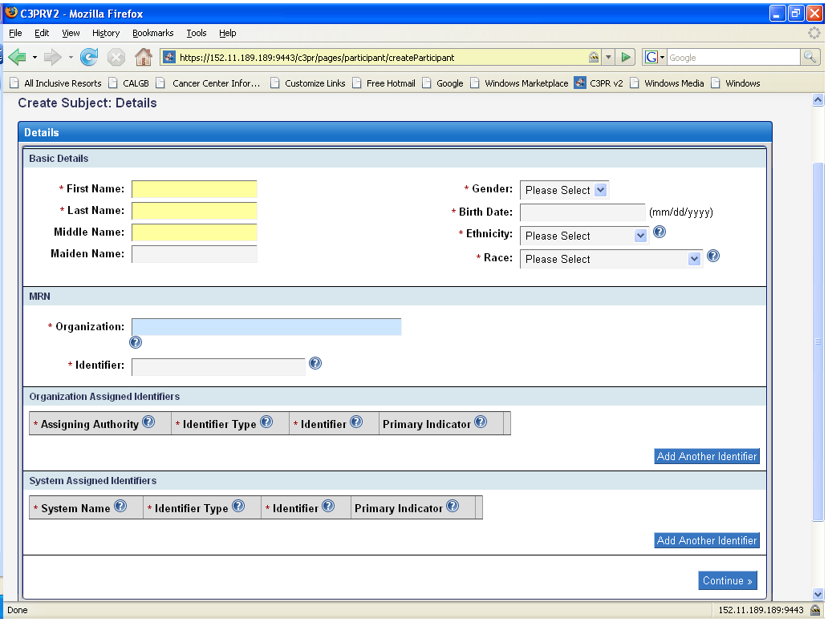
Create Subject
Notes:
Note the different terminology, patients, subjects, participants.

Slide 44
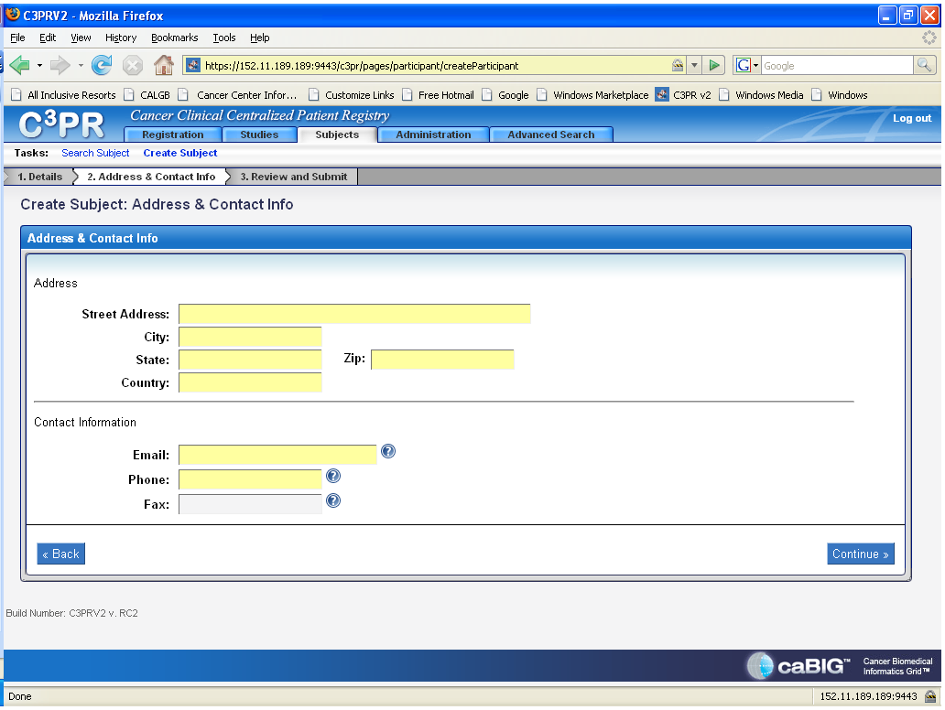
Create Subject: Continued
Notes:
As stated earlier, by completing this before the patient is registered, it can save some time since there is quite of bit of information to enter.
Once you complete all of the fields, click on continue and a subject overview will be created.

Slide 45
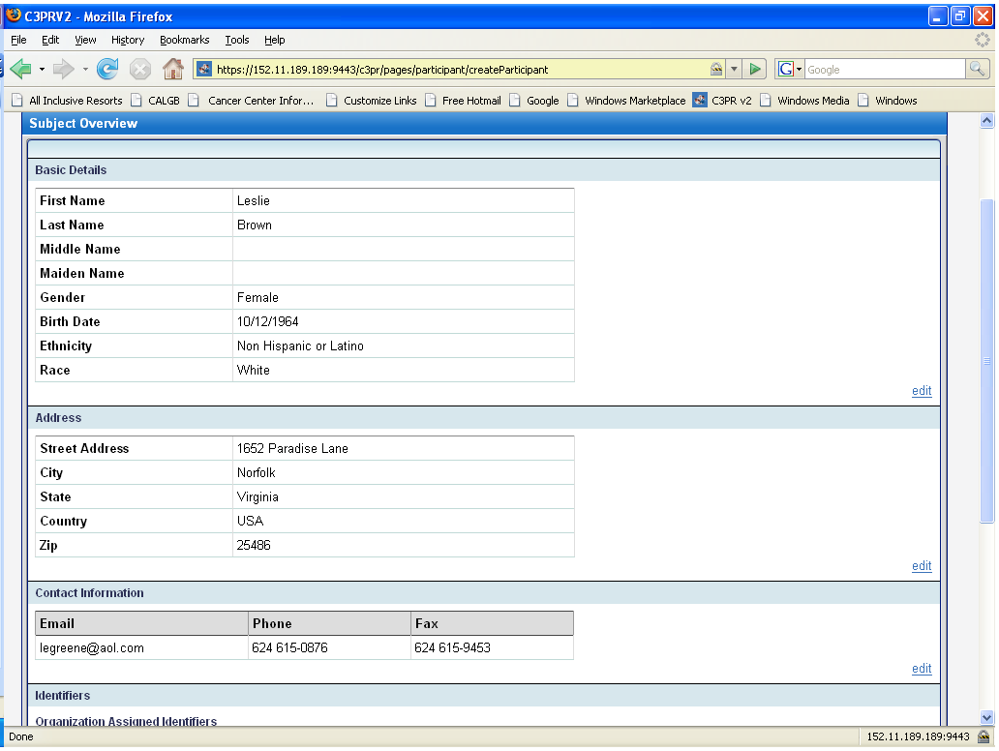
Create Subject: Review and Submit

Slide 46
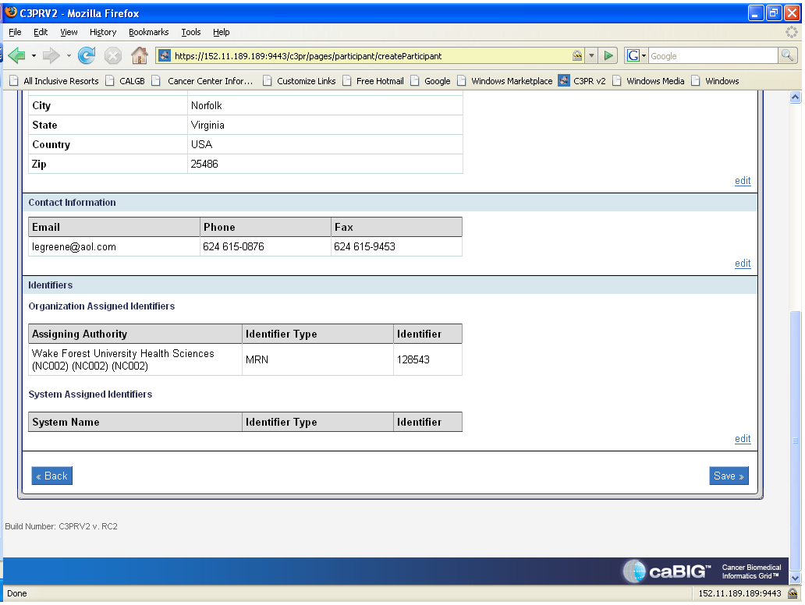
Create Subject: Review and Submit continued
Notes:
This is the bottom portion of the page. Once reviewed for accuracy, then click on the save button at the bottom. Note that there is an edit button to make changes/ corrections if needed before continuing.

Slide 47
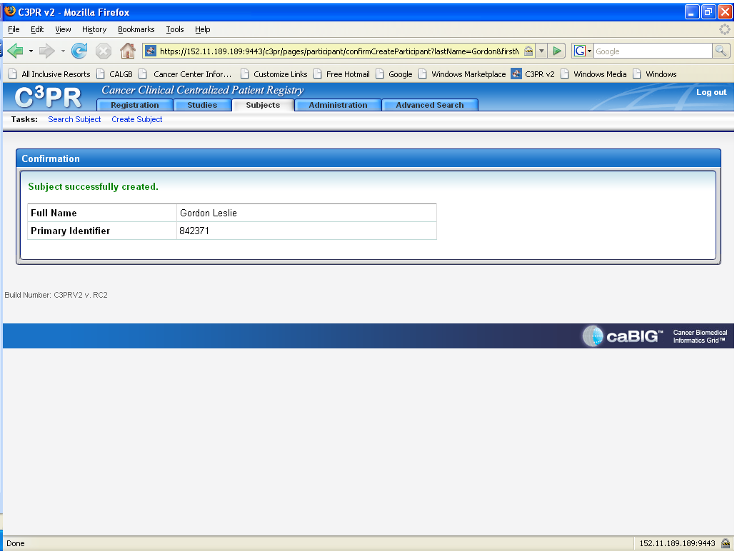
Create Subject: Confirmation
Notes:
This just shows that a subject has successfully been created. I would suggest printing this out in order to make the search for subjects easier.

Slide 48
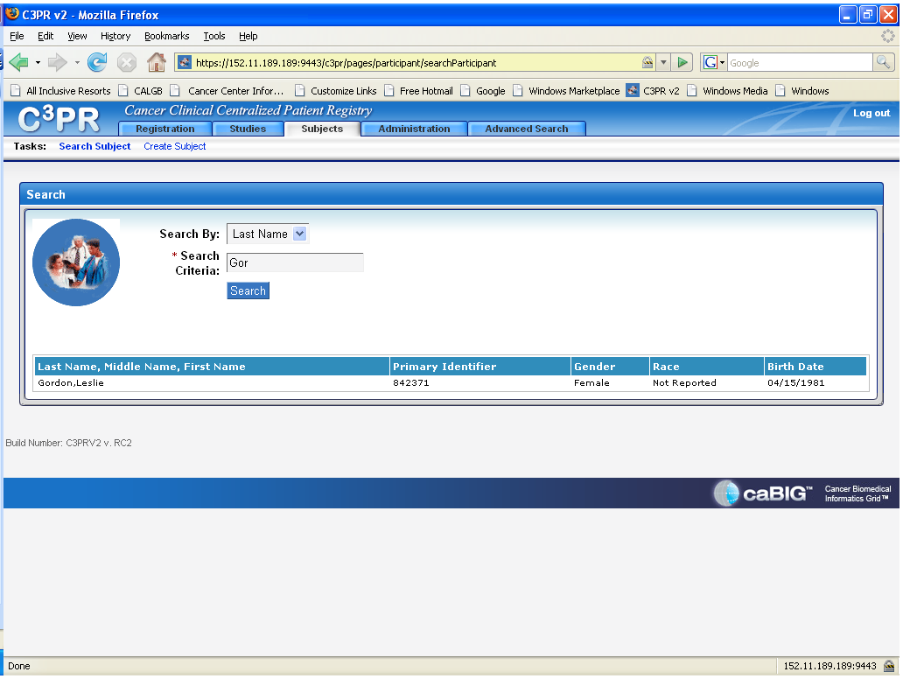
Search for a Subject
Notes:
As seen above, when selecting subjects, you have a choice to search for a subject or create a subject. If you are absolutely sure the subject has never been created in c3PR, you can start the create subject. However, if you are not certain if the subject has ever been created in c3PR for any trial, you would want to do a search first.
You can start the search by selecting to search by either last name, first name, or identifier. Last name was chosen above. As seen, only 3 letters of the last name were entered and the subject appeared. In order to review the subject summary, click on the selected subject’s name.

Slide 49
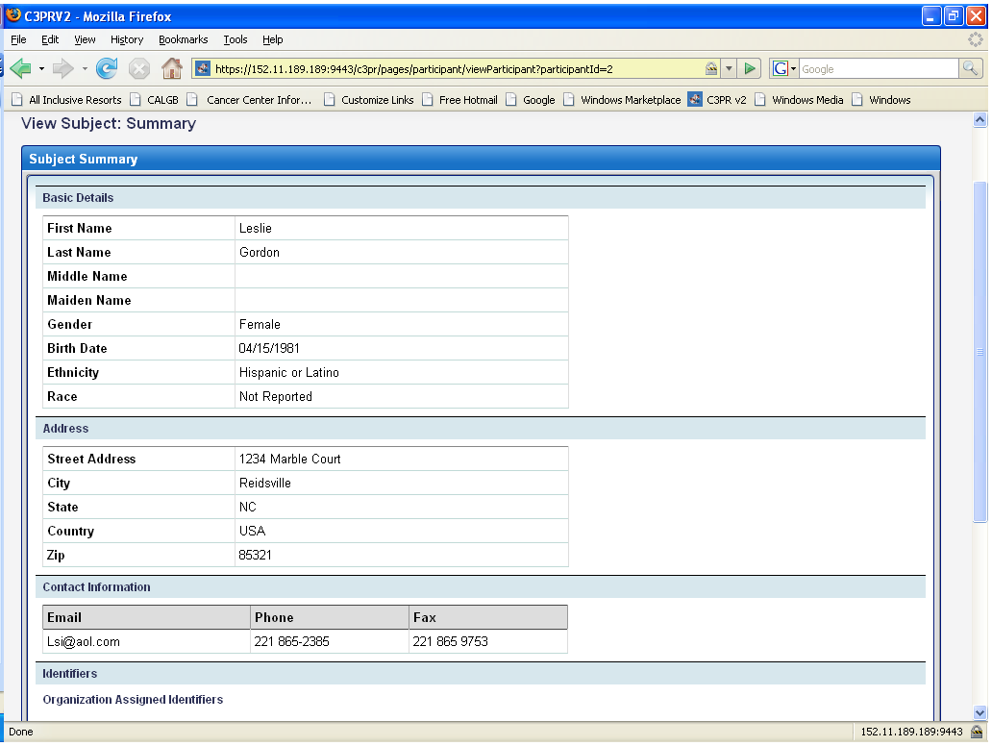
Search Subject: View Subject Summary

Slide 50
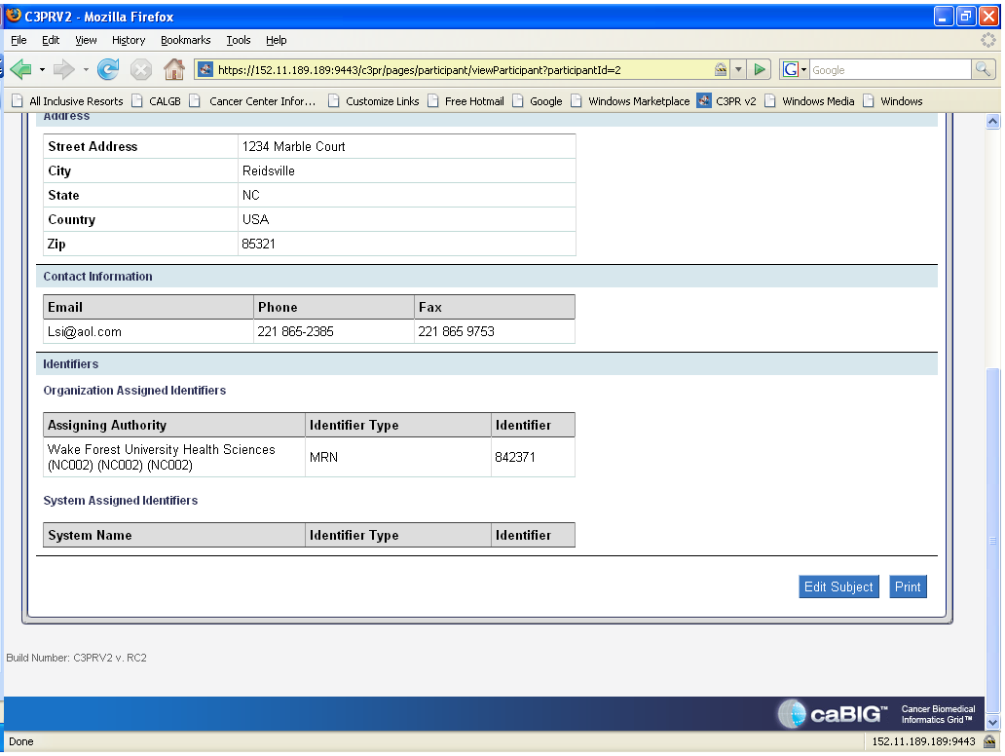
Search Subject: View Subject Summary continued
Notes:
This is bottom portion of the subject summary page. Note at the bottom that you can edit this information or print.

Slide 51
Lesson 6: Associating Subjects with Study
Who should do this?
Why this is a separate workflow?
Notes:
Changes in the interface and workflow may make it possible to combing lesson 6 and 7
Associating patient with trials can be done by the registrar, c3PR administrator, and site coordinator.
Associating patients with trials has two purposes. One is to register a patient to a trial and the other is to identify which trials the patient is already registered to.

Slide 52
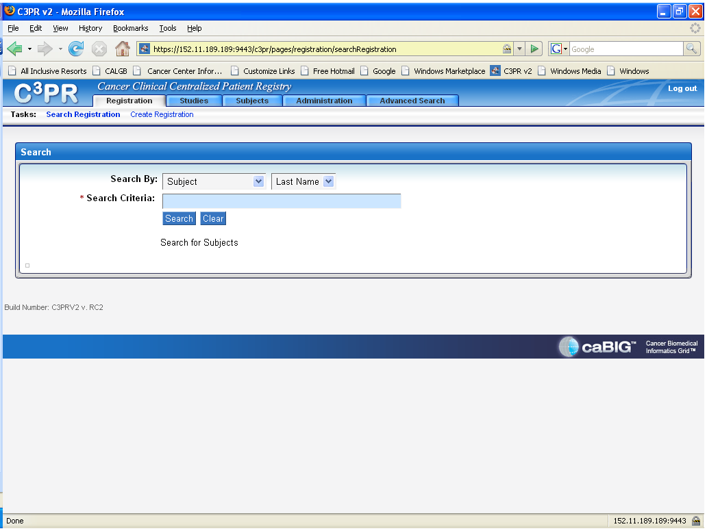
Associating Subjects with Study Search or Create
Notes:
There are two options under registrations. One is to search for a registration which associates patients with trials and the other is to create a registration which creates an association with a trial/trials. As seen above, if registrations is chosen, then the search task is created. Click on create registration to start a new registration.

Slide 53
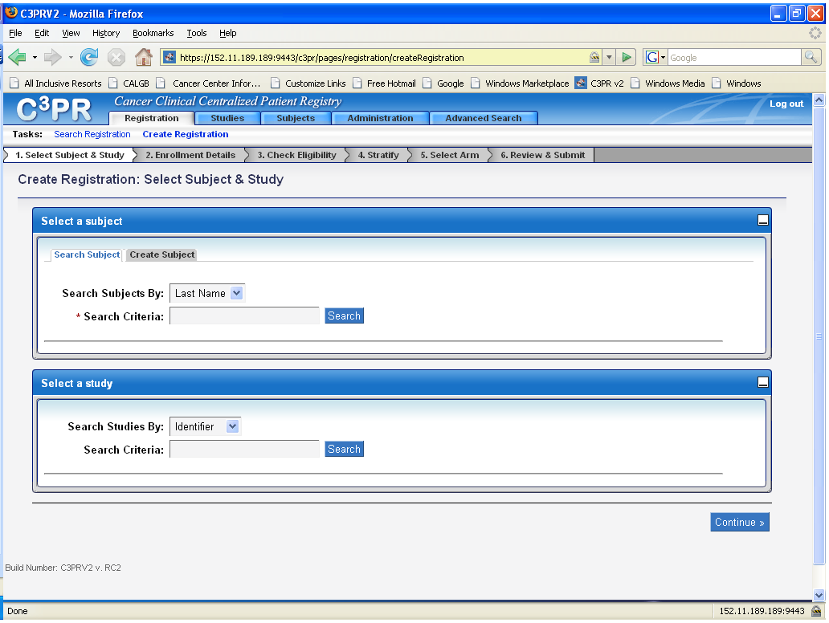
Create Registration
Notes:
As seen above, you create the registration by selecting the subject by last name, first name or identifier and select the study by identifier, short title, or status.

Slide 54
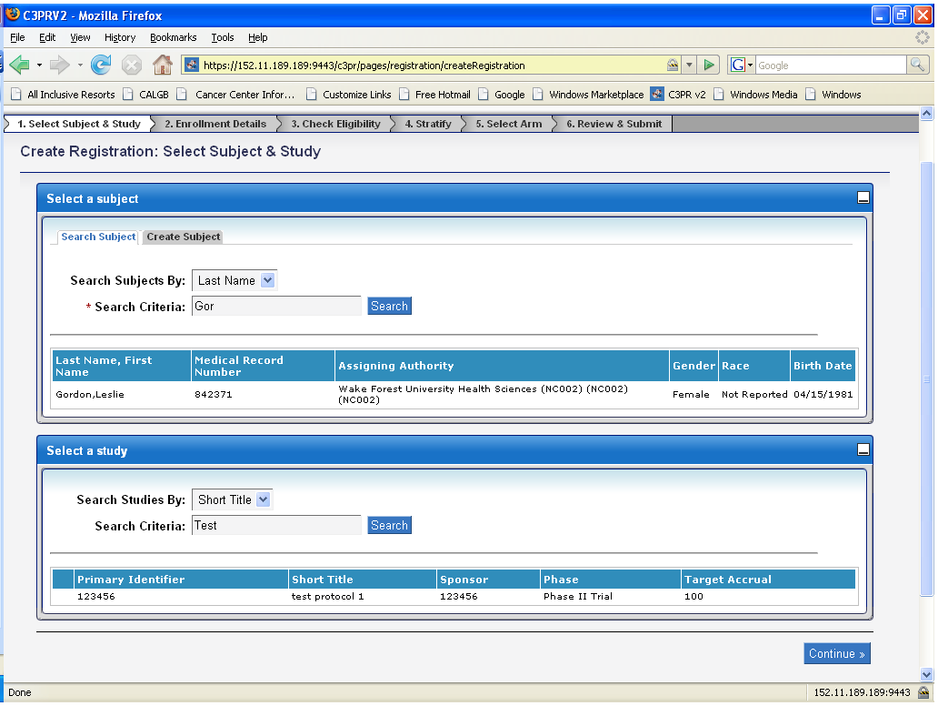
Create Registration: Select Subject and Study
Notes:
The subject was selected by last name and the study was selected by short title. The search button created the subject and study.

Slide 55
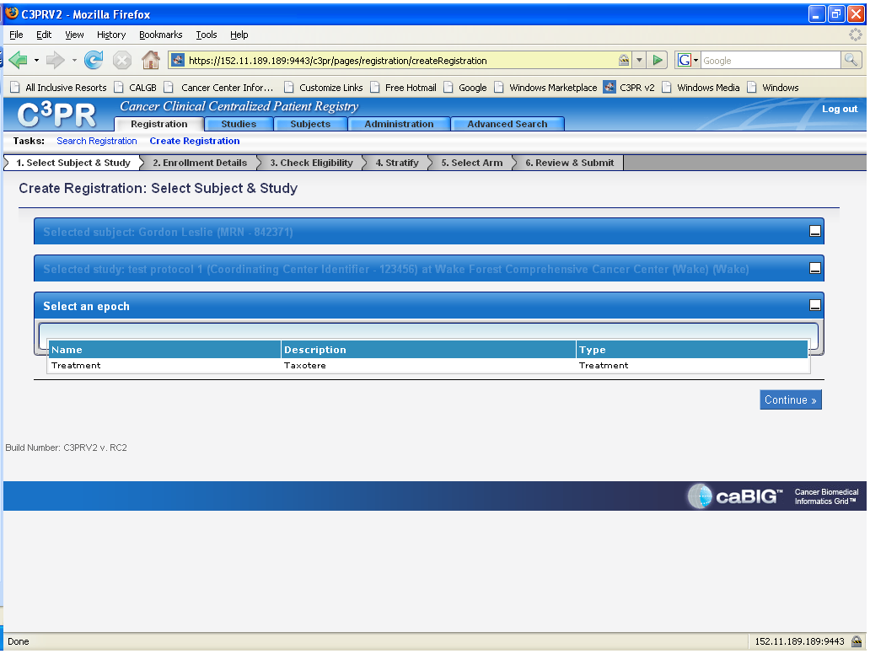
Create Registration: Select epoch
Notes:
If you click on the subject and study selected, you now have to select an epoch. Then continue.
Note foldup of completed selections

Slide 56
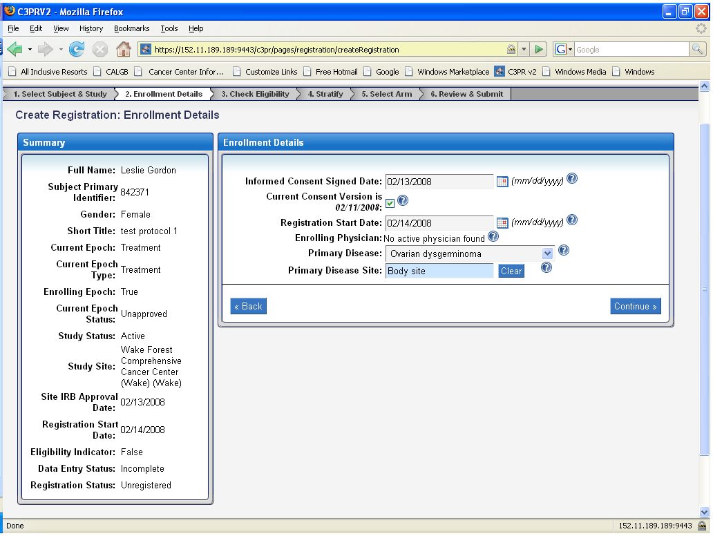
Create Registration: Enrollment Details
Notes:
A summary is listed and the enrollment details have to be completed. Then continue.

Slide 57
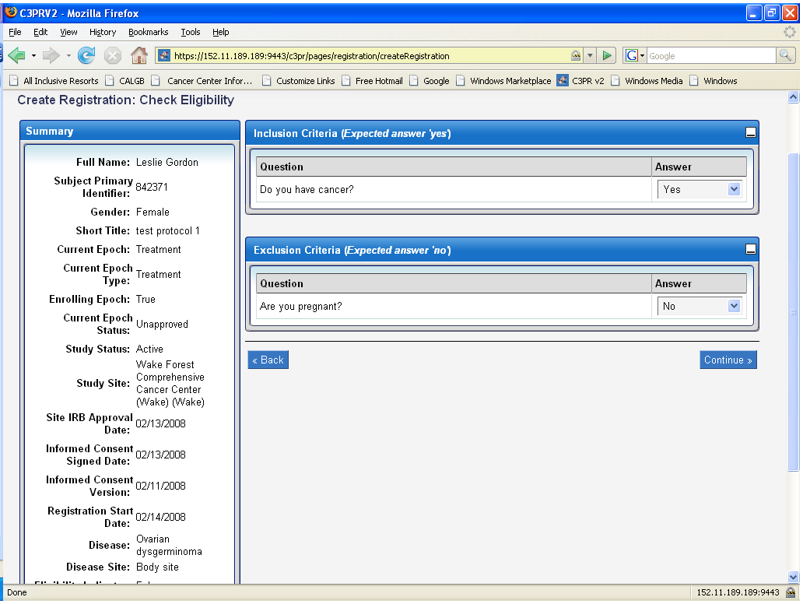
Create Registration: Check Eligibility
Notes:
A summary is listed again and the inclusion/exclusion criteria have to be completed. Then continue.

Slide 58
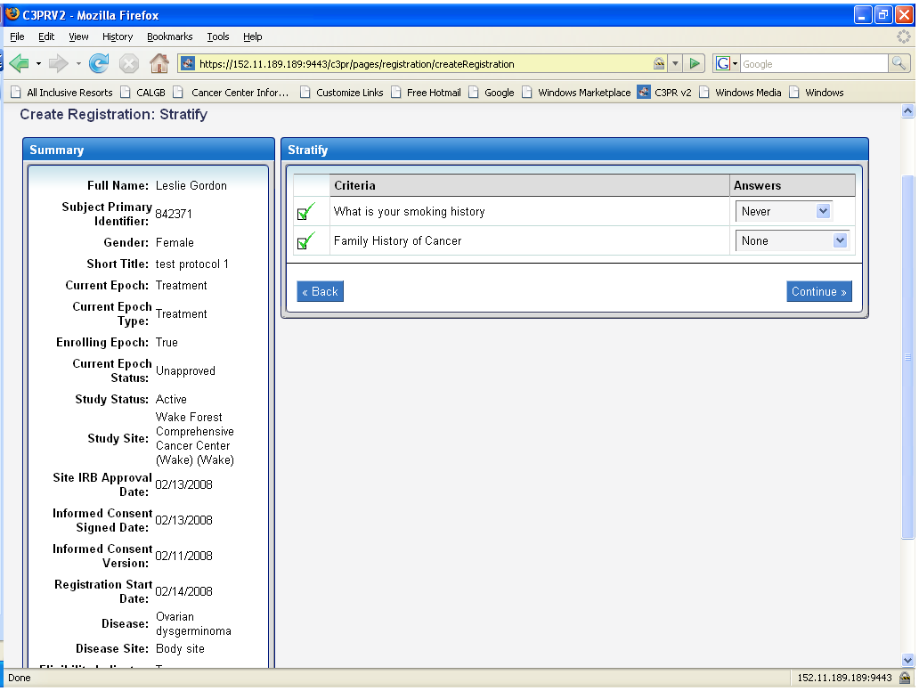
Create Registration: Stratify
Notes:
Summary is listed and stratification information has to be completed. This would not appear for a trial that does not have any stratification factors. Then continue.

Slide 59

Create Registration: Select Arm
Notes:
Summary continues to appear. Arm selection has to be completed. Continue.

Slide 60

Create Registration: Review and Submit
Notes:
At last, all of the entered information is listed. This needs to be reviewed carefully.

Slide 61

Create Registration: Review and Submit continued
Notes:
This screenshot is the bottom portion of the review and submit page. Once everything is reviewed and is correct, click on register.

Slide 62

Create Registration: Confirmation Message
Notes:
This page lets you know that a subject has been registered and to what study. As the instructions read, you should print a copy of this for the subject’s study records.

Slide 63

Search Registration
Notes:
In searching for a registration, you have to click on the search registration task.
You can then search for a participant by subject, study, or registration identifier.
If searching by subject, you can search by last name, first name or identifier. If searching by study, you can search by identifier or short title. If searching by registration identifier.
As seen above, the search was done by last name. You now hit the search button.

Slide 64

Search Registration: Results
Notes:
A list now appears of all the studies this participant is registered to. You now know what trials this subject is associated with. If you click on the information at the bottom of the screen, it will create an overview of this subject and the trials associated with.

Slide 65

Managing a selected Registration: Overview
Notes:
At this bottom of this page, there are options to print this or export.

Slide 66
Lesson 6 Review & Questions
How does this differ from your current systems workflow?

Slide 67
Lesson 7: Things you may not have seen before
Census tracts
Reservations
Epochs
Re-randomization
Notes:
This will require feedback from all reviewers. What are things that people find unusual or confusing

Slide 68
Lesson 7 Review & Questions
What other things have you seen that you did not recognize?
Where can I get information on census tracts
Can I ignore epochs and re-randomization if we do not use them?

Slide 69
Session Summary: Review
A reminder of C3PR objectives: simplifying and standardizing the patient registration

Slide 70
Session Summary: Questions
Notes:
Simply allow questions

Slide 71
Session Summary: Looking for more?
On line training session
Contact your institution’s CTMS manager about getting C3PR
List key contact information here
Notes:
Reiterate online site?

Slide 72
Session Summary: Course Evaluation
How could we improve this presentation?
Email XXXX@YYY.com

