Slide 1

Right and Wrong Examples of Safety
Rules and the Tools
Supervisors Safety
Broadcast
01/29/2009
Travis H. Kilpack
Utah SSM

Slide 2
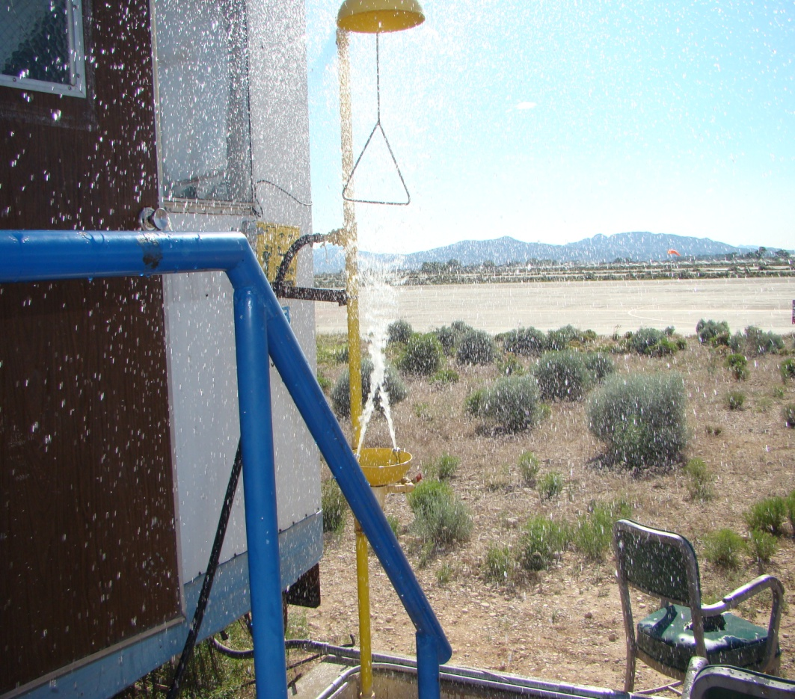
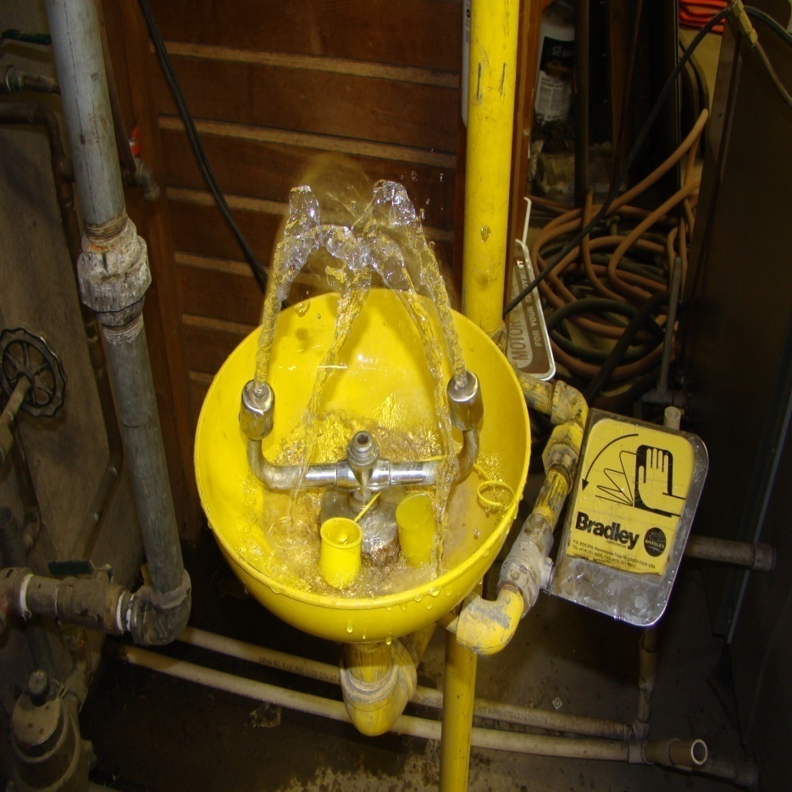
Eyewash Wrong Right
Eyewash stations should not exceed 30 psi. Eye streams should be inline and should not be strong enough to cause injury.
Shower and eyewash valves should be easy to activate with one motion and remain in the on position.
Notes:
Other considerations,
Temperature- outside units may require temperature control (heat)
Location – Units must be located no more than 100 feet or 10 seconds from the hazard and a worker may not travel through a door to access the eyewash/shower.
Clearance- A clear path must be provided to the eyewash and shower. Supplies and equipment must be at least 36” away.
Electrical- Any electrical outlets, panels, controls etc. must be outside of the potentially wet area or be gfci rated.

Slide 3
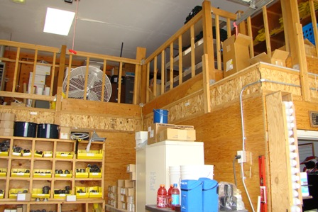
Railings, Mid-rails
Missing mid-rail
Missing
Toe kick
Mid rails and toe kicks are required to prevent personnel and objects from falling through. Railings must also be designed to hold a 200# person.

Slide 4
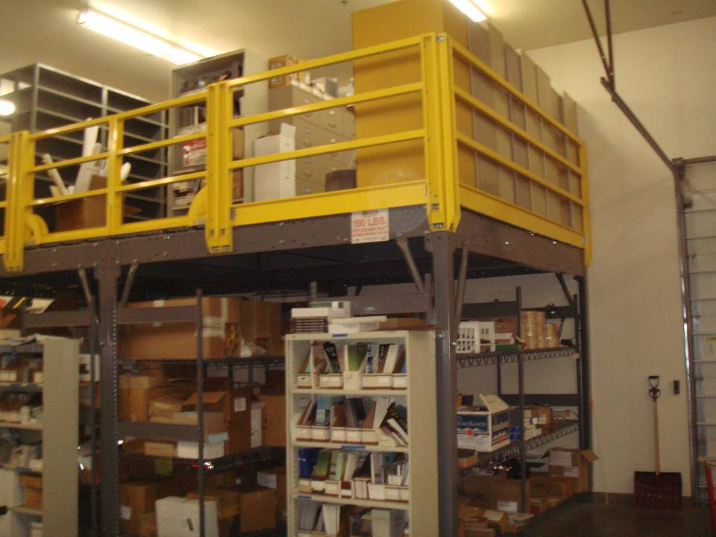
Proper Mezzanine Design
Notes:
Mid rails installed.
Railings are proper height and strength
Load limits are prominently posted

Slide 5
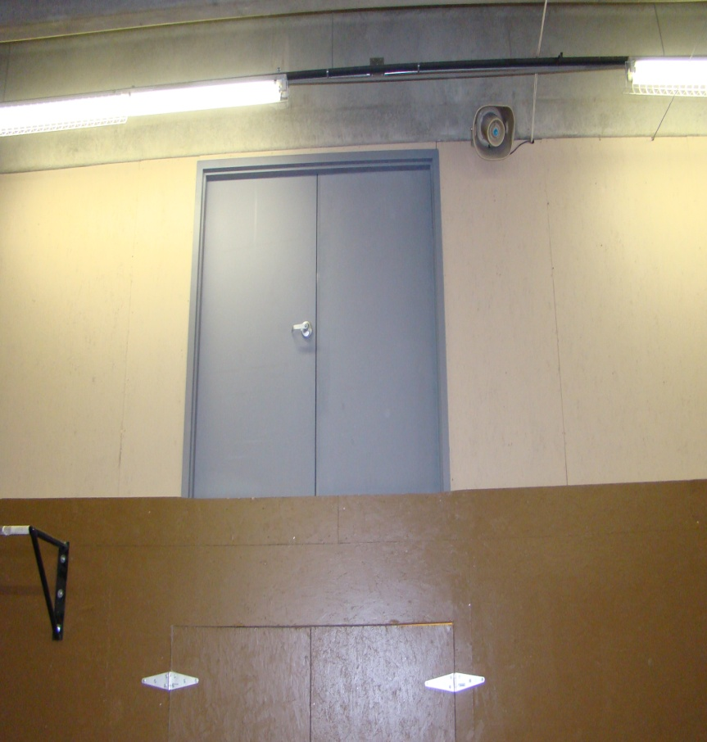
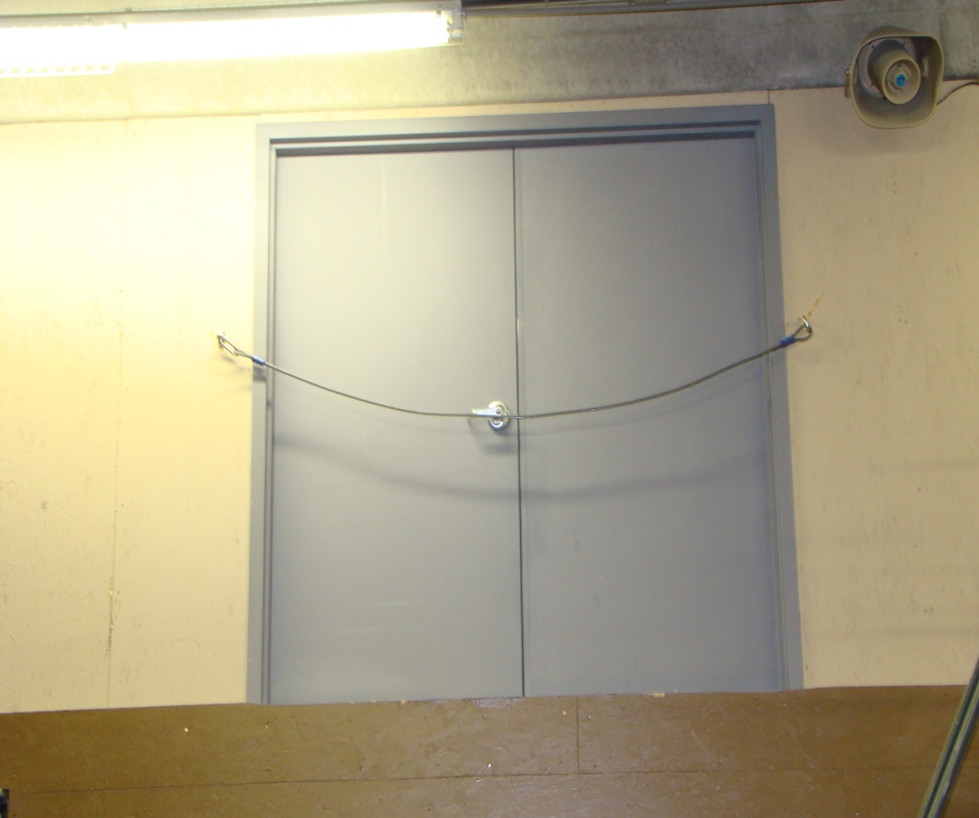
Fall Protection
Here a simple cable protects workers from inadvertently walking out the door. Commercially available railings and cage systems also work well to protect workers when loading and unloading supplies from elevated locations.

Slide 6
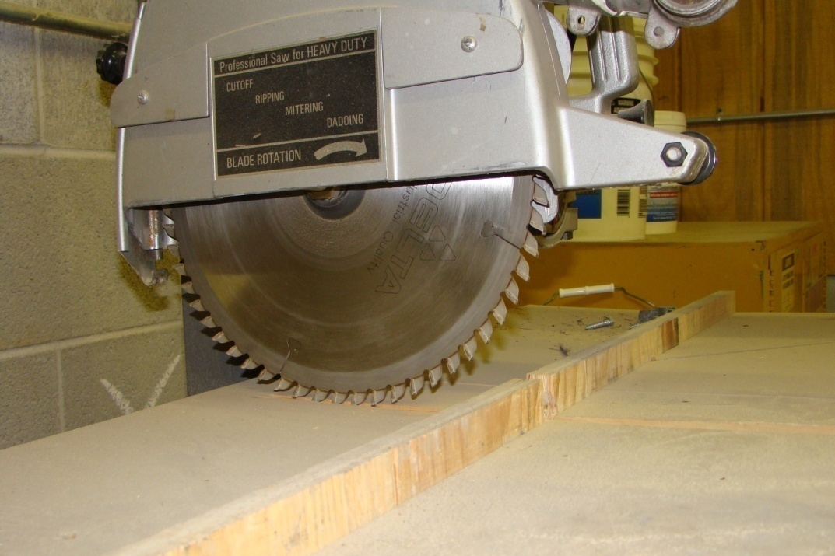
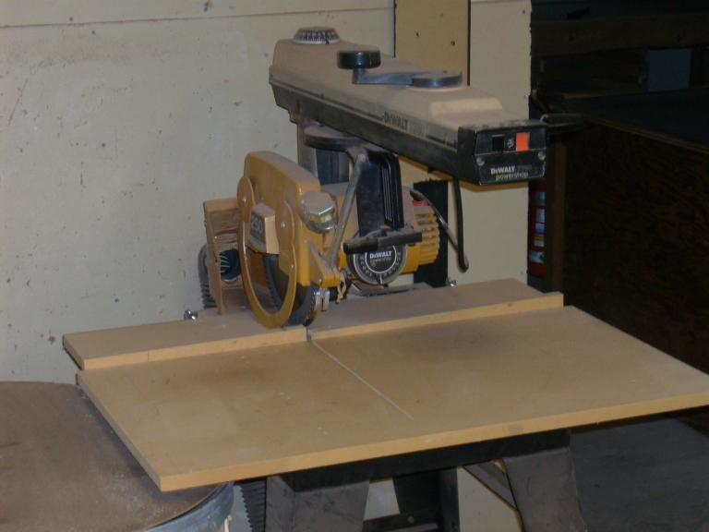
Machine Guarding
A blade guard is required to prevent inadvertent contact with the blade.

Slide 7
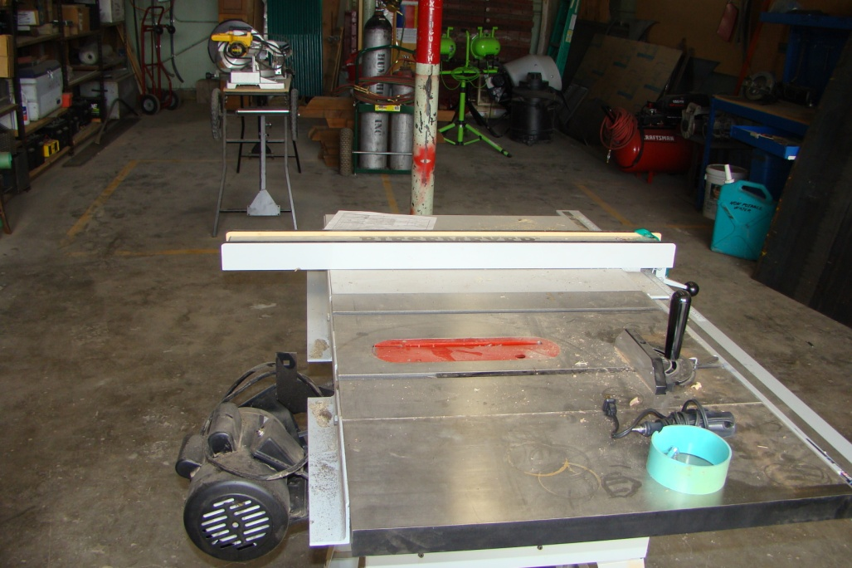
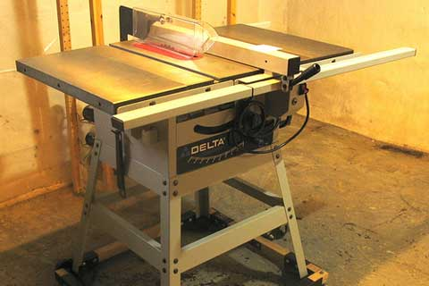
Machine Guard - Table Saw
A blade guard and riving knife are required to protect workers from contacting the blade and preventing kickback.

Slide 8
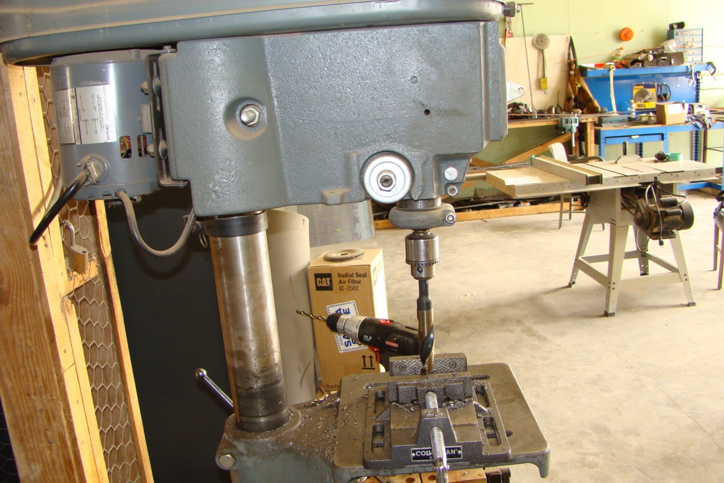
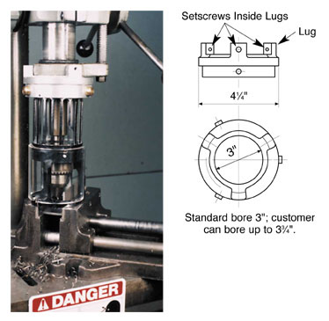
Machine guards – Drill Press
OSHA Interpretation 29 CFR 1910.212(a)(1) dated 10/15/1990 states that drill presses are required to have chuck guards installed. There are many designs that will meet the requirement.

Slide 9
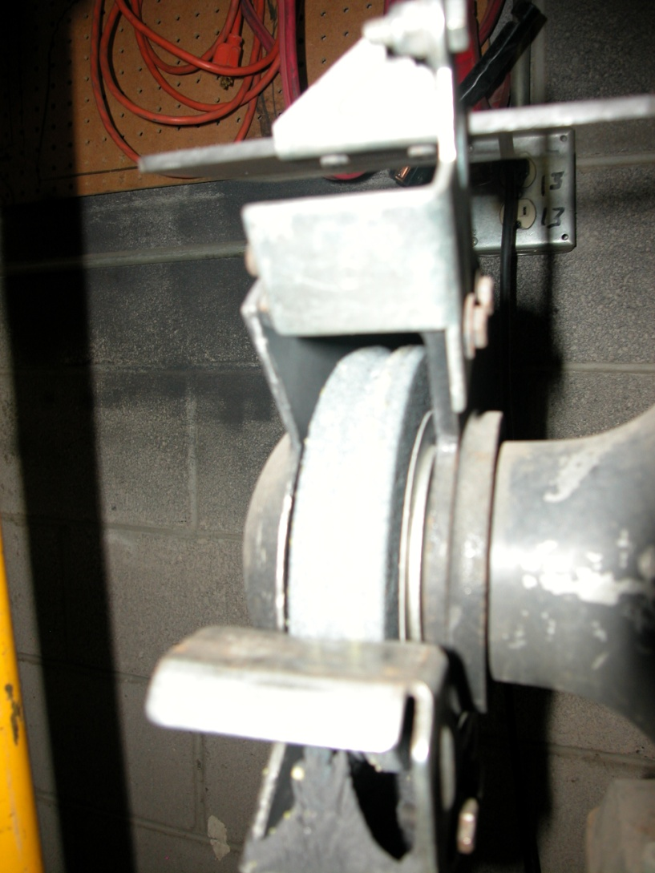
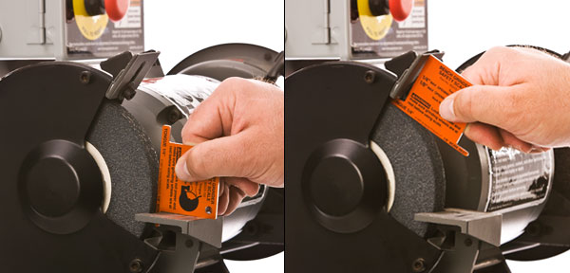
Machine guards - Grinders
Tool rests should be no more than 1/8” inch from the wheel, the tongue guard should be no more than 1/4 inch from the wheel. The wheel should be dressed and clean to prevent catastrophic failure while in use.

Slide 10
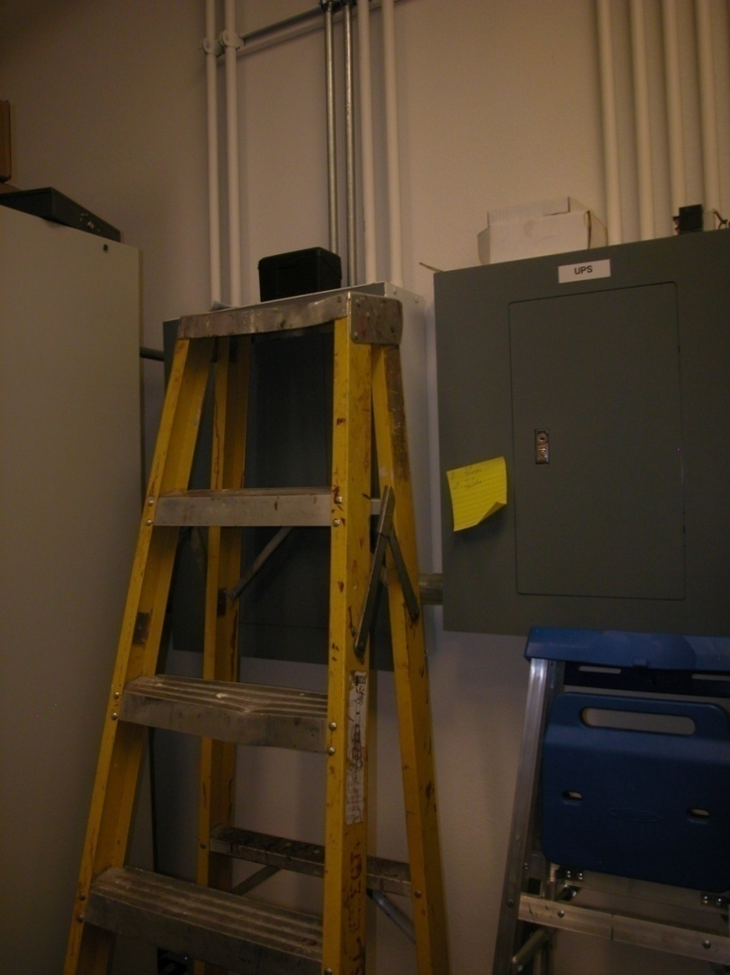
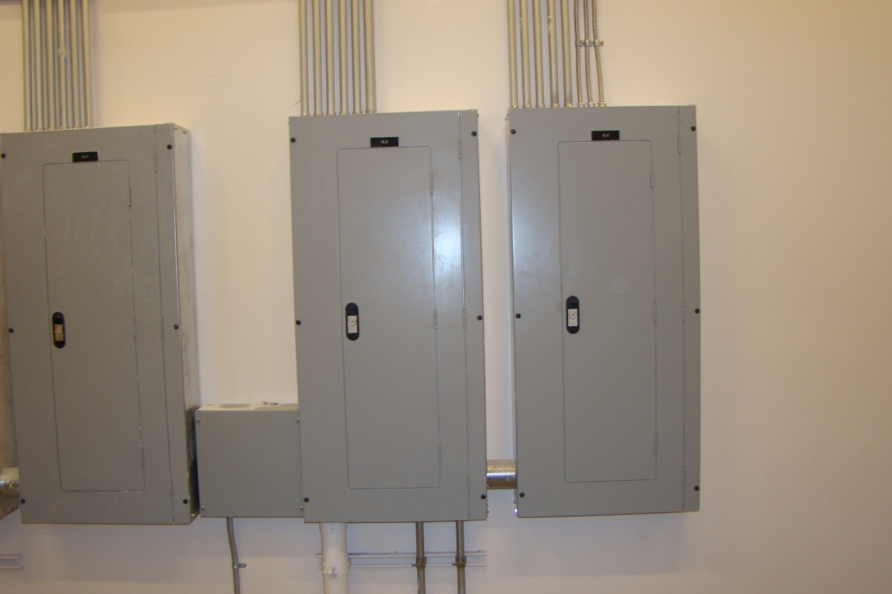
Electrical Panels- Housekeeping
Electrical panels should be kept clean and clear with nothing stored on or around. A 36” clearance must me maintained.

Slide 11
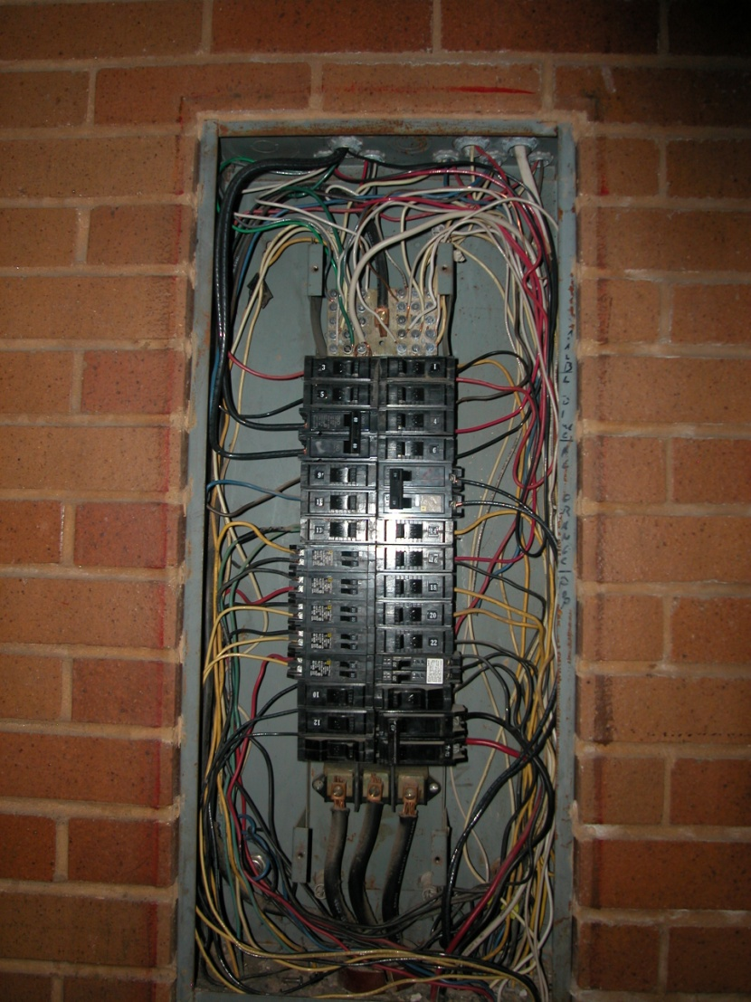
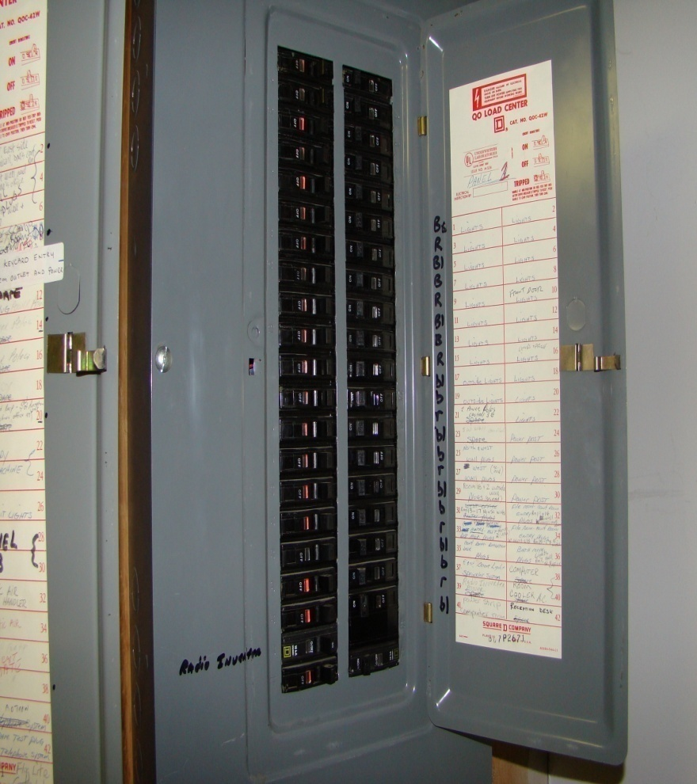
Electrical Panels - Exposure
Electrical panels must have covers installed and all blanks filled in order to prevent contact with energized circuits. Circuits should also be labeled to indicate the location and feed of the circuit. (ie. Lights room 219, not just “lights”),

Slide 12
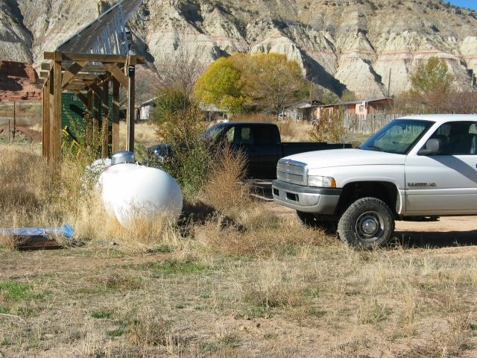
Propane Tanks
Bollards must be installed to protect propane tanks from damage. Vegetation and Debris should be cleaned from around the tank to prevent fire, and the tanks must be labeled.
Notes:
Bollards should be installed in accordance with the following requirements.
1. Constructed of steel no less than 4-inches in diameter, painted
yellow, and filled with concrete;
2. Spaced not more than 4-feet apart measured between posts on center;
3. Set not less than 3-feet deep in a concrete footing of not less than 15-inches in diameter;
4. Set with the top of the posts not less than 3-feet above grade;
5. Located not less than five feet from the tank
The above requirements came from the Uniform Fire Code Section 8001.9.3 - Protection from Vehicles

