Slide 1
NOAA’s Acquisition & Grants (AGO)

Slide 2
Summary of Content (in order of appearance)
Mission
Vision
Outputs: Products and Services
Programs
Budget
Leadership
Facilities and Personnel
Flow of Information
Highest Priority Issues
Urgent Issues

Slide 3
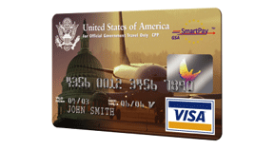
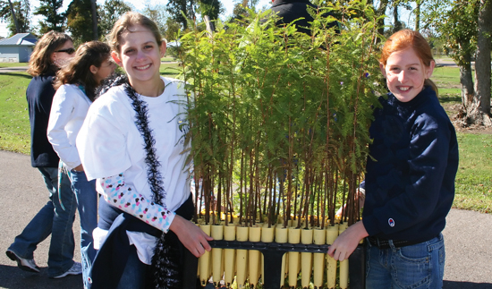
Mission
Acquire and deliver high-quality supplies and services for the best price, on time, and comply with public policy.
Support NOAA’s mission through effective, efficient and timely grant administration program partnerships that meet customers’ needs and comply with public policy.

Slide 4
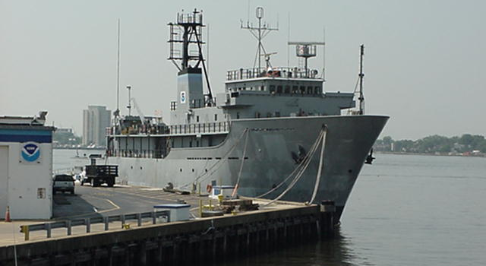
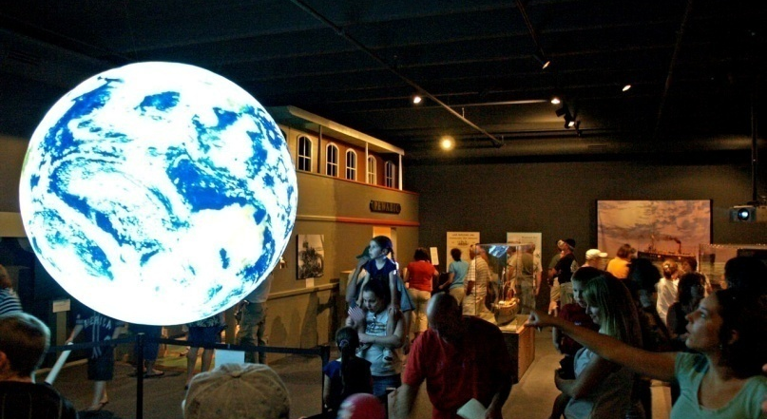
Vision
To be a Federal Acquisition leader in acquiring and delivering supplies and services:
by partnering with customers,
encouraging individual and organizational excellence,
and identifying new market sources and strategies.
To be a Federal Financial Assistance administration leader to engage external partners:
to promote the highest quality cooperation to fulfill NOAA’s Strategic Goals,
and to seek the broadest external awareness of opportunities for partnerships with NOAA
The Acquisition and Grants Office is an agency service organization seeking high customer satisfaction in support of the National Oceanic and Atmospheric Administration and Department of Commerce missions.

Slide 5
Outputs
Acquisition Service Operations
During FY 2008, AGO completed 16,030 procurement actions for essential goods and services
Total value of $1,136,292,245
Financial Assistance Service Operations
During FY 2008, AGO completed 1,917 awards to support research and conservation initiatives with state and local governments, non-profits, and colleges and universities.
Total value of $924,000,000
Notes:
Major Outputs
The NOAA Acquisition and Grants Office (AGO) is a corporate activity to purchase quality goods and services at a reasonable price from external vendors and to administer financial assistance awards (grants) to qualified recipients in support of NOAA’s mission.
Acquisition Service Operations
The purpose of this activity is to purchase gods and services through the use of contracts, simplified acquisition procedures, Bankcard transactions and interagency agreements and memoranda of understanding. These purchases are requested by each NOAA customer as specified by their requirements and are subject to all applicable federal laws, policies and regulations related to procurement. Simplified acquisitions procedures provide streamlined techniques to reduce the administrative burden of awarding lower dollar value or commercially available item procurements that account for the majority of purchases. Bankcards are issued to authorized government employees and typically can be used for purchases up to $2500 per month.
During FY 2007, AGO successfully completed 14,283 procurement transactions worth a total value of $1.1445 billion.
Financial Assistance Service Operations
The purpose of this activity it to provide technical and administrative support to NOAA programs that give financial assistance (authorized by statute) to a wide variety of non-federal recipients to produce results intended to enhance NOAA’s mission. This support involves all phases of the grant administration process including pre-award actions such as providing technical guidance during initial pre-selection activities, announcing and publishing requests for grant applications, conducting administrative review and award of recommended applications, monitoring award progress and terms and conditions and closing out of completed grant awards.
During FY 2007, AGO issued 1,955 grant awards worth a total of $ 924 million.

Slide 6
Programs
Acquisition
Grants
The purpose of the eight Acquisition Management Divisions is to administer procurement requests for goods and services from NOAA and selected Department of Commerce customers by:
Ensuring all policies, regulations and guidelines are followed to achieve fairness, open competition and due process objectives to protect the legitimate interests of the federal government as well as the vendor community.
Using the most appropriate procurement mechanisms –competitive or sole source contracts, simplified acquisition procedures or small purchases (Bank Card)—to fulfill customer requirements.
Seeking better achievement of mandated socioeconomic goals regarding use of small or disadvantaged elements of the vendor community through outreach.
The purpose of the Grants Management Division (GMD) is to support NOAA's mission by:
Reviewing solicitations for applications, processing applications, negotiating awards, managing administrative and financial aspects of awards, monitoring progress against expenditures, resolving audit problems, and closing out awards when the projects are completed.
Sponsoring workshops and training sessions for recipients and program officials to keep the NOAA grants community current on procedures and requirements relating to grants and cooperative agreements.
Using the most advanced information technology systems to automate the entire grants process.

Slide 7
AGO Budget
*

Slide 8
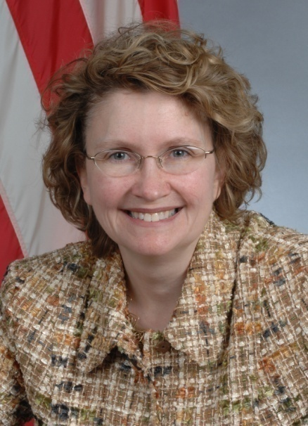
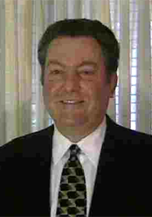
Who We Are: AGO Leadership
Maureen Wylie Acting Director,
Acquisition and Grants Office
Mitchell Ross
Acting Deputy Director,
Acquisition and Grants Office
Notes:
Helen M. Hurcombe
Director, Acquisition and Grants Office
Helen began working with NOAA in January 2000 as the Director of Acquisition and Grants. Prior to coming to NOAA in 2000, Helen filled a variety of positions, both in operational acquisition and grants offices as well as acquisition policy at the Social Security Administration (SSA). Her last position was as the Deputy Associate Commissioner for Acquisition and Grants, which included responsibilities as the Chief of the Contracting Office for SSA’s ten regional acquisition support offices and was a participant in their Senior Executive Service Candidate Development Program. Prior to working at SSA, Helen worked in operational acquisition offices in the National Institutes of Health and at the NASA/Goddard Space Flight Center.
Although she was born in Mobile, Alabama, Helen was raised in the Washington, DC, area. Helen has a Bachelor of Science Degree in Business and Management from the University of Maryland. She is married and has four children ranging in age from 20 to 26 and two grandchildren.

Slide 9
Facilities and Personnel
Acquisition
Grants
82 FTE
4 Acquisition Management Divisions in Silver Spring, MD
4 Regional Acquisition Divisions in the field (Seattle, WA, Boulder, CO, Kansas City, MO, and Norfolk, VA)
23 FTE
1 Grants Management Division in Silver Spring, MD
Notes:
Currently, several Acquisition Divisions in Silver Spring and in the field are comprised of 143 employees and 17 contractor staff and administer more than $1 billion annually in goods and services to support activities of the National Oceanic Atmospheric Administration and selected Bureaus of the Department of Commerce (DOC) of the greater Washington, D.C., area. Our primary customers are the National Marine Fisheries Service, the National Environmental Satellite, Data, and Information Service, the National Weather Service, the National Ocean Service, Oceanic and Atmospheric Research, and the Office of Global Programs in NOAA. Additionally, we support the International Trade Administration (ITA), the Bureau of Industry and Security (BIS), the Minority Business Development Agency (MBDA), the Economic Development Administration (EDA), the National Telecommunications and Information Administration (NTIS), and the National Institute for Science and Technology (NIST).
The purpose of the Grants Management Division (GMD) and its 24 employees and 3 contractor staff is to support NOAA's mission by reviewing solicitations for applications, processing applications, negotiating awards, managing administrative and financial aspects of awards, monitoring progress against expenditures, resolving audit problems, and closing out awards when the projects are completed. GMD sponsors workshops and training sessions for recipients and program officials to keep the NOAA grants community current on procedures and requirements relating to grants and cooperative agreements.

Slide 10
Information Flow Acquisition
Pre-Planning
Receive and analyze program decision memorandum
Meet with AAs and DAAs to discussion acquisition strategic planning
Planning
Draft funding allocation plans based on President’s budget
Prepare Advanced Acquisition Plans (AAPs) by Line Office
Pre-Award
Identify requirements and evaluation criteria
Determine spending plan and verify acct. codes
Manage Award
Close-Out
Receive deliverables and receipts from vendors
Arrange kick-off meeting with appropriate personnel
De-obligate remaining funds
Review all contract documents for completion and accuracy
Formulate and prepare budget
Submission of President’s budget
Consolidate AAPs and determine strategic sourcing opportunities
Hold annual meetings with customers to discuss AAPs
Determine spending plan
Enter requisition into C. Request
Develop Acquisition plan and strategy
Review for small business set aside
Brief ARB
Review and approve solicitation
Post solicitation
Evaluate bids
Sign and obligate in C. Buy
Award contract
File contract documents

Slide 11
Information Flow Grants
Pre-Award
Create/Review/ Publish RFA in Grants Online, FFO in Grants.gov and FRN
Submit Applications via Grants.gov
Award
Recommend Applicant for Award
Approve Selection Package
Post-Award
Submit Progress Reports
Submit Financial Reports SF-269/SF-272
Close-Out
Initiate Close-Out
Submit Final Documents
Approve Final Documents
Reconcile Financial Information
Close Grant
Manage User Accounts, Update Org Info
Certify Progress & Financial Reports
Impose/Remove Special Award Conditions
Prepare Award Package
Award Grant
Obligate Funds
Receive Applications via Grants.gov
Review, Evaluate Applications
Review Application Package
Modify/Withdraw Application
Notify Applicants (non-comp only)
Accept Grant Award
Amend/Suspend/ Reactivate/Transfer/ Terminate Award
Initiate Award Action Requests
KEY
NOAA User functionality
Grantee and NOAA User functionality
Notes:
Talking Points while people are reviewing this slide:
Grants Online can handle all of NOAA’s grants/cooperative agreements (competitive, non-competitive, Congressional earmark, institutional, formula) comprehensively and efficiently.
Grants Online has proven to be a successful workflow system solution to address all of NOAA’s grant processes.
The project has been favorably reviewed by the Gartner Group (2006) for its use of EVM and Mainstay Partners (2007) for its positive return on investment.
Launch into Grants Online Demonstration….

Slide 12
Highest Priority Issues
Managing High Risk Acquisitions
Satellites (NPOESS, GOES-R)
Ships (fisheries Research, hydrographic survey)
High Performance Computing
Gulfstream IV aircraft modification
Support of acquisition and grants workforce
Completion of Business Process Re-engineering

Slide 13
Urgent Issues
TO BE INSERTED AT A LATER DATE
NO ACTION REQUIRED FOR
THIS SLIDE

