Slide 1
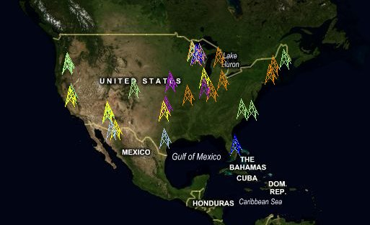
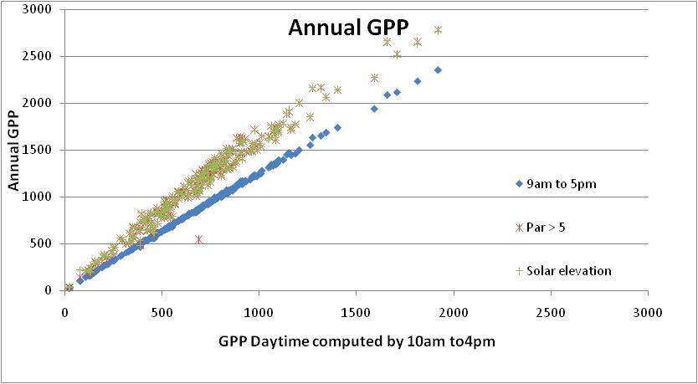
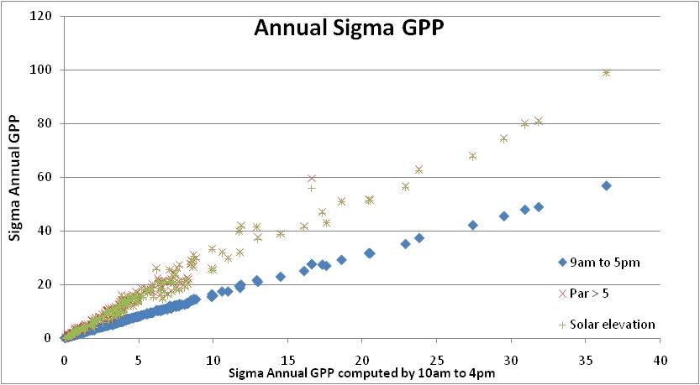
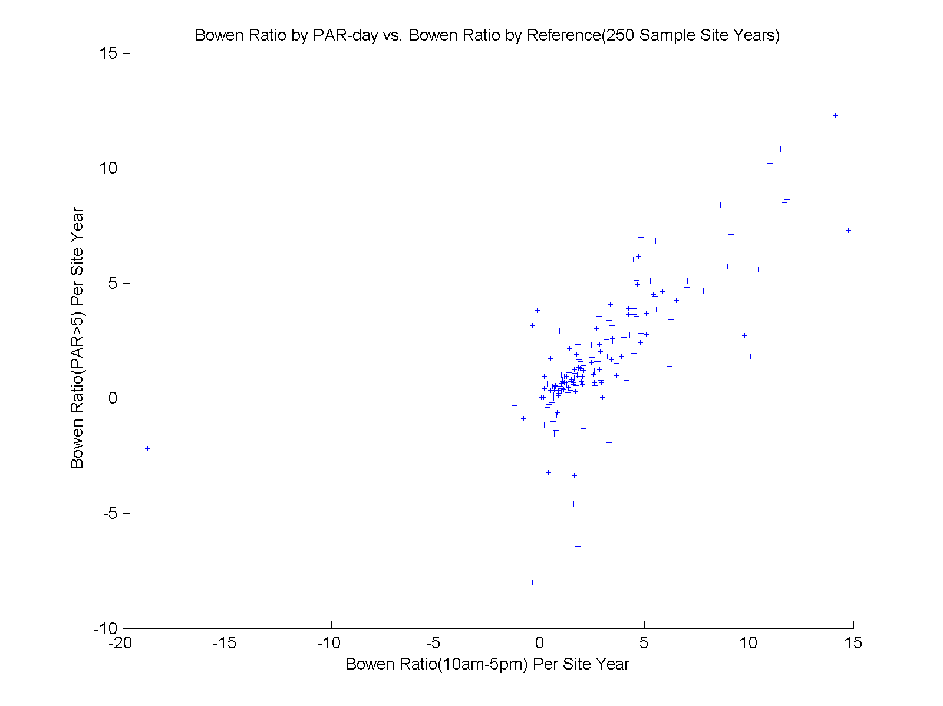
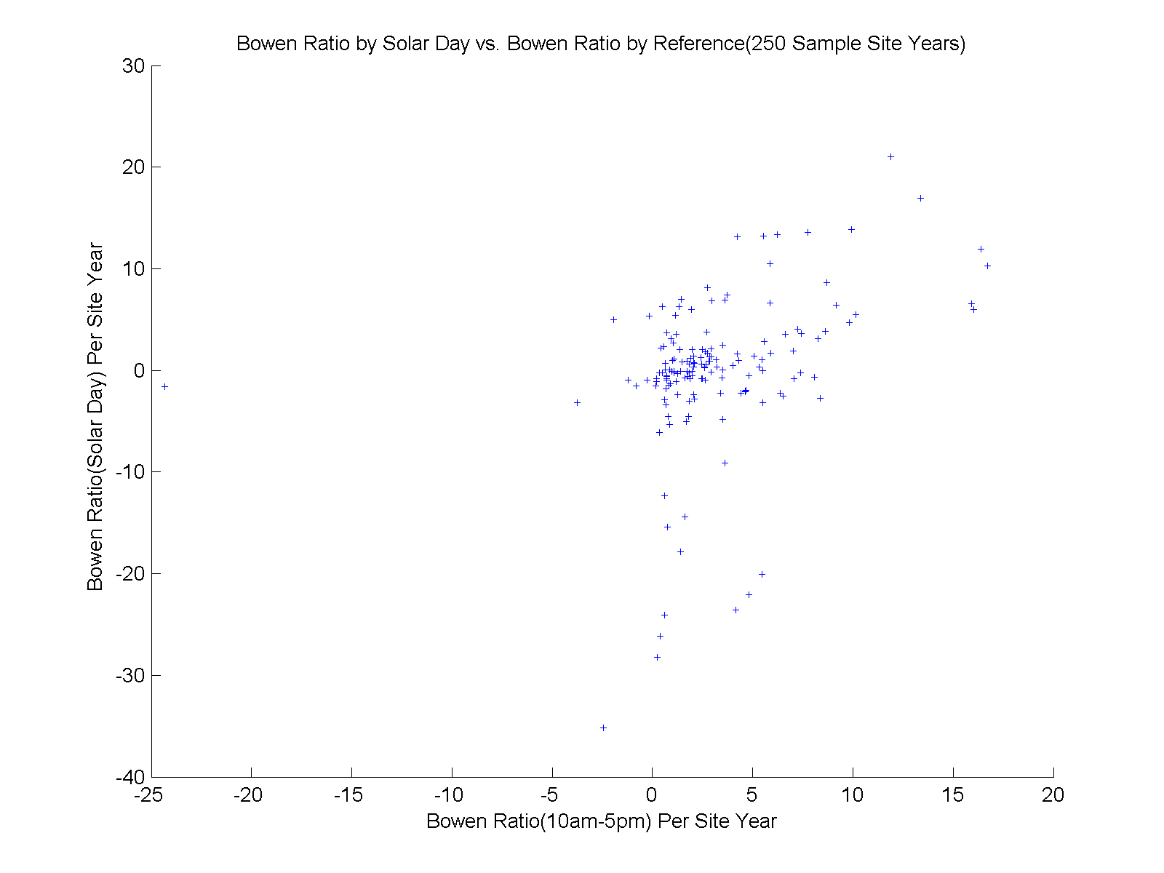
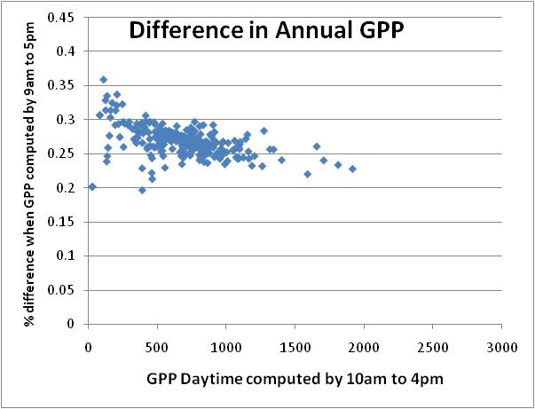
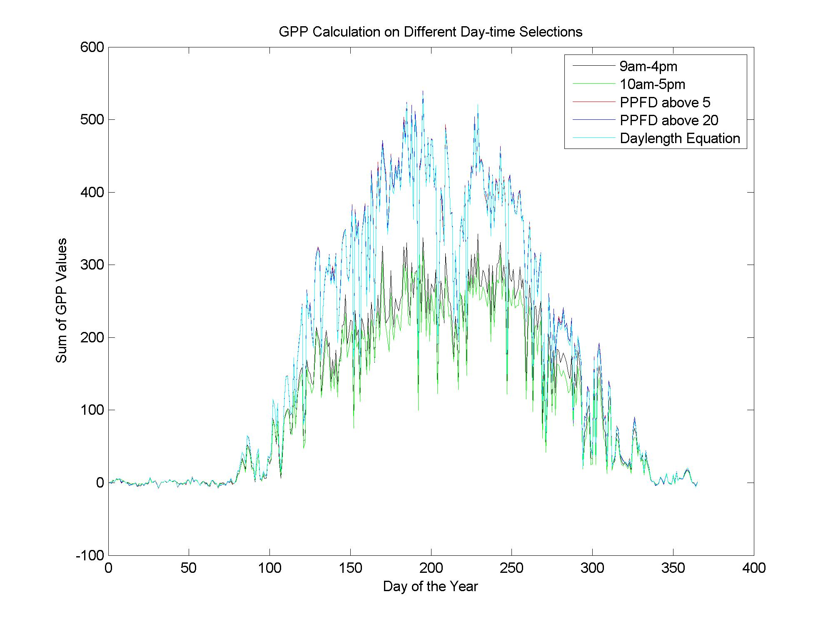
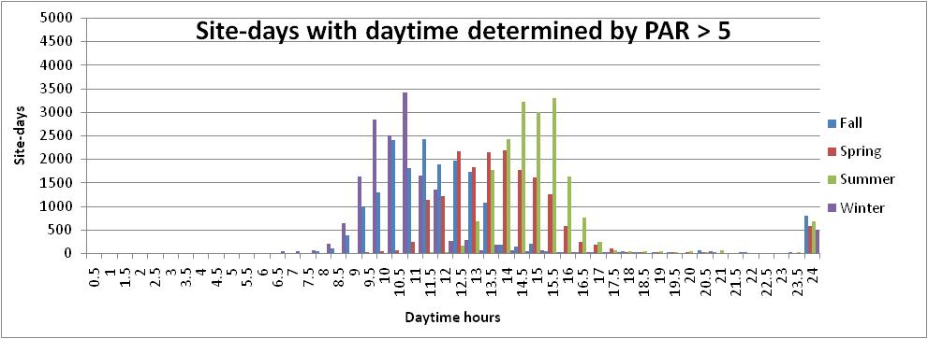
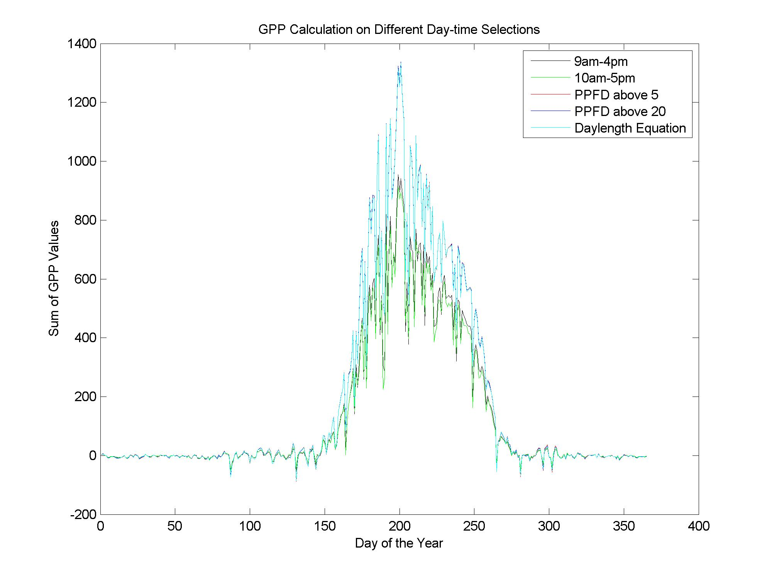
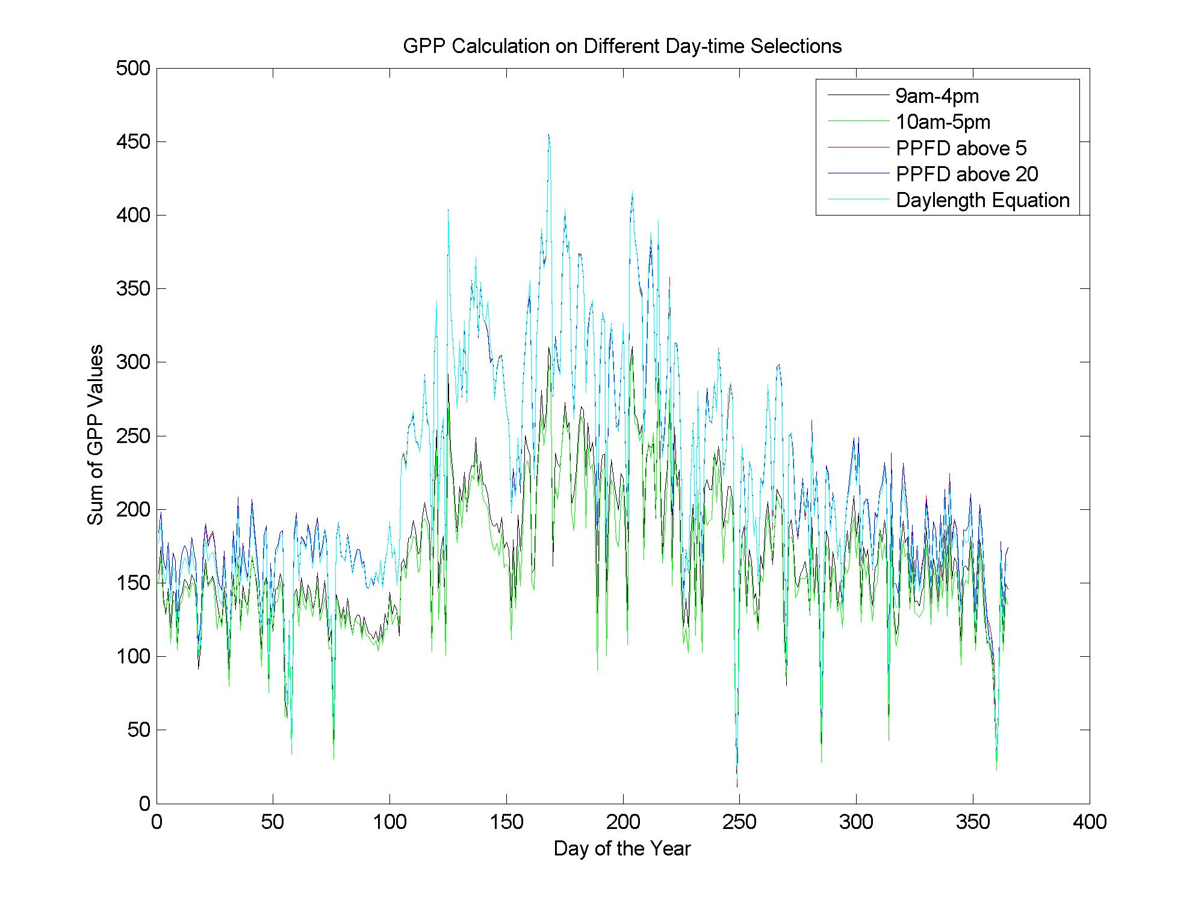
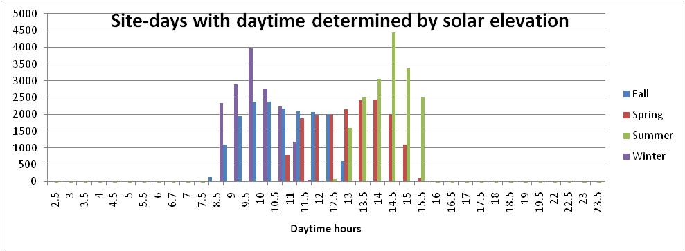








Deriving Daytime Variables from the Ameriflux Standard Eddy Covariance Data Set
B31A-0286
Catharine van Ingen^{ac} (vaningen@microsoft.com), Deb Agarwal^{abd} (daagarwal@lbl.gov), Marty Humphrey^{e} (humphrey@cs.virginia.edu) , Jie Li^{e} (jl3yhhrey@cs.virginia.edu)
Berkeley Water Centerª; Lawrence Berkeley National Laboratory^{b}; Microsoft Research^{c}; University of California, Berkeley^{d}; University of Virginia^{e}
Abstract
A gap-filled, quality assessed eddy covariance dataset has recently become available for the AmeriFlux network. This dataset uses standard processing and produces commonly used science variables. This shared dataset enables robust comparisons across different analyses. Of course, there are many remaining questions. One of those is how to define "during the day" which is an important concept for many analyses. Some studies have used local time – for example 9am to 5pm; others have used thresholds on photosynthetic active radiation (PAR). A related question is how to derive quantities such as the Bowen ratio. Most studies compute the ratio of the averages of the latent heat (LE) and sensible heat (H). In this study, we use different methods of defining "during the day" for GPP, LE, and H. We evaluate the differences between methods in two ways. First, we look at a number of statistics of GPP. Second, we look at differences in the derived Bowen ratio. Our goal is not science per se, but rather informatics in support of the science.
The daytime values computed with local time daytime differ from those computed with PAR > 5 or solar elevation. The computed daytimes always give a higher value of GPP.
203 site-years of data from 53 AmeriFlux sites were used in this study
Example computations of daytime GPP over a site year.
Annual values of GPP computed with local time daytime tend to be consistent. The 9am to 5pm daytime values tend to be 25% larger – a bit less than simple linear scaling of the time window. The differences are larger with smaller annual GPP values.
Local time based daytimes are simple time windows of 9am to 5pm and 10am to 4pm.
PAR (or PPFD) daytime uses the observed photosynthetic active radiation flux data. “Daytime” is when PAR > is above 5 or above 20.
US-HO1
lat. = 45.2041
biome = ENF
2003
Solar elevation (or daylength equation) daytime is centered at local noon with a length of day (Daylength) computed as:
Declination = 23.5 * cos(2π *
(DayOfYear – 172) /365)
Daylength = acos(- tan(π * Latitude /180) * tan(π * Declination/180)) * 2/15 *180/π
Daytime values of Bowen Ratio computed by solar elevation and PAR>5 differ more than the daily GPP values. We’re don’t yet know why.
While the annual values of GPP computed with the PAR > 5 and solar elevation tend to be the same, the actual duration of the “daytime” are different.
The plots at left show the number of site-days with a given length of daytime. Season are defined with 3 month duration; winter begins in December.
site ID | Name | Tower PI | PI E-Mail
US-ARb | ARM Southern Great Plains burn site- Lamont | Margaret Torn | mstorn@lbl.gov
US-ARc | ARM Southern Great Plains control site- Lamont | Margaret Torn | mstorn@lbl.gov
US-ARM | ARM Southern Great Plains site- Lamont | Margaret Torn | mstorn@lbl.gov
US-Bar | Bartlett Experimental Forest | Andrew Richardson | andrew.richardson@unh.edu
US-Blo | Blodgett Forest | Allen Goldstein | ahg@nature.berkeley.edu
US-Bo2 | Bondville (companion site) | Carl Bernacchi | bernacch@uiuc.edu
US-Dk1 | Duke Forest-open field | Gaby Katul | gaby@duke.edu
US-Dk2 | Duke Forest-hardwoods | Gaby Katul | gaby@duke.edu
US-Dk3 | Duke Forest - loblolly pine | Gaby Katul | gaby@duke.edu
US-Fmf | Flagstaff - Managed Forest | Sabina Dore | Sabina.Dore@nau.edu
US-FR2 | Freeman Ranch- Mesquite Juniper | Marcy Litvak | mlitvak@unm.edu
US-Fuf | Flagstaff - Unmanaged Forest | Sabina Dore | Sabina.Dore@nau.edu
US-Fwf | Flagstaff - Wildfire | Sabina Dore | Sabina.Dore@nau.edu
US-Ha1 | Harvard Forest EMS Tower (HFR1) | Bill Munger | jwmunger@seas.harvard.edu
US-Ha2 | Harvard Forest Hemlock Site | Julian Hadley | jhadley@fas.harvard.edu
US-Ho1 | Howland Forest (main tower) | Dave Hollinger | davidh@hypatia.unh.edu
US-Ho2 | Howland Forest (west tower) | Dave Hollinger | davidh@hypatia.unh.edu
US-IB1 | Fermi National Accelerator Laboratory- Batavia (Agricultural site) | Roser Matamala | matamala@anl.gov
US-IB2 | Fermi National Accelerator Laboratory- Batavia (Prairie site) | Roser Matamala | matamala@anl.gov
US-KS1 | Kennedy Space Center (slash pine) | Bert Drake | drakeb@si.edu
US-KS2 | Kennedy Space Center (scrub oak) | Bert Drake | drakeb@si.edu
US-Los | Lost Creek | Ken Davis | davis@essc.psu.edu
US-LPH | Little Prospect Hill | Julian Hadley | jhadley@fas.harvard.edu
US-Me1 | Metolius - Eyerly burn | Bev Law | bev.law@oregonstate.edu
US-Me2 | Metolius-intermediate aged ponderosa pine | Bev Law | bev.law@oregonstate.edu
US-Me3 | Metolius-second young aged pine | Bev Law | bev.law@oregonstate.edu
US-Me4 | Metolius-old aged ponderosa pine | Bev Law | bev.law@oregonstate.edu
US-MMS | Morgan Monroe State Forest | Danilo Dragoni | ddragoni@indiana.edu
site ID | Name | Tower PI | PI E-Mail
US-Me1 | Metolius - Eyerly burn | Bev Law | bev.law@oregonstate.edu
US-Me2 | Metolius-intermediate aged ponderosa pine | Bev Law | bev.law@oregonstate.edu
US-Me3 | Metolius-second young aged pine | Bev Law | bev.law@oregonstate.edu
US-Me4 | Metolius-old aged ponderosa pine | Bev Law | bev.law@oregonstate.edu
US-MMS | Morgan Monroe State Forest | Danilo Dragoni | ddragoni@indiana.edu
US-MOz | Missouri Ozark Site | Lianhong Gu | lianhong-gu@ornl.gov
US-NC1 | NC_Clearcut | Jiquan Chen | Jiquan.Chen@utoledo.edu
US-NC2 | NC_Loblolly Plantation | Jiquan Chen | Jiquan.Chen@utoledo.edu
US-Ne1 | Mead - irrigated continuous maize site | Shashi Verma | sverma@unlnotes.unl.edu
US-Ne2 | Mead - irrigated maize-soybean rotation site | Shashi Verma | sverma@unlnotes.unl.edu
US-Ne3 | Mead - rainfed maize-soybean rotation site | Shashi Verma | sverma@unlnotes.unl.edu
US-NR1 | Niwot Ridge Forest (LTER NWT1) | Russ Monson | Russell.Monson@colorado.edu
US-Oho | Oak Openings | Jiquan Chen | Jiquan.Chen@utoledo.edu
US-PFa | Park Falls/WLEF | Ken Davis | davis@essc.psu.edu
US-SRM | Santa Rita Mesquite | Russ Scott | rscott@tucson.ars.ag.gov
US-Syv | Sylvania Wilderness Area | Ken Davis | davis@essc.psu.edu
US-Ton | Tonzi Ranch | Dennis Baldocchi | baldocchi@nature.berkeley.edu
US-UMB | Univ. of Mich. Biological Station | Peter Curtis | curtis.7@osu.edu
US-Var | Vaira Ranch- Ione | Dennis Baldocchi | baldocchi@nature.berkeley.edu
US-WCr | Willow Creek | Ken Davis | davis@essc.psu.edu
US-Wi0 | Young red pine (YRP) | Jiquan Chen | Jiquan.Chen@utoledo.edu
US-Wi1 | Intermediate hardwood (IHW) | Jiquan Chen | Jiquan.Chen@utoledo.edu
US-Wi2 | Intermediate red pine (IRP) | Jiquan Chen | Jiquan.Chen@utoledo.edu
US-Wi4 | Mature red pine (MRP) | Jiquan Chen | Jiquan.Chen@utoledo.edu
US-Wi5 | Mixed young jack pine (MYJP) | Jiquan Chen | Jiquan.Chen@utoledo.edu
US-Wi6 | Pine barrens #1 (PB1) | Jiquan Chen | Jiquan.Chen@utoledo.edu
US-Wi7 | Red pine clearcut (RPCC) | Jiquan Chen | Jiquan.Chen@utoledo.edu
US-Wi8 | Young hardwood clearcut (YHW) | Jiquan Chen | Jiquan.Chen@utoledo.edu
US-Wi9 | Young Jack pine (YJP) | Jiquan Chen | Jiquan.Chen@utoledo.edu
US-Wkg | Walnut Gulch Kendall Grasslands | Russ Scott | rscott@tucson.ars.ag.gov
US-Ne1
lat. = 41.1651
biome = CRO
2004
US-KS2
lat. = 28.6086
biome = CSH
2004
Our thanks to Tower Primary Investigators
and their sponsors
URL: http://www.fluxdata.org/

