Slide 1
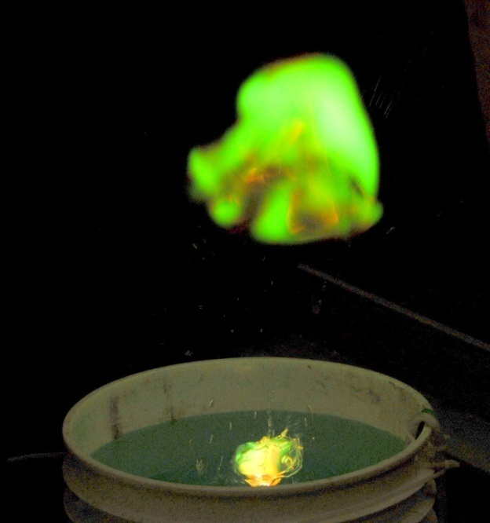
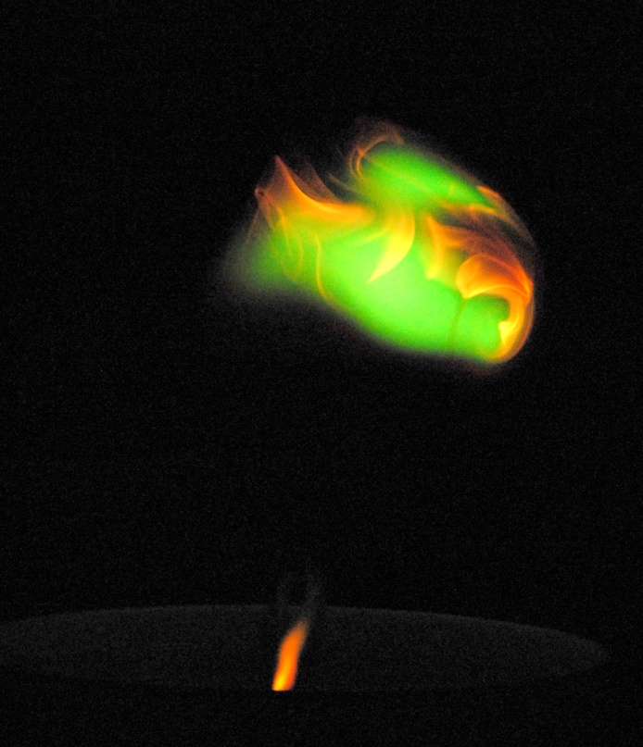
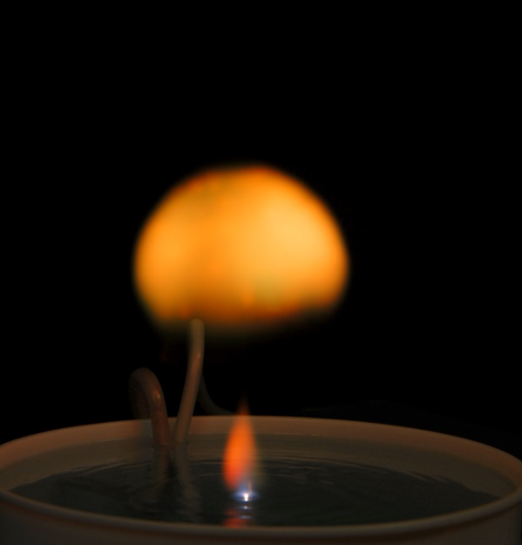
Free-Floating Atmospheric Pressure Ball Plasmas
G. A. Wurden, Z. Wang, C. Ticos
Los Alamos National Laboratory
Los Alamos, NM 87545 USA
C. J. v. Wurden
Los Alamos High School
Los Alamos, NM 87544
Presented at the
PPPL Colloquium
Sept. 17, 2008
LA-UR-08-06284
Notes:
Optical Biosensor Detects Biological Toxins and Infectious Agents
Toxins (poisons produced by living organisms) and disease-causing organisms such as viruses work by binding to specific receptors on the surface of an affected cell. Binding causes the receptors to aggregate, allowing the toxin or invading virus to enter the cell.
Our Optical Biosensor uses optically tagged natural receptors embedded in a synthetic cell membrane to mimic a natural chain of events. When a target protein binds, the receptors in the cell membrane are pulled into a cluster by the toxin’s binding sites (shown for cholera toxin in red). The close proximity of the receptors, which are normally further apart, triggers an energy transfer leading to a fluorescent response.

Slide 2
Outline of this talk
A discussion of ball lightning reports in nature
How can ball plasmas be made in the laboratory?
Detailed experiments on long-lived free-floating atmospheric pressure ball plasmas
Comparison of laboratory ball plasmas with “ball lightning”
Summary

Slide 3
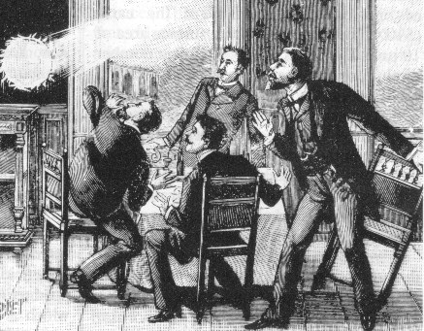
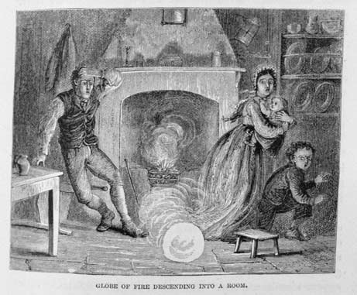
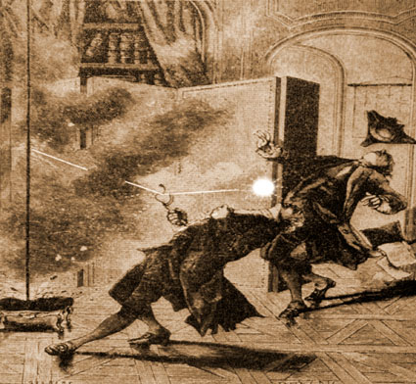
Ball Lightning (BL) reports are hundreds of years old
Causing amazement, bewilderment, fear, even death
Most reports during thunderstorms
BL floats along (often downwards)
BL is easily bright enough to be seen in daylight
In 1753, Russian scientist Georg Richmann was killed while trying to trap lightning, possibly by ball lightning, according to descriptions.

Slide 4
A few books
“Nature of Ball Lightning”, S. Singer, 1972. 175 pages
“Lightning, Auroras, Nocturnal Lights, and related luminous phenomena”, by William R. Corliss, 1982, published by The Sourcebook Project. ISBN 0-915554-09-7. A catalog of reports including ordinary ball lightning, BL with projections or spikes, with diverging rays, double and triple, minature, giant,transparent, fragmenting, materialization inside enclosures, black BL, electromagnetic effects, internal structures, long tails, external to aircraft. 240 pages
“Ball Lightning: An Unsolved Problem in Atmospheric Physics” by Mark Stenhoff, Published by Springer, 1999
ISBN 0306461501, 9780306461507 349 pages
“Lightning: Physics and Effects” by Vladimir A. Rakov, Martin A. Uman
Published by Cambridge University Press, 2003
ISBN 0521583276, 9780521583275 687 pages

Slide 5
Ball Lightning (BL) ?
A rare natural phenomenon, with a wide range of reported properties
Hundreds of reports over the centuries, many by reliable observers, but not much hard data
Size…from as small as a pea, to as large as a house, but typically less than 1 foot diameter. Duration: seconds to a minute
Varied colors…green, red, violet, blue, yellow, or changing
Shape…generally spherical, but also rods, dumbbells, spiked balls
Features….sometimes with internal structures, can vanish suddenly or explode, with or without noise, with or without an odor, with or without damage to other objects.
Has been reported inside closed rooms…such as aircraft cabins
Has been reported to go through window screens…and supposedly through even glass.
Usually, though not always, associated with thunderstorms.
Can float across a room, or down a lane, without rising noticeably. Can “descend” from the sky.

Slide 6
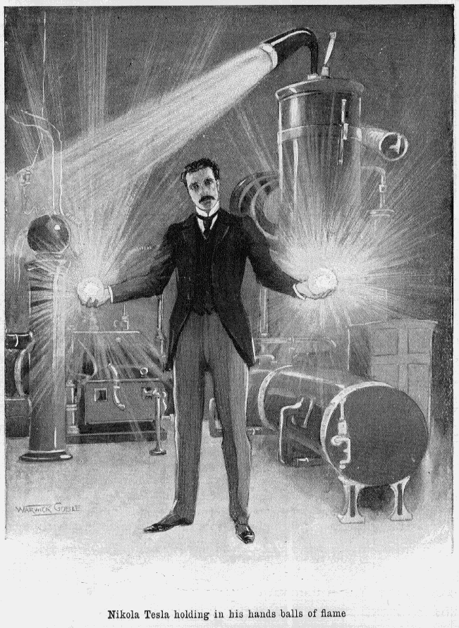
Notable scientists have tried to reproduce BL in the lab
Nikola Tesla impressed journalists in his lab in Colorado, 1899
Jim Tuck, an early pioneer in fusion research, played with trying to make BL, based from observations of sparking US Navy submarine battery banks.
Ball Lightning, A STATUS SUMMARY To NOVEMBER 1971
By J. L. Tuck
Los Alamos report: LA-4847-MS
ABSTRACT
Experiments to study Ball Lightning artificially are reported. Switch opening arcs at currents of up to 100,000 amperes from a large submarine storage battery (50-600V) have given interesting but indecisive results. Higher voltage ~10 kV slowed-down condenser discharges have been similarly indecisive but with encouraging afterglows. Conjectures are made that: a) the ball lightning luminosity comes from a chemiluminescent reaction preceded by a chemi-ionization, b) the ball lightning coherence is a consequence of a weak surface force in a cold plasma containing positive ion-negative ion dipoles. The scope of further theoretical and experimental work to elucidate these conjectures is outlined.
Pearson Magazine, “The New Wizard of the West”, article,1899

Slide 7
One theory of BL deals with dusty plasmas
J. Abrahamson and J. Dinniss, Nature (London) 403, 519 (2000) theorize that the long life of ball lightning could be due to oxidation of dust inside the ball. They predict the presence of filamentary structures inside the ball.
A recent PRL 100, 065001 (2008), measures the dust inside a microwave produced ball plasma
Evidence for Nanoparticles in Microwave-Generated Fireballs Observed
by Synchrotron X-Ray Scattering
J. B. A. Mitchell,1 J. L. LeGarrec,1 M. Sztucki,2 T. Narayanan,2 V. Dikhtyar,3 and E. Jerby3,*
1P.A.L.M.S., U.M.R. No. 6627 du C.N.R.S., Universite´ de Rennes I, 35042 Rennes Cedex, France
2European Synchrotron Radiation Facility, BP-220, 38043 Grenoble Cedex, France
3Faculty of Engineering, Tel Aviv University, Ramat Aviv, 69978, Israel
(Received 18 October 2007; published 11 February 2008)
The small-angle x-ray scattering method has been applied to study fireballs ejected into the air from
molten hot spots in borosilicate glass by localized microwaves [V. Dikhtyar and E. Jerby, Phys. Rev. Lett.
96 045002 (2006)]. The fireball’s particle size distribution, density, and decay rate in atmospheric pressure
were measured. The results show that the fireballs contain particles with a mean size of 50 nm with
average number densities on the order of 10^9. Hence, fireballs can be considered as a dusty plasma
which consists of an ensemble of charged nanoparticles in the plasma volume. This finding is likened to
the ball-lightning phenomenon explained by the formation of an oxidizing particle network liberated by
lightning striking the ground [J. Abrahamson and J. Dinniss, Nature (London) 403, 519 (2000)].

Slide 8
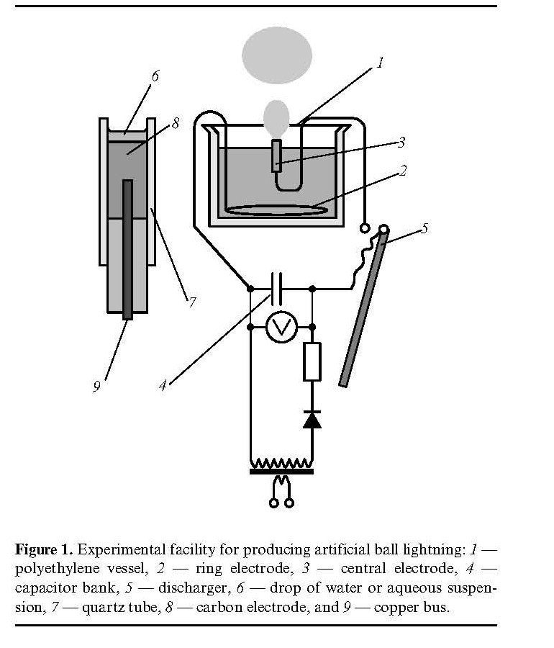
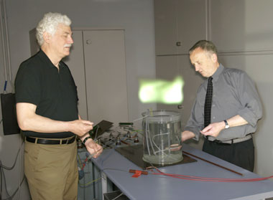
Russian scientists have reported a method to produce ball plasmas in the laboratory
We heard reports (New Scientist, June 7, 2006) of ball plasmas being generated above a bucket of water, by a German research group led by Prof. Gerd Fussmann at the Humboldt University in Berlin, in the summer of 2006.
Their technique was actually based on work published by Russian researchers, A. Egorov, S. Stepanov, and G. Shabanov, in Physics-Uspekhi 47 (1) 99-101 (2004), entitled “Laboratory demonstration of ball lightning”. (See Fig. 1)

Slide 9
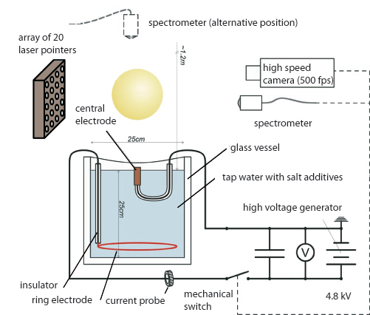
The Berlin effort is led by fusion spectroscopist, Prof. Gerd Fussmann
Analysis of Long-living Plasmoids at Atmospheric Pressure
Stefan Noack,†, Alex Versteegh*, Burkhard Jüttner and Gerd Fussmann,‡
AG Plasmaphysik, Humboldt-Universität zu Berlin, Newtonstr. 15, 12489 Berlin, Germany
†Fakultät für Physik und Geowissenschaften, Universität Leipzig, Linnéstr. 5, 04103 Leipzig, Germany
*Eindhoven University of Technology, P.O. Box 513, 5600 MB Eindhoven, The Netherlands
‡Max-Planck-Institut für Plasmaphysik, EURATOM Association, Germany
AIP CONFERENCE PROCEEDINGS (2008) Vol.993, p.129-132
International Conference on Research and Applications of Plasmas/4th German-Polish Conference on Plasma Diagnostics for Fusion and Applications, PLASMA 2007, Greifswald, Germany
Abstract. Ball-like plasmoids were generated by discharging a capacitor bank via a water surface. In the autonomous stage after current zero they have diameters up to 0.2 m and lifetimes of some hundreds milliseconds. They were studied by applying high speed cameras, spectroscopy and an array of lasers. The latter allows to determine the index of refraction and thus give information on the internal structure of the plasmoids.
Long-living plasmoids from an atmospheric water discharge,
Versteegh, A. ; Behringer, K. ; Fantz, U. ; Fussmann, G. ; Juttner, B. ; et al. Plasma Sources, Science and Technology (May 2008) vol.17, no.2, p.024014 (8 pp.)
See also:

Slide 10
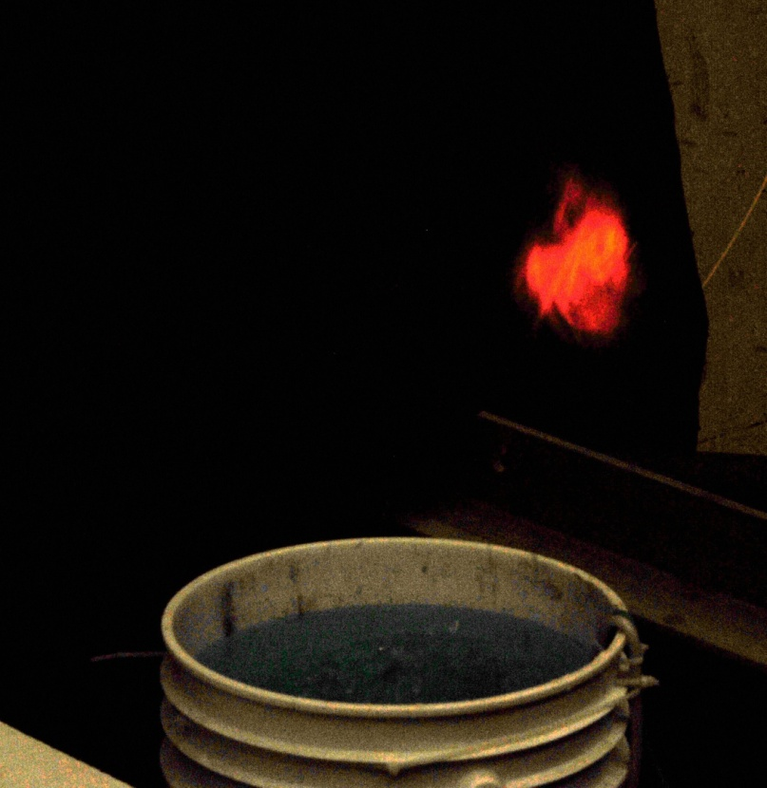
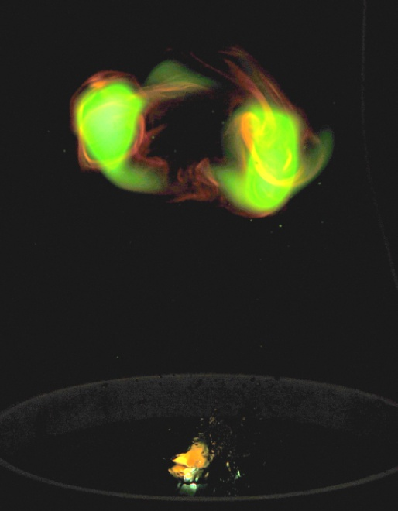
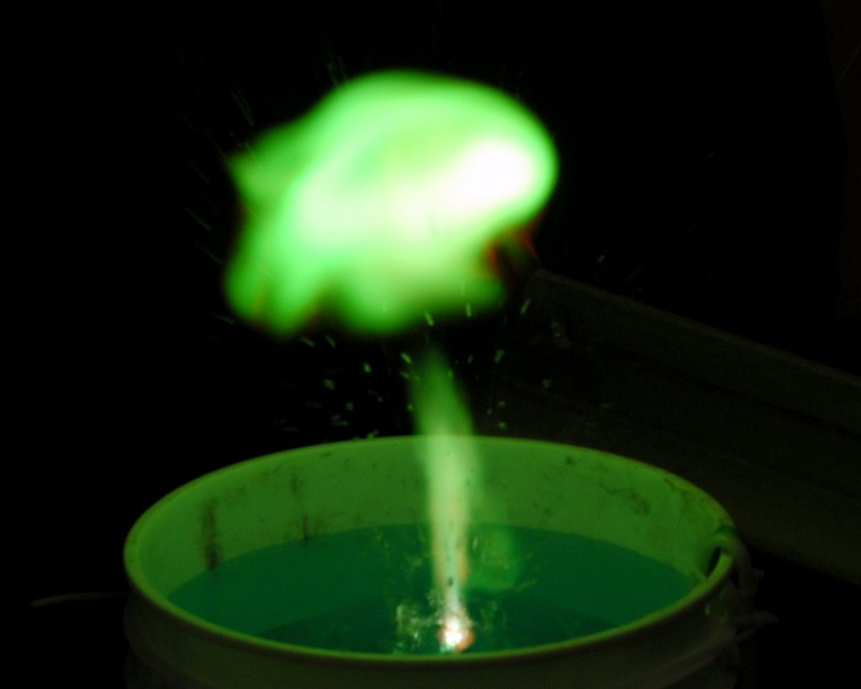
We have made several experiments in Los Alamos:
At LANL, with a 1mF, 10kV cap bank, hooked up to copper electrodes in a 5-gallon bucket, filled with a weak solution of tap water and copper sulfate. Various high speed cameras, including DiCam Pro, Phantom 4, and Phantom 7.3 were available. We learned that a negative center electrode is essential to forming good ball plasmas.

Slide 11
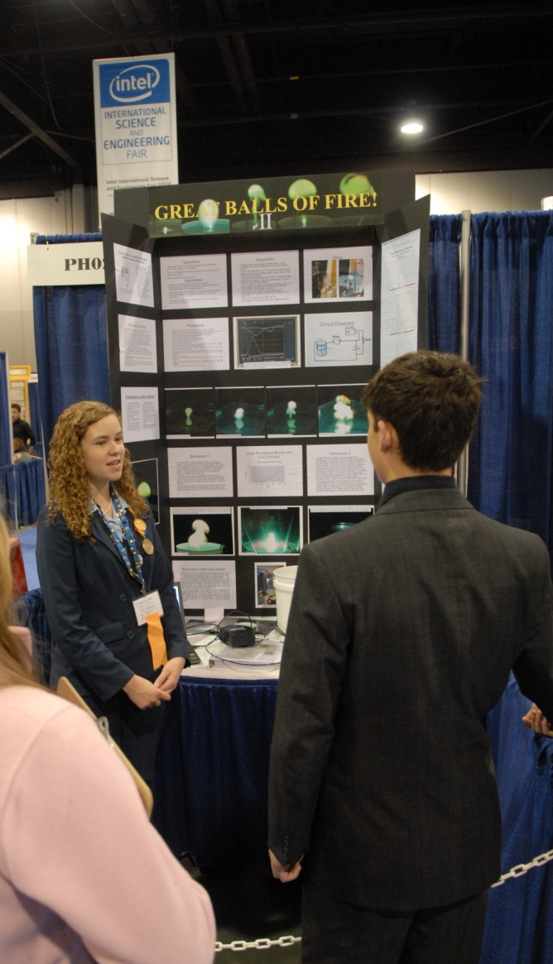
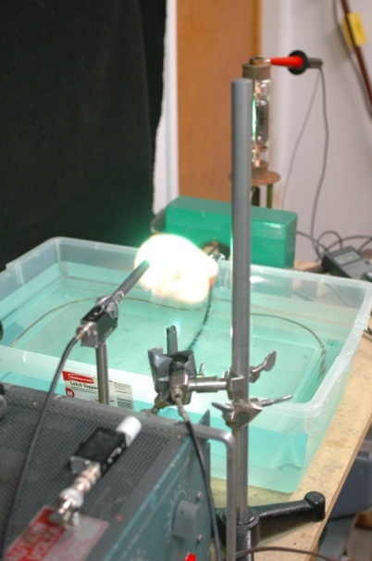
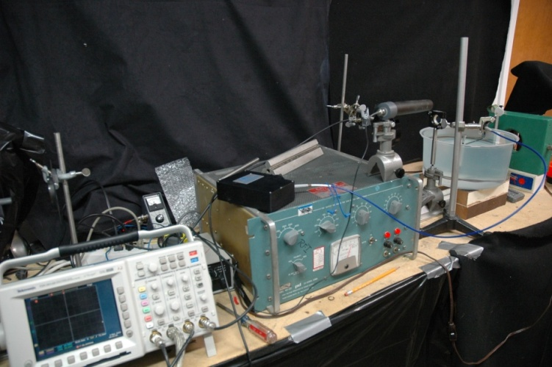
We have made several experiments in Los Alamos:
In Caroline von Wűrden’s lab (a garage), we used a 0.4mF capacitor, charged to 4-5 kV, in a 2-gallon plastic bucket, using distilled water, and a variety of salts, including copper sulfate, sodium chloride, lithium chloride, and copper chloride. We used a spectrometer loaned from Ocean Optics, and optics donated from CVI. A 2-channel 60 MHZ digital scope recorded light and current waveforms via USB port to a laptop computer. FLIR Systems engineers took mid-IR movies for us. Vision Research engineers took up to 20,000 fps visible video, and we took digital Nikon visible photos and standard video movies. A flush-cut center electrode surrounded by a ceramic piece was optimal.

Slide 12
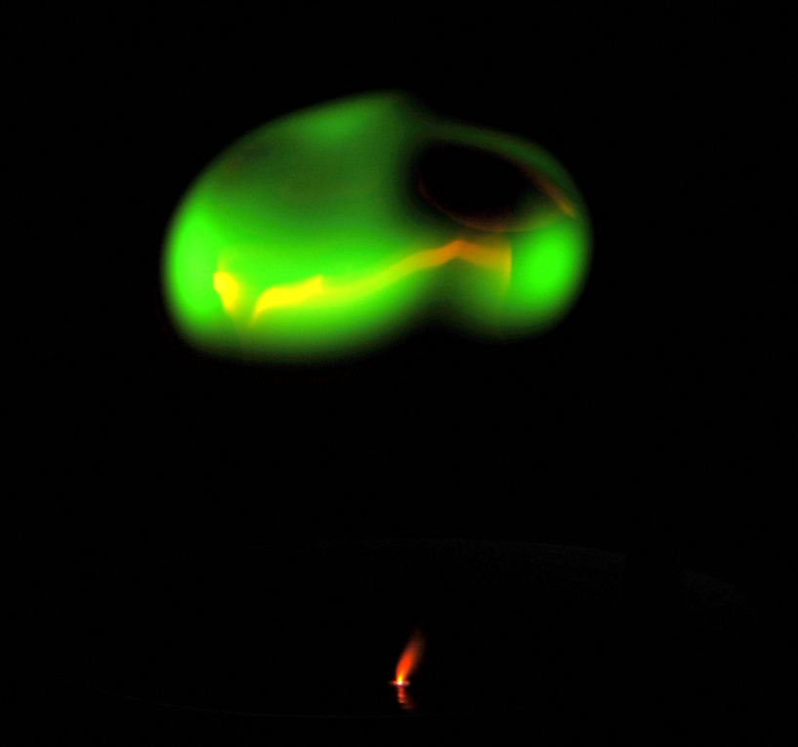
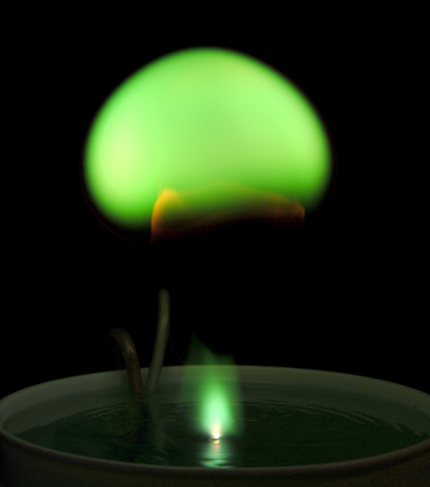
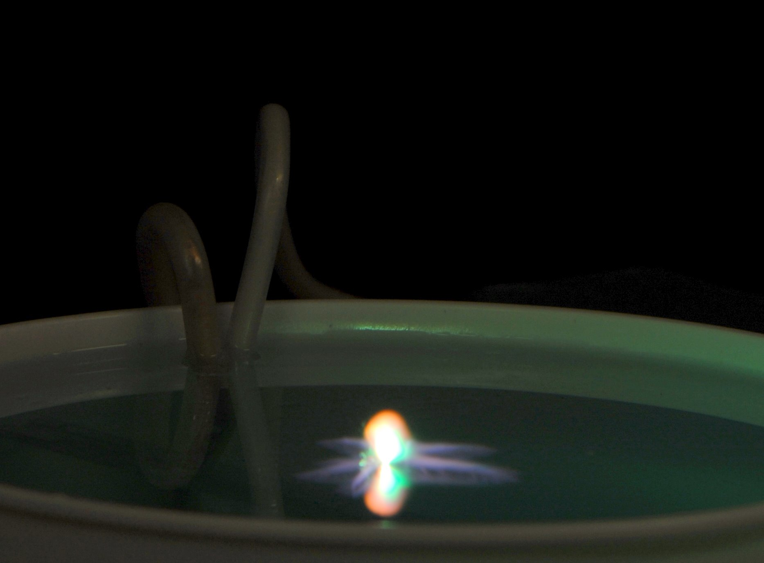
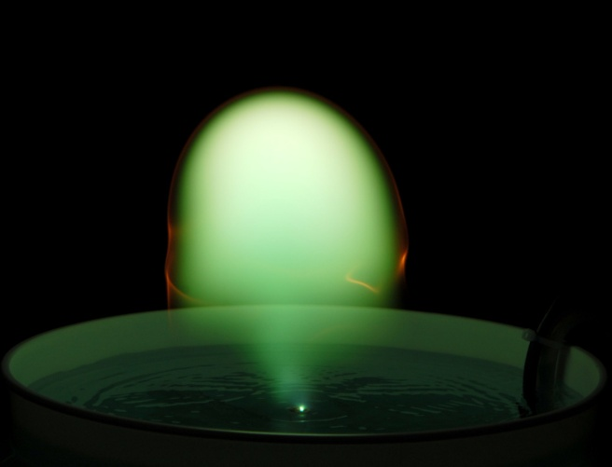
Still visible photography shows discharge evolution
Initial “spider breakdown”, bubble and stalk, detached “ball”, and vortex “smoke ring”.

Slide 13
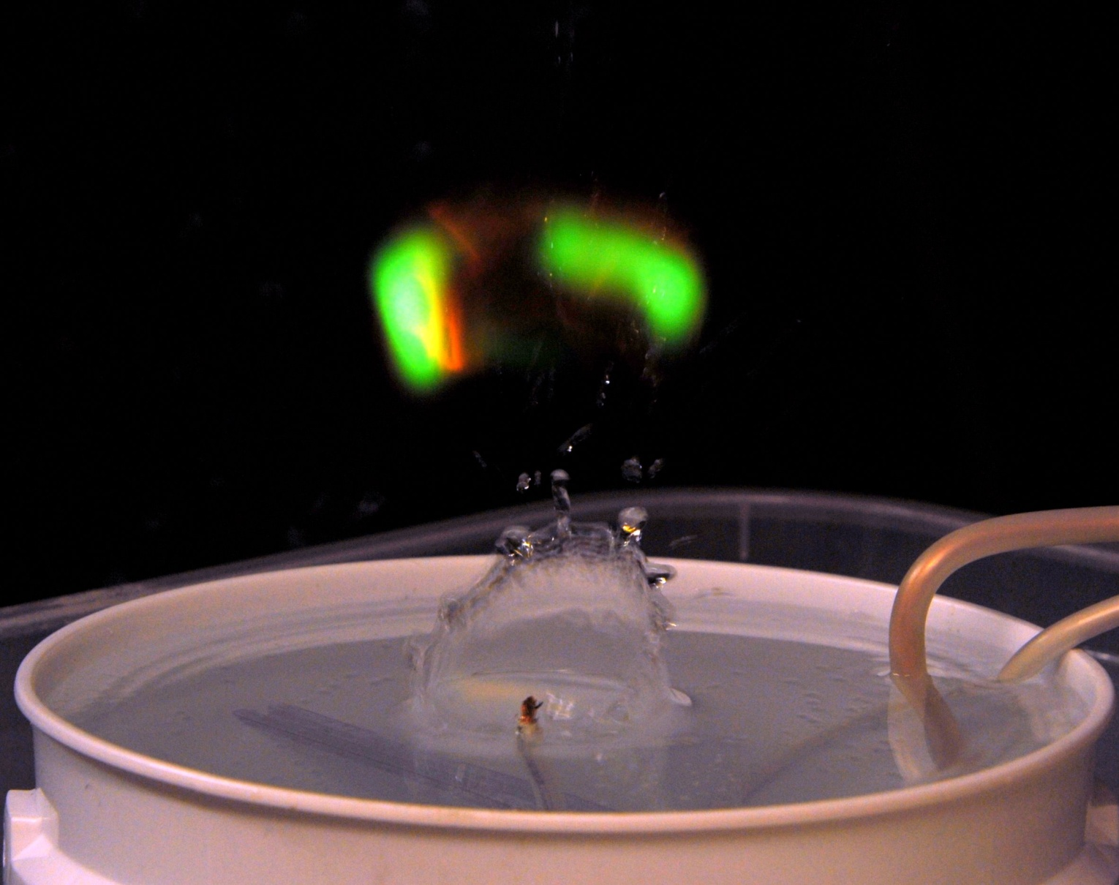
If the center electrode tip is exposed part way above the water, it kicks up water into the air !

Slide 14
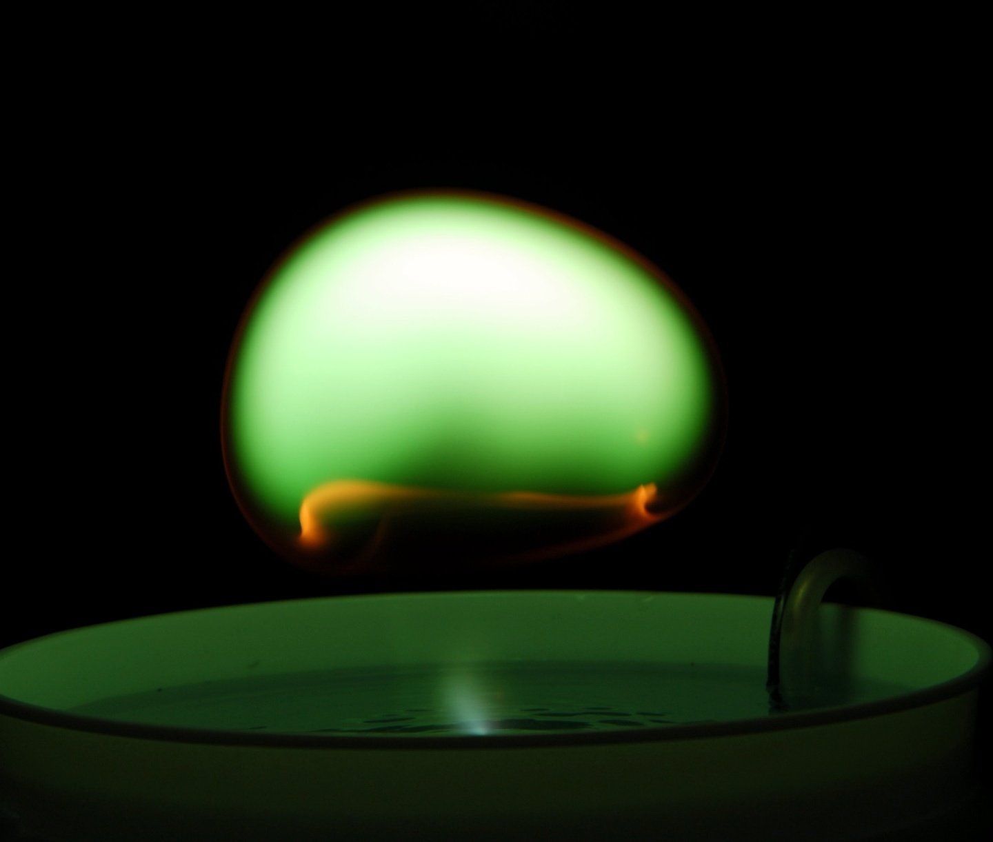
We found that a flush-electrode wire doesn’t kick up any water by comparison

Slide 15
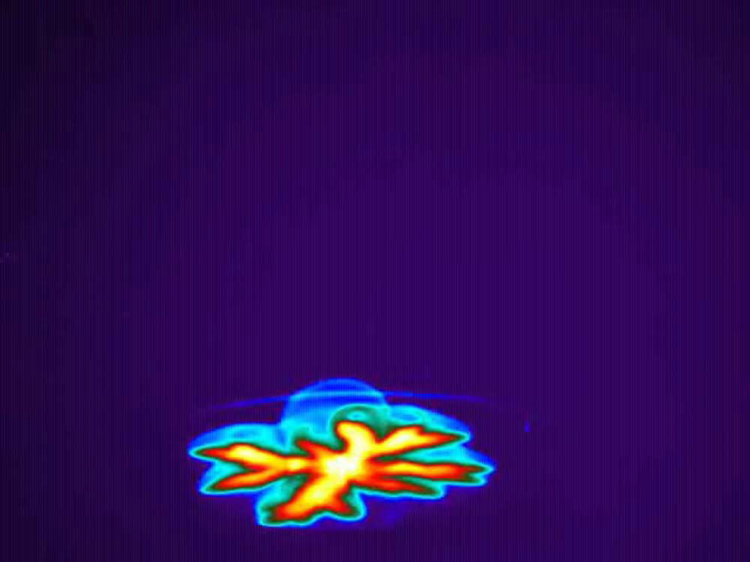
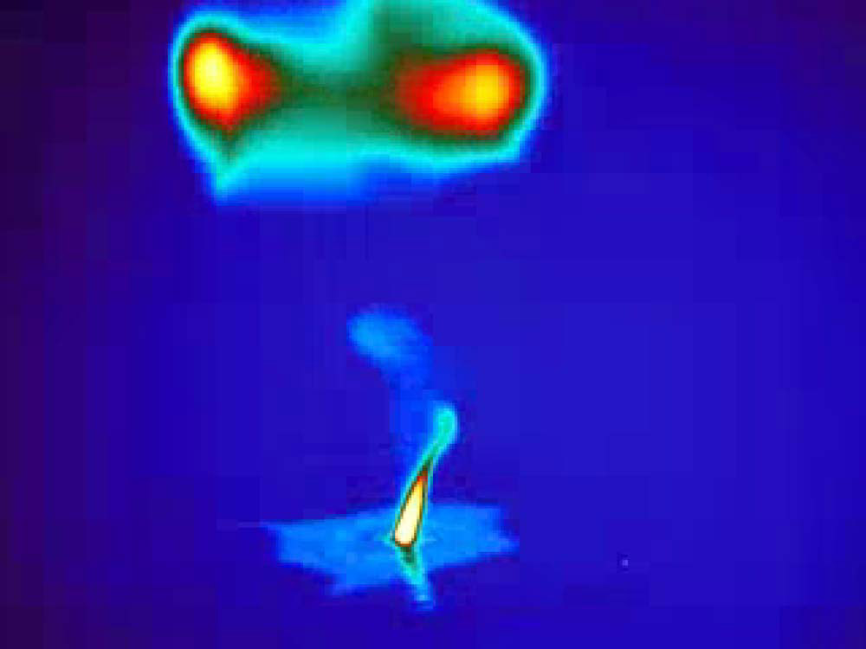
Infrared images reveal lift-off of vapor bubble at early times, and torus-smoke ring at late times
FLIR Systems SC-6000 QWIP camera IR images
931 usec Exposures, at T= +17 msec, and T=+483 msec

Slide 16
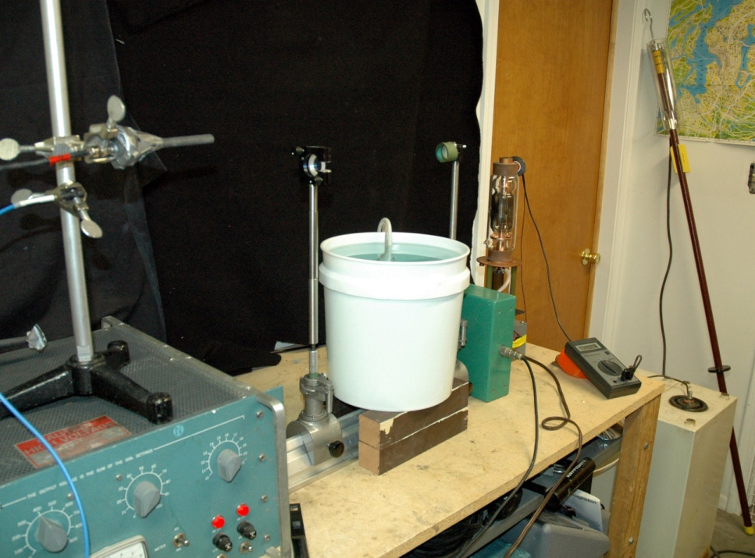
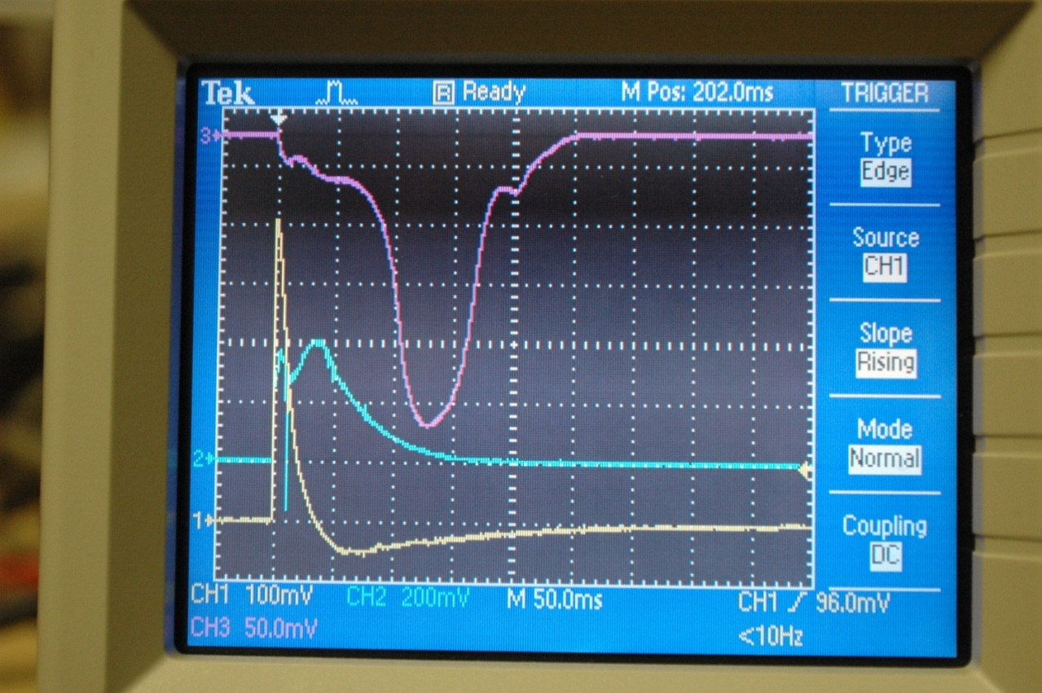
Current and light histories are monitored
Yellow: discharge current, 10 Amp/div Blue: wide angle photodiode
Purple: collimated light diode, 30 cm above water surface

Slide 17
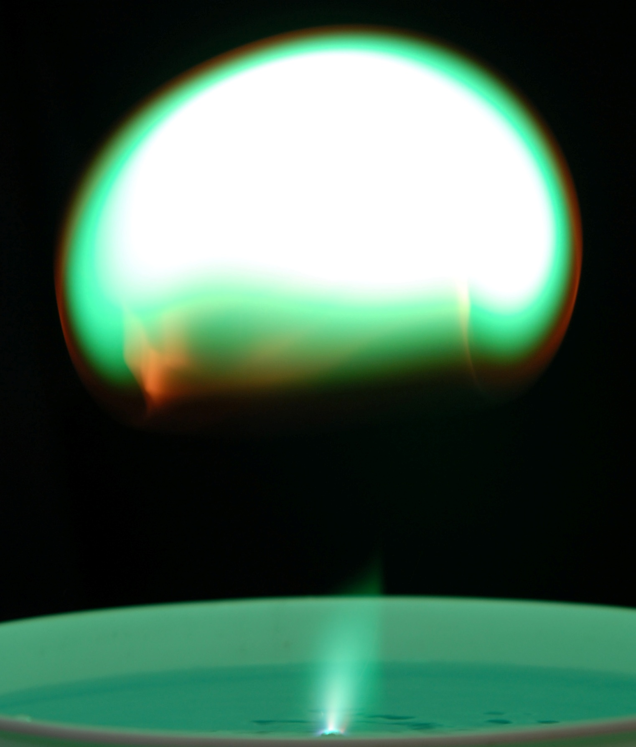
Plasma-air boundary
With a Copper electrode, and a weak Copper Sulfate solution, an orange-ish boundary layer is observed to separate the surrounding air from the greenish ball plasma.
At late times, it rolls up into a vortex ring, with filamentary structures.
1/90 second, f4, ISO 100,
white is over-exposed

Slide 18
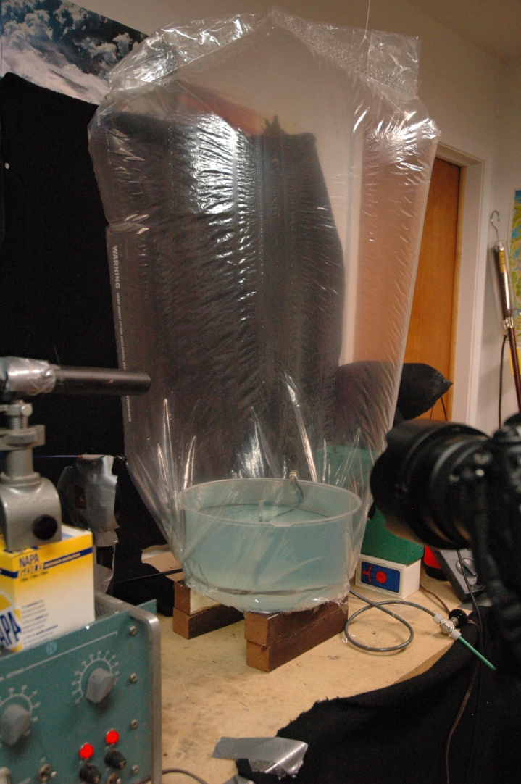
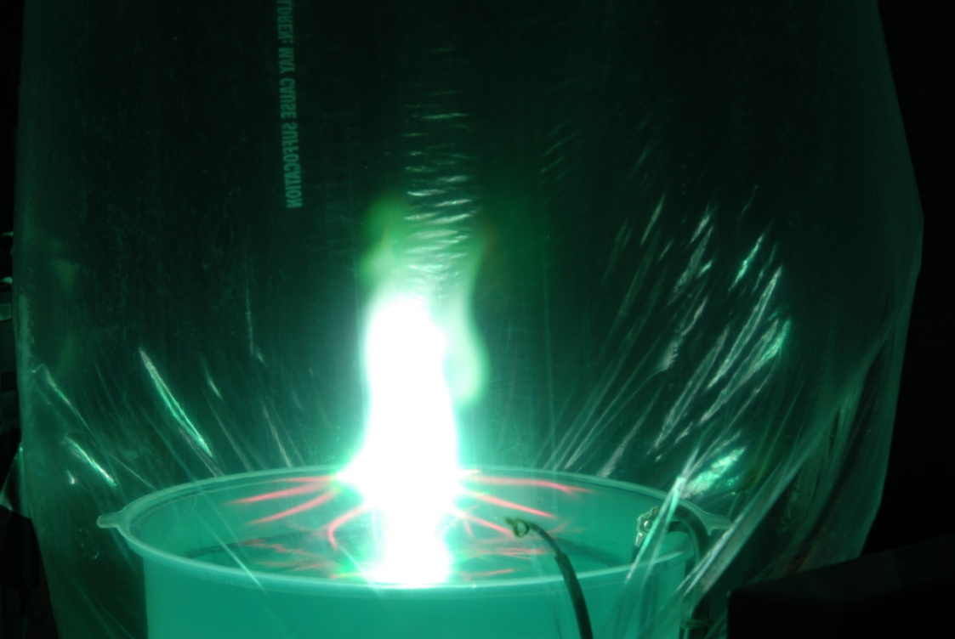
What is the nature of the boundary layer?
To find out, get rid of the air!
Put the entire experiment in a bag full of helium
The orange boundary layer is gone
The plasma makes more of a jet, and less of a “ball”
The spider legs become much more pronounced, and red
H-alpha looking towards the water surface….no helium lines

Slide 19
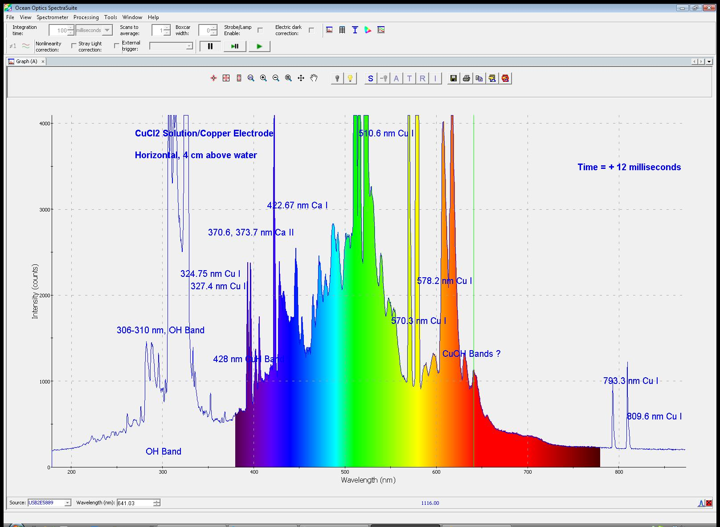
Using an Ocean Optics spectrometer, spectrograms are obtained every 3 milliseconds

Slide 20
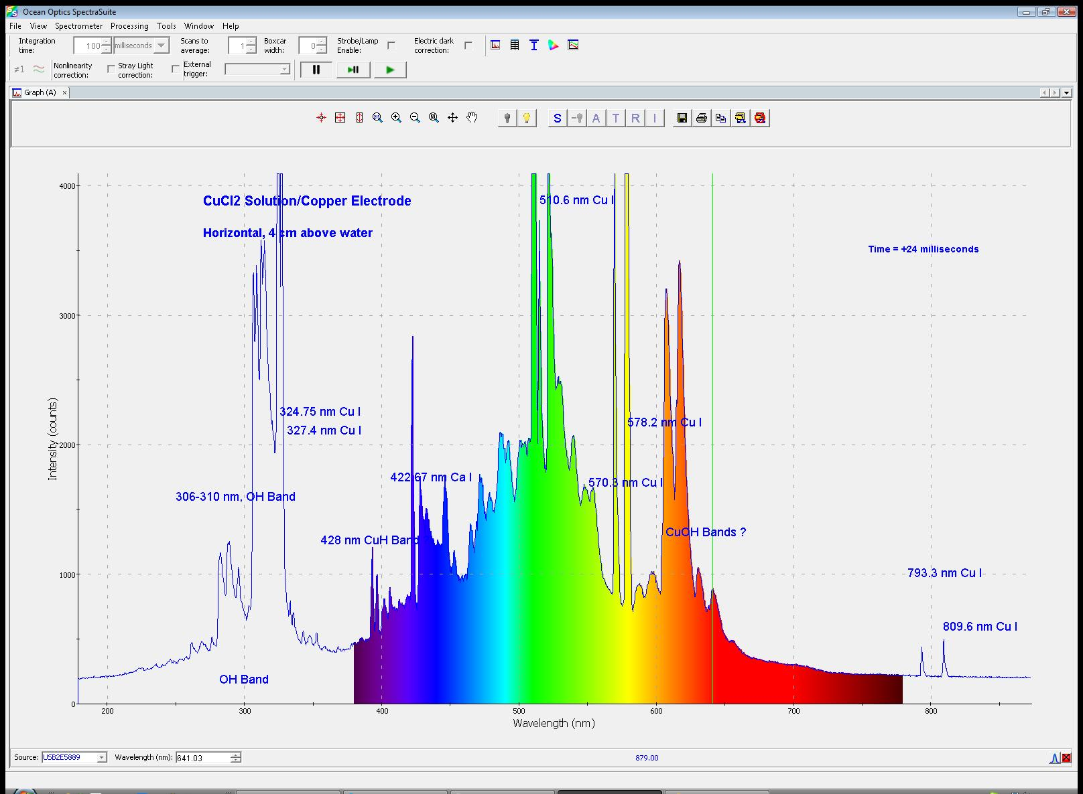
A fixed horizontal sight line samples the light from the plasma, as the ball floats upwards.

Slide 21
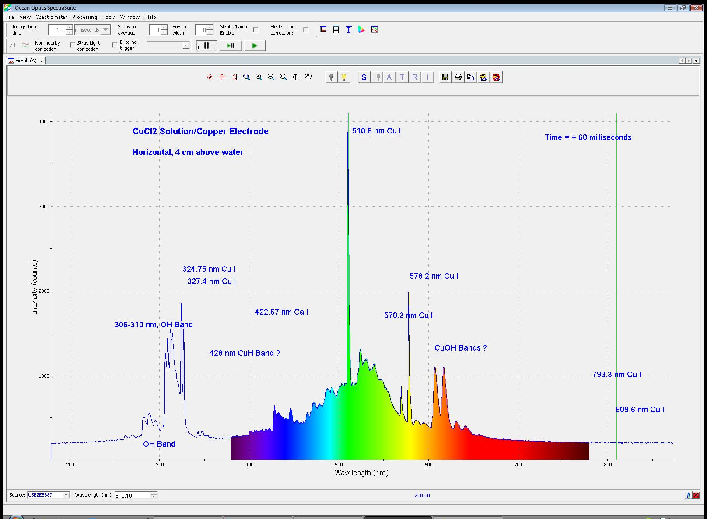
The light spectra simplify over time, as the ball plasma cools

Slide 22
Two dominant spectral lines are from Cu I
The 510.6 nm and 578.2 nm green and yellow emission lines dominate the spectrum, (unless you are looking down towards the center electrode arc).
These are known laser lines of a copper vapor laser.
We attempted to see if the ball plasma could be an active medium for lasing, at 510.6 nm. Using a flat 100% back reflector, and an 80% concave (R=0.5 m) output coupler, we looked for possible short pulse lasing action as the ball floats upward across a 0.3 m long stable hemispherical resonator optical cavity, but did not see it.

Slide 23
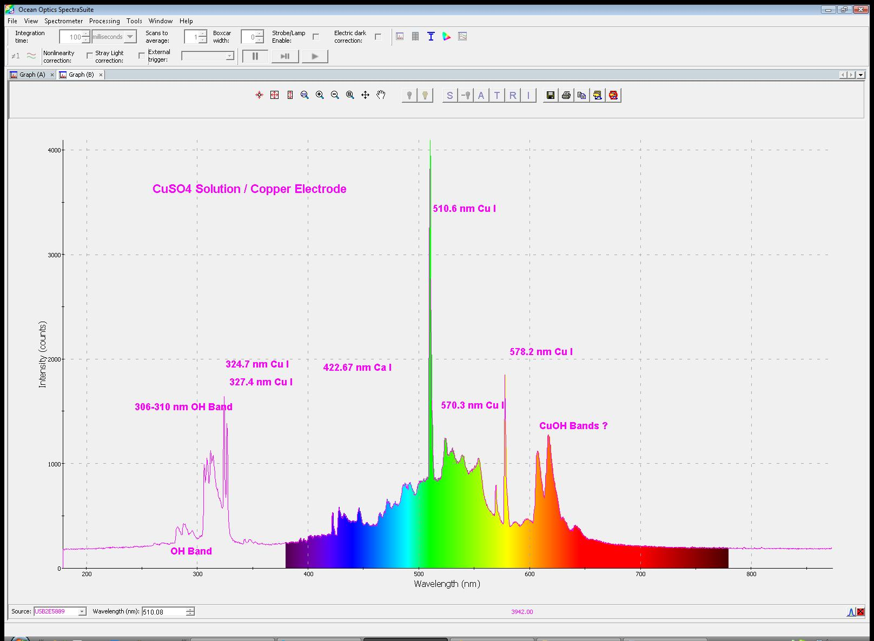
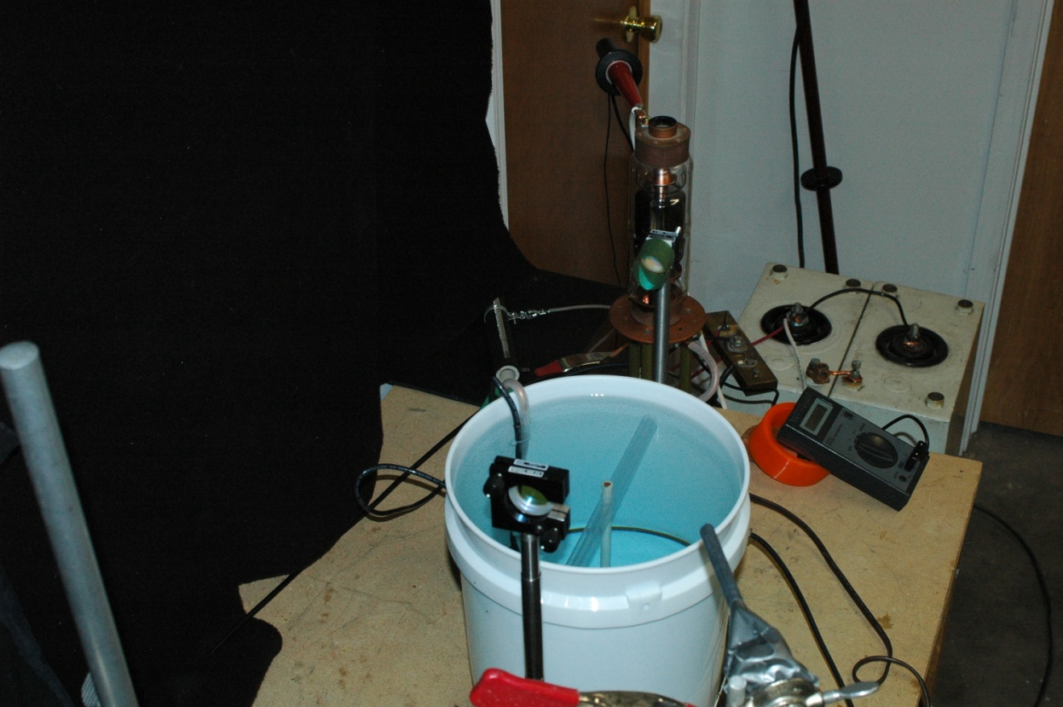
Setup looking for laser action
Laser mirrors are visible in the photo below, on mounts above the bucket
Since the emission and geometry changes as a function of time (height), the laser cavity location has to be scanned

Slide 24
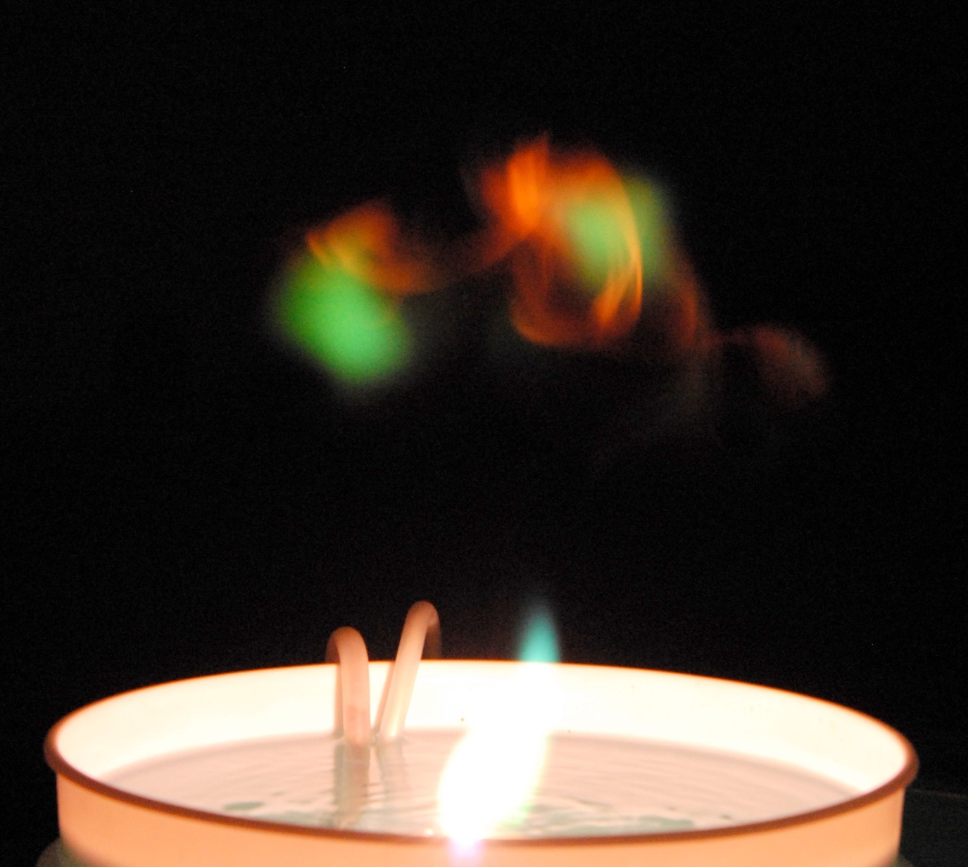
Filamentary structures are visible in the cloud
At late times, reddish filaments are seen, and are the last things still emitting visible light. In this case, a NaCl solution is used with a copper center electrode.

Slide 25
Summary of our experiments
A long-lived (0.3 second, 10-20 cm diameter) ball plasma floating in the air above a water surface has been formed and studied in the laboratory. A 0.4 - 1 mF capacitor is charged to 4-5 kV, and subsequently discharged (30-60 Amps, 20-50 msec duration) into central copper cathode fixed just below the surface of a bucket of water (with a weak solution of various salts in distilled water, such as CuSO₄ or CuCl₂, LiCl or NaCl). An underwater ring anode completes the circuit. A bubble of hot vapor from the water surface rises up in the first few milliseconds, and changes from a mushroom cloud with stalk, to a detached quasi-spherical object, evolving into a vortex ring. The plasma consists of ionized water vapor, with positive salts and OH⁻ radicals, as well as molecular species, and it completely excludes nitrogen or oxygen from the rising plasma structure. A fine boundary layer is visible in orange, in contrast to a green ball interior when using Cu/CuSO₄, and filamentary structures are visible at late times. Finally, a rising whisp of smoke ring is observed as a residue. A variety of visible and infrared imaging (both video and still cameras) are used, along with 200-800 nm time & space resolved spectroscopy, to identify features of this laboratory analog to ball lightning.

Slide 26
Summary
Long lived free-floating plasmas are generated above a bucket of water.
The plasma consists of excited molecules, hydroxyl radicals, and positive salts from the solution and center electrode material.
Air is excluded from the plasma (no nitrogen or oxygen lines are seen spectroscopically). We were unable to see copper laser emission at 510.6 nm from the medium. When discharged into a Helium atmosphere, the orange boundary layer is absent, and initial spider legs are red (H-alpha).
At later times, the ball detaches, and evolves into a Hill-vortex type structure. Dusty filamentary structures can be seen inside of the plasma, which at late times remain turn into a non-glowing Hill-vortex smoke ring.
Our ball plasmas in the lab do NOT reproduce all the features of ball lightning…particularly, they are too buoyant in air.

