Slide 1
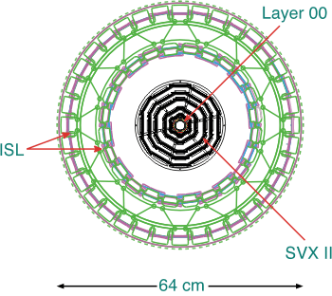
CDF Silicon Detectors
ISL PortCard Leak Repair
October 11th 2007 Ken Schultz (kschultz@fnal.gov)

Slide 2
Introduction
May 8th: Problems with the Silicon Readout Electronics for Layer 0 and ISL cooling system started:
Flow dropped from 1.7 to 1.3 lpm
Pressure increased
Differential Pressure dropped
The problem did not appear to be with a valve but like an obstruction, likely an air bubble.
This was investigated during an access due to Accelerator Safety System tests on May 10th:
During the access: Rate of Rise and visual inspection were realized.
The investigation pointed to an air leak in the system.
After access: it was not possible to recover the amount of flow needed to reach the lower limit required by the interlock system.

Slide 3
I wish to thank all who helped! This Succeeded by TEAM Effort
Task Force Members:
Del Allspach, Mary Convery, Jose Enrique Garcia, Doug Glenzinski , Ignacio Redondo Fernandez, Ulrich Husemann, C.M. Lei, Mike Lindgren Aseet Mukherjee, Bill Noe, Robert Roser, Ken Schultz, David Stuart, Bob Wagner, Peter Wilson
Also the CDF Tech Team for their support.
Reviewers:
Jim Strait, Bob Kephart, Rich Stanek, Richard
Schmitt, Bill Cooper

Slide 4
Silicon Cooling Systems (I)
Cools sensors, readout electronics on detector (SVX chips) and nearby readout electronics (Portcards)
SVX and ISL have independent cooling systems using water and ethylene glycol as coolant
SVX (-10ºC)
SVX 70/30 water/glycol
ISL (+6ºC) - includes portcards for ISL/L00 on one cooling ring and SVX on a separate cooling ring
Need to keep SVX colder to reduce impact of radiation damage
ISL initially used water, added 10% glycol in 2005 to avoid rare freeze condition

Slide 5
Silicon Cooling Systems (II)
Each system broken into ~10 cooling circuits on face of central detector with separate electronic control valves
From control valves cooling lines follow COT/Silicon cables to COT face
Operated sub-atmospheric: leak sucks air into system rather than pushing coolant onto detector or electronics

Slide 6
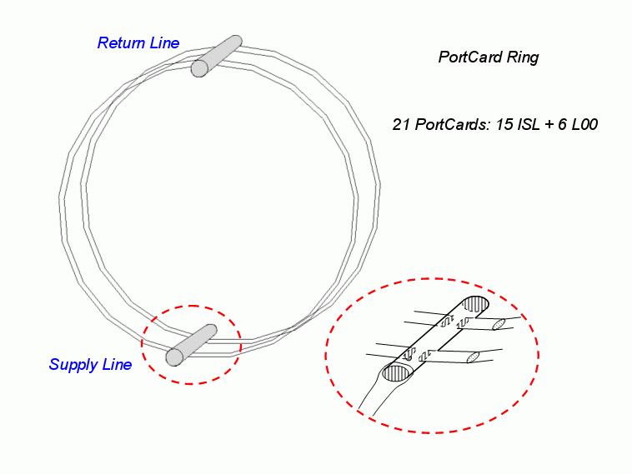
ISL Port Card Cooling Manifold Assembly
O.D. = 55.5cm

Slide 7
Leak Observations
In May, Doug and I investigated leak in east postcard ring
Isolated to manifold/ring assembly with catheters
Bore scope investigation shows pitting on heat affect zone (HAZ) of manifold
Observe suspected hole on supply manifold next to first tube
Estimate size of order 20mils
Pitting observed in several locations
Notes:
Around this time the west port card cooling manifold began to show similar symptoms as the east. We suspected that a leak was developing but most likely in the return manifold. This proved to be wrong, in fact the leak was in the supply and was at least a factor of 2 magnitude greater than the east.

Slide 8
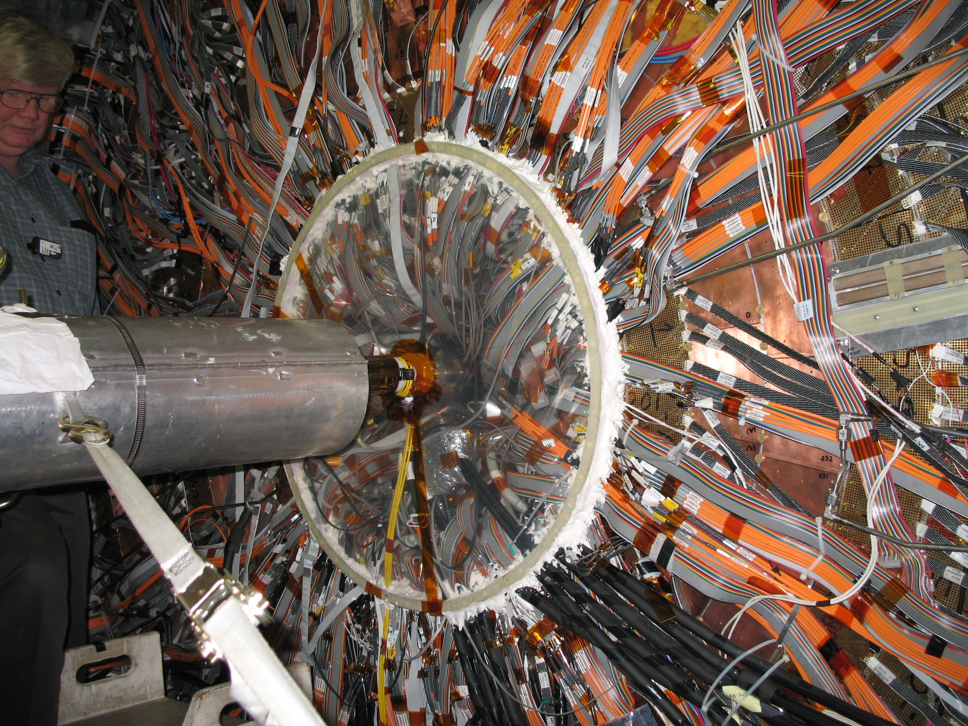
COT
Supply & Return Manifolds
Are > 63.5 cm in Z
Silicon Volume

Slide 9
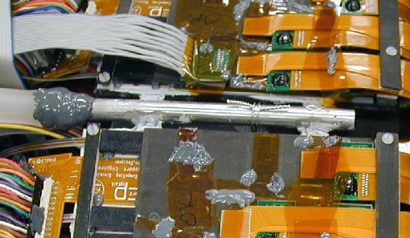
Port Card Manifold at Port Card Support Ring
Manifold
Manifold
Oval Tubes

Slide 10
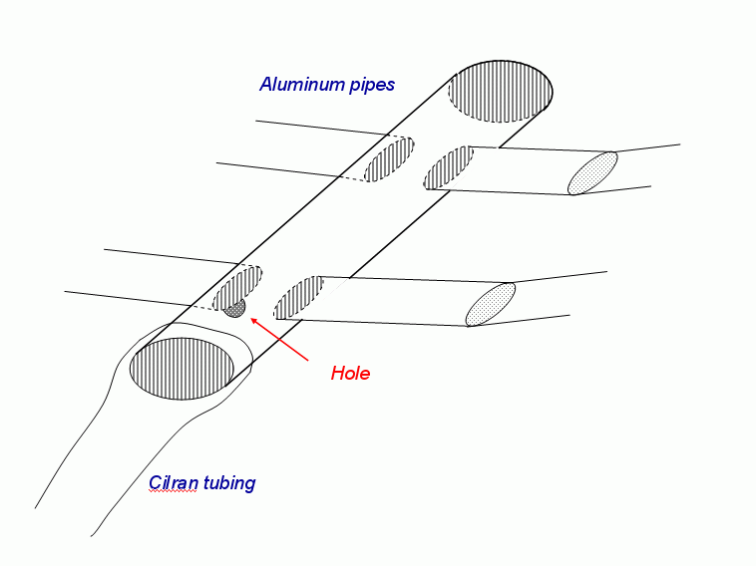
In July further investigation with bore scopes (new camera)
Clear pitting observed on at least 7 of 8 weld locations
Pressure test isolating rear ring/manifold shows leak there
Assume West looks same as East

Slide 11
Repair Concerns
Failed to do repair in July access
Not able to get tools in place inside manifold
Bends in Cilran tubing sharper than expected
Mockup was too optimistic
Did not attempt deposition of epoxy

Slide 12
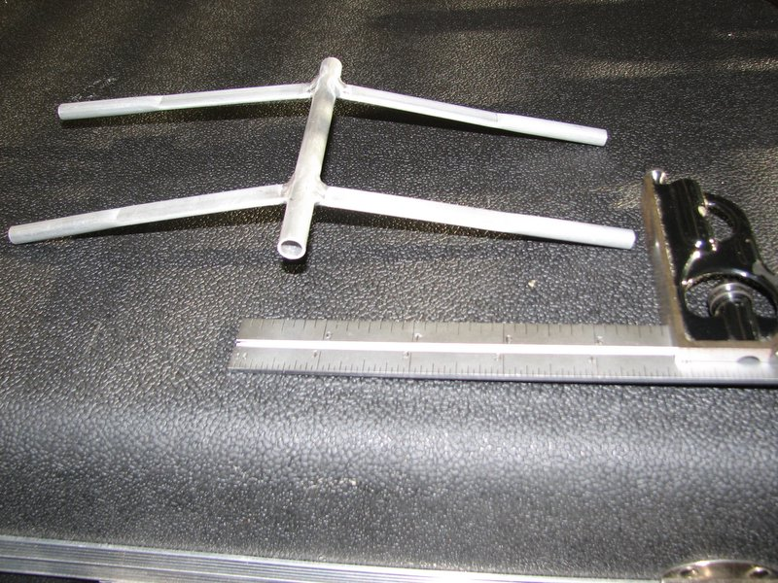
Manifold Mockup
Weld Areas
Oval Tube

Slide 13
Keeping Silicon Dry
Requirements:
Cold and Dry
Solution:
We will turn the COT bore into a dry room

Slide 14
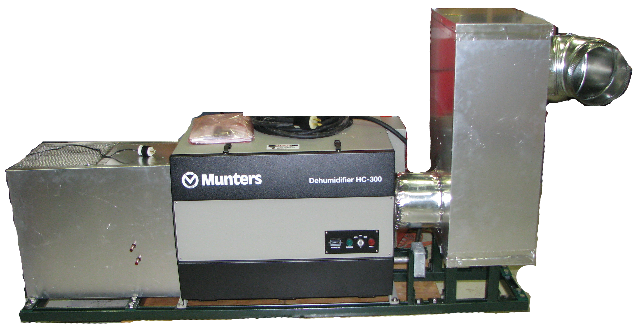
Air Drying System
Build Air drying system for east and west ends
Separate dryers for each side
Push dry air through Si volume
from end opposite workers to
push humid air away from Silicon

Slide 15
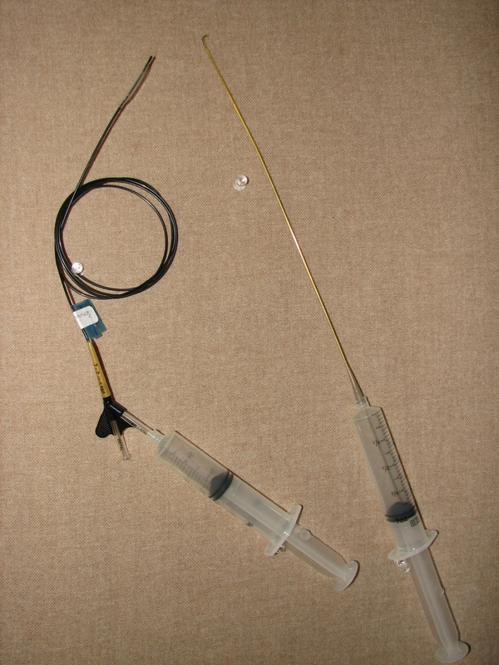
Repair Equipment
Test: Mock up - deposit epoxy over pitting in Al and filling holes in mockup of manifold
Wets and fills 30, 40 mil holes when applied from above or below
Good bonding on surface previously contaminated with coolant
Cures at temperature of tube ~15°C
Tested and practiced along 1m length of tubing using tooling and bore scope

Slide 16
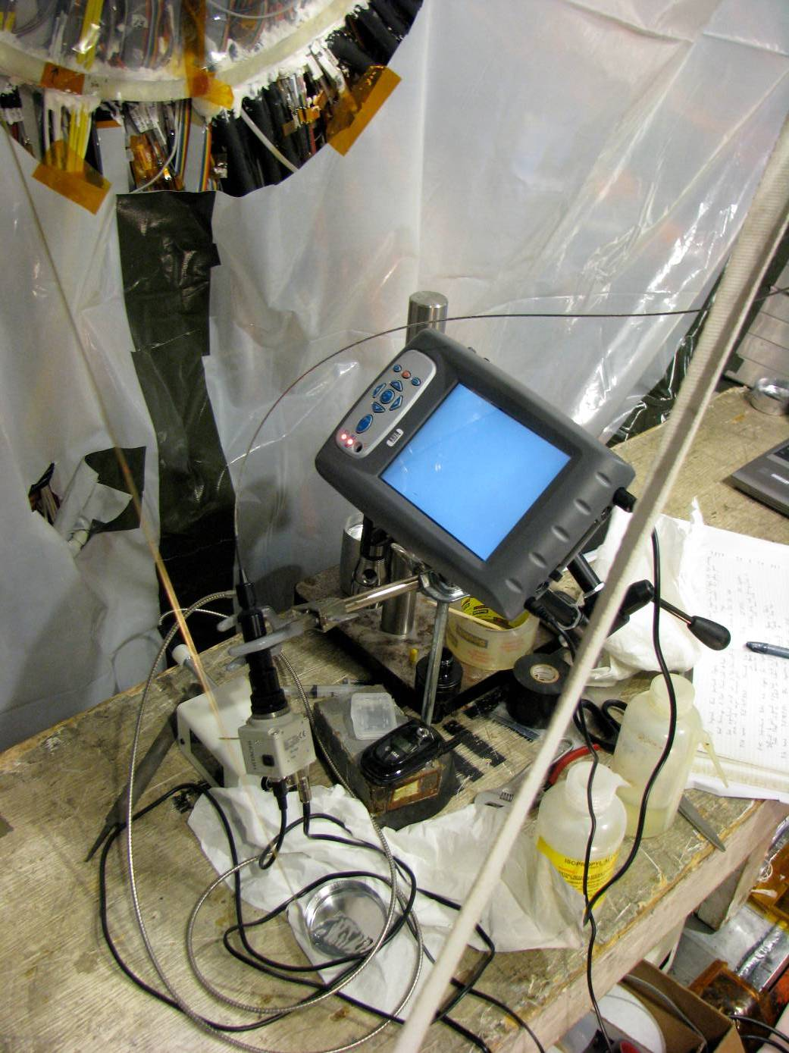
Repair Technique
Leak was repaired with epoxy (3M DP190 faster curing version of structural epoxy 3M 2216 used in ladder cooling line joints)
Tooling to transport and deposit epoxy
New bore scopes greatly improved resolution
Filled all pitting areas - applied bead around the annulus of each joint

Slide 17
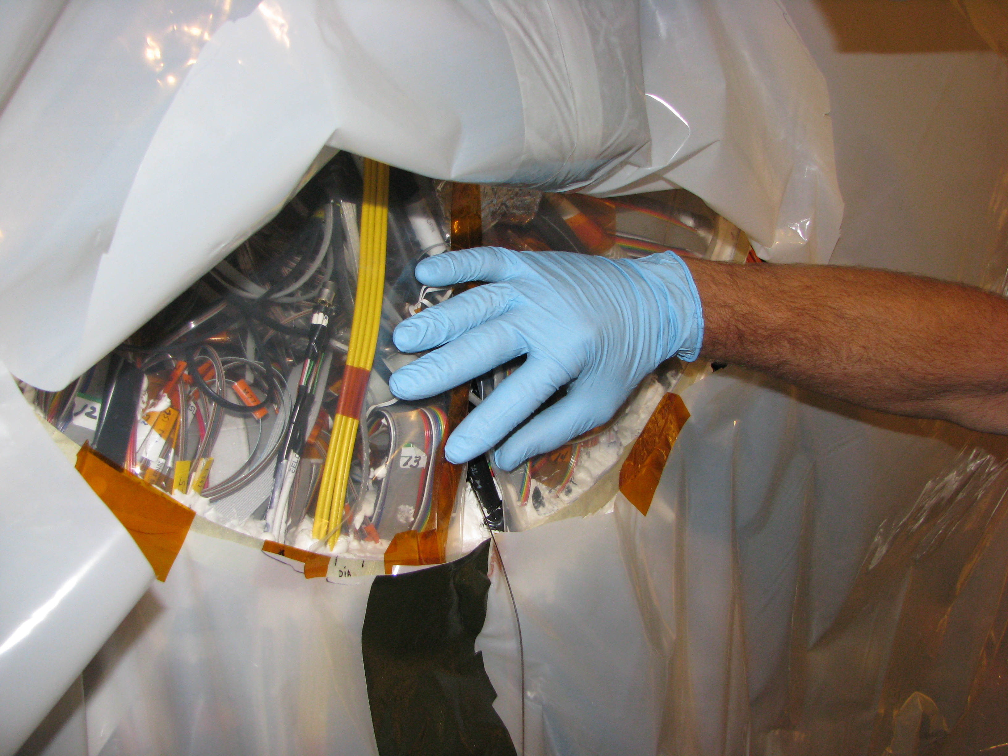

Slide 18
Videos / Conclusion
Epoxy Application
Leak Detection
Balloon Test
Epoxy a Total of 16 Joints – East/West
Full System is Ready for Start Up…

