Slide 1
NOAA’s Office of Education (OEd)

Slide 2
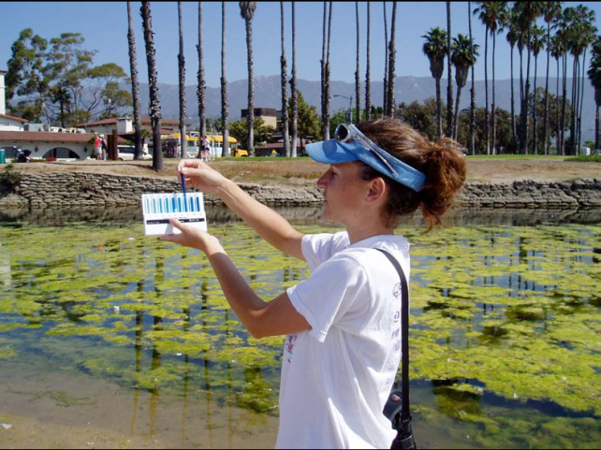
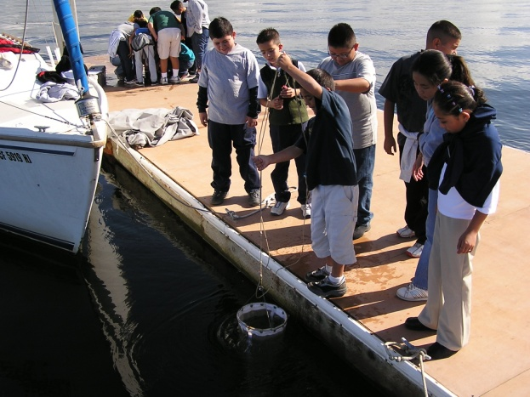
Summary of Content
Mission
Vision
Outputs: Products and Services
Programs
Budget
Leadership
Facilities and Personnel
Flow of Information
Highest Priority Issues
Urgent Issues

Slide 3
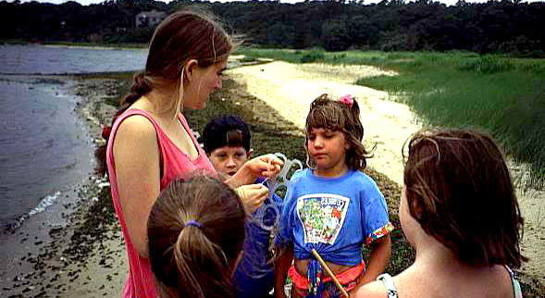
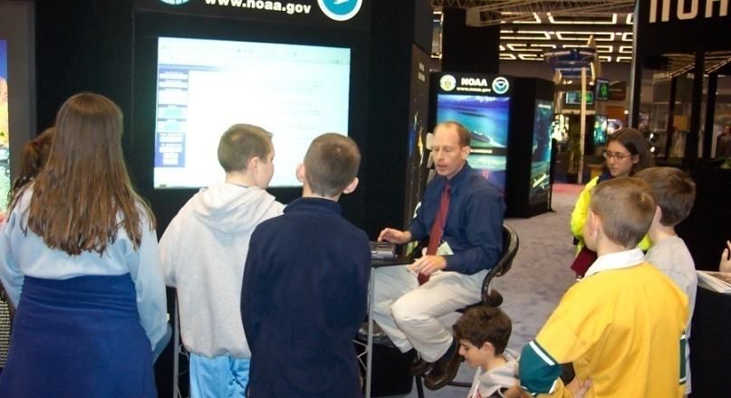
Mission and Vision
NOAA’s education program will improve the public’s understanding and appreciation of NOAA-related sciences and of the natural resources the agency is charged to protect resulting in an environmentally literate constituency that can make informed decisions and take appropriate actions
An environmentally literate public and a diverse workforce who will use NOAA’s products and services to make informed decisions that enable responsible action

Slide 4
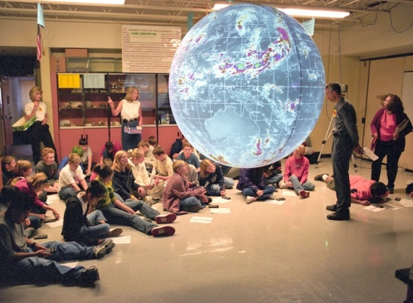
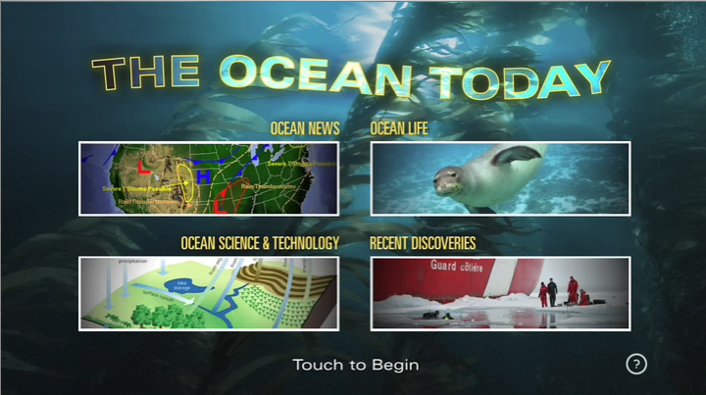
Outputs
Long Term Outputs
Short Term Outputs
Provide leadership on the Education Council (e.g., Education Plan)
Co-chair the Ocean Education Interagency Working Group
Increase agency visibility through the Education Outreach Center
Provide educational training to enhance employee’s education skills
Promote literacy through:
The Environmental Literacy Grants
The Bay Watershed Education and Training Grants
Provide student opportunities through:
The Undergraduate Scholarship Program
The Ernest F. Hollings Scholarship Program
The Nancy Foster Scholarship Program
Increase workforce diversity in STEM fields through:
The Graduate Sciences Program
The Cooperative Science Centers at Minority Serving Institutions
Disseminate NOAA-related content through:
The Science On a Sphere museum partners
The Ocean Today kiosk aquarium network

Slide 5
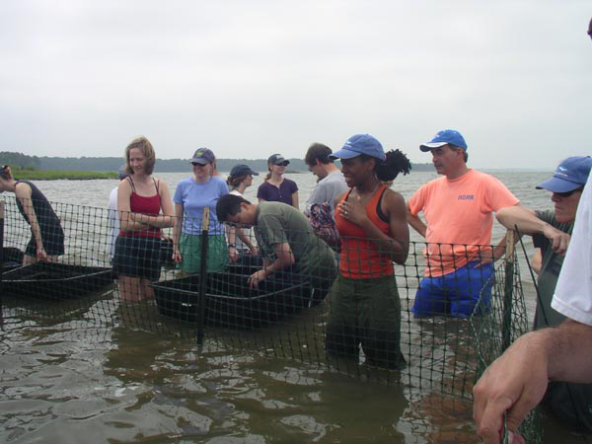
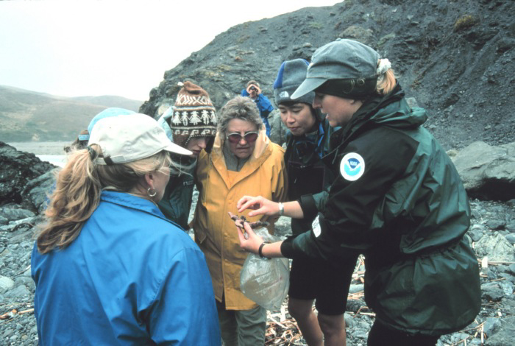
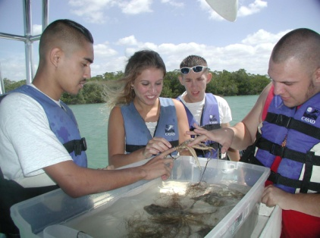
Services
The Office of Education (OEd) is a staff office within the NOAA Administrator’s Office with staff in downtown Washington, D.C. and in Silver Spring, Maryland.
The Office of Education:
Provides advice and counsel to the Under Secretary on matters pertaining to education
Coordinates education activities across NOAA and oversees the implementation of the NOAA’s Education Plan and Policy in conjunction with the NOAA Education Council
Ensures that NOAA’s education programs and activities are based on NOAA-related science and support the agency’s cross-cutting priority of promoting environmental literacy
Works with external partners to promote environmental literacy efforts that directly and indirectly benefit the NOAA mission

Slide 6
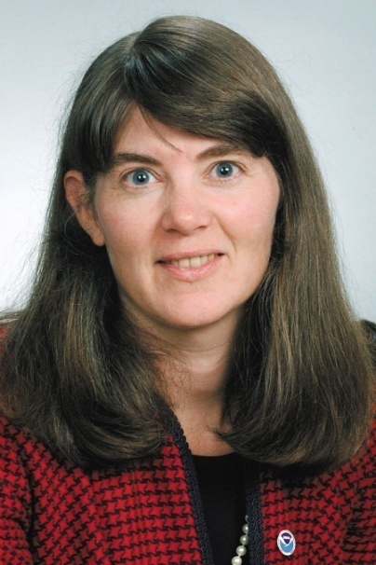
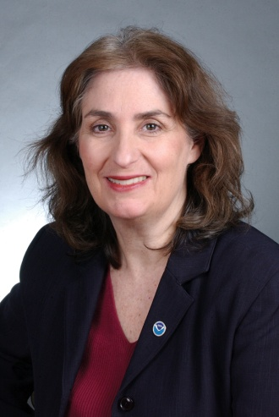
Who We Are: Oed Leadership
Louisa Koch Director of Education (Career)
Marlene Kaplan Deputy Director of Education (Career)

Slide 7
Facilities and Personnel
NOAA’s Office of Education (OEd) has offices in both Silver Spring, Maryland and Washington, D.C.
OEd personnel include the following:
FTE: 18
Contractors: 8
Fellows: 2
Students Occupying OEd/EPP FTE: 11*
*These students occupy an FTE in the Educational Partnership Program (EPP) as part of the Graduate Sciences Program (GSP). Some students work full-time. Others attend graduate school full-time and work at a minimum of 640 hours per year. Their duration in the GSP is based on degree pursued (master's or doctorate), depth of research, and course offerings at the academic institutions. EPP routinely supports 12-15 students per year, each occupying an individual FTE.

Slide 8
Office of Education Organizational Chart
Director
Deputy Director
K-12 &
Informal Education
Grant Programs
Environmental Literacy
& BWET
Policy
Planning
Coordination
EPP &
Scholarships
Scholarships
EPP

