Slide 1
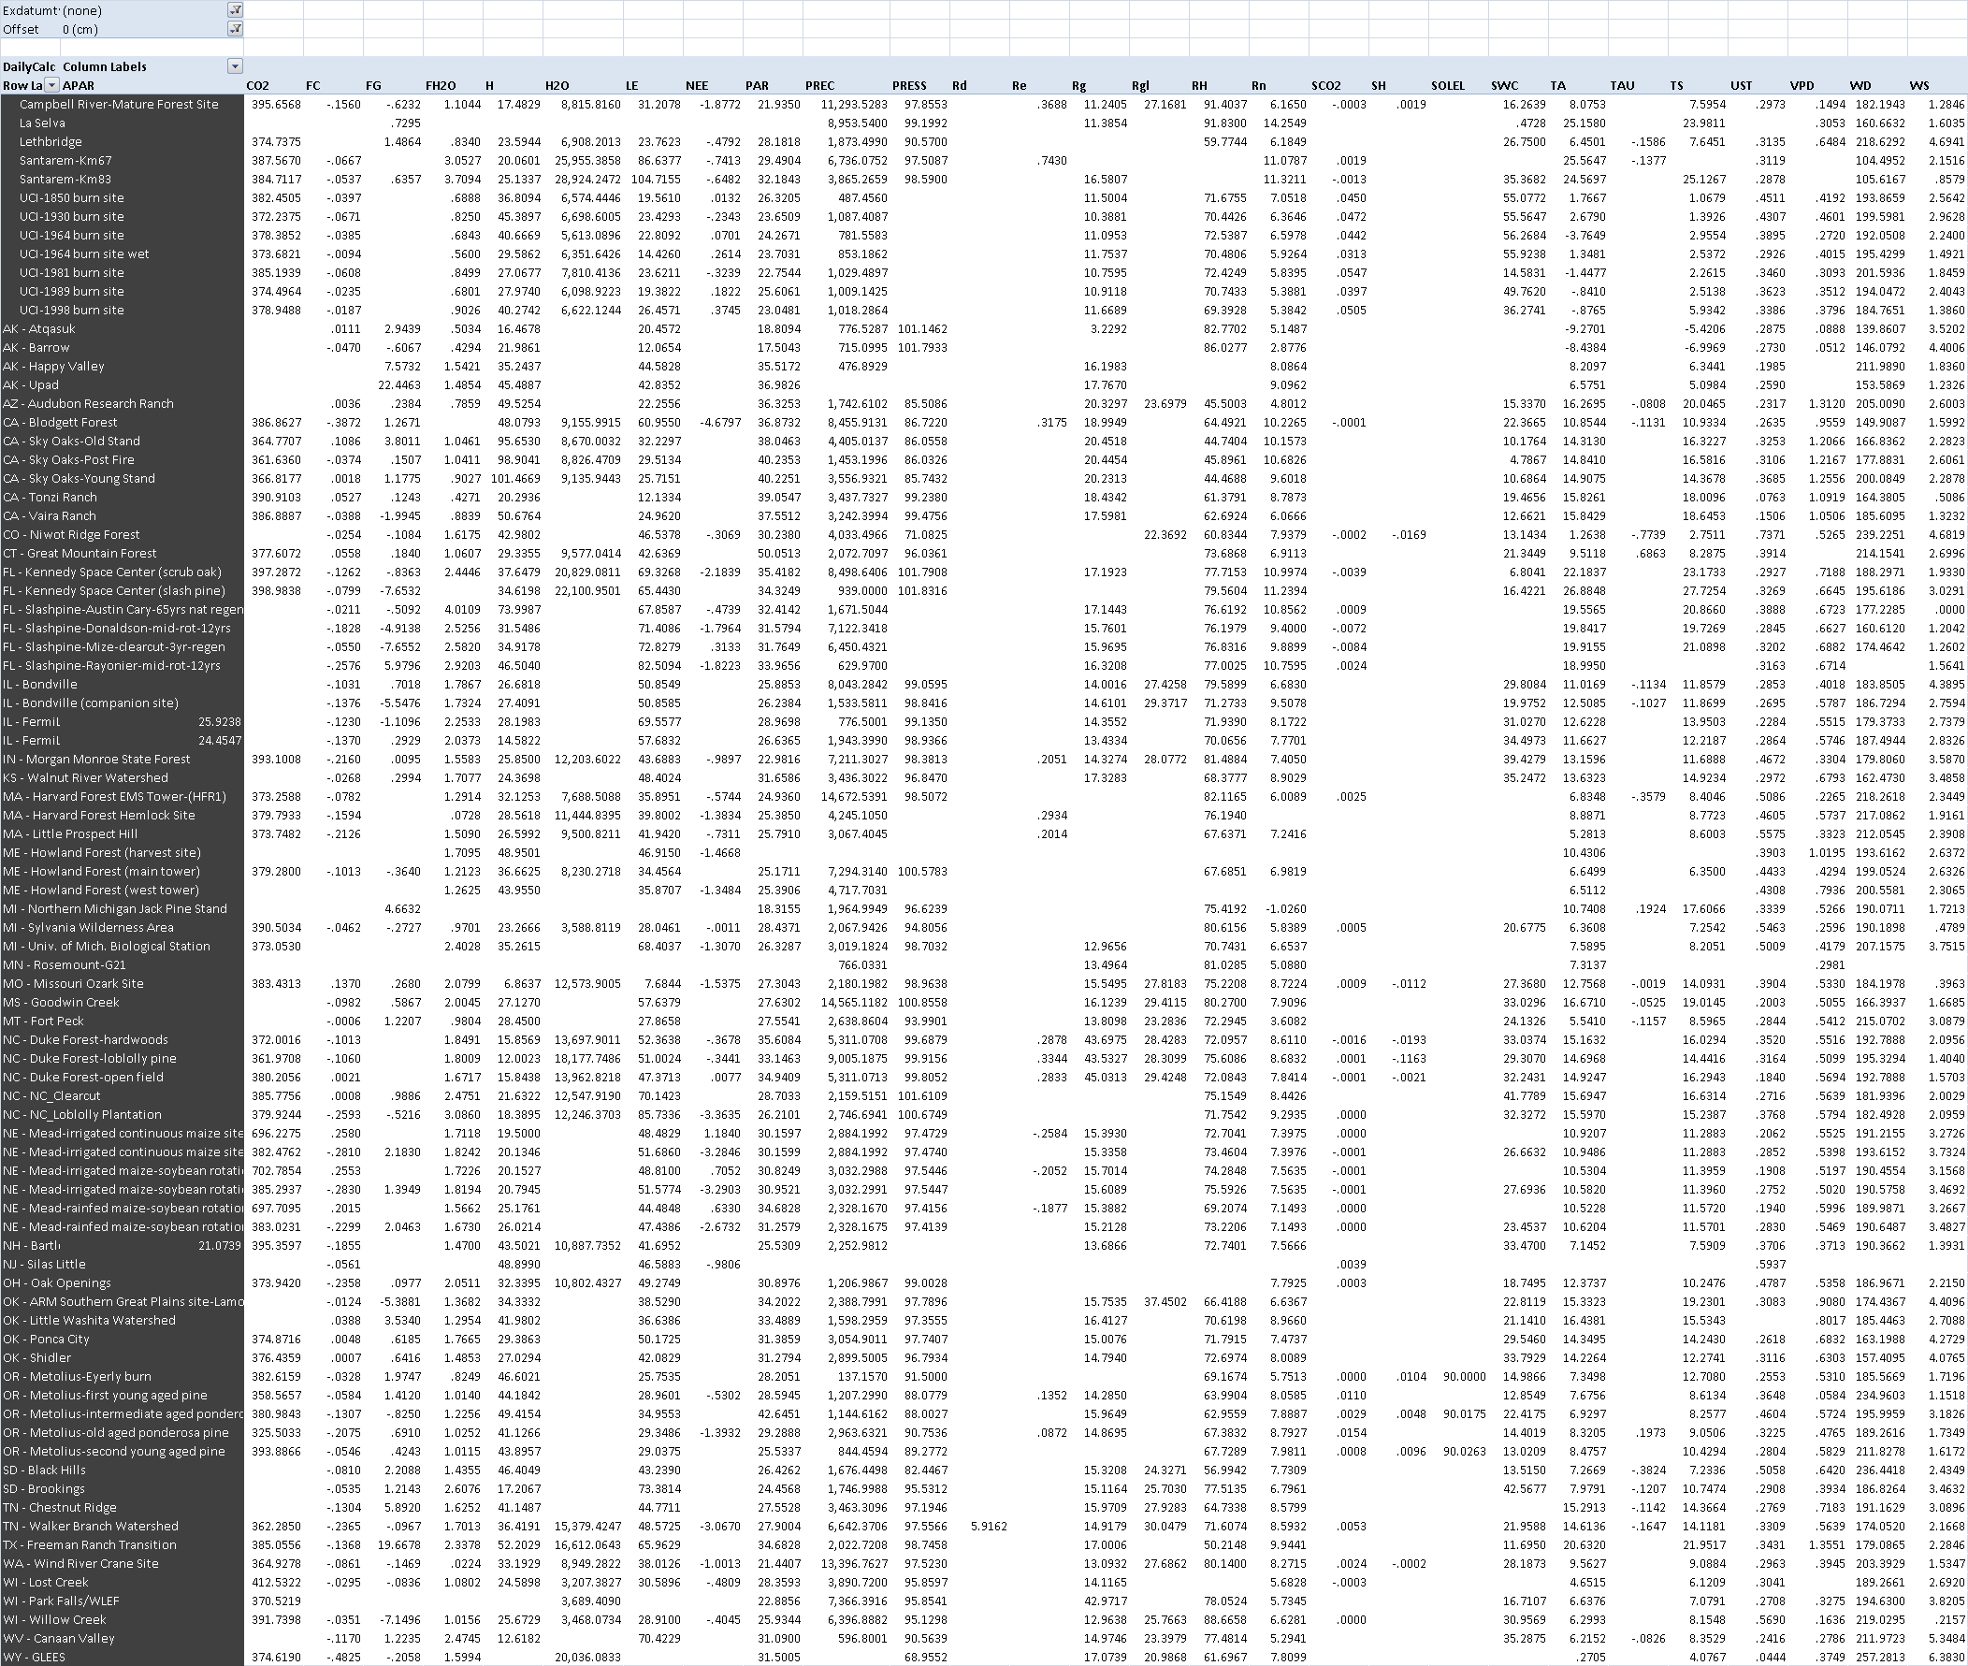
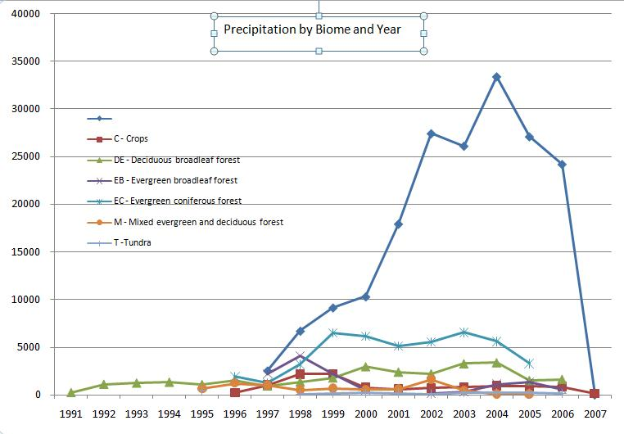
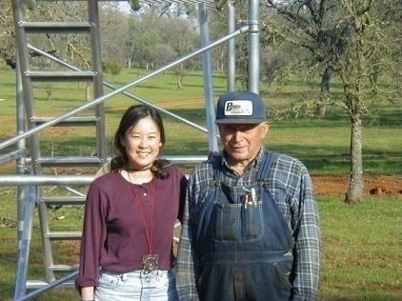
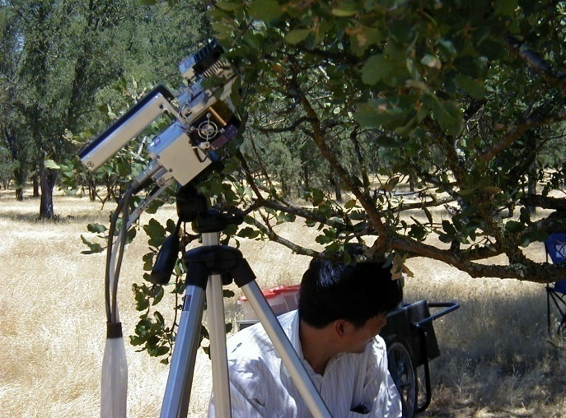


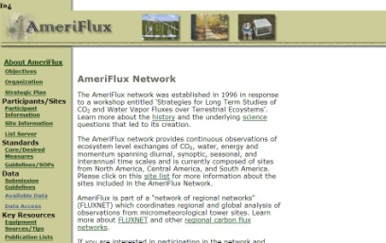


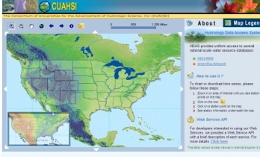
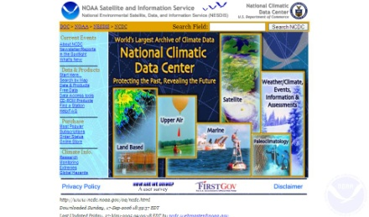
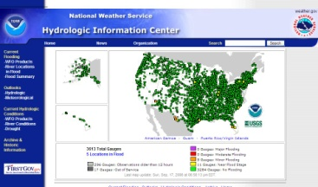

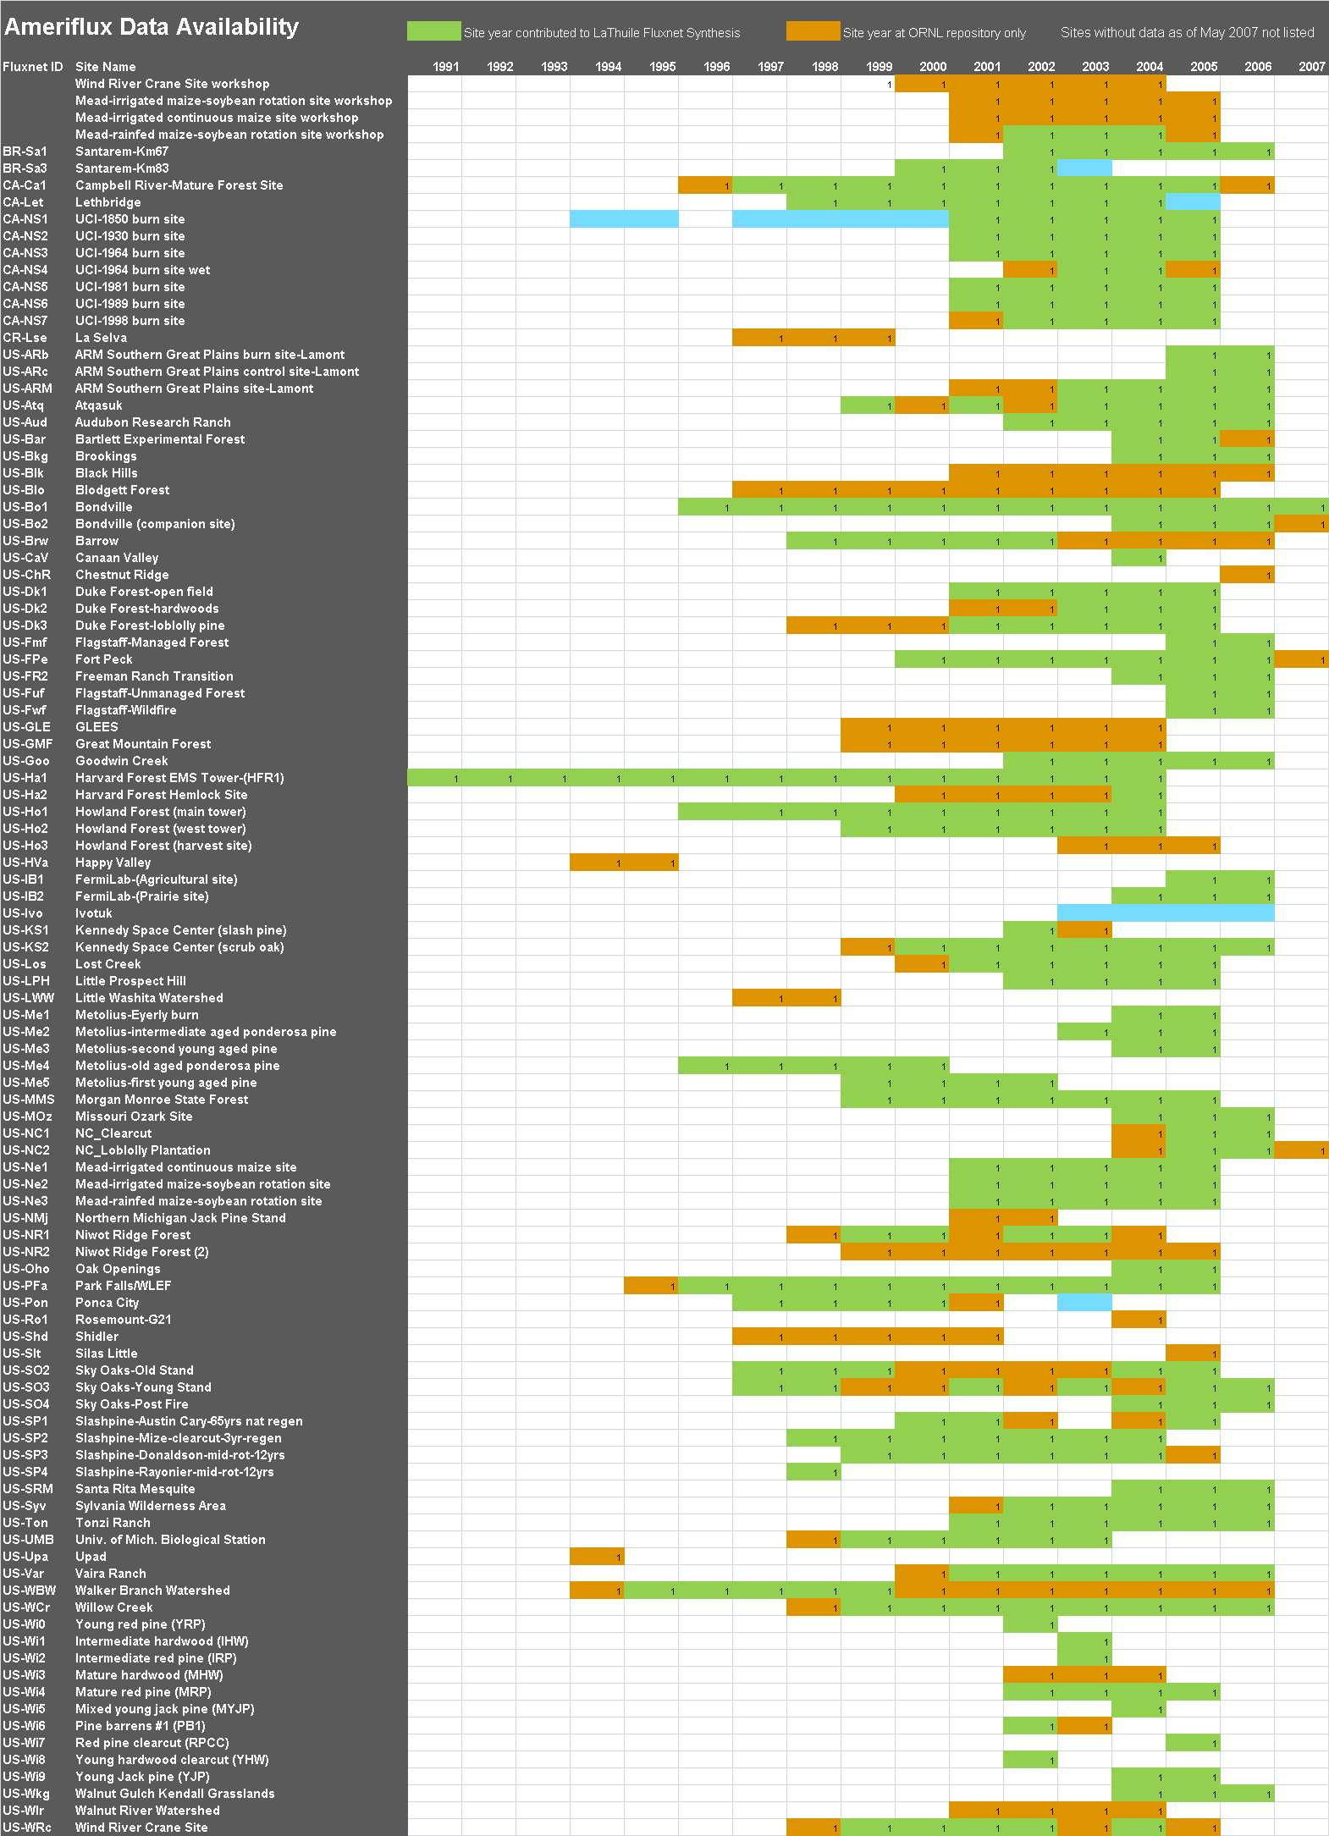


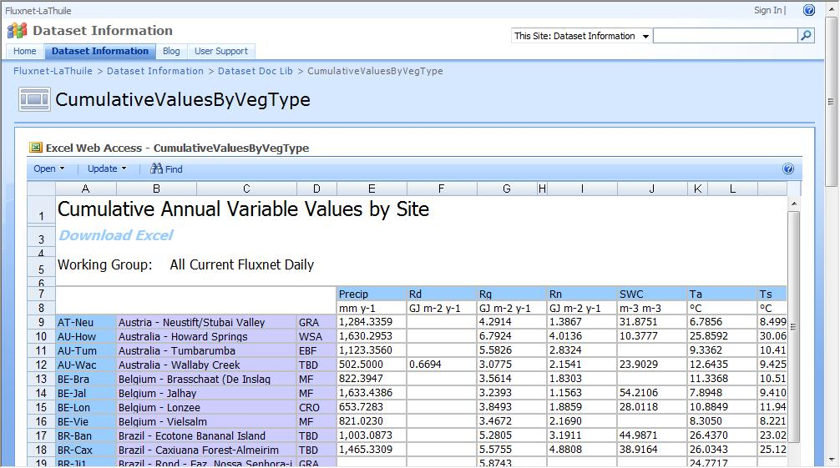
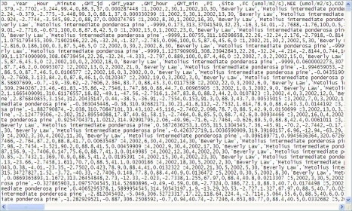
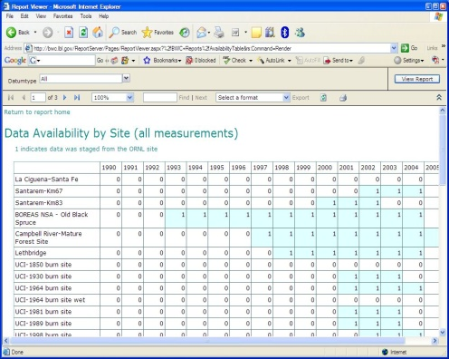
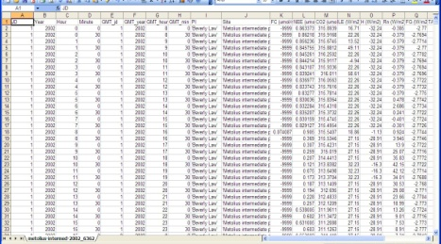
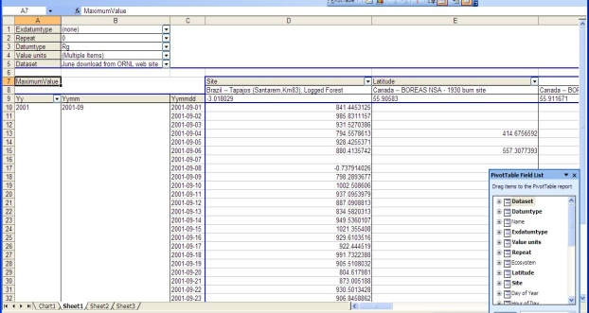
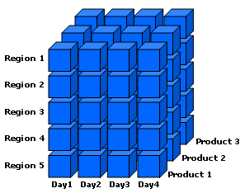
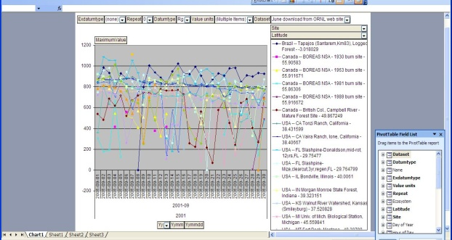
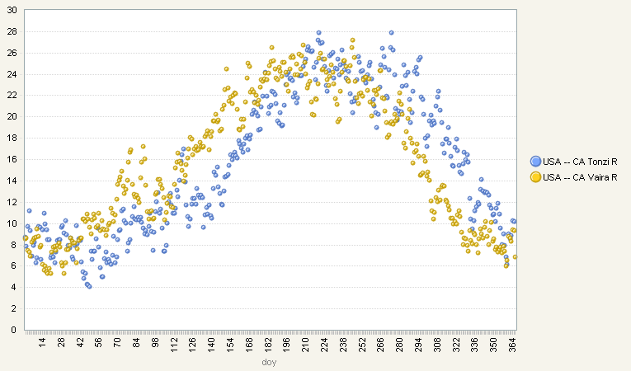
A Next Generation AmeriFlux Network Data Server Deb Agarwal, Catharine van Ingen, and Susan Holladay Berkeley Water Center and ORNL
Enabling cross-site carbon-climate synthesis depends on:
Data and site ancillary data submitted to network archives by tower investigators
Common processes for data quality assessment and gap filling now evolving
Collaborative analyses that build on single site investigations
Enabling data availability browsing and simple analyses
Leads to dramatically increased data availability – 600+ site years from 250+ sites now available
Requires help from investigators: no longer bypass common processes and the archives, apply their own corrections, lose data files, etc which can make comparing results problematic
Ameriflux data server
Common data repository capturing provenance information and common data processing
Ancillary and biological data being incorporated
Data browsing, mining, and plotting capabilities
Data repository that is easy to maintain, load with data, and expand capabilities
Reduce cut & paste manipulation of data
Dramatically increase the scale of the data that can be analyzed
Large Data Archives
Ameriflux/Fluxnet Data Intersection
FLUXNET Data Site – http://www.fluxdata.org
~920 site years from ~240 sites
Summaries of data and availability information
Data download
Pivot tables
Collaboration services
Site PI contact support
Local measurements
All data and site ancillary data are held in a relational (SQL) database
Available data from ORNL web archive automatically downloaded and ingested into the database
Site ancillary data updated infrequently by manual load
Selected data and site ancillary data flow into data cubes (OLAP database)
Client visualization and analysis tools query the database or data cube
CSV Files
Reports and Excel Pivot
Table and Chart
ORNL Ameriflux
Web Site
Fully normalized schema for both data and ancillary/biological data
Built in versioning to handle data changes for cleaning
What’s going on at higher latitudes?
(It should be getting colder)
Data Cube User Support Available
Tutorials - Wednesday and Thursday, 3-5pm, Evergreen Room
One-on-one - help available at this table during meeting breaks
E-mail: bwc-support@lists.berkeley.edu
Data Cube
Measurements per Month
BWC SQL Server
Database
Data is often missing in the winter!
http://bwc.berkeley.edu/

