Slide 1
Economic Recovery Forum
Congressman Keith Ellison
Minnesota’s Fifth District
February 9, 2009

Slide 2
Root Causes of Economic Crisis
Rooted in Collapse of the Housing Bubble
Began in 2007 -> Intensified in 2008 -> Full blown by 2009
Housing Crisis driven by:
Imprudent Mortgage Lending – Explosion of predatory lending, ARMs, and other products
Financial Services Deregulation
Explosion of Risky Financial Practices such as securitization and the usage of Credit Default Swaps
Not caused by increased lending to minority and underserved communities mandated in the Community Reinvestment Act

Slide 3
Economic Crisis Timeline
2007 - Housing Market begins to soften
Recession starts in Dec 07
Mar 2008 – Federal Government works with JP Chase to rescue bear Stearns, deemed too big to fail
Sep 2008 - Fannie Mae and Freddie Mac placed into Government conservatorship
Sep 2008 - Lehman Brothers goes bankrupt
Sep 2008 - AIG taken over by Government; provided with emergency federal loans

Slide 4
Economic Crisis Timeline (con’t)
Sep 2008 – Bush Administration and Federal Govt. approach Congressional leaders to warn of collapse of financial markets due to “freezing up of credit markets”; ask Congress to act on $700 Billion Financial Services Rescue package
Oct 2008 – Congress passes Wall Street Rescue Package
Nov 2008 – Automobile companies request help; Bush Administration makes them eligible for Financial Services Rescue Package funds

Slide 5
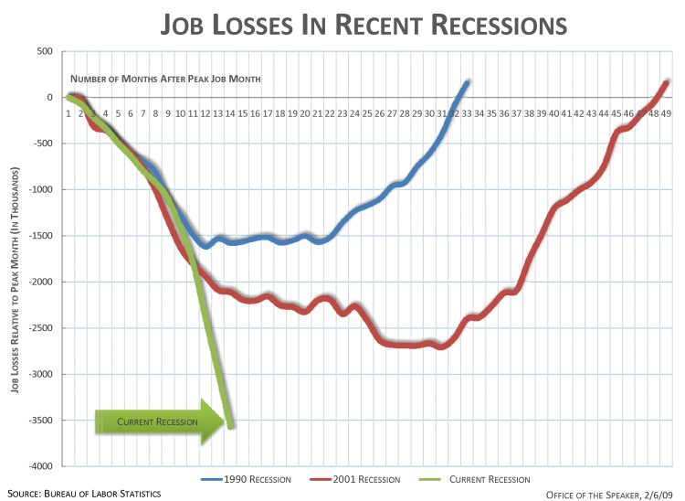
Unemployment Situation Darkens
JOB LOSSES:
In January 2009, American job losses totaled 598,000 – the worst month of jobs losses since 1974 and the 13th straight month of job losses.
Total job loss since the recession began in December 2007 has climbed to 3.6 million, the largest 13-month job loss on record (series began in 1939). About one-half of this decline occurred in the past 3 months.

Slide 6
Situation
BROAD RANGE OF INDUSTRIES IMPACTED:
Factories slashed 207,000 jobs in January, the largest one-month drop since October 1982
Construction companies got rid of 111,000 jobs
Professional and business services chopped 121,000 positions
Retailers eliminated 45,000 jobs. Leisure and hospitality axed 28,000 slots
UNEMPLOYMENT & PART-TIME WORK:
In January 2009, the unemployment rate surged to 7.6 percent -- the highest level in 16 years – up from 4.7 percent in 2007
The number of Americans looking for work climbed to 11.6 million in January – 4.1 million more than a year ago and the highest number in 26 years. An additional 3.1 million Americans have been forced into part-time work in the last year
CONSUMER SPENDING AND CONFIDENCE:
Consumer spending fell in December for a record sixth consecutive month, capping the worst year since 1961. Consumer confidence slid to another all-time low in January
HOUSING PRICES
Housing prices have fallen 11% since their peak in April 2007
First year of declining prices since the Great Depression

Slide 7
Need for Quick House Action
H.R. 1 is the first crucial step in a concerted effort to
Create and save 3 to 4 million jobs
Jumpstart the economy
Begin the process of transforming our economy for the 21st century with both economic recovery tax cuts and targeted priority investments with unprecedented accountability measures built in*
* After passage of the final bill, visit www.recovery.gov

Slide 8
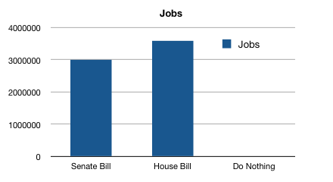
Jobs – What Would Happen?

Slide 9
Impact to MN from House Stimulus Package

Slide 10
Tax Cuts vs Spending
Bang for the Buck
Tax Cuts
Make Dividend and Capital Gains Tax Cuts Permanent $0.38
Extend Alternative Minimum Tax $0.48
Accelerated Depreciation $0.27
Spending Increases
Extending Unemployment Insurance Benefits $1.63
Temporary Increase in Food Stamps $1.73
General Aid to State Governments $1.38
Increased Infrastructure Spending $1.59

Slide 11
Analysis of Senate Proposal
The Senate Stimulus Package focuses more heavily on tax cuts than the House Package
Proposed Educational Program Cuts:

Slide 12
Senate Proposal (con’t)
Proposed Community Program Cuts

Slide 13
Current Status
Current status:
Senate will vote on cloture Monday night (Feb 9th ) with final passage expected Tuesday (Feb 10th)
Conference committee begins immediately

Slide 14
What can I do?
Become a 5th District Lobbyist and join me in fighting for our children
Contact Senator Amy Klobuchar and your U.S. Representative urging them to support the House version of the American Recovery and Reinvestment Act of 2009. There is still time!
Sen. Amy Klobuchar: (612) 727-5000 or (202) 224-3244
House Switchboard: (202) 225-3121 www.house.gov
Senate Switchboard: (202) 224-3121 www.senate.gov
Call the Economic Recovery Campaign Toll-Free Number for Congress: 866-544-7573
Write about how the current economic situation is affecting you personally and send your letter to your local media, legislators, council members, opinion leaders, etc. It is important to communicate your personal experiences of unemployment, lack of health care, or lack of basic public services. Testimonies are powerful!
Call on legislators who are opposed to this legislation and let them know they are standing in the way of JOBS for their constituents. This legislation is about JOBS not spending.
Share your story about how this economic crisis is affecting you and your family and join your fellow Americans in supporting bold action to speed recovery:
Contact http://my barackobama.com/sharestories
After passage, visit www.recovery.gov to verify expenditures

