Slide 1
Late gas accretion onto primordial mini-halos a model for pre-reionization dwarfs and extragalactic compact High-Velocity Clouds
Massimo Ricotti (U of Maryland)

Slide 2
I will discuss mainly 3 recent papers:
Ricotti, Gnedin & Shull 2008
Bovill & Ricotti 2008
Ricotti 2008
Outline:
Part I : pre-reionization fossils
Part II: late (cold) gas accretion onto mini-halos
I will describe an exciting but controversial hypothesis for the origin of (some) Local Group dwarf spheroidals: Fossil relics of the first galaxies
Near field Cosmology may provide the only observational test for theories of galaxy formation in early universe !

Slide 3
INTRO The First Galaxies: important questions
How small were the first galaxies?
How many? … and how do they look like?
Where are the first galaxies today?
Still we do not have these answers: not only the properties of the galaxies but their global formation rate is regulated by feedback (radiative and chemical feedback)

Slide 4
Reionization feedback:
IGM temperature at reionization T≈2×10⁴ K
Jeans mass M_{jeans}(IGM)≈10⁸ M_{sun}
Suppression of gas accretion and star formation in halos with v_{cir} < 20 km/s (ref: Babul & Rees 1992, Efstathiou 1992)
Confirmed by simulations (ref: Gnedin 2000, Bullock et al. 2000 )

Slide 5
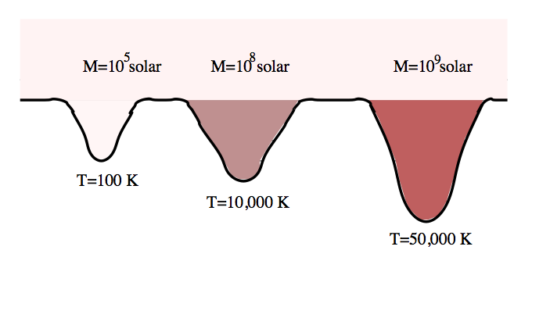
After reionization star formation in mini-halos stops: passive stellar evolution
The smallest galaxies in the Universe can only form before reionization!

Slide 6
Definition: “pre-reionization” dwarfs
Galaxies that form in mini-halos with:
T_{vir}< 20000 K (M_{dm} < 10⁸ M_{sun} or v_{cir}<20 km/s)
In order to initiate star formation one of the following is necessary:
Sufficient H₂ formation in metal free gas (catalyst: H⁻)
Sufficient metal pre-enrichment
If none available: the mini-halo remains dark (forever?) and pre-reionization dwarfs do not form!
Why makes a difference?
Number of mini-halos ≈ 1/M²

Slide 7


Two Different views:
Our view: pre-reionization dwarfs formed in large number and some of their fossils can be found in the Local Group (a fraction of dwarf spheroidals)
Old view: none of Local group dwarf spheroidal are pre-reionization fossils. They are tidally stripped dIrr (more massive, formed mostly after reionization)

Slide 8
Why do we think so?
(Physical processes at play)

Slide 9
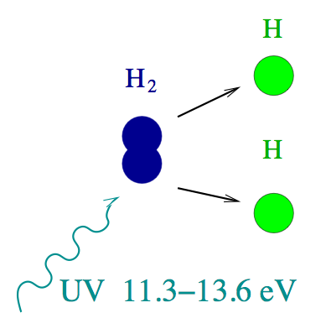
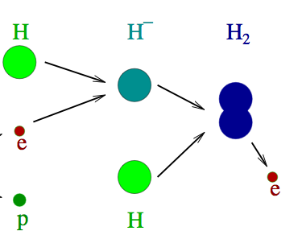
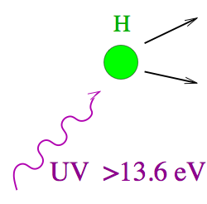
H2 photo-dissociation:
Negative feedback
Suppress galaxy formation
H2 formation:
Free electrons
at virialization

Slide 10
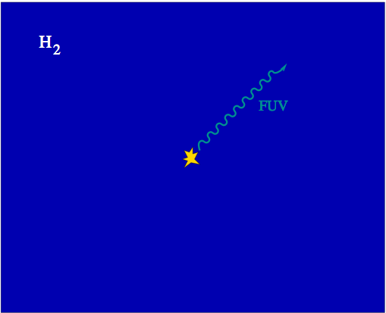
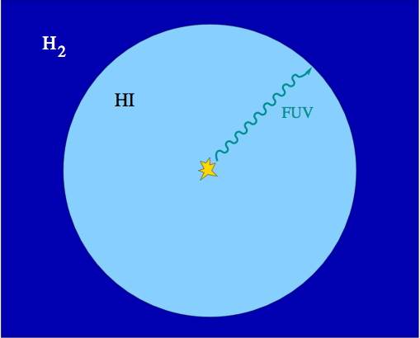
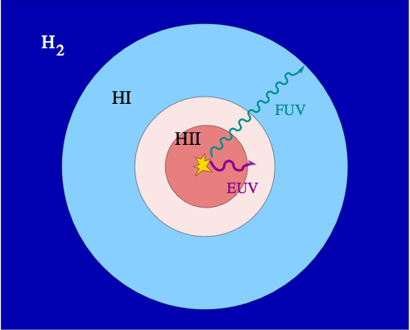
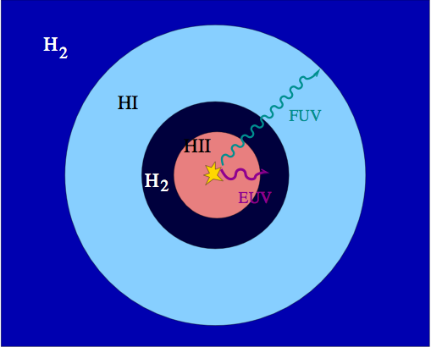
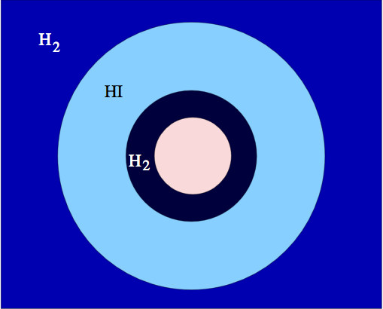
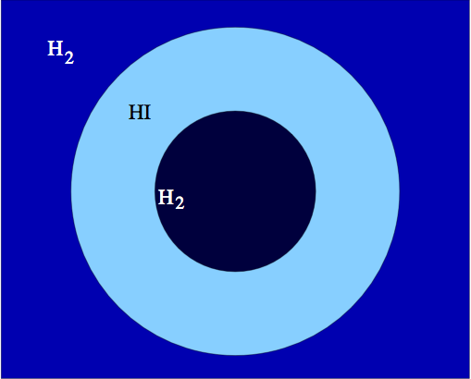
Positive Feedback regions

Slide 11
Net Positive or Negative Feedback?
Radiation:
Ionizing UV and X-rays (effect mostly ignored):
promote H2 formation and cooling (global-positive)
Heat the gas and produce galactic winds (negative)
Non ionizing UV: destroy H2 (global-negative)
Chemical (very uncertain):
Chemical enrichment (positive)
SN winds (negative?)

Slide 12
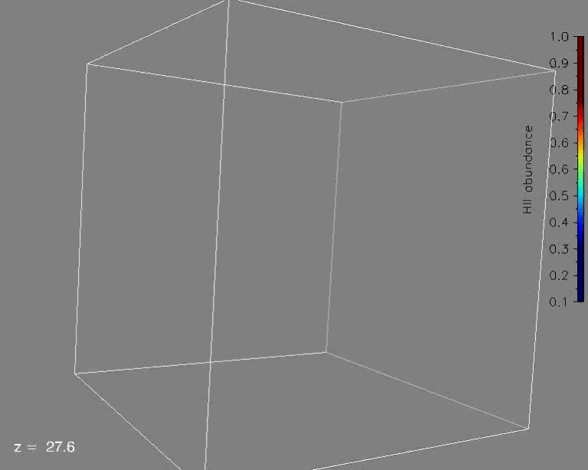
Simulations of the first galaxies
Feedback-regulated galaxy formation
1 Mpc box size
10³ M_{sun} mass res.
3D radiative transfer
Run ends at redshift of reionization
Ref: Ricotti, Gnedin & Shull 2002

Slide 13
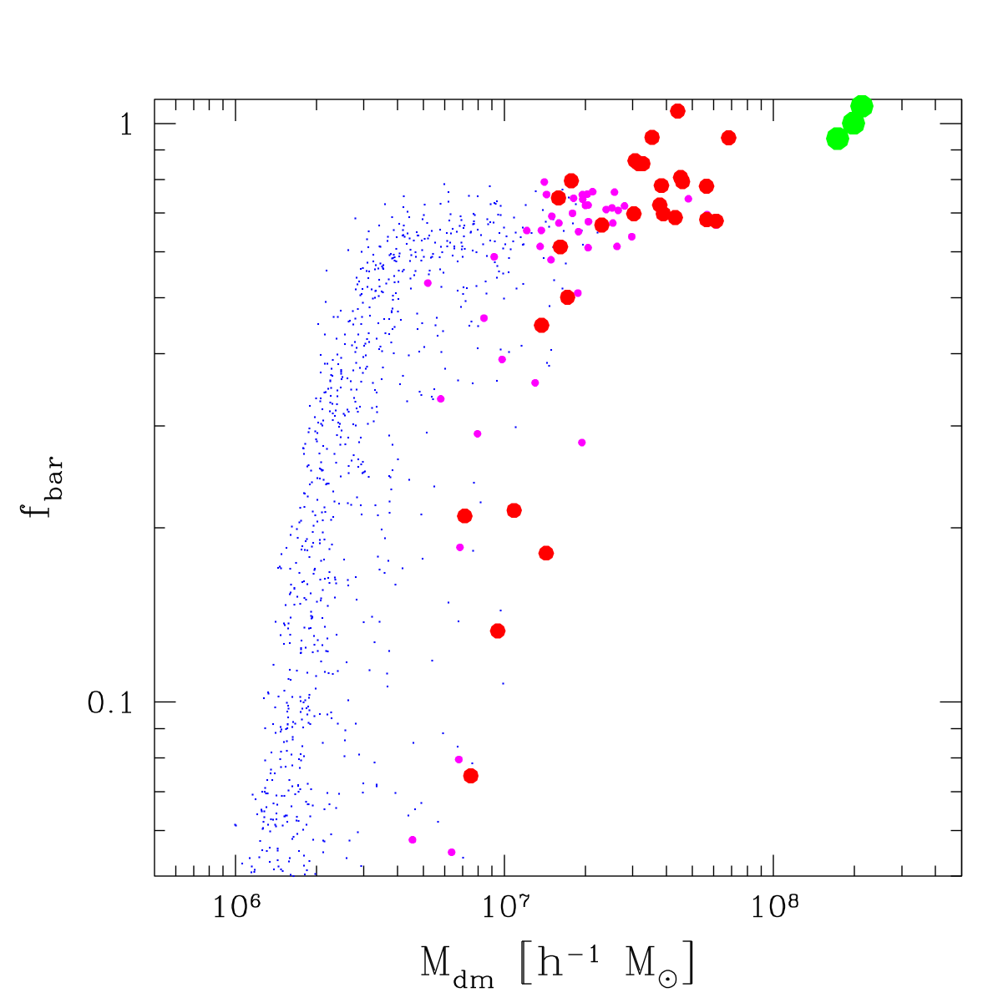
Feedback: photo-heating winds
Luminous galaxies
Pre-reionization
dwarfs
Fraction of cosmic baryons
Dark
galaxies

Slide 14
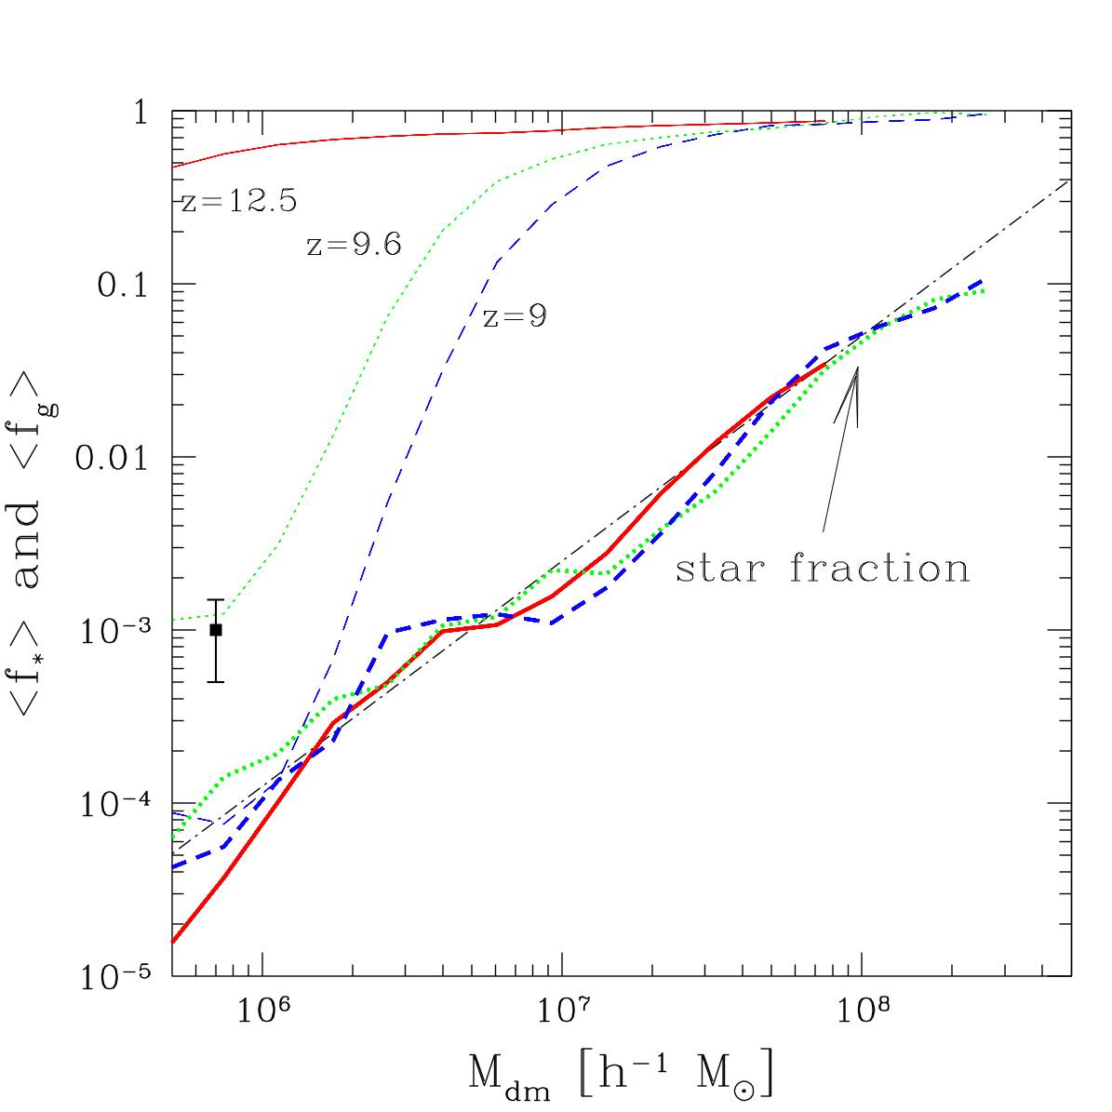
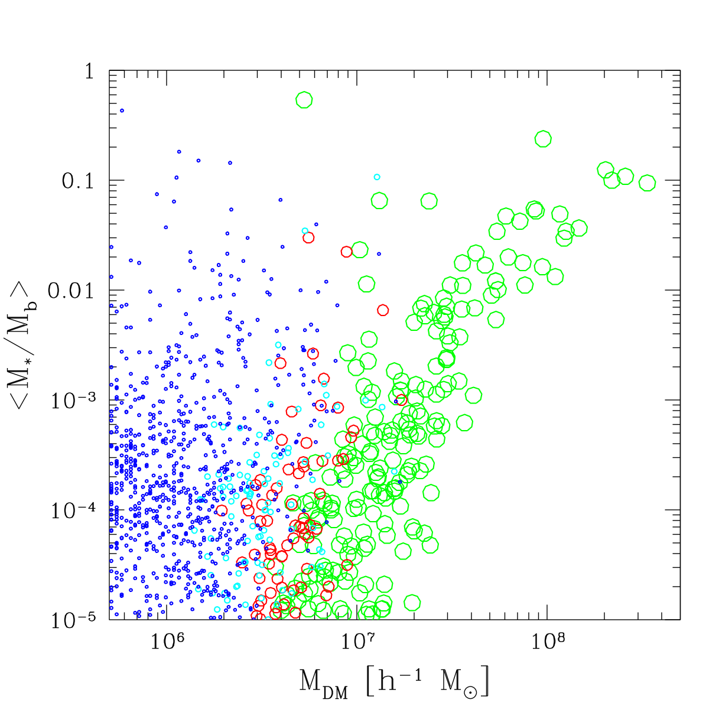
Pre-reionization dwarfs: numerous but faint!
Fraction of baryons in stars
Pre-reionization
dwarfs

Slide 15
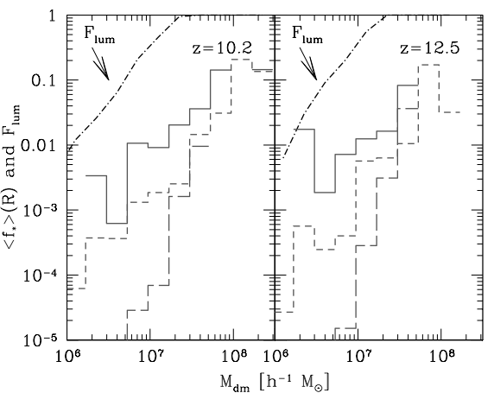
“Dark galaxies”

Slide 16
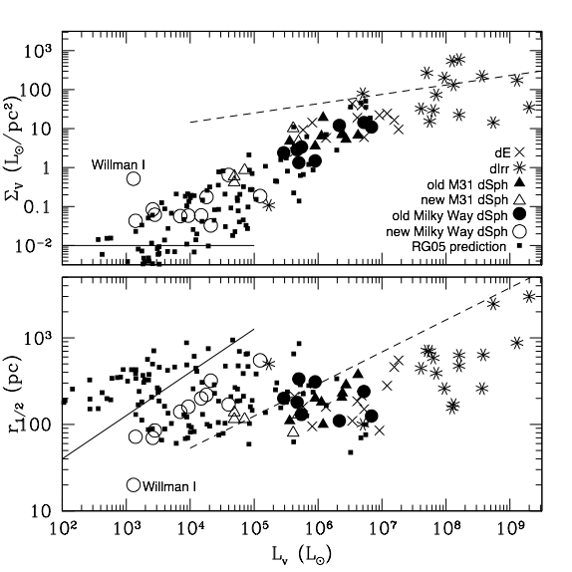
Pre-reionization fossils and ultra-faint dSphs: a model prediction!
Ref: Ricotti & Gnedin 05, Bovill & Ricotti 08

Slide 17
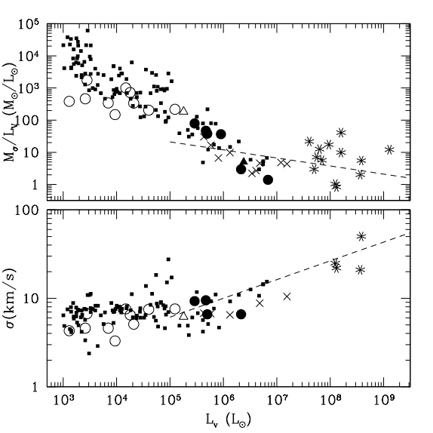

Slide 18
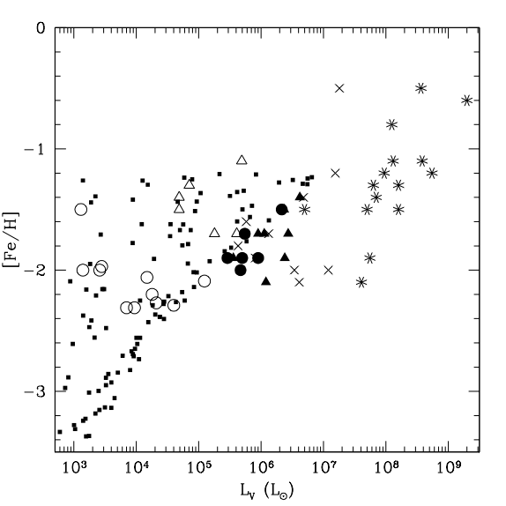
Luminosity-metallicity relation

Slide 19
Same
Luminosity
Not same metallicity!
Fraction of baryons in stars

Slide 20
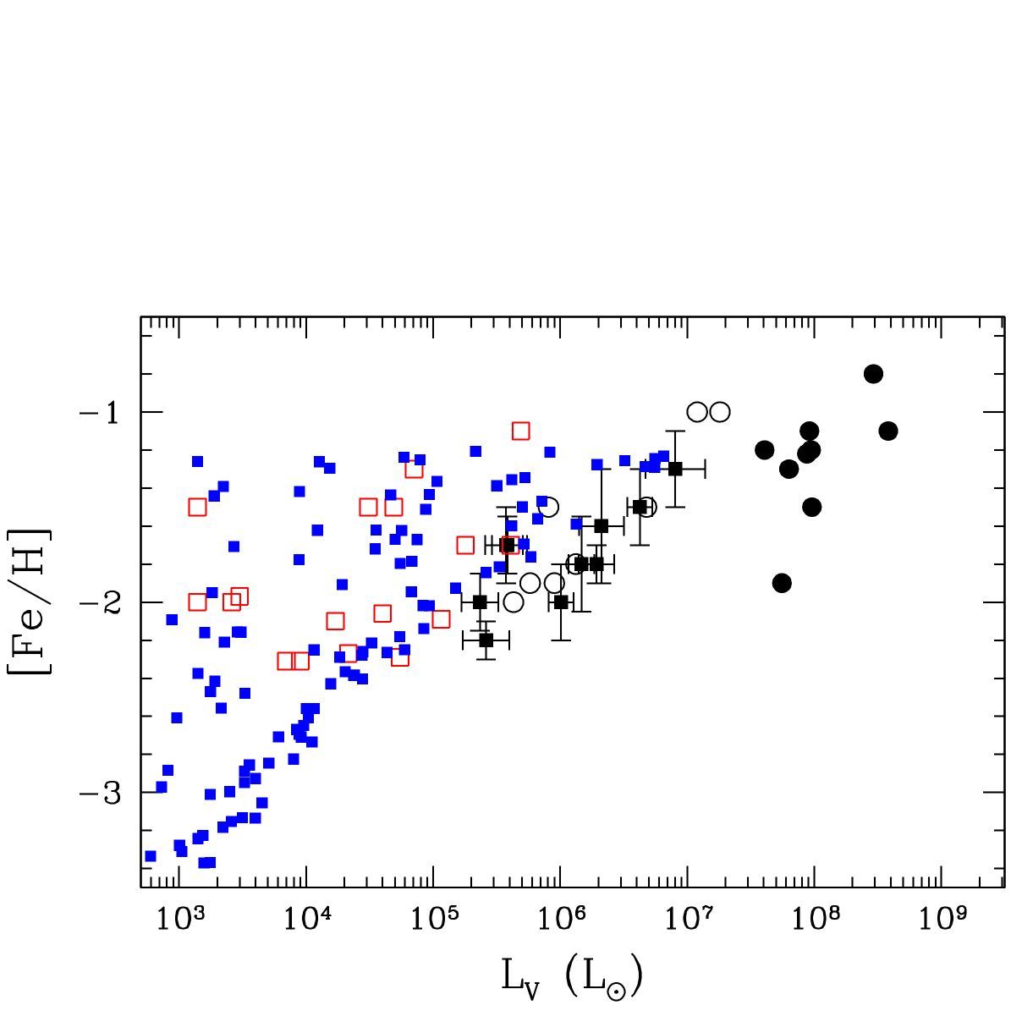
Metallicity

Slide 21
Problem with stellar populations and abundance patterns
Most dSphs have a dominant old stellar population (like Globular Clusters)
However, the SFH in dSphs is often complex, with minor episodes of SF at later times (eg., see Grebel et al. 04 and Fenner et al.)
Recent claim: some ultra-faint dwarfs show evidence for mixed stellar populations
How bad is this for pre-reionization fossils ?

Slide 22
Can reionization suppress star formation in mini-halos forever?
Part II

Slide 23

The puzzle of Leo T
Is one of the smallest dSphs: σ*=6.9 km/s
Looks as a pre-reionization fossil
Distance 430 kpc from Galactic center
Is gas rich! ☹
Forming stars at z=0!
Leo T properties:
☐ r_{core}=100 pc
☐M_{dm}/M_{gas}=10-30
☐N_{H}=7x10²⁰ cm⁻²
Ref: Ryan-Weber et al 2008
Leo T definitively does not fit our model !

Slide 24
Revisiting gas accretion onto mini-halos
Ability to accrete gas increases with increasing:
Γ=[v_{cir}/c_{s}(IGM) ]²=T_{vir}/T_{IGM}
IGM temperature decreases at redshift z<3
Concentration of dark halo, c=r_{h}/r_{s}
Concentration of first minihalos increases with decreasing redshift if halo evolves in isolation
Gas must be able to recombine (and cool)
(note that t_{cool}<t_{rec})

Slide 25
Message to take home
The reionization feedback idea is valid but fails at z<2 if the halo is highly concentrated
Minihalos virialized before reionization, that evolve to z=0 in the low-density IGM, have a late phase of gas accretion and possibly star formation
Do these objects exist? ➔

Slide 26

…. some details

Slide 27
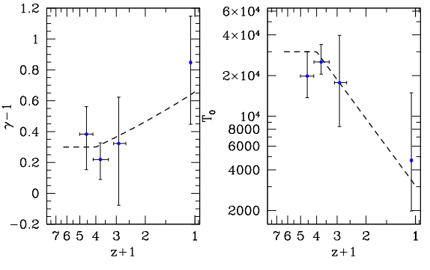
Evidence 1: Evolution of the IGM temperature (from observations of the Lyman-alpha forest)
Ref: Ricotti, Gnedin & Shull 2000

Slide 28
Evidence 2: Dark Halo Concentration
Concentration increase as the halo evolves, after virialization,
in expanding universe (low density IGM).
From N-body simulations:
Refs: Bullock et al. 2001, Wechsler et al. 2002, Ricotti 2003, Ricotti, Pontzen & Viel 2007

Slide 29
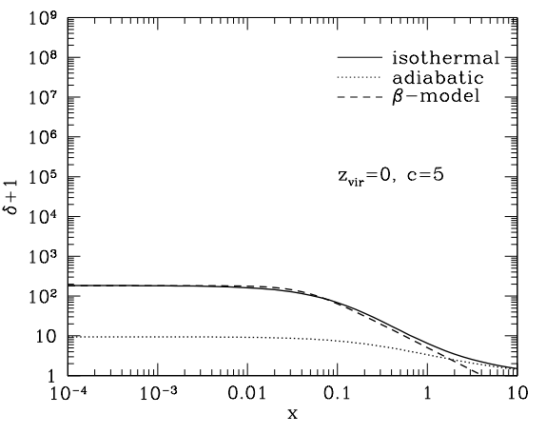
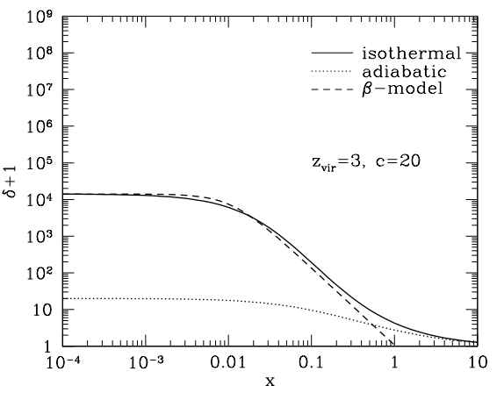
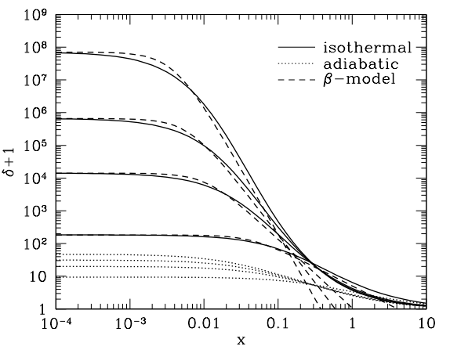
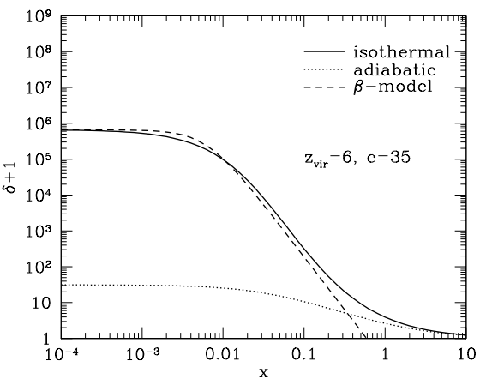
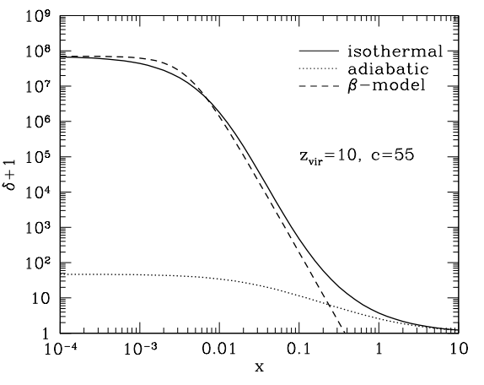
Gas density profile in NFW potential
z=0, Γ=1

Slide 30
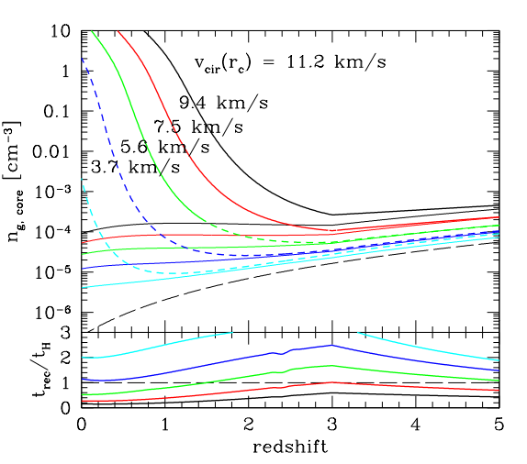
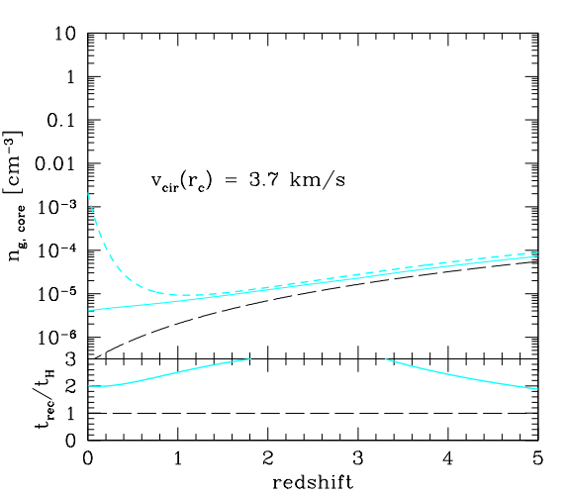
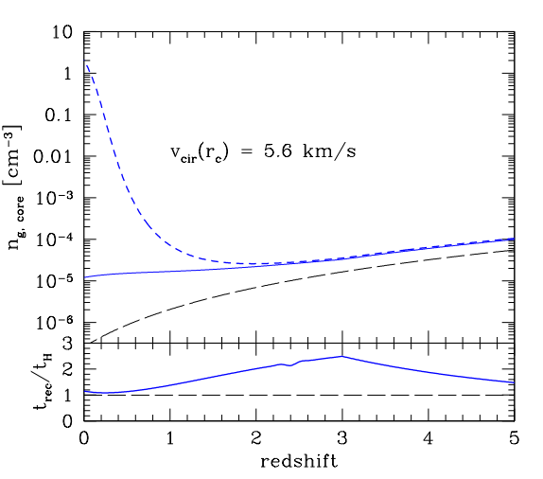
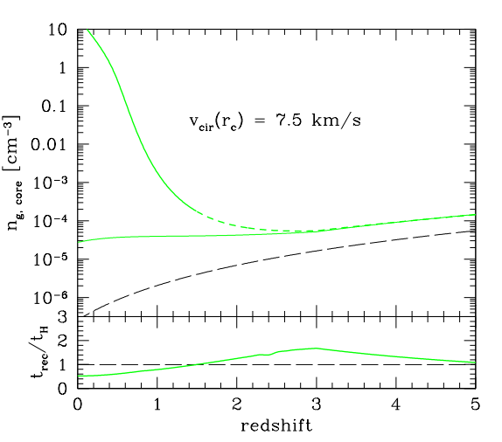
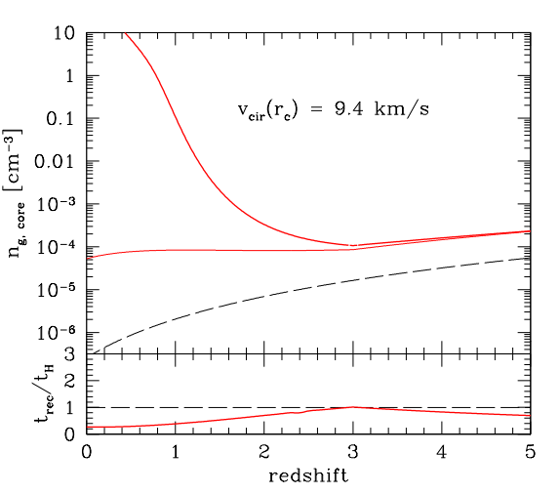
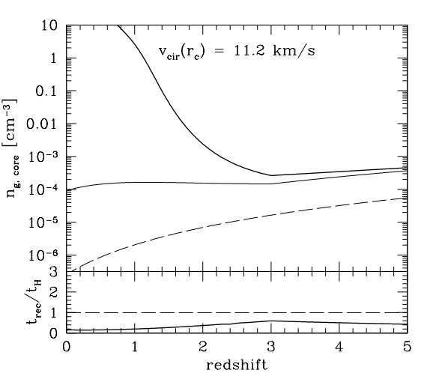
Late gas accretion onto mini-halos
Z_{vir}=10
Ref: Ricotti 2008

Slide 31
+
n = # of standard deviations from the mean density
of initial density perturbation (ie, how rare the object is)

Slide 32
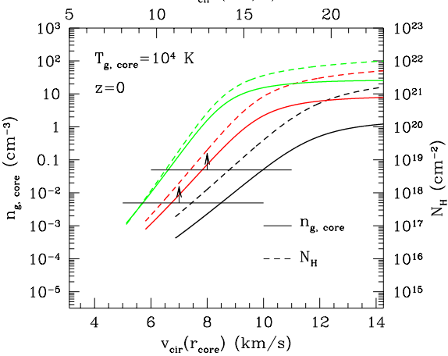
Mini-halos with gas and no stars (comp. HVC?)
Green: 4-σ pert.
Red: 3-σ pert.
Black: 2-σ pert.
Ref: Ricotti 2008

Slide 33
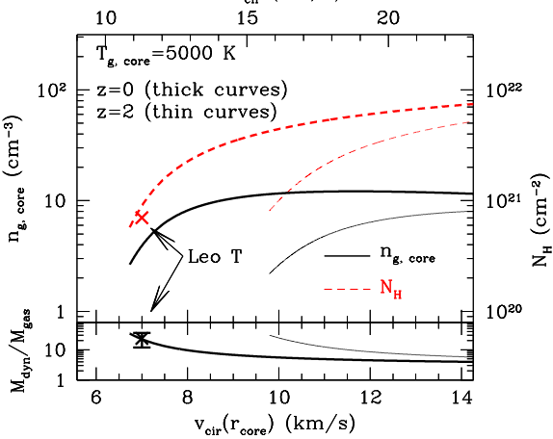
Star forming mini-halos at z=0 and z=2
3-σ pert.
Ref: Ricotti 2008

Slide 34
More on properties of accreted gas
Leo T:
☑ r_{core}=100 pc
☑M_{dm}/M_{gas}= 10-30
☑N_{H}=7x10²⁰ cm⁻²
(V_{cir}=11 km/s)

Slide 35
Compact HVCs or unknown population?
If compact HVCs are at distances of about 1 Mpc model may work for some of them
☐ r_{h}= 15 kpc
☐ r_{core}=100 pc
☑ N_{H}=10¹⁸ - 10¹⁹ cm⁻²
Most are probably undetected because too faint and/or too small
Refs: Blitz et al. 1999, Braun & Burton 1999, Robinshaw et al. 2002,
Sternberg et al. 2002, Putman et al. 2003, Maloney & Putman 2003,

Slide 36
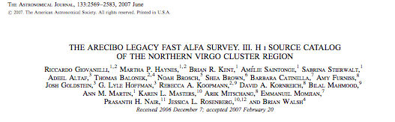
Can ALFALFA find these objects if they are nearby?
Very rough estimate (we need to asses ionization corrections):
Angular size: 3-30 arcmin (for 1-10 kpc size at 1 Mpc)
H Mass (total): 10⁵-10⁷ M_{sun} (but mostly ionized?)
H Mass of the core (few 100 pc): 10³-10⁵M_{sun}
We do not know yet their number per square degree

Slide 37
Summary
Found pre-reionization fossils in the Local Group?
Revisitation of reionization feedback on formation of dwarf galaxies
Mini-halos with v_{cir}< 20 km/s stop accreting gas after reionization but, if they evolve in isolation, have a recent (z<1-2) phase of accretion from IGM and star formation
Pre-reionization fossils may have bimodal SFH
Dark mini-halos may accrete gas for the first time at z<1. Compact HVCs or undiscovered population?

Slide 38
Future work
Work on testing the model versus known compact HVC population
Zero metallicity star formation at z=0?
Simulated maps of the distribution of gas rich mini-halos around the Milky Way in 21cm and H-alpha emission (including simulated maps with ALFALFA sensitivity and resolution)

Slide 39
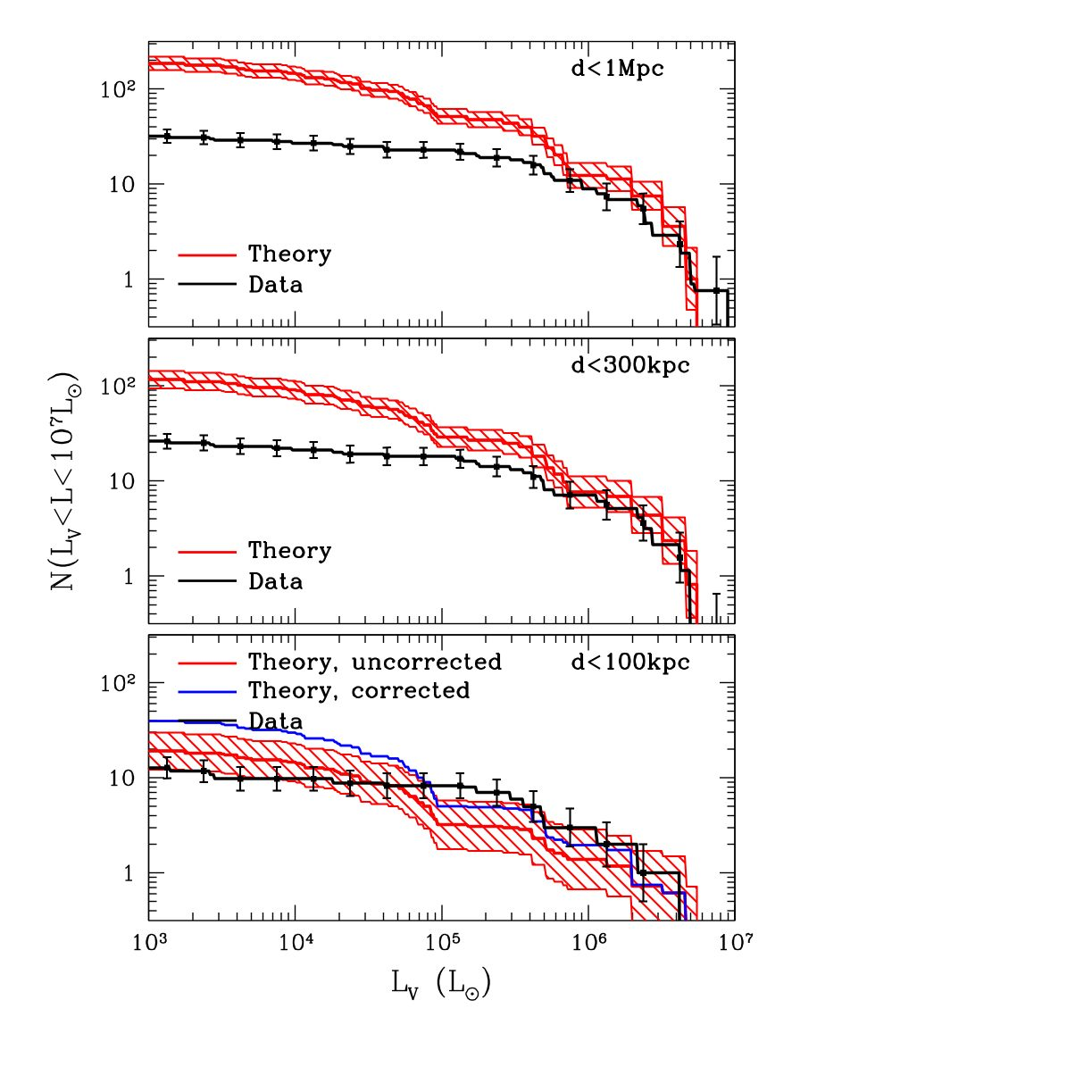
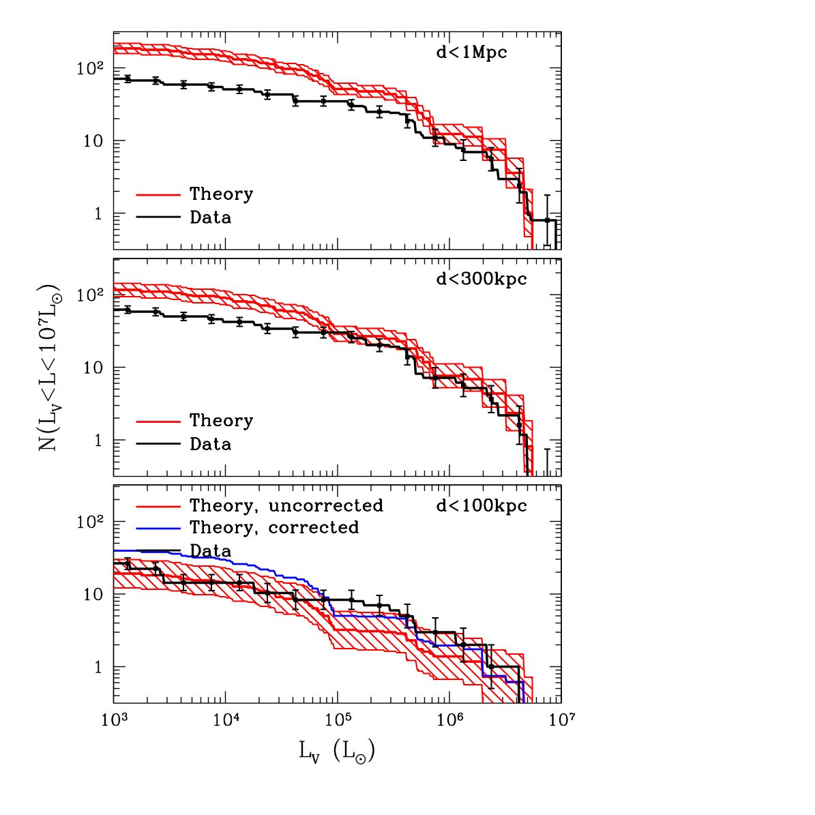
Luminosity Functions
Ok
Let’s include the new dwarfs
Missing satellites problem
revisited

Slide 40
If gas is isothermal:

