Slide 1





Gamma-ray Large Area Space Telescope
GLAST Signatures of UHECRs Production in GRBs
by
S. Guiriec
Laboratoire de Physique Théorique et Astroparticules (LPTA)
Theoretical Model in Collaboration with
D. Gialis, G. Pelletier, F. Piron
Seminar – NASA MSFC – Friday, May 23th, 2008

Slide 2
Outline
1 Overview of GLAST :
The GLAST mission
The “GLAST Burst Monitor” (GBM) & the “Large Area Telescope” (LAT)
The LAT, a Pair Conversion Telescope
2 GLAST, an Unprecedent Telescope for Studying GRBs :
Brief introduction to GRBs
Overview of GLAST instruments : GBM and LAT
High energy emission models and GLAST
3 UHECR Production in GRBs and Signature with the LAT

Slide 3
Outline
1 Overview of GLAST :
The GLAST mission
The “GLAST Burst Monitor” (GBM) & the “Large Area Telescope” (LAT)
The LAT, a Pair Conversion Telescope
2 GLAST, an Unprecedent Telescope for Studying GRBs :
Brief introduction to GRBs
Overview of gamma ray instruments : GBM and LAT
High energy emission with GLAST
3 UHECR Production in GRBs and Signature with the LAT

Slide 4
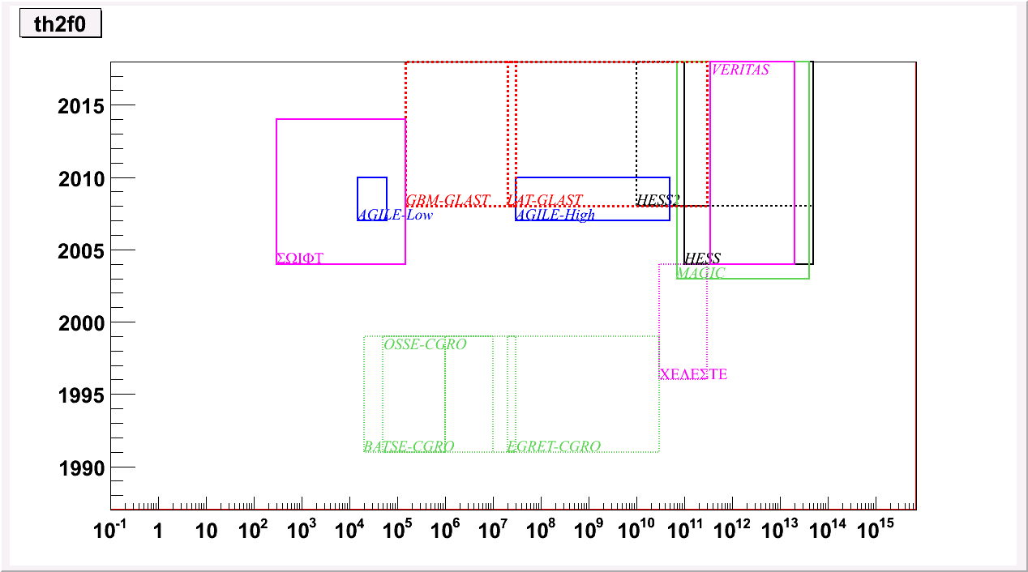
The GLAST Mission
NASA’s space mission
Countries: USA, Germany, France, Italy, Sweden and Japan.
Launch: ~June 3rd, 2008
Mission duration: 5 to 10 years
Scientific goals: AGNs, Gamma-Ray Bursts (GRBs), pulsars, galactic black holes and microquasars, galactic and extragalactic diffuse emissions, solar bursts, dark matter and new physics…
Recent History of the Gamma-Ray Astronomy
Date (years)
SWIFT
CELESTE
eV
Energy range (eV)

Slide 5
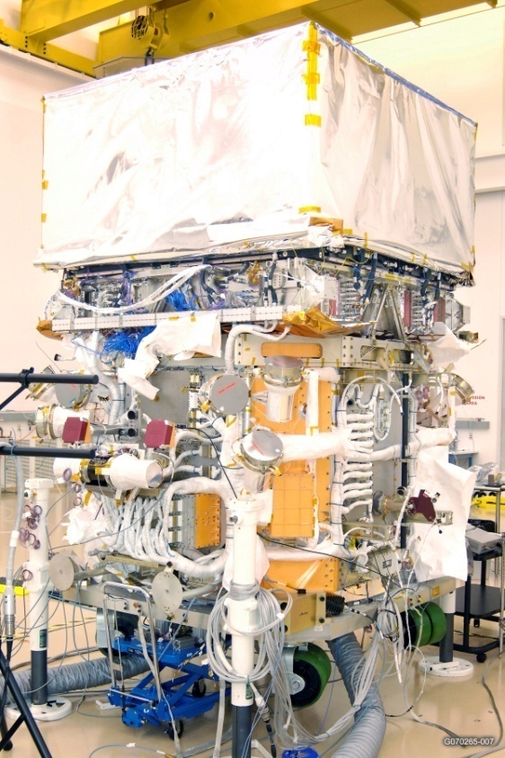
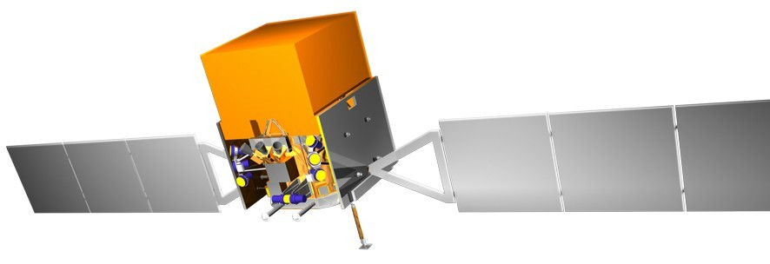
The GLAST Detectors
GBM
LAT
GBM (8keV -> 30 MeV) :
Goal : GRBs + transient sources (LAT + GCN alerts)
12 NaI detectors (trig., loc., spec.)
2 BGO detectors (spec.)
Field of view : >9.5 sr

Slide 6
The GLAST Detectors
GBM
LAT
LAT (20 MeV to >300 GeV) :
Effective Area: 8000 cm² (5 x EGRET)
Field of view: ~2.4 sr (4 x EGRET)
Angular resolution: ~0.1° at 10 GeV.
Dead Time: 27 μs -> allow the GRB study
Wide field of view + large duty cycle + spectral overlap over 1 decade = complementarity with TeV telescopes (catalogue of sources for pointing)

Slide 7
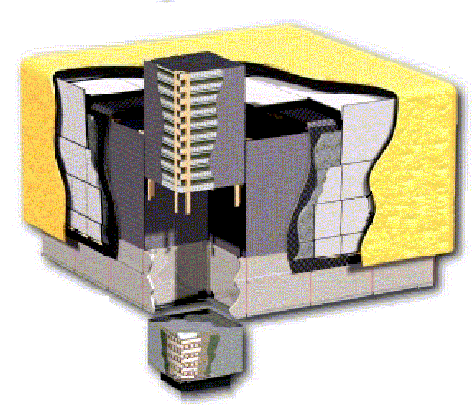
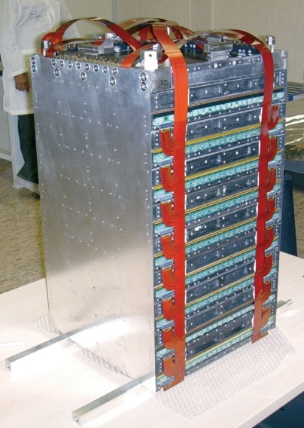
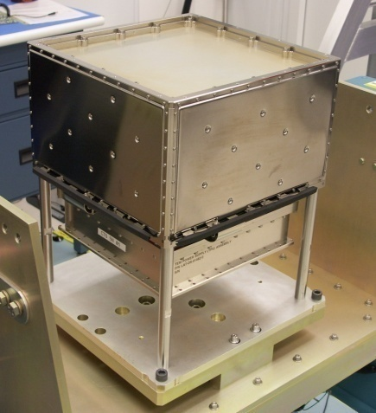
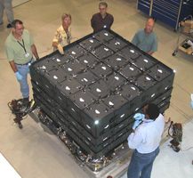
The LAT, a pair conversion telescope
γ
Tracker
e⁺
e–
Hodoscopic electromagnetic calorimeter
Anticoincidence system

Slide 8
Outline
1 Overview of GLAST :
The GLAST mission
The “GLAST Burst Monitor” (GBM) & the “Large Area Telescope” (LAT)
The LAT, a Pair Conversion Telescope
2 GLAST, an Unprecedent Telescope for Studying GRBs :
Brief introduction to GRBs
Overview of gamma ray instruments : GBM and LAT
High energy emission with GLAST
3 UHECR Production in GRBs and Signature with the LAT

Slide 9
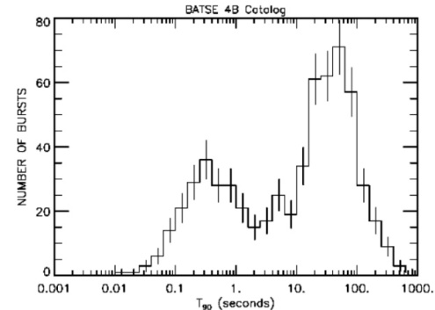
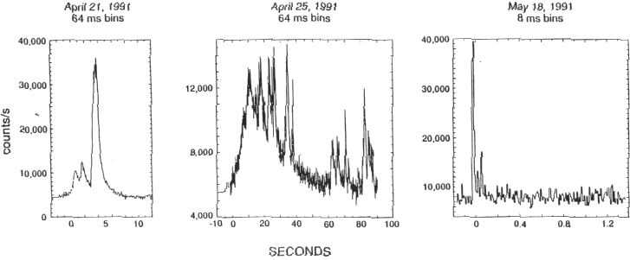
GRBs - Some Observational Facts
Intense and short gamma-ray emission : prompt emission – keV-MeV range.
Afterglow emission up to a few days after the prompt emission : radio -> X-rays.
Isotropic distribution in the sky (cf. BATSE).
Cosmological origin confirmed by afterglow detection and observation.
Bimodal time distribution (cf. BATSE).
High variability of the prompt emission LC: long var. and short var. (millisecond variability)

Slide 10
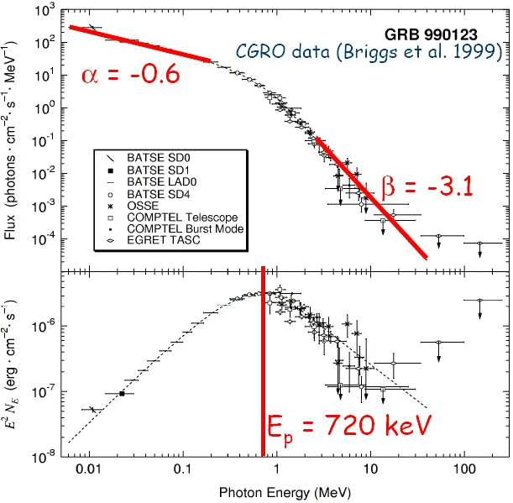
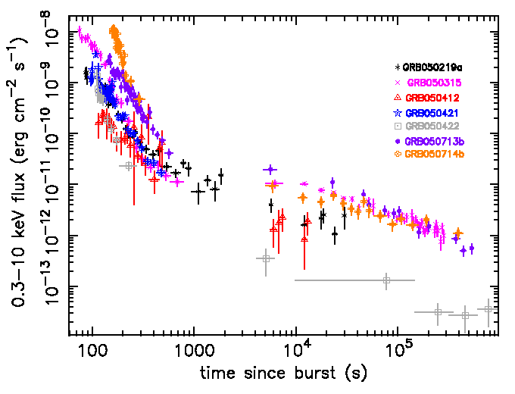
GRBs - Some Observational Facts
Prompt emission spectrum well fitted with Band’s functions :
New features in the afterglow light curves (SWIFT results) :
Nousek et al 2006, ApJ, 642, 389
I
Flares
IV
II
10³-10⁴ s
10²-10³ s
III

Slide 11
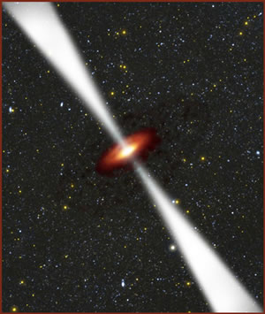
GRBs – Nature of the Central Engine
Cosmological distance + Huge released energy
Accretion mechanisms
Milli-second variability in the light curves
Compact sources
Acromatic breaks in the afterglow light curves
Collimated jet
Variability + gamma visibility
Relativistic jet (compactness)

Slide 12
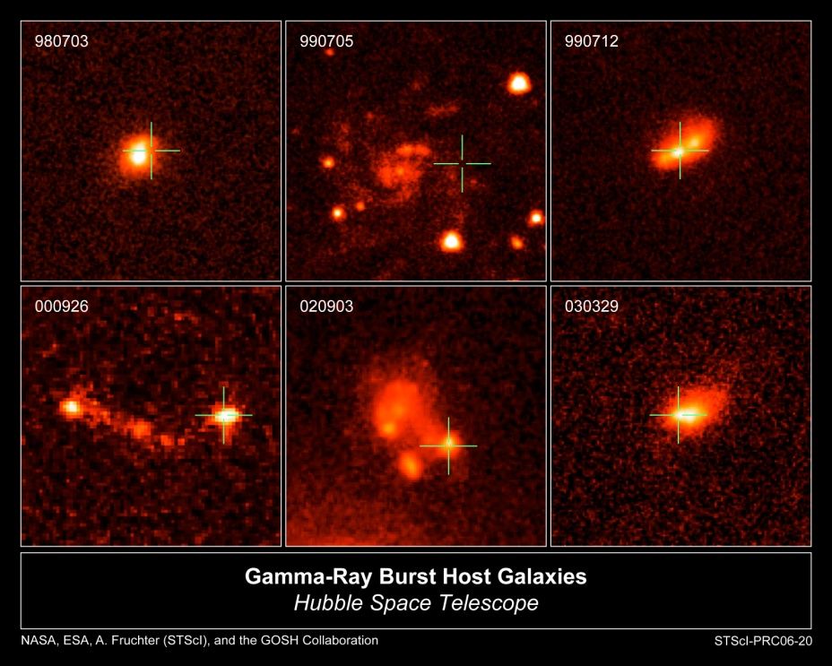
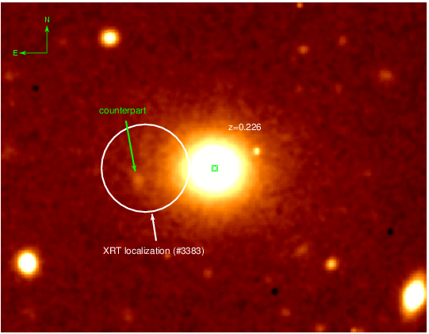
GRBs – Central Engine Origin
Two scenarios :
1) Long GRBs: Collapse of a supermassive star
Association GRBs - supernovae
Long GRBs occur mainly in the inner part of the host galaxy
2) Short GRBs : Coalescence of compact objects
Short GRBs occur in the outer part or outside the host galaxy

Slide 13
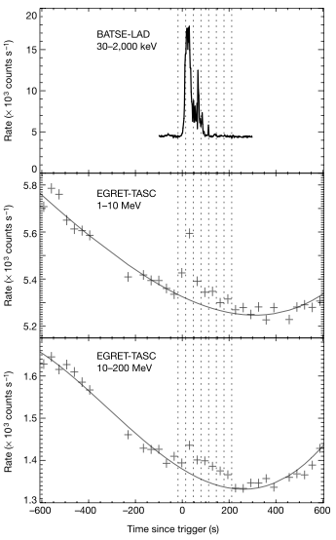
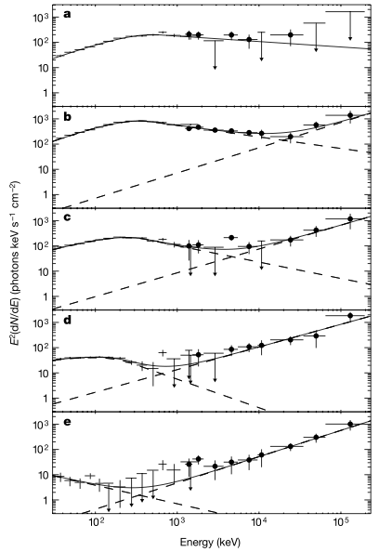
High Energy Emission in GRBs
Very little is known about high energy emission in GRBs above ~100 MeV (cf. EGRET)
High energy prompt emission :
Few GRBs detected with EGRET
Constant HE component independant of the temporal evolution of the LE.
GRB941017
-18 to 14 sec
14 to 47 sec
47 to 80 sec
(Gonzalez et al. 2003)
Not supported by sync models
80-113 sec
113-211 sec

Slide 14
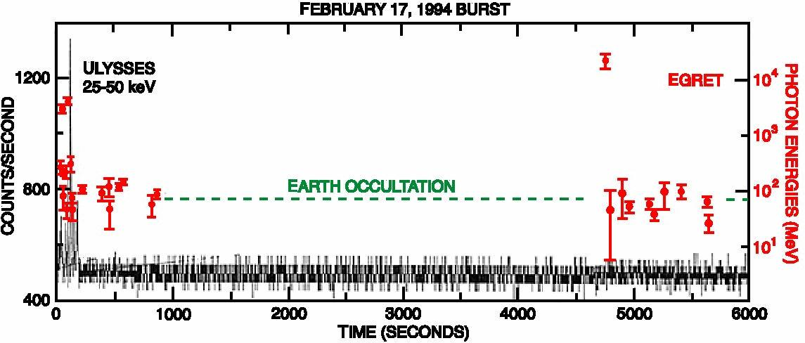
High Energy Emission in GRBs
Very little is known about high energy emission in GRBs above ~100 MeV (cf. EGRET)
High energy prompt emission :
Few GRBs detected with EGRET
Constant HE component independant of the temporal evolution of the LE.
High energy extended/delayed emission
Egret detected a extended/delayed HE emission 90 min after the prompt emission with a 18 GeV photon.
GRB940217

Slide 15
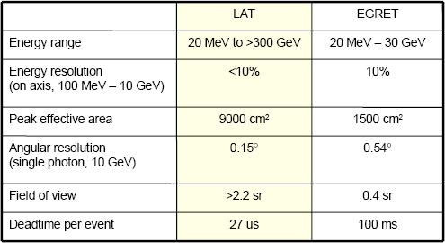
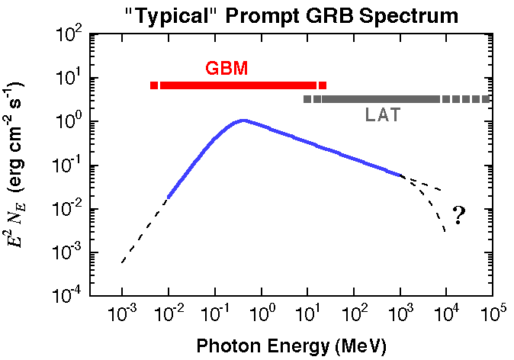
GLAST and Gamma-Ray Bursts
Observing mode and wide field of view.
Improved GRB detection
Short deadtime
Temporal analysis , especially for short GRBs
Good angular res. and Large eff. area
Improved GRB localization
The GBM, a dector design to be very reactive.
GBM and LAT will cover the full prompt emission providing Band’s parameters and E_{peak} for all the detected GRBs.
SWIFT-GLAST complementarity: spectral measurements over 9 decades (from 0,1 keV up to >300 GeV)
E_{peak}
GBM will detect at least 1/4 of the SWIFT GRBs
7 energy decades !!!

Slide 16
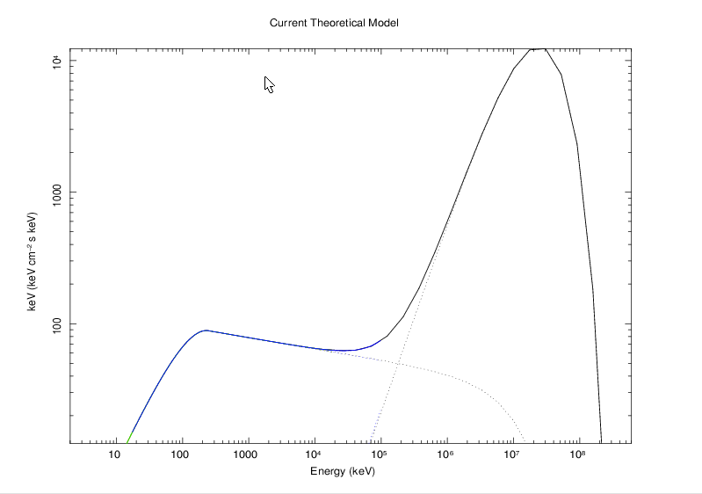
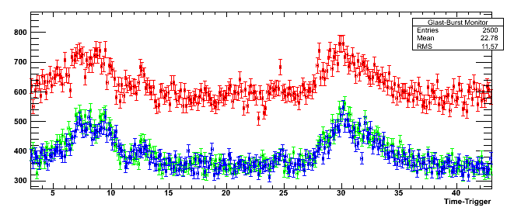
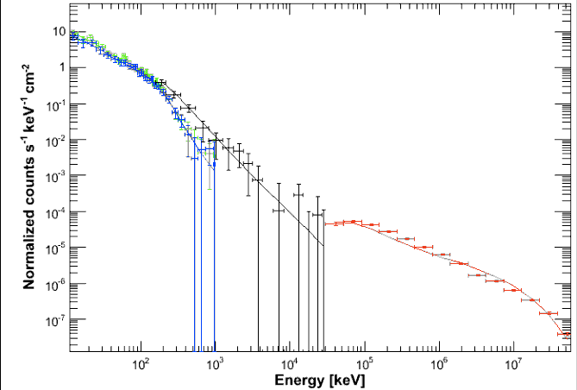
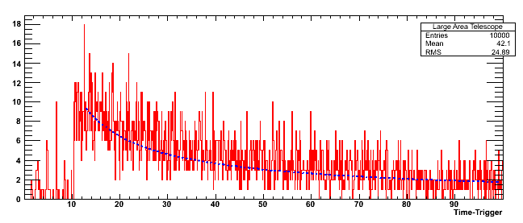
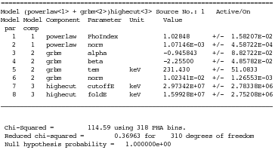
Simulations in the GLAST framework (1/2)
Simulation of the HE emission as in GRB 941017 (Gonzalez et al 2003)
As observed with CGRO
Extrapolation at LAT energies
Theoretical model introduced in the GBM and LAT simulators
Analysis: Bouvier, Guiriec & Omodei
Counts
GBM & LAT LC
Counts
Spectal analysis
(Band+Powerlaw+HE cutoff)

Slide 17
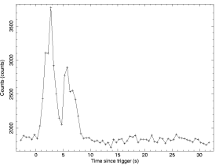
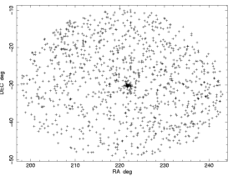
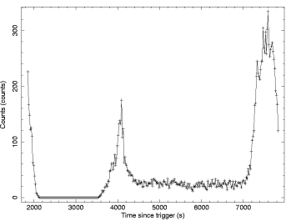
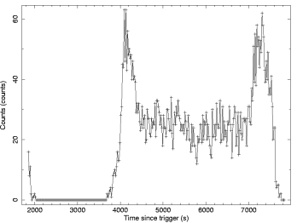
Simulations in the GLAST framework (2/2)
Simulation of the HE afterglow as in GRB 940217
Analysis: Guiriec
GBM-BGO prompt emission LC
No LAT signal during the prompt phase
Counts
Time since trigger (s)
DEC (°)
Counts
Counts
RA (°)
Time since trigger (s)
Time since trigger (s)
Count excess at the GRB position -> HE afterglow
Delayed HE emission 3600s after the prompt emission
Same after reduction of the earth albedo

Slide 18
The « Fireball » Model
(Goodman, 1986) (Rees & Mészaros, 1992)
r=0
r_{s}=10⁹cm
r_{b}=10¹²cm
r_{d}
Internal shocks
Increase of the layer width in Rs and mild relativistic shocks
External relativistic shock
Forward and reverse
Injection (Γ~1 in r=0)
Layer propagation at constant width
Layer acceleration
Prompt (synchrotron/IC radiation)
Afterglow (synchrotron)
1) Initial phase :
Injection
: Lorentz factor
η : baryonic loading
r₀ : black hole size (~10⁷ cm)
r_{s} : saturation radius
r_{b} : broadening radius
r_{d} : decelerating radius
Acceleration
Propagation at constant width
2) Internal shocks : light curve variabilities during the prompt emission
3) External shock : Afterglow emission

Slide 19
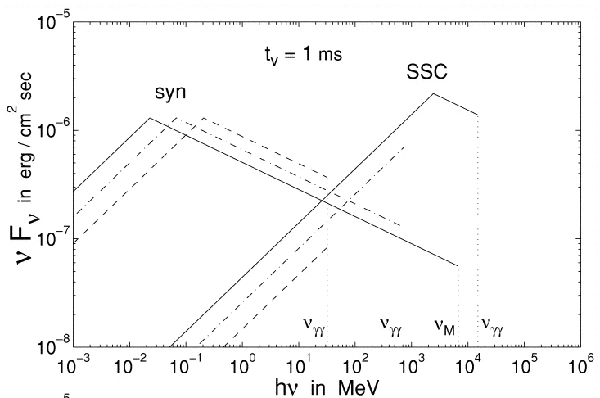
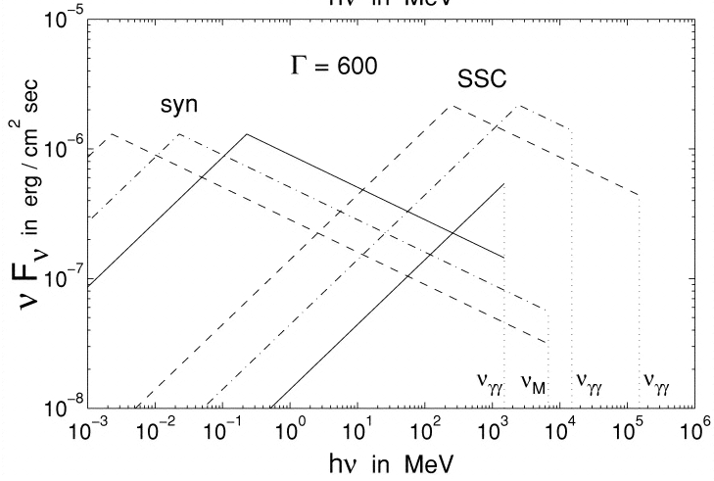
High Energy Emission in GRBs – Models
Fireball Model:
Leptonic models
Internal shocks –> Prompt emission :
Gamma Rays -> Sync and SSC from e⁻
γ-γ absorption -> High energy cut-off
Guetta & Granot 2003
GBM
LAT
t_{v}~10 ms
Γ~200
t_{v}~10s
Γ~200
t_{v}~1 ms
Γ~350
t_{v}~1s
Γ~350
t_{v}~0.1s
t_{v}~0.1 ms
Γ~600
Γ~600

Slide 20
High Energy Emission in GRBs – Models
Fireball Model:
Leptonic models
Internal shocks –> Prompt emission :
Gamma Rays -> Sync and SSC from e⁻
γ-γ absorption -> High energy cut-off
Early afterglow : Sync and SSC
External shock -> Afterglow : Sync and SSC
External shock -> HE afterglow : e⁻ IC scattering of X-ray flare photons

Slide 21

High Energy Emission in GRBs – Models
Fireball Model:
Leptonic models
Hadronic models
Cosmic rays accelerated by 1st order Fermi process.
Emission mechanisms : electron, positron, proton synchrotron, π⁰ decay, …
Radiation emited by electromagnetic cascades within the GRB blast wave.
Photopion production and decay: protons interaction with synchrotron photons or external radiation field.

Slide 22
High Energy Emission in GRBs – Models
Fireball Model:
Leptonic models
Hadronic models
Hybrid models (black body and no thermal components)
Electromagnetic models (poynting flux)
Emission in GLAST energy range -> discrimination between these models.

Slide 23
Outline
1 Overview of GLAST :
The GLAST mission
The “GLAST Burst Monitor” (GBM) & the “Large Area Telescope” (LAT)
The LAT, a Pair Conversion Telescope
2 GLAST, an Unprecedent Telescope for Studying GRBs :
Brief introduction to GRBs
Overview of gamma ray instruments : GBM and LAT
High energy emissions with GLAST
3 UHECR Production in GRBs and Signature with the LAT

Slide 24
The « Fireball » Model
(Goodman, 1986) (Rees & Mészaros, 1992)
r=0
r_{s}=10⁹cm
r_{b}=10¹²cm
r_{d}
Internal shocks
Increase of the layer width in Rs and mildly relativistic shocks
External relativistic shock
Forward and reverse
Injection (Γ~1 in r=0)
Layer propagation at constant width
Layer acceleration
Prompt (synchrotron/IC radiation)
Afterglow (synchrotron)
1) Initial phase :
Injection
: Lorentz factor
η : baryonic loading
r₀ : black hole size (~10⁷ cm)
r_{s} : saturation radius
r_{b} : broadening radius
r_{d} : decelerating radius
Acceleration
Propagation at constant width
2) Internal shocks : light curve variabilities during the prompt emission
3) External shock : Afterglow emission

Slide 25
UHECRs Generation in GRBs
Steps of the scenario :
1 Syn from accelerated e⁻ (internal shocks) -> Prompt emission (keV->MeV)
e⁻ acceleration
2 BATSE (or GBM ) prompt emission (keV-MeV) -> constrain magnetic parameters
Synchrotron emission from e⁻ & simplified hypothesis
Two ways for constraining the magnetic parameters
3 Magnetic parameters -> UHECRs production (internal shocks) ?
Proton acceleration
Possible LAT signature ?
2 Prompt emission, electron synchrotron emission and constraints on the magnetic parameters of the GRB jet.
3 Proton acceleration during the internal shocks and Ultra-High Energy Cosmic Rays (UHECRs) production.
4 Possible signature of the UHECR synchrotron emission with the LAT.

Slide 26
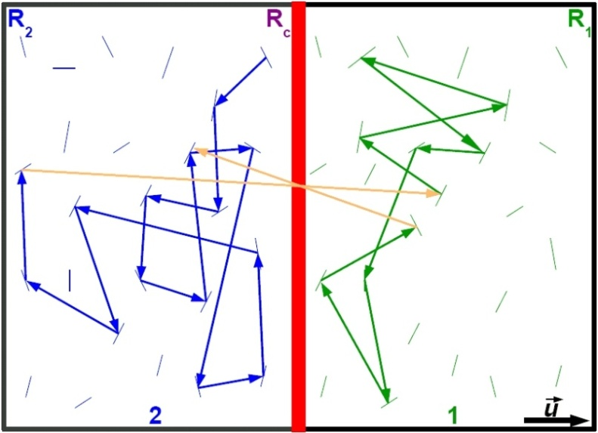
e⁻ Acceleration in Internal Shocks
Mild relativistic internal shocks -> acceleration of charged particles (Fermi processes)
4 magnetic parameters to control electron acceleration :
Magnetic field intensity : B(r_{b})
Decreasing index of the magnetic field : B α r ^{- α}
Spectral index of the MHD perturbations : S₀.k^{-β} with k the wave vector
Intensity level of the perturbations : η_{t}=<δB²>/<B²>
Peculiarity of this model:
Diffusive regime associated with Kolmogorov turbulence (β=5/3) which is less efficient but more realistic than the empirical Bohm approximation (Waxman, 1997) usually used.
D. Gialis and G. Pelletier, ApJ, 2005

Slide 27
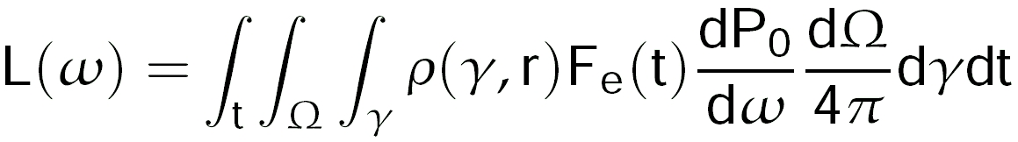
e⁻ Syn as a Mean to Constrain Mag. Parameters
Electron synchrotron emission during the prompt phase as a function of time
e⁻ Lorentz Factor
e⁻ energy distribution
Fraction of accelerated e⁻
Synchrotron power from one e⁻

Slide 28
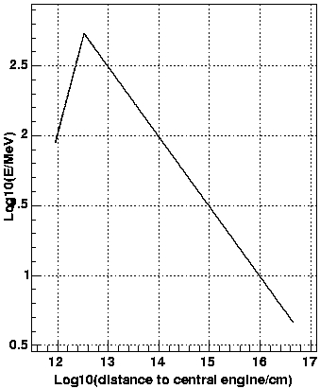

e⁻ Syn as a Mean to Constrain Mag. Parameters
Electron synchrotron emission during the prompt phase as a function of time
e⁻ Lorentz Factor
e⁻ energy distribution
Fraction of accelerated e⁻
Synchrotron power from one e⁻
2 simplifying hypothesis in the following simulations
r_{c}
1) Mono energetic electrons at γ_{max}:
Expansion losses t_{acc}=t_{exp}
, χ
r_{b}
e⁻ maximum energy Log₁₀(E/MeV)
sync losses t_{acc}=t_{syn}
r_{d}
r_{b} : int shocks start (~10¹²cm)
r_{d} : int shocks end
Log10(distance to central engine/cm)

Slide 29
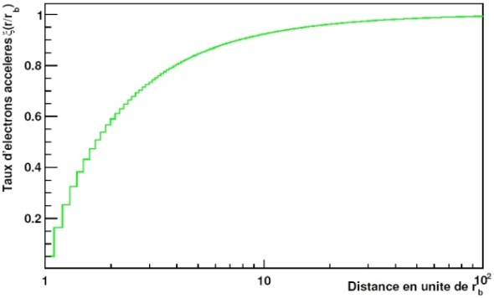
e⁻ Syn as a Mean to Constrain Mag. Parameters
Electron synchrotron emission during the prompt phase as a function of time
e⁻ Lorentz Factor
e⁻ energy distribution
Fraction of accelerated e⁻
Synchrotron power from one e⁻
2 simplifying hypothesis in the following simulations
1) Mono energetic electrons at γ_{max}
2) No shock dynamic but ξ(t):
Accelerated e⁻ ratio -> ξ(t)
r_{b} : int shocks start (~10¹²cm)
r_{d} : int shocks end
Distance to central engine in rb units (log)

Slide 30
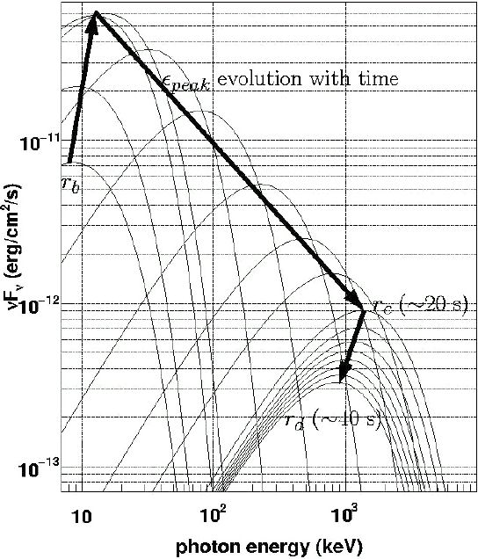
keV-MeV Prompt Emission Evolution -> Magnetic Parameters
Instantaneous νF_{ν} spectra at several instants
ε_{peak}

Slide 31


keV-MeV Prompt Emission Evolution -> Magnetic Parameters
Instantaneous νF_{ν} spectra at several instants
From r_{b} to r_{c}, ε_{peak} increase depends on the magnetic parameters α and β

Slide 32


keV-MeV Prompt Emission Evolution -> Magnetic Parameters
Instantaneous νF_{ν} spectra at several instants
From r_{b} to r_{c}, ε_{peak} increase depends on the magnetic parameters α and β
From r_{c} to r_{d}, ε_{peak} decrease depends only on α
α, β -> ε_{peak} evolution (prompt emission - keV->MeV)
Very interesting for GBM

Slide 33
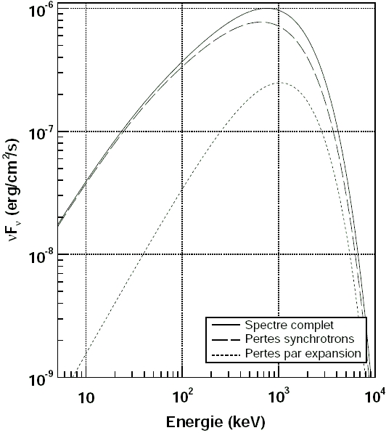
keV-MeV Prompt Emission Evolution -> Magnetic Parameters
Instantaneous νF_{ν} spectra at several instants
νF_{ν} integrated over all the prompt emission
Total spectrum
syn losses contribution
Exp losses contribution

Slide 34
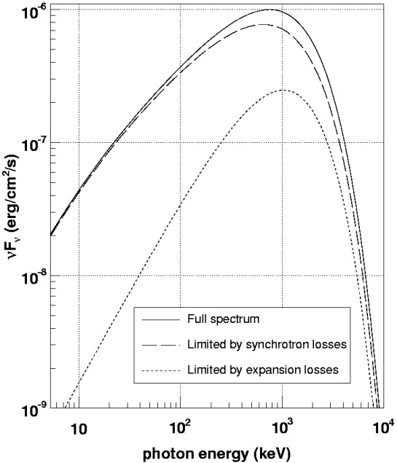
keV-MeV Total Prompt Emission -> Magnetic Parameters
Comparing simulations with BATSE data
Simulations support :
high magnetic field
low profile decrease
lower perturbation intensity than usually assumed
GRB990123 well reproduced with :
B(r_{b}) = 10⁵ G , α = 1 , β = 5/3 (Kolmogorov) , η_{t} = 1,4.10⁻²
α_{Band} = - 0,88
β_{Band} = - 3,1
α_{Band} = -0,6
β_{Band} = -3,1
E_{peak} = 860 keV
E_{peak} = 720 keV
E_{tot} = 1,3.10⁵¹ ergs
T₉₀ = 18s

Slide 35
New Mechanism for Proton Acceleration
Traditionnal Fermi Mechanisms
Magnetic parameter values
UHECRs can’t be generated (internal shocks)
New approach to accelerate protons in the prompt phase
By scattering off the jet’s layers seen as magnetic fronts at the very beginning of the internal shocks, protons can be accelerated to reach UHE range.
D. Gialis and G. Pelletier, A&A, 425, 395 (2004)
jet
Solid layers = magnetic fronts
Proton scattering

Slide 36
LAT – UHECR Synchroton Emission
Source
Observer
Photons nb in the LAT
Jet
GeV Range :
Typical energy for a UHECR synchrotron photon (>10 GeV)
keV-MeV Range :
Central engine
-1,5<α_{Band}<-0,5
-3,1<β_{Band}<-2
E_{peak} ~ 200 keV
duration ~ 20s
Typical Band’s parameters based on BATSE:
GLAST-LAT could observe few tens of photons from UHECRs (z=1).
Possible detection with ACTs if repointing can be done during the very first seconds of the prompt phase (depends on EBL effects).

Slide 37
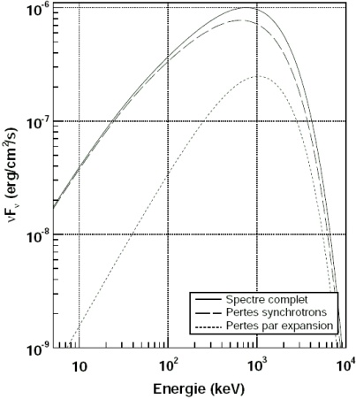
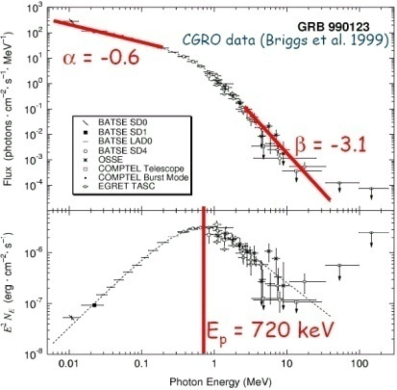
GRB Model - Summary
Our Model (e⁻ syn)
Traditional Fermi Processes
No UHECRs !!! (internal shocks)
~
Estimation of the Magnetic Parameters
BATSE (keV-MeV)
UHECRs !!!
(first instants of the internal shocks)
Additional Mechanism
UHECR Syn in the LAT energy range (GeV)
&
detectable

Slide 38
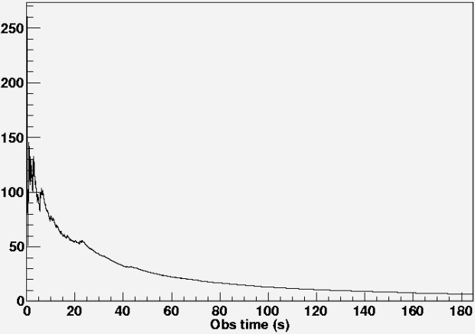
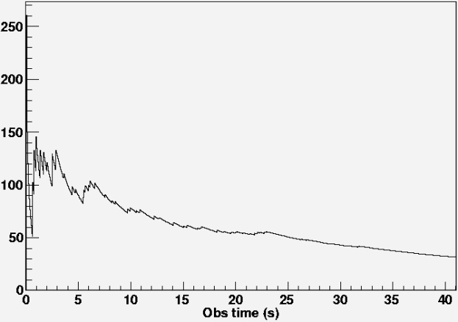
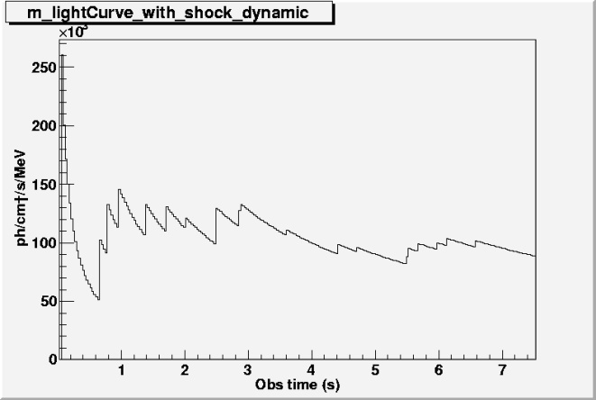
GRB Model - Discussion
Test power law and pile-up distribution for the e⁻ instead of the mono energetic distribution.
Shock dynamics to reproduce light curves (variability, …)
Program included in the simulation but still being tested
Accurate estimation of the electron and hadron synchrotron emission by GLAST using the GBM and LAT fast simulators.
Simulation of Gamma-Ray Bursts distributed in distance (and spectrum,…)
Rate of GRBs detection by GLAST-LAT of synchrotron photons from UHECRs.

Slide 39
Conclusion
GLAST now ready for launch.
First results expected in few months.
GBM & LAT will provide alerts to lead multiwave length studies.
GBM & LAT will discriminate between HE emission models for GRBs.
According to the semi leptonic and hadronic model presented in the last part, the LAT could show the possibility to produce UHECRs in GRBs.
Presented at ICRC 2007 (Guiriec, Gialis, Pelletier & Piron)
Publication in preparation

Slide 40
BACKUP

Slide 41
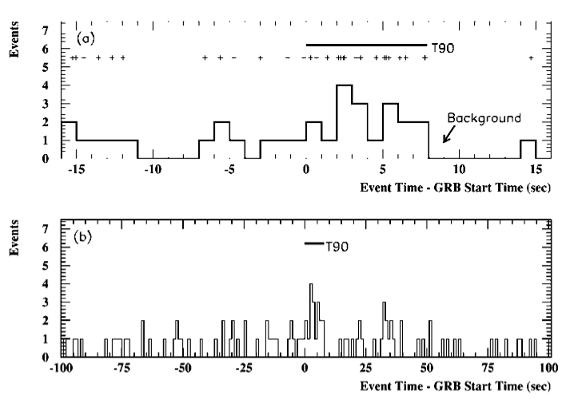

Very High Energy Emission in GRB 970417a
GRB 970417a : 3 σ detection with Milagrito (Atkins et al. 2000)
Z<0.2 to avoid strong attenuation by the EBL

Slide 42
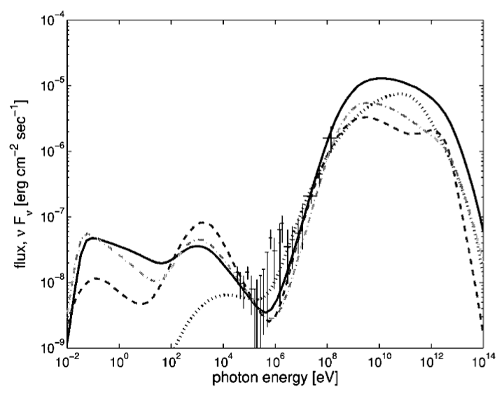
High Energy Emission in GRBs – Models
Early afterglow : Synchrotron and SSC emission
Pe’er & Waxman 2004
z=0.25
z=0.06
z=0.1
z=0.15
EGRET observation: GRB 941017
GLAST

Slide 43
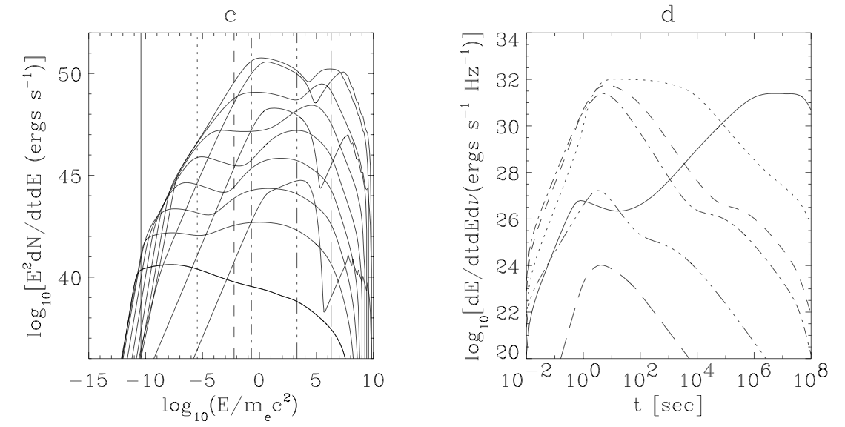
High Energy Emission in GRBs – Models
External shock – Afterglow emission : Synchrotron and SSC emission
Dermer, Chiang & Mitman 1999
4
3
R-band
5
2
8.6 GHz
6
7
1
8
1
3 keV
9
10
100 keV
11
TeV
GeV
GBM
LAT

Slide 44
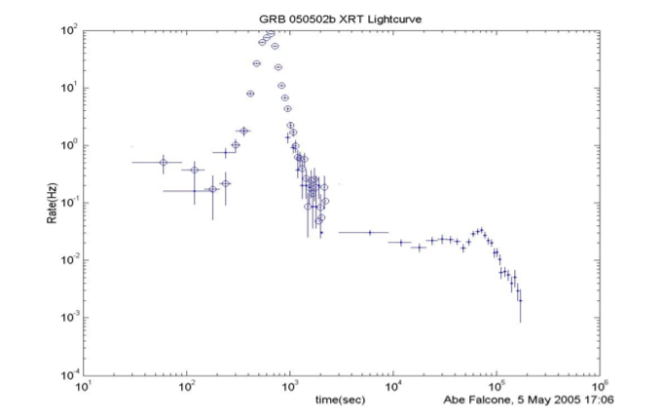
High Energy Emission in GRBs – Models
External shock -> HE afterglow : e⁻ IC scattering of X-ray flare photons
(Wang, Li & Meszaros 2006)
GeV-TeV flares :
Could discriminate between external shock and late central engine activity scenarios.
Could explain the delayed emission observed in GRB 940217 and its 18 GeV photon.

Slide 45
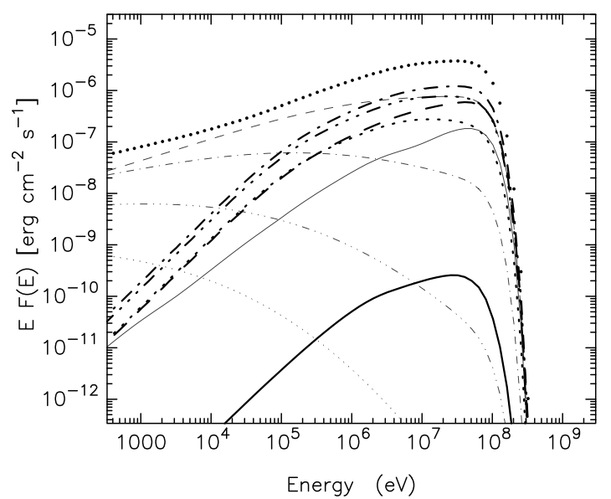
High Energy Emission in GRBs – Models
Radiation emited by electromagnetic cascades within the GRB blast wave.
IC (heavy curves)
Synchrotron (light curves)
GLAST window
z = 1
Total radiation
z = 1
1st generation
2nd generation
3rd generation
GLAST
4th generation
5th generation
Cooling of electrons by synchrotron loss

Slide 46
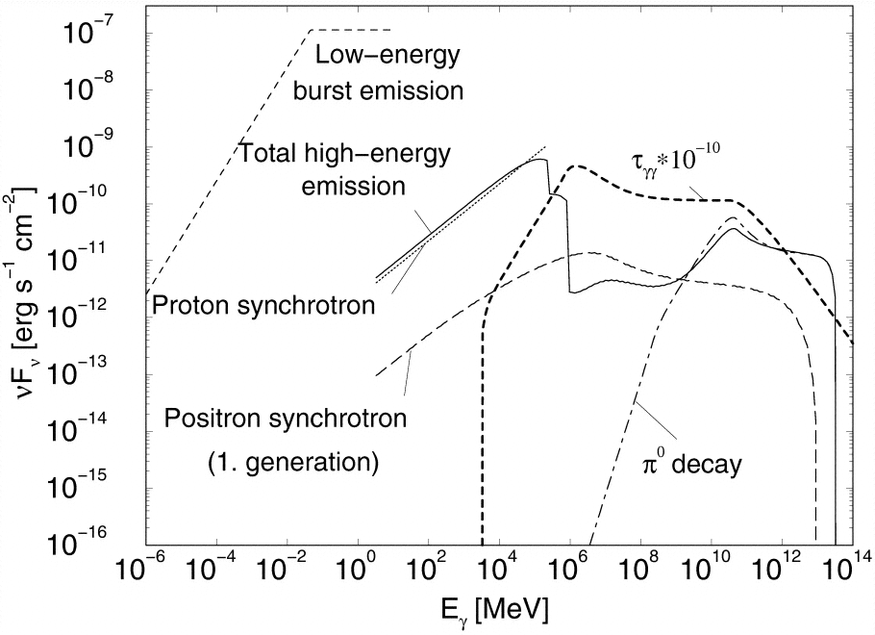
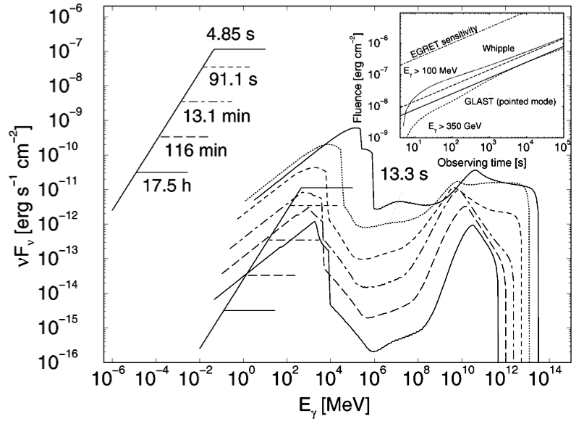
High Energy Emission in GRBs – Models
Photopion production and decay: protons interaction with synchrotron photons or external radiation field.
Bottcher & Dermer 1998
GLAST window

Slide 47
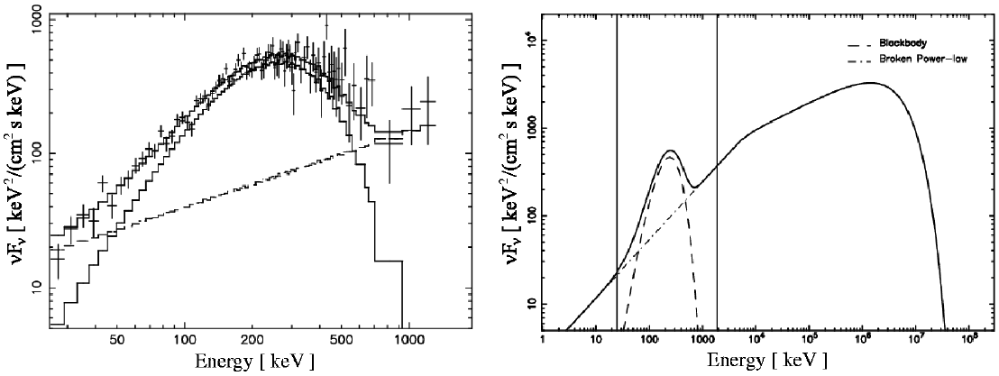

High Energy Emission in GRBs – Models
Hybrid models (black body and no thermal components)
BATSE data for GRB 911016 well fitted with hybrid model
No thermal component
GBM
LAT
Blackbody component
Fit of BATSE data from GRB 911016
Simulation and extrapolation of BATSE data for GRB 911016 in the LAT energy range
GLAST simulation based on BATSE data from GRB 911016

Slide 48
Hadronic and Leptonic Acceleration in the GRB Internal Shock Model

Slide 49
Outline
(1) Brief description of the GRB internal shock model.
(2) Diffuse Shock Acceleration (DSA) model : basis.
(3) Fermi acceleration in the internal shock stage.
(4) Hadronic acceleration in the internal shocks.
(5) Cosmic Ray generation : an additional acceleration process.
(6) Leptonic acceleration in the internal shocks.

Slide 50
The GRB internal shock model
(see e.g. Rees M. & Mészáros P., ApJL, 430:L93-L96, 1994, or Piran T., RvMP, 76:1143-1210, 2005)
A relativistic outflow is produced by a central engine (black hole + magnetized torus) of size r₀ ≈ 10⁷ cm ⇔ set of (independant) collimated shells or layers (1 ≤ N_{s} ≤ c Δt_{w}/r₀.).
Outflow duration : Δt_{w} < 2 s for SGRBs and > 2 s for LGRBs.
Baryonic loading parameter : η ≡ E/Mc² ≈ 50 to 500 for a total energy E ≈ 10⁵⁰ to 10⁵² erg.
Four main stages
I – The acceleration of the layers between r₀ and the distance r_{s} ≈ η r₀ : E_{in} ⇒ E_{kin}.
II – Propagation with no collision, and with a Lorentz factor distribution close to η between r_{s} and r_{b} ≈ η² r₀.
The layers become transparent at a radius r∗ close to r_{b}. A thermal emission is possible in keV range.
III – The internal shock stage :
(a) First collisions occur around r_{b} : E_{kin} ⇒ E_{in}.
(b) Particles (protons, electrons, …) are accelerated by Fermi processes in shocks.
(c) The GRB prompt emission is produced via synchrotron cooling of accelerated particles : E_{in} ⇒ E_{γ} .
For the terrestrial observer, the energy of photons is boosted by a Lorentz factor close to η.
IV – The interaction with the surrounding medium leads to the external shock and the reverse shock : production of the afterglow emission (and X flares ?).

Slide 51







Diffuse Shock Acceleration (DSA) model : basis
(see e.g Blandford, R., and D. Eichler, 1987, Physics Reports 154, 1 and Bell, A. R., 1978a, MNRAS, 182,147.)
The case of a non-relativistic shock
Compression ratio: r ≡ρ₁/ρ₂.
(For a strong shock (u₁>>c_{s1}): r = 4 ou 7)
Hypothesis
(a) u₁ = r u₂ << c
(b) B = B₀ + δB, |B₀|>>|δB|
(c) P_{B} ≈ P_{kin}
For a relativistic particle (ε = pc):
1st order Fermi process for a Fermi cycle
u-d-u ⇒
with a characteristic time
2nd order Fermi process on both sides of
the shock ⇒
with a characteristic time
u₁ > c_{s1}
(in the shock frame)
u₂ < c_{s2}
(speed = V_{a})
ρ₁
ρ₂
B_{1⊥}
B_{1ℓ}
B_{2⊥}= r B_{1⊥}
B_{2ℓ}= B_{1ℓ}
P₁
P₂>> P₁
Upstream
SHOCK
Downstream
Conclusion
Because of (c), V_{a} is of the order of u₂ and
And, if P_{RC} << P_{kin}, r = 4 and

Slide 52









Fermi acceleration in the internal shock stage
The internal shocks are mildly relativistic : ⇒ for
BUT one can assume that the theory of DSA in non-relativistic shock applies:
What does the scattering frequency (ν _{s}) depends on ? (see e.g. Casse F. & al., Phys. Rev. D, 65, 2002)
It depends on the energy of the particle and on the magnetic field (intensity and turbulence level).
Hypothesis
(1) The intensity of the magnetic field, on both sides of the shocks, depends on r : B(r) ∝ r^{-α} where 1< α < 2, and B(r_{b}) ≈ 10⁴ – 10⁶ G.
(2) We define a turbulence spectrum of magnetic perturbations :
where k_{min} = 2π/ℓ_{max}, ℓ_{max} ≈ ΔR, the width of a layer, and β , the index of the turbulence spectrum.
Consequences
t_{acc} ∝ the mean free path of the particle in an irregular magnetic field :
r_{L}, Larmor’s radius, ℓ_{c} (≈ ΔR) the magnetic correlation length, and μ the cosine of the pitch angle.
(Gialis D. & Pelletier G., Astrop. Phys., 20: 323-333, 2003)
and
with
the turbulence level,

Slide 53








Hadronic acceleration in the internal shocks
Hadrons (protons and heavier nuclei ⇔ Cosmic Rays) undergo a synchrotron cooling.
For a CR : ⇒ for .
We deduce with .
BUT there is a stronger constraint : .
Then ⇒ with .
Conclusion (Gialis D. & Pelletier G., Astrop. Phys., 20: 323-333, 2003)
This regime cannot produce UHECRs : for α = 1 and β = 5/3 (Kolmogorov);
For a proton;
where
(in R_{c})

Slide 54

Cosmic Ray generation : an additional acceleration process
The additional acceleration process (1/2)
(see e.g . Pelletier G. & Kersalé E., A&A, 361:788-794, 2000, and Gialis D. & Pelletier G., A&A, 425:395-403, 2004)
Hypothesis:
(1) Each internal shock can be described as a magnetic front in the resulting shocked layer.
(2) In the comoving frame, these magnetic fronts are mildly relativistic and can propagate in
both opposite directions.
(3) Protons can undergo a relativistic Fermi acceleration by scattering off the magnetic fronts.
(4) Protons can be confined and accelerated, in their initial layer, until they reach the local
confinement energy given by Hillas’ criterium : in the observer frame,
This energy is constant for α = 1.

Slide 55



Cosmic Ray generation : an additional acceleration process
The additional acceleration process (2/2)
(see e.g . Pelletier G. & Kersalé E., A&A, 361:788-794, 2000, and Gialis D. & Pelletier G., A&A, 425:395-403, 2004)
Interests:
Simulations showed that CRs have an energy distribution: , with p ≥ 2, and ε in [100 GeV, 10¹¹ GeV] in the observer frame.
(1) The acceleration time is much lower than the cooling synchrotron time and the expansion time.
It mainly depends on the number of layers N_{s}:
The cooling by photo-production of pions has an upper characteristic time.
(2) The average energy gain per random scattering is close to γ∗², with 1.4 < γ∗ < 2, the average
Lorentz factor of layers in the comoving wind frame.
(3) The average number of scatterings, before escaping, can be simply estimated (with N_{s} >>1) by
, for a proton with an initial energy ε₀.
For ε₀ between 1 and 10⁴ GeV, N_{scat} is of the order of a few tens and the energy gain γ∗^{2 Nscat} is high
enough to achieve the UHECRs range.
This estimate was checked in a numerical Monte-Carlo simulation, including dynamics.
(see Gialis D. & Pelletier G., A&A, 425:395-403, 2004)

Slide 56







Leptonic acceleration in the internal shock stage (1/2)
What about a progressive acceleration regime for electrons ?
Energy of electron is also limited by synchrotron cooling:
And the transition occurs at the distance
At r_{c}, the electrons can reach their maximal energy.
(Gialis D. & Pelletier G., ApJ, 627: 868-876, 2005, and Guiriec S., Gialis D., Piron F. & Pelletier G., in prep., 2008)
with
and by the expansion:
with
β = 5/3
1 ≤ α ≤ 2
where
r_{b}~
For α = 1, β = 5/3;
e
e

Slide 57







Leptonic acceleration in the internal shock stage (2/2)
The synchrotron emission
For an electron with an energy ε, this emission reaches a maximum power close to the cut-off energy
In the observer frame, this cut-off energy, at the distance r and for ε = γ _{max}(r)m_{e}c² (= ε_{syn} or ε_{exp}), is
At r_{c}, the cut-off energy is maximum, and does not depend on the magnetic field intensity;
It only depends on the index β and η_{t} the level of magnetic irregularities.
For an electronic distribution f(γ,r) ( with ε = γ m_{e}c²), the observed flux F(ν) can be expressed by :
(Gialis D. & Pelletier G., ApJ, 627: 868-876, 2005, and Guiriec S., Gialis D., Piron F. & Pelletier G., in prep., 2008)
for r_{b} ≤ r ≤ r_{c},
for r_{c} ≤ r .
(r)
with
and
.

Slide 58
Conclusion
In the GRB internal shocks
(1) A progressive acceleration regime (t_{acc} ∝ mean free path), including a magnetic turbulence spectrum, cannot produce UHECRs.
(2) To produce UHECRs, we need an additional acceleration process.
⇒ Relativistic Fermi acceleration by scattering off the magnetized fronts.
(3) A progressive acceleration regime for electrons gives lower limits on their maximal energy.
It could give also some constraints on the magnetic field and on its turbulence level.
⇒ SEE Sylvain Guiriec’s talk about the consequences !!

Slide 59





Assemblage des modules de calorimètre
Assemblage d’un module :
Electronique « front end » :
Interférences électromagnétiques ?
Position et largeur des piédestaux
Suppression de zéro
Discriminateurs à basse et haute énergie
Discriminateur de sélection automatique du gain
Vérifier la stabilité de la colle optique

Slide 60





Tests d’environnement du calorimètre
Les tests : compatibilité électromagnétique, vibration, température sous vide(TVAC)
Procédure TVAC:
Caractéristiques suivies:
Position et largeur des piédestaux
gains électroniques
« Tack delay »
Rapport des signaux entre diodes (LE+/LE-, LE+/HE+ et LE-/HE-)
Mesure de l’énergie et de la position des dépôts dans les cristaux
Linéarité des seuils « CAL_LO », « CAL_HI », suppression de zéro, choix du gain

Slide 61




The « Trending » program
« Trending » to follow time and temp. Evolution of the electronic and cristals properties.
Graphs level 0
level 1
Pedestal position
Pedestal position
Canal number
Pedestal position
LEX1
Pedestal position
Test phase number (ie time)

Slide 62








Temporal evolution of the variables
Vaiables evolution with temperature
Peak distribution = stability
Anormal spread for pedestal

Slide 63


Pedestal position evolution with temperature
Pedestal posiion
T°C
Variability of the pedestal position with temperature
Pedestal position
But reproductibility
Caracteristic to take into account during calibration

Slide 64
Rejet du bruit de fond dans le LAT
GlastRelease
Rayonnement cosmique chargé principale source de bruit de fond du LAT
Sources de particules
Sous-systèmes du LAT
Taux de déclenchement du LAT sur fond sera ~1000 x supérieur au taux de déclenchement sur signal gamma
Simulation physique
Simulations Monte Carlo
(interaction des particules dans le détecteur)
Importance du rejet
Réponse des sous-systèmes
Simulation de l’électronique de bord
Arbre de décision (« Insightful Miner»)
Simulation électronique
Conditions de déclenchements et filtres
Plusieurs classes d’événements plus ou moins pures en gamma (présence d’événements résiduels du fond)
Lot d’événements au format des données réelles (gamma avec quelques centaines de Hz de fond)
Reconstruction
Reconstruction au sol (ACD, trajectographe, calorimètre)
Étude fonds diffus
Étude sursauts gamma
…
Ensemble des variables de reconstruction caractérisant l’événement

Slide 65
MipFinder
MipFinder is looking for proton MIP tracks
MipFinder algorithm
Cleaning
Tracking
: Energy deposits incompatible with a MIP (5 to 30 MeV)
Incident proton
Proton close to MIP
MIP track as reconstructed in the CAL
Nuclear interaction,
End of te MIP track
Secondary particles

Slide 66




MipFinder
Tracker
Calorimeter
Proton
LAT
Photon gamma
MipFinder track
Simulated proton track

Slide 67
The MipFinder variables
Centre :
Longueur :
χ² :
E_{c} :
Position du centre de la trace
Longueur du segment de trace
Qualité de reconstruction de la trace
E_{c}1
E_{c}2
E_{RM} :
E_{c}3
E_{c}4
Trace MF
E_{c}5
Perte d’énergie par ΔE/ Δx
E_{c}6
Energie contenue dans un cylindre d’un rayon de Molière
Equivalent vertical de la perte ΔE/ Δx
E_{c}= ΣE_{c}(i)/nbCouches
d_{err} :
D_{b} :
δE_{c} :
Trace reconstruite dans le trajectographe
Trace trajectographe
Rms de la distribution des E_{c}(i)
Trace MF
D_{b}
Trace MF
d_{err}

Slide 68


MipFinder
50MeV-120MeV
500MeV-1,2GeV
Y
Y

Slide 69
MipFinder
50 MeV – 120 MeV | MF efficiency | « simple cuts » efficiency | Y efficiency | X_{eff} efficiency | Y_{ω} efficiency
Gamma-rays | 8% | 15% | 5% 20% | 5% 20% | 5% 20%
Protons | 65% | 61% | 63% 81% | 63% 81% | 64% 80%
500 MeV – 1.2 GeV | MF efficiency | « simple cuts » efficiency | Y efficiency | X_{eff} efficiency | Y_{ω} efficiency
Gamma-rays | 50% | 2% | 5% 20% | 5% 20% | 5% 20%
Protons | 90% | 9% | 42% 66% | 42% 66% | 23% 43%

Slide 70

MipFinder
D_{B}
1.2 GeV – 300 GeV | D_{B} efficiency
Gamma-rays | 5% 20%
Protons | 45-50% 60-70%

Slide 71

D_{B}

Slide 72







Contrainte sur le champ magnétique
Ajustement des spectres synthétiques avec une fonction de Band
Moyenne des paramètres de Band (BATSE) :
α
β
E_{b}
Simulations numériques :

Slide 73







Contrainte sur le champ magnétique
Paramètres initaux : κ₀=700, α=1, β=5/3, B_{b}=10⁵G
Influence du paramètre κ0 :
Influence du paramètre α :
Influence du paramètre B_{b} :

Slide 74
Le comportement dual de D_{b}
Dans la région du MIP
Dans la région dominée par les interactions nucléaires
Trace trajectographe
Gerbe de particules
Trace MF
Protons
Proton secondaire au MIP
Centre de la trace MF
D_{b}
Module de calorimètre
Photons gamma

Slide 75



Observabilité de l’émission synchrotron des UHECRs par le LAT
Estimation de l’énergie synchrotron des UHECRs en fonction de l’énergie synchrotron provenant des électrons
Evaluation de l’énergie E_{r}^{e} mesurée par le détecteur en provenant de l’émission synchrotron des électrons sur la base de paramètres de Band typiques (-1,5<α_{Band}<-0,5 ; -3,1<β_{Band}<-2 ; E_{peak} ~ 200 keV ; durée ~ 20s)
Estimation de l’énergie synchrotron mesurée par le détecteur pour les UHECRs
Calcul du nombre de photons au-dessus d’un seuil en énergie provenant de l’émission synchrotron des UHECRs
Le GLAST-LAT devrait observer entre 10 et 200 photons en provenance des UHECRs.
Possibilité de détection avec les télescopes au TeV si repointage durant les toutes premières secondes de la phase prompte (mais attention à l’atténuation par l’EBL)

