Slide 1
Update: Blue Ribbon Task Force on Sustainable Digital Preservation and Access
Dr. Fran Berman
BRTF-SDPA Co-Chair with thanks to Sayeed Choudhury, Brian Lavoie, Amy Friedlander, Abby Smith, David Minor, Ardys Kozbial, and Robert McDonald

Slide 2
Presentation Outline
Data Preservation
The Blue Ribbon Task Force
History, membership, charge and focus
Deliverables
Activities
A Call to Action

Slide 3
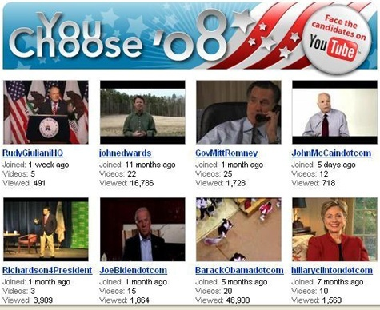
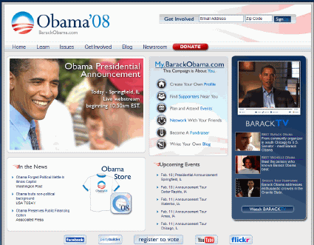
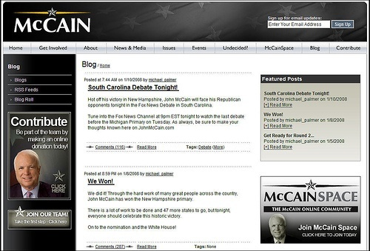
Our Digital World 1
The 2008 Cyber-election
Fundraising via website
YouTube videos of the candidates
Blogs as vehicles for discussing issues
On-line organizing
Digital data from historic 2008 cyber-election will be valuable for decades to come

Slide 4

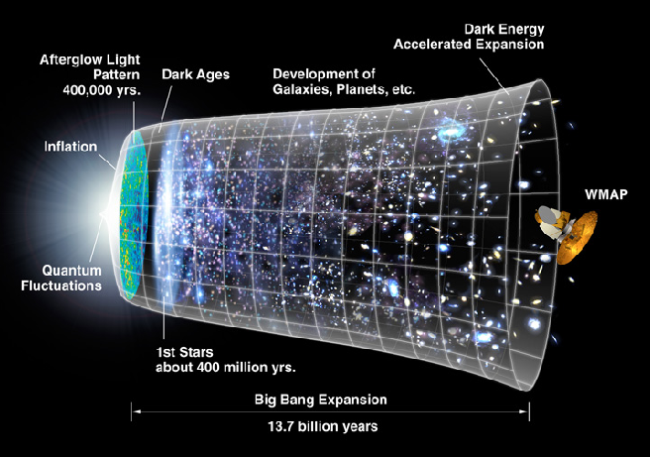
Our Digital World 2
The First Billion Years After the Big Bang
400 TB of data produced from ENZO astrophysics simulations
Data will be mined and analyzed, of great value for several years after computation
Simulation results illustrate growth of stars, galaxies, and galaxy clusters, dark matter, etc. after the Big Bang

Slide 5

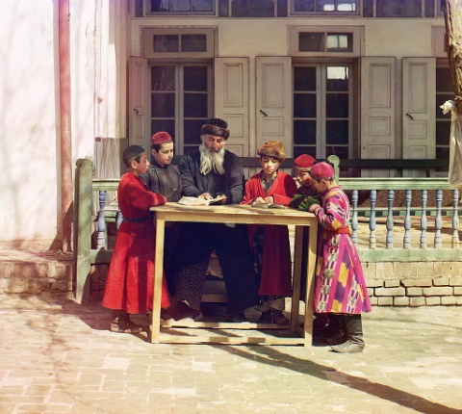
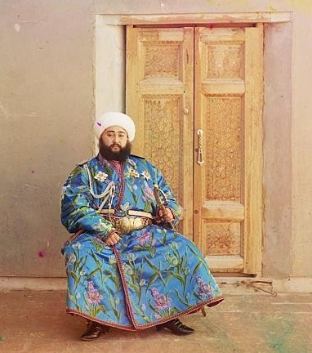
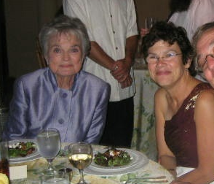
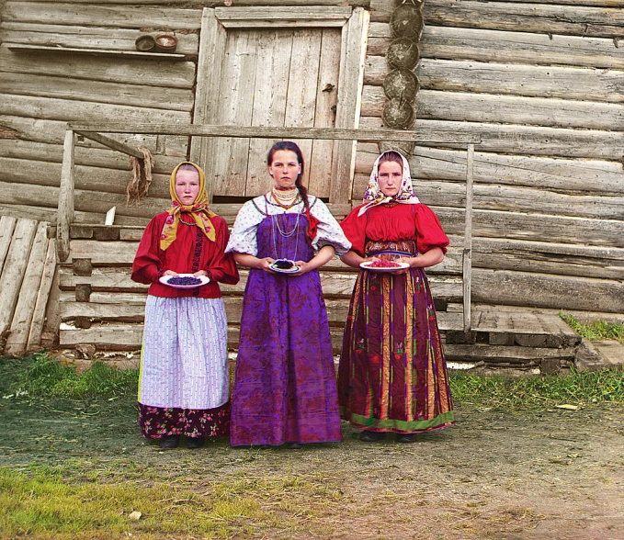
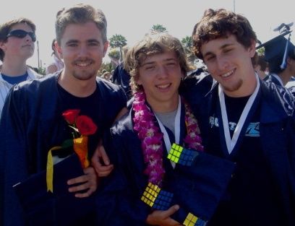
Our Digital World 3
Family Photographs

Slide 6
Data Preservation
Key Questions:
What should we save?
How and who should save it?
Who should pay for it?
The answer to 3) depends in part on the answers to 1) and 2).
Value
Cost
Time

Slide 7
Who should pay?
The “Free Rider” non-solution: “Let X do it”
where X is:
The Government
The Libraries
The Archivists
Google, Yahoo, Microsoft, etc.
Data users
Data owners
Data creators, etc.
For valued digital data that is a “public good”, creative partnerships are needed to provide preservation solutions with
Trusted stewards
Feasible costs for users
Sustainable costs for infrastructure
Very low risk for data loss, etc.

Slide 8
A Framework for Thinking about Digital Stewardship and Preservation
Digital Data Collections
Repositories / Facilities
Increasing value
Increasing community base
Decreasing risk of loss or damage
Increasing respon- sibiity,
Increasing stability
Increasing trust
Increasing infra- structure
Reference, nationally/ internationally important, irreplaceable data collections
Key research and community data collections
Personal data collections
National / international scale repositories, libraries, archives
“Regional” scale libraries and targeted data archives / centers
Private repositories
Societal value
Community value
Individual value
The Data Pyramid

Slide 9




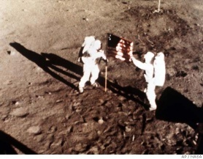






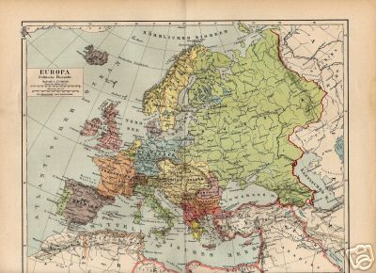








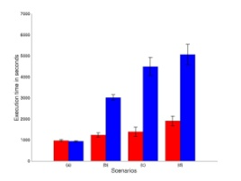
Why not just let XXXXXXX do it? Multi-sector solutions required for data in the public interest
Societal value
Community value
Individual value

Slide 10
Blue Ribbon Task Force on Sustainable Digital Preservation and Access
History:
International Blue Ribbon Task Force (BRTF-SDPA) initiated to study issues of economic sustainability of digital preservation and access
Proposals developed during Spring-Summer 2007
BRTF-SDPA pre-planning took place Fall 2008
Kick-off meeting in DC held in January 2008
Task Force meeting 2008-2009
BRTF is an independent group who will report to the community
University
State
College
Federal
USER
Non-profit
Commercial
Local
International
Image courtesy of Chris Greer, October 2006

Slide 11
BRTF-SDPA Charge
To conduct a comprehensive analysis of previous and current efforts to develop and/or implement models for sustainable digital information preservation
To identify and evaluate best practice regarding sustainable digital preservation among existing collections, repositories, and analogous enterprises
To make specific recommendations for actions that will catalyze the development of sustainable resource strategies for the reliable preservation of digital information
Provide a research agenda to organize and motivate future work.

Slide 12
Scope of BRTF-SDPA
BRTF focusing on economic sustainability of digital data for which there is a clear public interest
Materials may come from a variety of sectors and in a variety of forms (text, audio, video, website, scientific data set, e-journals, etc.)
Some of this data can/will be identified at its inception as data of long-term value; some will not: retention value will only become apparent over time.
Economic sustainability models must be developed / identified in the context of changing arrangements between multiple missions and models for various sectors
Target audiences and relevant domains may also vary over time
Key topic for consideration: transfer of preservation responsibilities and associated digital content from one party to another party (or sets of parties) based on trigger or milestone events and changes in perceptions of value.

Slide 13
BRTF-SDPA Participants
Blue Ribbon Task Force:
Paul Ayris, University College London
Fran Berman, SDSC/UCSD
Bob Chadduck, NARA Liaison
Sayeed Choudhury, Johns Hopkins University
Elizabeth Cohen, AMPAS/Stanford
Paul Courant, University of Michigan
Lee Dirks, Microsoft
Amy Friedlander, CLIR
Chris Greer, NITRD Liaison
Vijay Gurbaxani, UC Irvine
Anita Jones, University of Virginia
Ann Kerr, Consultant
Brian Lavoie, OCLC
Cliff Lynch, CNI
Dan Rubinfeld, UC Berkeley
Chris Rusbridge, DCC
Roger Schonfeld, Ithaka
Abby Smith, Consultant
Anne Van Camp, Smithsonian
Sponsoring Agencies/Institutions:
National Science Foundation
Mellon Foundation
Library of Congress
National Archives and Records Administration
CLIR
NITRD
JISC
Member institutions
Specific Responsibilities
Fran Berman / co-Chair
Amy Friedlander / First Report Editor
Ann Kerr / January Panel Rapporteur
Brian Lavoie / co-Chair
Susan Rathbun / Task Force Support
Abby Smith / Second Report Editor
Jan Zverina / Communications Lead
Lucy Nowell / NSF Program Officer
Don Waters / Mellon Program Officer
Laura Campbell, Martha Anderson / LC representative

Slide 14
BRTF Deliverables
Goal is to go beyond the “3 R’s”:
Data preservation is Really important
More Research is needed.
More Resources are needed.
First Year (2008) Report (positive, “what is”):
Describe past and current models of economic sustainability for digital preservation (interviews, testimony, case studies, etc.);
Identify points of convergence/divergence; “lessons learned”;
What we know so far, and what our key knowledge gaps are.
Second Year (2009) Report (normative, “what should be”):
General cost framework: key cost categories of digital preservation
Set of economic models/“scenarios”: alternate ways of organizing digital preservation activities, within the context of the cost framework
Describe each model: features, pros, cons, trade-offs, etc.
List real world conditions for which each model is best suited.
“If your digital preservation context is X, we recommend you consider using model Y to organize your activities in a sustainable way.”

Slide 15
BRTF-SDPA Working Definition of Economic Sustainability
Economic sustainability in a digital preservation context: The set of business, social, technological, and policy mechanisms that
Encourage the gathering of important information assets into digital preservation systems, and
Support the indefinite persistence of the digital preservation systems, thus securing access to and use of the information assets into the long-term future
Economically sustainable digital preservation requires
Recognition of the benefits of preservation on the part of key decision-makers, as part of a process of selecting digital materials for long-term retention;
Appropriate incentives to induce decision-makers to act in the public interest;
Mechanisms to secure an ongoing allocation of resources, both within and across organizations, to digital preservation activities;
Efficient use of limited preservation resources;
Appropriate organization and governance of digital preservation activities.

Slide 16
Challenges in Developing an Economic Model
Difficult to compare and contrast different studies given diverse definitions of costs, units of measurement, scope or accounting methods
Need to include costs associated with
human dimensions (e.g., management)
infrastructure elements of storage (e.g., power and cooling)
data characteristics (e.g. size, format, type)
Key related work: relevant and related recent studies focusing on various “parts of the elephant” (e.g. LIFE, BL cost models which focus on entire life-cycle of costs as well as inter-temporal considerations (e.g., inflation/deflation, interest rates))

Slide 17
Year 1 Deliverable: Report which describes Current and Best Practices for Economic Sustainability
2008 Report will focus on
Key issues for economic sustainability of digital preservation and access
Key concepts and terminology
Relevant literature
Compilation and analysis of evidence on existing efforts to implement economically sustainable digital preservation activities
The purpose is to provide a thorough survey of the problem space as it exists today, which in turn will provide context for and inform the work of BRTF in the second year.
BRTF Year 1 Report is currently being drafted by Task Force members and Editor Amy Friedlander. Due out by January 2009.

Slide 18
What We’d Like to Know from the Community: Questions on Economic Sustainability for Digital Preservation
What is the nature of the digital materials being preserved
source(s), content, volume, format, copyright restrictions, frequency of use … ?
Who are the stakeholders for these materials?
Who benefits from the preservation of the target materials?
What is the “value proposition” for this preservation effort?
Why are stakeholders interested in the long-term preservation of the materials?
What are the anticipated future uses of the materials?
Is the “value proposition” perpetual, or does it expire within a finite time frame?
What are the key features of long-term preservation for these materials?
What are the elements of “successful preservation” : Bit preservation only? Format migration? Rich description/documentation with metadata?
What are the key features of a preservation service that would meet the preservation requirements of the stakeholder community.
What are the “economic aspects” of digital preservation?
Given preservation requirements for the materials, what are the key cost categories associated with a preservation strategy aimed at meeting these requirements?
Does the organization responsible for preservation also have a stake in the ongoing availability of the materials, or is it performing a “service for hire”?
What are the mechanisms by which funding is generated for digital preservation activities? How are “paying stakeholders” identified?

Slide 19
2008 BRTF Panels
January Panel Speakers:
John Gantz, IDC
Stijn Hoorens, RAND
Andy Maltz, AMPAS
Edmund Mesrobian, RealNetworks
July Panel Speakers:
Helen Berman, Protein Data Bank
Kris Carpenter, Internet Archive
Myron Gutmann, Interuniversity Consortium for Political and Social Research
Rick Luce, Emory Library
Paul Ratnaraj, Wharton Research Data Services
Nan Rubin, Public Television
Rick Zuray, Boeing
Stuart McKee, Microsoft

Slide 20
Other Venues for BRTF Information Gathering
Testimony – template will be available on the website for community input on economic sustainability
In-depth interviews – with community leaders
Literature search – Related work on on economic sustainability for digital preservation and/or related efforts
Task Force members – diverse, international group representing broad spectrum of sectors, perspectives, institutions

Slide 21
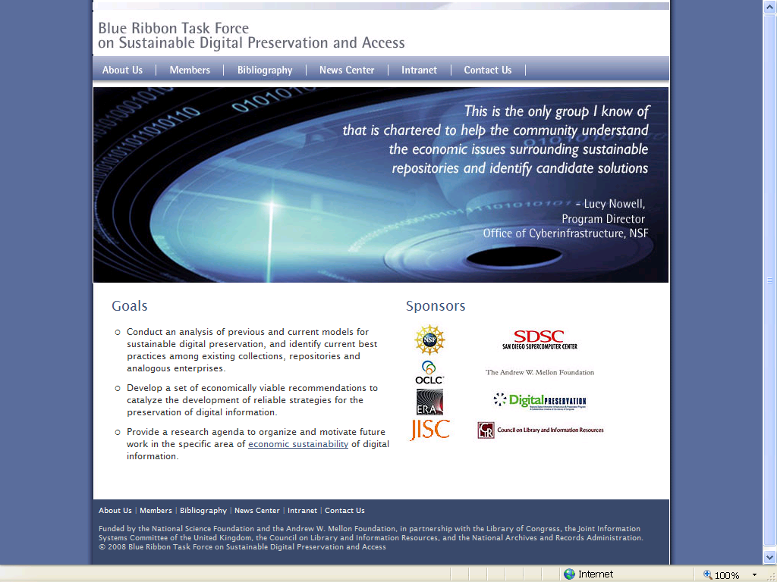
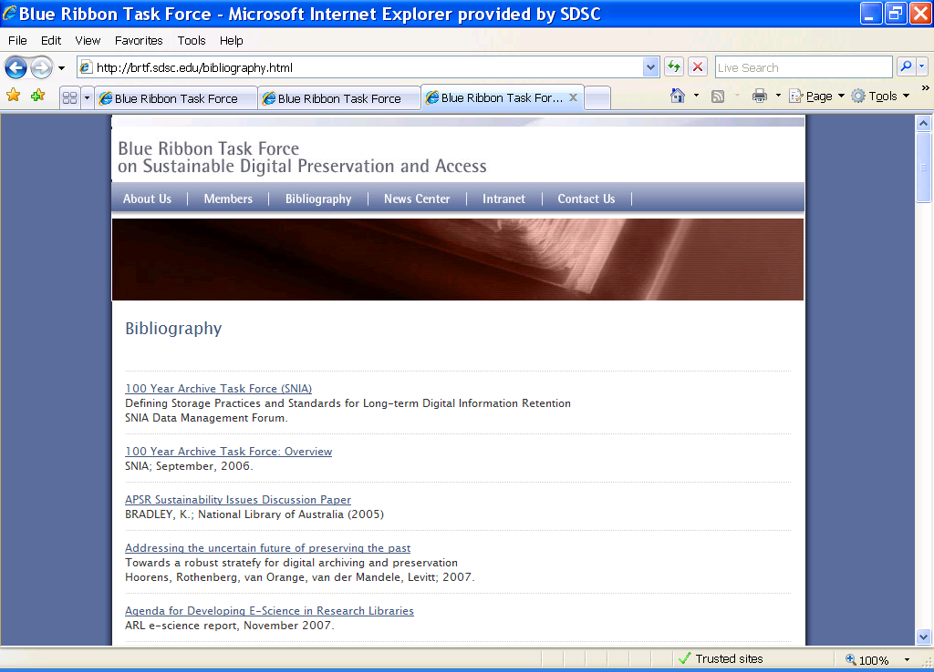
Other Deliverables: BRTF-SDPA Website (brtf.sdsc.edu)
BRTF-SDPA website being developed as a community resource for
information about the Task Force
input from the community
literature related to Digital Preservation
Templates for “testimony” to be available on the website
Suggestions for inclusions for the bibliography encouraged

Slide 22
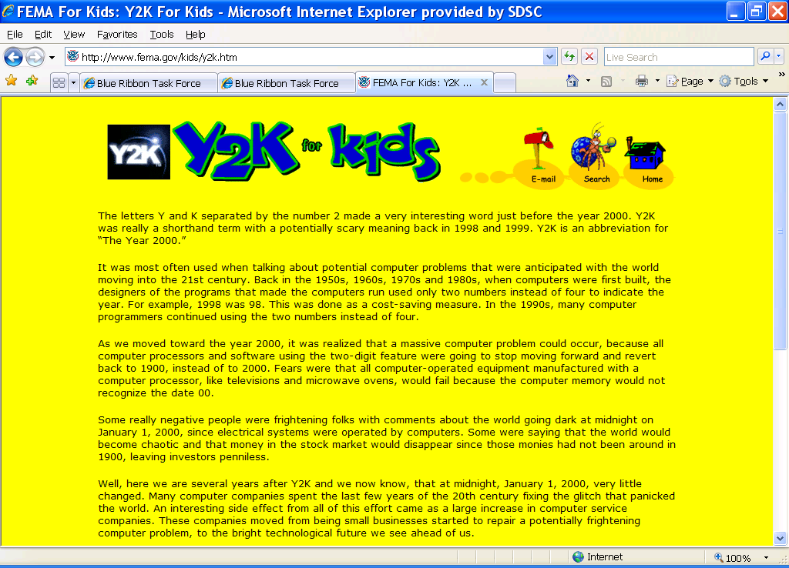

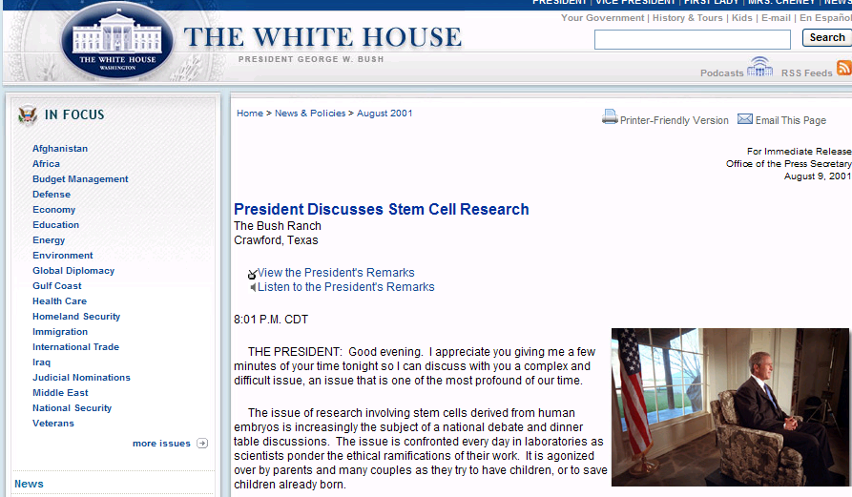
Community Outreach -- Call to Action for both BRTF and the NDIIPP Community: Get the message out beyond the “usual suspects”
Does your dry cleaner know what digital preservation is?
We can help focus attention and encourage new resources from decision makers and the general public if we get the message out

