Slide 1
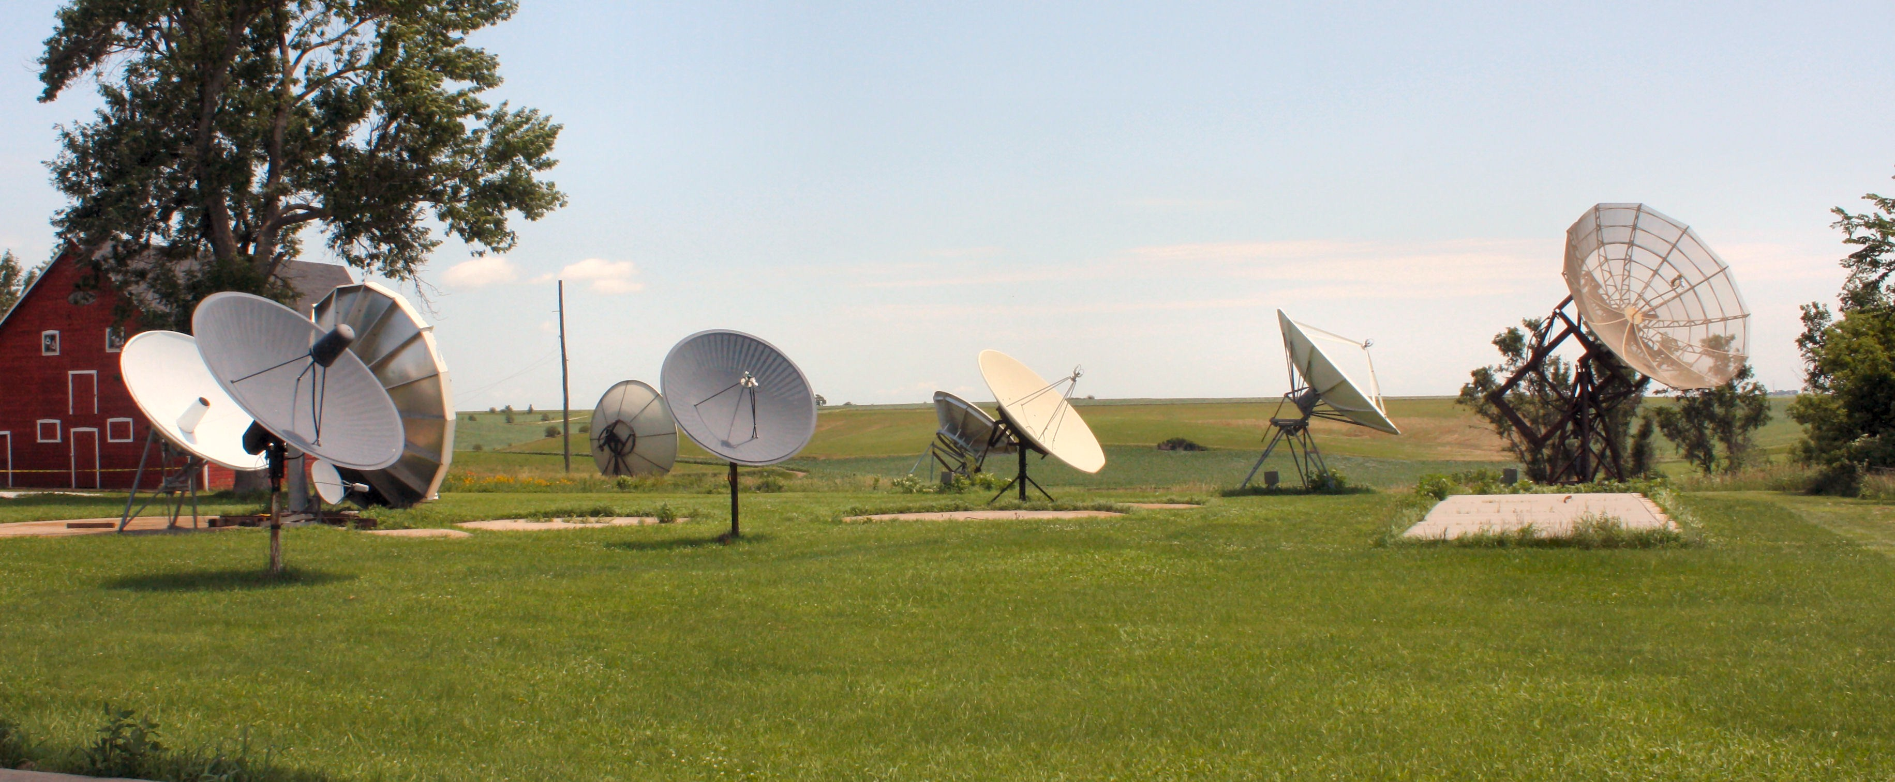
SCOLA

Slide 2

SCOLA is a content acquirer/provider.
We import and re-transmit electronic
and hard media from 105 countries
in 90 languages from around the world.
Presently, the media is equally split
between satellite/internet downloads
and hard copy received by courier.

Slide 3
Resources by Country:
Afghanistan, Albania, Argentina, Armenia, Austria, Azerbaijan, Bangladesh,
Belarus, Belgium, Bolivia, Bosnia, Botswana, Brazil, Bulgaria, Canada,
Chile, China, Colombia, Croatia, Cuba, Czech Republic, Dominican Republic,
Ecuador, Egypt, Ethiopia, France, Georgia, Germany, Ghana, Greece, Honduras,
Hungary, Iceland, India, Indonesia, Iran, Iraq, Israel, Italy, Ivory Coast,
Japan, Jordan, Kazakhstan, Kosovo, Kurdistan, Kyrgyzstan, Latvia,
Lebanon, Liberia, Lithuania, Macedonia, Malawi, Malaysia, Mexico,
Moldova, Myanmar, Nepal, Netherlands, Nigeria, Pakistan, Peru, Philippines(Manila),
Philippines (Pampanga), Philippines (Cebu), Philippines (Jolo),
Philippines (Zamboanga), Poland, Portugal, Qatar, Romania, Russia, Saudi Arabia,
Serbia, Sierra Leone, Singapore, Slovakia, Slovenia, Somalia, South Africa,
South Korea, Spain, Spain (Basque), Spain (Catalunya), Spain (Galicia), Sri Lanka,
Sudan, Taiwan, Tajikistan, Tanzania, Thailand, Turkey, Turkmenistan, Uganda,
Ukraine, United Arab Emirates, Uruguay, Uzbekistan, The Vatican, Venezuela,
Vietnam and Zambia

Slide 4
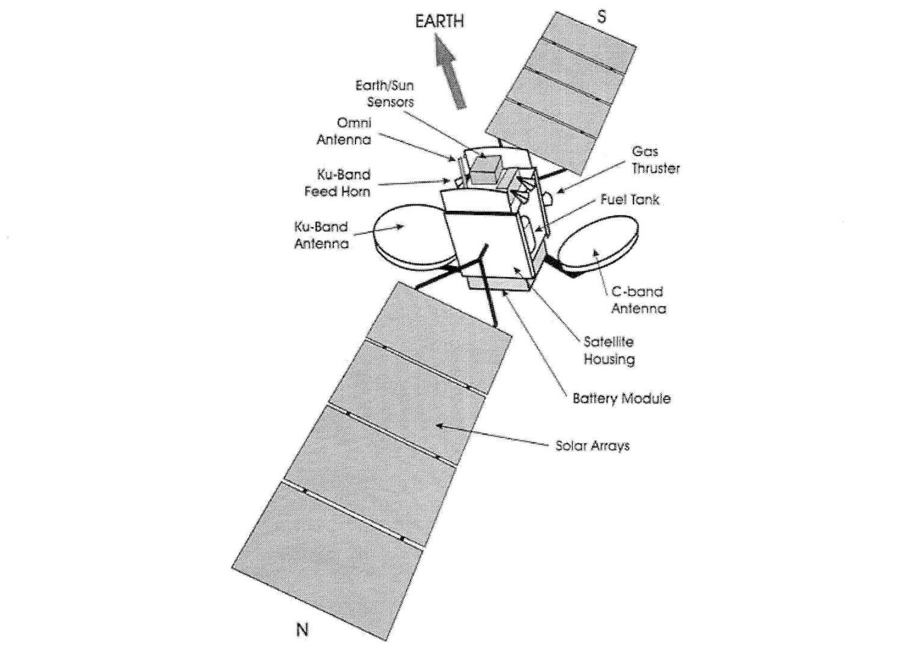
I, Satellite

Slide 5
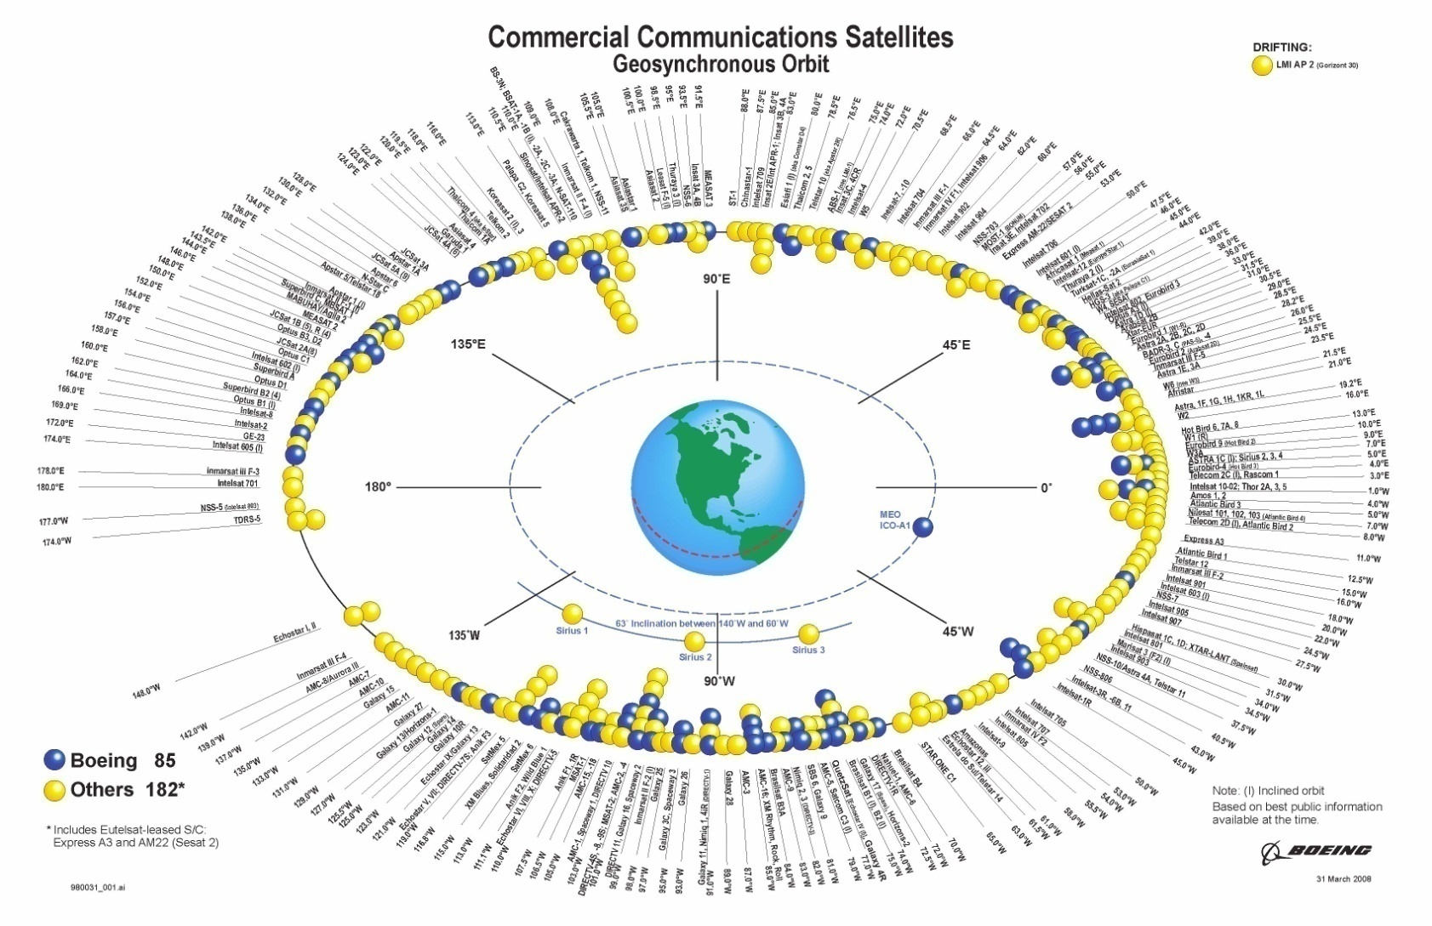
Geostationary Satellites
We are here.
Galaxy 25, 97* West
Notes:
SCOLA’s uplink satellite, Galaxy 25, is located at 97 degrees W.

Slide 6
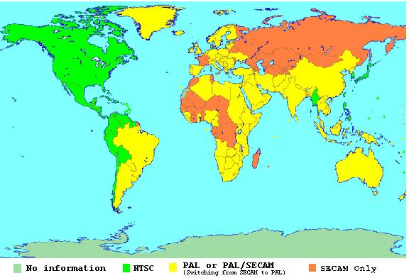
Global Broadcast Standards

Slide 7
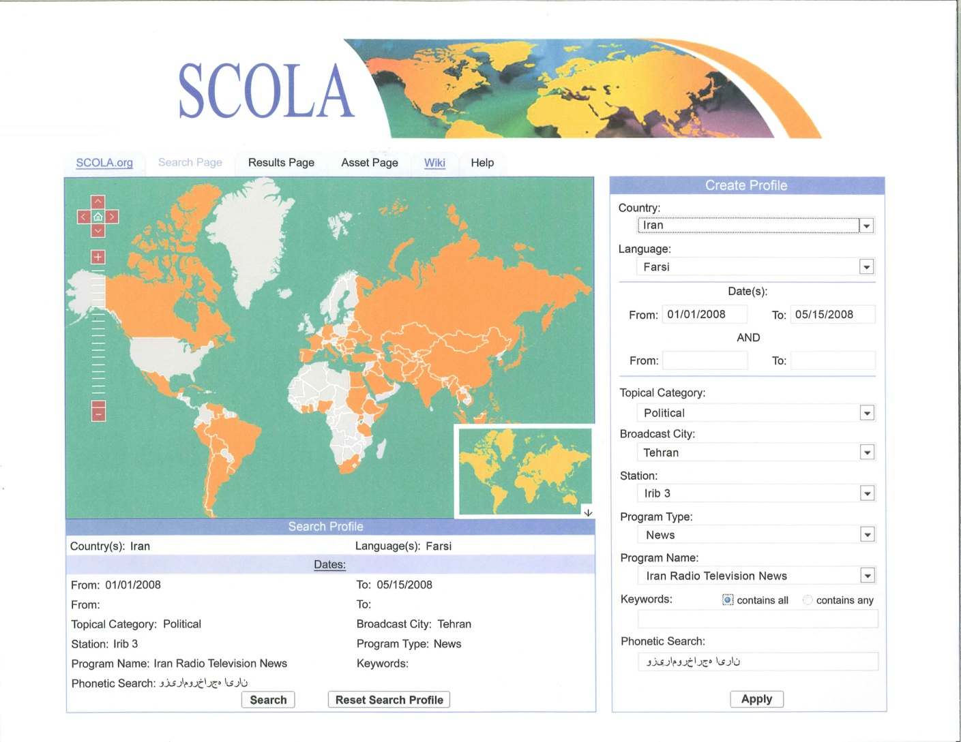
SCOLA Digital Archive
Notes:
As an NDIIP partner SCOLA began development of its Digital Archive in 2006.

Slide 8
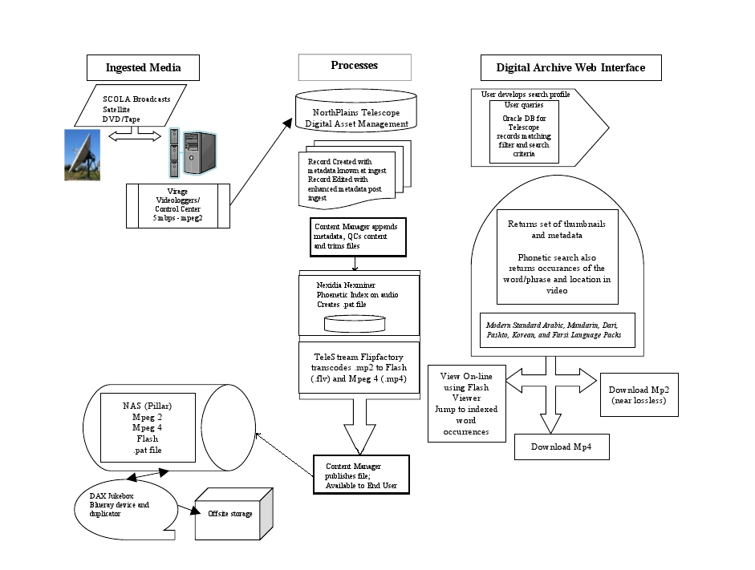
Archiving Process

Slide 9
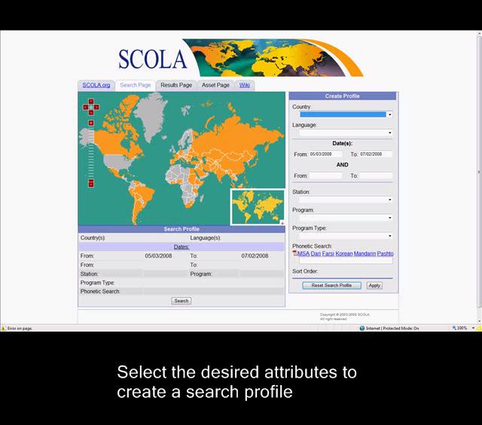
SCOLA Digital Archive

Slide 10
The Philosophy Behind SCOLA’s Archive
SCOLA’s archival philosophy is to preserve world history in a technically-accessible way in support of language and cultural learning endeavors. We support language research and education, and are mission-driven to use technology to its fullest.
Notes:
Move to under picture of hard media

Slide 11

Re-Living History

Slide 12
So, how much should we archive?

Slide 13
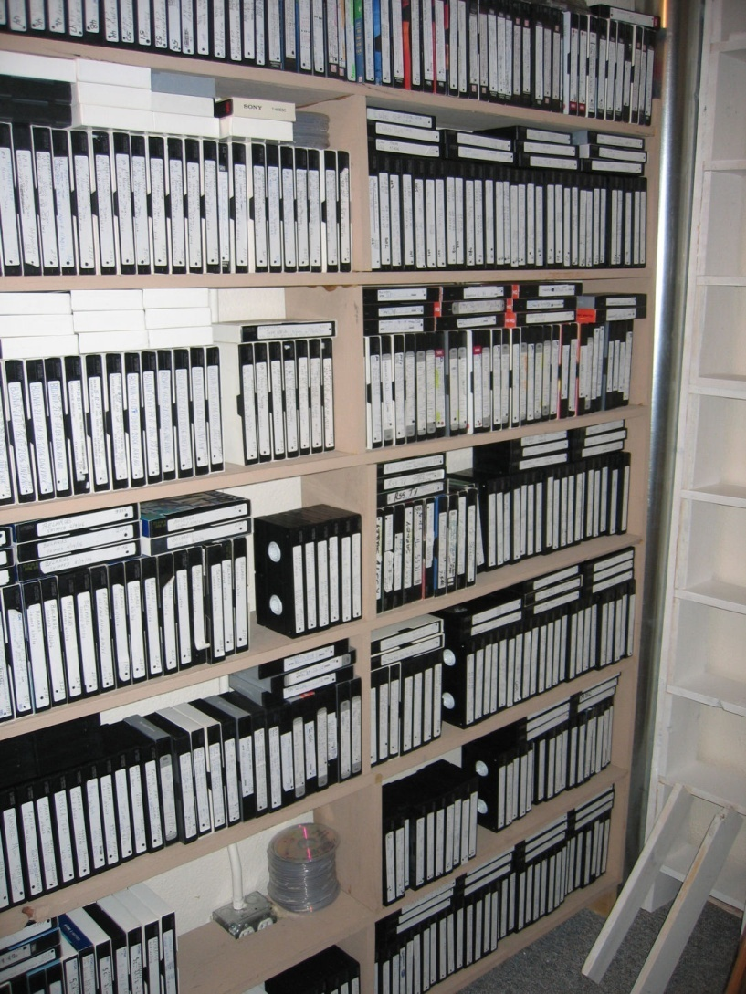

Slide 14
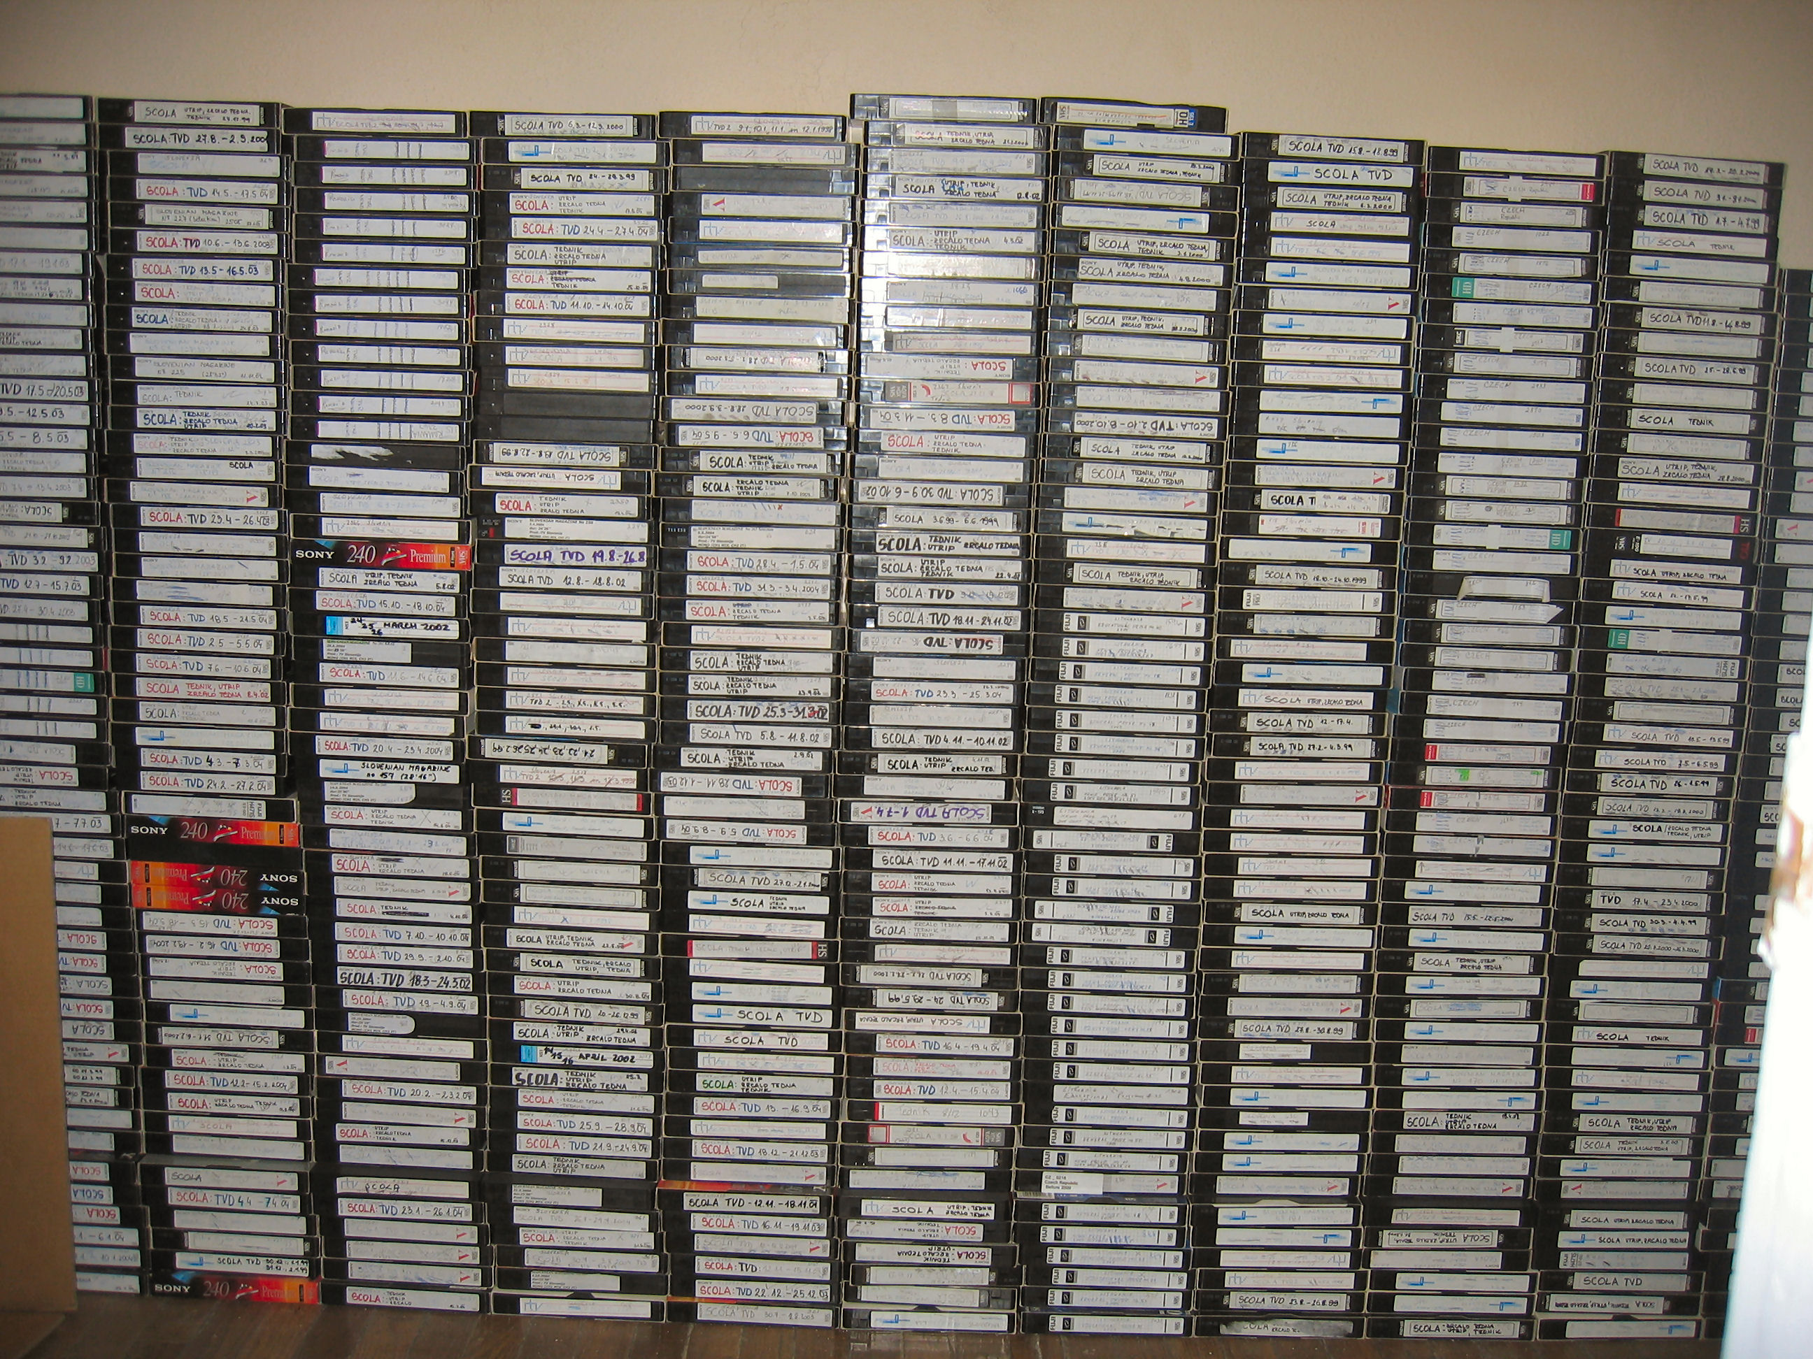

Slide 15
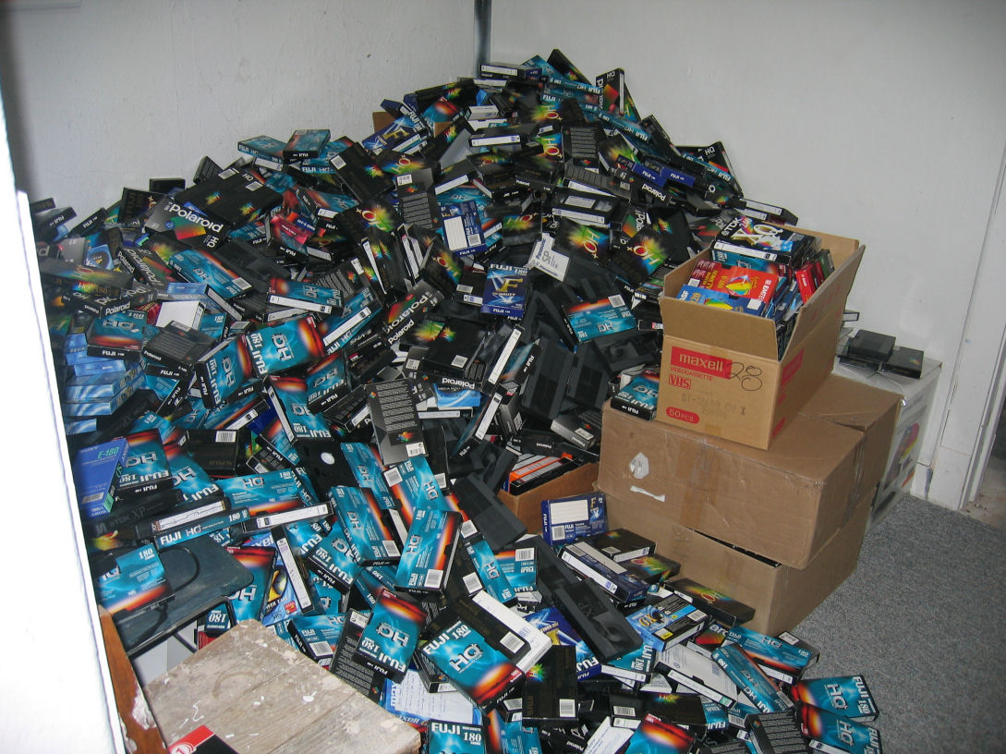

Slide 16
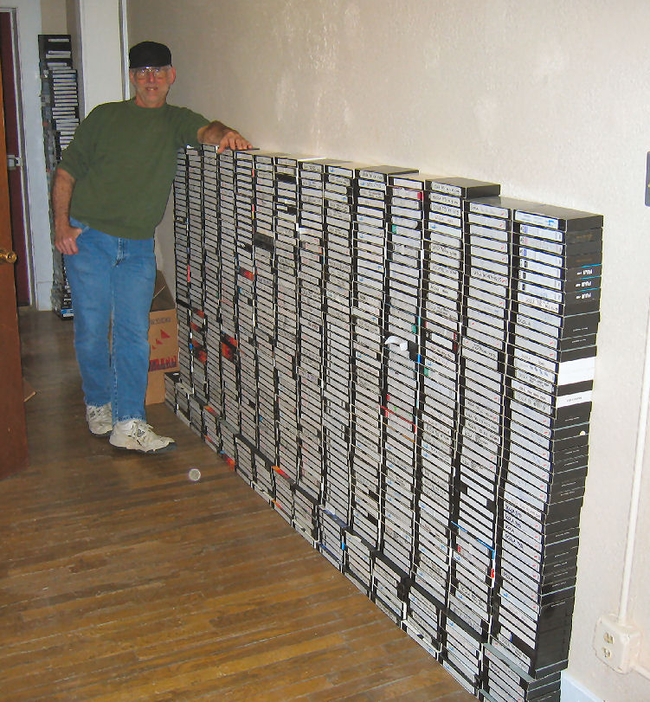

Slide 17
Who are our end-users?
Language schools
International businesses
Educators
Libraries
Researchers
Archivists
Individual affiliates
Partners-in-promotion

Slide 18
The Future
Channel 7 will feature South Asian programming and is projected to begin broadcasting October 1, 2008. The expanded archival content will include languages and dialects rarely heard outside their countries of origin.
SCOLA’s “Global Marketplace”; “virtually visit, tour and shop the world.”
Continually adding to our growing list of online services:(“On the Street” Videos &“Insta-Classes”).
SCOLA’s new International Teleport Distribution
Notes:
Continuall ad

Slide 19
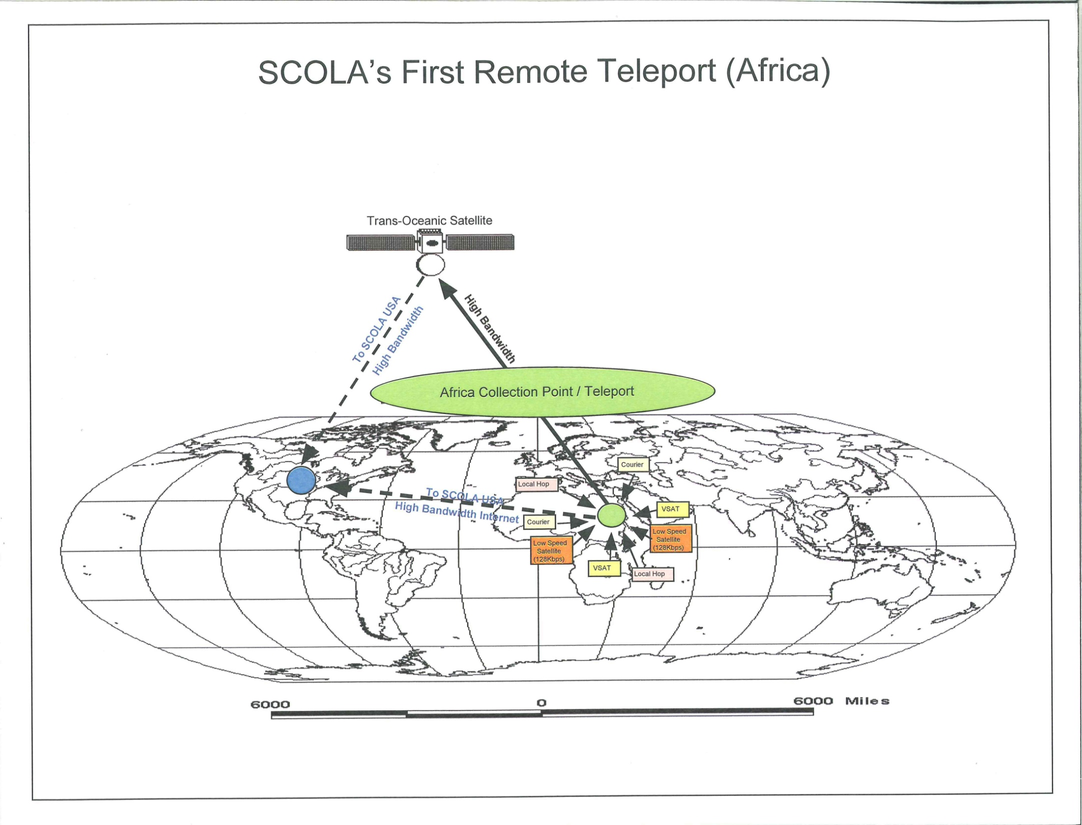
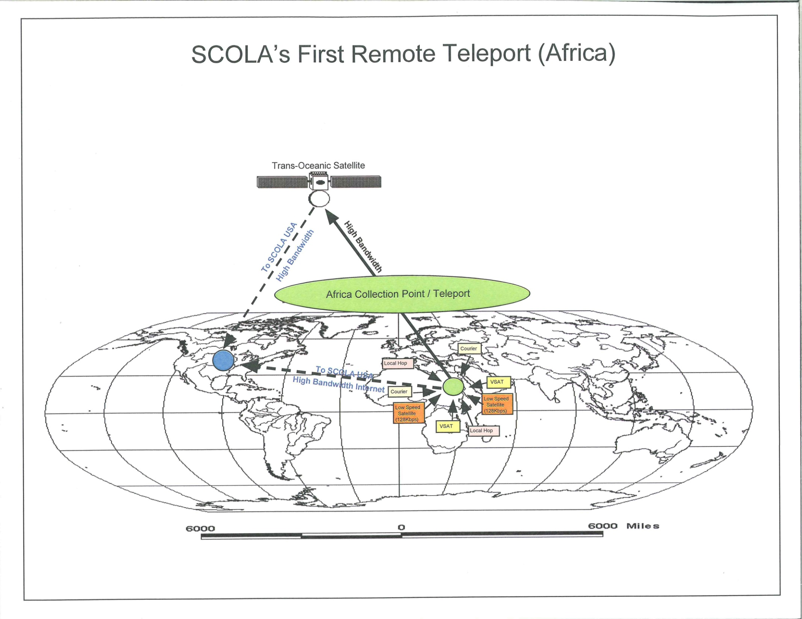

Slide 20
SCOLA’S MISSION STATEMENT
SCOLA's mission is to help the people of the world learn about one another; their cultures, their languages and their ideologies. SCOLA emphasizes the importance and effectiveness of modern information technology as a tool in overcoming barriers to global understanding and will remain at the forefront of its application.

