Slide 1
Phased Cone Proposal
Eric Anderssen, LBNL

Slide 2
Overview
These are just ‘Cartoon CAD’ models
Detail dimensions need to be worked out with West Cone/FGT
While they are ‘cartoons’ I tried to get the right number of basic parts
Fasteners other than glue are not included, but will indicate bolted/pinned joints
Most parts similar to ATLAS Pixel Support Tube
Could build in short order after dimensions are finalized…
Should wait to assure IST/ISC/Pixels/FGT do not impose auxiliary constraints
Neighboring parts cannot lag by more than one CD…

Slide 3
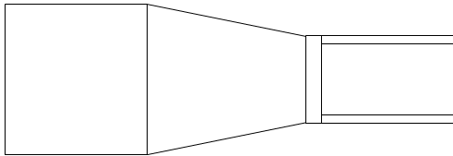
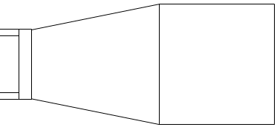
Cut Apart Current Cones next Summer
Keep at Brookhaven
Send to Berkeley
Old East Cone and most of Beams to be reused to support New West Cone
Old West cone refurbished into New East Cone in Berkeley
Cut location in Carbon Beam away from Al Insert—details later
Should probably cut more accurately than indicated…

Slide 4
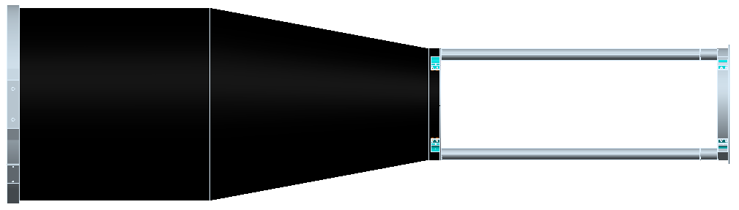
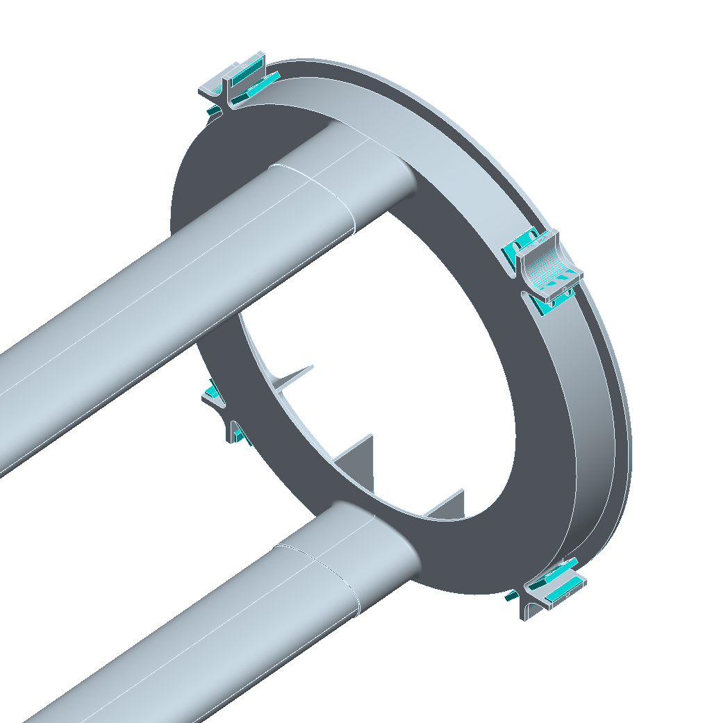
Modified East Cone
~1.5m
Some Tooling Required…
View as Temporary Fix—Should be ACAP (as cheap as possible)
Supports end of New West Cone/FGT
Replicates Old Beam Pipe Interfaces
Includes SSD if required
Only for summer ’08 to ‘09
Wholly Machined/Bonded Solution
Tooling to locate Buck Plate while bonding is required…
Buck Plate aimed for
Easy Swap of replacement

Slide 5
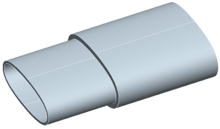
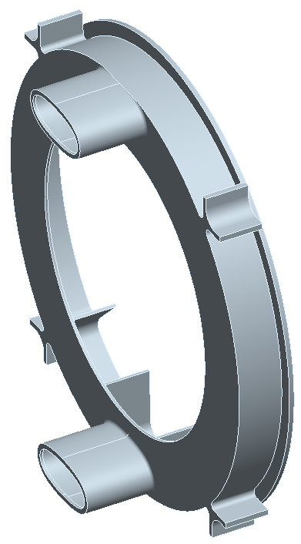
Make a Low Mass ‘Buck Plate’
Beam
Plate
Coupling
Insert
Coupling Insert reduces risk of large complex machined plate
Quicker to modify smaller part if needed…
Insert can take up mis-match in geometry of current Beam and match to ‘perfect geometry’ of machined plate (bonded)
Plate includes SVT mounts and all other interfaces of current plate, Machined directly into features
Mass Approx Equal to current Plate
Needs to include
Beam Pipe Mount
And other interfaces

Slide 6
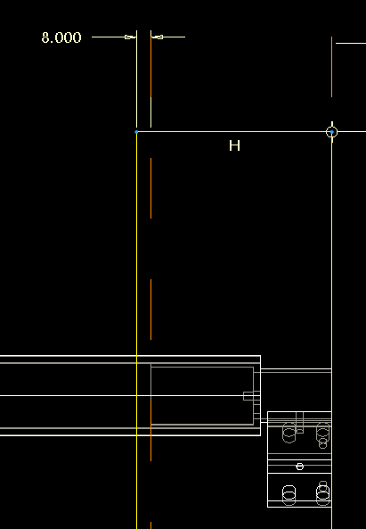
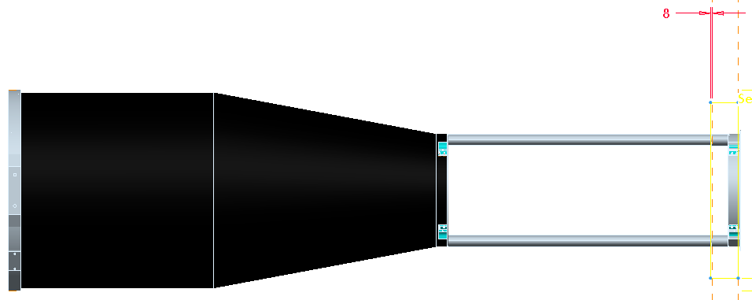
Plate Needs to Make up Cut Lengths
Lengths just guessed—need FGT/West Cone to do better
Cut placed just past insert—easier to cut, cleaner bond
May need to find way to couple to outer skin of Beam
Not done with current Beam

Slide 7
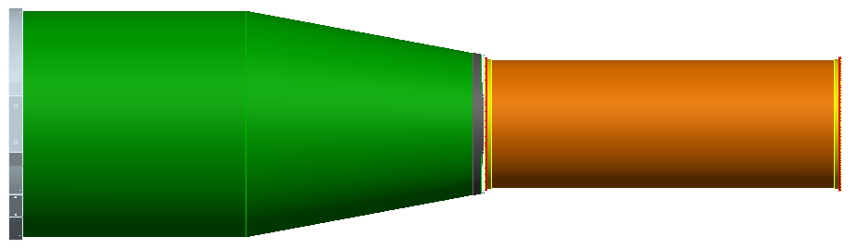
Goal—Swap-in Replacement
New East Cone with Cylindrical Shell made from Old West Cone
Swap in by matching Bolted Interface to New West Cone…
Include SSD interface On Shell
Modification
Will Take Up
Length…
Should Be
Same Length

Slide 8
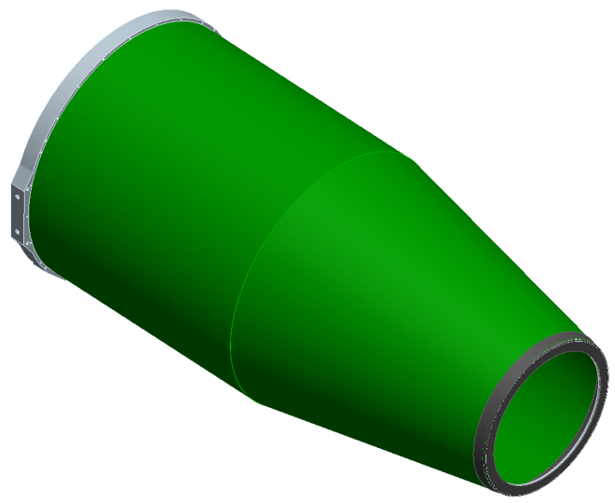
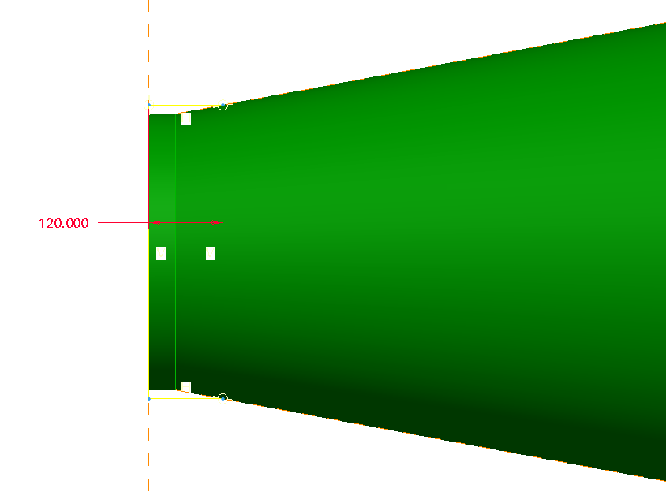
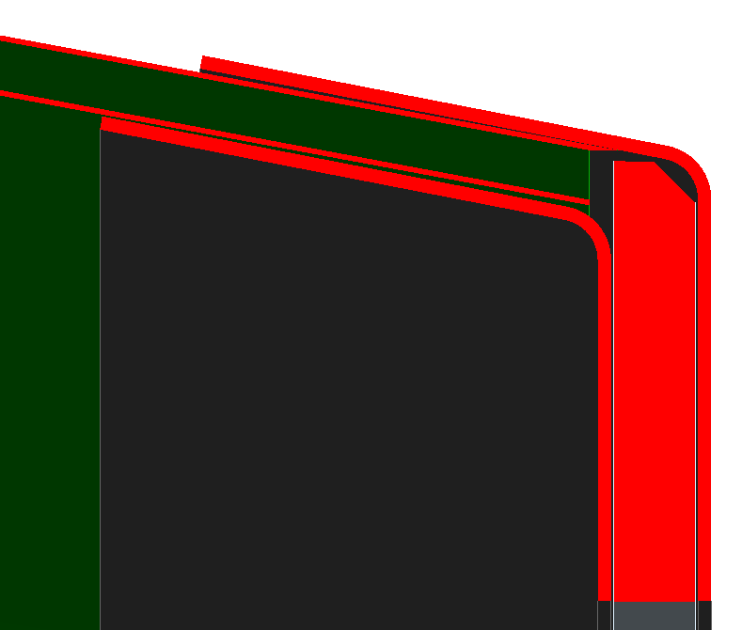
Old West Cone Modification--Flanges
Cut Back Length Determined by MFG Radii of new Flanges—also allowance for Bolt Flange Radii

Slide 9
Flange on New East Cone
R220-225
Gap or Standoffs for
IST Services Needed
Auxiliary Goal of Flange Two-Fold
New Interface to Cone (remove old BP Interface Plate)
Use Same Tool for large cylinder of IST and Intra-Cone Cylinder (SSD Support Shell)
Small Taper Angle necessitated larger cut back
Still only 120mm—easy to make shells shorter/longer with same tool

Slide 10
Some Cost Benefit Analysis
Cost of Re-use of (ye) Olde East Cone is a good bet
Need something to support FGT and BP for Run 9 (10?)
Minimal Mod, Tooling and Part count to use old Cone and beams
Likely under $25k parts/tool—just labor to bond at BNL
IST needs a large Cylinder
Intra-Cone Cylinder only marginal cost of fabrication if same diameter
Flange Tooling similar, additional design work minimal
Cost of Re-Using old West Cone uncertain—it is a Renovation
Geometry may be uncertain enough to cause refab of tooling
Risk of Damage during trim to new length—errors/damage may need again more tooling
Should investigate marginal cost of making New East Cone using West Cone Tooling
Tooling costed in FGT—only cost of part fab
Balance against cost/risk of old west cone renovation

Slide 11
Proposal/Conclusion
Baseline should be what is outlined here
Modified East Cone with requirement for bolt-in swap
Modified West-Cone as new East Structure
Would like agreement (decision) on this as the approach
Main requirement here is common bolted interface and quickly reaching length-and diameter interfaces
Allows Detailed cost studies to proceed
This Gives FGT and the NWC a clear interface to meet as early as possible
Simple mechanical interface—lengths and Bolt Circles are easy to track even when they change…
Keep open the issue of how the New East Cone is implemented
Proposed baseline has its risks
New West Cone may be an attractive option over refurbishing Old West Cone
This should be the ‘backup’ solution—still need to understand what it looks like/costs

