Slide 1
Fermilab AAC
Superconducting Helical Solenoids
V. Kashikhin for Superconducting Magnet Team

Slide 2
Outline
Helical Solenoid for MANX
HS possible applications
Long HS mechanical concept
HS 4-Coils model
HS NbTi and Nb3Sn models
Short model plan and schedule

Slide 3
Helical Cooling Channel
A helical cooling channel has been proposed to quickly reduce the six-dimensional phase space of muon beams for muon colliders, neutrino factories, and intense muon sources.
A novel superconducting magnet system for a muon beam cooling experiment is being developt at Fermilab.
The inner volume of the cooling channel is filled with liquid helium where passing muon beam can be decelerated and cooled in a process of ionization energy loss.
The magnet parameters are optimized to match the momentum of the beam as it slows down.
The results of 3D magnetic and mechanical analysis, and fabrication considerations are discussed.

Slide 4
Helical Solenoid Applications
Mu2e TS
Technology
Project-X
Mu2e +HS
Muon Collider Cooling
MICE+MANX
HS
NbTi & Nb3Sn
4-coil models
RF+HS
HTS HS
models
Projects
R&D

Slide 5
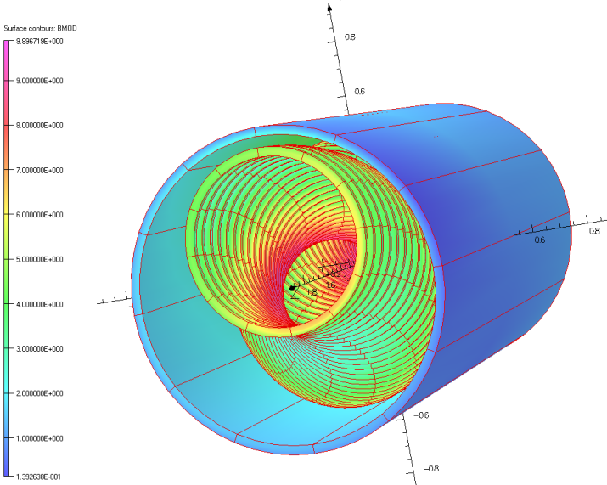
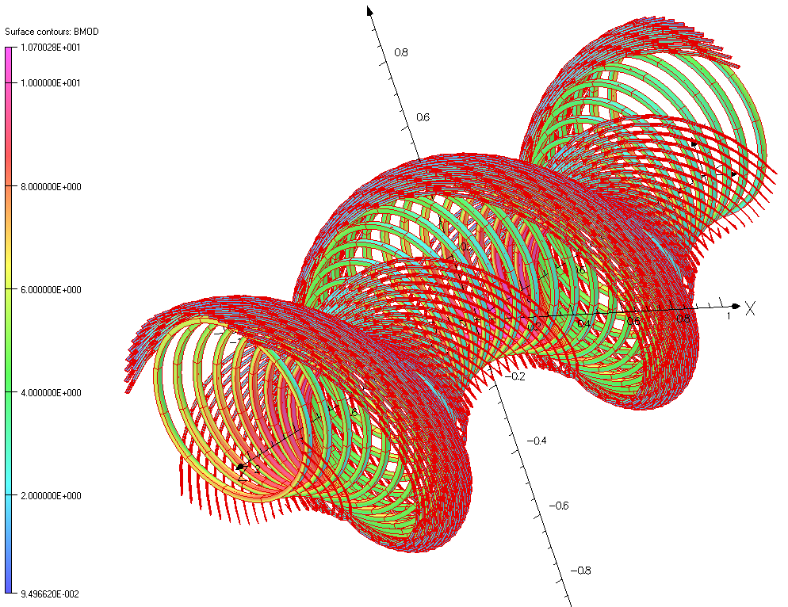
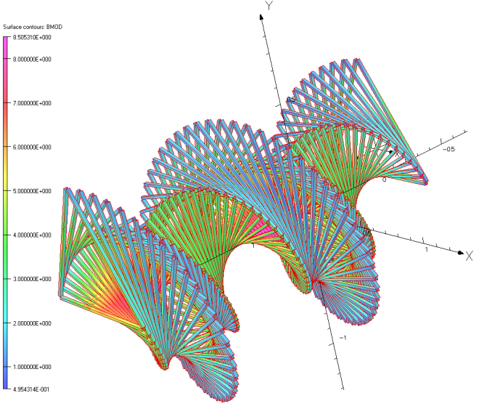
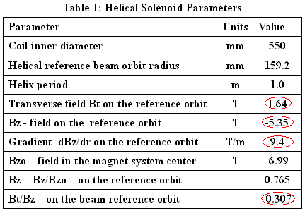
Helical Solenoids with 1 m Period
Magnet systems based on the Helical Solenoids are capable of generating fields required for the optimal muon cooling even at short helix periods.
Large bore straight solenoids, helical multipole windings or trapezoidal coils can be used for eliminating of the misbalance between transverse and longitudinal fields.
Demonstration models can use helical multipole windings for greater flexibility. The final design will be more efficient with non-circular shape coils.
The high 8.5 T - 11 T peak fields drive the design to the use of Nb3Sn superconductors.

Slide 6
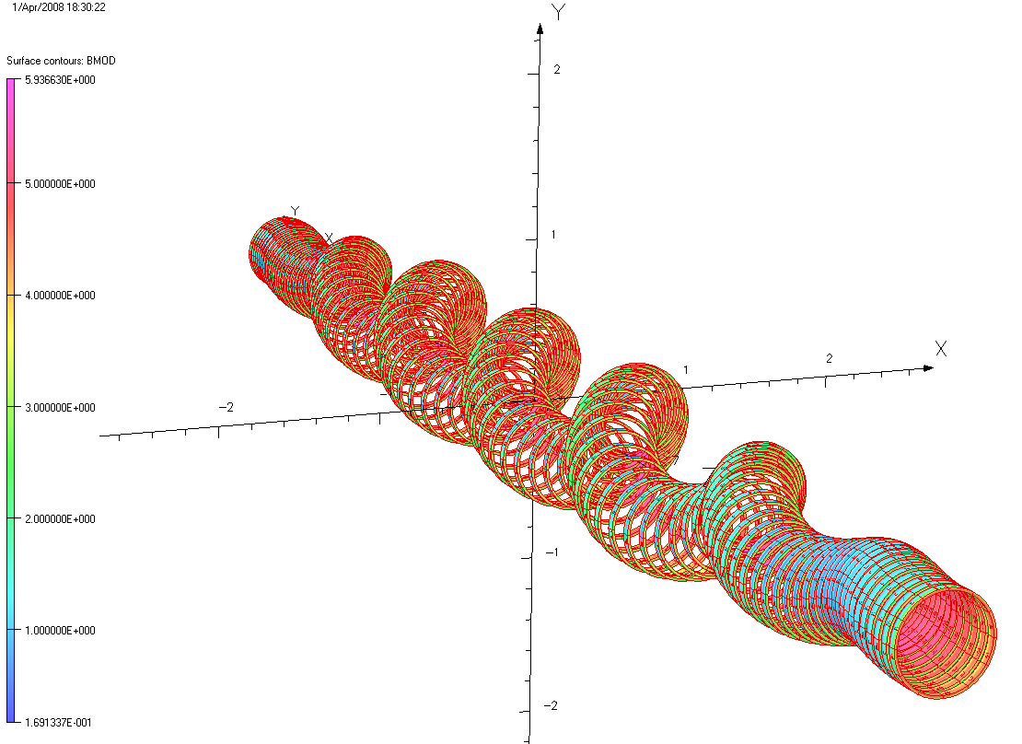
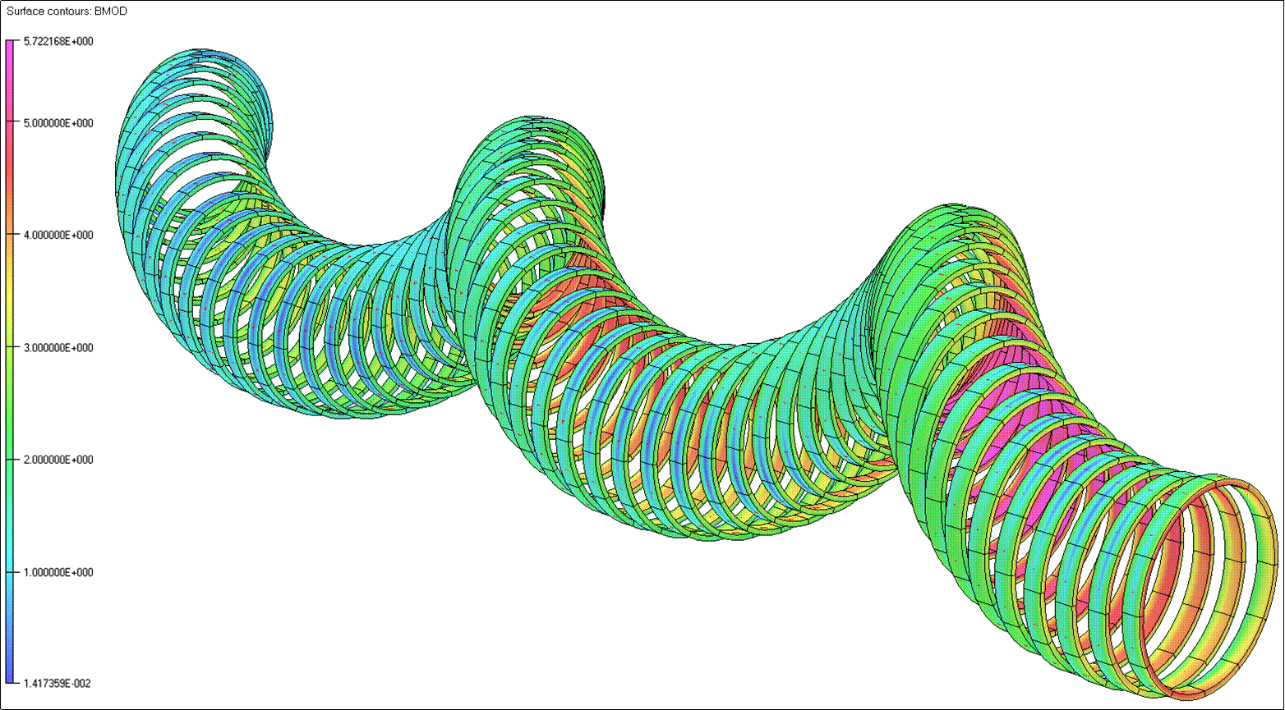
10 m & 4 m MANX Helical Solenoids
The MANX base line design is a 10 m long HS with helical matching sections of 3 m long at front and far ends.
The 4 m HS design could be used in combination with tangential to muon helical orbit injection. This magnet system will be cheaper at least 2 times than 10 m HS.

Slide 7
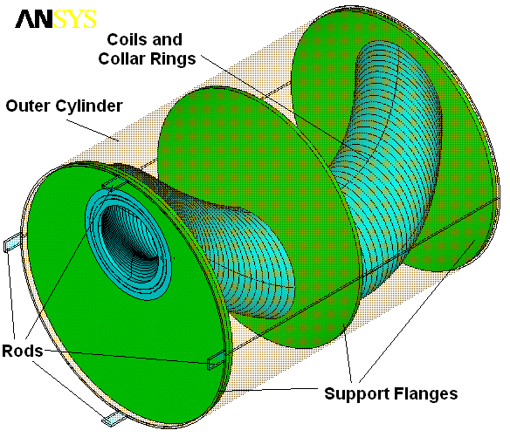
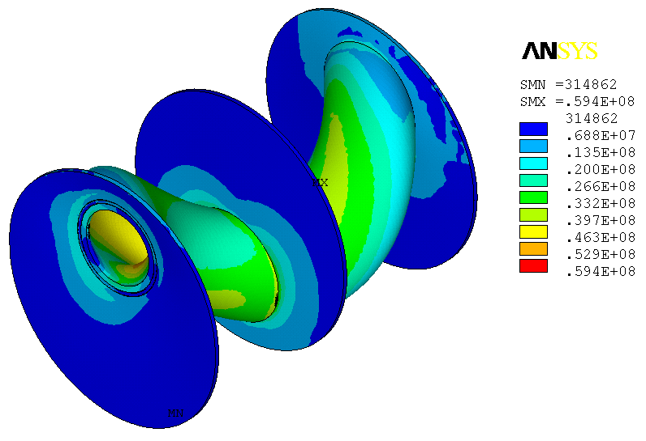
Long Helical Solenoid Mechanical Concept
Hoop Lorentz forces intercepted by stainless steel bandage rings around the coils
Transverse Lorentz forces intercepted by support flanges
Outer LHe vessel cylinder provide mechanical rigidity to the structure
The peak stress is ~60 MPa

Slide 8
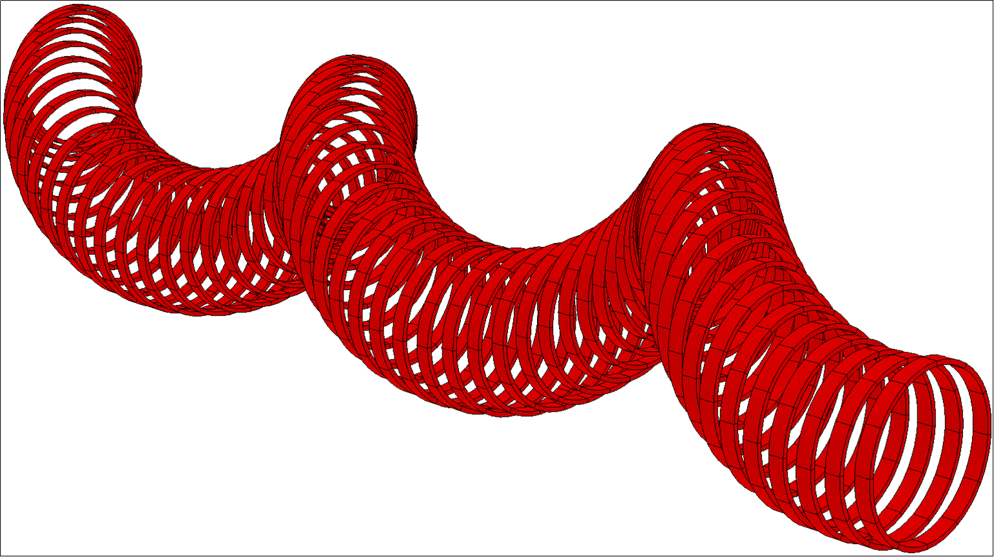
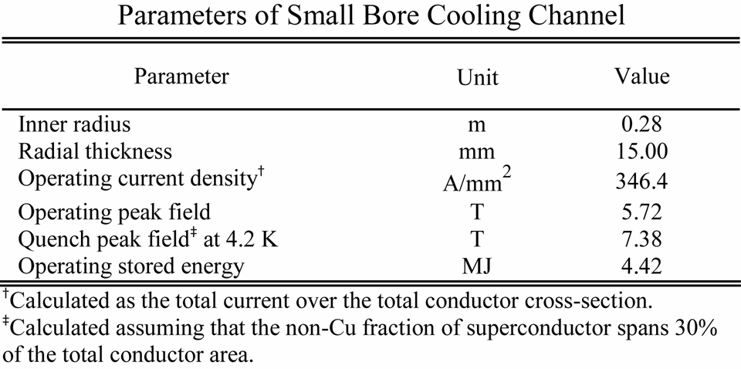
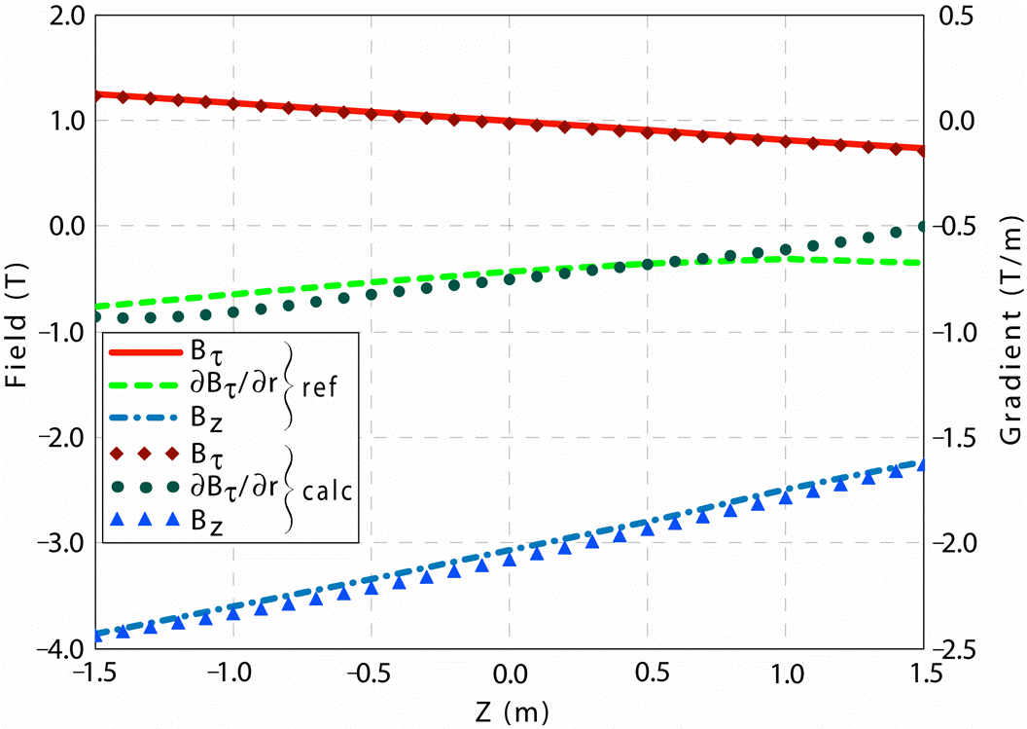
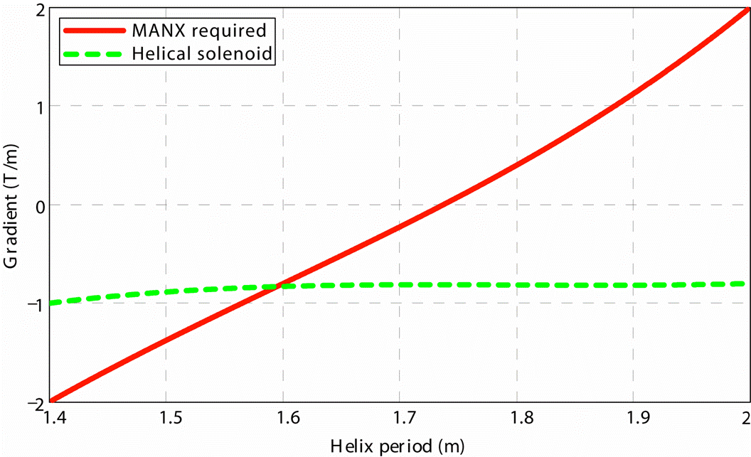
Helical Solenoid for MANX
The solenoid consists of a number of ring coils shifted in the transverse plane such that the coil centers follow the helical beam orbit.
The total current in the rings changes along the channel to obtain the longitudinal field gradients.
The magnet system has a fixed relation between all components for a given set of geometrical constraints.
Thus, to obtain the necessary cooling effect, the coil should be optimized together with the beam parameters.
One can see that the optimum gradient for the helical solenoid is -0.8 T/m, corresponding to a period of 1.6 m.

Slide 9
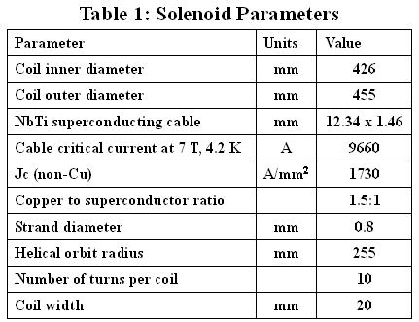
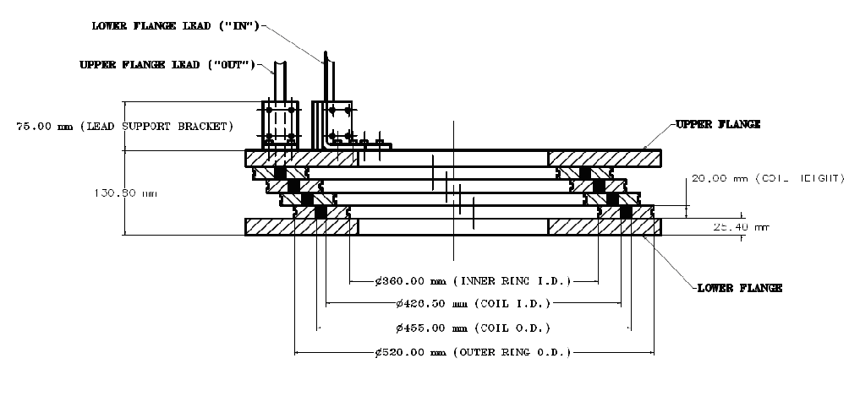
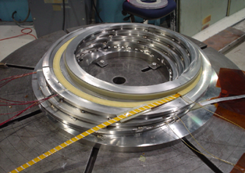
4-Coil Model
Main goal is to develop the mechanical concept which could be extrapolated to the long solenoids without changing the structure.
Each coil is wound from Rutherford type superconducting cable on a stainless steel bobbin.
Outer stainless steel collar rings provide the coil support and intercept the radial Lorentz forces.
The short model consists of four superconducting coils with support structures and end flanges.
By operating at ~14 kA, it is intended to reach the fields, forces, and stresses of the long HS to verify the design concept and fabrication technology.
Two ways to protect coils from the transverse motion under Lorentz forces:
-Weld the inner and outer support rings to each other, forming a solid mechanical structure.
-Machine steps on both sides of the inner and outer support rings locking the coil motion in the transverse direction.

Slide 10
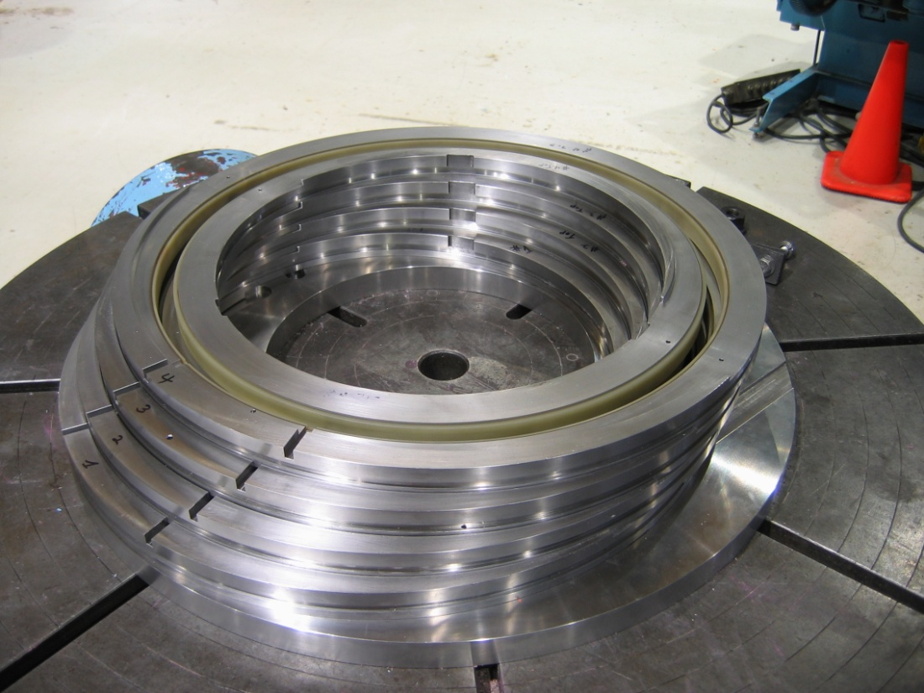
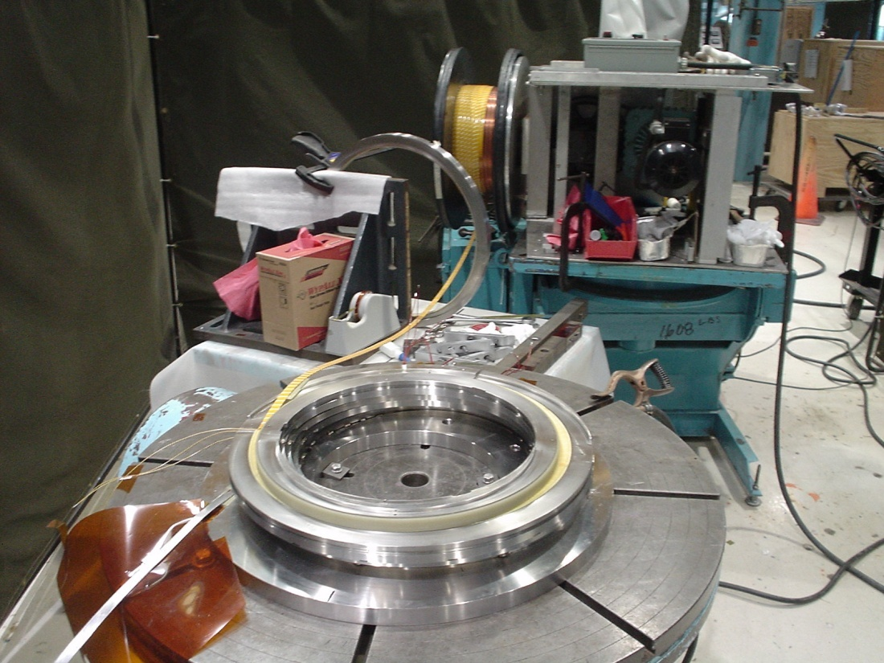
4-Coil Model Fabrication
Outer ring
Ground insulation
Inner ring
Superconducting cable
Bandage rings control assembly
Winding process

Slide 11
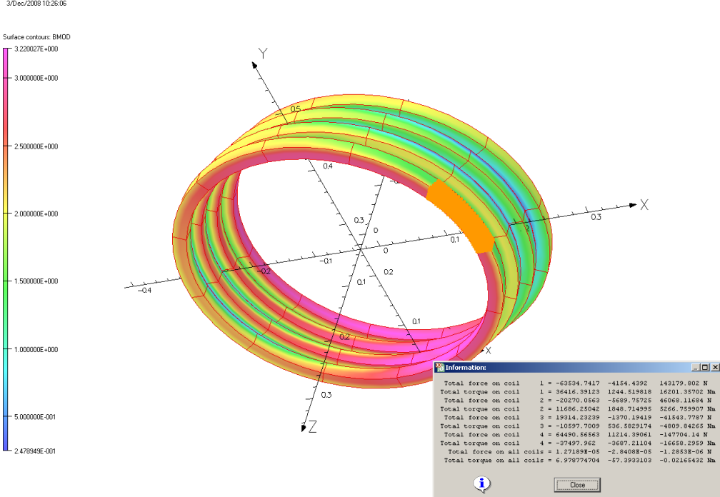
4-Coil Model 1 Test Results
Parameter | Short HS nominal | Short HS Max | Long HS | HS Test Results
Peak superconductor field, T | 3.3 | 4.84 | 5.7 | 4.38
Current, kA | 9.6 | 14 | 9.6 | 13.6
Coil inner diameter, mm | 420 | 420 | 510 | 420
Number of turns/section | 10 | 10 | 10 | 3x9+10
Fx force/section, kN | 70 | 149 | 160 | 119
Fy force/section, kN | 12 | 25 | 60 | 21
Fxy force/section, kN | 71 | 151 | 171 | 121
Fz force/section, kN | 157 | 337 | 299 | 273
HS Model
Long HS

Slide 12
Improved NbTi 4-coil model 2
The base line of magnetic and mechanical design is the same as for Model 1
Use the wider NbTi FNAL made cable, hard bend wound
The design should accommodate NbTi and Nb3Sn cable technology
Rectangular 15 mm wide cable with 28x1 mm dia. strands
Use the same ground insulation as in Model 1
Improve the electrical insulation of heaters, voltage taps, etc
Protect coil insulation during welding from sparks (Cu foil, etc)
Correct the leads outlet areas to avoid shorts
Carefully fix the leads in space outside of the solenoid

Slide 13
Nb3Sn 4-coil model 3
The base line magnetic and mechanical design is the same as for NbTi Model N2
Use the Nb3Sn 15mm wide cable with 28 strands of 1 mm dia. Cable is hard bend wound
Cable should be glass tape insulated with ceramic binder
Use the multilayer glass cloth with binder for ground insulation
Protect coil insulation during welding from sparks (Cu foil, etc)
Provide an effective Argon gas circulation during reaction
Correct the lead outlet areas to avoid shorts
Carefully fix the leads in space outside the solenoid

Slide 14
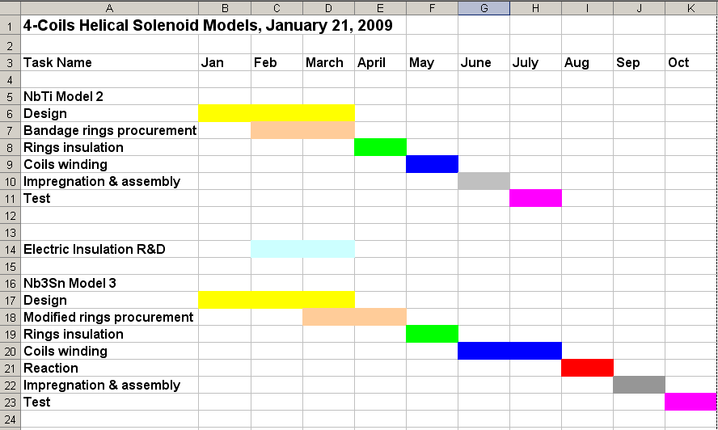
4-Coils Models Schedule

Slide 15
MANX Magnet Cost Estimation
Specifications 0.5 FTE
Magnet conceptual design 3.5 FTE
Technology issues 3.5 FTE+ 0.1M$ M&S
Engineering design 7.0 FTE
Procurement, component test 0.7 FTE+ 5.2M$ M&S
Installation and commissioning 8.0 FTE+ 0.5M$ M&S
Budget profile:
Year 1 6.2 FTE+0.1M$
Year 2 7.0 FTE+1.5M$
Year 3 3.0 FTE+3.0M$
Year 4 7.0 FTE+1.2M$
Total 23.2 FTE+5.8M$
Estimated by A.V. Zlobin

Slide 16
Summary
The main goal of this project is to build Long Helical Solenoid.
Base line design should be proved by 4-coil models.
Models will be based on NbTi and Nb3Sn technology.
Find technical decisions acceptable also for long solenoids.
Investigate electrical insulations capable withstand HS winding process and 650 °C reaction temperature.
Investigate epoxy vacuum impregnation for HS.
Investigate magnetic and mechanical HS performance.
Investigate HS quench protection.
Design MANX magnet system.

